Slide 1
HR Attrition Analysis
A Comprehensive Exploratory Data Analysis
By:
Naveen Muralikrishnan

Slide 2
The problem
Company
Problem statement
This analysis is done based on the Attrition Dataset of an IT Firm based out of India.
The dataset has Exit Survey of employees in the last 5 Years.
Analyse on the various factors that constitute around an employee who left the Organization and provide insights on how to reduce Attrition in the future.

Slide 3
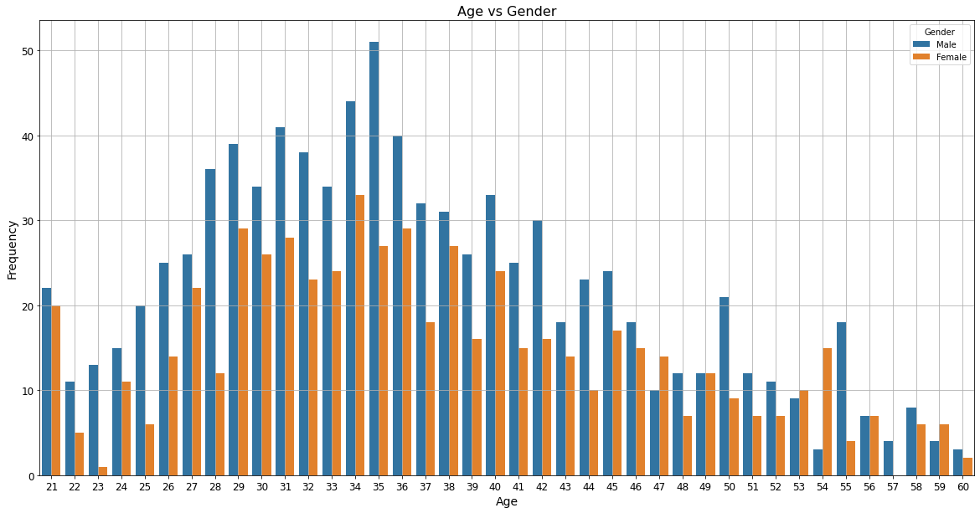
How many employees have attrited based upon their age and gender?
Male employees have attrited more than Female.
Male Employees at age of 35 and Female Employees at the age of 34 have attrited more when compared to other ages irrespective of the Gender.

Slide 4
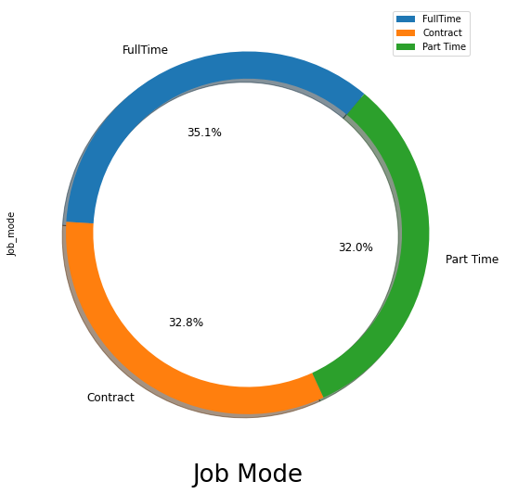
What is the relation between the Attrition and Job Mode?
The high proportions of Contract and Part Time employment may be one of the factors for the Attrition as they weren't made as Full Time employees or given a New Contract

Slide 5
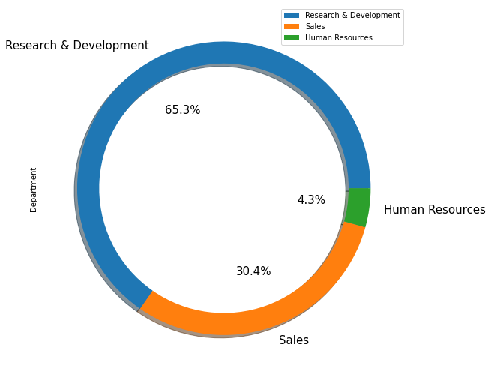
What is the relation between the Attrition and Department?
Research and Development department has the most attritions accounting upto 65.3%

Slide 6
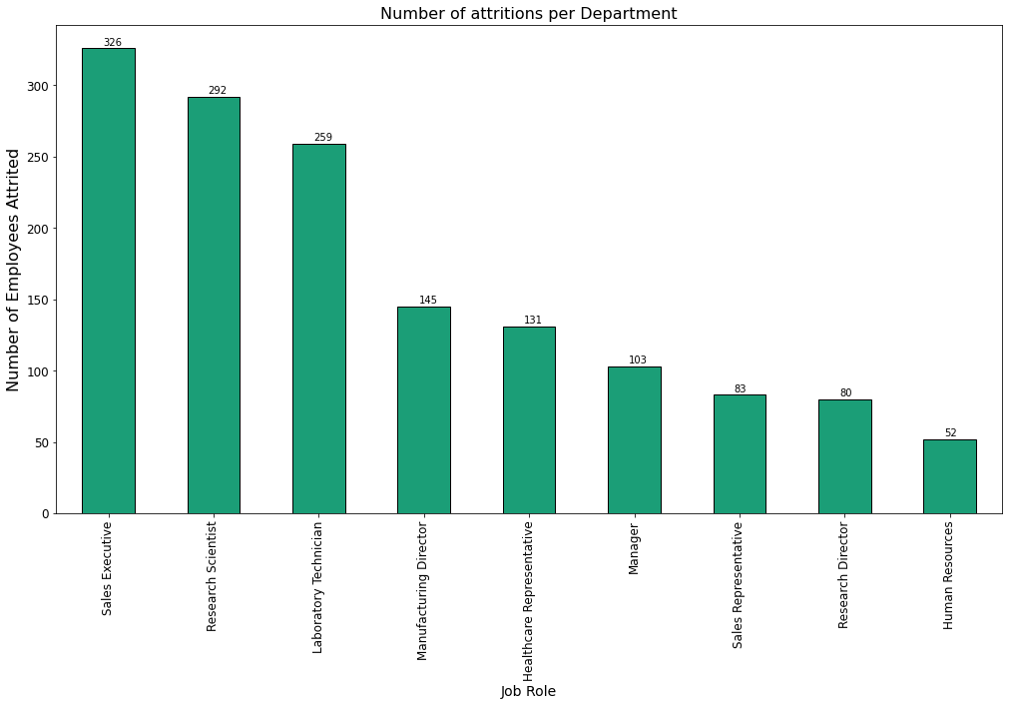
What are the Job Roles having the most attritions across the departments?
Sales Executives have left the Organization more than other Roles followed by Research Scientist and Laboratory Technician.
The Human Resources are the least to leave the Organization in the period of 5 Years

Slide 7
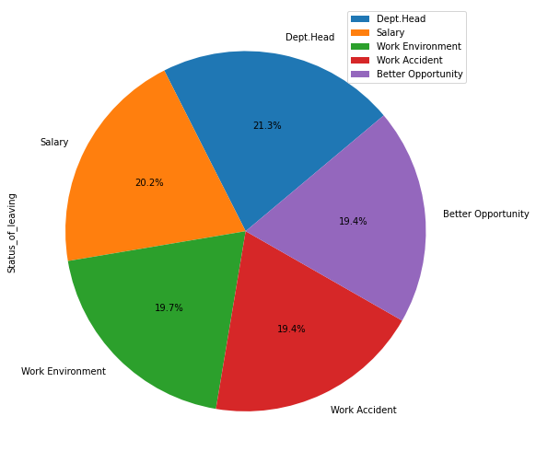
What is the reason for employees leaving the Organization?
Department Head being the major reason for attrition
Work Accident has 19.4% reasons which is quite alarming for the Organization and there's a concern of the Workplace Security.
Work Environment has 19.7% reasons also adds up to Work Accident.

Slide 8
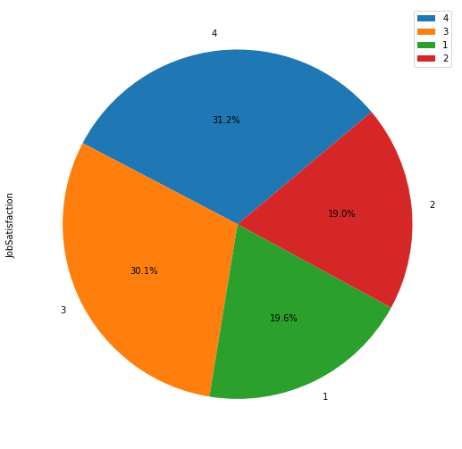
Is there a relation between the Job Satisfaction and Attrition?
31.2% Attrited Employees are fully satisfied in their job giving 4/4 in their survey.
Also 30.1% employees gave a 3/4 in the survey.
We can infer that the Organization failed to retain the satisfied employees.

Slide 9
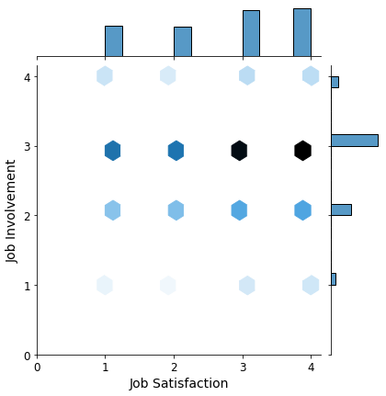
Is there a relation between the Job Satisfaction and Job Involvement?
We infer that the employees who gave 3 and 4 as Job Satisfaction gave 3 as Job Involvement
This shows how the company failed to retain the satisfied employees

Slide 10
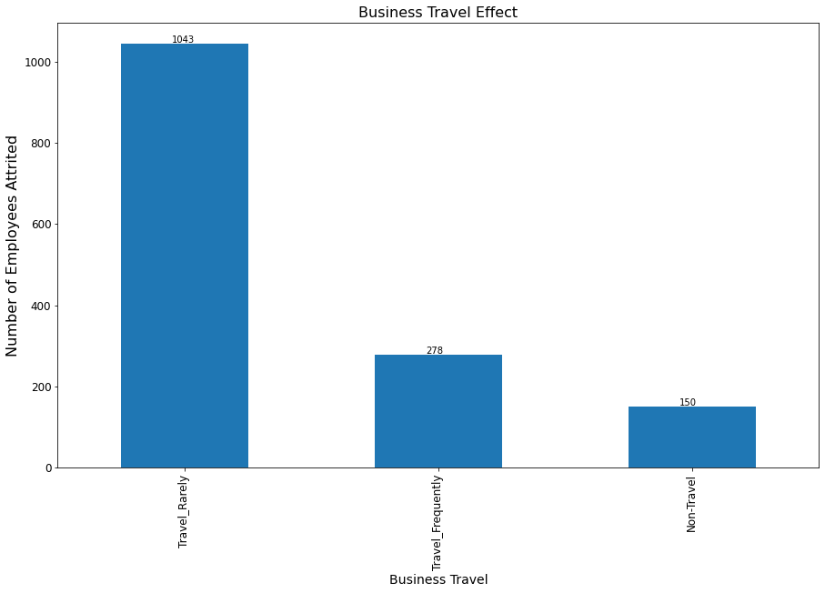
Is Business Travel a reason for the Attrition?
Only 278 attrited employees had to Travel Frequently.
There is very less evidence that the attrited employees cared about the Business Travel.

Slide 11
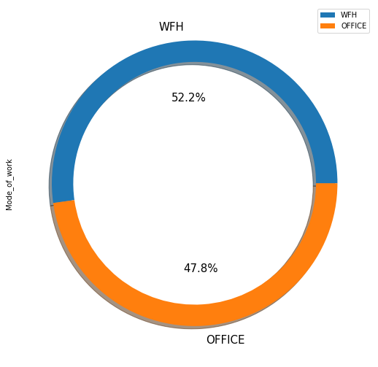
What is the association between the Work Mode and Attrition?
The Organization has gone with a Hybrid work model with WFH being the preferred mode of work for Employees
Also there is no data to support the employee's mental health due to WFH.

Slide 12
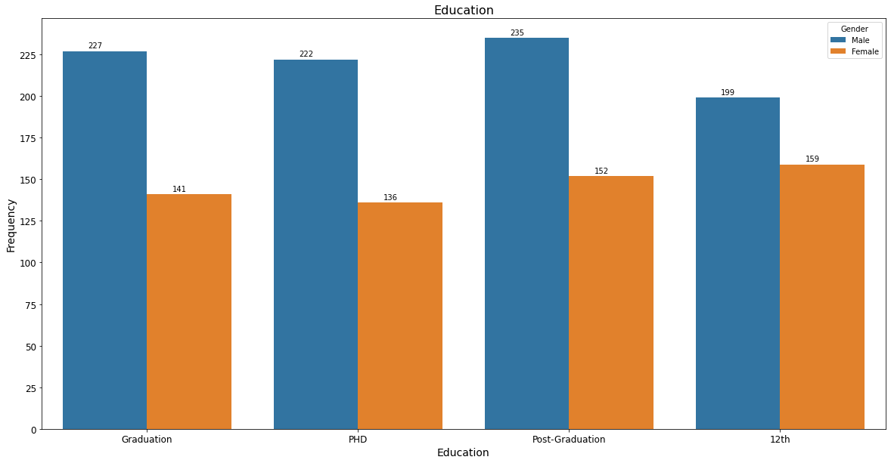
What is the count of attrited employees' Higher Education?
There are almost equal amounts of Employees who had their highest education details across the 4 categories namely Graduation, Ph D, Post-Graduation and 12th.

Slide 13
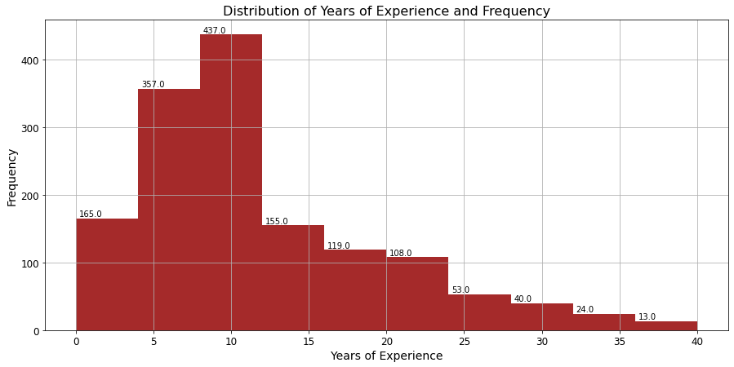
What is the relationship between Employee Attrition and Total Experience?
The majority of the attrited employees belonged to those having experience between 4 to 11 years of Overall Experience.

Slide 14
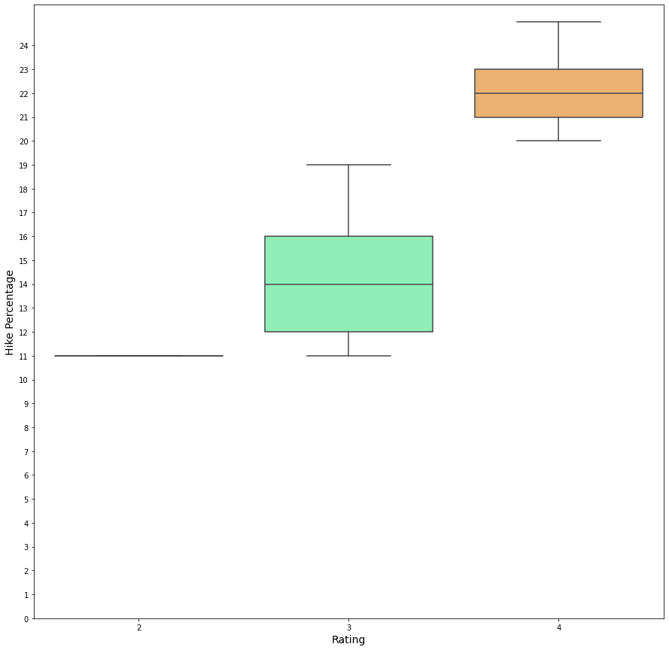
What's the relationship between Performance Review and Hike Percentage?
All the employees were given ratings between 2 to 4
Rating of 2 has a hike Percentage of 11%
Rating of 3 has a hike percentage ranging between 12 to 16, average being 14
Rating of 4 has a hike percentage ranging between 21 to 23, averaging at 22

Slide 15
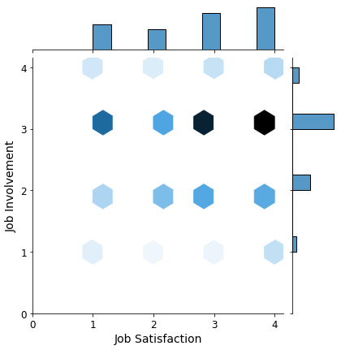
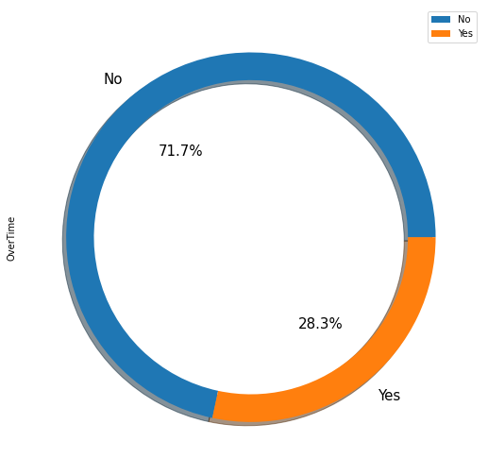
Has the employee worked Overtime?
28.3% employees worked Over Time in their tenure in the Organization.
Even Majority of Employees who worked Overtime were satisifed in their jobs and are highly involved

Slide 16
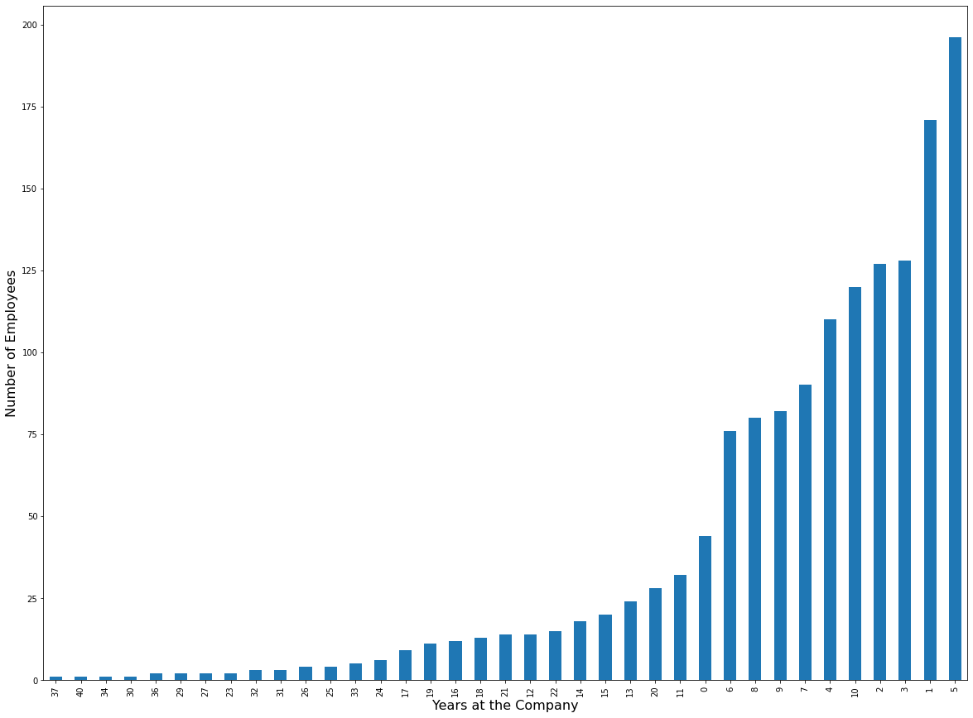
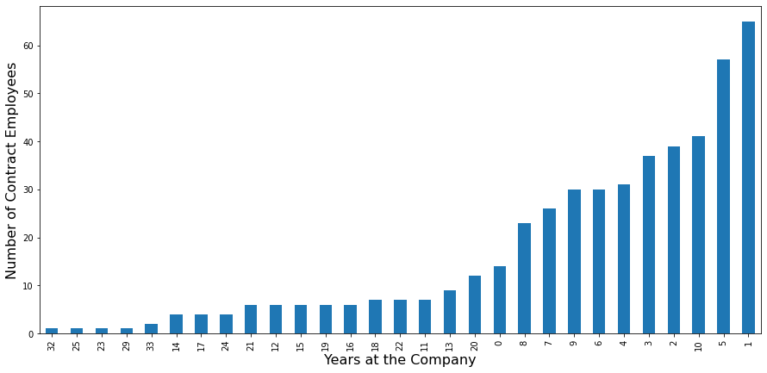
How many Years has the employee spent in the Organization before leaving?
The Contract employees left the Organization after 1 Year is more, saying that there has been significant Projects having 1 Year as Duration.

Slide 17
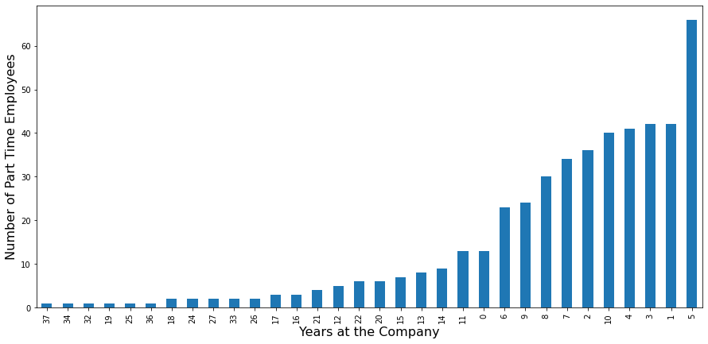
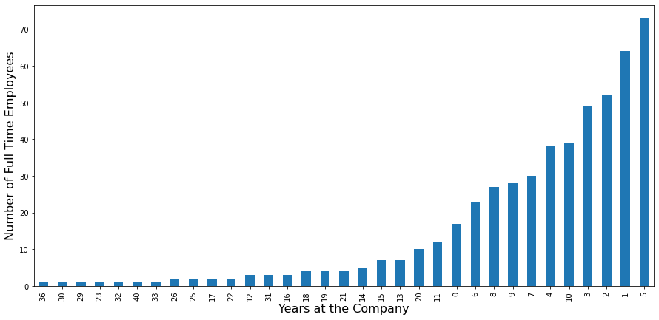
How many Years has the employee spent in the Organization before leaving?
Part-Time and Full-time Employees who worked 5 years in this Organization attrited more.

Slide 18
Insights
There should be proper Behavioral sessions for the Department Heads to improve the morale of Employees in the workplace.
The Organization should improve the Full-Time employees percentage to avoid large number of attritions.
Despite the employees having Job Satisfaction and Job Involvement, the Organization failed to retain them. The Management must be advised to improve the Management team who should convey and convince to the employees submitting the Resignation to revoke the Resignation.
The Salary Hike Percentage is on Par to the Industry Standard, but the Salary is below Average. The compensation must be revisited for all the employees.
As 52.2% employees are in WFH, sessions to improve their morale is recommended on a regular basis.

Slide 19


