Slide 1

PROJECT SEMINAR
ON
Distributed E-Health Care System Using SOA
By,
Batch no:2
P.V.D.N.Srilakshmi
Ch.V.S.Lakshmi
N.L.V.K.Suresh

Slide 2

CONTENTS:
ABSTRACT
INTRODUCTION
OBJECTIVES
MODULES
REQUIREMENTS
EXISTING SYSTEM
PROPOSED SYSTEM
DDM TOOL FOR HMS
FEASIBILITY
ARCHITECTURE DIAGRAM
SCREEN SHOTS
REFERENCES
CONCLUSION

Slide 3
ABSTRACT:
This project deals with the Corporate Medicare Management. This project is very helpful to both Medicare staff as well as to the public. All the branches of the Medicare can be
integrated with one to another. So any body can get the status of each branch easily from the Medicare center. People can take appointments online by approaching the website of
Medicare Center. That site also includes Information about the Facilities, Specialties available in every Medicare Branch. So they can also send their problems about their health and get some useful tips from the doctors.

Slide 4
INTRODUCTION
This project deals with the Corporate Medicare Management.
This project is very helpful to both Medicare staff as well as to the public.
It is having mainly Administration and Client modules.
All the branches of the Medicare can be integrated with one to another.
So any body can get the status of each branch easily from the Medicare center.

Slide 5
OBJECTIVES:
In Medicare management situations we are dealing with Data Mining objectives such as:
To optimize bed occupation.
To improve the use of operating theatres, avoiding the cancellation of operations.
To know how emergencies affect to the administration of the hospital departments
or services (cancellation of operations, etc).
To optimize the allocation of human and material resources to wards and shifts.
To detect the influence of certain diseases in the hospital’s services.
To find clusters of patients.

Slide 6
MODULES:
It is having mainly two modules:
Administration module:
Administration module mainly deals with the all the Medicare management such as department, ward, staff, inventory management of the Medicare.
Client module:
Client module mainly includes doctors , patients etc.

Slide 7
REQUIREMENTS:
Software Requirements Specifications:
OPERATING SYSTEM : WIN 98/2000/XP, UNIX/LINUX
DATA BASE : ORACLE
SOFTWARE : APACHE TOMCAT
FRONT END TOOL : DHTML
LANGUAGE : JAVA
SCRIPTING LANGUAGE : JAVA SCRIPT
WEB COMPONENTS : SERVLETS, JSP
DATA MINING TOOL : WEKA

Slide 8
REQUIREMENTS:
Hardware Requirements Specifications:
PROCESSOR : Pentium-IV
PROCESSOR SPEED : 2.4GHZ
MONITOR : COLOR MONITOR
HARD DISK : 40GB
RAM : 512MB
MOUSE : SCROLLING MOUSE
KEY BOARD : MM KEY BOARD

Slide 9
EXISTING SYSTEM FEATURES:
Integration of Corporate Medicare centers is very difficult
In most of the cases the database is similar from one hospital to another hospital.
Lack of generic and unique model we have to implement the same set of data model for every newly established Medicare Center.
It is very difficult to analyze the usage percentage of hospital resources, Bed occupation Ratio, Administration, Laboratory information even in a single center

Slide 10
PROPOSED SYSTEM FEATURES:
In this project we are trying to implement which parts of a data-mining project for hospital management are equal or highly similar across different hospitals (at least in the same national healthcare system).
This allows us to design several data mining modules, which can be portable across several hospitals, thus dramatically reducing the time to implement a data-mining program in a new hospital.

Slide 11
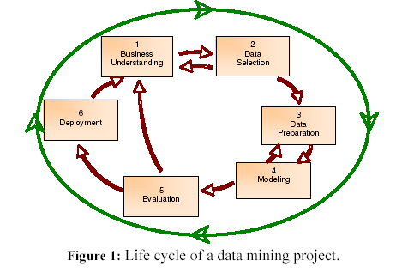
Structure of an Automated Tool for Medicare Management:
CRISP-DM (Standard Cross-Industry Process for Data Mining), is a consortium of companies (initially granted by the European Commission) which has defined and validated a data mining process that is applicable to several industry sectors.

Slide 12
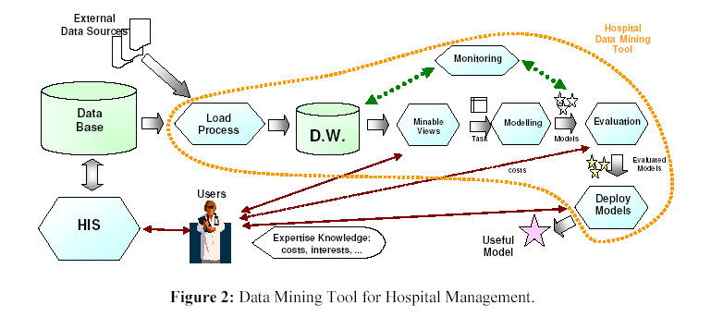
DATAMINING TOOL FOR HOSPITAL MANAGEMENT:

Slide 13
Now, the previous objectives have to be transformed into Data Mining objectives, such as:
To carry out global models about pressure emergencies by different time periods (daily, by shifts of work, by day of the week, etc).
To generate a model for predicting the number of daily hospitalizations coming from emergencies.
To obtain predictive models of global and partial use of beds by hospital service.
To construct models for estimating how the resources of a hospital are affected by a certain disease (for instance, influenza).
To carry out models to cluster patients (by age, by area, by pathology class, etc).

Slide 14
FEASIBILITY:
Feasibility study should be performed on the basis of various criteria and parameters.
The various feasibility studies are:
1.Economic Feasibility
2. Operational Feasibility
3. Technical Feasibility

Slide 15
ARCHITECTURE DIAGRAM:
SOA
Admin
Doctor
(Register)
Patient
(Register)
Pharmacy
(Register)
New Admin
Creation
Schedule
Patient
Bill General
Invite Doctor
Check
Appointment
Check
Appointment
Get Diagnostic Report
Logout

Slide 16
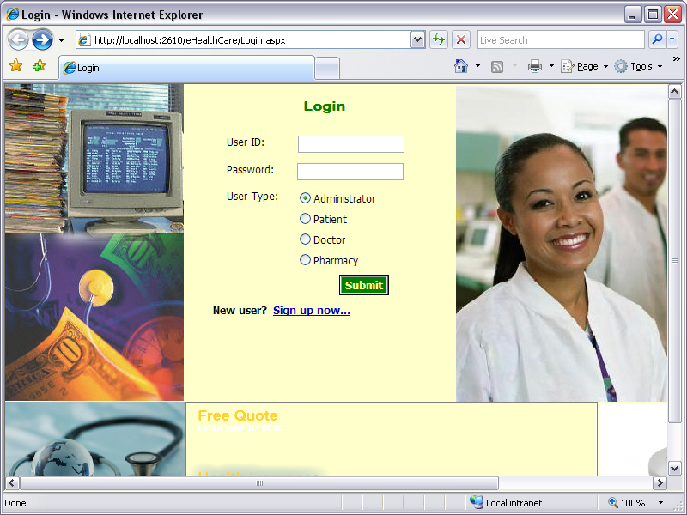
SCREEN SHOTS:

Slide 17
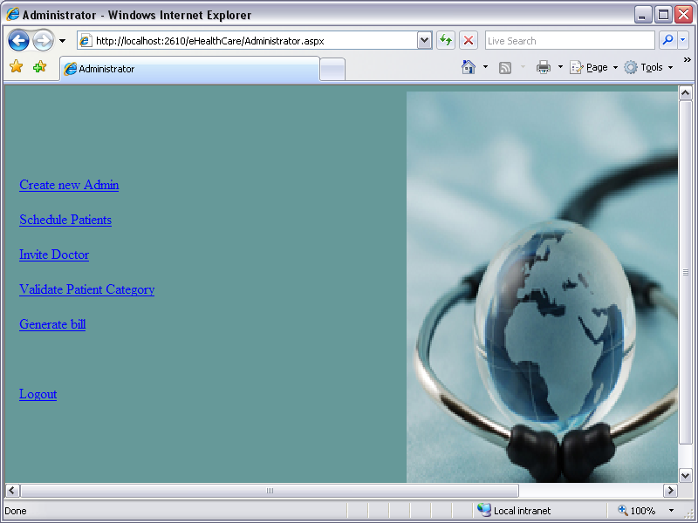

Slide 18
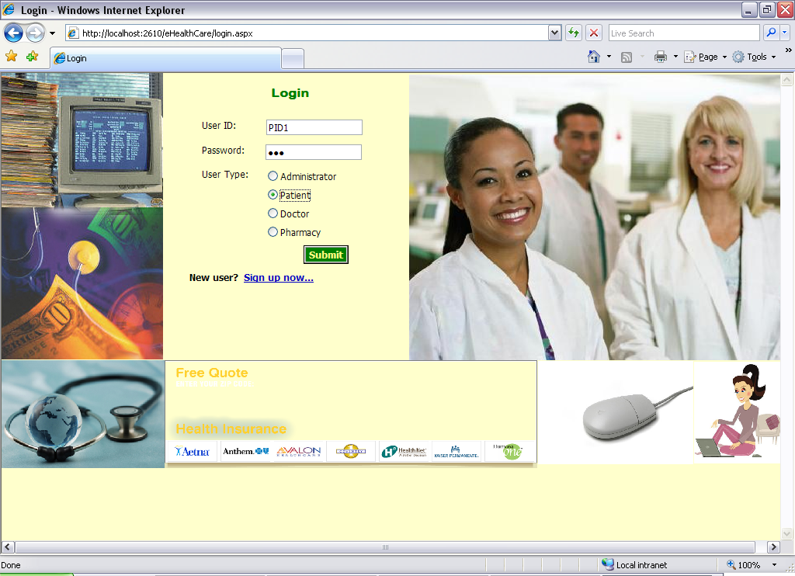
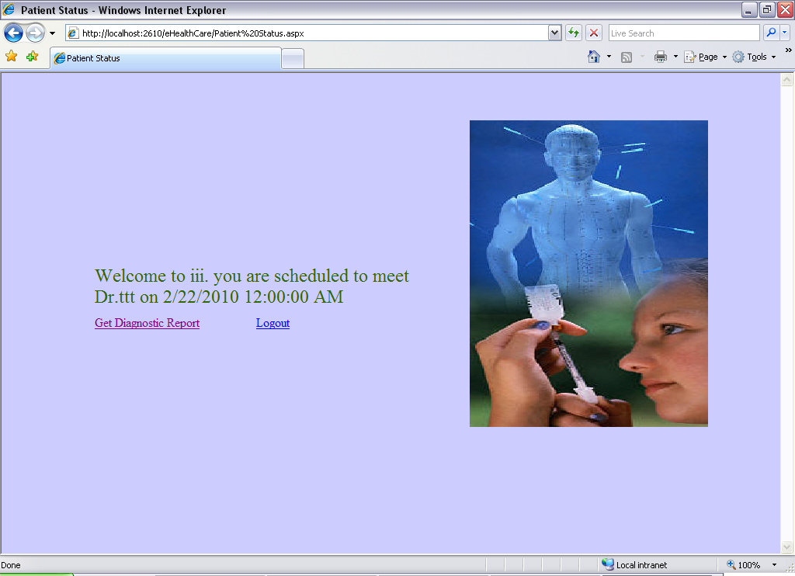

Slide 19
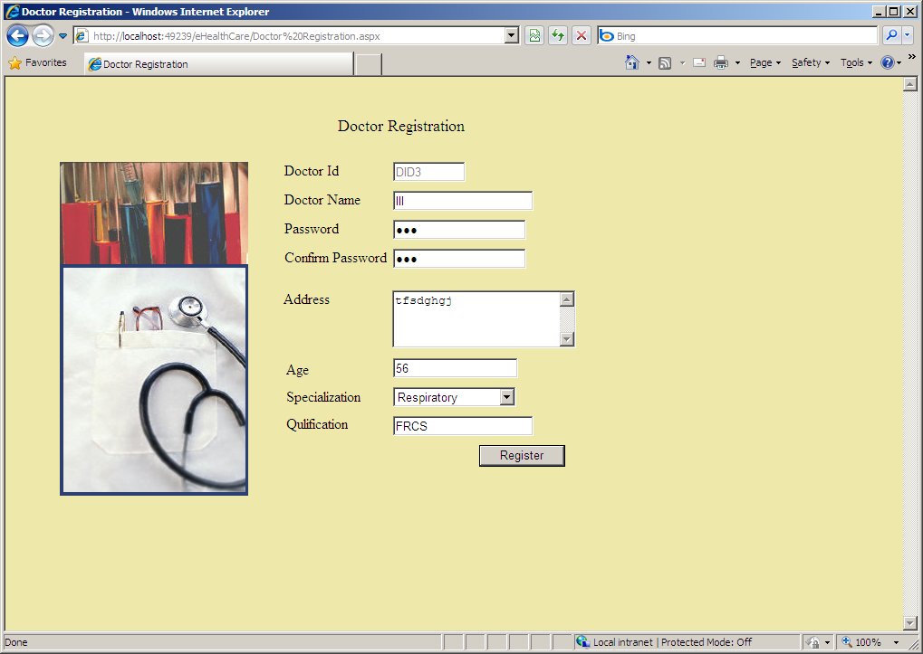
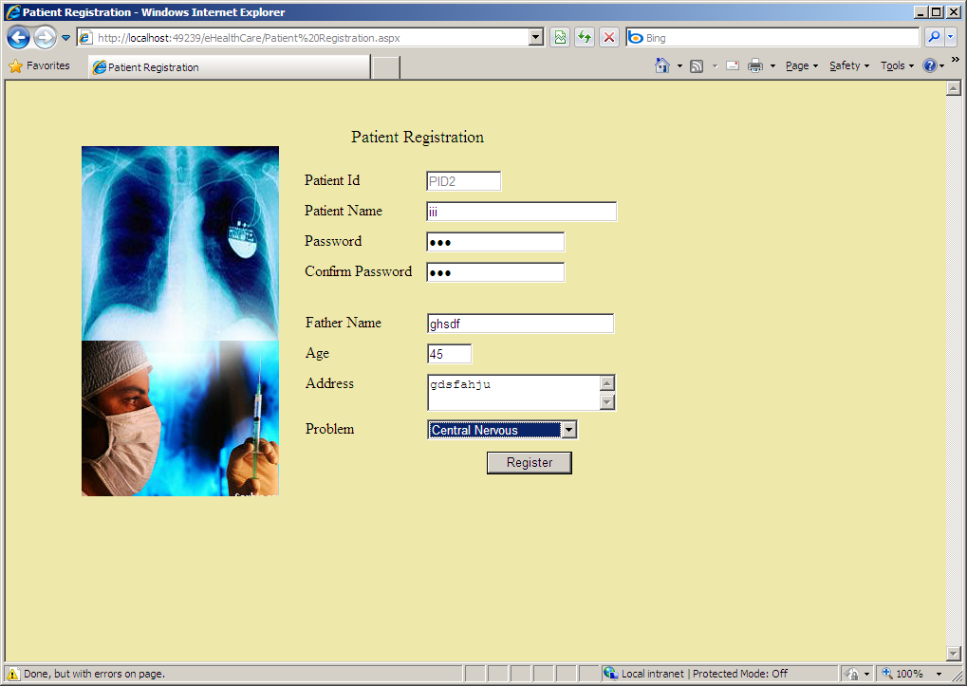
REGISTRATION SCREENS:

Slide 20
REFERENCES:
www.who.int.com
www.omg.org
www.ehealth.com
www.webhealthsoa.com

Slide 21
CONCLUSION:
The growing quality demand in the hospital sector makes it necessary to exploit the whole potential of stored data efficiently, not only the clinical data, in order to improve diagnoses and treatments, but also on management, in order to minimize costs and improve the care given to the patients.
In this sense, Data Mining (DM) can contribute with important benefits to the health sector, as a fundamental tool to analyze the data gathered by hospital information systems (HIS) and obtain models and patterns which can improve patient assistance and a better use of resources and pharmaceutical expense.

Slide 22


QUERIES….?

Slide 23

THANK YOU…….

