Slide 1
Blockchain in Talent Acquisition
-Naveen Kumar Naganaboina

Slide 2
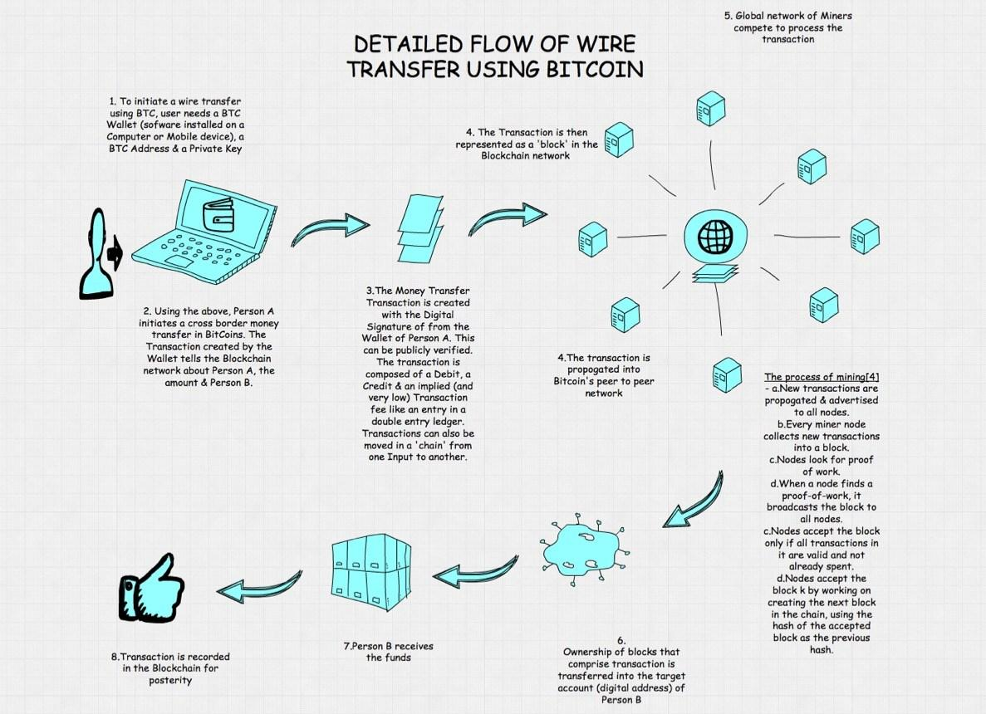
Blockchain Example - Bitcoin

Slide 3
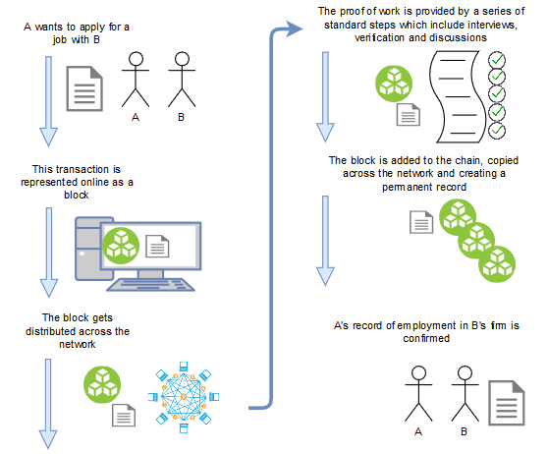
Proposed Model

Slide 4
Objective
The main objective to using Blockchain in recruiting domain would be:
Eliminating the fake profiles as each resume will be verified by the proof of work
Standardizing the procedure of recruitment of a candidate by involving multiple actors from the blockchain in verification
Providing each candidate with a standard score report that shows their competency
Bitcoin when introduced had the goal of eliminating third parties i.e. banks in conducting and verifying a transaction. Similarly, we can eliminate third party recruitment agencies and directly connect the candidate with the job.

