Slide 1

Weekly report <E-bill>
Naveen, Programmer
Chubchik Alexander, Tester
14.05.2021

Slide 2

Email confirmation for Log in
New activity added in application
Code for checking correct Email id and Password
No Fake log in
Added userlogin() method
Added Forgotpassword() method

Slide 3

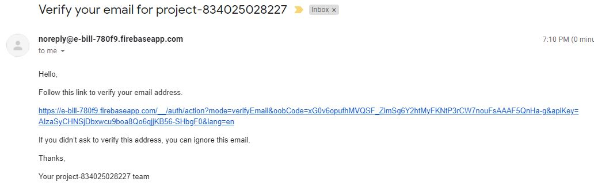
When user login with his email id and password he/she will get mail for verification .

Slide 4

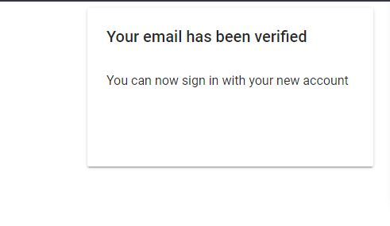

Slide 5
Using Email
Vk
Using Whatsapp with team members

Slide 6
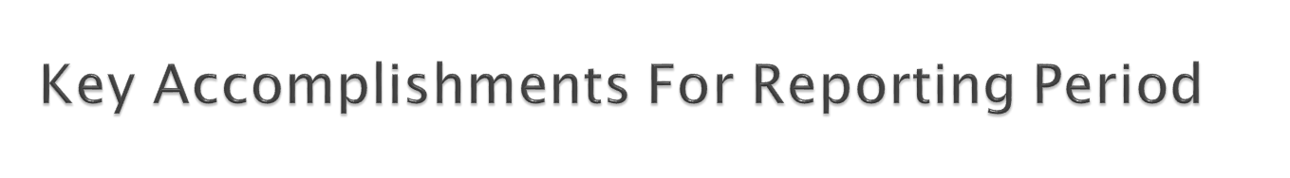
Kick off meeting
WBS
PMP
STP
Metrics
Configuration Management
Test
Design Main activity and Registration activity

Slide 7
Past Accomplishments | Plan | Actual
<Task/Milestone> | DD-MM-YYYY | DD-MM-YYYY
Kick of Meeting | 04-03-21 | 27-02-21
SOW | 04-03-21 | 27-02-21
PMP | 18-03-21 | 24-03-21
Authentication ,Registration | 14-04-21 | 14-04-21
Real time Database | 22-04-21 | 22-04-21
Email Verification | 07-05-21 | 06-05-21
Future Milestones | % | Plan | Forecast
<Task/Milestone> | <n>% | DD-MM-YYYY | DD-MM-YYYY
Getting bill format , Delivery confirmation | 20 | 26-05-21 | 25-05-21

Slide 8
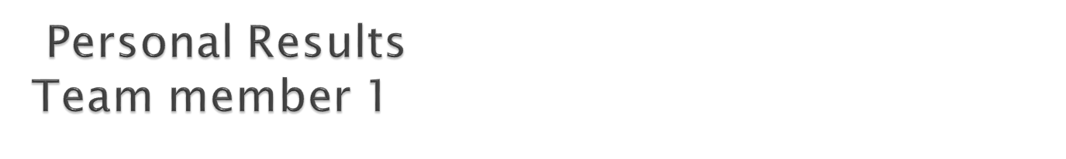
NAVEEN
Completed design of main activity and register activity for the Delivery boy
Coding for 2 activities in java
XML design for 2 activities
Email verification
Userlogin method
Checked correct mail id format
Authentication

Slide 9
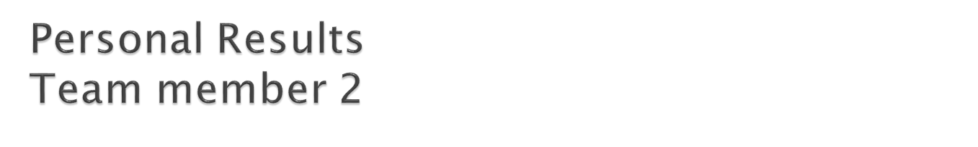
Chubchik Alexander
Usability testing
Functional testing
Debug reports
Password change method

Slide 10

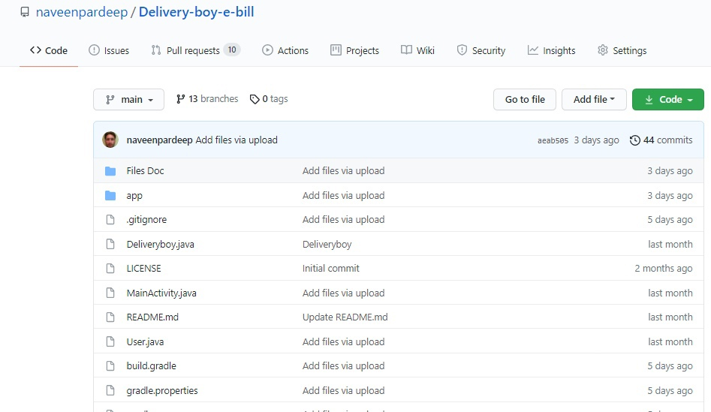

Slide 11
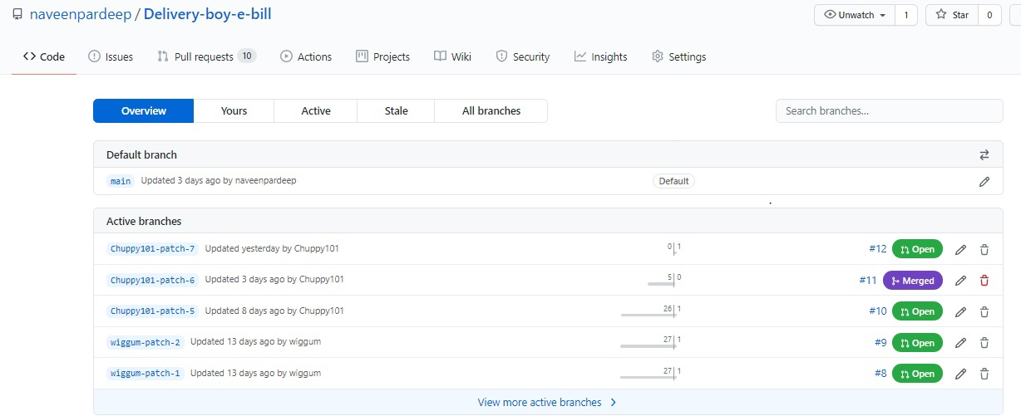

Slide 12
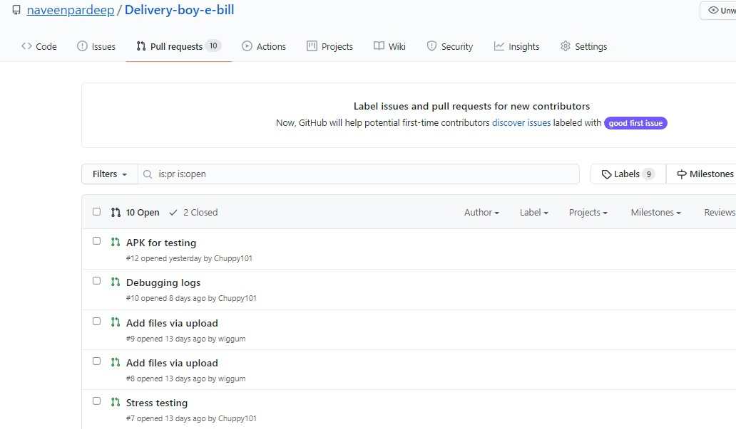

Slide 13
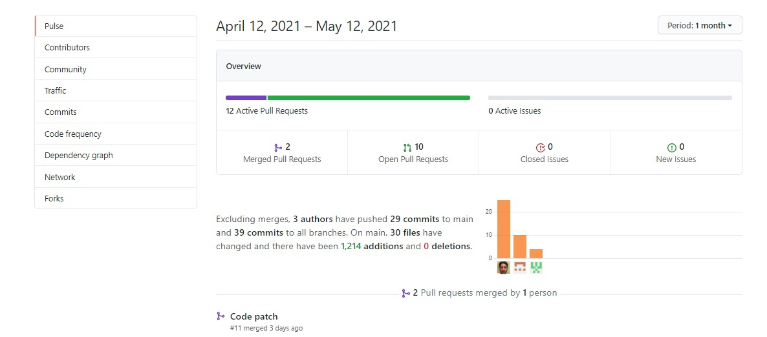

Slide 14
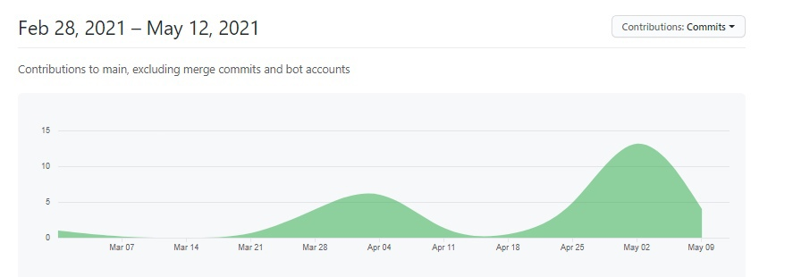

Slide 15
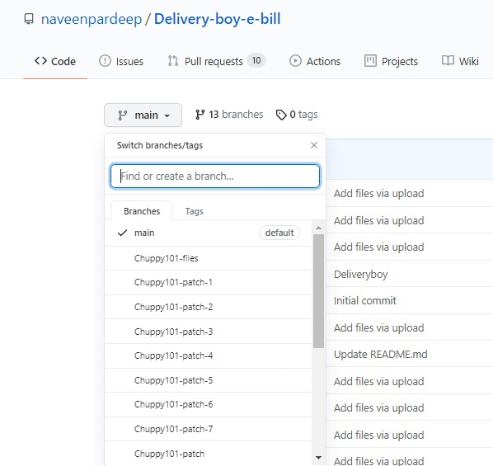

Slide 16
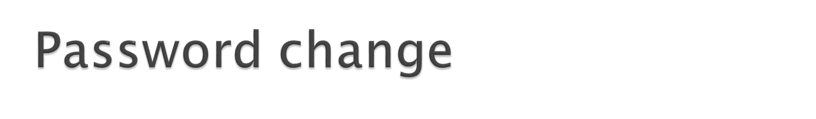
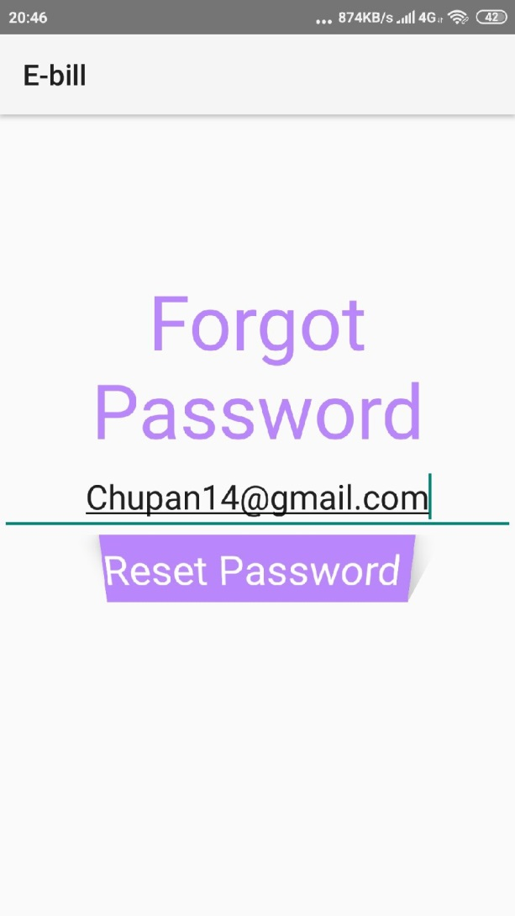

Slide 17
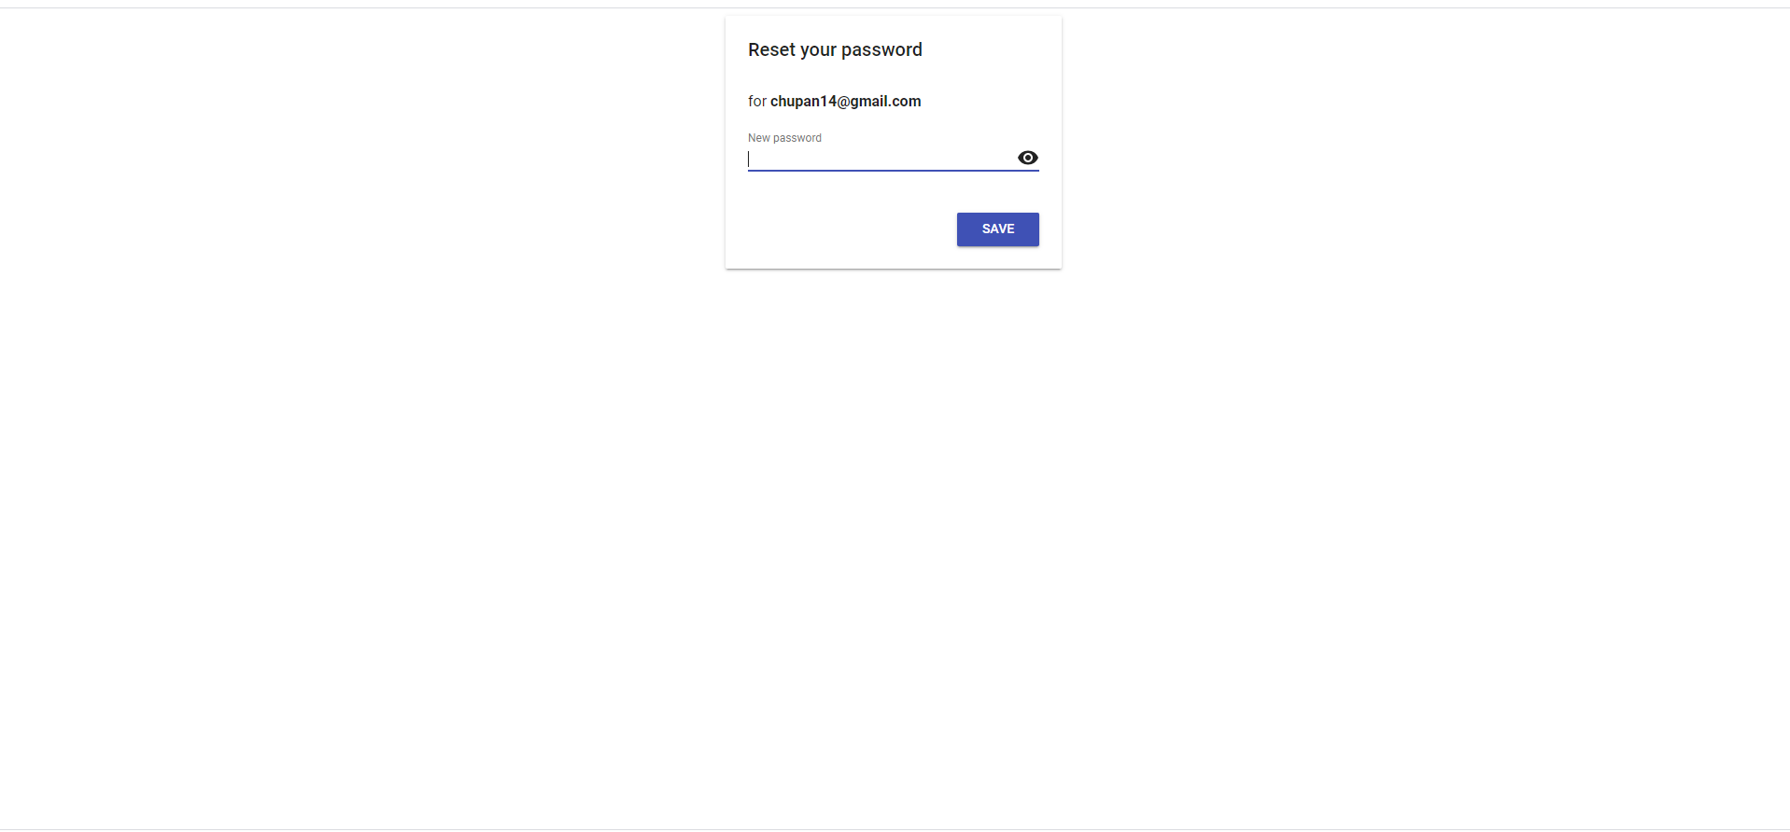

Slide 18


Slide 19
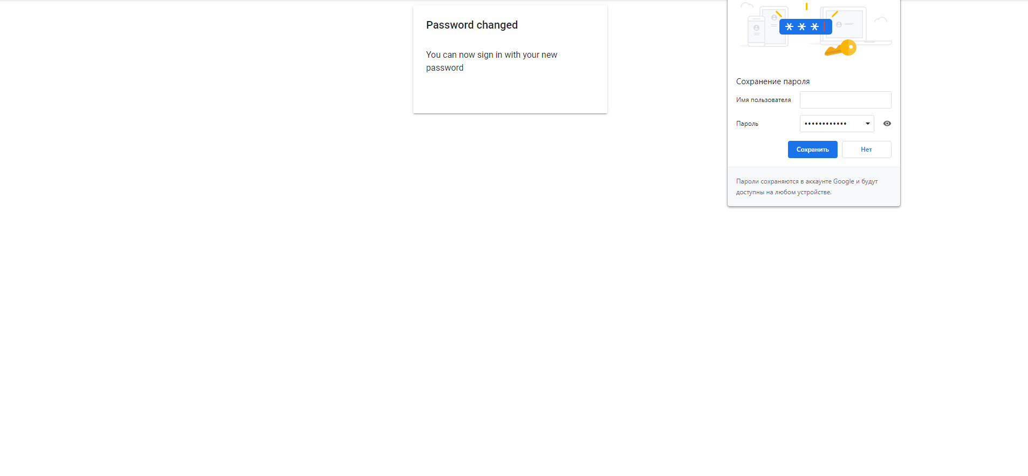

Slide 20

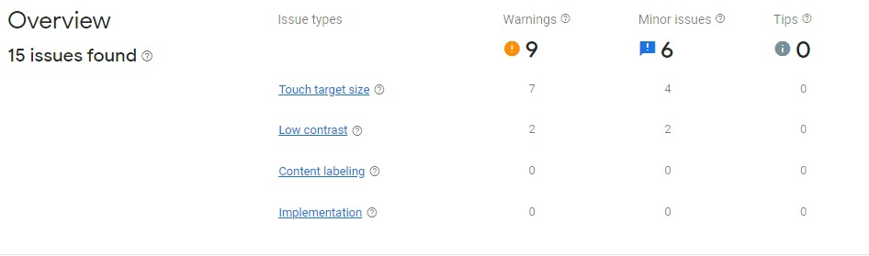

Slide 21
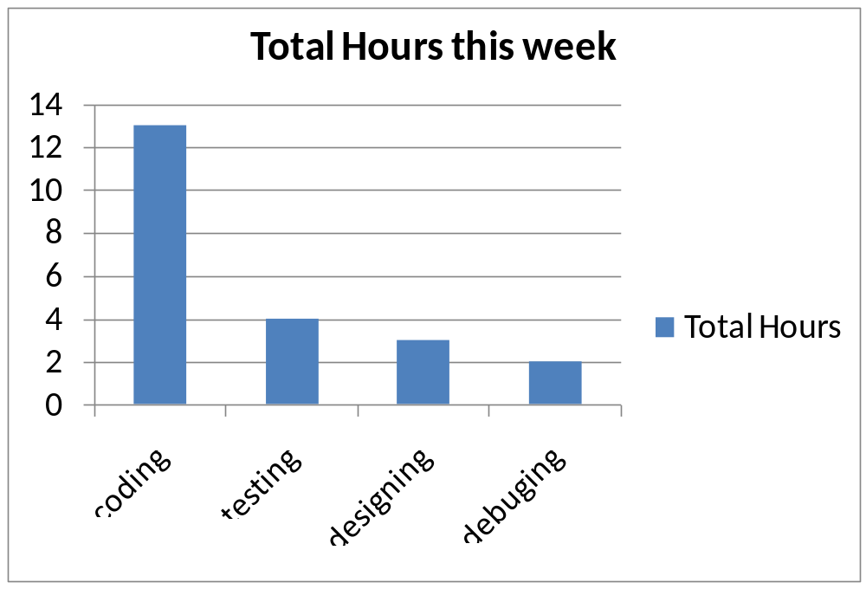

Slide 22

Add e-bill page design
Delivery Confirmation

Slide 23


