Slide 1
WELCOME
DEPARTMENT OF COMPUTER SCIENCE
SRI VENKATESWARA UNIVERSITY
INDIA

Slide 2
IT APPLICATIONS TO IMPROVE EFFICIENCY IN HEALTH CARE SYSTEMS
By
K.SEKAR
Research Supervisor
Prof. M. PADMAVATHAMMA
M.Sc., M.Ed., M.Phil., M.S., Ph.D.
Chair Person , BOS
DEPARTMENT OF COMPUTER SCIENCE
SRI VENKATESWARA UNIVERSITY

Slide 3
WELCOME
Prof. R.Balasubramanian
M.S.University, Tirunelveli

Slide 4
Health Care System
Health Care System is the highest priority of the new millennium. Information Technology is widely used in Health Care Systems. Health Care Systems is an integration of Computer Science, Information Technology and health care.
It deals with information in health and bio medicine ^{[32]}. Information Technology helps patients to be more involved in managing chronic diseases like heart disease, diabetes etc. Developments in Information Technology provide solutions for better health care systems.
Most of the Countries are spending a lot of resources for improvement of health care systems with the use of IT.
Cont..
Research Supervisor: Prof. M. PADMAVATHAMMA @ DEPARTMENT OF COMPUTER SCIENCE

Slide 5
Health Care System
Applications of IT in Health Care Systems are listed below:
  Tele Medicine
  Hospital Management Information System(HMIS)
  Customer Service/Web Portals
  Medical Transcription
Information Technology will be used to improve the quality of Health Care Systems and the delivery of health services. It plays a vital role in improving the efficiency of health care systems.
Health Care Industry is effectively using Information Technology like Electronic Health Records (EHR) , Chronic Disease Management Systems, Computerized Practitioners Order Entry (CPOE), Clinic Decision Support, Electronic Transfer of Prescription, Electronic Appointment Booking, Personal Health Record and Telemedicine.
Cont..
Research Supervisor: Prof. M. PADMAVATHAMMA @ DEPARTMENT OF COMPUTER SCIENCE

Slide 6
Health Care System
As per the increasing demands of stake holders in Health Care Systems – Patients, Doctors & Insurance Agency needs significant improvement.
Enhanced technologies should be fast, reliable, secure, and accurate thereby enabling the stake holders to use the applications of Health Care Systems more efficiently.
Cont..
Research Supervisor: Prof. M. PADMAVATHAMMA @ DEPARTMENT OF COMPUTER SCIENCE

Slide 7
MOTIVATION OF THE PROBLEM CONTEXT
Information Technology will be used to improve the quality of Health Care Systems and the delivery of health services. It plays a vital role in improving the efficiency of health care systems. Health Care Industry is effectively using Information Technology like Electronic Health Records (EHR), Chronic Disease Management Systems, Computerized Practitioners Order Entry (CPOE), Clinic Decision Support, Electronic Transfer of Prescription, Electronic Appointment Booking, Personal Health Record and Telemedicine.
This system needs to be secured with appropriate cryptosystem for effective utilization and access for different parties which will provide more security to the Health Care Systems .
To overcome this drawback we propose “IT APPLICATIONS TO IMPROVE EFFICIENCY IN HEALTH CARE SYSTEMS”.
Research Supervisor: Prof. M. PADMAVATHAMMA @ DEPARTMENT OF COMPUTER SCIENCE

Slide 8
Literature Survey
In the part of my research work I reviewed below quarterlies to analysis major issues in the present.
Paper 1:- “BIOMETRICS AUTHENTICATION TECHNIQUE FOR INTRUSION DETECTION SYSTEMS USING FINGERPRINT RECOGNITION”.
Explains some users do not use the password regularly in this place they will store/remember password in their work. Therefore, they could not be authenticated through a remember password system. On the other hand, all genuine users could enroll their fingerprint and use a fingerprint-based system.
Findings: The authentication of the user data in transit will use the existing stored or remember password, to overcome the stored/remember password we are providing fingerprint model authentication.
Paper 2:- RSA and DSA can fail catastrophically when used with malfunctioning random
number generators, but the extent to which these problems arise in practice has never
been comprehensively studied at Internet scale.
Source: “https://factorable.net/weakkeys12.extended.pdf”
Research Supervisor: Prof. M. PADMAVATHAMMA @ DEPARTMENT OF COMPUTER SCIENCE

Slide 9
Literature Survey
Findings: For key generation of weak p and q in asymmetric cryptographic will lead major security concern which will provide the access to the hackers. To overcome this finding we are using the finger print data from one finger from right hand .
Paper 3: “RSA Key Generation Using Combination of Fingerprints” IOSR-JEC, e-ISSN:2278-0661, Health care system transfers the huge sensitive data in the publicly shared media. To secure these shared data, there is a significant interest shown by the researchers in the cryptographic domain leading to many innovative and efficient encryption methods. Every encryption method needs to use strong keys.
Findings: For key generation of asymmetric cryptographic required an unpredictable large random number is required to generate the pair of keys.
Paper 4: “Communication Systems in Healthcare” presented in PMCID: PMC1579411,2016 May; 27(2): 89–98, https://www.ncbi.nlm.nih.gov/pmc/articles/PMC1579411/, . As a consequence there is increasing interest in, and use of, information and communication technologies to support health services.
Findings: Sharing the health care data between different parties’ is a hefty work and also the data should be shared between different entities such as lab, doctor, inter hospital, network hospital and different hospital.
Research Supervisor: Prof. M. PADMAVATHAMMA @ DEPARTMENT OF COMPUTER SCIENCE

Slide 10
PROBLEM CONTEXT
Health care efficiency is a major part of the medical data transaction and money transaction.
The Health care data is getting hacked through different applications used in Health Care Systems. Attacks ^{[23]} can be performed at transit or rest level, parties (Patients, Doctors, insurance companies and Bank) may easily act under false identities and then disappear during and after transaction; etc.
The exchange of data between parties involved in Health Care Systems is based on protocols ^{[24]} which should be secure in terms of data storage and decision making.
Cont..
Research Supervisor: Prof. M. PADMAVATHAMMA @ DEPARTMENT OF COMPUTER SCIENCE

Slide 11
PROBLEM CONTEXT
The need to increase level of trust between Patients, Doctors, Insurance Companies, Banks on the Internet and counter security threats has increased the need for designing IT applications that increases the efficiency of Health Care Systems. Different types of IT applications are available in HMIS .
Increasing the efficiency of these applications in Health Care Systems is essential.
Cont..
Research Supervisor: Prof. M. PADMAVATHAMMA @ DEPARTMENT OF COMPUTER SCIENCE

Slide 12
PROBLEM CONTEXT
Some of the Systems used are:
  Operational and Tactical Systems:
  Used mainly for processing of information.
  Clinical and Administrative Systems:
  Used in maintenance of patient details.
  Subject and Task Based Systems:
  Used for maintenance of Electronic Medical Reports
  Financial Systems:
  Used in Maintenance of Medical Expenses & Bill Submissions.
  In our research we propose the secure systems to protect the data and implement the IT applications to improve the efficiency of health care systems.
Cont..
Research Supervisor: Prof. M. PADMAVATHAMMA @ DEPARTMENT OF COMPUTER SCIENCE

Slide 13
OBJECTIVE & SCOPE OF RESEARCH WORK
Health Care Industry ^{[31]} is effectively using Information Technology like Electronic Health Records (EHR), Chronic Disease Management Systems, Computerized Practitioners Order Entry (CPOE), Clinic Decision Support, Electronic Transfer of Prescription, Electronic Appointment Booking, Personal Health Record and Telemedicine. This system needs to be secure to improve the efficiency of the IT applications in Health Care System.
The scope of the research is developing secure IT applications to improve the efficiency in Health Care Systems. Using biometric and public cryptosystem we can secure different health care IT applications at application level which is priceless compared to hardware security.
Cont..
Research Supervisor: Prof. M. PADMAVATHAMMA @ DEPARTMENT OF COMPUTER SCIENCE

Slide 14
OBJECT & SCOPE OF THE RESEARCH WORK
In our biometric and public cryptosystem approach we use the finger biometric as input for public key generation of MJ₂-RSA (Multi Prime Jordan-RSA) cryptosystem. In existing process users generate the random number as input to the public cryptosystem for key generation which is not secure.
Our secure health care IT Applications system model will enable organizations to restrict the sensitive data access and data theft which leads potential threat of efficiency of the organization. To overcome existing hardware level security system we provide the software level security system, which will be the costless and more effective.
Cont..
Research Supervisor: Prof. M. PADMAVATHAMMA @ DEPARTMENT OF COMPUTER SCIENCE

Slide 15
OBJECT & SCOPE OF THE RESEARCH WORK
Design and develop an efficient Health Care model to register users (patient, doctor, hospital authorities, technicians) using finger print and MJ₂-RSA algorithm.
Designing and implementing efficient Health Care System to secure the medical transactions between different parities like Lab, Medical provider, different hospital, and insurance company.
Design and implementation of secure protocols in Health Care System for authentication of digital health data and transaction.
  MJ₂-RSA protocols for secure transactions using finger prints.
  MJ₂-RSA secure protocol for digital data access for authorized users.
Authenticating (VRHCS) Verifiable Recoverable Health Care System for transactions between patient, doctors and hospital authority.
Cont..
Research Supervisor: Prof. M. PADMAVATHAMMA @ DEPARTMENT OF COMPUTER SCIENCE

Slide 16
METHODOLOGY
Implementation of Proposed MJ₂-RSA cryptosystem with performance analysis
Security and Performance plays an important role in Health Care System improvement. We propose a faster MJ₂-RSA by analyzing the performance of different public key cryptosystem.
Cont..
Research Supervisor: Prof. M. PADMAVATHAMMA @ DEPARTMENT OF COMPUTER SCIENCE

Slide 17
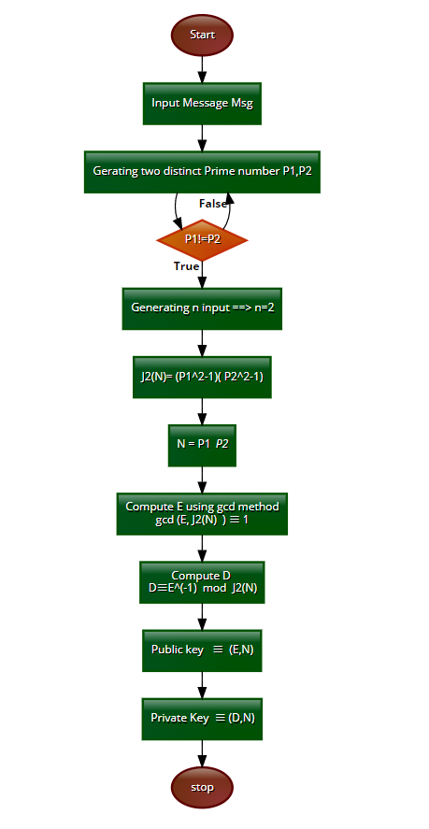
Flow Chart of New Variant MJ₂-RSA cryptosystem
Research Supervisor: Prof. M. PADMAVATHAMMA @ DEPARTMENT OF COMPUTER SCIENCES

Slide 18
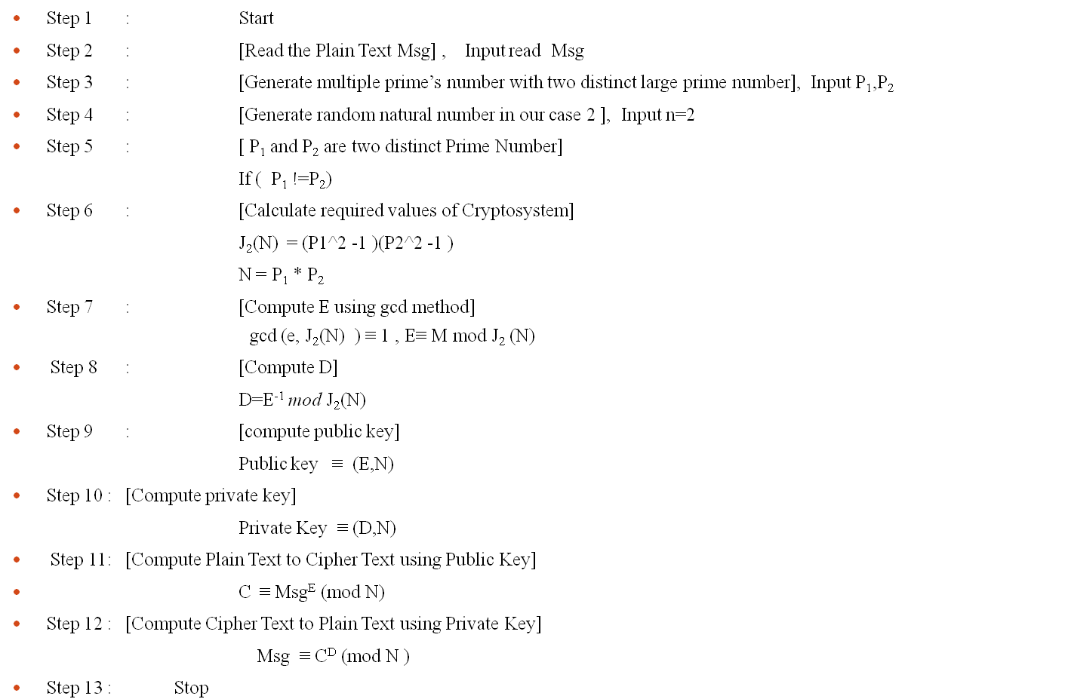
New Variant MJ₂-RSA cryptosystem
Research Supervisor: Prof. M. PADMAVATHAMMA @ DEPARTMENT OF COMPUTER SCIENCES

Slide 19
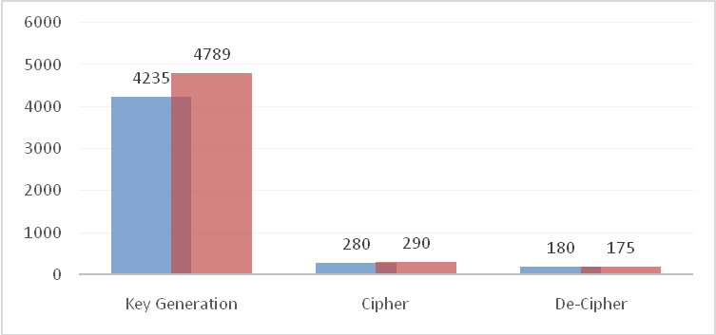
Comparison between RSA and MJ₂-RSA
Phase | RSA | MJ₂-RSA
Key Generation | 4235 | 4789
Cipher | 280 | 290
De-Cipher | 180 | 175
Research Supervisor: Prof. M. PADMAVATHAMMA @ DEPARTMENT OF COMPUTER SCIENCE

Slide 20
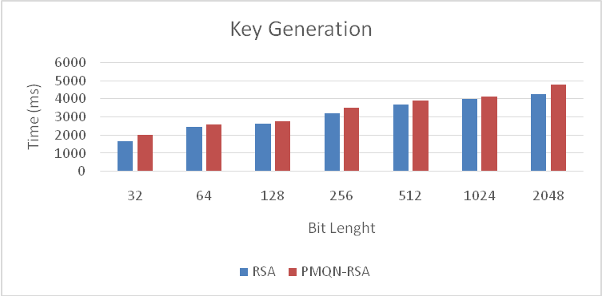
Key Generation Time Performance
Bit length | RSA | MJ₂-RSA
32 | 1673 | 2010
64 | 2450 | 2600
128 | 2613 | 2752
256 | 3213 | 3521
512 | 3678 | 3879
1024 | 3978 | 4125
2048 | 4235 | 4789
MJ₂- RSA
Research Supervisor: Prof. M. PADMAVATHAMMA @ DEPARTMENT OF COMPUTER SCIENCE

Slide 21
Cipher\Encryption Phase
Cipher Phase
Bit length | RSA | MJ₂-RSA
32 | 10 | 10
64 | 15 | 15
128 | 60 | 130
256 | 182 | 175
512 | 212 | 218
1024 | 254 | 250
2048 | 280 | 290
Research Supervisor: Prof. M. PADMAVATHAMMA @ DEPARTMENT OF COMPUTER SCIENCE

Slide 22
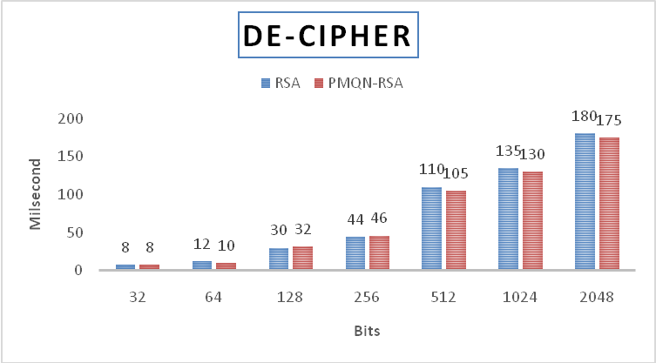
De-Cipher\Decryption Phase
De-Cipher Phase
Bit length | RSA | MJ₂-RSA
32 | 8 | 8
64 | 12 | 10
128 | 30 | 32
256 | 44 | 46
512 | 110 | 105
1024 | 135 | 130
2048 | 180 | 175
Research Supervisor: Prof. M. PADMAVATHAMMA @ DEPARTMENT OF COMPUTER SCIENCE

Slide 23
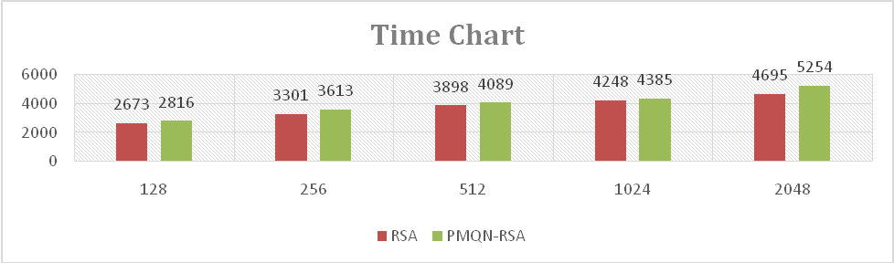
Time Complexity of MJ₂-RSA Cryptosystem
Time Complexity
Bit length | RSA | MJ₂-RSA
128 | 2673 | 2816
256 | 3301 | 3613
512 | 3898 | 4089
1024 | 4248 | 4385
2048 | 4695 | 5254
MJ₂- RSA
Research Supervisor: Prof. M. PADMAVATHAMMA @ DEPARTMENT OF COMPUTER SCIENCE

Slide 24
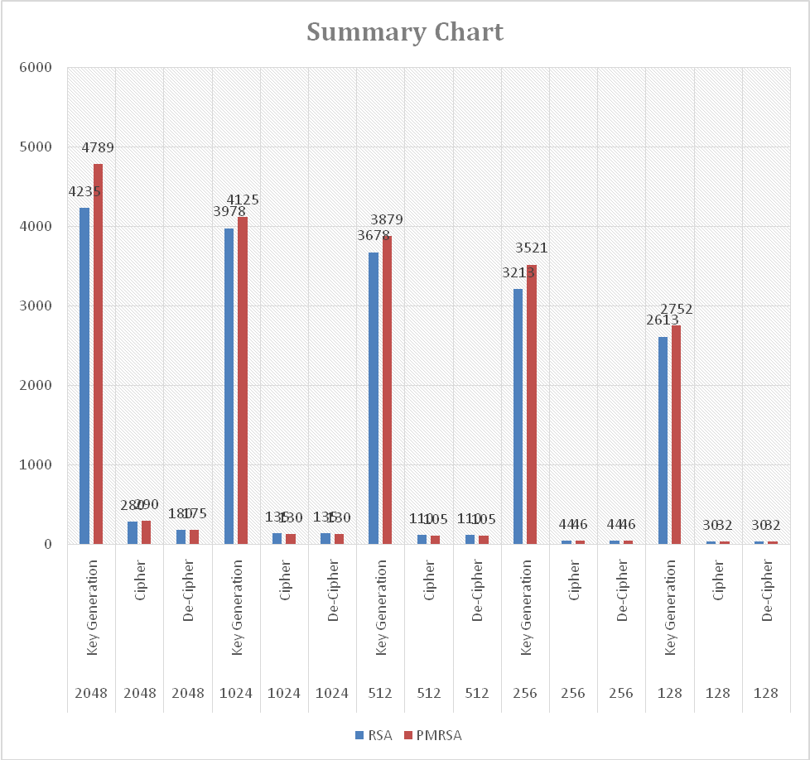
Analysis between RSA and MJ₂-RSA
Bit length | Phase | RSA | MJ₂-RSA
2048 | Key Generation | 4235 | 4789
2048 | Cipher | 280 | 290
2048 | De-Cipher | 180 | 175
1024 | Key Generation | 3978 | 4125
1024 | Cipher | 135 | 130
1024 | De-Cipher | 135 | 130
512 | Key Generation | 3678 | 3879
512 | Cipher | 110 | 105
512 | De-Cipher | 110 | 105
256 | Key Generation | 3213 | 3521
256 | Cipher | 44 | 46
256 | De-Cipher | 44 | 46
128 | Key Generation | 2613 | 2752
128 | Cipher | 30 | 32
128 | De-Cipher | 30 | 32
MJ₂- RSA
Research Supervisor: Prof. M. PADMAVATHAMMA @ DEPARTMENT OF COMPUTER SCIENCE

Slide 25
Methodology
User’s Finger Prints are captured and stored in the look-up table
In this phase user 10 fingers (i.e 5 finger from right and 5 finger from left) will captured and stored into the look-up table for future and next phase of implementation.
Implementation of Proposed MJ₂-RSA cryptosystem using fingerprint data
Using the look up data any one of the right finger nearby value will P and left finger value nearby value Q, these P and Q values are input value for our MJ₂-RSA cryptosystem.
Research Supervisor: Prof. M. PADMAVATHAMMA @ DEPARTMENT OF COMPUTER SCIENCES

Slide 26
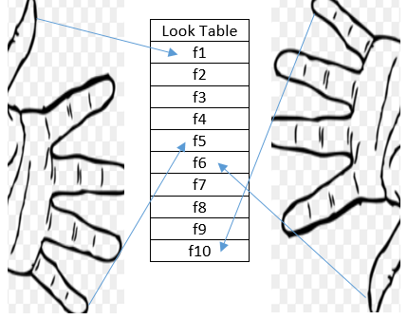
Figure showing Capture of Finger Prints in Look Table
Research Supervisor: Prof. M. PADMAVATHAMMA @ DEPARTMENT OF COMPUTER SCIENCE

Slide 27
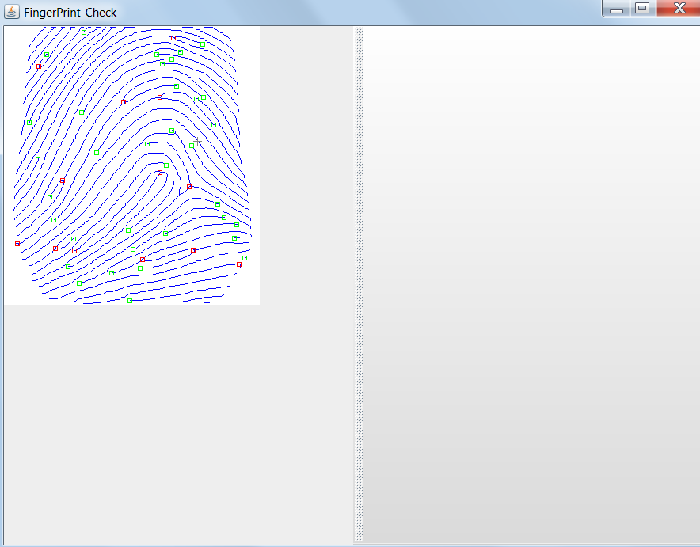
look up table finger print
Research Supervisor: Prof. M. PADMAVATHAMMA @ DEPARTMENT OF COMPUTER SCIENCES

Slide 28
METHODOLOGY
Implementation of Proposed MJ₂-RSA cryptosystem with protocols
Using the look-up table we are generating MJ₂-RSA public and private keys for different users (patient, doctor, hospital authorities) and providing the optimized protocols for secure and quicker protocols communication
  Patient to families (one to one/one to many)
  Patient to doctor (one to one) or Patient to lab (one to one) & Patient to e-payment (one to one)
  Patient to hospital ( one to many)
  Hospital to hospital (many to many)
Implementation of fingerprint MJ₂-RSA cryptosystem for storing and retrieving Health data/transactions.
Using fingerprint MJ₂-RSA cryptosystem protocol for one to one, one to many, many to many parties to improve the health care system communication in secure manner.
Cont..
Research Supervisor: Prof. M. PADMAVATHAMMA @ DEPARTMENT OF COMPUTER SCIENCE

Slide 29

Biometric finger print implementation in MJ₂-RSA
Step 1:- Reading the lookup table Randomly selecting two distinct values from (f1,f2, …. F10) the user’s finger lookup table f2 and f6
Step 2:- Choosing the Parameters from the lookup table calculating nearby primes number f1 ≡ P and f6 ≡ Q
Step 3:- Public Key Generation N = PQ ,
Step 4:- Public Key Generation Public-Key PK = (E, J_{k} (N))
Step 5:- Private Key Generation Private-Key SK = (D, J_{k} (N))
Research Supervisor: Prof. M. PADMAVATHAMMA @ DEPARTMENT OF COMPUTER SCIENCE

Slide 30
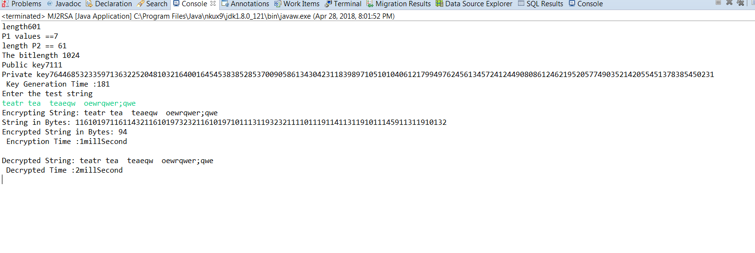
Sample Screen Shot
Research Supervisor: Prof. M. PADMAVATHAMMA @ DEPARTMENT OF COMPUTER SCIENCE

Slide 31
Health Care System
In this research, a cryptosystem ^{[10]} is developed that can be implemented in Health Care System to increase process improvement between different parties. Our cryptosystem ^{[4][5]} will secure the health data and system which will provide complete security in the Health Care System.
Designing and implementing efficient Health Care System to secure the medical transactions.
Design and implementation of secure protocols in Health Care System for authentication of digital health data and transaction
Research Supervisor: Prof. M. PADMAVATHAMMA @ DEPARTMENT OF COMPUTER SCIENCES

Slide 32
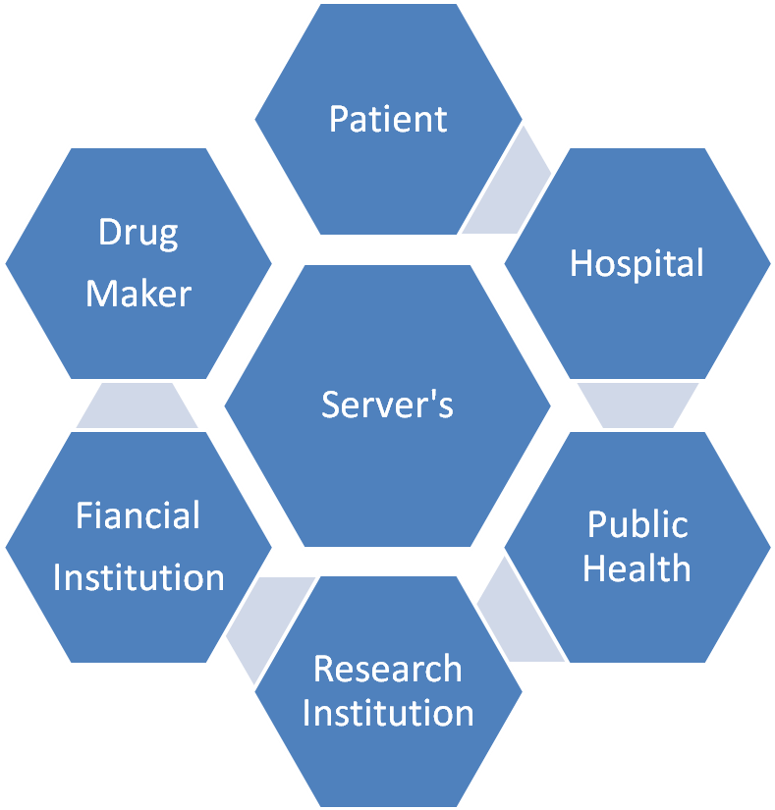
Different Parties accessing the Health care data
Research Supervisor: Prof. M. PADMAVATHAMMA @ DEPARTMENT OF COMPUTER SCIENCES

Slide 33
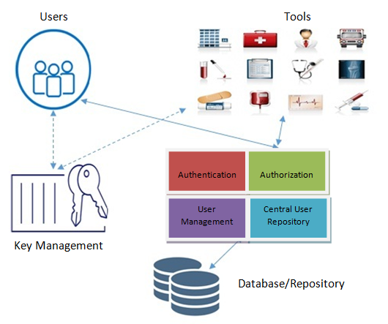

Health Care System Model
Research Supervisor: Prof. M. PADMAVATHAMMA @ DEPARTMENT OF COMPUTER SCIENCE

Slide 34
Protocol access between Patient and Health care communication system
Patient Request for Connection to ZTTP Server
ZTTP Server established the connection
ZTTP Server Creates the Session for Customer for future Communication
Patient send user id, user password and role via ZTTP to Secure Health Communication Server
ZTTP will check the user data accessibility in Health Care system database
Response will be sent to ZTTP, then ZTTP will check the access management details in the access management server
Finally response will be sent specifying user details to ZTTP.
After successful validation of the user, ZTTP will provide the data access in the Health care system without any further complication.
Research Supervisor: Prof. M. PADMAVATHAMMA @ DEPARTMENT OF COMPUTER SCIENCE

Slide 35
Protocol access between Patient and Health care communication system
Health Care System
Access Manager Server
Patient Server
Patient
ZTTP
Database
Patient Request connection to ZTTP Server
ZTTP Server establish connection
Patient sends information and role Via ZTTP Server to Secure Health care Server
Access Check? OK : Reject
ZTTP Checks User Data accessibility in Health care system
Access status shared to ZTTP
Session Created
Validation user? OK : Reject
User can access data using session created
Research Supervisor: Prof. M. PADMAVATHAMMA @ DEPARTMENT OF COMPUTER SCIENCE

Slide 36
Protocol access between Health Parties(Doctor/Lab/Nurses) and Health care communication system
Health parties request for connection to ZTTP server
ZTTP server establishes the connection
ZTTP server creates the session for customer for future communication
Health Parties send user id, user password and role to via ZTTP to Secure Health Communication Server
ZTTP will check the user data accessibility in Health Care system database
Response will be sent to ZTTP then ZTTP will check
  The access management details in the access management server
  The Policy management details in the Policy management server
Finally response will be sent to the ZTTP to specified user details to the ZTTP
After successful validation of the user ZTTP will provide the data access in the Health care system without any further complication.
Research Supervisor: Prof. M. PADMAVATHAMMA @ DEPARTMENT OF COMPUTER SCIENCES

Slide 37
Protocol access between Health Parties(Doctor/Lab/Nurses) and Health care communication system
Health Care System
Access Server ASj
Policy Server PSj
Database / Storage Server DSj / SSj
Doctor / Hospital
ZTTP
Health Parties Request connection to ZTTP Server
Connection? Established : Reject
ZTTP Server establish connection
Health Parties send user ID/PWD and roles to Via ZTTP to Secure Health care System
Session checked ? Authenticated : Rejected
ZTTP will Checks User Data accessibility in DSj
Status Ack
Check access Management
Status Ack
Check Policy access in PSj
Status Ack
Check DSj, ASj, PSj, : OK : Rejected
ZTTP will Provide Session and Data Access Privileges for authenticated users
Research Supervisor: Prof. M. PADMAVATHAMMA @ DEPARTMENT OF COMPUTER SCIENCES

Slide 38
PATIENT / DOCTOR /ADMIN ACCESS MANAGEMENT OF DATA
Patient
Doctor
Admin
Login
Access Server ASj
ZTTP
Policy Server PSj
Success
Storage Server Sj
Patient
Doctor
Admin
Patient Personal Data
Medical Data
Patient Personal Data / Payment
fig 5.1 Patient / Doctor /Admin Access management of Data
Research Supervisor: Prof. M. PADMAVATHAMMA @ DEPARTMENT OF COMPUTER SCIENCES

Slide 39
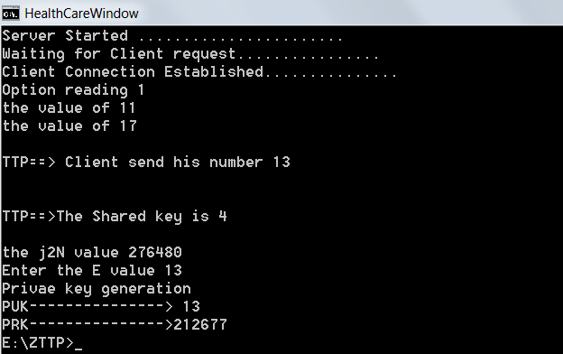
Patient-Server Communication – Server Side
Research Supervisor: Prof. M. PADMAVATHAMMA @ DEPARTMENT OF COMPUTER SCIENCES
Notes:
Sid

Slide 40
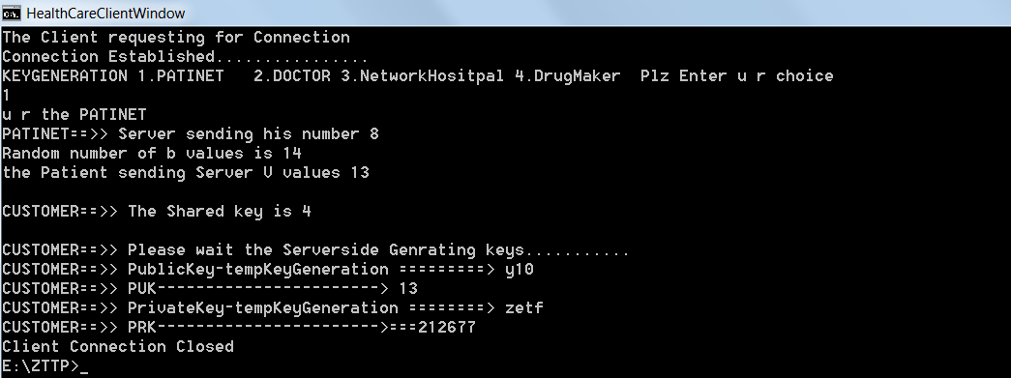
Patient server communication client side
Research Supervisor: Prof. M. PADMAVATHAMMA @ DEPARTMENT OF COMPUTER SCIENCES

Slide 41
METHODOLOGY
Authenticating (VRHCS) Verifiable Recoverable Health Care System for transactions between patient, doctors and hospital authority.
Research Supervisor: Prof. M. PADMAVATHAMMA @ DEPARTMENT OF COMPUTER SCIENCE

Slide 42
TFHCDAS Architecture
TFHCDAS
SERVER
MJ₂ – RSA Class Library
SSj
ASj
PSj
Protocol Secure & Execution of Data
Recovery
TFHCDAS Client
TFHCDAS ZTTP
Research Supervisor: Prof. M. PADMAVATHAMMA @ DEPARTMENT OF COMPUTER SCIENCES

Slide 43
CONCLUSIONS AND FUTURE WORK
User’s Finger Prints are captured and storing into the look-up table
In this phase user 10 fingers (i.e., 5 fingers from right and 5 fingers from left) will captured and stored into the look-up table for future and next phase of implementation.
Implementation of Proposed MJ₂-RSA cryptosystem using fingerprint data.
Using the look up data any one of the right fingers nearby value will P and left finger value nearby value Q, these P and Q values are input value for our novel MJ₂-RSA cryptosystem.
Implementation of Proposed MJ₂-RSA cryptosystem with performance analysis
Security and Performance plays an important role in Health Care System improvement. We propose a faster MJ₂-RSA^{[35]} analyzing the performance of different public key cryptosystem.
Research Supervisor: Prof. M. PADMAVATHAMMA @ DEPARTMENT OF COMPUTER SCIENCE

Slide 44
CONCLUSIONS AND FUTURE WORK
Implementation of Proposed MJ₂-RSA cryptosystem with protocols with performance analysis
Implementation fingerprint MJ₂-RSA cryptosystem for storing and retrieving Health data/transactions.
Using fingerprint MJ₂-RSA cryptosystem protocol for one to one, one to many, many to many parties to improve the health care system communication in a secured manner.
Implementation Bio-metric health care system model to improve the effectiveness in the Health care system.
Providing the Bio-metric health care system model to improve the efficacious and provide the secure connection protocol for one to one, one to many, many to many parties to improve the health care system communication in a secured manner. Bio-metric health care system model is provided for VRHCS (Verifiable, Recoverable Health Care System) for verifying the transaction of payment protocols.
Research Supervisor: Prof. M. PADMAVATHAMMA @ DEPARTMENT OF COMPUTER SCIENCE

Slide 45
Scope for Future Research Work
Using Health Care System data in Machine learning on competitive advantage & beyond
By reviewing further (international) cases of different sector’s and their data usage policy, using their policy data classification will improve the health care system data using machine learning.
Using Health Care System data in Big Data on competitive advantage & beyond
By reviewing additional (international) cases of different sector’s and their health care system security implementing big data techniques pattern will provide more in depth solutions for future health care products usage and access.
Research Supervisor: Prof. M. PADMAVATHAMMA @ DEPARTMENT OF COMPUTER SCIENCE

Slide 46
References
Alfred J. Menezes, Paul C. Van Oorschot, Scott A. Vanstane, “Handbook of Applied Cryptography”.
Amino Witno, “Group Theory”, WON Series in Discrete Mathematics and Modern Algebra, Vol. 5, Jan 2009.
Bruce S, "Applied Cryptography", 2nd John Wiley and Sons, Inc. 1996
Cesar Alison Monteiro Paixao, Decio Luiz Gazzoni Filho, “An efficient variant of the RSA Cryptosystem”.
Dan Boneh, “Twenty Years of Attacks on the RSA Cryptosystem”, Notices of the AMS, Vol. 46, No.2, Feb. 1999.
Dan Boneh and H. Shacham,“Fast variants of RSA”, CryptoBytes, vol.5, no. 1, pp. 1–9, 2002
Diffie W and Hellman M, “New Direction in Cryptography”, IEEE Transaction on Information Theory, IT-22(6): 644-654, 1976
Elgamal T, “A Public Key Cryptosystem and a Signature Scheme Based on Discrete Logarithm”, IEEE Trans. on Inf. Theory, IT-31, No.4, pp.469-472, 1985.
Hassan Takabi, James B.D. Jhosi, “Security and Privacy Challenges in Cloud Computing
Environments”, IEEE Security and Privacy, pp. 24-31, Dec 2010.
Hung-Min Sun, Mu-En Wu, Wei-Chi Ting, and M. Jason Hinek, “Dual RSA and Its Security Analysis”, IEEE Transactions on Information Theory, Vol. 53, No. 8, August 2007.
Kui Ren, Cong Wang, and Qian Wang, “Security Challenges for the Public Cloud”, IEEE Internet Computing, pp. 70-73, Jan-Feb, 2012.
Lee Badger Tim Grance, Robert Patt-Corner, Jeff Voas, “DRAFT Cloud Computing Synopsis and Recommendations”, NIST Special Publication 800-146, May – 2011.
NIST SP SOO-145, The NIST Definition of Cloud Computing, http://csrc.nist.
Gov/publications/drafts/SOO-145IDraft-SP-SOO-145-clouddefinition.pdf, NIST Special Publication SOO-145, January 2011.
RajkumarBuyya, James Broberg, Andrzej Gocinski, “Cloud Computing Principles and Paradigms”, John Wiley & Sons, Inc., Publication, 2011.
Rivest R, Shamir A, and Aldeman L, “A method for obtaining digital signatures and public-key cryptosystems”, Commun. ACM, vol. 21, no.2, pp. 120–126, 1978.
R.Sesshadri and T.Raghu Trivedi, Generate a key for MAC Algorithm using Biometric Fingerprint, International Journal of Ad hoc, Sensor & Ubiquitous Computing (IJASUC) ,1(4), 2010, 38-45.
Roli Bansal, Priti Sehgal and PunamBedi, Minutiae Extraction from Fingerprint Images - a Review, IJCSI International Journal of Computer Science Issues, 8(5), 2011, 74-85.
Kamini H Solanki, Chandni Patel, "Biometric Key Generation In Digital Signature Of Asymmetric Key Cryptographic To Enhance Security Of Digital Data", International Journal of Engineering Research & Technology (IJERT), Vol. 2, Issue 2, pp. 1-8, Feb.2013.
Dr. Manish Manoria, Ajit Kumar Shrivastava, Satyendra Singh Thakur, DebuSinha, "Exploring the Prospect of Secure BiometricCryptosystem using RSA for Blind Authentication", International Journal of Wisdom Based Computing, Vol. 1 (2), pp. 24-27, August 2011.
AjitAppari, M.EricJohnson,”Information Security and Privacy in Health Care”, August 2008.
Research Supervisor: Prof. M. PADMAVATHAMMA @ DEPARTMENT OF COMPUTER SCIENCE

Slide 47
THANK Q
ONE & ALL

Slide 48
Journal & Conference Proceedings
A research paper entitled “IMPROVING EFFICIENCY OF HEALTH CARE SYSTEM USING FINGER PRINT MJ₂-RSA CRYPTOSYSTEM” presented in “International Journal of Advanced Computational Engineering and Networking, ISSN: 2320-2106, Volume-5, Issue-10, Oct.-2017”
A research paper entitled “IDENTITY AND AUTHENTICATION USING FINGERPRINT BIOMETRICS MJ₂-RSA CRYPTOSYSTEM IN HEALTH CARE SYSTEM” presented in “K.Sekar et al, International Journal of Computer Science and Mobile Applications, Vol.5 Issue. 12, December- 2017, pg. 14-20 ISSN: 2321-8363”
A research paper entitled “A SURVEY ON IT APPLICATIONS IN HEALTHCARE SYSTEMS” presented in “Journal of Network Communications and Emerging Technologies (JNCET), Volume 7, Issue 11, November (2017)”
A research paper entitled “IMPROVING THE QUALITY OF HEALTH CARE SYSTEMS BASED ON IT APPLICATIONS”, presented in International Journal of Computer Science and Mobile Applications, Vol.5 Issue. 11, November- 2017, pg. 56-60, ISSN: 2321-8363(UGC Approved), Impact Factor: 5.515, Journal No: 63603.
A research paper entitled “BUSINESS PROCESS RE-ENGINEERING CAPABILITY BASED ON ECMM EFFICIENT CONFIGURATION MODEL AND MANAGEMENT”, presented in Computer Modelling & New Technologies 2017 21(2) 71-79
A research paper entitled “COMPARATIVE STUDY OF ENCRYPTION ALGORITHM OVER BIG DATA IN CLOUD SYSTEMS”, presented in Published in the 2016 3rd International Conference on “Computing for Sustainable Global Development”, 16 March, 2016
A research paper entitled “PRIVACY PRESERVING-AWARE OVER BIG DATA IN CLOUDS USING GSA AND MAP REDUCE FRAMEWORK”, presented in IJARCET, Volume 5, Issue 8, PP.2282-2293, 2016
Research Supervisor: Prof. M. PADMAVATHAMMA @ DEPARTMENT OF COMPUTER SCIENCE

