Slide 1
Show Time Tickets
Project team 4
Course: 44691-02

Slide 2
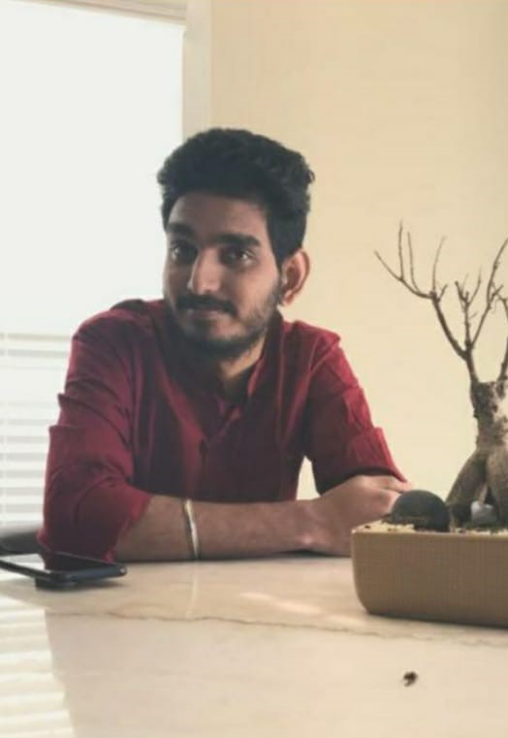
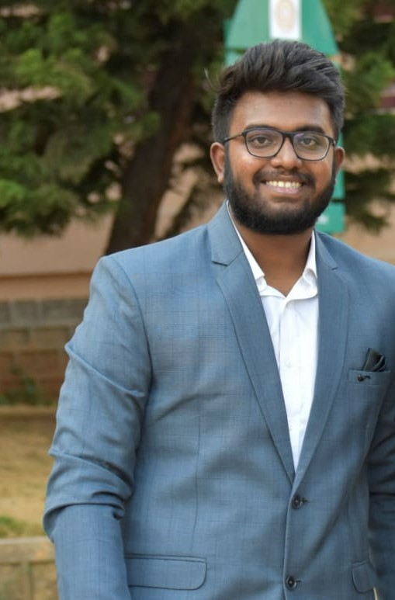
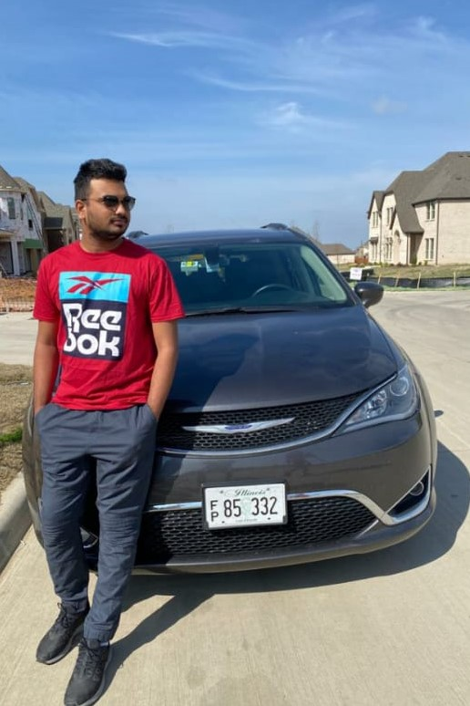
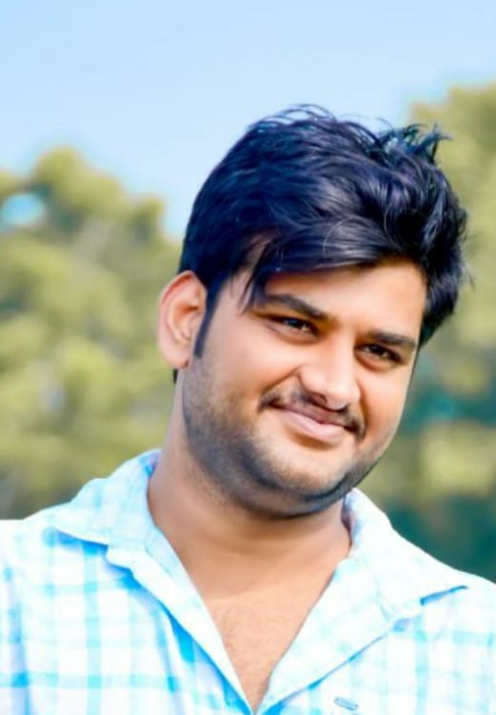
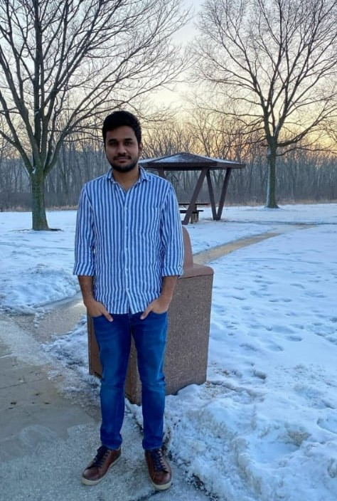
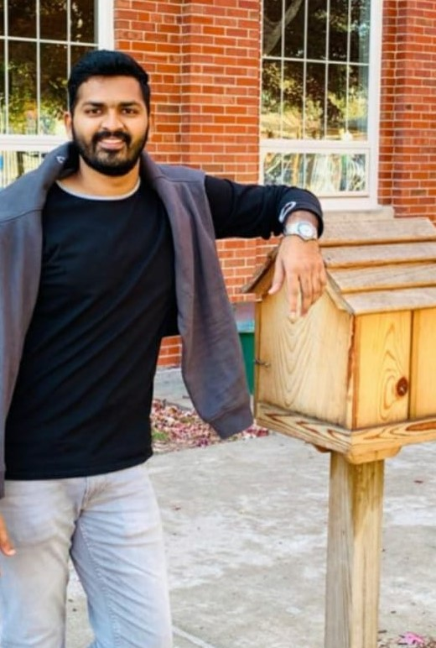
Team Members
Saiprasad
Bobbilla
Sai Naveen Bhargava Gajavalli
Praneeth Reddy Kalluri
Pavan Sai Kumar Reddy Kamjula
Pranay Allikanti
Chaitanya Popuri
Naveen 2

Slide 3
Outline
Project description
Task’s assigned
Demo

Slide 4
Project Description
The purpose of the Show Time Tickets application is to book the movie tickets online by selecting the movie preferences.
The application lets the user select the seats according to their preference.

Slide 5
Task’s Assigned
Sai Naveen Bhargava Gajavalli
Responsible Activities:
Movie Management
View Movie Listing
Admin Login
Partially Responsible Activities:
Live Chat
View Movie Timing
Ticket Activity
Check History
Seat Activity
Check out

Slide 6
Task’s Assigned
Pranay Allikanti
Responsible Activities:
View Movie Timing
Ticket Activity
Reminder
Partially responsible Activities:
Movie Management
View Movie Listing
Admin Login
Seat Activity
Checkout
Check History

Slide 7
Task’s Assigned
SaiPrasad Bobbilla
Responsible Activities:
Seat Activity
Checkout
Check History
Partially responsible Activities:
Movie Management
View Movie Listing
Admin Login
View Movie Timing

Slide 8
Task’s Assigned
Pavan Sai Kumar Reddy Kamjula
Responsible Activities:
Feedback
Cart Management (Add/Delete)
Ticket Count Page
Partially responsible Activities:
Search Filter
FAQ Page
Live Chat
Remainder
Notification
Edit and View Profile Activity
Payment Activity

Slide 9
Task’s Assigned
Praneeth Reddy Kalluri
Responsible Activities:
Payment Activity
Notification
Edit and View Profile Activity
Partially responsible Activities:
Cart Management
Feedback
Search Filter in the Home Activity
FAQ page

Slide 10
Task’s Assigned
Chaitanya Popuri
Responsible Activities:
Search Filter
FAQ page
Live Chat
Partially responsible Activities:
Cart Management
Feedback
Reminder
Edit and View Profile
Notification
Payment Activity

Slide 11
Summary
This application helps to eliminate the efforts of the offline procedure.
This application also allow the users to cancel the tickets at any time before the show begins.
This application has a good UI which helps the users to easily understand the process.

Slide 12
Any Questions?
Saiprasad
Bobbilla
Sai Naveen Bhargava Gajavalli
Praneeth Reddy Kalluri
Pavan Sai Kumar Reddy Kamjula
Pranay Allikanti
Chaitanya Popuri

Slide 13
Thank You

