Slide 1
Java Programming
Collection Framework
Module 7
Notes:
1

Slide 2
Agenda
1
Introduction to Collection
2
Collection Hierarchy
3
Generics
4
Understanding List, Set and Map

Slide 3
Objectives
At the end of this module, you will be able to:
Implement various Collection classes & interfaces
Explore Generics
Apply Best practices in Collections

Slide 4
Introduction to Collection
Notes:
4

Slide 5
Introduction
A Collection is a group of objects
Collections framework provide a a set of standard utility classes to manage collections
Collections Framework consists of three parts:
Core Interfaces
Concrete Implementation
Algorithms such as searching and sorting
Notes:
A Collection (sometimes called a container) is simply an object that groups multiple elements into a single unit. Collection is used to store, retrieve objects, and to transmit them from one method to another.
The Collections API (also called the Collections framework) standardizes the way in which groups of objects are handled by your programs. It presents a set of standard utility classes to manage such collections. This framework is provided in the java.util package and comprises three main parts:
The core interfaces, which allow collections to be manipulated independent of their implementation. These interfaces define the common functionality exhibited by collections, and facilitate data exchange between collections.
A small set of implementations, which are concrete implementations of the core interfaces, providing data structures that a program can use.(Eg LinkedLists, Arrays, Vectors, Stack etc)
An assortment of algorithms, which can be used to perform various operations on collections, such as sorting and searching.
The collection classes are useful in a variety of ways and are the fundamental building blocks of the more complicated data structures used in the other java packages in your own applications. There are several types of collections. They vary in storage mechanisms used, in the way they access data and in the rules about what data may be stored.
Note : The Java Collection technology is similar to the Standard Template Library (STL) defined by C++.

Slide 6
Advantages of Collections
Reduces programming effort
Increases performance
Provides interoperability between unrelated APIs
Reduces the effort required to learn APIs
Reduces the effort required to design and implement APIs
Fosters Software reuse
Notes:
Reduces programming effort by providing useful data structures and algorithms so you don't have to write them yourself.
Increases performance by providing high-performance implementations of useful data structures and algorithms. Because the various implementations of each interface are interchangeable, programs can be easily tuned by switching implementations.
Provides interoperability between unrelated APIs by establishing a common language to pass collections back and forth.
Reduces the effort required to learn APIs by eliminating the need to learn multiple ad hoc collection APIs.
Reduces the effort required to design and implement APIs by eliminating the need to produce ad hoc collections APIs.
Fosters software reuse by providing a standard interface for collections and algorithms to manipulate them.
6

Slide 7
Collection Hierarchy
Notes:
7

Slide 8
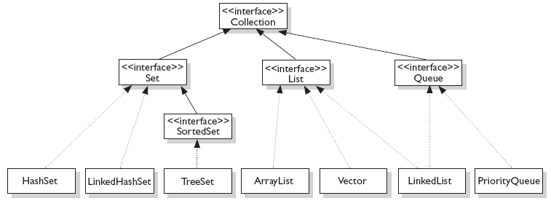
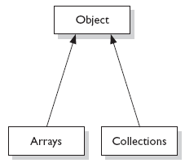
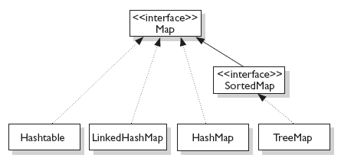
Interfaces and their implementation
Notes:
The core collection interfaces are the interfaces used to manipulate collections, and to pass them from one method to another. The basic purpose of these interfaces is to allow collections to be manipulated independently of the details of their representation.
When you understand how to use these interfaces, you know most of what there is to know about the framework. The core collections interfaces in hierarchical order are shown in Fig:1
Not all collections in the Collections Framework actually implement the Collection interface. Specifically, none of the Map-related classes and interfaces extend from Collection. So while SortedMap, Hashtable, HashMap, TreeMap, and LinkedHashMap are all thought of as collections, none are actually extended from Collection.
Note: Collections is a class, with static utility methods, while Collection is an interface with declarations of the methods common to most collections including add(), remove(), contains(), size(), and iterator().
8

Slide 9
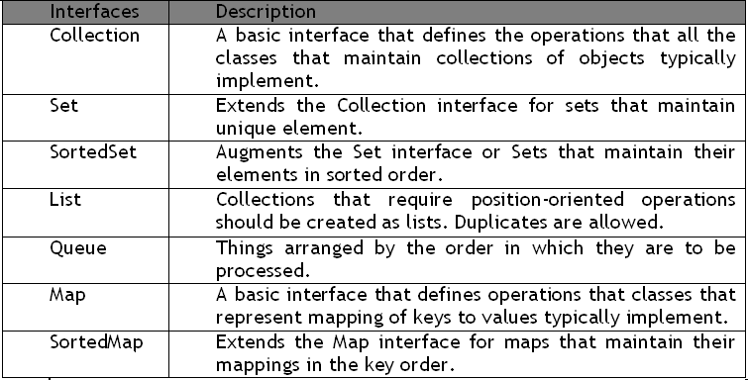
Collection Interfaces
Notes:
These are the 4 major interfaces:
Set Interface
A Set cares about uniqueness. It doesn't allow duplicates.
List Interface
A List cares about the index. The one thing that List has that non-lists don't have is a set of methods related to the index. Those key methods include things like get(int index), indexOf(Object o), add(int index, Object obj), and so on.
Queue Interface
A Queue is designed to hold a list of "to-dos," or things to be processed in some way.Although other orders are possible, queues are typically thought of as FIFO (first-in, first-out). Queues support all of the standard Collection methods and they also add methods to add and subtract elements and review queue elements.
Map Interface
A Map cares about unique identifiers. You map a unique key (the ID) to a specific value, where both the key and the value are, of course, objects. You're probably quite familiar with Maps since many languages support data structures that use a key/value or name/value pair. The Map implementations let you do things like search for a value based on the key, ask for a collection of just the values, or ask for a collection of just the keys. Like Sets, Maps rely on the equals() method to determine whether two keys are the same or different.
9

Slide 10
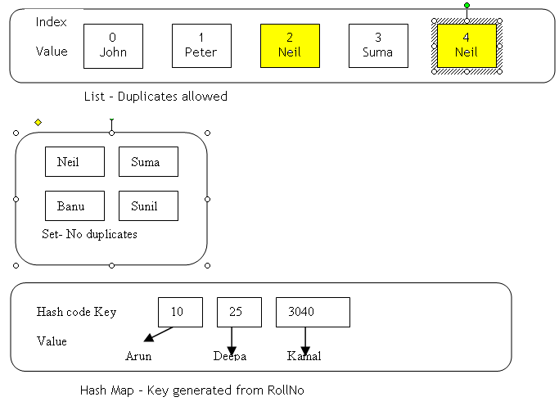
Illustration of List, Set and Map

Slide 11
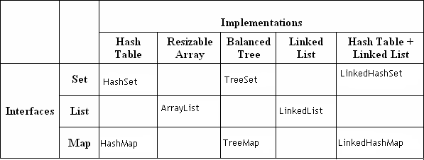
Collection Implementations
Notes:
Classes that implement the collection interfaces typically have names of the form <Implementation-style><Interface>. The general purpose implementations are summarized in the table above.
HashSet A HashSet is an unsorted, unordered Set. It uses the hashcode of the object being inserted, so the more efficient your hashCode() implementation the better access performance you'll get. Use this class when you want a collection with no duplicates and you don't care about order when you iterate through it.
LinkedHashSet A LinkedHashSet is an ordered version of HashSet that maintains a doubly-linked List across all elements. Use this class instead of HashSet when you care about the iteration order. When you iterate through a HashSet the order is unpredictable, while a LinkedHashSet lets you iterate through the elements in the order in which they were inserted.
TreeSet A TreeSet stores objects in a sorted sequence. It stores its elements in a tree and they are automatically arranged in a sorted order.
ArrayList Think of this as a growable array. It gives you fast iteration and fast random access. It is an ordered collection (by index), but not sorted. ArrayList now implements the new RandomAccess interface—a marker interface (meaning it has no methods) that says, "this list supports fast (generally constant time) random access." Choose this over a LinkedList when you need fast iteration but aren't as likely to be doing a lot of insertion and deletion.
LinkedList A LinkedList is ordered by index position, like ArrayList, except that the elements are doubly-linked to one another.

Slide 12
Notes:
This linkage gives you new methods (beyond what you get from the List interface) for adding and removing from the beginning or end, which makes it an easy choice for implementing a stack or queue. Keep in mind that a LinkedList may iterate more slowly than an ArrayList, but it's a good choice when you need fast insertion and deletion. As of Java 5, the LinkedList class has been enhanced to implement the java.util.Queue interface. As such, it now supports the common queue methods: peek(), poll(), and offer().
HashMap The HashMap gives you an unsorted, unordered Map. When you need a Map and you don't care about the order (when you iterate through it), then HashMap is the way to go; the other maps add a little more overhead. Where the keys land in the Map is based on the key's hashcode, so, like HashSet, the more efficient your hashCode() implementation, the better access performance you'll get. HashMap allows one null key and multiple null values in a collection.
TreeMap TreeMap is a sorted Map.
LinkedHashMap Like its Set counterpart, LinkedHashSet, the LinkedHash-Map collection maintains insertion order (or, optionally, access order). Although it will be somewhat slower than HashMap for adding and removing elements, you can expect faster iteration with a LinkedHashMap.

Slide 13
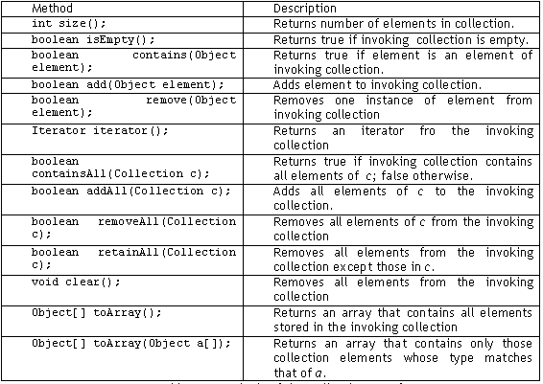
Collection interface methods
Notes:
The Collection Interface is the foundation on which the collection framework is built. It declares the core methods that all collections will have. Some of these methods are summarized in table above.
The bulk operations perform some operation on an entire Collection in a single shot. They are done through methods, containsAll(), addAll(), removeAll(), retainAll(), clear().
The Collection Interface is the foundation on which the collection framework is built. It declares the core methods that all collections will have. Some of these methods are summarized in table above.
The bulk operations perform some operation on an entire Collection in a single shot. They are done through methods, containsAll(), addAll(), removeAll(), retainAll(), clear().
13

Slide 14
Quiz
1. Which of the following classes is not implemented from the Collection interface?
a. TreeSet
b. HashTable
c. Vector
d. Linked List
2. Which of the following is a class?
a. Collection
b. Collections
3. Which of the following does not accept duplicate values?
a. ArrayList
b. LinkedList
c. TreeSet
d. Vector
HashTable
Collections
TreeSet

Slide 15
Generics
Notes:
15

Slide 16
What are and Why Generics?
Mechanism by which a single piece of code can manipulate many different data types without explicitly having a separate entity for each data type
Before Generics
List myIntegerList = new LinkedList(); // 1 myIntegerList.add(new Integer(0)); // 2 Integer x = (Integer) myIntegerList.iterator().next(); // 3 Line no 3 if not properly typecasted will throw runtime exception
After Generics
List<Integer> myIntegerList = new LinkedList<Integer>(); // 1 myIntegerList.add(new Integer(0)); //2 Integer x = myIntegerList.iterator().next(); // 3
Notes:
Look at the following pieces of code:
List myIntegerList = new LinkedList(); // 1
myIntegerList.add(new Integer(0)); // 2
Integer x = (Integer) myIntegerList.iterator().next(); // 3
The cast on line 3 is slightly annoying. Typically, the programmer knows what kind of data has been placed into a particular list. However, the cast is essential. The compiler can only guarantee that an Object will be returned by the iterator. To ensure the assignment to a variable of type Integer is type safe, the cast is required. Of course, the cast not only introduces clutter. What if programmers could actually express their intent, and mark a list as being restricted to contain a particular data type? This is the core idea behind generics. Here is a version of the program fragment given above using generics:
List<Integer> myIntegerList = new LinkedList<Integer>(); // 1
myIntegerList.add(new Integer(0)); //2
Integer x = myIntegerList.iterator().next(); // 3
Notice the type declaration for the variable myIntegerList. It specifies that this is not just an arbitrary List, but a List of Integer, written List<Integer>. We say that List is a generic interface that takes a type parameter - in this case, Integer. We also specify a type parameter when creating the list object. The other thing to pay attention to is that the cast is gone on line 3. The compiler can now check the type correctness of the program at compile-time.

Slide 17
What problems does Generics solve?
Problem: Collection element types
Compiler is unable to verify types
Assignment must have type casting
ClassCastException can occur during runtime
Solution: Generics
Tell the compiler type of the collection
Let the compiler fill in the cast
Example: Compiler will check if you are adding Integer type entry to a String type collection (compile time detection of type mismatch)
Notes:
Type cast not being checked at compile-time leads to a major problem occurring at application’s runtime.
Biggest achievement of the Generics is to avoid the runtime Exceptions.

Slide 18
Using Generic class
Instantiate a generic class to create type specific object
In J2SE 5.0, all collection classes are rewritten to be generic classes
Vector<String> vs = new Vector<String>();
vs.add(new Integer(5)); // Compile error!
vs.add(new String(“hello”));
String s = vs.get(0); // No casting needed
Notes:
Usage of Generic classes is pertaining to the type that is required. Once the Generic class is used for specific type compile-time and runtime errors can be avoided.

Slide 19
Using Generic class (Contd.).
Generic class can have multiple type parameters
Type argument can be a custom type
HashMap<String, Mammal> map =
new HashMap<String, Mammal>();
map.put(“wombat”, new Mammal("wombat"));
Mammal w = map.get(“wombat”);

Slide 20
Generics and Sub typing
You can do this
Object o = new Integer(5);
You can even do this
Object[] or = new Integer[5];
So you would expect to be able to do this
ArrayList<Object> ao = new ArrayList<Integer>();
But you can’t do it!!
This is counter-intuitive at the first glance

Slide 21
Generics and Sub typing (Contd.).
Why this compile error? It is because if it is allowed, ClassCastException can occur during runtime – this is not type-safe
ArrayList<Integer> ai = new ArrayList<Integer>();
ArrayList<Object> ao = ai; // If it is allowed at compile time,
ao.add(new Object());
Integer i = ao.get(0); // This would result in
// runtime ClassCastException
No inheritance relationship between type arguments of a generic class
Notes:
Generic classes do not support inheritance relationship between type arguments.

Slide 22
Generics and Sub typing (Contd.).
The following code work
ArrayList<Integer> ai = new ArrayList<Integer>();
List<Integer> li = new ArrayList<Integer>();
Collection<Integer> ci = new ArrayList<Integer>();
Collection<String> cs = new Vector<String>(4);
Inheritance relationship between Generic classes themselves still exist
Notes:
Although the inheritance relationship between the type arguments of the generic classes doesn’t exist, Inheritance relationship between Generic classes themselves still exist.

Slide 23
Generics and Sub typing (Contd.).
The following code work
ArrayList<Number> an = new ArrayList<Number>();
an.add(new Integer(5));
an.add(new Long(1000L));
an.add(new String(“hello”)); // compile error
The entries maintain inheritance relationship

Slide 24
Why Wildcards?
To print the contents of the collection following method will not help
void printCollection(Collection<Object> c) {
for (Object o : c)
System.out.println(o);
}
It has to be re-written as
void printCollection(Collection<?> c) { for (Object e : c) { System.out.println(e);
}}
Notes:
Suppose you want to print the elements of a collection, you might write in the following way in JDK1.4.
void printCollection(Collection e)
{
Iterator i = e.iterator();
for (k = 0; k < e.size(); k++)
{
System.out.println(i.next());
}}
Using generics you may write it like this:
void printCollection(Collection<Object> c)
{
for (Object e : c)
{
System.out.println(e);
}}

Slide 25
Notes:
The problem is that this new version is much less useful than the old one. Whereas the old code could be called with any kind of collection as a parameter, the new code only takes Collection<Object>, which, as we’ve just demonstrated, is not a supertype of all kinds of collections!
So what is the supertype of all kinds of collections? It’s written Collection<?> (pronounced “collection of unknown”) , that is, a collection whose element type matches anything. It’s called a wildcard type for obvious reasons.
We can write:
void printCollection(Collection<?> c)
{
for (Object e : c) { System.out.println(e);
}
}
and now, we can call it with any type of collection. Notice that inside printCollection(), we can still read elements from c and give them type Object. This is always safe, since whatever the actual type of the collection, it does contain objects. It isn’t safe to add arbitrary objects to it however:
Collection<?> c = new ArrayList<String>();
c.add(new Object()); // compile time error
Since we don’t know what the element type of c stands for, we cannot add objects to it. The add() method takes arguments of type E, the element type of the collection. When the actual type parameter is ?, it stands for some unknown type. Any parameter we pass to add would have to be a subtype of this unknown type. Since we don’t know what type that is, we cannot pass anything in. The sole exception is null, which is a member of every type. On the other hand, given a List<?>, we can call get() and make use of the result. The result type is an unknown type, but we always know that it is an object.

Slide 26
Defining Generic class
Add type parameters in class definition
Typically use one capital letter for types
Use anywhere in class that type is required
public class Pair<F, S> {
F first; S second;
public Pair(F f, S s) {
first = f; second = s;
}
}
Notes:
Generic Class definition will require the parameter types to be defined in class declaration.
For eg. Notice the class Pair has two arguments as F and S.

Slide 27
Defining Generic Classes (Contd.).
public class Pair<F, S> {
F first; S second;
public Pair(F f, S s) {
first = f; second = s;
}
public void setFirst(F f){ first = f;}
public F getFirst(){ return first;}
public void setSecond(S s){ second = s; }
public S getSecond(){ return second;}
}
Notes:
Notice the use of F and S datatypes in the constructor and the setFirst() and setSecond() methods.

Slide 28
Usage of the Generic Classes
// Create an instance of Pair <F, S> class.
// Let's call it p1.
Number n1 = new Integer(5);
String s1 = new String("Sun");
Pair<Number,String> p1 =
new Pair<Number,String>(n1, s1);
// Set internal variables of p1.
p1.setFirst(new Long(6L));
p1.setSecond(new String("rises"));

Slide 29
Extending the Generic Classes
public class PairExtended<F, S, T>
extends Pair<F, S> {
T third;
/** Creates a new instance of PairExtended */
PairExtended(F f, S s, T t){
super(f, s);
third = t;
}
public T getThird(){
return third; } }

Slide 30
Usage of the Extended Generic Class
// Create an instance of PairExtended<F, S, T> class
// with concrete type arguments, <Number, String, Integer>
Number n4 = new Long(3000L);
String s4 = new String("james");
Integer i4 = new Integer(7);
PairExtended<Number, String, Integer> pe4
= new PairExtended<Number, String, Integer>(n4, s4, i4);

Slide 31
Raw Type
Generic type instantiated with no type arguments
Pre-J2SE 5.0 classes continue to function over J2SE 5.0 JVM as raw type
// Generic type instantiated with type argument
List<String> ls = new LinkedList<String>();
// Generic type instantiated with no type
// argument – Raw type
List lraw = new LinkedList();

Slide 32
Type Erasure
Enables Java applications that use generics to maintain binary compatibility with Java libraries and applications that were created before generics
So generic type information does not exist during runtime
During runtime, the class that represents ArrayList<String>, ArrayList<Integer> is the same class that represents ArrayList
Notes:
An important constraint the governed the way the generics are added to java was the need for compatibility with previous versions of java. Simply put, generic code had to be compatible with preexisting , non generic code. Thus any changes to the syntax of the java language, or to the JVM had to avoid the breaking older code.
When a generic type is instantiated, the compiler translates those types by a technique called type erasure — a process where the compiler removes all information related to type parameters and type arguments within a class or method. Type erasure enables Java applications that use generics to maintain binary compatibility with Java libraries and applications that were created before generics.

Slide 33
Type Erasure Example code: True / False
ArrayList<Integer> ai = new ArrayList<Integer>();
ArrayList<String> as = new ArrayList<String>();
Boolean b1 = (ai.getClass() == as.getClass());
System.out.println(“ Do ArrayList<Integer> and ArrayList<String>
share same class?” + b1);
O/P:
Do ArrayList<Integer> and ArrayList<String> share same class?true
Notes:
As an example , ArrayList has been instantiated as aj (ArrayList of integers) and as as (ArrayList of String).But both the instances will depict the same class as ArrayList at runtime.

Slide 34
Interoperability with pre J2SE 5 code
For raw type, compiler does not have enough type information (for type checking) so it just generates “unchecked” or “unsafe” warning
If you ignore them, ClassCastException can still occur during runtime
List<String> ls = new LinkedList<String>();
List lraw = ls;
lraw.add(new Integer(4)); // Compiler Warning
String s = ls.iterator().next(); // Runtime error

Slide 35
Recommendations
Do not use raw type whenever possible
If you have to use raw type or have to use pre-J2SE 5.0 compiled classes or libraries, make sure the “unsafe” compile warnings are really just warnings

Slide 36
AutoBoxing with Collections
Boxing conversion converts primitive values to objects of corresponding wrapper types
// prior to Java 5, Explicit Boxing
int i = 11;
Integer iReference = new Integer(i);
// In Java 5,Automatic Boxing
iReference = i;
Unboxing conversion converts objects of wrapper types to values of corresponding primitive types
// prior to Java 5,Explicit Unboxing
int j = iReference.intValue();
j = iReference; // In Java 5, Automatic Unboxing
Notes:
J2SE 5 adds to the java language autoboxing and auto-unboxing.
Primitive types and their corresponding wrapper classes can now be used interchangeably. For example the following lines of code are legitimate in Java 5:int a = 0;
Integer b = a; //
int c = new Integer(b);
This is often referred to as automatic boxing or unboxing.
If an int is passed where an Integer is expected, the compiler will automatically insert a call to the Integer constructor. Conversely, if an Integer is provided where an int is required, there will be an automatic call to the the IntValue method.
Autoboxing is the process by which a primitive type is automatically encapsulated into its equivalent type wrapper whenever an object of that type is needed.
Auto-unboxing is the process by which the value of a boxed object is automatically extracted (unboxed ) from type wrapper when its value is needed.

Slide 37
Quiz
1. Which of the following are true regarding Generics?
a. It lets you enforce compile-time safety on collections
b. When using collections, a cast is needed to get elements out of the Collection
c. Both option a and option b are true
d. None of the above are true
2. Will the following code compile?
List<Animal> aList = new ArrayList<Animal>();
a. True
b. False
Both option a and option b are true
True

Slide 38
Understanding List, Set and Map
Notes:
38

Slide 39
The ArrayList Class
It can grow dynamically
Array Lists are synchronized
It provides more powerful insertion and search mechanisms than arrays
Gives faster Iteration and fast random access
Ordered Collection (by index), but not Sorted
ArrayList<Integer> list = new ArrayList<Integer>();
list.add(0, new Integer(42));
int total = list.get(0).intValue();
Notes:
Let's Check the power of ArrayList with an example:
import java.util.*;
public class ArrayListTest {
public static void main(String[] args) {
List<String> test = new ArrayList<String>();
String s = "hi";
test.add("string");
test.add(s);
test.add(s+s);
System.out.print(test.size());
System.out.print(test.contains(42));
System.out.print(test.contains("hihi"));
test.remove("hi");
System.out.print(test.size());
} }
which produces:
3 false true 2

Slide 40
Iterator
Iterator is an object that enables you to traverse through a collection
Can be used to remove elements from the collection selectively, if desired
public interface Iterator<E>
{
boolean hasNext();
E next();
void remove();
}
ArrayList<Integer> ai=new ArrayList<Integer>();
Iterator i=ai.iterator();
while (i.hasNext())
System.out.println(i.next());
Notes:
Java provides 2 interfaces that define the methods by which you can access each element of a collection : enumeration & iterators. Enumeration is a legacy interface and is considered obsolete for new code. It is now superceded by the iterator interface.
The iterator() method returns an iterator to a collection. It is very similar to an Enumeration, but differs in the two respects:
Iterator allows the caller to remove elements from the underlying collection during the iteration with well-defined semantics.
Method names have been improved.
The first point is important: There was no safe way to remove elements from a collection while traversing it with an Enumeration. The semantics of this operation were ill defined, and differed from implementation to implementation.
boolean hasNext() - Returns true if there are more elementsObject
next() - Returns next element. Throws NoSuchElementException if there is no next element.
void remove() - Removes current element. Throws IllegalStateException if an attempt is made to call remove() that is not preceded by a call to next()

Slide 41
ListIterator
Used for obtaining a iterator for collections that implement List
ListIterator gives us the ability to access the collection in either forward or backward direction
Notes:
class ListIteratorExample {
public static void main(String[] args) {
ArrayList aList = new ArrayList();
//Add elements to ArrayList object
aList.add("1");
aList.add("2");
aList.add("3");
ListIterator listIterator = aList.listIterator();
System.out.println("Previous Index is : " + listIterator.previousIndex());
System.out.println("Next Index is : " + listIterator.nextIndex());
//advance current position by one using next method
listIterator.next();
System.out.println("After increasing current position by one element : ");
System.out.println("Previous Index is : " + listIterator.previousIndex());
System.out.println("Next Index is : " + listIterator.nextIndex());
}}

Slide 42
Advantage of Iterator over for-each method
for-each construct can also be used for iterating through the Collection
Use Iterator instead of the for-each construct when you need to:
Remove the current element
The for-each construct hides the iterator, so you cannot call remove
Iterate over multiple collections in parallel
for(Object o : oa) {
Fruit d2 = (Fruit)o;
System.out.println(d2.name); }
Notes:
class Fruit {
public String name;
Fruit(String n) { name = n; } }
class ItTest {
public static void main(String[] args) {
List<Fruit> d = new ArrayList<Fruit>();
Fruit f = new Fruit("Apple");
d.add(f);
d.add(new Fruit("Pear"));
d.add(new Fruit("Orange"));
Iterator<Fruit> i3 = d.iterator(); // make an iterator
while (i3.hasNext()) {
Fruit d2 = i3.next(); // cast not required
System.out.println(d2.name); }
System.out.println("size " + d.size());
System.out.println("get1 " + d.get(1).name);
d.remove(2);
Object[] oa = d.toArray();
for(Object o : oa) {
Fruit d2 = (Fruit)o;
System.out.println(d2.name); } } }

Slide 43
Enhanced for loop
Iterating over collections looks cluttered
void printAll(Collection<emp> e) {
for (Iterator<emp> i = e.iterator(); i.hasNext(); )
System.out.println(i.next()); } }
Using enhanced for loop we can do the same thing as
void printAll(Collection<emp> e) {
for (emp t: e) )
System.out.println(t); }}
The loop above reads as “for each emp t in e.”
Notes:
The enhanced for loop can be used for both Arrays and Collections
import java.util.ArrayList;
class enhancedforloop {
static void print(int a[]) {
for(int i:a)
System.out.println(i); }
static void print1(ArrayList a) {
for(Object i:a)
System.out.println(i); }
public static void main(String arg[]) {
int a[]={1,2,3,4,5};
print(a);
ArrayList i=new ArrayList();
i.add(1);
i.add(30);
i.add(20);
print1(i);
System.out.println (Integer.MAX_VALUE); } }

Slide 44
Linked List
Implements the List interface
Some Useful Methods
void addFirst(Object x)
void addLast(Object x)
Object getFirst()
Object getLast()
Object removeFirst()
Object removeLast()
Notes:
class eg{
public static void main(String[] args) {
System.out.println("Linked List Example!");
LinkedList <Integer>list = new LinkedList<Integer>();
int num1 = 11, num2 = 22, num3 = 33, num4 = 44;
int size;
Iterator iterator;
//Adding data in the list
list.add(num1);
list.add(num2);
size = list.size();
System.out.println("Adding data at 1st location: 55");
//Adding first
list.addFirst(55);
System.out.println("Adding data at 3rd location: 55");
//Adding data at 3rd position
list.add(2,99);
System.out.print("Now the list contain: ");
iterator = list.iterator();
while (iterator.hasNext()){
System.out.print(iterator.next()+" "); } }}

Slide 45
The HashSet Class
No duplicates allowed
A HashSet is an unsorted, unordered Set
Can be used when you want a collection with no duplicates and you don't care about the order when you iterate through it
Uses HashTable for storage
Set<Integer> s = new HashSet<Integer>();
ba[0] = s.add(1);
ba[1] = s.add(2);
ba[2] = s.add(3);
Notes:
Remember that Sets are used when you don't want any duplicates in your collection. If you attempt to add an element to a set that already exists in the set, the duplicate element will not be added, and the add() method will return false. Remember, HashSets tend to be very fast because they use hashcodes.
import java.util.*;
class eg {
public static void main(String[] args) {
Set<Integer> s = new HashSet<Integer>();
s.add(1);
s.add(2);
s.add(3);
s.add(4);
s.add(5);
for(Integer i : s)
System.out.print(i + " "); }}
O/P: 2 4 1 3 5
Note: The order of the objects printed are not predictable

Slide 46
TreeSet
No duplicates allowed
Iterates in sorted order
Sorted Collection
By default elements will be in ascending order
Not synchronized
If more than one thread wants to access it at the same time then it must be synchronized externally
TreeSet<String> t1 = new TreeSet<String>();
t1.add("One");
t1.add("Two");
t1.add("Three");
Notes:
TreeSet implements the Set interface, backed by a TreeMap instance. This class guarantees that the sorted set will be in ascending element order, sorted according to the natural order of the elements, or by the comparator provided at set creation time, depending on which constructor is used.
class treeset{
public static void main(String args[]){
TreeSet<String> t1 = new TreeSet<String>(); //create a Treeset object
t1.add("One");
t1.add("Two");
t1.add("Three");
t1.add("Four");
t1.add("Five");
System.out.println("Contents of treeset");
Iterator it1 = t1.iterator(); //obtaining iterator object
while(it1.hasNext()){ // to iterate thru collection.
Object o1=it1.next();
System.out.print(o1+”\t”); } } }

Slide 47
The HashMap class
HashMap uses the hashcode value of an object to determine how the object should be stored in the collection
Hashcode is used again to help locate the object in the collection
Gives you an unsorted and unordered Map
Allows one null key and multiple null values in a collection
HashMap are not synchronized
HashMap<String,Double> hm = new HashMap<String,Double>();
hm.put("John Doe", new Double(3434.34));
hm.put("Tom Smith", new Double(123.22));
Notes:
Map is an object that stores key/value pairs. Given a key, you can find its value. Keys must be unique, but values may be duplicated. The HashMap class provides the primary implementation of the map interface. The HashMap class uses a hash table to implement Map interface. This allows the execution time of basic operations, such as get() and put() to be constant. In the following example, it maps names to account balances.
import java.util.*;
class HashMapDemo {
public static void main(String args[]) {
// Create a hash map
HashMap<String,Double> hm = new HashMap<String,Double>();
// Put elements to the map
hm.put("John Doe", new Double(3434.34));
hm.put("Tom Smith", new Double(123.22));
hm.put("Jane Baker", new Double(1378.00));
hm.put("Tod Hall", new Double(99.22));
hm.put("Ralph Smith", new Double(-19.08));
// Get a set of the entries
Set set = hm.entrySet();

Slide 48
Notes:
// Get an iterator
Iterator i = set.iterator();
// Display elements
while(i.hasNext()) {
Map.Entry me = (Map.Entry)i.next();
System.out.println(me.getKey() + ": "+ me.getValue()); }
// Deposit 1000 into John Doe's account
double balance = ((Double)hm.get("John Doe")).doubleValue();
hm.put("John Doe", new Double(balance + 1000));
System.out.println("John Doe's new balance: " +
hm.get("John Doe")); } }
The output of the program is
Ralph Smith: -19.08
Tom Smith: 123.22
John Doe: 3434.34
Tod Hall: 99.22
Jane Baker: 1378.0
John Doe's new balance: 4434.34
The above program first populates the HashMap object. Then the contents of the map are displayed using a set-view, obtained by calling entrySet(). The keys & values are displayed by calling getKey() and getValue() methods of the Map.Entry interface.
Note: TreeMap instead of HashMap would have given a sorted output.

Slide 49
The Hashtable Class
Part of java.util package
Implements a hashtable, which maps keys to values
Any non-null object can be used as a key or as a value
The Objects used as keys must implement the hashcode and the equals method
Synchronized class
Hashtable<String,Double> balance = new Hashtable<String,Double>();
balance.put("Arun", new Double(3434.34));
balance.put("Radha", new Double(123.22));
Notes:
import java.util.*;
class HashTableDemo {
public static void main(String args[]) {
// Create a hash map
Hashtable<String,Double> balance = new Hashtable<String,Double>();
Enumeration names;
String str;
double bal;
balance.put("Arun", new Double(3434.34));
balance.put("Radha", new Double(123.22));
balance.put("Ram", new Double(99.22));
// Show all balances in hash table.
names = balance.keys();
while(names.hasMoreElements()) {
str = (String) names.nextElement();
System.out.println(str + ": " +
balance.get(str)); }
System.out.println(); } }

Slide 50
Properties
Extends Hashtable.
Used to maintain lists of key value pairs in which both the key and the value are Strings
Useful method
//Used to print all the system properties
Properties p=System.getProperties();
p.list(System.out);
//Used to get a system property user.name
System.out.println(p.getProperty("user.name"));
Notes:
import java.util.*;
class mysysproperties
{
public static void main(String arg[])
{
Properties p=System.getProperties();
p.list(System.out);
System.out.println(p.getProperty("user.name"));
}
}

Slide 51
TreeMap
Implements Map interface
Provides efficient means of storing key/value pairs in sorted order
Allows rapid retrieval
Guarantees that its elements will be sorted in ascending key order
Notes:
import java.util.*;
class TreeMapDemo{
public static void main(String arg[]){
TreeMap tm = new TreeMap();
tm.put("Suresh",new Double(15357.75));
tm.put("Meenu",new Float(18345.50));
tm.put("Viren",new Integer(20000));
tm.put("Avinash",new Double(19900.25));
tm.put("Priya",new Integer(12000));
tm.put("Zakir",new Float(16500.90));
tm.put("Nirav",new Double(22000));
tm.put("Jayesh",new Integer(15000));
tm.put("Poorva","Zero");
Set salary = tm.entrySet();
Iterator it = salary.iterator();
while(it.hasNext()){
Map.Entry e = (Map.Entry) it.next();
System.out.println(e.getKey()+" : "+" is "+e.getValue());
} } }

Slide 52
The Vector Class
The java.util.Vector class implements a growable array of Objects
Same as ArrayList, but Vector methods are synchronized for thread safety
New java.util.Vector is implemented from List Interface
Creation of a Vector
Vector v1 = new Vector(); // allows old or new methods
List v2 = new Vector(); // allows only the new (List) methods.
Notes:
Vectors (the java.util.Vector class) are commonly used instead of arrays, because they expand automatically when new data is added to them. The Java 2 Collections API introduced the similar ArrayList data structure.
ArrayLists are unsynchronized and therefore faster than Vectors, but less secure in a multithreaded environment. The Vector class was changed in Java 2 to add the additional methods supported by ArrayList. The description below is for the (new) Vector class.

Slide 53
Quiz
1. TreeSet map = new TreeSet();
map.add("one");
map.add("two");
map.add("three");
map.add("one");
map.add("four");
Iterator it = map.iterator();
while (it.hasNext() ) {
System.out.print( it.next() + " " );
}
A. Compilation fails
B. four three two one
C. one two three four
D. four one three two
four three two one

Slide 54
Quiz (Contd.).
2. public static void before() {
Set set = new TreeSet();
set.add("2");
set.add(3);
set.add("1");
Iterator it = set.iterator();
while (it.hasNext())
System.out.print(it.next() + " ");
}
Which of the following statements are true?
A. The before() method will print 1 2
B. The before() method will print 1 2 3
C. The before() method will not compile.
D. The before() method will throw an exception at runtime.
The before() method will not compile

Slide 55
Summary
In this module, you were able to
Implement various Collection classes and interfaces
Explore Generics
Apply Best practices in Collections

Slide 56
References
Oracle Sun Developer Network (2010). Introduction to the Collections Framework. Retrieved on 9 April, 2012, from, http://java.sun.com/developer/onlineTraining/collections/Collection.html
Campione, M and others. The Java Tutorial: a Short Course on the Basics. New Jersey: Addison-Wesley, 2001.
Schildt, H. Java: The Complete Reference. J2SETM. Ed 5. New Delhi: McGraw Hill-Osborne, 2005

Slide 57
Thank You

