Slide 1
Using Asynchronous Map-Only Update for Write Optimization of Column-Store Databases in Map-Reduce
Naveen Reddy Thumma
Department of Computer Science and Information Systems
Youngstown State University

Slide 2
What is Column-Store Database?
Column-store database is also known as columnar database or column oriented database
Practical use of a column store versus a row store differs little in the Relational DBMS world
The data structure of a column-store database exclusively uses BATs (Binary Association Tables)
The history of column-store database can be traced back to 1970s. Not until about 2005 when many open source and commercial implementations of column-store databases took off
Database can more precisely access the data it needs to answer a query rather than scanning and discarding unwanted data in rows

Slide 3
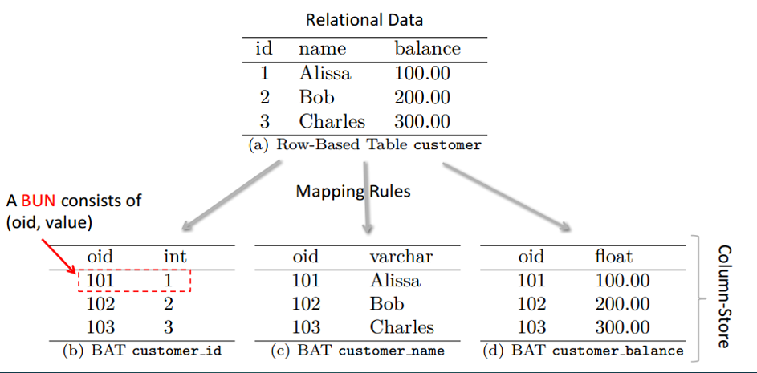
Row Based To Column Store

Slide 4
Features of Column-Store Databases
The goal of a columnar database is to efficiently write and read data to and from hard disk storage in order to speed up the time it takes to return a query.
One of the main benefits of a columnar database is that data can be highly compressed . The compression permits columnar operations — like MIN, MAX, SUM, COUNT and AVG— to be performed very rapidly
Another benefit is that because a column-based DBMSs is self-indexing, it uses less disk space than a relational database management system

Slide 5
Features of Column-Store Databases
Existing works majorly focus on write optimizations in a main memory column-store database
very few works focused on optimizing the write performance on the out-of-core (OOC or external memory) column-store databases
One such example is Vertica which introduced a specially designed data storage procedure, called k-safety, to ensure update transactions
Nevertheless, k-safety focuses more on transaction control rather than write performance

Slide 6
Write Optimization in Column-Store Database
Optimizing write operations in a column-store database has always been a challenge
The data in a column-store database is vertically decomposed into BATs and randomly distributed over the storage
Furthermore, assuming an external memory storage is employed, there is a non-trivial probability that a BAT is too large to fit into one page on the storage
writing on a column-store database will be significantly delayed by ad hoc access to large BATs across multiple pages.

Slide 7
Updating Column Store Database
The data structure of a column-store database exclusively uses BATs (Binary Association Tables)
This consists of oid also known as object identifiers along with a column of attribute values
In traditional BAT, an update by a given OID involves in 2 phases:
1. Search the location in BAT by OID (Time consuming)
2.Update the value at the target location
So to avoid searching we introduce timestamp in our table

Slide 8
Timestamped Binary Association Table (TBAT)
TBAT is similar to Bat But only thing is that it has an extra column as Timestamp along with oid and attribute values
The major improvement of TBAT is that, first of all,TBAT does not require any global pre-sorting or indexing
Based on TBAT, we propose an update algorithm and a selection algorithm that can achieve efficient data updating and retrieving without any help from extra global data structures

Slide 9
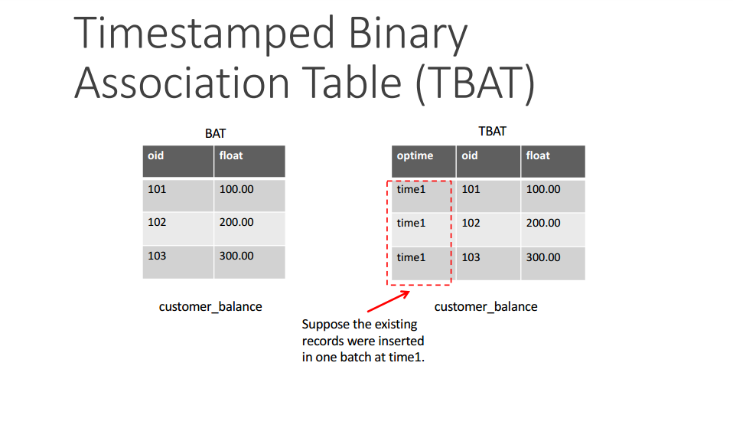

Slide 10
What is HDFS?
HDFS is a distributed file system that provides high-performance access to data across Hadoop clusters. HDFS has become a key tool for managing pools of big data
When HDFS takes in data, it breaks the information down into separate pieces and distributes them to different nodes in a cluster, allowing for parallel processing.
HDFS is built to support applications with large data sets, including individual files that reach into the terabytes. It uses a master/slave architecture

Slide 11
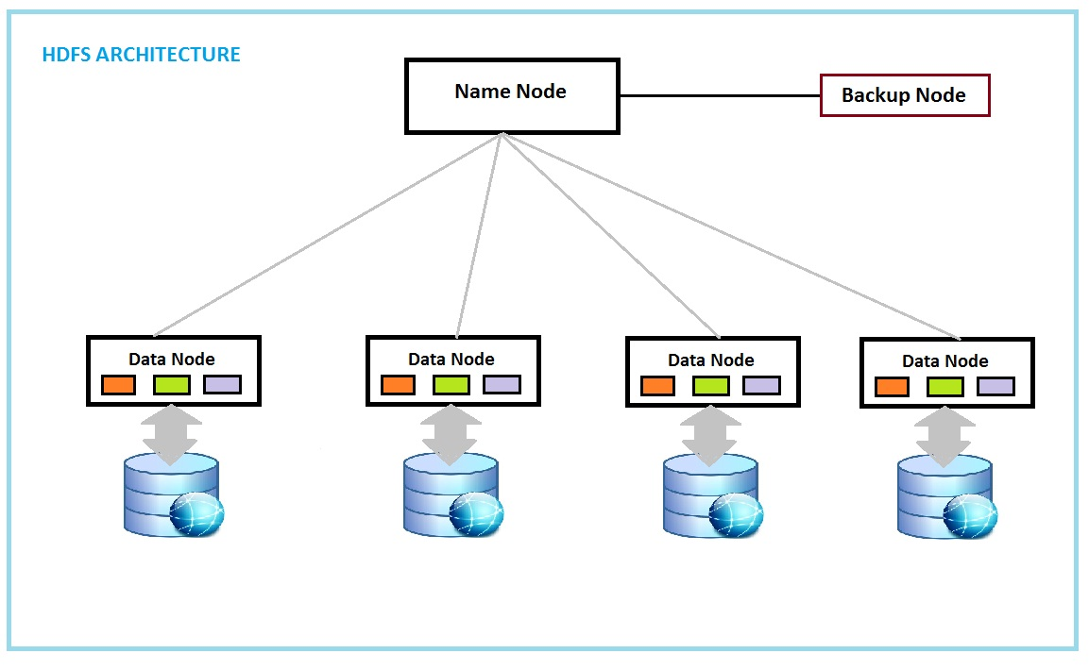

Slide 12
What is MapReduce
The term MapReduce actually refers to two separate and distinct tasks. It is inspired by functional programming map() and reduce() function
The first is the map job, which takes a set of data and converts it into another set of data, where individual elements are broken down into tuples (key/value pairs
The reduce job takes the output from a map as input and combines those data tuples into a smaller set of tuples. As the sequence of the name MapReduce implies, the reduce job is always performed after the map job.
Mapreduce was invented by Google

Slide 13
Map() function processes a key/Value pair to generate a set of intermediate key.value pair
Map
MapReduce
Reduce() Function that merges all intermediate values associated with the same intermediate key
Reduce

Slide 14
BAT on HDFS
The update on the BAT involves two phases
First is to search for the location of the target record (or BUN) in BAT by oid
Second is to update the record value at the corresponding location
we further extend the BAT into the Map-Reduce environment.
Searching for target records in a BAT is not efficient if nested loops are involved. This phase can be converted into an left outer join operation between the BAT and the update list (of BUNs)
When the update list size is small enough to fit into the memory, a map-side left outer join is performed. Otherwise, a common reduce-side left outer join can be performed when the update size is too large. In both cases, the join result is retained on HDFS as the intermediate result.

Slide 15
BAT Map-Reduce Update Algorithm
1: if sizeof(update list) ≤ threshold then
2: temp = bat map-side update list ON OID
map-side left outer join
3: else
4: temp = bat reduce-side update list ON OID
reduce-side left outer join
5: for all line ∈ temp do
6: if line.update list.OID != NULL then if this line
is matched in the outer join
7: output(BUN(line.update list.OID,
8: line.update list.VALUE))
9: else
10: output(BUN(line.bat.OID,line.bat.VALUE))
return SUCCESS

Slide 16
TBAT on HDFS
There are multiple versions of same oid data with different attribute values and timestamp stored throughout the HDFS
Here The target TBUN is the one with the latest timestamp and attribute value
There are two filtering phases involved in the algorithm. The MAPPER performs the first filtering on the map side, where, for each TBAT slip, the MAPPER selects only the TBUNs with their oids that fall into the given selection rang
Then key-value pairs are emitted by the MAPPER that are comprised of the oid of the selected TBUN and a nested pair, which consists of the value of the TBUN and the timestamp
This key value are sorted according to the oid and then sent to reducer and this will select target pair with most recent timestamp

Slide 17
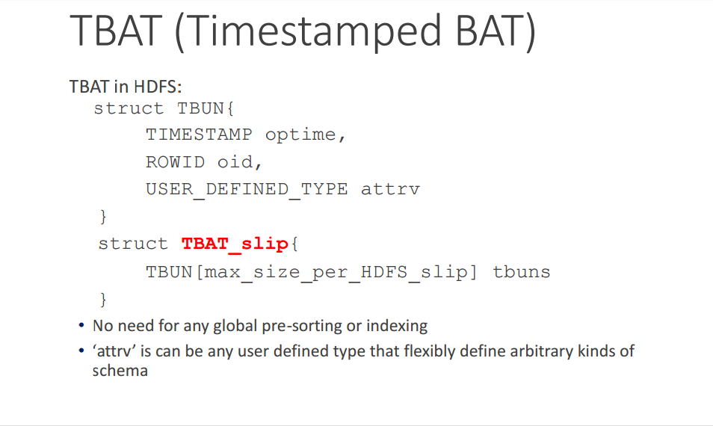

Slide 18
Asynchronous Map-Only(AMO) Update on Column-Stores
AMO update is to avoid seeking and writing and uses timstamp to lable the newly updated data and append to TBAT.
In AMO update list of target BUNs are also assumed to be collected in a distributed environment
Once the update list is submitted for execution, the mapper of the AMO update simply appends the list of updating TBUNs at the end of the TBAT file. In HDFS
The file append operation has been supported in Apache Hadoop since the 0.20.0 release

Slide 19
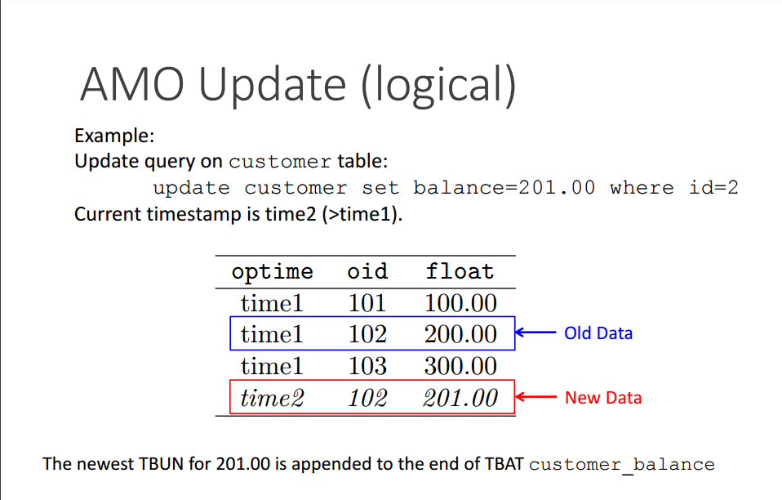

Slide 20
Update Experiment
Performed on a Cloudera Distributed Hadoop (CDH) cluster
• 1 master and 2 slaves
• Total HDFS capacity= 310GB (block size = 64MB)
• Interconnection is Gigabit Ethernet
Code written in Apache Pig
Data sets: 1GB ,10GB ,20GB random synthetic data in BAT and TBAT.
Update queries: 15% of the original data.

Slide 21
Update Experiment
For this experiment first we created a Cluster using CDH (cloudera distribution Hadoop) system where we created one master and 2 slaves on our YSU – Data lab Servers
We Created the data using a java programme which helps us to generate Bat and Tbat files . We executed this java files in our master and then transferred it to HDFS using HDFS Put command
Now to analyse we used pig a high-level platform for creating programs that run on Apache Hadoop. Pig can execute its Hadoop jobs in MapReduce and used grunt shell to execute

Slide 22
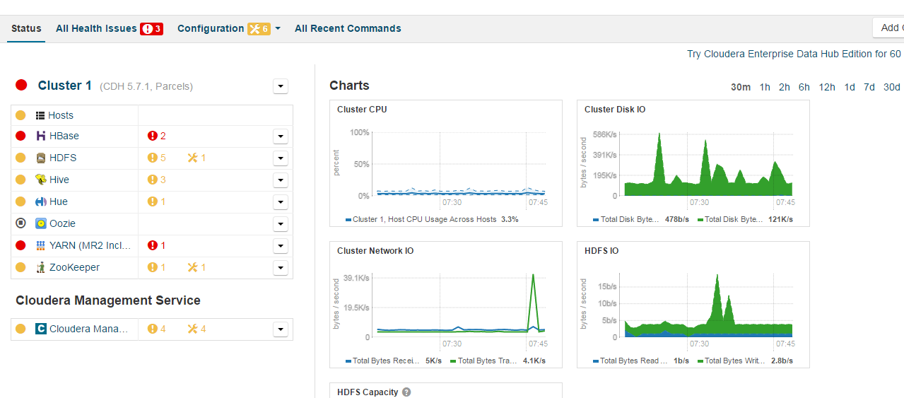

Slide 23
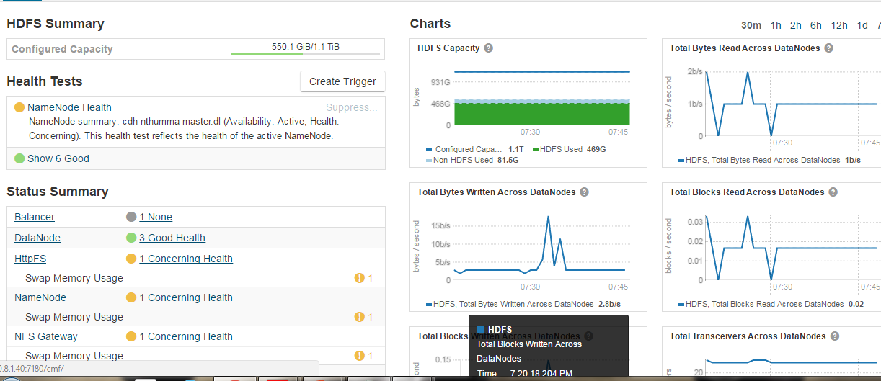

Slide 24
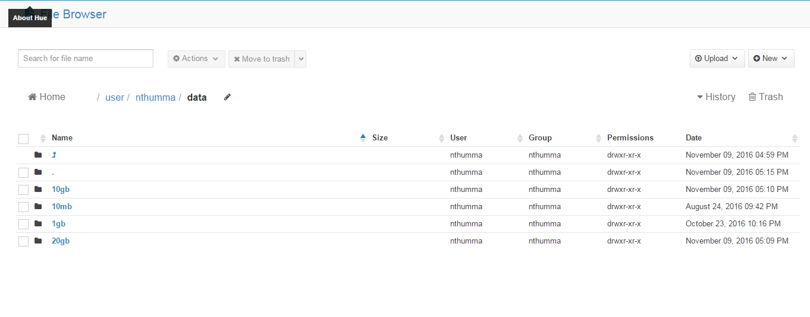

Slide 25
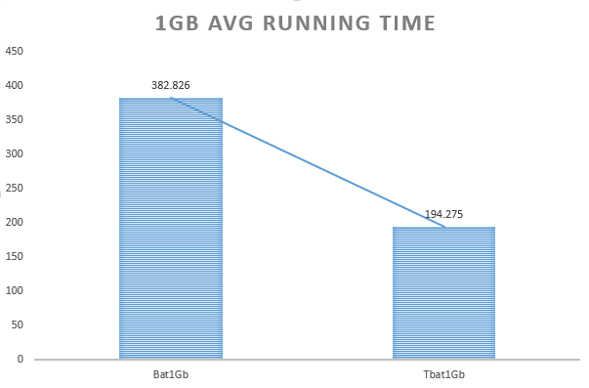
BAT Took 1.97 times more time to update the file than TBAT

Slide 26
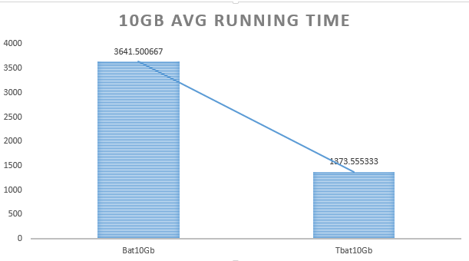
Here BAT Took 2.65 times more than TBAT to update the file

Slide 27
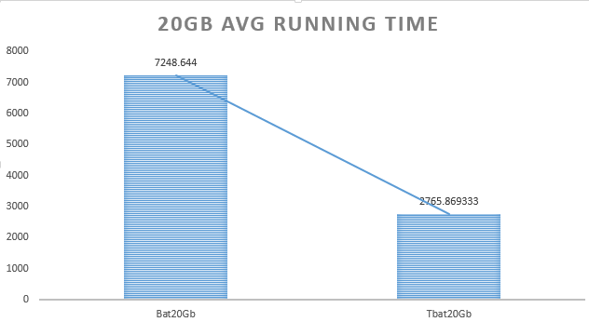
BAT Took 2.62 times more time to update a file than BAT

Slide 28
Conclusion
In this research we introduced AMO Method for write optimization on column store Databases in MapReduce environment
This has a effective data structure called TBAT(Timestamped Binary Association Table ) which improves update performance without need of global indexing
Map-Reduce selection algorithm is developed for fast data retrieval

Slide 29
Future works
For future works, we will investigate, in depth, the performance variation of the Map-Reduce selection algorithm on TBAT after different percentages of the file is updated
Another topic is to introduce a distributed local indexing on each TBAT slip in HDFS to improve the global data retrieval performance.

Slide 30

Thank You! Naveen Reddy Thumma Computer Science and Information Systems Youngstown State University, Youngstown, OH

Slide 31
Questions?

