Slide 1
Other notable spark subsystems
Spark Streaming, GraphX

Slide 2
Spark Streaming
Analyzes continual streams of data
Common example: processing log data from a website or server
Data is aggregated and analyzed at some given interval
Can take data fed to some port, Amazon Kinesis, HDFS, Kafka, Flume, and others
“Checkpointing” stores state to disk periodically for fault tolerance

Slide 3
Spark Streaming
A “Dstream” object breaks up the stream into distinct RDD’s
Simple word count example: ssc= StreamingContext(sc, 1) lines = ssc.textFileStream(“books”) counts = lines.flatMap(lambda line: line.split(“ “)).map(lambda x: (x, 1) \ .reduceByKey(lambda a, b: a + b) counts.pprint() This looks for text files dropped into the “books” directory, and counts up how often each word appears over time, updating every one second. You need to kick off the job explicitly: ssc.start() ssc.awaitTermination()

Slide 4
Spark streaming
Remember your RDD’s only contain one little chunk of incoming data.
“Windowed operations” can combine results from multiple batches over some sliding time window
See window(), reduceByWindow(), reduceByKeyAndWindow()
updateStateByKey()
Lets you maintain a state across many batches as time goes on
For example, running counts of some event
See stateful_network_wordcount.py example in the SDK

Slide 5
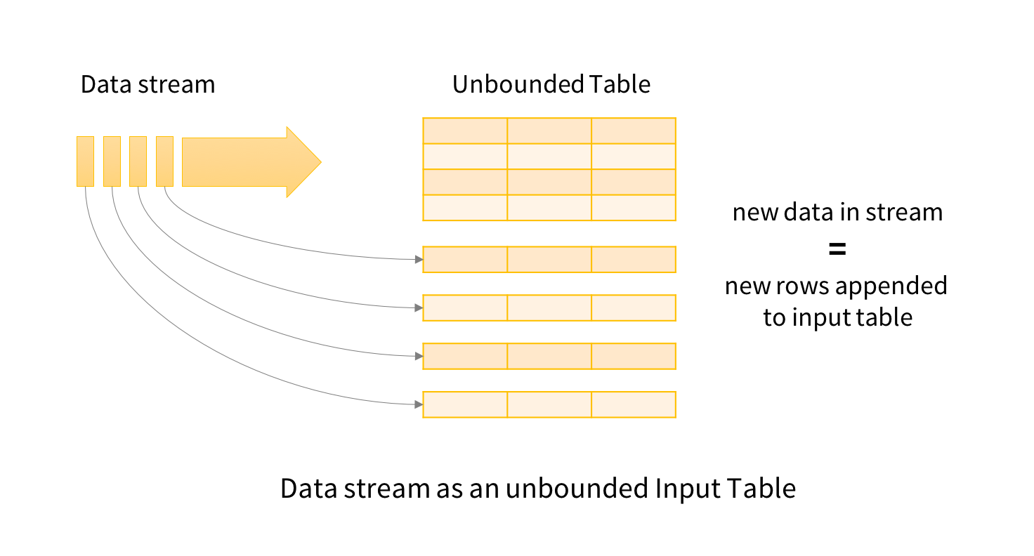
Structured streaming
Models streaming as a Dataframe that just keeps expanding
The new way to do it; Python support is relatively recent
Streaming code ends up looking a lot like non-streaming code
Dataframes provide interoperability with MLLib
Let’s look at an example…

Slide 6

Exercise
Stream top URL’s in the past 30 seconds

Slide 7
Introducing windows
A “windowed” operation looks back over some period of time
For example, consider only events that happened in the past 10 minutes – 10 minutes would be the “window”
The “slide interval” defines how often we evaluate a window

Slide 8
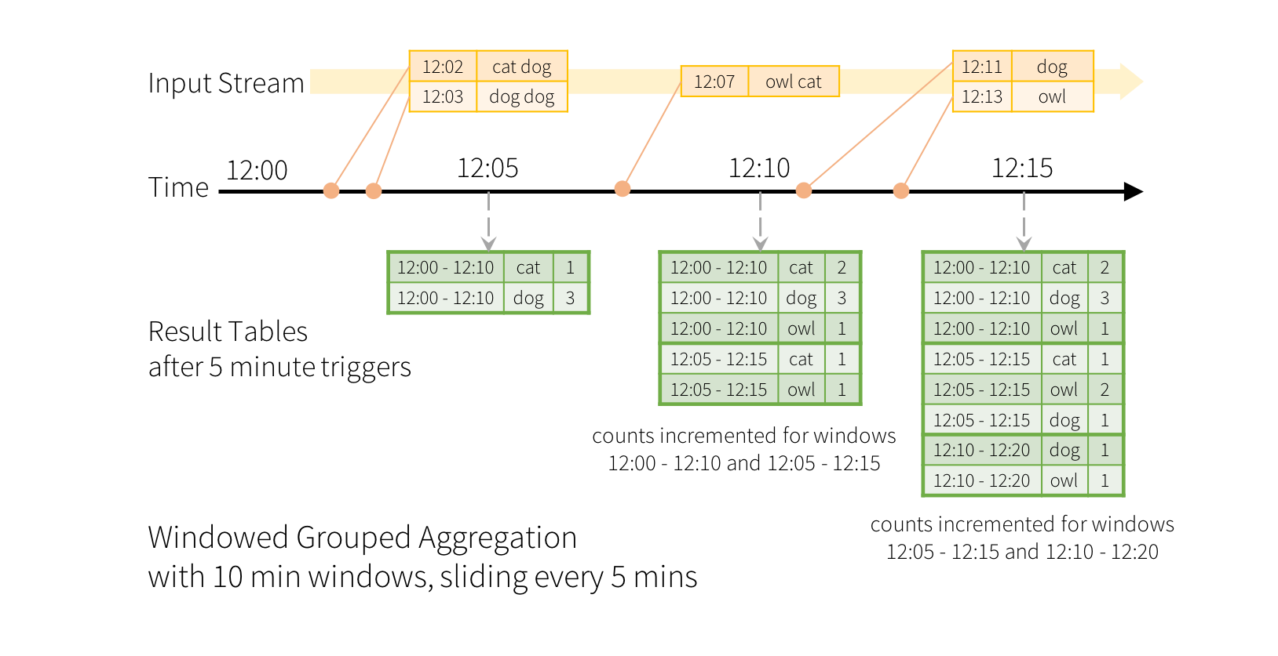
Window example
Image credit: https://spark.apache.org/docs/latest/structured-streaming-programming-guide.html#window-operations-on-event-time

Slide 9
Windowed aggregation code
dataset.groupBy(func.window(func.col(“timestampColumnName”), windowDuration = “10 minutes”, slideDuration = “5 minutes”), func.col(“columnWeAreGroupingBy”)

Slide 10
Your challenge
Modify the StructuredStreaming script to keep track of the most-viewed URL’s (endpoints) in our logs
Compute this with a 30 second window and 10 second slide

Slide 11
Useful snippets
logsDF.groupBy(func.window(func.col(“eventTime”), “30 seconds”, “10 seconds”), func.col(“endpoint”))
logsDF.withColumn(“eventTime”, func.current_timestamp())
endpointCounts.orderBy(col(“count”).desc())

Slide 12
Graphx
Not that kind of graph…
Graphs like our social network of superheroes – graphs in the computer science / network sense.
Currently Scala-only. Python support doesn’t appear to be forthcoming.
However, it’s only useful for specific things.
It actually wouldn’t have helped us much with our “degrees of separation” example
But it can measure things like “connectedness”, degree distribution, average path length, triangle counts – high level measures of a graph
It can also join graphs together and transform graphs quickly

Slide 13
graphx
Introduces VertexRDD and EdgeRDD
Otherwise, GraphX code looks like any other Spark code for the most part
So if your job / task focuses on network analysis – it might be worth learning Scala

