Slide 1



Resume Screening and Job Description Matching
An ML system that ranks resumes for a job and explains the skill gaps
Naveen | Batch 3 | Data Science & AI/ML Capstone, Problem Statement 5
The problem
Why keywords fail
The goal
Recruiters read hundreds of resumes by hand. It is slow, and different reviewers judge differently.
Simple keyword search misses good candidates who describe the same skill in other words.
Predict fit (No / Potential / Good), rank candidates for a job, and show matched and missing skills.
Decision support only: the final hiring decision stays with the recruiter.
Notes:
This project builds a system that helps recruiters. You give it one job description and many resumes. It predicts how well each resume fits (No Fit, Potential Fit or Good Fit), ranks the candidates, and shows which required skills each candidate has and which are missing. Keyword search alone misses candidates who use different words, so the system also compares the meaning of the text. It supports the recruiter; it does not make the hiring decision.

Slide 2
Dataset
8,000 labelled job description and resume pairs from Hugging Face
8,000
records (6,241 train, 1,759 test)
Sample record (each row is one text field + a label)
For the given job description <<Role: Basel Business Analyst ... 6+ years of relevant technical and business work experience ... SQL ...>> the resume: <<Summary Highly motivated Sales Associate with extensive customer service and sales experience ...>>. The result is, No Fit
3
labels: No Fit, Potential Fit, Good Fit
351
different job descriptions
Splits used (validation holds out whole jobs, like the test set)
Split | Rows | Job descriptions
Train | 5,285 | 240
Validation | 943 | 40
Test (untouched) | 1,759 | 71
Source: huggingface.co/datasets/facehuggerapoorv/resume-jd-match
Access: load_dataset() in Python; src/data_loader.py rebuilds all splits
Notes:
The data comes from a public Hugging Face dataset with 8,000 records: 6,241 for training and 1,759 for testing. Each record is one long text that contains a job description and a resume, plus a label: No Fit, Potential Fit or Good Fit. I load it with the datasets library, and src/data_loader.py rebuilds all the splits. After cleaning, I have 5,285 training rows, 943 validation rows and 1,759 test rows. The validation set holds out whole job descriptions, because the test set only has jobs that never appear in training.

Slide 3
EDA and Preprocessing Decisions
Every cleaning step came from a measured finding in the data
Finding
Decision
The label was written inside the training text ("The result is, No Fit")
Removed it, so the model cannot read the answer
12 rows had conflicting labels, 1 row was a duplicate
Removed them
Emails, phone numbers, links and words stuck together
Cleaned the text; kept real terms like JavaScript
Test jobs never appear in training
Validation set holds out whole jobs
98.4% of pairs are longer than BERT's 512-token limit
Split long text into chunks for embeddings
About 50% of rows are No Fit
Use macro F1 and class weights
Notes:
The labels are about 50% No Fit and 25% each for Potential Fit and Good Fit, with the same balance in every split. The most important finding was label leakage: every training record ended with the answer, so I removed it. I also removed 12 rows with conflicting labels and one duplicate, cleaned emails, phone numbers and links, and fixed words stuck together. Test jobs never appear in training, so validation holds out whole jobs. Almost all texts are longer than BERT's limit, so long texts are split into chunks. Because classes are imbalanced, I use macro F1 and class weights. EDA also showed that simple word overlap rises only slightly from No Fit (0.178) to Good Fit (0.215), so keywords alone are weak.

Slide 4
Baseline and Advanced Model Architecture
Start simple, then combine skills, experience and meaning in one XGBoost model
Baselines (validation macro F1)
Advanced model: XGBoost hybrid (validation macro F1 0.545)
Job description + resume → clean text
Majority class (always No Fit)
0.218
Keyword: TF-IDF cosine
0.408
14 features
skill overlap and missing skills
experience vs requirement
TF-IDF and embedding similarity
Sentence-BERT embeddings
compare JD and resume
(difference + product, 768 values)
→ PCA to 32 values
Resume only (no job text)
0.426
Logistic Regression
0.463
Random Forest
0.498
XGBoost (46 inputs, depth 5)
Also compared: Sentence-BERT model 0.527, DistilBERT 0.373
No Fit / Potential Fit / Good Fit + fit score (0–100)
Notes:
I started with simple baselines. Always predicting No Fit gives 0.218 macro F1. Keyword matching with TF-IDF gives 0.408. A check that uses only the resume, without the job, already gives 0.426, because resumes are reused across many jobs, so a real model must beat that. Random Forest on my 14 features reaches 0.498. The final model is an XGBoost hybrid. It uses 14 engineered features (skills, experience and text similarity) plus 32 values that compare the meaning of the job and the resume using Sentence-BERT embeddings. It outputs the label and a fit score used for ranking. It reached 0.545 on validation. I also fine-tuned DistilBERT, but it scored only 0.373 because it can read only 512 tokens of very long texts.

Slide 5


Experiment Tracking and Hyperparameters
22 runs logged; every choice made on the validation set, test kept untouched
Model | Settings tried | Chosen
Logistic Regression | C = 0.01, 0.1, 1, 10 | C = 0.01
Random Forest | depth none / 10; min leaf 1 / 5 / 20; 300 trees | depth none, leaf 5
Sentence-BERT model | C = 0.01, 0.1, 1 | C = 0.01
XGBoost hybrid | depth 3 / 5; learning rate 0.05; early stopping; with / without embeddings | depth 5, with embeddings
DistilBERT | learning rate 2e-5; batch 16; 2 then 4 epochs | epoch 3
Every run saved to experiments.csv: model, features, settings, validation F1, accuracy, training time
Ablation: embeddings add +0.048 F1 to XGBoost (0.497 → 0.545)
Notes:
I tracked every run in experiments.csv with the model, features, settings, validation score and training time: 22 runs in total. I tuned only on the validation set and never touched the test set until the end. The table shows what I tried and what was chosen. The chart shows validation macro F1 for each model: the XGBoost hybrid is best at 0.545. An ablation study shows the value of the embeddings: the same XGBoost with only the 14 features scored 0.497, and adding the embedding components raised it to 0.545.

Slide 6
Evaluation Results and Error Analysis
On 71 unseen jobs, the hybrid model is best, and it shortlists far better than keywords
0.500
0.662
0.781
Confusion matrix (rows: actual, columns: predicted)
 | No | Potential | Good
No Fit | 608 | 147 | 102
Potential | 151 | 193 | 100
Good Fit | 125 | 170 | 163
Macro F1 (keyword 0.368)
Precision@5 (random 0.486)
NDCG@5 (keyword 0.634)
Good Fit is the hardest: only 163 of 458 found (recall 0.36)
Most mistakes are between neighbouring labels
Some labels look wrong, e.g. a sales resume marked Good Fit for a software job
Resume alone scores 0.441, so labels partly depend on the resume itself
Notes:
These are the final results on the test set, which was never used before: 1,759 pairs from 71 jobs the model had never seen. The XGBoost hybrid is the best model with macro F1 0.500, compared with 0.368 for keyword matching. For shortlisting, about 2 out of every 3 candidates in the top 5 are real fits (Precision@5 0.662, versus 0.486 for random order), and NDCG@5 is 0.781. The confusion matrix shows No Fit is recognised well, but Good Fit is the hardest: the model found only 36% of Good Fit pairs, often calling them Potential Fit. Most mistakes are between neighbouring labels. Some labels look wrong, and the resume alone already scores 0.441, which limits how high any model can go. Test scores are a little lower than validation because validation was used to choose settings.

Slide 7
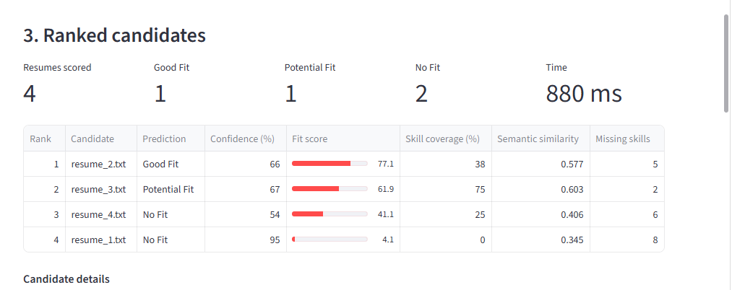
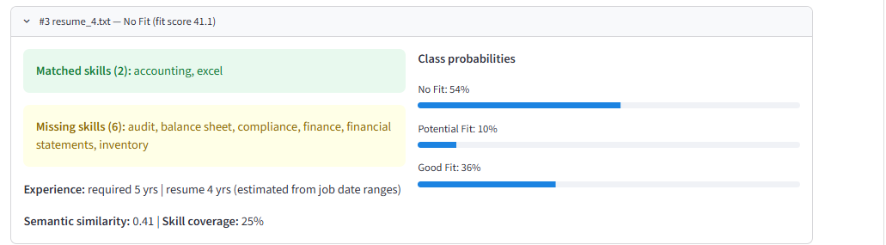
Deployment Demo and Inference Workflow
Runs locally on a laptop CPU: Streamlit app for recruiters, FastAPI for other systems
1
Paste a job description; upload or paste resumes (PDF / TXT)
2
Clean the text with the same rules used in training
3
Find skills (203-skill list) and years of experience
4
Build 14 features + 32 embedding values
5
XGBoost predicts the label and a fit score
Demo: 3 correct predictions + 1 failure case (resume_4: actually Good Fit, predicted No Fit)
6
Rank candidates; show matched and missing skills
streamlit run app/streamlit_app.py
~1 second for 4 full resumes; laptop results identical to training (F1 0.500)
Notes:
The system runs locally, with no cloud and no GPU. The recruiter pastes a job description and uploads resumes. The app cleans the text with exactly the same rules as training, finds skills and experience, builds the features and embeddings, and the XGBoost model predicts the label and a fit score. Candidates are ranked by fit score, with matched and missing skills shown. A FastAPI service offers the same through /match and /health. For the demo, I use one real accounting job with four test resumes: three are predicted correctly and one is a failure case. resume_4 is actually Good Fit but predicted No Fit: it matches only 2 skills, misses audit and compliance, and has 4 years against 5 required. Even so, its fit score still ranks it above the true No Fit resume, which is why the tool is for shortlisting, not automatic rejection. A verification script showed the laptop gives exactly the same predictions as training.

Slide 8




Risks, Limitations, Ethics and Future Work
A useful shortlisting aid, not a replacement for the recruiter
Limitations
Risks
Good Fit often missed (recall 0.36)
Experience read only from job dates
Labels partly tied to the resume; some look wrong
Short resumes are less reliable
May not transfer to other industries or formats
Keyword skill matching can pick up noise (e.g. "legal")
Recruiters could over-trust the score
Ethics and fairness
Future work
No personal details used: only job vs resume comparisons
F1 similar across experience bands (0.49–0.51)
Unknown experience → send to human review
Decision support only; recruiter decides
Read stated experience ("6 years")
Context-aware skill extraction
More embedding components, reranker
Tune the Good Fit threshold
Notes:
Limitations: the model often misses Good Fit, experience is estimated only from job dates, the labels partly depend on the resume itself and some look wrong, and short resumes are less reliable. Risks: it may not work as well on other industries, keyword skill matching can pick up noise, and recruiters might trust the score too much. Ethics: the model uses no personal details, only comparisons between the job and the resume. Performance is similar across experience levels, which matters because experience can relate to age. Cases with unknown experience should go to a human. Future work: read stated experience, smarter skill extraction, more embedding components or a reranker, and tuning the Good Fit threshold. Thank you, I am happy to take questions.

