Slide 1

Linkage Between ENSO and Significant Wave Height Over Head Bay Of Bengal
Seminar on B. Tech Project
Under the Supervision of:
Professor Rajib Maity
Civil Engineering Department
Susmitha Dasavaraneni
20NA30029
Ocean Engineering and Naval Architecture Department
Indian Institute of Technology, Kharagpur

Slide 2
Contents
Introduction
Motivation and Objectives
Literature Review
Study Area and Data
Methodology
Results and Discussion
Conclusions
Future Work
References

Slide 3
INTRODUCTION

Slide 4
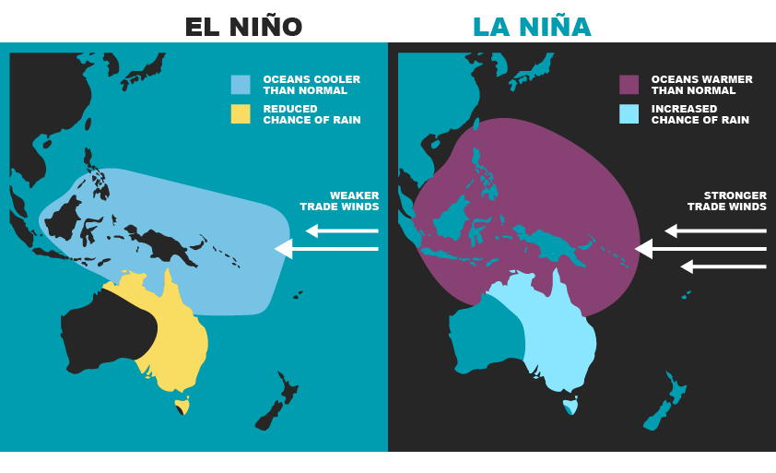
El Niño-Southern Oscillation (ENSO)
The El Niño-Southern Oscillation (ENSO) is a recurring climate pattern involving changes in the temperature of waters in the central and eastern tropical Pacific Ocean.
El Niño and La Niña are the extreme phases of the ENSO cycle; between these two phases is a third phase called ENSO-neutral.
Image source – National Environment Science Program

Slide 5
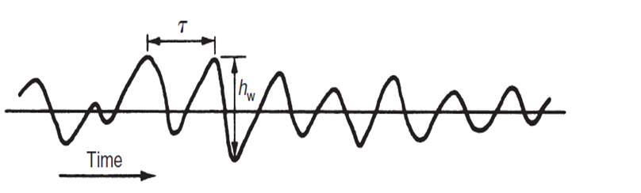
Significant Wave Height
A typical wave profile, as recorded at a fixed point in an irregular wave system is shown-
If the wave heights measured are arranged in order of reducing magnitude the mean height of the highest third of the waves is called the significant wave height.
We measure it because, in many applications of wave data, larger waves are more "significant" (important) than smaller waves.
Image source: Water Wave Mechanics for Engineers and Scientists Robert G. Dean Robert A. Dalrymple

Slide 6
Motivation
SWH is a critical factor in maritime safety and climate studies, making understanding and predicting it essential for the Bay of Bengal.
The project aims to uncover the intricate relationship between SWH and the El Niño-Southern Oscillation (ENSO) phenomenon, as represented by the NINO 3.4 index.
The Head Bay of Bengal experiences unique climatic dynamics, and variations in SWH are hypothesized to be closely linked to ENSO patterns.
Beyond local maritime concerns, the project contributes to improved climate modeling and forecasting, addressing the broader challenges of climate change.

Slide 7
Objectives
Linkage Exploration: Investigate and establish the intricate linkage between the ENSO phenomenon, as represented by the NINO 3.4 index, and the Significant Wave Height (SWH) over the Head Bay of Bengal.
Predictive Modeling: Develop a robust predictive model leveraging machine learning techniques to accurately forecast SWH based on NINO 3.4 indices.
Temporal Analysis: Conduct a comprehensive temporal analysis, covering the period from 1950-01-01 to 2023-09-01, to capture long-term trends and variations.
Geospatial Scope: Focus on the geographical coordinates 86–93°E and 19.5–23°N, encompassing the specific region of interest in the Head Bay of Bengal

Slide 8
Literature Review
Name of the Paper | Name of Author | Major Findings
Spectral Wave Characteristics over the Head Bay of Bengal: A Modeling Study | Anandita Patra | The study employed a nested modeling approach, using SWAN and WAM models, to simulate wave characteristics in the Head Bay of Bengal. Results demonstrated seasonal variability, spatial differences, and significant agreement with measured data, providing valuable insights for applications like climate studies and coastal engineering
Climate Variability Impacts on Global Extreme Wave Heights: Seasonal Assessment Using Satellite Data and ERA5 Reanalysis | Anandita Patra | The study investigates the influence of climate variability modes (ENSO, NAO, NPO, and SAM) on extreme significant wave height (SWH) using satellite altimeter and ERA5 reanalysis data. Distinct seasonal responses are identified, revealing connections between extreme SWH and atmospheric circulation patterns.
Regional-wise characteristic study of significant wave height for the Indian Ocean | S. Sreelakshmi & Prasad K. Bhaskaran | Altitude-derived Significant Wave Height (HS) in the Indian Ocean (IO) correlates well with ERA5 and WWIII datasets, although underestimations are noted. Trend analysis shows a declining trend during 2007–2011, with variations related to La Niña events and a significant increase in wave height during the 2012–2016 El Niño

Slide 9
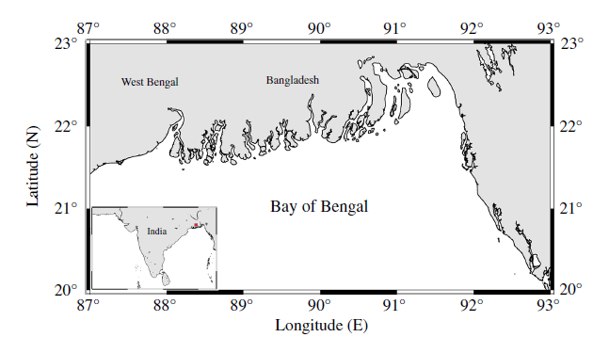
Study Area and Data
Our study area has the geographical coordinates 86–93° E and 19.5–23° N and is situated at the northward limit of the Bay of Bengal.
Head of Bay of Bengal
Data
Data | Source | Timeline
ENSO | National Oceanic and Atmospheric Administration | 1950/01/01 - 2023/09/01
Significant Wave Height | ERA5 monthly averaged data on single levels from 1940 to the present | 1950/01/01 - 2023/09/01
Image Source: Spectral Wave Characteristics over the Head Bay of Bengal: A Modeling Study

Slide 10
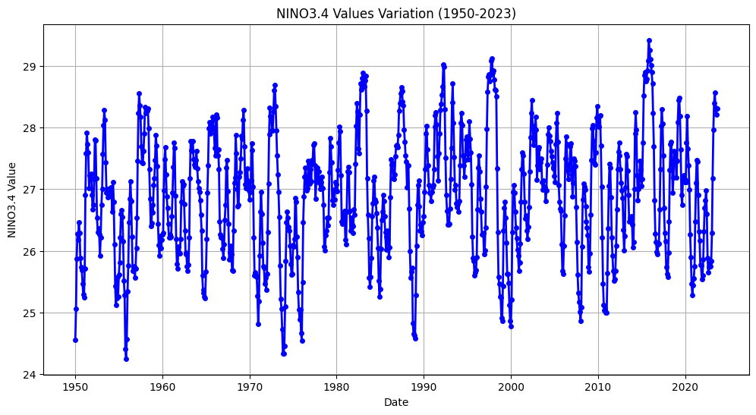
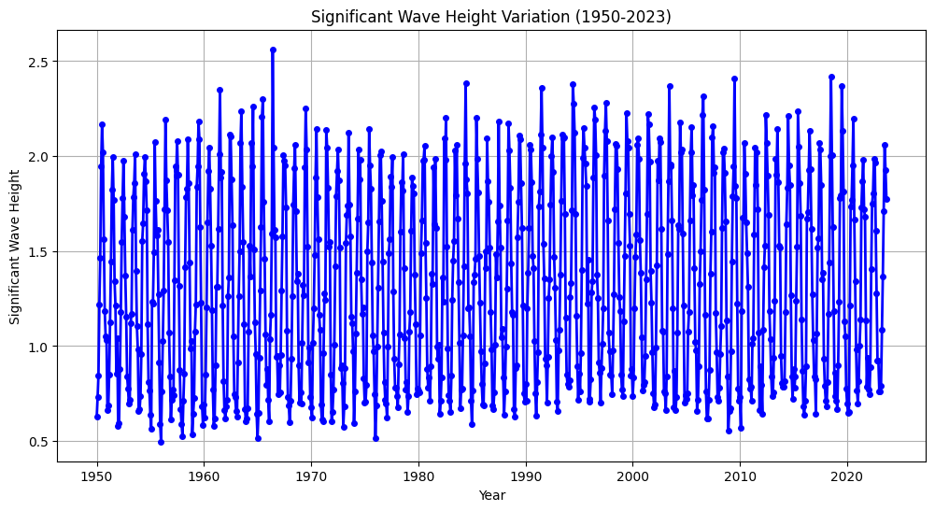
Data

Slide 11
Methodology
Random Forest Regression
Training Set
Training Data 1
Training Data 2
……...
Training Data n
Decision Tree1
Decision Tree 2
………
Decision Tree n
Voting
(averaging)
Test Set
Prediction

Slide 12
Methodology
Gradient Boost
Testing Data
Tree 1
Tree 2
Tree K
……………..
Residual
Residual
Residual
Output
Output
………………….
Output
Ensemble Prediction

Slide 13
Methodology
Support Vector Regression
Testing Data

Slide 14
Methodology
Random Forest Regression
Testing Data

Slide 15


Methodology
Assesment of Model Performance
Root Mean Square Error (RMSE) = $\sqrt{\frac{1 }{n}\sum_{i=1}^{n}{{\left(Y_{mi}{−Y}_{0i}\right)}^{2} }}$
Nash–Sutcliffe model efficiency coefficient (NSE) = $1−\frac{\sum_{i=1}^{n}{{\left(Y_{Oi}−Y_{mi}\right)}^{2}}}{\sum_{i=1}^{n}{{\left(Y_{Oi}−Y_{O}\right)}^{2}}}$
Correlation Coefficient (CS) = $\frac{\sum_{i=1}^{n}{(Y_{mi}−Y_{m})(Y_{oi}−Y_{o})}}{\sqrt{\sum_{i=1}^{n}{{(Y_{mi}−Y_{m})}^{2}}} \sqrt{\sum_{i=1}^{n}{{(Y_{oi}−Y_{o})}^{2}}}}$
n - number of data pairs $Y_{mi}$ - $model output$ value
$Y_{oi}$- model observed value
$Y_{m}$ - prediction average
$Y_{o}$ - observation average

Slide 16
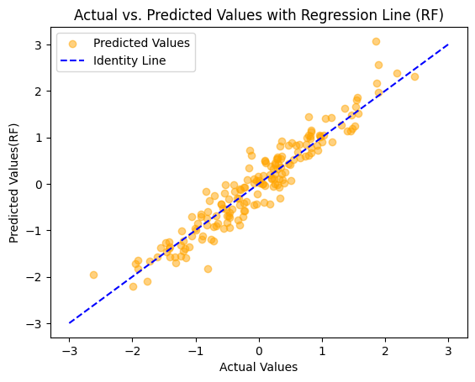

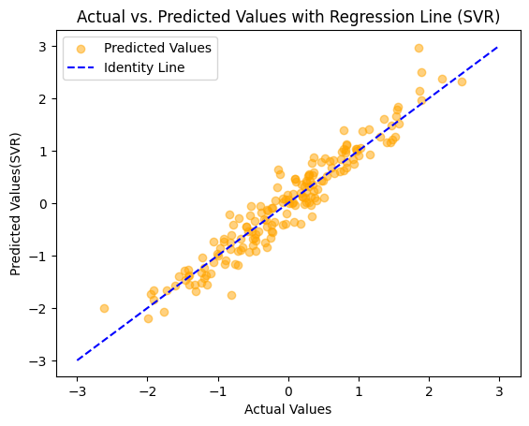

Results and Discussion
Regression Plots

Slide 17
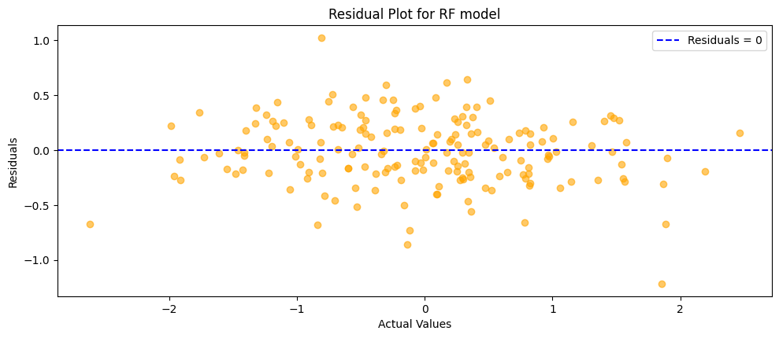


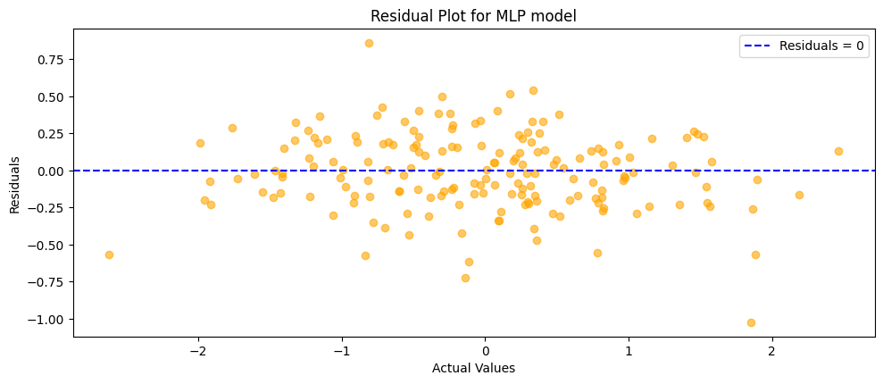
Results and Discussion
Residual Plots

Slide 18
Results and Discussion
Model Selection
Regression Algorithm | Root Mean Square error | Nash–Sutcliffe model efficiency coefficient | Correlation Coefficient
Random Forest Regression | 0.31613 | 0.13394 | 0.06191
Gradient Boost Regression | 0.29753 | 0.28692 | 0.06198
Support Vector Regression | 0.28896 | 0.45609 | 0.205749
Multi-layer Perceptron | 0.26629 | 0.63719 | 0.204073

Slide 19
Conclusions
In conclusion, this project aimed to develop predictive models for significant wave height (SWH) based on the NINO3.4 index. The dataset from 1950 to 1955 was analyzed using various machine learning algorithms, including Random Forest, Gradient Boosting, Support Vector Regression, and Multi-Layer Perceptron.
The models were trained and evaluated on both training and testing datasets, and performance metrics such as Root Mean Squared Error (RMSE), Nash-Sutcliffe Efficiency (NSE), and the Correlation Coefficient were employed to assess their effectiveness.

Slide 20
References
Patra, A., & Bhaskaran, P. K. (2016). Trends in wind–wave climate over the head Bay of Bengal region. The International Journal of Climatology, 36, 4222–4240.
Patra, A., & Bhaskaran, P. K. (2017). Temporal variability in wind–wave climate and its validation with ESSO-NIOT wave atlas for the head Bay of Bengal. Climate Dynamics, 49,1271–1288.
Patra, A., Min, S.-K., & Seong, M.-G.(2020). Climate variability impacts on global extreme wave heights: Seasonal assessment using satellite data and ERA5 reanalysis. Journal of Geophysical Research: Oceans, 125, e2020JC016754.
Sreelakshmi, S., Bhaskaran, P.K. Regional wise characteristic study of significant wave height for the Indian Ocean. Clim Dyn 54, 3405–3423 (2020). https://doi.org/10.1007/s00382-020-05186-6

