Slide 1
EXPlainable Artificial Intelligence (XAI)
Jonnalagadda Naveen Reddy

Slide 2
Introduction
Explainable AI (XAI) refers to the set of techniques, methods, and practices used to make the decision making processes of artificial intelligence systems more understandable, interpretable, and transparent to humans.
The primary goal of XAI is to provide insights into why AI models make specific predictions or decisions, especially in situations where AI is used in critical applications, such as healthcare, finance, autonomous vehicles, and law enforcement.

Slide 3
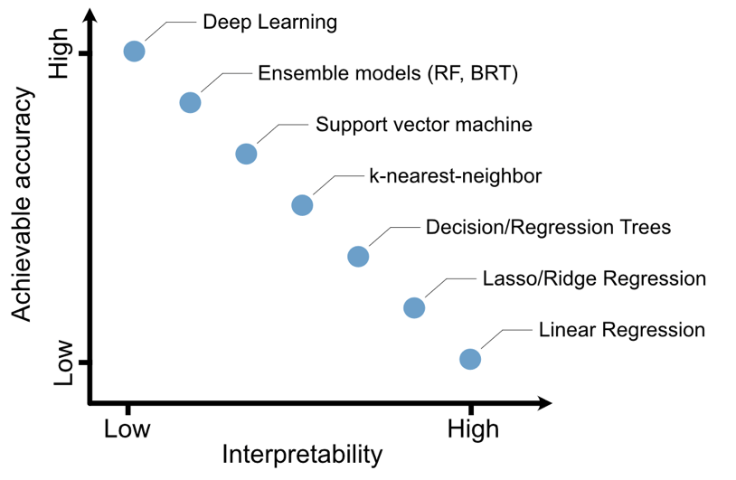
Accuracy vs Interpretability

Slide 4
EXample
Understanding the relationship between land use/land cover (LULC) and land surface temperature (LST) :
Independent variables :
1. Landscape features : NDBI, NDWI, GNDVI
2. Topographic features : Elevation, Slope
3. LULC features : Urbanized area, Land Cover Map, Agricultural area, Forest area, Grassland area, Wetland area, Bareland area, Water area.

Slide 5
XGBoost
We developed the LST prediction model and estimated the LST reduction effects after specific LULC changes.
Results showed that the prediction accuracy of LST was maximized when landscape, topographic, and LULC features within a 150 m buffer radius were adopted as independent variables.
Do all the variables show equal importance in final prediction ?
BLACK BOX

Slide 6
SHAP
Shaply Additive exPlanations
These values assign an importance score to each feature in a prediction.
These scores indicate how much each feature contribute to the final prediction. If a feature is irrelevant (i.e., its value doesn't affect the prediction), its SHAP value will be close to zero.

Slide 7
SHAP
Shaply Additive exPlanations
These values assign an importance score to each feature in a prediction.
These scores indicate how much each feature contribute to the final prediction. If a feature is irrelevant (i.e., its value doesn't affect the prediction), its SHAP value will be close to zero.

Slide 8
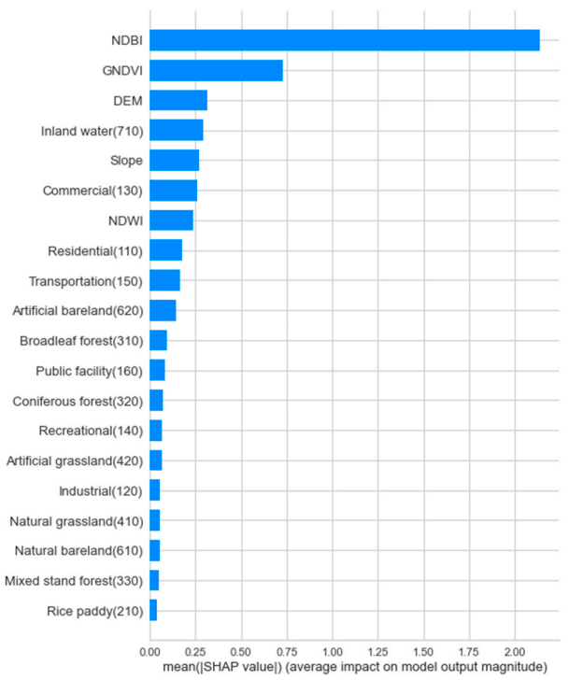

Slide 9
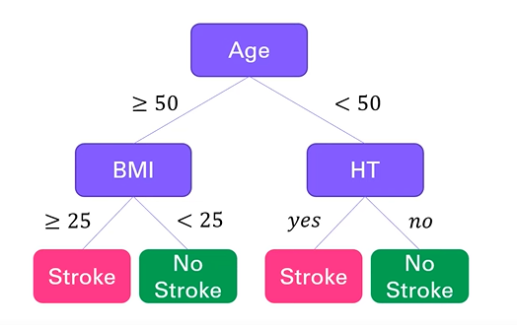
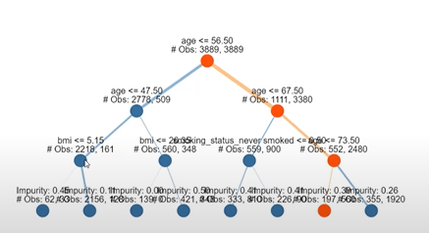

Slide 10
Objective
To develop a Long term Precipitation Prediction Model with Explainable Artificial Intelligence (XAI) for transparent decision-making in weather forecasting.
Approach
Data Collection
Data Preprocessing
Model Evaluation
Precipitation prediction
Explanations
Visualization of results and explanations

Slide 11
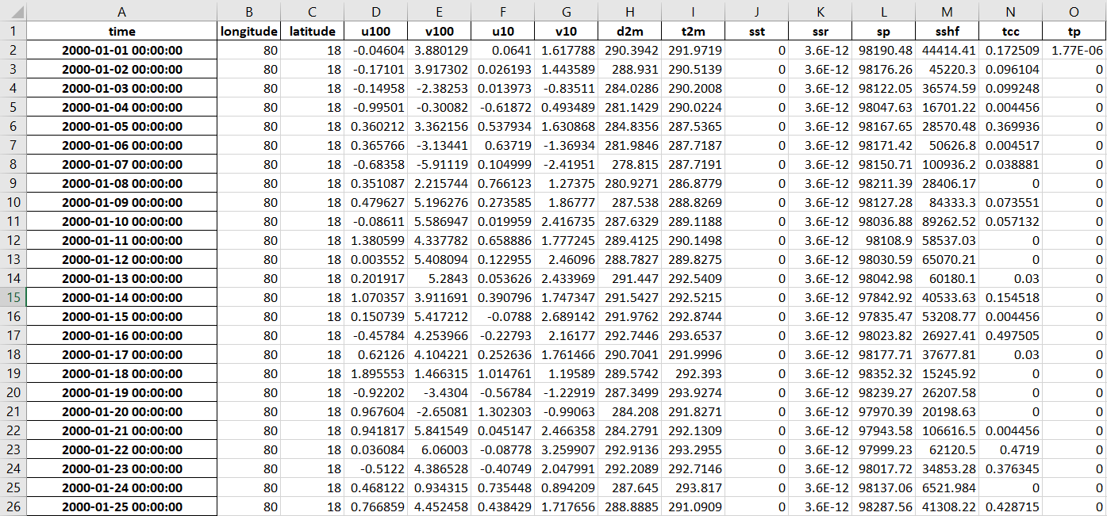
Data collection

Slide 12
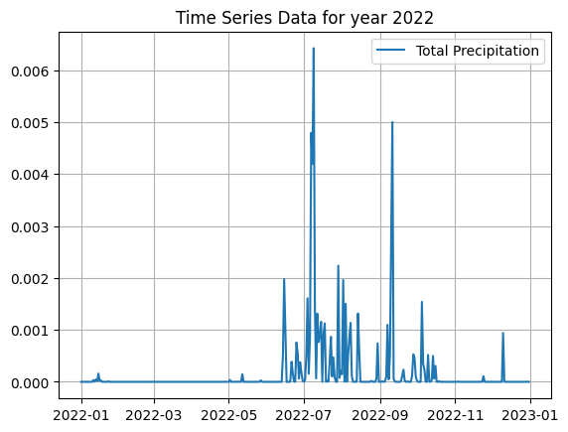
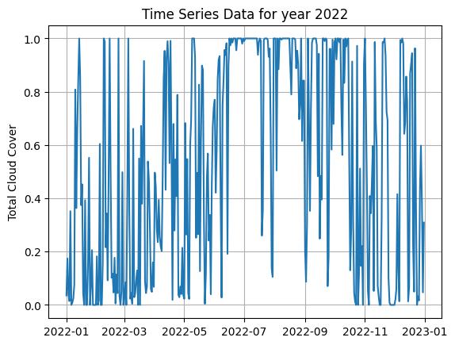
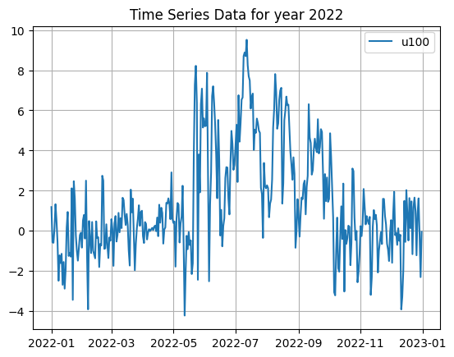
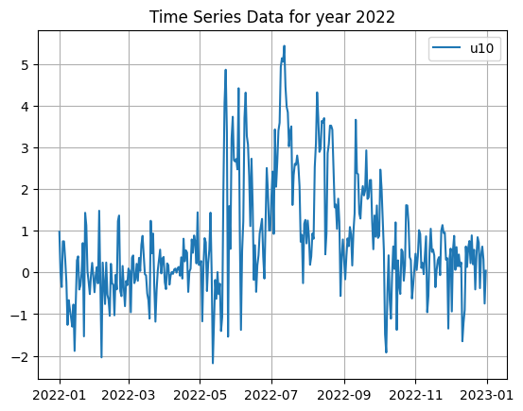

Slide 13
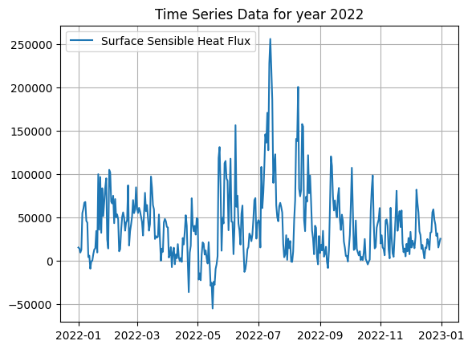
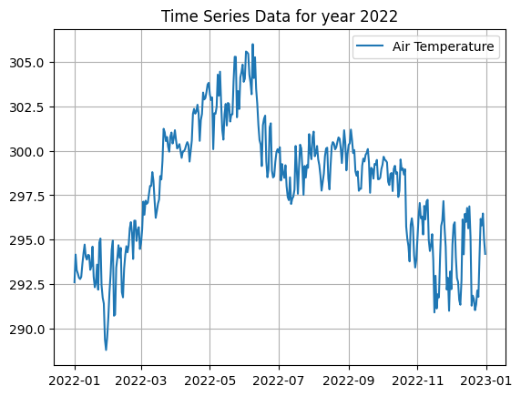

Slide 14
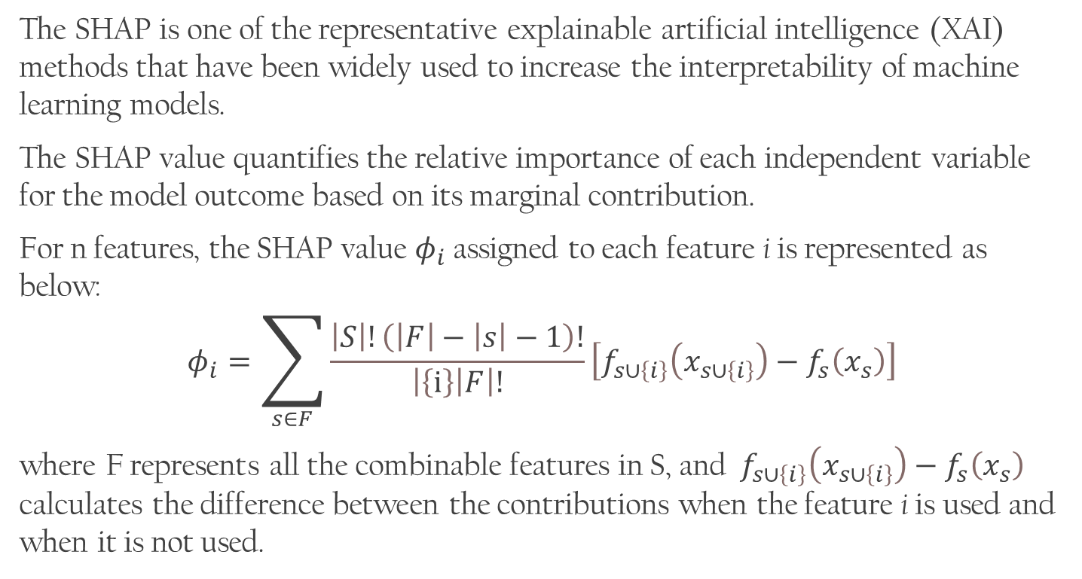
Shapley Additive Explanations (SHAP)
The SHAP is one of the representative explainable artificial intelligence (XAI) methods that have been widely used to increase the interpretability of machine learning models.
The SHAP value quantifies the relative importance of each independent variable for the model outcome based on its marginal contribution.
For n features, the SHAP value $φ_{i}$ assigned to each feature i is represented as below:
$$φ_{i}=\sum_{s∈F}{\frac{\left|S\right|!\left(\left|F\right|−\left|s\right|−1\right)!}{\left|\left.\left\{ⅈ\right\}\right|F\right|!}\left[f_{s∪\left\{i\right\}}\left(x_{s∪\left\{i\right\}}\right)−f_{s}\left(x_{s}\right)\right]}$$
where F represents all the combinable features in S, and ${ f}_{s∪\left\{i\right\}}\left(x_{s∪\left\{i\right\}}\right)−f_{s}\left(x_{s}\right)$ calculates the difference between the contributions when the feature i is used and when it is not used.

Slide 15
THANK YOU

