Slide 1

Naveen Mathews Renji

Slide 2
About Me
Education: Stevens Institute of Technology (MS in CS), Ramaiah Institute of Technology (BE in CS)
Technical Skills: Proficient in JavaScript, C, C#, Python, and more
Web Technologies: Experienced with NodeJS, React, ExpressJS, and others
Database Knowledge: Skilled in MongoDB, Redis, SQL, and more
ML/AI Libraries: Familiar with HuggingFace, Pytorch, Tensorflow, and others

Slide 3

Professional Experience
Graduate Research Assistant (Dr Carlo Lipizzi)
Graduate Student Assistant (Dr Ting Liao)
Software Engineer at Athenahealth (Aetna)
Engineering Intern at Athenahealth (Aetna)
Photo: people sitting down near table with assorted laptop computers
Photo by Marvin Meyer
Powered by Unsplash

Slide 4
Academic Projects
StockScope: A real-time stock market analysis web application
SolarStep: A web application to streamline solar panel installation process
MCUCollector: A Marvel character collection application
ConcertCompass: A SPA integrating with the Ticketmaster API
ProductProdigy: A product comparison web application
Compiler Design Edu: An educational web app
Hotel Cancellation Predictor: A machine learning project
SmartDriveAI: A project utilizing machine learning for autopilot driving

Slide 5

Publications
A Comparative Study of Different Machine Learning Algorithms in the Detection of Parkinson’s Disease
Indian Sign Language to Speech Translation in Real-Time
This Photo by Unknown Author is licensed under CC BY-SA

Slide 6

Awards and Activities
Best Project Award for Solar Step
Graduate Scholarship at Stevens Institute of Technology
Best Project Award from Ramaiah Institute of Technology
AISSCE Topper for the English Subject
Co-founder of the ISB Model United Nations
Ambassador for IIMUN
Authored articles on Medium

Slide 7

Research Work 1: Novel Semantic Similarity Search Evaluation Algorithm
Experimented on semantic similarity search using different models and data storages
Models used: Word2Vec, MiniLM, and RoBERTa
Data Storages: Pinecone Vector Index, Local memory
Developed a novel comprehensive evaluation algorithm
Working on a paper detailing the research findings and the new algorithm

Slide 8
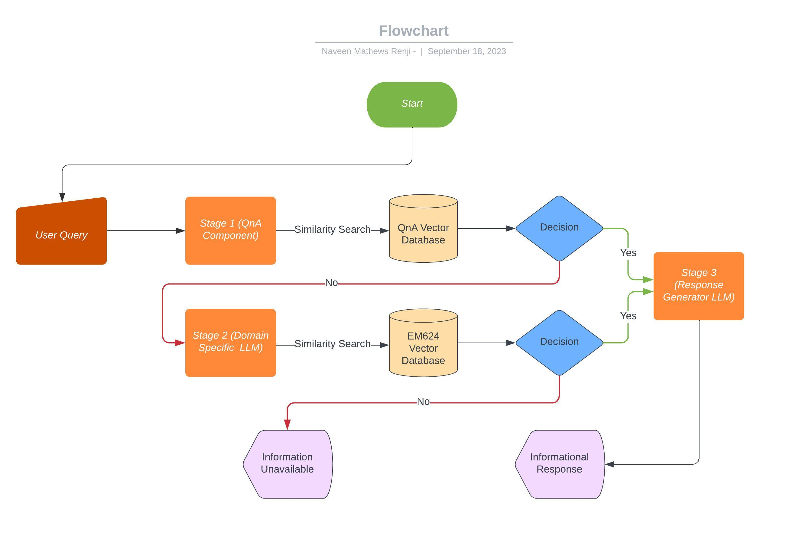
Research Work 2: SSE-EduBot
A pioneering educational tool designed for the EM 624 course
Multi-stage functionality with distinct features
Incorporates domain-specific data collection, data preprocessing, and vectorization
Utilizes a Large Language Model for response generation
Features a robust backend API and user-friendly interface
Ongoing system refinement for enhanced efficacy

Slide 9
Thank you!

