Slide 1
Real Time Indian Sign-Language to Speech Translation to Assist People With Hearing and Speech Impairment
GUIDE
DR.S.RAJARAJESHWARI
TEAM
KRUTHIKA K | 1MS17CS048
MANASA KESHAVMURTY | 1MS17CS058
NAVEEN MATHEWS RENJI | 1MS17CS072
POOJA KUMARI | 1MS17CS081

Slide 2
Agenda
Sign language is the language used by people with speech and hearing impairment. Unless the concerned parties know the language, there is a communication barrier between them. In most cases they is an interpreter involved. To reduce the dependencies on interpreters and to bridge the communication gap, we develop a sign language translation system that translates the sign language by the user using deep learning algorithms and presents a grammatically correct translation in text/speech format using natural language processing.

Slide 3
Introduction
Sign language and gestures are vision based. It uses hand movements and facial expressions for communicating a message and is one of the main modes of communication for mute people. However not everybody always understands the nuances of the message they are trying to convey. Subtle differences in expression can convey a totally different message. Our aim is to bridge the conversational gap between the two parties thus enabling everyone to express their thoughts freely.

Slide 4
PROBLEM DEFINITION
CURRENT METHODOLOGY
There exists models that convert American Sign Language to sentences. However, most of these techniques are not based on deep learning. These models also cannot handle the nuances of the Indian Sign Language.
PROPOSED METHODOLOGY
We use the Indian sign Language and deep neural networks to develop a model that can convert gestures of ISL into English text and speech.

Slide 5
System Requirements
Hardware Interfaces
A phone camera with a minimum 4mp resolution.
The Android phone should be compatible to have OS Android 5.0 (API level 21) or higher.
Software Interfaces
Python and OpenCV will be used to extract information from the frames which are derived from the users recorded video.
Google’s Cloud service - Google Colab will be used to access the database that stores signs , facial expressions along with their translation. This is used to generate the output after processing the data.
Pytorch will enable efficient Training and Testing of the deep neural network.
Android Studio will be used as the android software development environment to create the Android application.
Communication Environment
The user’s phones must be 4G compatible and must also have enabled 4G without compromise to speed and usable mobile network data.
Operating Environment
Operating system: Android
Database: Google Colab
Backend: Python and OpenCV
Frontend: Android studio

Slide 6
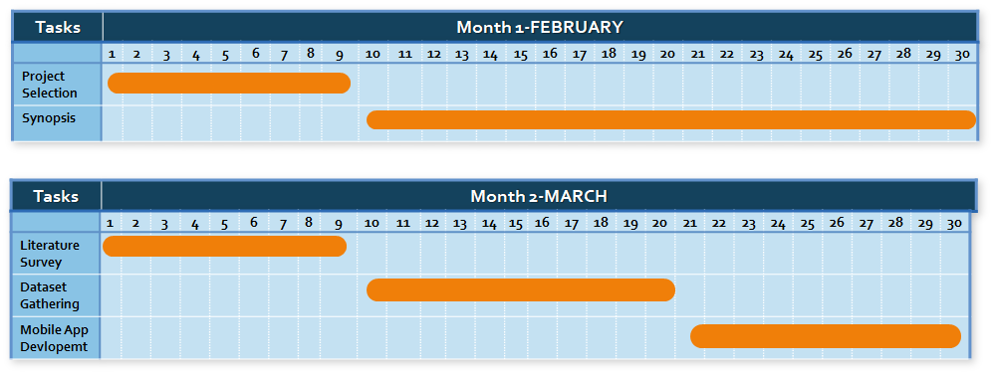
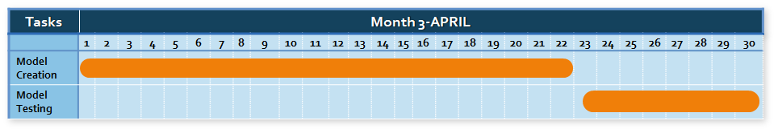
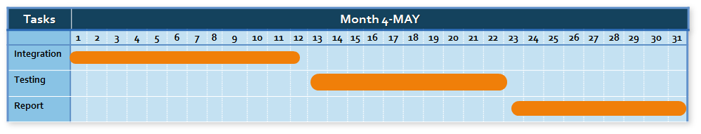
Planning-
GANTT CHART

Slide 7
Literature Survey & Related Work
We conducted a literature survey for 14 related works.Below is the tabular analysis of the same.
REFERENCE | TECHNIQUE | DATASET | ALGORITHM | RESULTS
VISION BASED HAND GESTURE RECOGNITION USING FOURIER DESCRIPTOR FOR INDIAN SIGN LANGUAGE (2016) | Fourier descriptor and Euclidean distanCE | ISL STATIC ALPHABETS 26 (780 Signs) | Fourier descriptor used for feature extraction and nearest neighbour using Euclidean distance used for classification. | 94.15% accuracy is acquired under similar illumination and distance conditions.
A NOVEL APPROACH OF SIGN RECOGNITION FOR INDIAN SIGN LANGUAGE (2018) | Filtering of color and Eigen vectors for extracting features | IMAGES OF ISL NUMBERS. | Skin Color filtering used for noise removal and hand detection. Eigen value & Eigen vector used to extract the features of the image. Euclidean distance used for classification. | The video frames are color filtered and features after extraction is used to classify the numbers.
HAND GESTURE RECOGNITION AND VOICE CONVERSION FOR DEAF & DUMB (2018) | Image processing techniques and Principle Component Analysis (PCA) Technique for Feature Extraction | Dataset is self-created | K-Nearest Neighbor (KNN) and Support Vector Machine (SVM) for Classification of signs. | Implementation of this system gives up to 90% accuracy

Slide 8
REFERENCE | TECHNIQUE | DATASET | ALGORITHM | RESULTS
Hand Gesture Spotting Using Sign Language through Computer Interfacing (2014) | SURF and Hu Moment Invariant technique | Images of sign language gestures are self created. | Hybrid classification using KNN and SVM. SURF and Hu Moment invariant. | Experimental success rate of 96%.
Indian Sign Language Recognition Using Eigen Value Weighted Euclidean (2013) | Distance Based Classification Technique | database of hand gestures with uniform background | Eigen value weighted Euclidean distance | gesture recognition accuracy of 95%
Hand Gesture Recognition System for Deaf and Dumb People Using PCA (2016) | Image pre-processing techniques of morphology, thresholding and binarization. | Images of sign language gestures are self created. | Feature extraction using PCA and classification using KNN. | Hand Gestures predicted with accuracy of 87%
Real-Time Hand Gesture Recognition Using Finger Segmentation (2014) | Labelling algorithm for finger recognition and palm segmentation |  | Rule classifier used for classification | Gesture recognition accuracy of 97%

Slide 9
ARCHITECTURE DESIGN
HARDWARE CAMERA
VIDEO PROCESSING USING OPENCV
CNN TO IDENTIFY HANDS FROM IMAGE
RNN TO IDENTIFY HANDS GESTURE
IMAGES
VIDEOS
NATURAL LANGUAGE PROCESSING
TEXT
NO PROCESSING REQUIRED
CONVERT VIDEO TO FRAMES
SPEECH

Slide 10
LOW LEVEL DESIGN-DATA FLOW
IMAGE
AS A FRAME
IMAGES FOR LETTERS/DIGITS
SEQUENCE OF 1 FRAME
HARDWARE CAMERA
GREY SCALE
CNN
RNN
SENTENCES IN SUBJECT-OBJECT VERB ORDER
VIDEOS FOR WORDS/SENTENCES
SEQUENCE OF MULTIPLE FRAMES
NATURAL LANGAUGE PROCESSING
VIDEO TO FRAME
OUTPUT
GRAMMATICALLY CORRECT SENTENCES

Slide 11
Algorithmic description
Convolution neural network
These networks are a class of deep feedforward neural networks that are based on weight sharing.
This neural network is given grayscale images as input. It processes them and converts them to vectors that denote the positions of the hands in the image.
It uses a filter that runs across the input images along with maxpooling to identify specific features in images that help identify gestures.

Slide 12
Recurrent neural network
Recurrent Neural Networks are used whenever memory of previous computations is required. It is used to identify the hand gesture by considering the gestures denoted by the current and the previous frames.
This network takes in the input vectors and outputs letters/digits/words in the order of subject - object - verb.
Optimizer
Adam optimizer combines the features of AdaGrad and RMSProp to learn adaptively, and is currently known to be the best learning algorithm.

Slide 13
Reason for choosing architecture
The project has been designed such that it incorporates major applications of machine learning and deep learning. Also, various concepts such as image and video processing, different neural architectures etc. are used as an attempt to make the translations more accurate and relevant. Simplicity and effectiveness are the key factors considered while designing and developing the application.

Slide 14
Conclusion
Though hardware implementation can give greater accuracy in some situations but it deviates from our goal of making communication easy and accessible as it is expensive and requires regular maintenance. We aim to bridge the communication gap in the most accessible manner. Deep neural networks have revolutionized how different Machine Learning problems are approached. Using them within an Android app will greatly increase its accessibility and its availability to all parties requiring a sign language interpreter can solve this problem and give significant results, and that is precisely what this project explores.

Slide 15
References
Kusumika Krori Dutta, Satheesh Kumar Raju K, Anil Kumar G S, and Sunny Arokia Swamy B. Double handed indian sign language to speech and text. In Proceedings of the 2015 Third International Conference on Image Information Processing (ICIIP), ICIIP ’15, pages 374–377, Washington, DC, USA, 2015.IEEE Computer Society.
K. Dabre and S. Dholay. Machine learning model for sign language interpretation using webcam images. In 2014 International Conference of Circuits, Systems, Communication and Information Technology Applications (CSCITA), pages 317–321, April 2014.
K. Dixit and A. S. Jalal. Automatic indian sign language recognition system. In 2013 3rd IEEE International Advance Computing Conference (IACC), pages 883–887, Feb 2013.

