Slide 1
Continuous Delivery Commit Phase Dashboard
Shane Murphy

Slide 2
Challenge
IBM Collaboration Solutions are to adopt CD for all development teams.
ICS Director to report progress on set of CD Trnasformation Checkpoints and metrics regularly.
CD is a pattern language used to automate and improve software delivery process.
Automated testing
Continuous Integration
Contiuous Deployment
Provide information to team members, management and executives to compare against their goals.
To display summary data relating to the continuous delivery.
Build Duration
Manual Testing Duration (automatable)
API Test Coverage
Manual Testing Duration (non-automatable)
Time from Final Code Submission to Production (Cloud)
Time from Final Code Submission to Production (On-Premises)
SPRs per capita
Cumulative Open & deferred defects

Slide 3
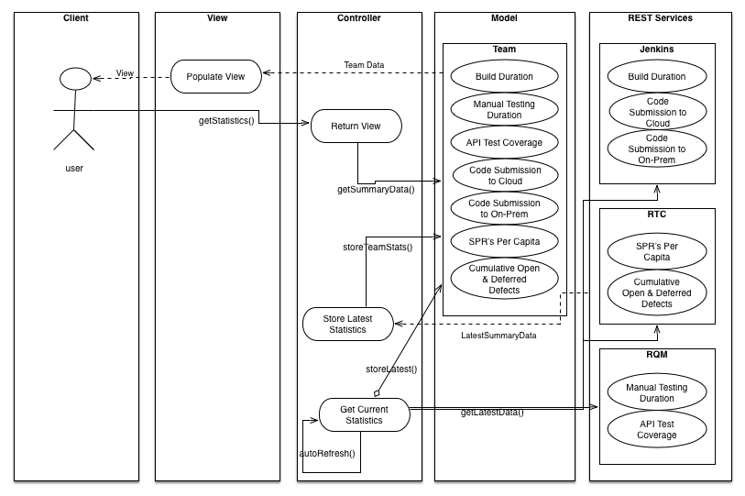
Design

Slide 4
Solution
VirtualBox and Ubuntu used to host and run the RTC Server
IntelliJ IDE
MVC Architecture with Services Layer
Implemented using Groovy & Grails
Grails plugins used.
For example:
Spring Security
Google Charts
Quartz2
Views use SiteMesh to Insert different data into one template used across the application
D3.js and Google Charts API used to create the graphs
MySQL Database for backend
Cron Jobs update the local database to reflect RTC
Database hosted on MAMP
User Logins implemented with Spring Security and custom profiles
Integrated with RTC, research into how to extract data from Jenkins/RQM undertaken. Sample data used.

Slide 5
Revision
Spent more time trying to integrate with Jenkins/RQM than adding functionality
Project entered a yellow status.
Rescoped to focus on the commit phase in order to meet deadline.
Build Duration
Commit Phase Testing duration (automated)
SPRs opened per capita (general quality measure)
Cumulative open and deferred defects (technical debt)
User Login and personalisation
Use Mock data

Slide 6
Learning outcomes
Groovy
Grails
Hibernate
Quartz2
Configuration
Servers
Databases
Virtual Machines
RTC, RQM, Jenkins
Insight into SDLC in a real world environment
IBM Experience
IBM Culture
SDLC
Tools
Regular meetings with mentor

