Slide 1
Python on Containers
Deploying Web Services on Kubernetes
Naveen sivanandam, VMWARE INDIA

Slide 2
Agenda
Jargon
Why Kubernetes?
Kubernetes Intro
Demo

Slide 3
Terminology
Container – package and isolate applications within runtime environment. Easy to move between dev, test, prod.
Docker – technology to build, ship, version and run containers
Docker Engine
Docker Registry
Kubernetes – Container Orchestration Platform
Manage hundreds/thousands of containers running on hundreds of machines

Slide 4
Why Kubernetes?
Docker solves the container problem.
Applications span tens/hundreds of containers. Need a higher-level management platform for
Seamless deployments
Auto-scaling
Efficient resource utilization
Kubernetes is portable, extensible and self-healing

Slide 5

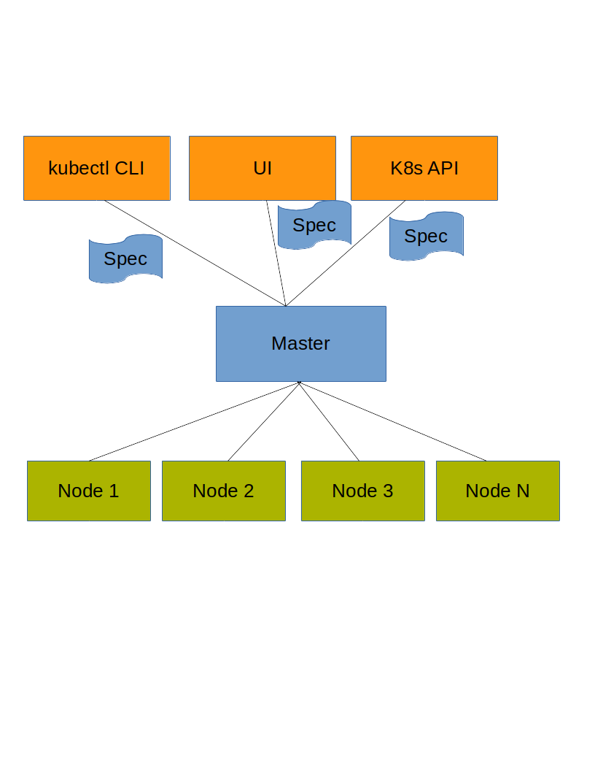



Kubernetes
K8s Master
K8s Node

Slide 6
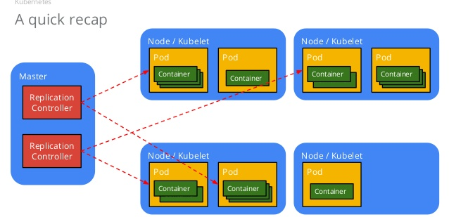
K8s Objects
Pod – building block of k8s that we create and deploy. Represents a running process in k8s cluster. Encapsulates container(s), storage and network stack.
Deployment – Declarative updates for Pods. Describes the desired state - number of pod replicas are running at any time, rolling update strategy etc.
Service – Logical set of pods. Provides decoupling from ephemeral pods.

Slide 7
minikube
Runs a single-node cluster inside a VM – for development
Installation
Kubectl CLI
$ curl -LO https://storage.googleapis.com/kubernetes-release/release/$(curl -s https://storage.googleapis.com/kubernetes-release/release/stable.txt)/bin/linux/amd64/kubectl && chmod +x kubectl && sudo mv kubectl /usr/local/bin/
VirtualBox
https://www.virtualbox.org/wiki/Linux_Downloads
minikube:
curl -Lo minikube https://storage.googleapis.com/minikube/releases/latest/minikube-linux-amd64 && chmod +x minikube && sudo mv minikube /usr/local/bin/

Slide 8
Demo
minikube start
kubectl create -f hello.yml
curl $(minikube service simple-flask-app --url)
minikube stop

