Slide 1
Module

Slide 2
introduction
Modules are used to categorize Python code into smaller parts. A module is simply a Python file, where classes, functions and variables are defined. Grouping similar code into a single file makes it easy to access. Have a look at below example.x

Slide 3
Advantage
Reusability:
Module can be used in some other python code. Hence it provides the facility of code reusability.
Categorization:
Similar type of attributes can be placed in one module.

Slide 4
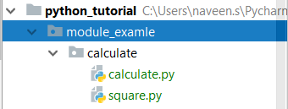
Importing MODULE
"import" statement can be used to import a module.
import file_name1, file_name2,...file_name(n)
#square.py
def cal(a): ans=a*a print (ans)
#Calculate.py import square square.cal(5) square.cal(9)

Slide 5
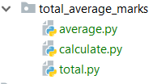
Importing Multiple Modules
#total.py def gettotal(m1,m2,m3,m4,m5): return(m1+m2+m3+m4+m5)
#average.py def getaverage(total,count): return(total/count)
#calculate.py import total,average m1=150 m2=156 m3=176 m4=200 m5=187 ans_total=total.gettotal(m1,m2,m3,m4,m5) ans_average=average.getaverage(ans_total,5) print("Total: "+str(ans_total)) print("Average: "+str(ans_average))

Slide 6
from.. import statement
from..import statement is used to import particular attribute from a module
from module_name import attribute1,attribute2,attribute3,...attributen
from cal_perimeter import squ_perimeter,tri_perimeter print(squ_perimeter(4)) print(tri_perimeter(3,4,8))

