Slide 1
Hack-Your Own Web App
Naveen Srinivasan

Slide 2
Why?
Hacking yourself first method assessing website security without access to the source code.
This is applicable to any web stack. Java, .NET, PHP, RAILS

Slide 3

Not my own idea
I learnt a lot of this from Troy Hunt. http://www.troyhunt.com/ who is a security expert.

Slide 4
Tools
Chrome - Developer tools
Charles Proxy - Mac, Windows and Linux - Free trial
Fiddler - Windows - Free

Slide 5
http://hackyourself.troyhunt.com
Vulnerable Site

Slide 6
Transport Level Security
Man in the Middle
Loading login form over HTTP is risky
Cookies over insecure connection
Mixed mode content - HTTPS and HTTP

Slide 7
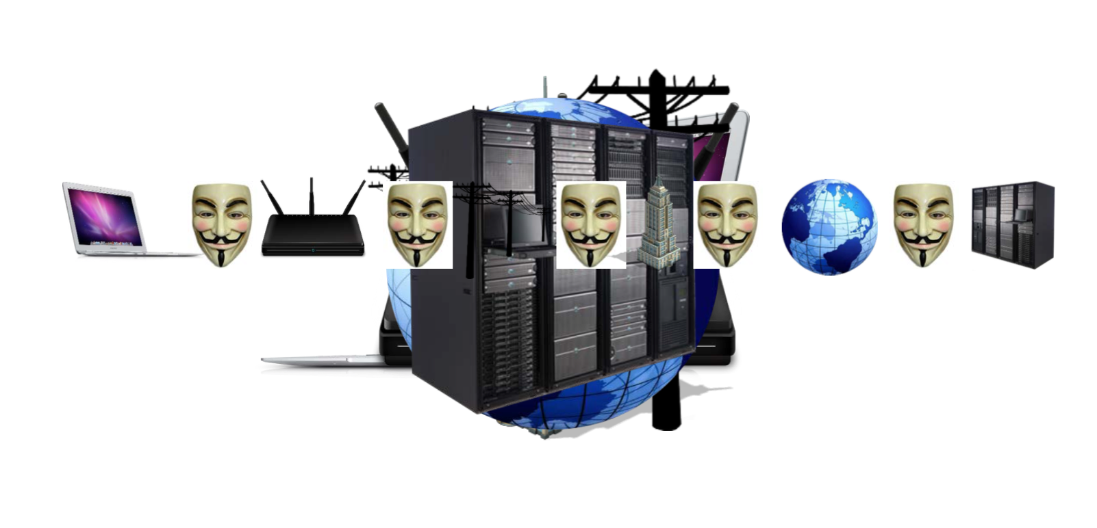
Man In The Middle

Slide 8
Demo - Loading login form over HTTP is risky

Slide 9
Mixed mode content
All assets must be loaded in HTTPS mode especially Javascript.
If the cookie isn’t marked as secure the session cookie could be transported in a insecure manner
https://httpshaming.tumblr.com/

Slide 10



XSS - Cookie Stealing
Demo

Slide 11
Server Response Headers
The server response header like ‘Tomcat’ can help the attacker start scripting for a brute force manager username password to again access and upload a war file which in case could destabilize the entire system
www.shodan.io can give out sites that run version of a server to find a victim

Slide 12
Parameter Tampering
Demo - Request- using voting .
Open Web Application Security Project - ZAP Tool

Slide 13
CSRF - Cross Site Request Forgery

Slide 14
Click Jacking

