Slide 1
Blockchain Simulator
A Project for Course “Introduction to Blockchain”
Naveen Tiragati
Masters Student, Computer Science
University Of Missouri –Kansas City

Slide 2
Outline:
GIT Repository
My Project Flow Chart
Introduction
Requirements
Network Topology (Linear Graph)
Block Data Structure.
Block Validation
Difficulty (Mining)
My Project Flow Chart(Again)
Results
Future Work

Slide 3
GIT Repository
Entire Code along with this PPT is secured in the following Git Repository:
https://github.com/naveentiragati/bcs

Slide 4
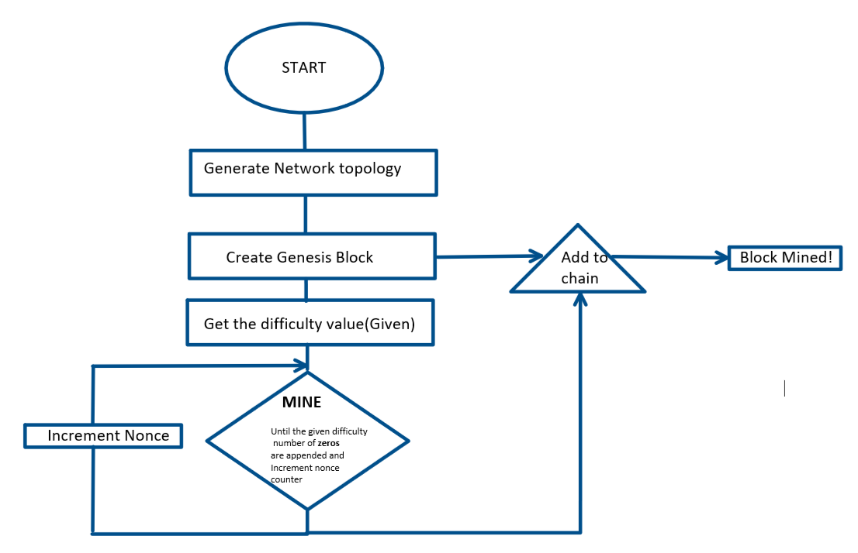
My Project Flow Chart

Slide 5
Introduction
Developed a blockchain simulator which can simulate network generation, block generation and validation. This simulator can be used for better understanding of the concepts that we learnt throughout the course.
For a given input of number of nodes our simulator generates simple P2P Network, generates genesis block and starts mining and validates the entire chain for false blocks and tell if the chain is valid or not.

Slide 6
Requirements
Coding Language : JAVA 1.8
IDE used : Intellij

Slide 7
Network Topology (Linear Graph)
We know that the Blockchain runs on a peer to peer network. To simulate the peer to peer network we used a linear graph topology.
Simulated Simple P2P Liner Graph topology
Actual P2P Network

Slide 8
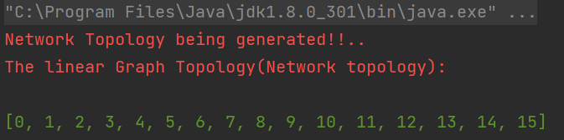
Network Topology (Linear Graph)
Simulated Simple P2P Liner Graph topology
Output of the linear graph generated:

Slide 9
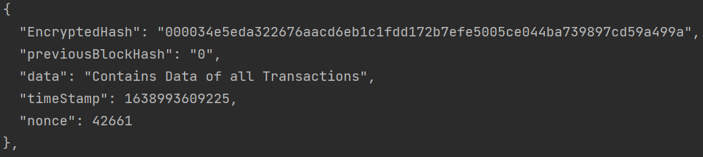
Network Topology (Linear Graph)
The Genesis Block
Simulated Simple P2P Liner Graph topology
The Genesis Block
The Previous Hash value for the Genesis Block is 0

Slide 10
Block Data Structure
Now the each mined block should be stored in some form of data structure in order to access the transaction history, data, time stamp etc. and also we need to verify of the new block mined is valid is or not.
We used ArrayList<> in JAVA to implement this.
It is the simplest form of data structure which is backed by the basic arrays. An ArrayList, or dynamically resizing array, allows you to have the benefits of an array while offering flexibility in size. You won’t run out of space in the ArrayList since it’s capacity will grow as you insert elements.
More clear explanation at : https://medium.com/@Emmanuel.A/data-structures-arraylist-239a5b39cd7e

Slide 11
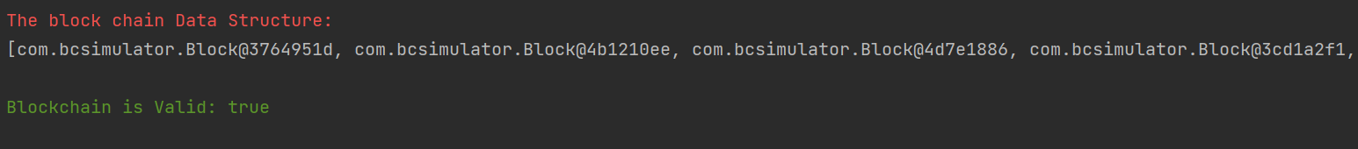
Block Data Structure
Output of Blockchain Structure:
The Arraylist give us a serialized java objects which are not human readable
In order to pretty print those we use Gson library which converts serialized java objects to Json and pretty print them.

Slide 12
Block Validation
The Block Validation is implemented using multiples ways in order to make sure the entire chain of transactions are valid.
If the new block generated is having certain leading number of zeros as defined.
By checking if the hash of the previous block and the value of previous hash in the current block for entire chain of transactions if correct or not.
By Recalculating the hash values by looping through entire history and comparing with the existing hash values.

Slide 13
Block Validation
Pseudo Code for validation
Start
Start
Start
IF Current hash = calculated hash
IF Current previous hash = previous block hash
IF Current hash = Certain number of leading “0”s
Chain Valid
Chain Valid
Chain Valid

Slide 14
Difficulty (Mining)
In POW the block is generated when we find the correct nonce value such that it is less than the target!
Also the target is flexible to change(In our code it is adjusted using difficulty value)
Start
Difficult Value = n
In Loop until 0’s set in difficult value (n) is appended
Exit

Slide 15
Difficulty (Mining)
calculatedEncryptedhash = SHA 256(previousBlockHash + data + nonce)
Nonce is the value obtained from mining. Like explained in previous slide the nonce value is incremented until we get the difficulty number of zero’s
SHA 256
Calculated String
Encrypted Hash

Slide 16
My Project Flow Chart

Slide 17
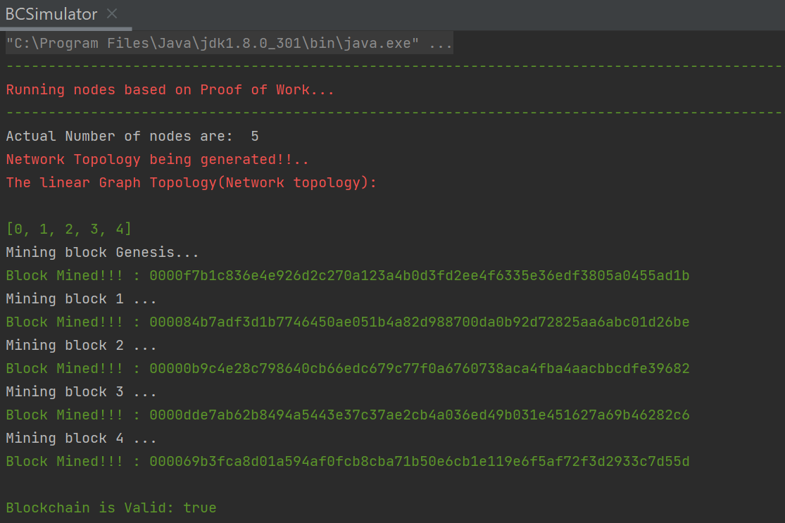
Results:
Using POW

Slide 18
Implementing DPOS
Delegated Proof of Stake(DPOS) is evolution of Proof of stake. Here we have delegates instead of miners. The way the delegates selected varies from one proof of stake mechanism to other. Once the delegates are determined they will validated the block and it to the chain of blocks.
DPoS depiction of Simulated Simple P2P Liner Graph topology
DPoS depiction of Actual P2P Network

Slide 19
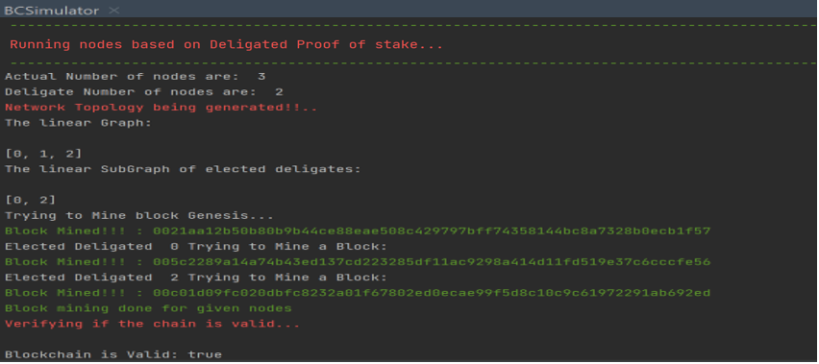
Results:
Using DPOS

Slide 20
Future Implementations:
Complicated network topology.
Average extrapolated aggregated propagation time of different consensus and compare them.
Implementing coin age based selection of delegates instead of random selection for DPoS.

Slide 21

Thanks to Professor and Teaching Assistant
Baek-Young Choi, Ph.D., Professor
Department of Computer Science and Electrical Engineering
Manasa Leela Gummadavelly, Ph.D., Student, Teaching Assistant
Department of Computer Science and Electrical Engineering
Your Knowledge, skills and insights have helped me learn new technology quickly. I Will be grateful for considering an extra credit Project for this course. ☺

Slide 22
End of Presentation ☺

