Slide 1
Blockchain Simulator
A Project for Course “Introduction to Blockchain”
Naveen Tiragati
Masters Student, Computer Science
University Of Missouri –Kansas City

Slide 2
Outline:
Introduction
Requirements
Network Topology (Linear Graph)
Block Data Structure.
Block Validation
Difficulty (Mining)
Results
Future Work

Slide 3
Introduction
Developed a blockchain simulator which can simulate network generation, block generation and validation. This simulator can be used for better understanding of the concepts that we learnt throughout the course.
For a given input of number of nodes our simulator generates simple P2P Network, generates genesis block and starts mining and validates the entire chain for false blocks and tell if the chain is valid or not.

Slide 4
Requirements
Coding Language : JAVA 1.8
IDE used : Intellij

Slide 5
Network Topology (Linear Graph)
We know that the Blockchain runs on a peer to peer network. To simulate the peer to peer network we used a linear graph topology.
Simulated Simple P2P Liner Graph topology
Actual P2P Network

Slide 6
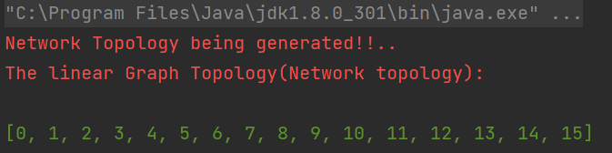
Network Topology (Linear Graph)
Simulated Simple P2P Liner Graph topology
Output of the liner graph generated:

Slide 7
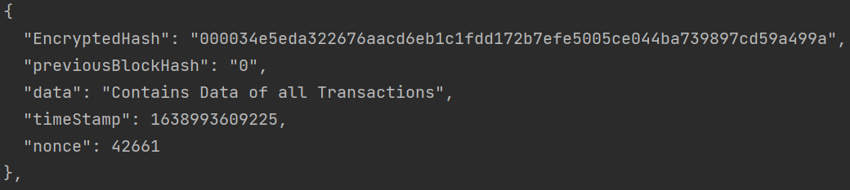
Network Topology (Linear Graph)
The Genesis Block
Simulated Simple P2P Liner Graph topology
The Genesis Block
The Previous Hash value for the Genesis Block is 0

Slide 8
Block Data Structure
Now the each mined block should be stored in some form of data structure in order to access the transaction history, data, time stamp etc. and also we need to verify of the new block mined is valid is or not.
We used ArrayList<> in JAVA to implement this.
It is the simplest form of data structure which is backed by the basic arrays. An ArrayList, or dynamically resizing array, allows you to have the benefits of an array while offering flexibility in size. You won’t run out of space in the ArrayList since it’s capacity will grow as you insert elements.
More clear explanation at : https://medium.com/@Emmanuel.A/data-structures-arraylist-239a5b39cd7e

Slide 9
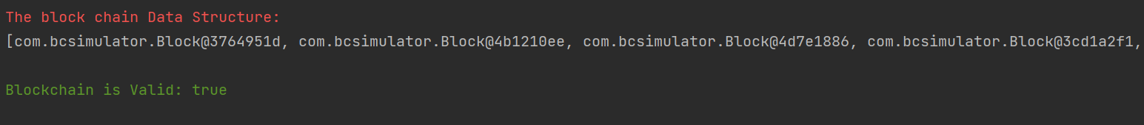
Block Data Structure
Output of Blockchain Structure:
The Arraylist give us a serialized java objects which are not human readable
In order to pretty print those we use Gson library which converts serialized java objects to Json and pretty print them.

Slide 10
Block Validation
The Block Validation is implemented using multiples ways in order to make sure the entire chain of transactions are valid.
If the new block generated is having certain leading number of zeros as defined.
By checking if the hash of the previous block and the value of previous hash in the current block for entire chain of transactions if correct or not.
By Recalculating the hash values by looping through entire history and comparing with the existing hash values.

Slide 11
Block Validation
Pseudo Code for validation
Start
Start
Start
IF Current hash = calculated hash
IF Current previous hash = previous block hash
IF Current hash = Certain number of leading “0”s
Chain Valid
Chain Valid
Chain Valid

Slide 12
Difficulty (Mining)
In POW the block is generated when we find the correct nonce value such that it is less than the target!
Also the target is flexible to change(In our code it is adjusted using difficulty value)
Add top down entire psudo code, you have taken a picture on android phone

Slide 13
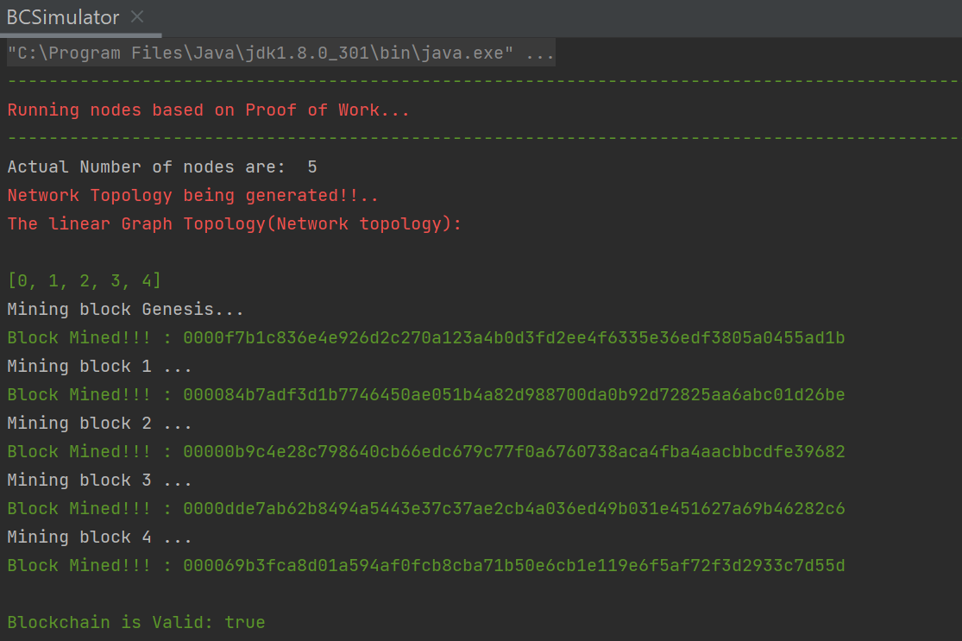
Results:
Using POW

Slide 14
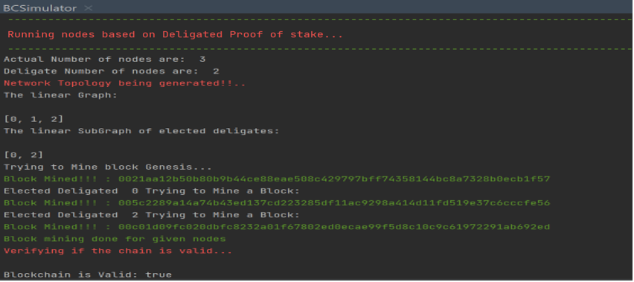
Results:
Using DPOS

Slide 15
Future Implementations:
Complicated network topology.
average extrapolated aggregated propagation time of different consensus and compare them
implementing coin age based selection of delegates instead of random selection for DPoS.

Slide 18

Thanks to Professor and Teaching Assistant
Baek-Young Choi, Ph.D., Professor
Department of Computer Science and Electrical Engineering
Manasa Leela Gummadavelly, Ph.D., Student, Teaching Assistant
Department of Computer Science and Electrical Engineering
Your Knowledge, skills and insights have helped me learn new technology quickly. I Will be grateful for considering an extra credit Project for this course. ☺

Slide 19
End of Presentation ☺

