Slide 1
TREES

Slide 2
TREE
A tree is a non-linear data structure used to represent hierarchical relationship existing amongst several data items.
There is a special data item called the root of the tree.
And its remaining data items are partitioned into number of mutually exclusive (i.e., disjoint) subsets, each of which is itself a tree. And they are called sub trees.

Slide 3
ROOT
Level 0
A
C
D
Level 1
B
E
F
G
H
I
Level 2
J
K
L
M
Level 3

Slide 4
A tree is a non-empty collection of vertices and edges that satisfies certain requirements.
A vertex is a simple object (also referred to as a node) that can have a name and can carry other associated information.
An edge is a connection between two vertices.
A tree may, therefore, be defined as a finite set of zero or more vertices such that:
There is one specially designated vertex called ROOT, and
The remaining vertices are partitioned into a collection of sub- trees, each of which is also a tree.

Slide 5
Root: It is specially designed data item in a tree. It is the first in the hierarchical arrangement for data items. In the above tree, A is the root item.
Node : Each data item in a tree is called a node. It is the basic structure in a tree. It specifies the data information and links (branches) to other data items. There are 13 nodes in the above tree.

Slide 6
Degree of a node: It is the number of sub trees of a node in a given tree. In the above tree.
The degree of node A is 3
The degree of node C is 1
The degree of node B is 2
The degree of node H is 0
The degree of node I is 3
Degree of a tree: It is the maximum degree of nodes in a given tree. In the above tree the node A has degree 3 and another node I is also having its degree 3. In all this value is the maximum. So, the degree of the above tree is 3.

Slide 7
Terminal node (s): A node with degree zero is called a terminal node or a leaf. In the above tree, there are 7 terminal nodes. They are E,J,G,H,KL and M.
Non-Terminal node (s) : Any node (except the root node) whose degree is not zero is called non-terminal node. Non-terminal nodes are the intermediate nodes in traversing the given tree from its root node to the terminal nodes (leaves). There are 5 non-terminal nodes.

Slide 8
Siblings: The children nodes of a given parent node are called siblings. They are also called brothers. In the above tree,
E and F are siblings of parent node B.
K,L and M are siblings of parent node .
Level: The entire tree structure is leveled in such a way that the root node is always at level 0. Then, its immediate children are at level 1 and their immediate children are at level 2 and so on upto the terminal nodes. In general, if a node is at level n, then its children will be at level n+1.

Slide 9
Edge: It is a connecting line of two nodes. That is, the line drawn from one node to another node is called an edge.
Path: It is a sequence of consecutive edges from the source node to the destination node. In the above tree, the path between A and J is given by the node pairs,
(A,B), (B,F) and (F,J)
Simple Path: A path is simple if all of its vertices are distinct.
Closed Path: A path is closed if the first vertex is the same as the last vertex (i.e., it starts and ends at the same vertex.)

Slide 10
Depth: The depth of a node X in a tree T is defined as the length of the simple path (number of edges) from the root node to X.
Height: The height of a node Y is the number of edges on the longest downward simple path from Y to a leaf.
The height of a tree is defined as the height of its root node. (Number of edges in the longest simple path from root to the deepest leaf)
So, the root always has a depth of 0 while leaf nodes always have a height of 0.
Note that a simple path is a path without repeated vertices.

Slide 11
For each node in a tree, we can define two features: height and depth.
A node’s height is the number of edges to its most distant leaf node.
On the other hand, a node’s depth is the number of edges back up to the root.
So, the root always has a depth of 0 while leaf nodes always have a height of 0.

Slide 12
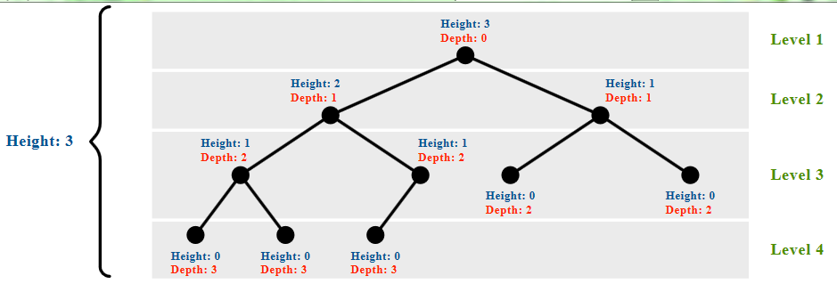

Slide 13
The height of a tree is equal to the maximum depth of a tree.
The depth of a node and the height of a node are not necessarily equal.
Height of an empty tree = -1
Height of tree with 1 node = 0

Slide 14
BINARY TREES: A binary tree is a finite set of data items which is either empty or consists of a single item called the root and two disjoint binary trees called the left sub tree and right sub tree.
A binary tree is the most commonly used non-linear data structure.
In a binary tree the maximum degree of any node is at most two. That means, there may be a zero degree node (usually an empty tree) or a one degree node and two degree node.

Slide 15
A
B
C
D
F
E
G
H
I

Slide 16
Representation of Binary tree in memory
The structure of each node of a binary tree contains the data field and two pointers, one for the left child and another for the right child.
left
right
data

Slide 17
struct tnode
{
struct tnode * left;
int data;
struct tnode * right;
};
There are two ways by which we can represent a binary tree:
Linked representation
Array representation

Slide 18
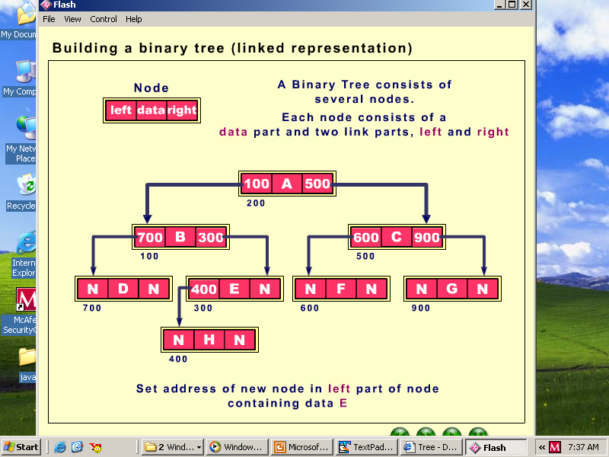

Slide 19
Array representation
0
A
1
C
2
B
5
F
6
G
3
D
4
E
J
9
M
12

Slide 20
a[0] | a[1] | a[2] | a[3] | a[4] | a[5] | a[6] | a[7] | a[8] | a[9]
A | B | C | D | E | F | G | ‘\0’ | ‘\0’ | J
a[10] | a[11] | a[12] | a[13] | a[14]
‘\0’ | ‘\0’ | M | ‘\0’ | ‘\0’

Slide 21
Array size can be taken as 2^{height+1}
In the above tree, height of tree=3, so, maximum size of array can be taken as 2⁽³⁺¹⁾ i.e 2⁴
If n is the number given to a node then its
left child occurs at the position (2n + 1) and
right child occurs at the position (2n + 2)
In the above tree, the node C is at number 2, So, its left child is at (2*2+1) i.e. 5th position and its right child will be at (2*2+2) i.e. at 6th position.

Slide 22
STRICTLY BINARY TREE.: A strictly binary tree is a type of binary tree where each node has either zero or two children, and there are no nodes with only one child.
Every Internal or non-terminal node will have 2 children and all leaf nodes will have 0 children.

Slide 23
Strictly Binary Tree
B, C and E are Internal Nodes
A
B
C
D
F
G
E
H
I

Slide 24
Full or Proper or Perfect Binary Tree:
It is a tree in which every node other than the leaves has two children.
A
B
C
D
F
G
E

Slide 25
Maximum number of nodes(say n) in a Perfect Binary tree with height h
n =2⁰ + 2¹+ 2²+……..+2^{h} (This is a GP series)
Sum of n terms of a GP series a, ar, ar², ar³, ……ar^{n-1}
Sn=a[(r^{n}-1)/(r-1)] if r!=1, r>1
Therefore, n =2^{(h+1)} - 1
2^{(h+1)} = n+1
(h+1) log₂2=log₂(n+1)
h= log₂(n+1) -1

Slide 26
COMPLETE BINARY TREE: A complete binary tree is a binary tree that satisfies two conditions: 1. In a complete binary tree, every level, except possibly the last, is completely filled. 2. All nodes are as far left as possible.

Slide 27
A complete binary tree is also sometimes called an almost complete binary tree.
A complete binary tree can have an incomplete last level, as long as all the leaves in it are pushed across to the left.
A perfect binary tree is a complete binary tree in which the last level is full.
In an almost complete binary tree, the last level will surely be incomplete unlike complete which may or may not have the incomplete last level. But, in both the cases, the leaves in the last level will be pushed to left only.

Slide 28
Not complete binary tree:
A
B
C
D
F
G
E
X
Y

Slide 29
Complete binary tree:
A
B
C
D
F
G
E
X
Y

Slide 30
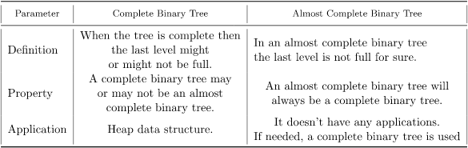

Slide 31
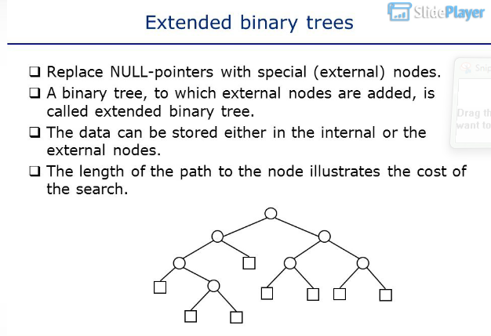

Slide 32
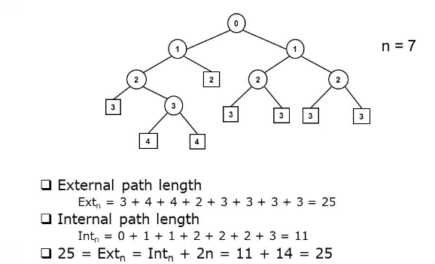
Here, numbers labelled on every node are the path lengths from root to that node.
Path length of a node is the number of distinct edges from root to that node.
There are 7 internal nodes(circular nodes) and 8 external nodes(rectangular ones)
External Path length= Internal Path length + 2* Number of Internal Nodes in the tree

Slide 33
TRAVERSALS IN BINARY TREE
Traversing of a binary tree refers to pass through the tree, enumerating each of its node once.
We may simply wish to print the contents of each node as we pass through. In either case, we speak of visiting each node as it is enumerated.

Slide 34
Preorder Traversal
To traverse a non empty binary tree in preorder (also known as depth first order), we perform the following three operations:
Visit the root.
Traverse the left sub tree in preorder.
Traverse the right sub tree in preorder

Slide 35
Inorder Traversal
To traverse a non empty binary tree in inorder (also known as symmetric order):
Traverse the left sub tree in inorder.
Visit the root.
Traverse the right sub tree in inorder

Slide 36
Postorder Traversal
To traverse a non empty binary tree in postorder :
Traverse the left sub tree in postorder.
Traverse the right sub tree in postorder
Visit the root.

Slide 37
PROBLEM: Write the preorder, inorder and postorder sequence of nodes.
A
B
C
D
F
G
E
H
I

Slide 38
Preorder: A B D G C E H I F
Inorder: D B G A H E I C F
Postorder: D G B H I E F C A

Slide 39
PROBLEM: Write the preorder, inorder and postorder sequence of nodes.
A
C
B
D
E
G
H
F
J
K
L

Slide 40
OUTPUT
Preorder: A B D E F C G H J L K
Inorder: D B F E A G C L J H K
Postorder: D F E B G L J K H C A

Slide 41
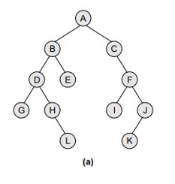
PROBLEM: Write the preorder, inorder and postorder sequence of nodes.

Slide 42
OUTPUT
Preorder: A,B,D,G,,H,L,E,C,F,I,J,K
Inorder: G,D,H,L,B,E,A,C,I,F,K,J
Postorder:G,L,H,D,E,B,I,K,J,F,C,A

Slide 43
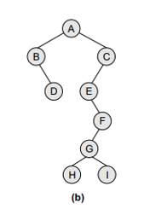
PROBLEM: Write the preorder, inorder and postorder sequence of nodes.

Slide 44
OUTPUT
Preorder: A,B,D,C,E,F,G,H,I
Inorder: B,D,A,E,H,G,I,F,C
Postorder: D,B,H,I,G,F,E,C,A

Slide 45
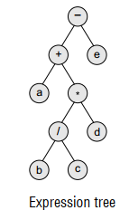
PROBLEM: Write the preorder, inorder and postorder sequence of nodes.

Slide 46
OUTPUT
Preorder: -,+,a,*,/,b,c,d,e
Inorder: a,+,b,/,c,*d,-,e
Postorder: a,b,c,/,d,*,+,e,-

Slide 47
PROBLEM - 1
A binary tree has 9 nodes. The inorder and preorder traversals of tree yield the following sequences of node:
Inorder : E A C K F H D B G
Preorder : F A E K C D H G B
Draw the tree.
Write the postorder sequence also.

Slide 48
The in-order traversal is used to determine the left and the right child nodes.
The pre-order and post-order nodes can be used to determine the root node.
Root node appears as the first node in pre-order and
Root node appears as the last node in post-order.

Slide 49
F
D
A
E
K
H
G
C
B

Slide 50
PROBLEM - 2
The inorder and preorder traversals of a tree yield the following sequences of node:
preorder : A B D G C E H I F
inorder : D G B A H E I C F
Draw the tree.
Write the postorder sequence also.

Slide 51
A
C
B
D
E
F
G
H
I

Slide 52
Postorder: G D B H I E F C A

Slide 53
PROBLEM – 3 (2017 Exam)
The inorder and preorder traversals of a tree yield the following sequences of node:
preorder : A B D F E J G C H I
inorder : F D B J E G A H I C
Draw the tree.
Write the postorder sequence also.

Slide 54
A
C
B
D
E
H
F
G
J
I

Slide 55
Post Order: F D J G E B I H C A

Slide 56
PROBLEM – 4
The Preorder and Inorder traversals of a tree yield the following sequences of node:
Preorder : A B C D E
Inorder : A B C D E
Draw the tree.
Write the Postorder sequence also.

Slide 57
A
B
Postorder: E D C B A
NOTE:
If Inorder and Preorder of a Binary tree are same:
Tree will always be a Right-Skewed Tree.
Postorder will be the reverse of Inorder or Preorder.
C
D
E

Slide 58
PROBLEM – 5
The Postorder and Inorder traversals of a tree yield the following sequences of node:
Postorder : E D C B A
Inorder : E D C B A
Draw the tree.
Write the Preorder sequence also.

Slide 59
A
Preorder: A B C D E
B
NOTE:
If Inorder and Postorder of a Binary tree are same:
Tree will always be a Left-Skewed Tree.
Preorder will be the reverse of Inorder or Postorder.
C
D
E

Slide 60
Binary Search Tree (BST)
A binary tree T is called a binary search tree if each node N of T has the following property:
The value at N is greater than every value in the left subtree of N
And is less than or equal to every value in the right subtree of N.
This property guarantees that the inorder traversal of T will yield a sorted listing of elements.

Slide 61
Prepare a BST with the following sequence:
40,60,50,33,55,11

Slide 62
40
33
60
11
50
55

Slide 63
Prepare a BST with the following sequence:
45, 39, 56, 12, 34, 78, 32, 10, 89, 54, 67, 81

Slide 64
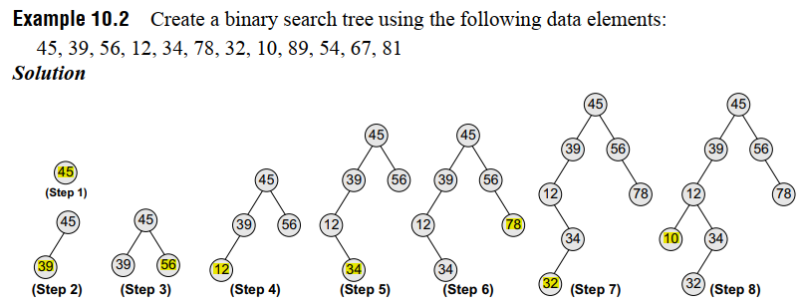
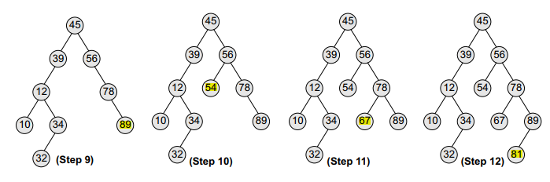

Slide 65
Prepare a BST with the following sequence:
20,17,6,8,10,7,18,13,12,5

Slide 66
20
17
18
6
8
5
7
10
13
12

Slide 67
Searching of a node in a BST
To search any node in a binary tree, initially the data that is to be searched is compared with the data of the root node.
If the data is equal to the data of the root then the searching is successful.
If the data is found to be greater than the data of the root node then the searching process proceeds in the right sub-tree of the root node.
Otherwise, searching process proceeds in the left sub-tree of the root node.

Slide 68
Same procedure is repeated for the left or right sub-tree until the data is found.
While searching the data if the leaf node of the tree is reached and the data is not found then it is concluded that the data is not present in the tree.

Slide 69
Insertion of a node in a BST
To insert any node into a BST, initially the data that is to be inserted is compared with the data of the root node.
If the data is found to be greater than or equal to the data of the root node then the new node is inserted in the right sub-tree of the root node, otherwise, the new node is inserted in the left sub-tree of the root node.

Slide 70
Now the root node of the right sub-tree or left sub-tree is taken and its data is compared with the data that is to be inserted and the same procedure is repeated.
This is done till the left or right sub-tree where the new node is to be inserted is found to be empty.
Finally, the new node is made the appropriate child of this current node.

Slide 71
Deletion from a BST
Case 1: Node-to-be-deleted has no children
Case 2: Node-to-be-deleted has exactly one child
Case 3: Node-to-be-deleted has two children

Slide 72
Case 1: Node-to-be-deleted has no children
In this case since the Node-to-be-deleted has no children the memory occupied by this should be freed and either the left link or the right link of the parent of this node should be set to NULL.
Which of these is set to NULL depends upon whether the node being deleted is a left child or a right child of its parent.

Slide 73
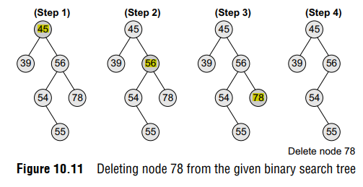
Case 1: Node-to-be-deleted has no children

Slide 74
Case 2: Node-to-be-deleted has exactly one child
In this case since the Node-to-be-deleted has one child, we have to adjust the pointer of the parent of the node to be deleted such that after deletion it points to the child of the node being deleted.
Rule: Replace the parent with the child.

Slide 75
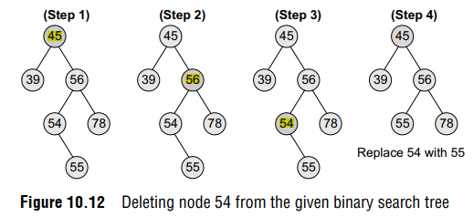
Case 2: Node-to-be-deleted has exactly one child

Slide 76
Case 3: Node-to-be-deleted has two children
To handle this case, replace the node’s value with its in-order predecessor (largest value in the left sub-tree) or in-order successor (smallest value in the right sub-tree).
The in-order predecessor or the successor can then be deleted using any of the cases 0 or 1.

Slide 77
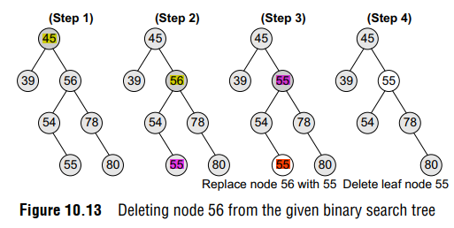
Deletion of node having TWO children:
Predecessor Approach: Replace the node having two children with its Inorder predecessor

Slide 78
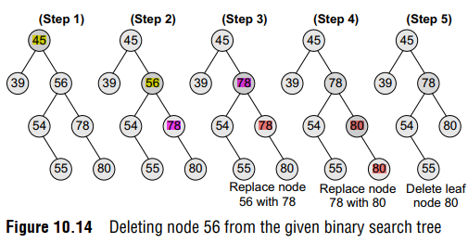
Deletion of node having TWO children:
Successor Approach: Replace the node having two children with its Inorder Successor

Slide 79
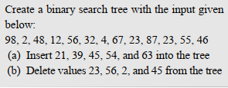

Slide 80
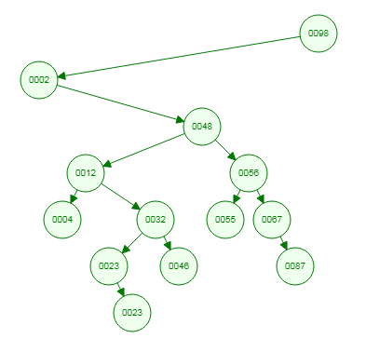
BST with the input data

Slide 81
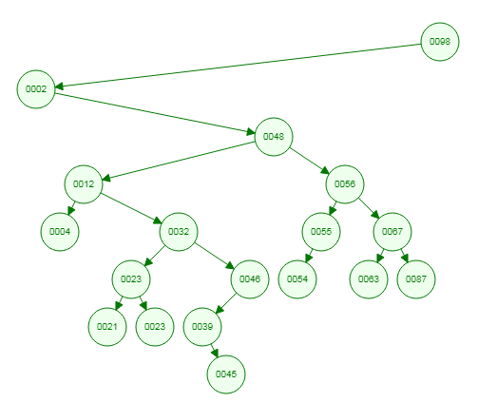
a

Slide 82
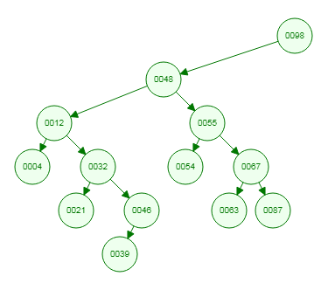
b

Slide 83
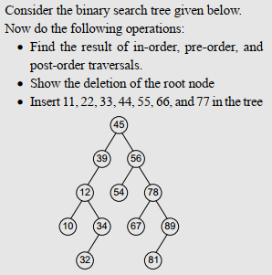

Slide 84
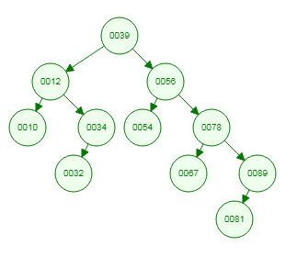
BST after deletion of root node(45). The root node (45) can also be replaced with Inorder successor (54). In that case, 54 will become the root node having 39 and 56 as left and right child respectively.

Slide 85
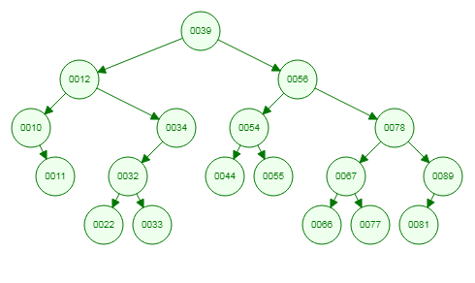
BST after Insertion of nodes

Slide 86
AVL Trees
AVL trees ensure that the heights of left and right subtrees of any node differ by at most 1. This balanced structure guarantees that the maximum height of the tree remains logarithmic, resulting in efficient search, insertion, and deletion operations. Compared to unbalanced binary search trees, AVL trees provide more consistent and predictable performance.

Slide 87
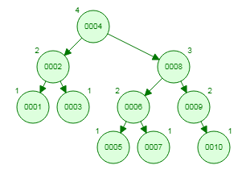
AVL Tree with numbers inserted in ascending order from 1 to 10

Slide 88
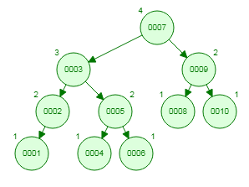
AVL Tree with numbers inserted in descending order from 10 to 1

Slide 89
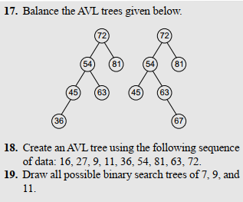

Slide 90
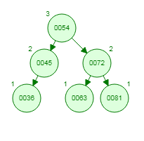
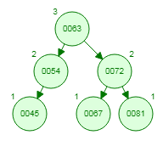
Answer of 17

Slide 91
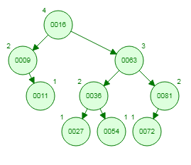
Answer of 18

Slide 92
Create AVL tree with the following nodes : 21, 17, 15, 23, 27, 20, 10, 13

Slide 93

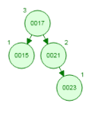

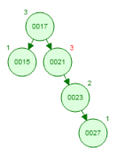
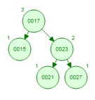
LL
RR

Slide 94
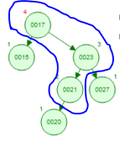
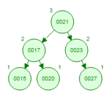
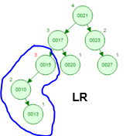
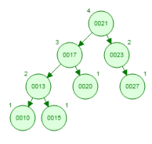
RL
Problem using All four rotations

Slide 95
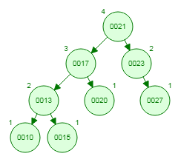

Slide 96
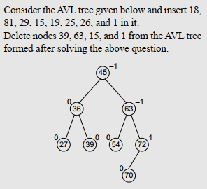

Slide 97
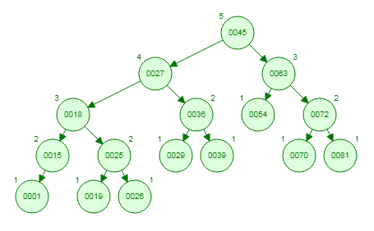
AVL Tree after Insertion of nodes

Slide 98
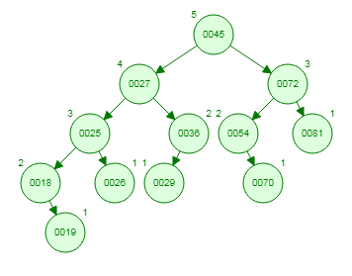
AVL Tree after Deletion of nodes

Slide 99
MCA 2021-22
Insert the following elements in empty AVL tree:
45, 55, 65, 75, 80, 90, 100, 110, 120, 130, 40, 35, 25, 20, 15, 10, 5

Slide 100
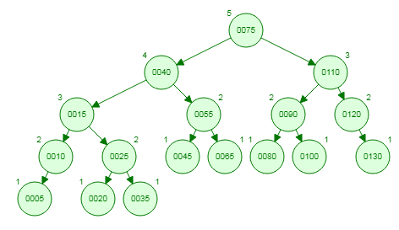

Slide 101
Sparse Matrix
Matrices with relatively high proportion of zero entries are called sparse matrices.
Lower Triangular Matrix: A square matrix where all the entries above the main diagonal are zero or equivalently, where all the non-zero entries can only occur on or below the main diagonal, is called a Lower Triangular matrix.

Slide 102
Lower Triangular Matrix
1 | 0 | 0 | 0 | 0
6 | 2 | 0 | 0 | 0
7 | 5 | 3 | 0 | 0
8 | 4 | 5 | 4 | 0
9 | 8 | 12 | 1 | 5

Slide 103
Upper Triangular Matrix: A square matrix where all the entries below the main diagonal are zero or equivalently, where all the non-zero entries can only occur on or above the main diagonal, is called a Upper Triangular matrix.
Tridiagonal Matrix: A square matrix where non-zero entries can only occur on the diagonal or on elements immediately above or below the diagonal, is called a tridiagonal matrix.

Slide 104
Upper Triangular Matrix
1 | 3 | 2 | 89 | 45
0 | 2 | 6 | 4 | 2
0 | 0 | 3 | 7 | 9
0 | 0 | 0 | 7 | 78
0 | 0 | 0 | 0 | 5

Slide 105
Tridiagonal Matrix
1 | 3 | 0 | 0 | 0
42 | 2 | 6 | 0 | 0
0 | 5 | 3 | 7 | 0
0 | 0 | 8 | 7 | 78
0 | 0 | 0 | 65 | 5

Slide 106
Suppose given sparse matrix is:
 | 0 | 1 | 2 | 3 | 4 | 5 | 6
0 | 0 | 0 | 0 | 5 | 0 | 0 | 0
1 | 0 | 4 | 0 | 0 | 0 | 0 | 7
2 | 0 | 0 | 0 | 0 | 9 | 0 | 0
3 | 0 | 3 | 0 | 2 | 0 | 0 | 0
4 | 1 | 0 | 2 | 0 | 0 | 0 | 0
5 | 0 | 0 | 0 | 0 | 0 | 0 | 0
6 | 0 | 0 | 8 | 0 | 0 | 0 | 0

Slide 107
3-tuple Representation of a sparse matrix in memory
int sparseMatrix[10][3]={
7,7,9,
0,3,5,
1,1,4,
1,6,7,
2,4,9,
3,1,3,
3,3,2,
4,0,1,
4,2,2,
6,2,8
};
NOTE:
The first row (i.e. 0th row) in this array stores the information about the Total number of rows, columns and non-zero elements present in the given array.
From the 1st row onwards this array stores the row and column position of a non-zero element and the value of the non-zero element.

