Slide 1


Amazon E-Commerce Performance Analysis
Insights from Power BI Dashboard
Presented by: Naveen Varjani
Date: 18th July 2025

Slide 2
What Business Challenges Are We Solving?
Amazon faces three key challenges in its e-commerce performance:
Inconsistent revenue growth across months and categories
High return rates in specific categories, impacting profitability
Mixed customer experience due to delivery delays and product issues
Purpose of This Analysis:
To identify actionable insights using order, product, customer, and delivery data — and provide clear recommendations to improve business outcomes.

Slide 3
What Data Did We Use?
The analysis was based on structured data across the following areas:
Orders: Order date, customer ID, product, category, subcategory
Financials: Unit price, sale price, discount, return revenue
Customer details: Gender, age group
Delivery data: Delivery type, wait time
Feedback: Customer rating, return reason
Tools Used:
Power BI Desktop, Power Query, DAX for custom calculations

Slide 4
How Did We Analyze the Data?
To turn raw data into meaningful insights, we followed this structured process:
Data Cleaning and Transformation
Removed missing values, corrected data types
Created new fields like Wait Days, Return Flag, and Rating Bucket
Measure Building with DAX
Built KPIs for Revenue, Orders, Return %, Profitability, and Churn Risk
Defined delivery performance logic based on wait times and delivery type
Dashboard Design
Developed three interactive tabs in Power BI:
Main Tab: Overall sales, trends, and delivery overview
Product Tab: Product-level returns, ratings, and subcategory analysis
Individual Product Tab: Deep dive into performance by product
Outcome:
A visual summary that highlights key gaps and growth opportunities in sales, delivery, and product performance

Slide 5
Key Performance Indicators (KPI Overview)
Total Revenue
Average Rating
Average Order Value
105,939,748
2.73
938
113,000
113,000
12.67%
Total Orders
Active Customers
Return Rate
These indicators provide a snapshot of overall performance, highlighting sales volume, customer activity, satisfaction, and the extent of product returns.

Slide 6
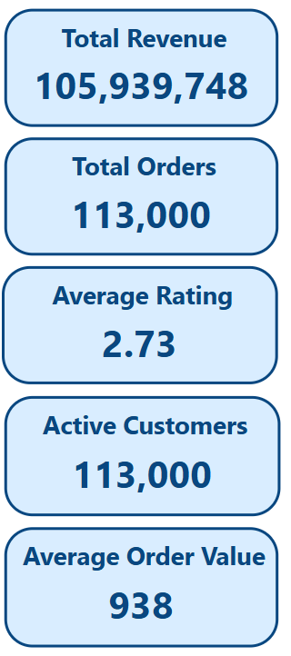
KPI | Significance
Total Revenue | Indicates overall sales performance across all products and time periods
Total Orders | Reflects total transaction volume processed
Active Customers | Shows customer base engaged in recent purchases
Average Rating | Suggests scope for improvement in product quality or delivery experience
Return Rate | Higher-than-ideal returns, often due to product mismatch or quality issues
Average Order Value | Represents typical order size; used to assess pricing and bundling strategies

Slide 7
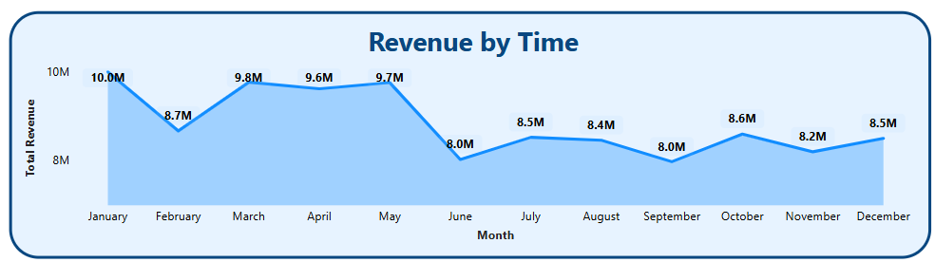
How Has Revenue Changed Over Time?
Revenue increased steadily from March to May
Sharp decline observed in June — the lowest-performing month
October and November showed a recovery in sales
Suggests a seasonal dip or marketing gap during September
Why This Matters:
Tracking revenue month-by-month helps identify seasonal trends, plan campaigns better, and ensure consistent cash flow.

Slide 8
Which Product Categories Drive the Most Revenue?
1. Top Revenue Contributors:
Electronics and Phone and Tablet lead in revenue, followed by Fashion
These categories are consistently driving sales volume and revenue
2. Highest Return Rates:
Health & Beauty and Fashion have the highest return rates
Returns are primarily driven by incorrect or damaged items
3. Revenue vs Return Mismatch:
Health & Beauty generates lower revenue but sees disproportionately high returns
Electronics, despite high revenue, maintains a relatively lower return rate — indicating product satisfaction

Slide 9
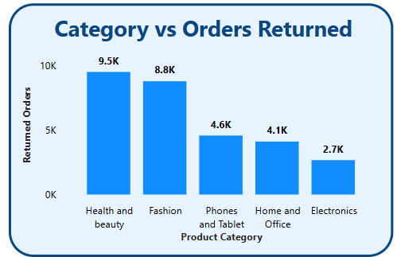
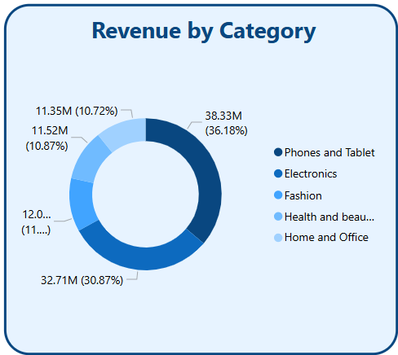
Why This Matters:
Analyzing revenue alongside returns helps identify product categories that may appear profitable but suffer from underlying issues such as quality, size mismatch, or customer dissatisfaction.

Slide 10
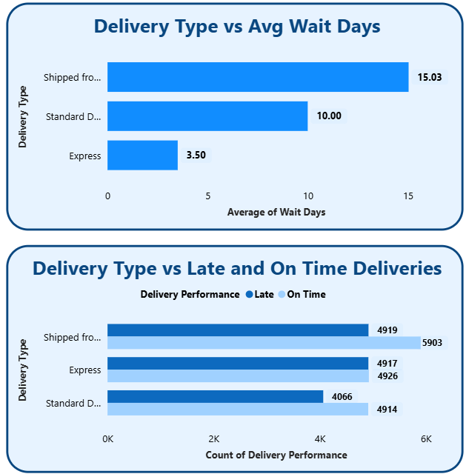
How Do Delivery Types Affect Wait Time and Timeliness?
On average, customers wait 15 days for orders shipped from abroad — the longest among all types.
Standard delivery takes 10 days, while Express keeps wait time low at 3.5 days.
Faster delivery types can significantly enhance customer experience.
Shipped from Abroad
~15.03 days
Standard Delivery
~10 days
Express Delivery
~3.5 days

Slide 11
Shipped from Abroad has the highest number of late deliveries — over 45% of its orders are delayed.
Express performs similar and shows delays in ~50% of deliveries.
Standard Delivery is most balanced, but late deliveries still affect over 40% of its orders.
Improving delivery timelines — especially for cross-border shipments — is crucial to reduce churn.

Slide 12
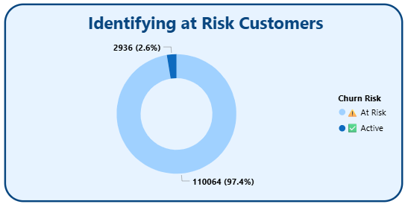
How Many Customers Are at Risk of Churning?
At Risk
110064
(97.4%)
Active
2936
(2.6%)
Out of 113,000 total customers, over 110064 (≈97.4%) have not placed an order in the last 60 days.
These customers are flagged as “At Risk” based on their last order date.
Targeted re-engagement campaigns (emails, discounts, or reminders) may help win them back.

Slide 13
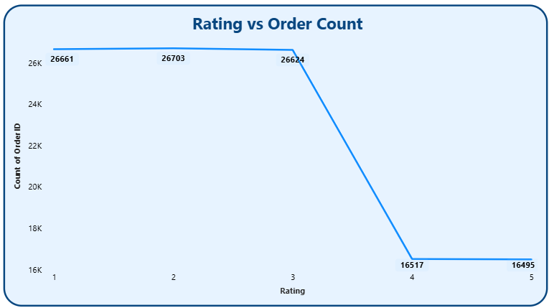
How Are Customers Rating Their Purchases?
Most ratings cluster around 1 to 3, with the average rating being 2.73.
Very few products receive ratings above average, indicating room for improvement in customer experience.
The left-skewed distribution suggests that customers are moderately satisfied but not delighted.
Why This Matters:
Ratings influence repeat purchases and customer trust. Low ratings can harm both product reputation and long-term loyalty.

Slide 14
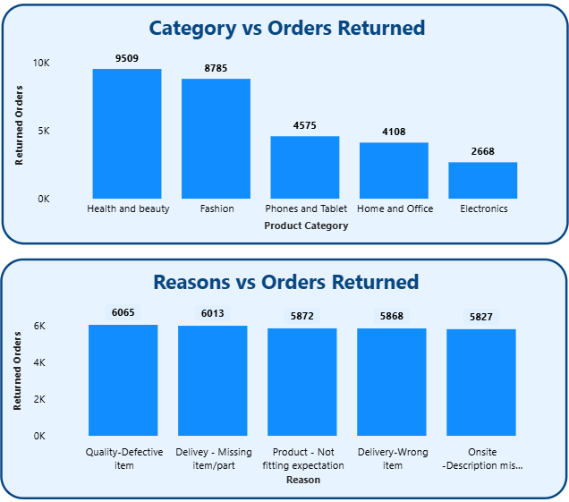
Why Are Customers Returning Products?
Most common return reason is “Quality-Defective Item” — 6065 returns.
Followed by “Delivery-Missing item/part” and “Product-Not fitting expectation” as major contributors.
Returns due to quality issues and miscellaneous reasons are fewer but still notable.
Why This Matters:
High returns not only hurt profitability but also reduce customer satisfaction. Addressing top reasons like fulfillment errors and packaging issues can reduce return rate.
Actionable Takeaways:
Improve picking & packing accuracy.
Introduce better quality checks before dispatch.

Slide 15
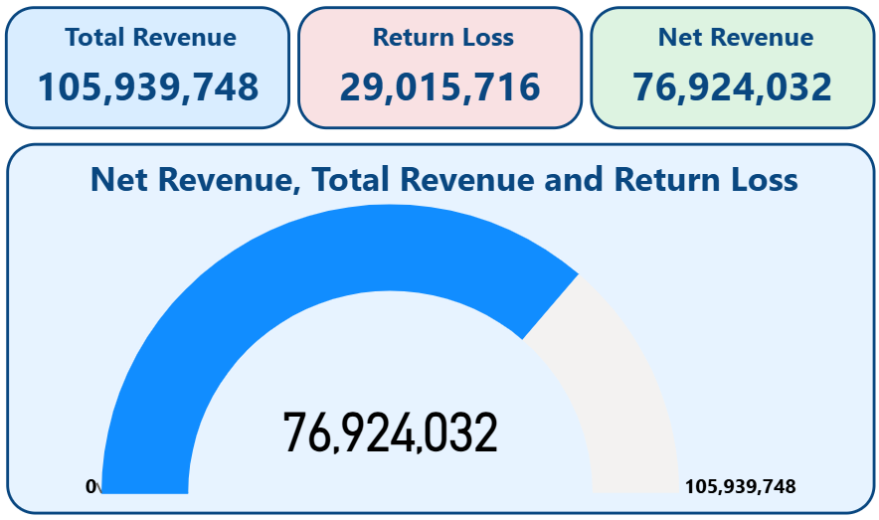
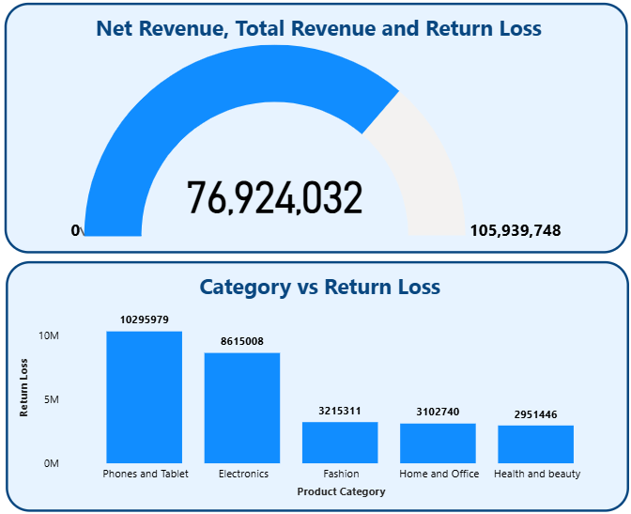
How Do Returns Impact Net Revenue?
Returns account for nearly 29,015,716 in lost revenue — about 27.38% of the total.
Net revenue gives a more realistic picture of business performance.
Phone and Tablet dispite being the lowest return rate category contributes most in return loss.
Actionable Insight:
Conduct deeper audits of top return reasons in high-return categories.
Improve fulfillment accuracy and packaging quality to reduce return volume.
Explore offering store credits or partial refunds as alternatives to full returns.

Slide 16
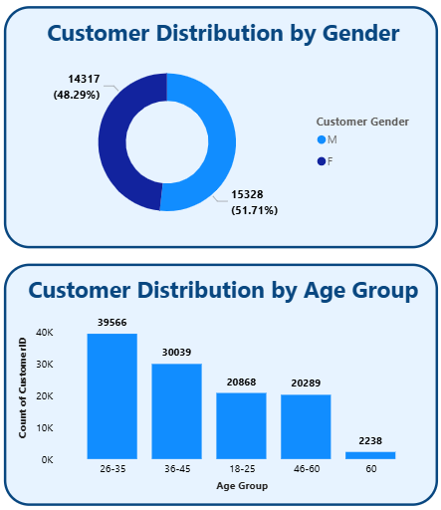
Who Are Our Customers?
Male and female customers are nearly evenly distributed, with a slight skew toward males.
The age group 26–35 forms the largest customer segment, followed by 36–45.
Customers above 60 contribute lower order volume and revenue.
Why This Matters:
Understanding who our customers are helps tailor product offerings, marketing communication, and delivery expectations based on age and gender patterns.
Actionable Insight:
Target 25–44 age group for promotional campaigns — they form the bulk of our customer base.
Introduce youth-oriented marketing for under-25 customers to expand reach.

Slide 17
Overall Findings and Suggested Actions Based on Data
Business Summary:
Total Revenue: ₹105,939,748 from 113,000 orders.
Total Returns: ₹29,015,203, representing 27.38% of total revenue.
Active Customers: Only 2.6% placed an order in the last 60 days; 97.4% are inactive or at risk.
Average Customer Rating: 2.73 — most ratings lie between 2.5 and 3.0.
Longest Average Wait Time: 15.03 days for “Shipped from Abroad”.
Categories with Highest Return Rates: Health & Beauty and Fashion.

Slide 18
Strategic Recommendations
Reduce Return-Related Revenue Loss:
Focus quality checks on categories with highest return loss (e.g., Health & Beauty).
Address top return reasons like “Wrong item delivered” and “Damaged product”.
Improve Delivery Timeliness:
Optimize timelines for “Shipped from Abroad” and “Standard Delivery”.
Use delivery type–specific SLAs and tracking to reduce delays.
Recover At-Risk Customers:
Design re-engagement strategies (personalized recommendations, limited-time offers).
Track customer inactivity and automate follow-up within 45–60 days.
Increase Product Ratings:
Improve customer experience around packaging, delivery, and support.
Encourage feedback from recent buyers to increase review volume.
Focused Marketing:
Age group 25–44 is the largest segment; tailor offers and ads toward this demographic.
Evaluate underperforming customer segments and explore expansion opportunities.

Slide 19
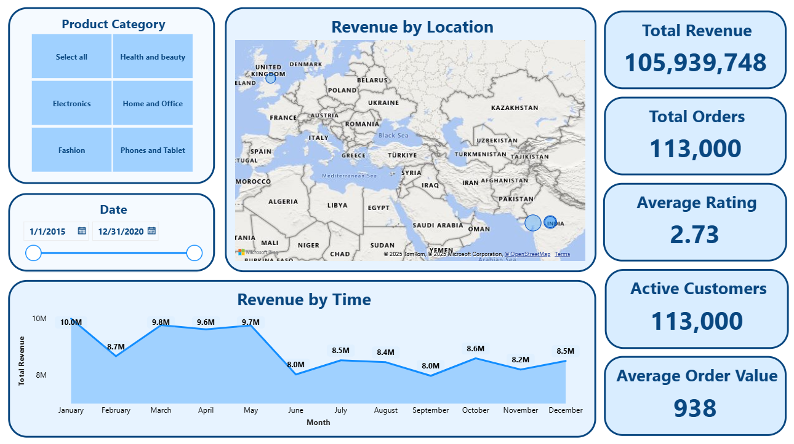
Power BI Dashboard - Main Tab Part 1

Slide 20
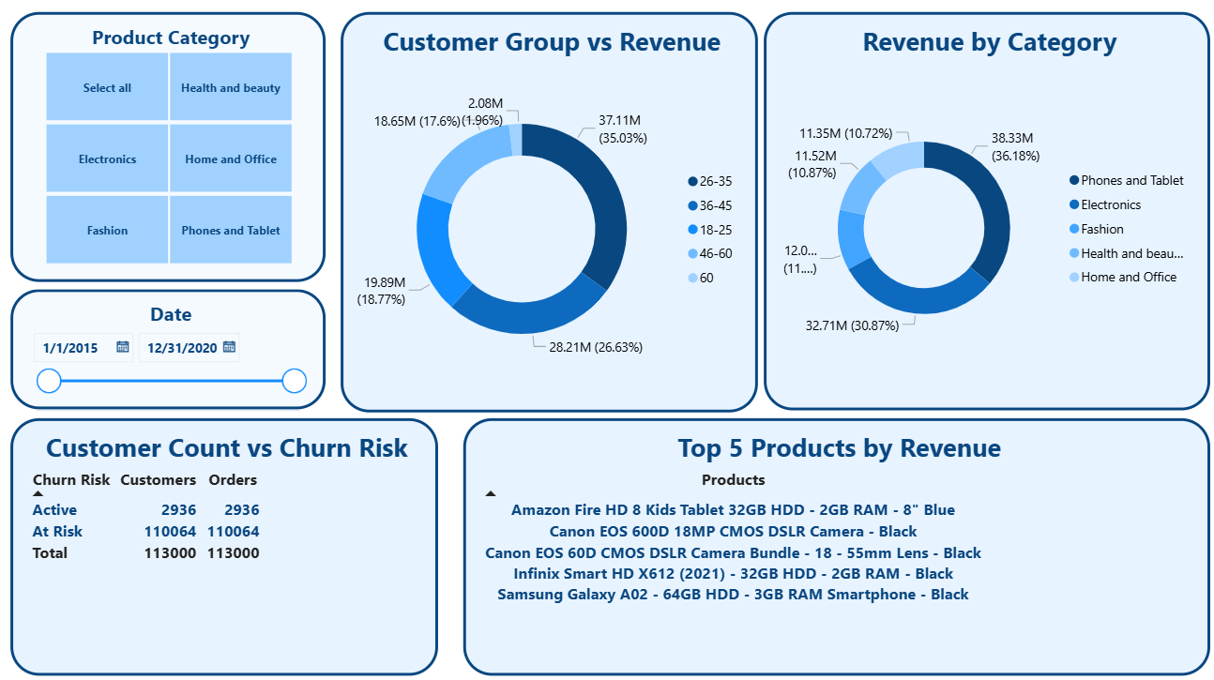
Power BI Dashboard - Main Tab Part 2

Slide 21
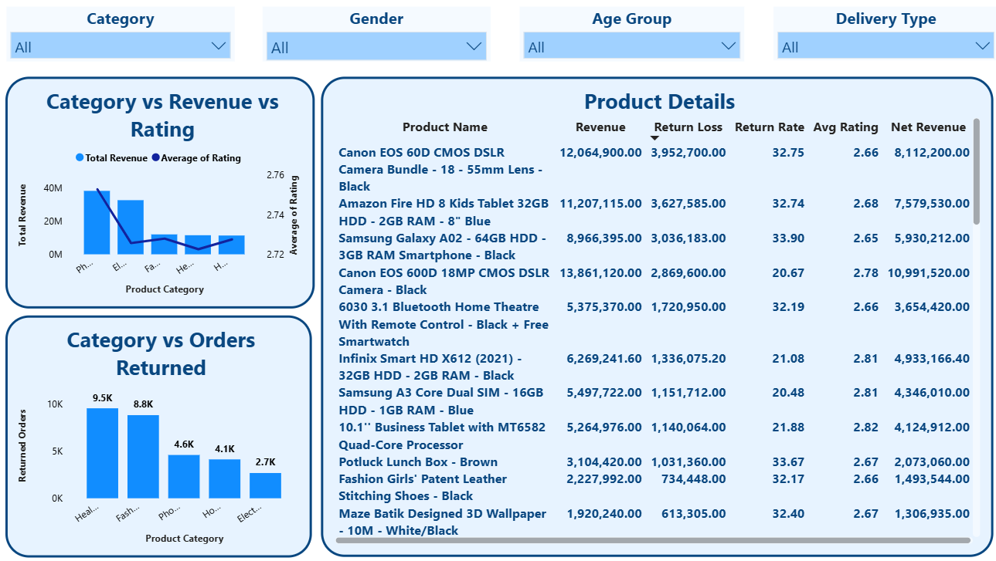
Power BI Dashboard - Product Tab Part 1

Slide 22
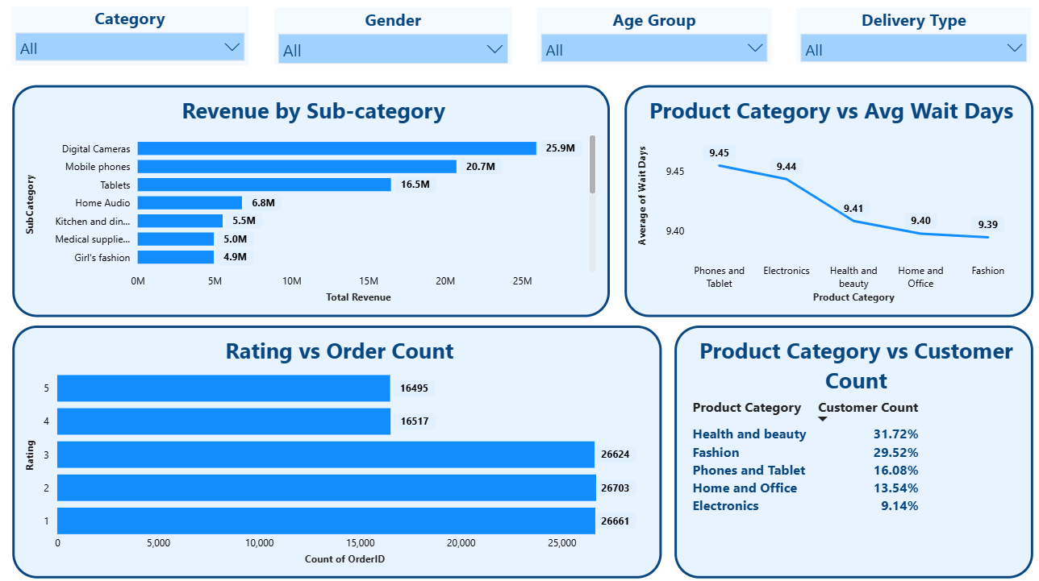
Power BI Dashboard - Product Tab Part 2

Slide 23
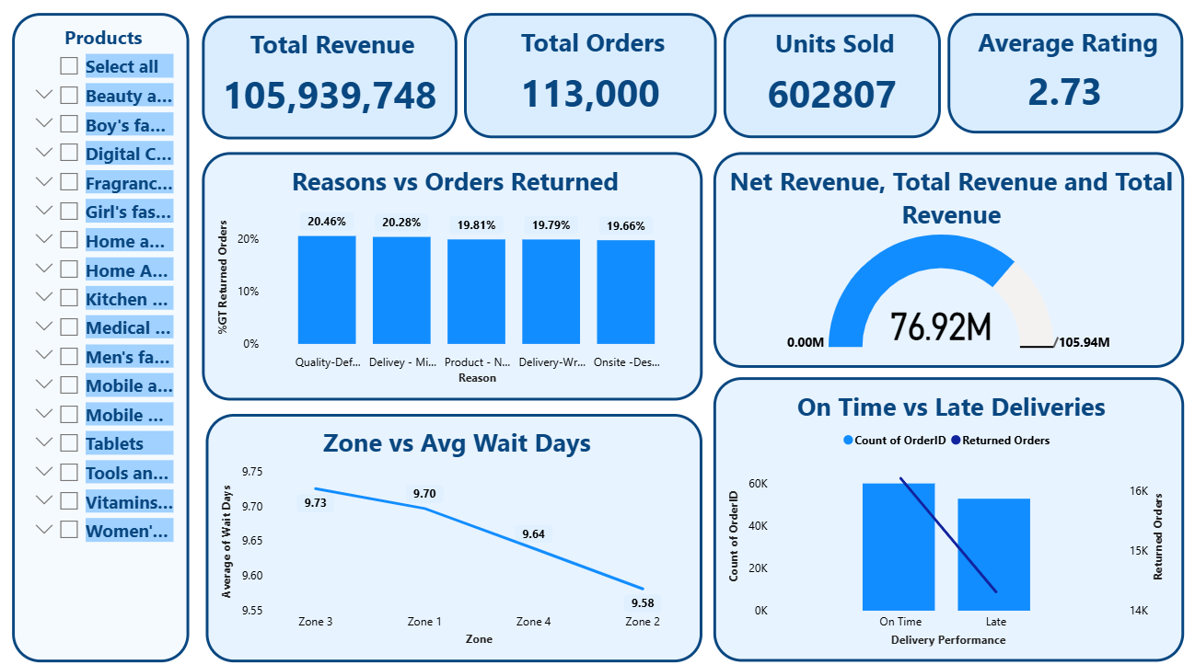
Power BI Dashboard - Individual Product Tab Part 1

Slide 24
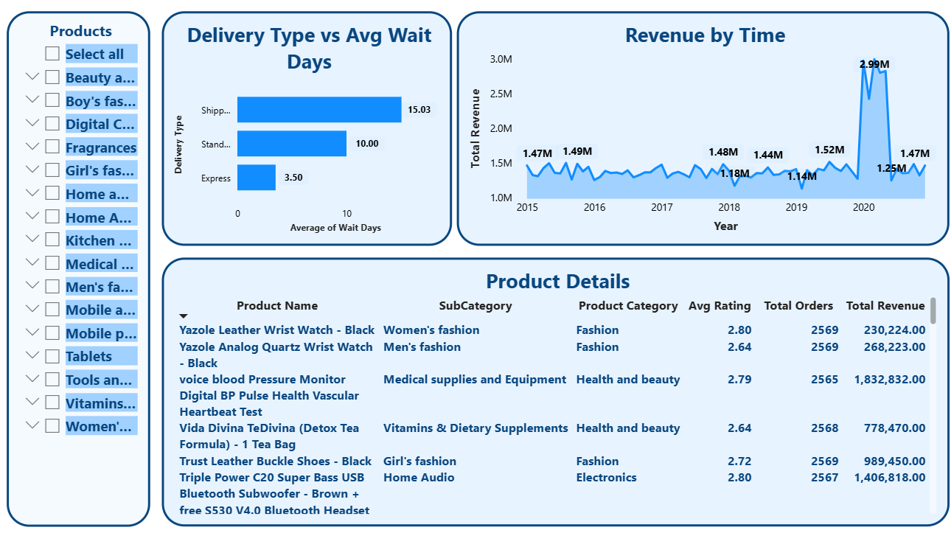
Power BI Dashboard - Individual Product Tab Part 2

Slide 25
Thank You

