Slide 1
Naveen Kumar
Big data/AI Enthusiast

Slide 2
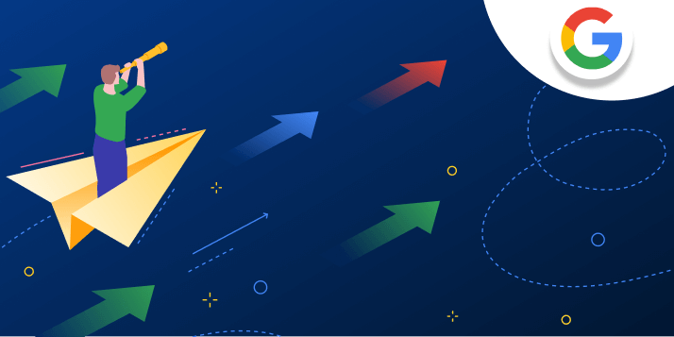
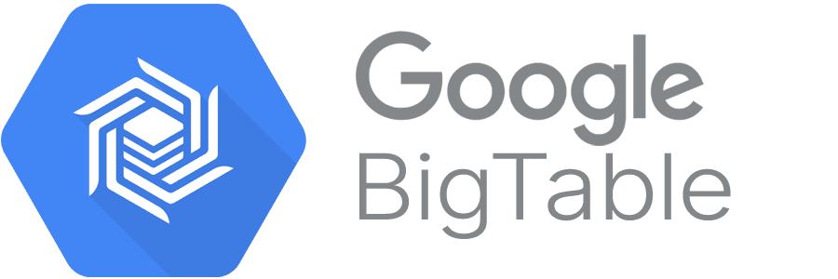
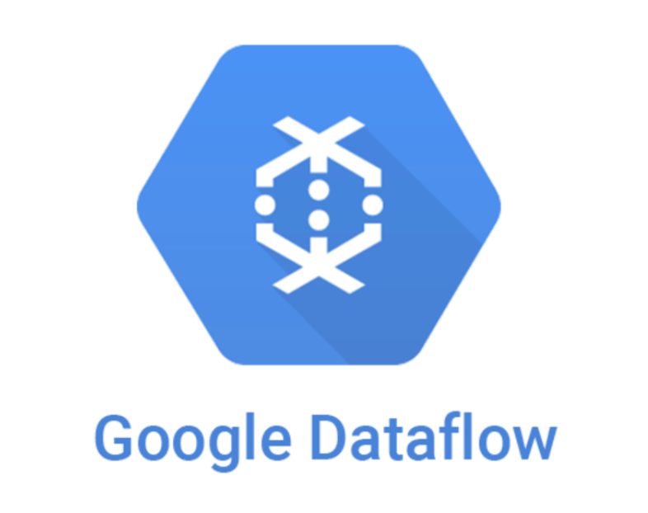
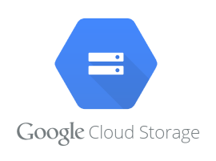
GCP Migration
Migrated HBase tables to GCP Bigtable using Dataflow pipelines
Moved on-prem Elasticsearch indexes to Elastic Cloud
Migrated Spark Jobs to Dataproc
Datalake application

Slide 3
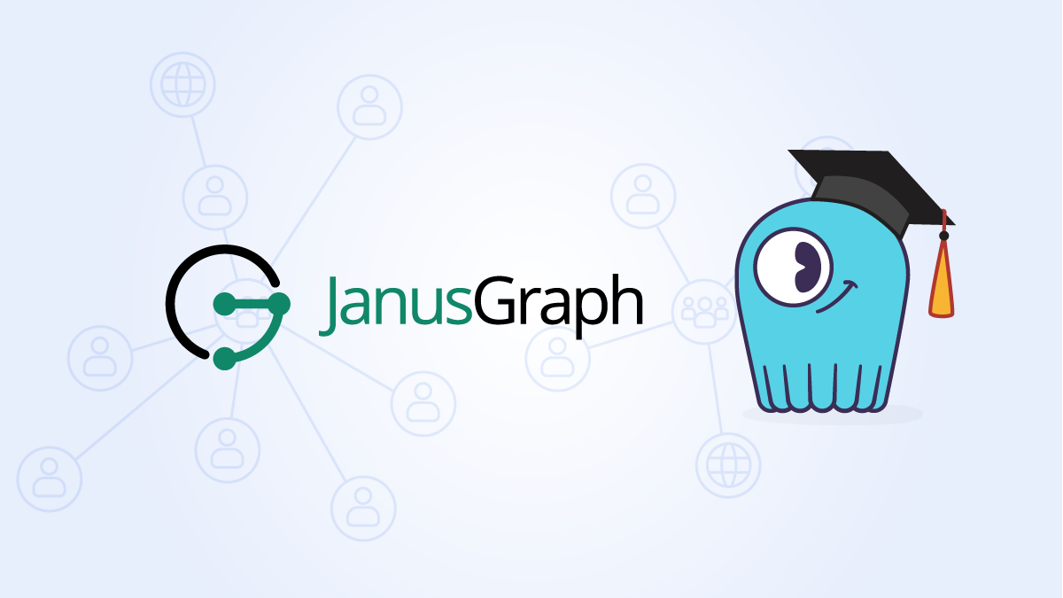
Janus Graph Compatibility
Unblocked Janusgraph compatibility issue. Officially its not supported for Bigtable.
Connected with janusgraph maintainer and understood its open source and not tested for Bigtable and its open for community support
Debugged the entire code base and found the root cause and created a abstract library to override the compatibly issue and made it compatible

Slide 4
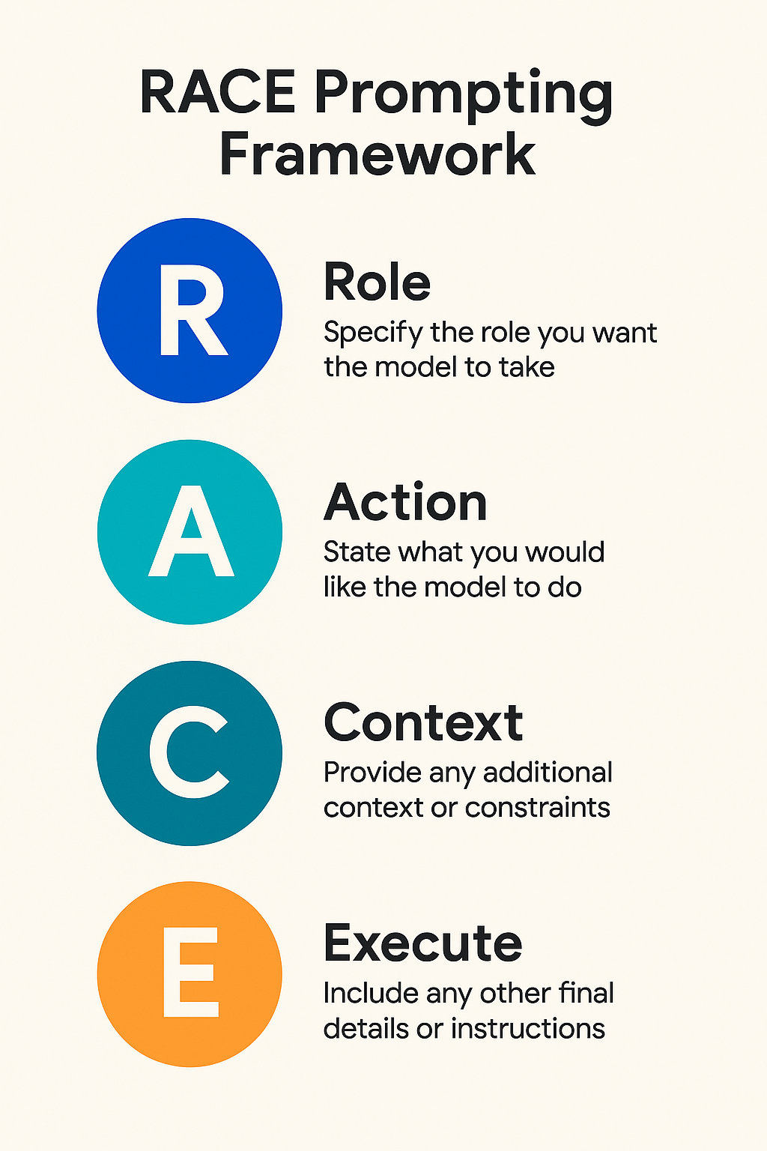
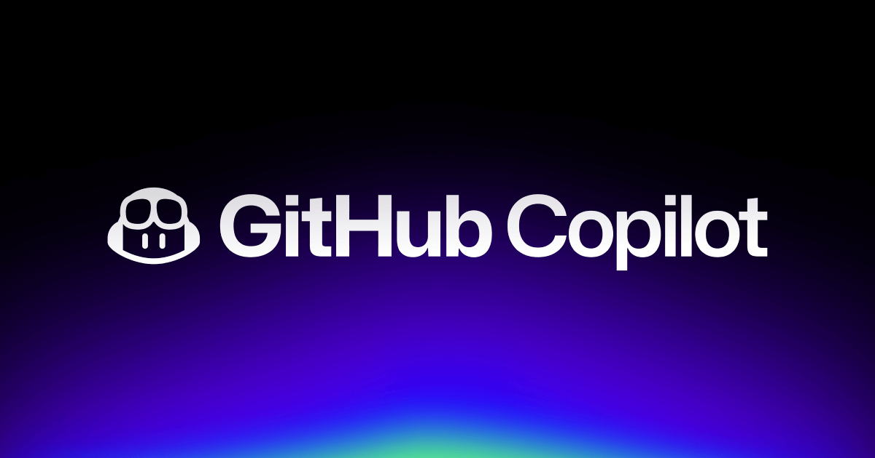
Copilot
Led team-wide adoption of GitHub Copilot and coached junior engineers on applying generative AI and VS Code’s agentic mode to accelerate development and migration. This further reduced migration time by 25%.
Worked with Prompting RACE framework. Role -> Action -> Context -> Execute.
Created prompting techniques with all these sequence of data which yield more precise data for migrating the application in ease.

Slide 5
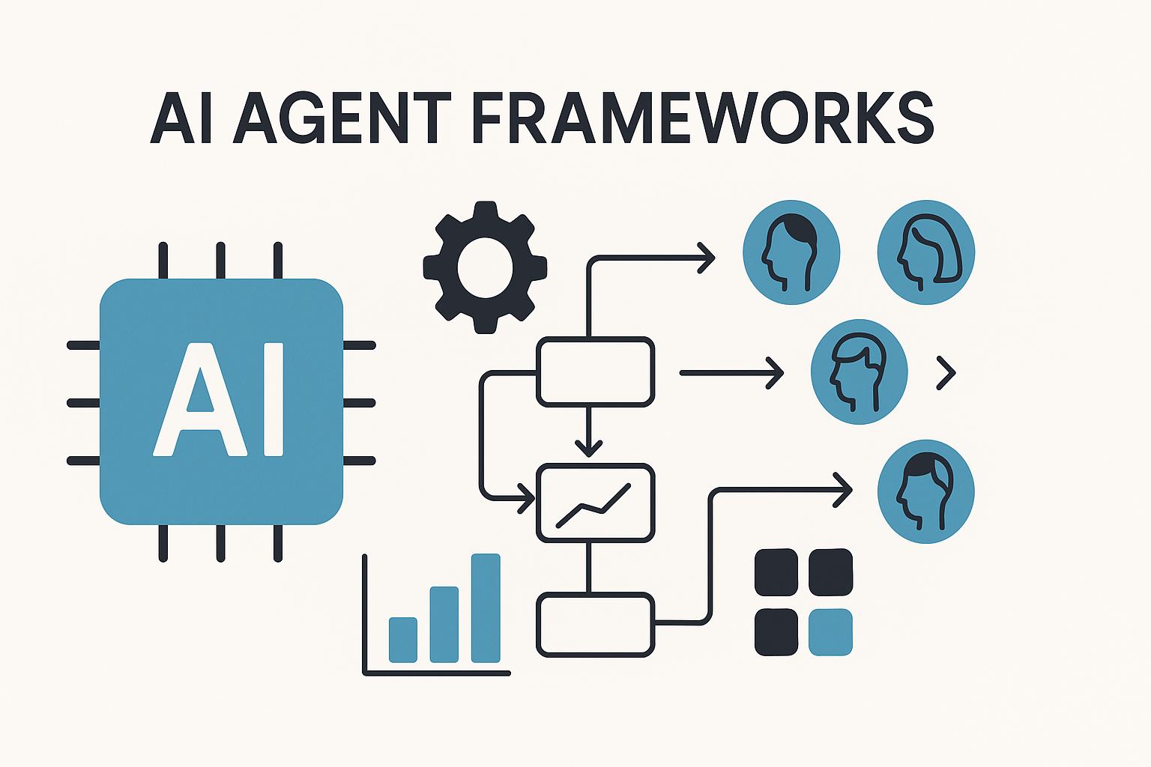
AI Agent
Built an autonomous documentation & onboarding agent that ingests a codebase or spec, auto-updates docs via Git diffs, and answers internal questions—using BeautifulSoup for parsing, LangChain core with RecursiveURLLoader, TextSplitter chunking, Google Embedding-001 vectors, and Gemini Flash 1.5 for QA, with persistent memory and explainability
Actively engaged in RAG workshops and seminars to deepen expertise in chunking methods (fixed-size, sentence based, and semantic) and retrieval strategies, including dense vector search, sparse search, hybrid approaches, and the use of diverse embedding models.

Slide 6
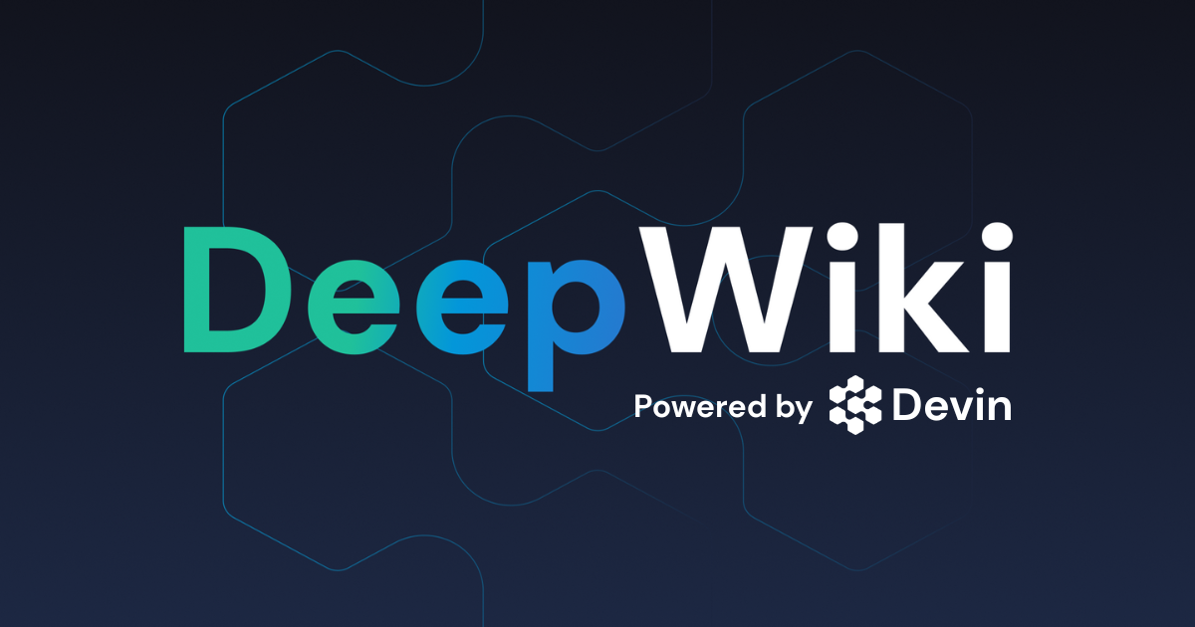
Deep Wiki
An AI-powered documentation platform that transforms static GitHub repository documentation into interactive, conversational experiences. DeepWiki provides up-to-date, queryable documentation for repositories worldwide, enabling developers to conduct deep research and get instant answers about codebases through natural language interactions.

Slide 7
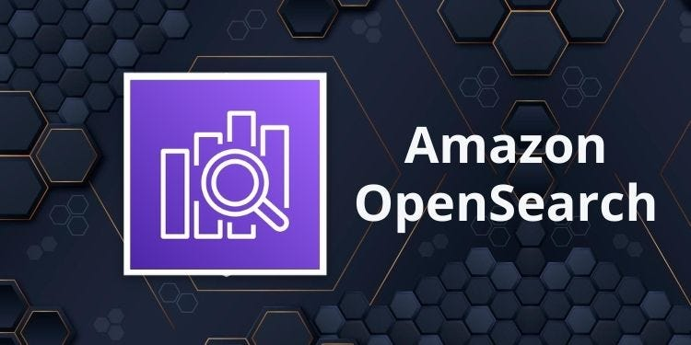

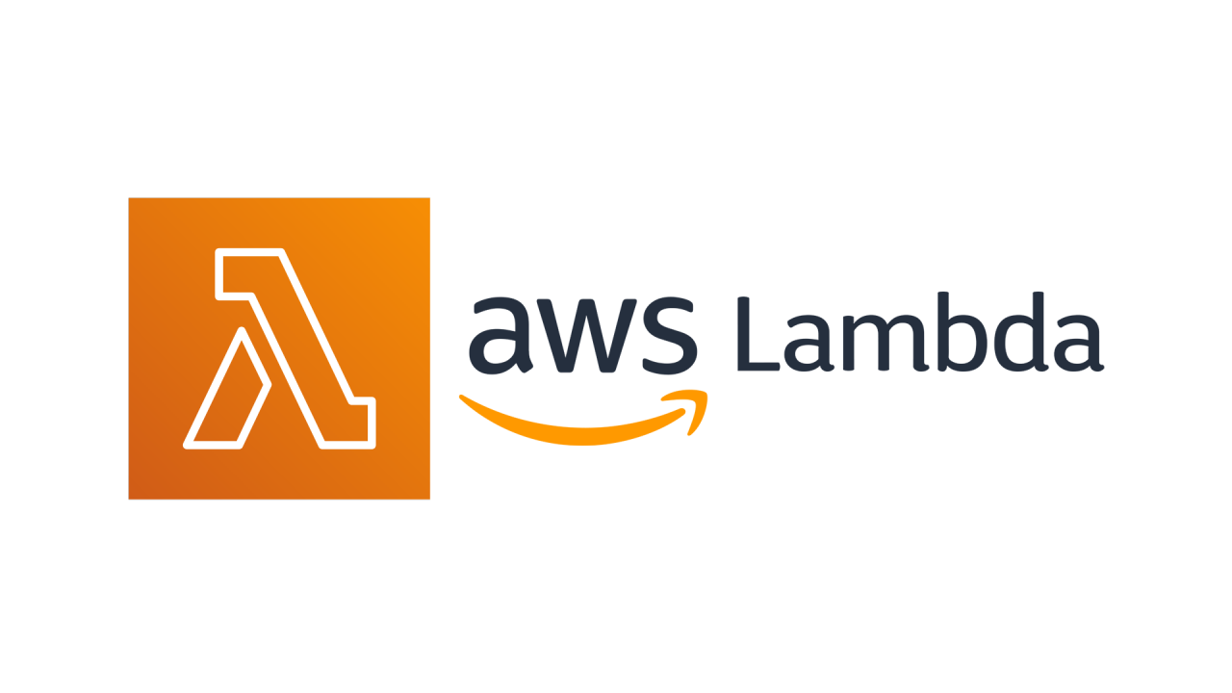


AWS
Jarvis AI (Multi-Tier Cloud Architecture)
Project Overview: Designed and implemented a scalable RAG (Retrieval Augmented Generation) system that periodically scrapes Wiki content, vectorizes it using AWS Open search, and enables intelligent querying through Large Language Models. Core Functionality:
Data Ingestion Pipeline: Automated Wiki scraping with periodic updates and content processing
Vector Database: Wiki content pushed to SQS and Data chucking & embedding (Lamda) vectorized and stored in AWS OpenSearch for semantic search
LLM Integration: Bedrock LLM API with embedding services enabling natural language queries against vectorized Wiki data
Real-time Query Processing: Chat service interface allowing users to ask questions and receive contextually relevant answers from Wikipedia knowledge base

Slide 8
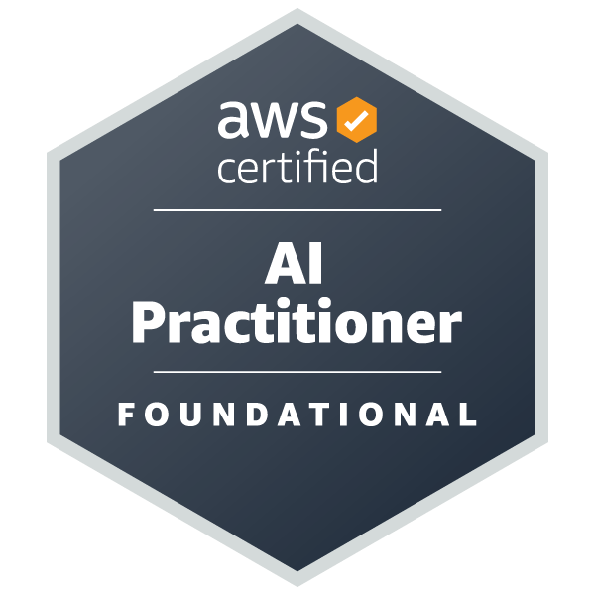

Certifications
AWS Certified AI Practitioner GCP Professional Cloud Architect (Udemy) AWS Certified ML Engineer Associate (In Progress)

