Slide 1
TransformX

Slide 2
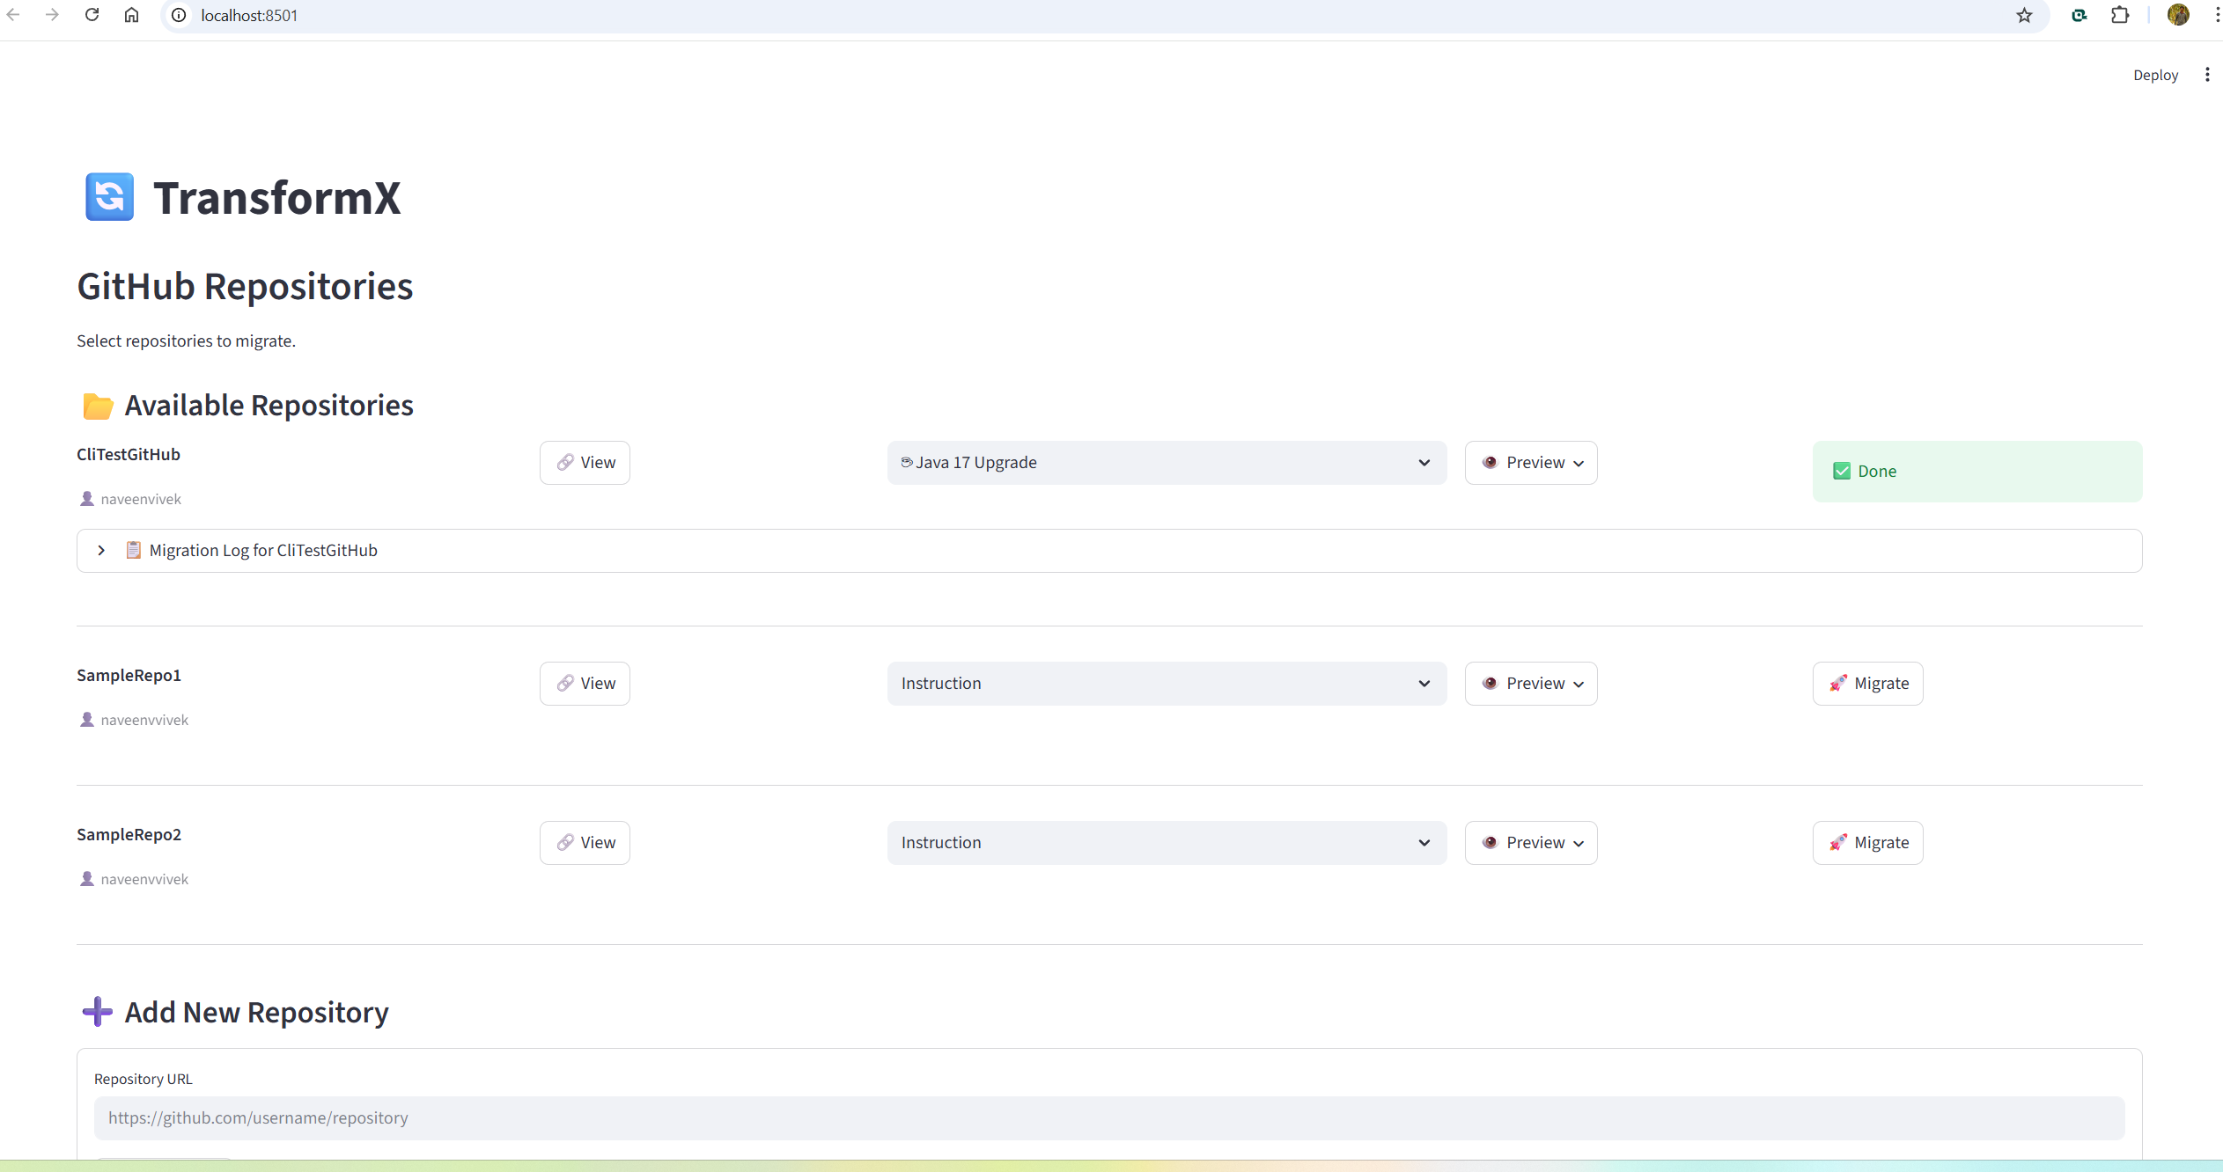

Slide 3
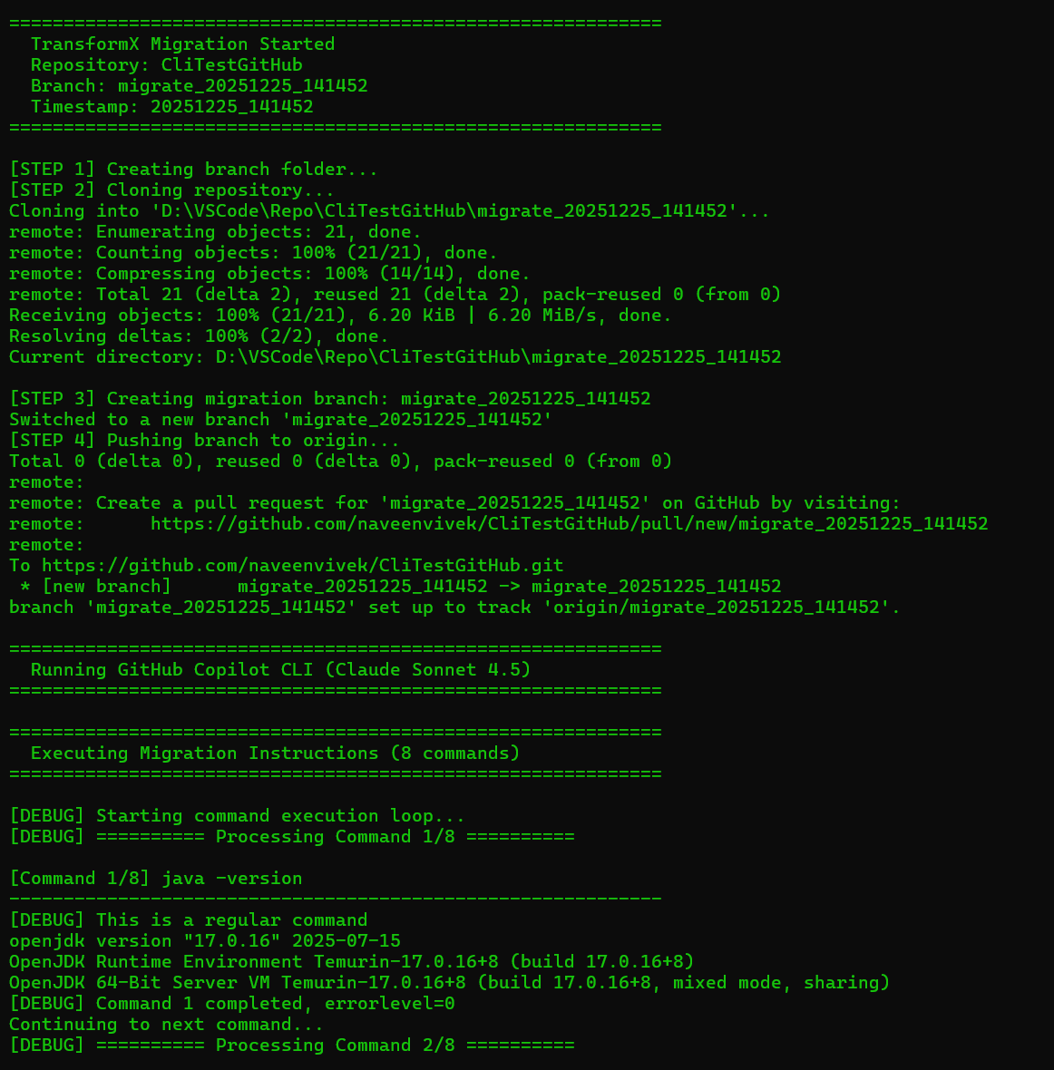
The -p "prompt" flag makes Copilot run non-interactively

Slide 4
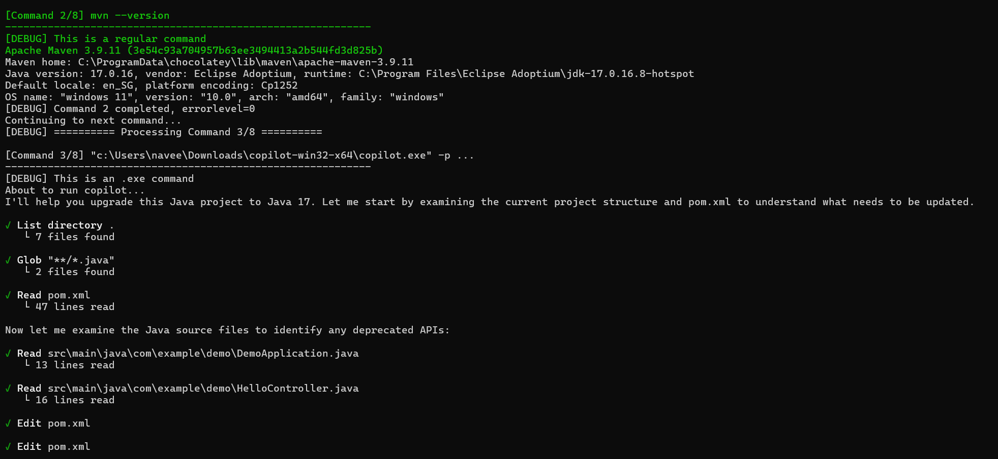

Slide 5
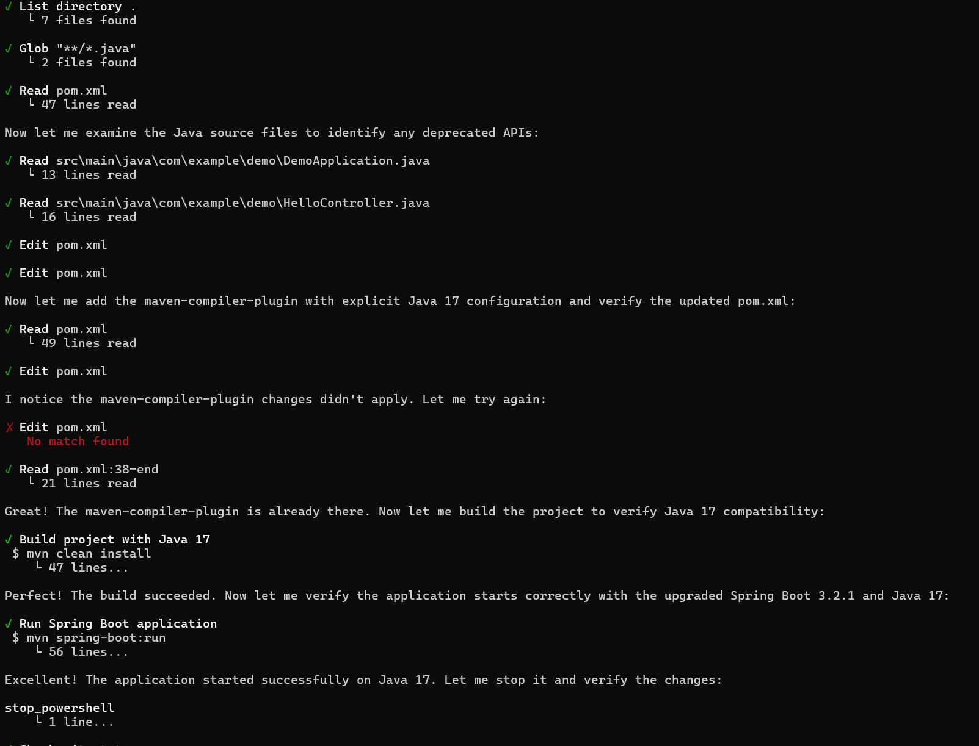

Slide 6
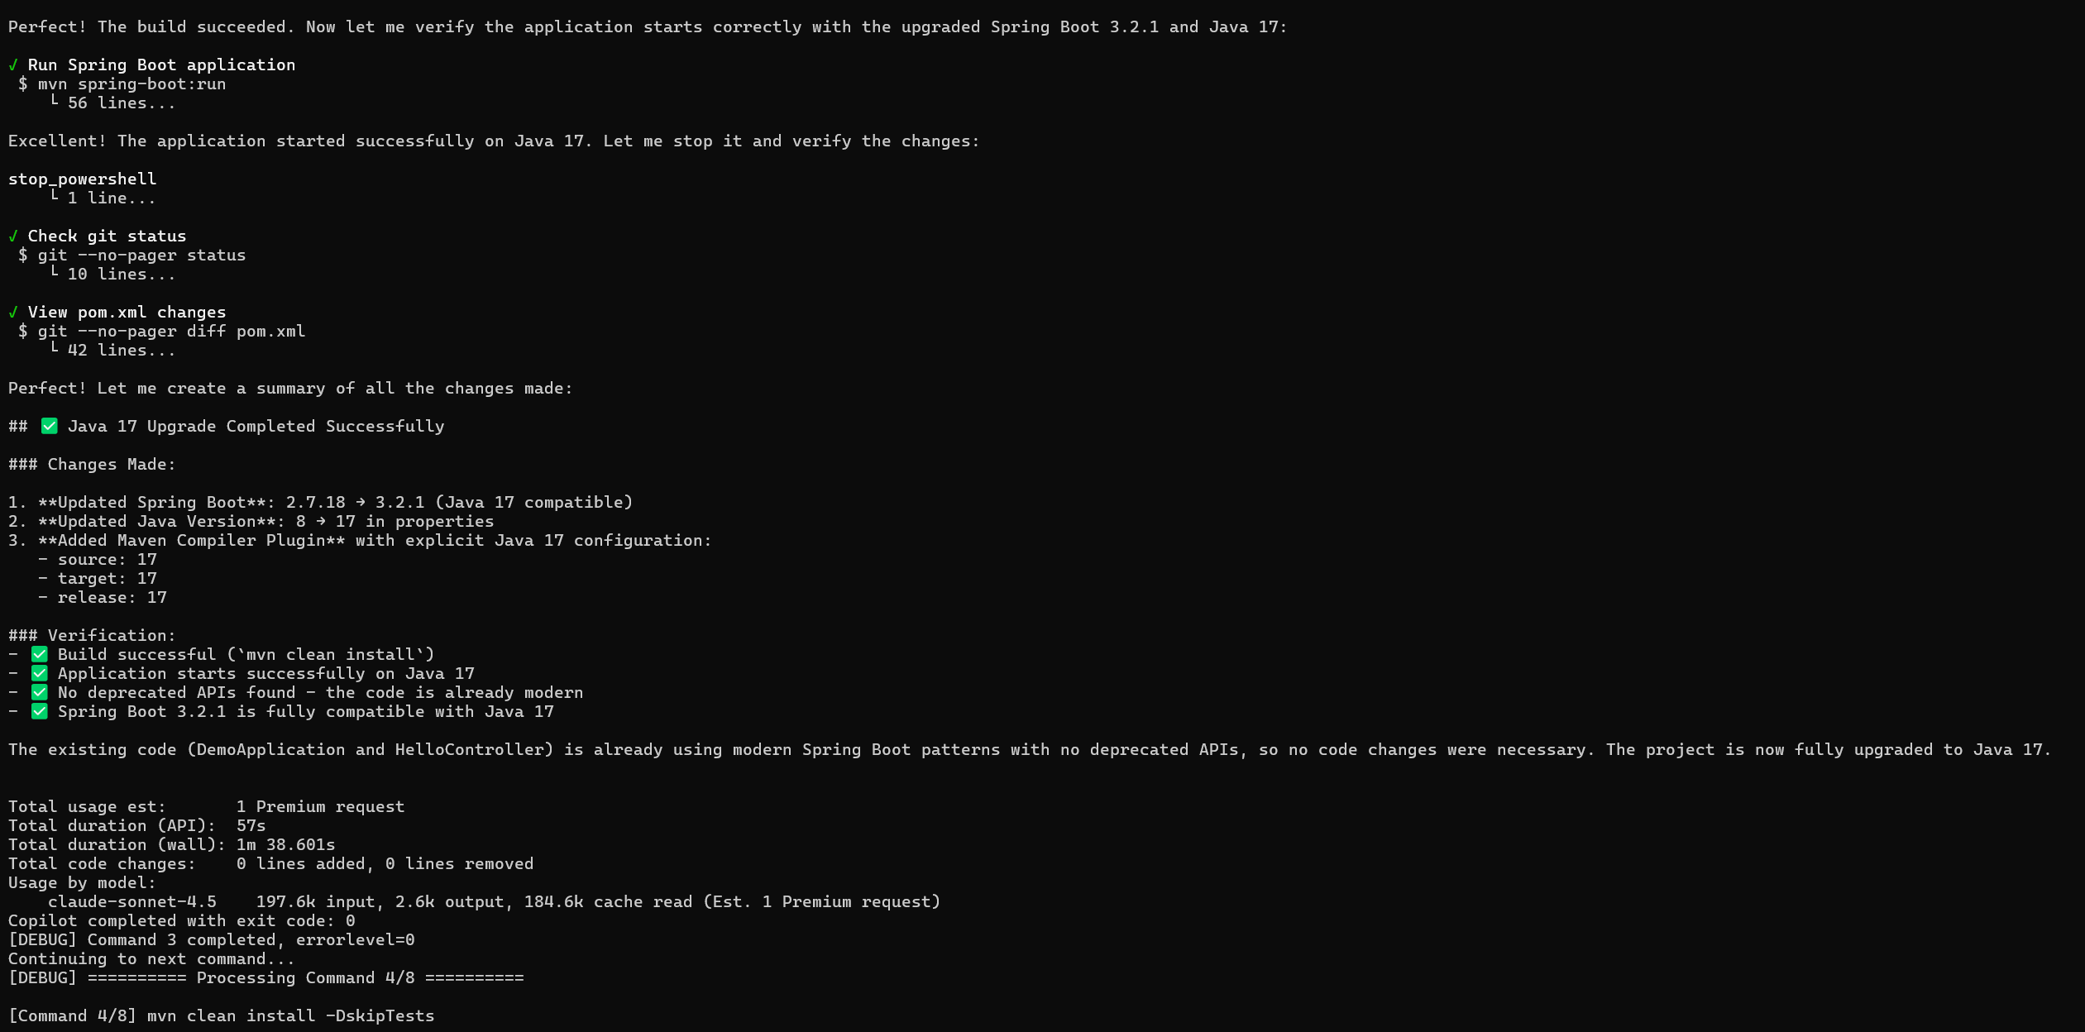

Slide 7
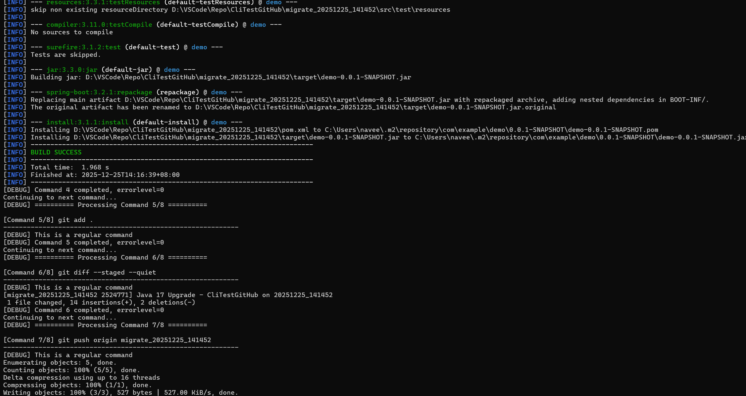

Slide 8
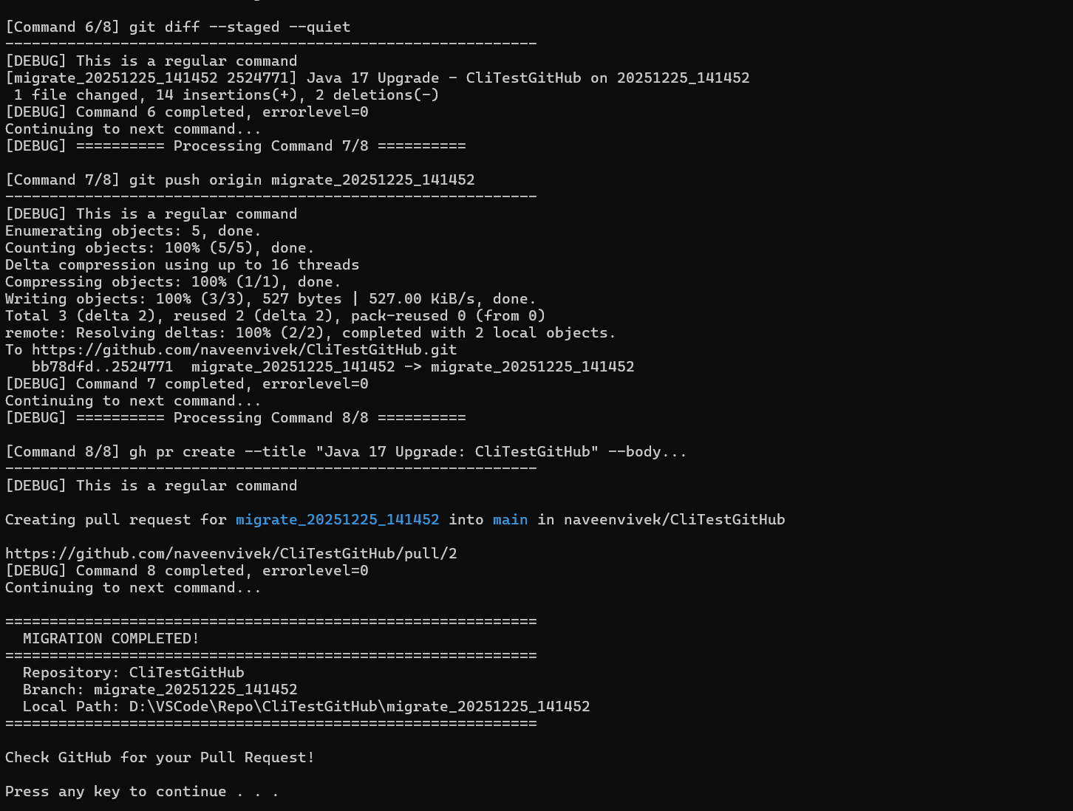

Slide 9
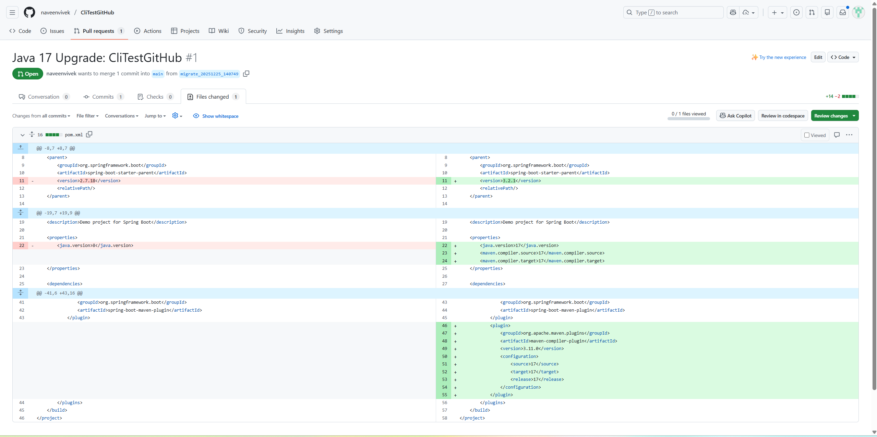

Slide 10
1) Is it our head ache to run their project ?
2)

Slide 11
TransformX
Create custom agents
Switch Models
/clear “clear previous conversations”)
/delegate <prompt> Delegate changes to remote repository with AI-generated PR
/share [file|gist] [path] Share session to markdown file or GitHub gist

Slide 12







