Slide 1

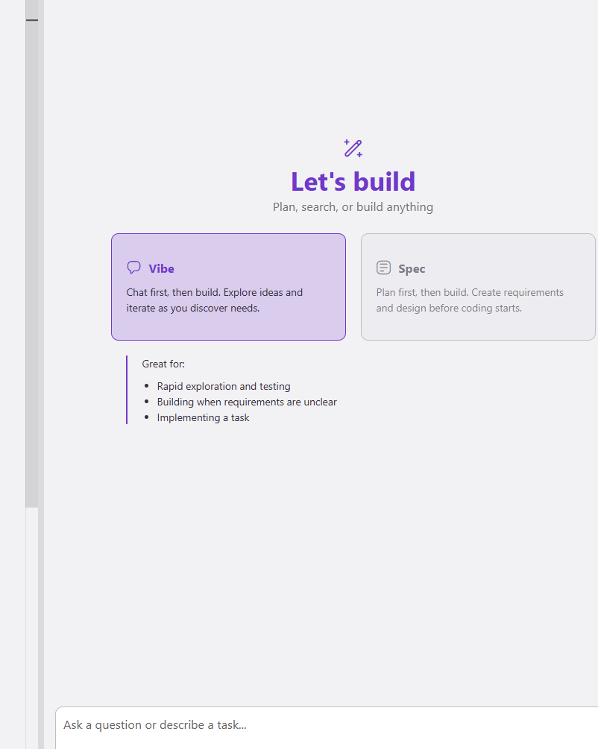
KIRO

Slide 2
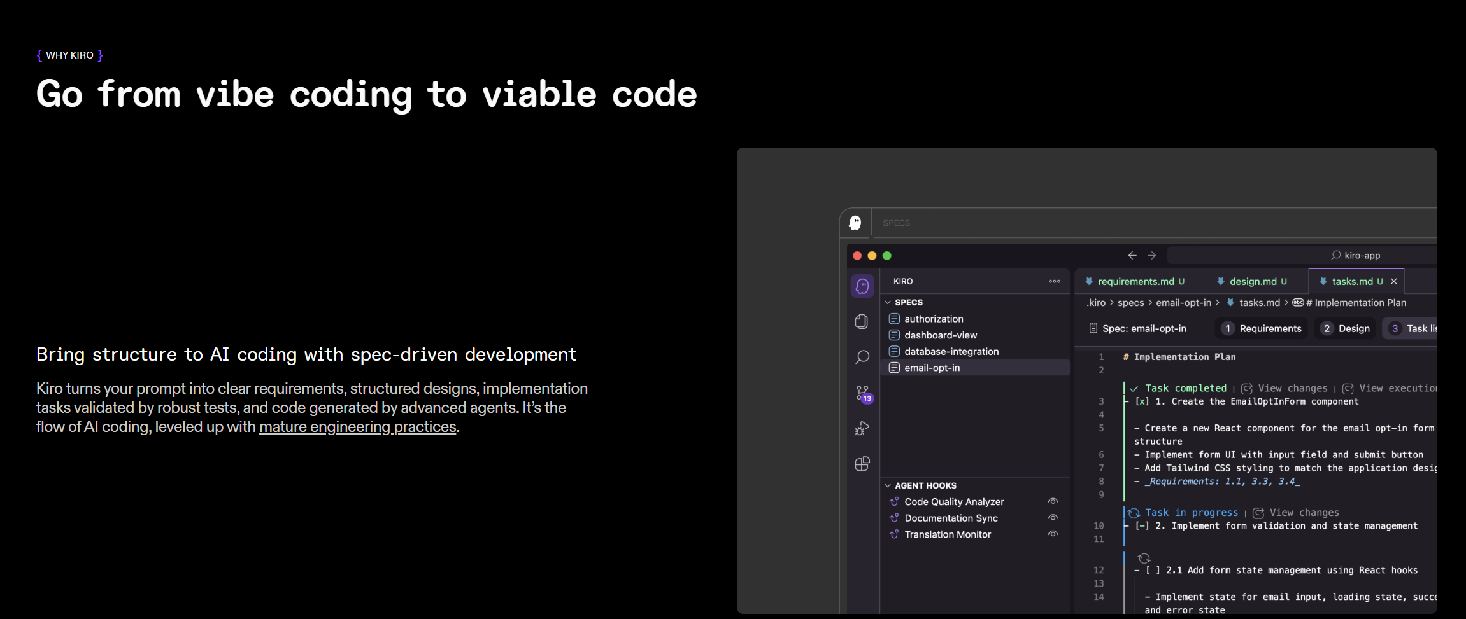
Go from vibe coding to viable code

Slide 3
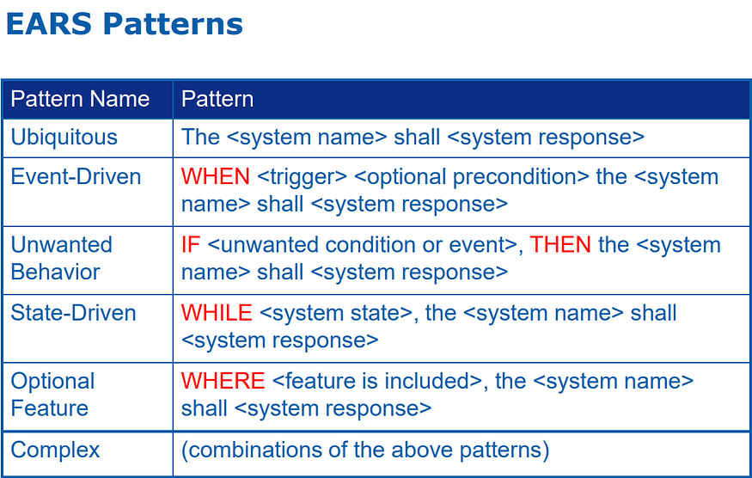
EARS: The Easy Approach to Requirements Syntax

Slide 4
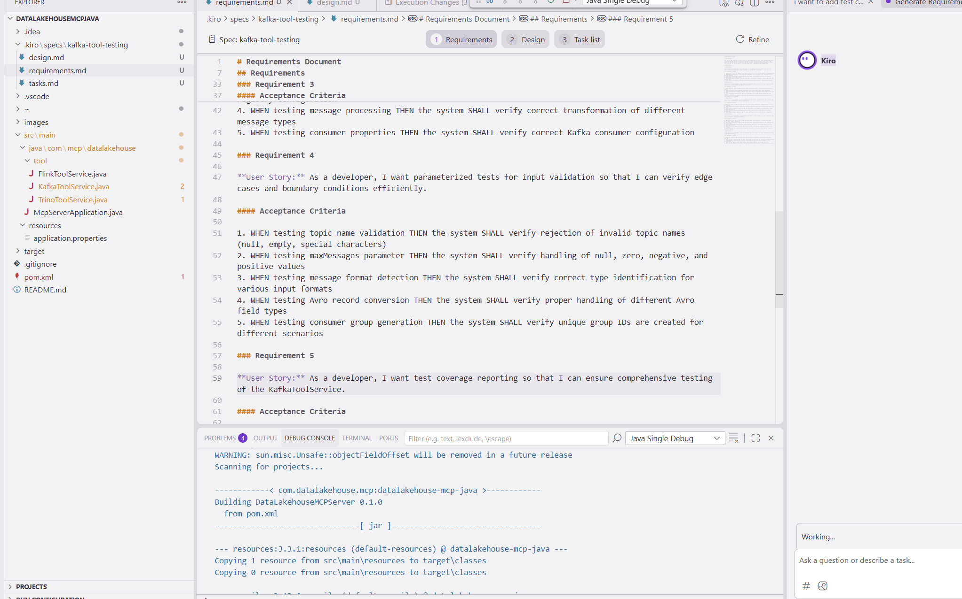
requirements.md - Captures user stories and acceptance criteria in structured EARS notation

Slide 5
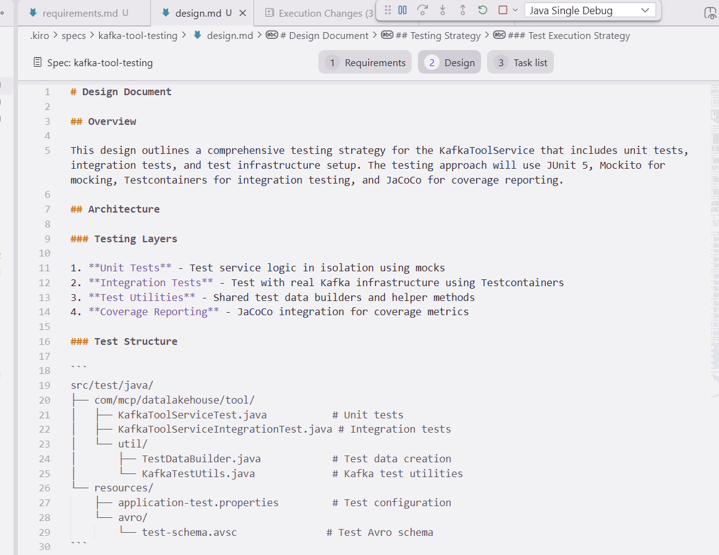
design.md - Documents technical architecture, sequence diagrams, and implementation considerations

Slide 6
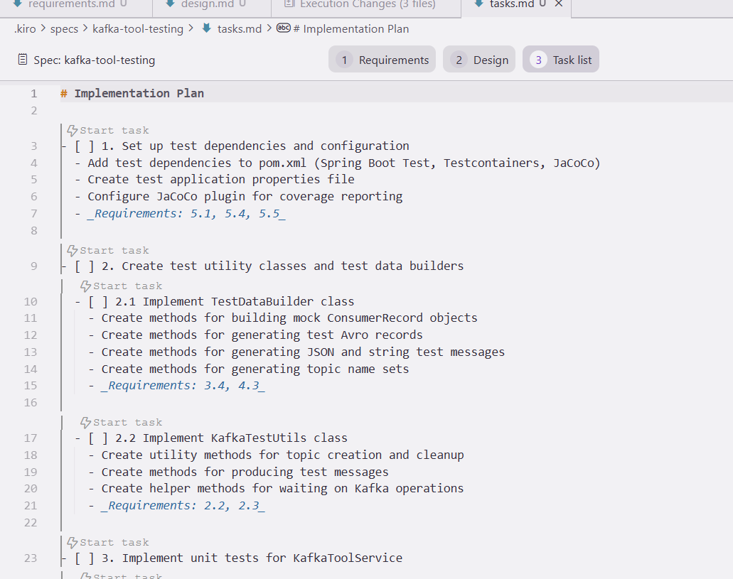
tasks.md - Provides a detailed implementation plan with discrete, trackable tasks
Plan is well-mapped to the requirements, making it traceable and verifiable.
Example : Task 1 will only be considered done when you’ve satisfied all three requirements:
5.1 → Test dependencies/config must exist
5.4 → Documentation for test execution must exist
5.5 → Coverage gate must be wired into CI/CD

Slide 7
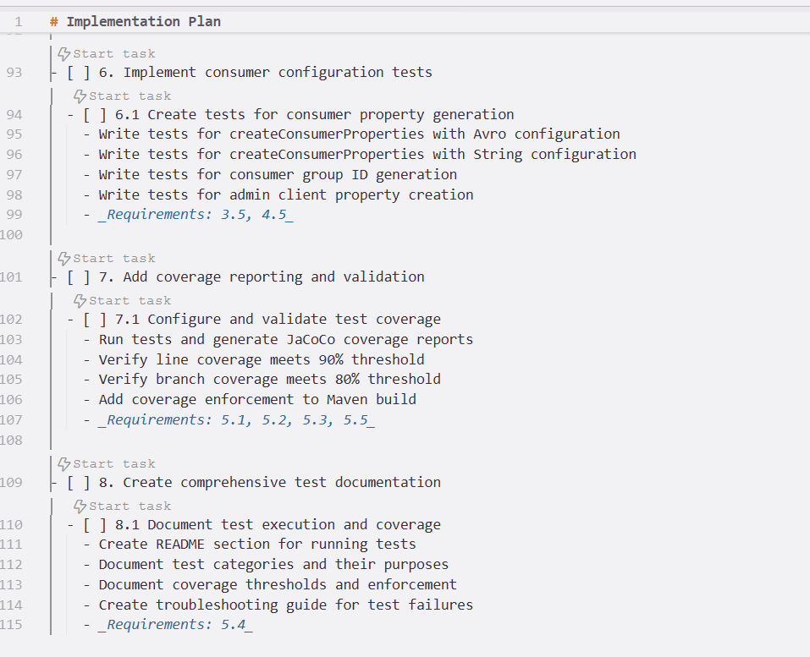

Slide 8
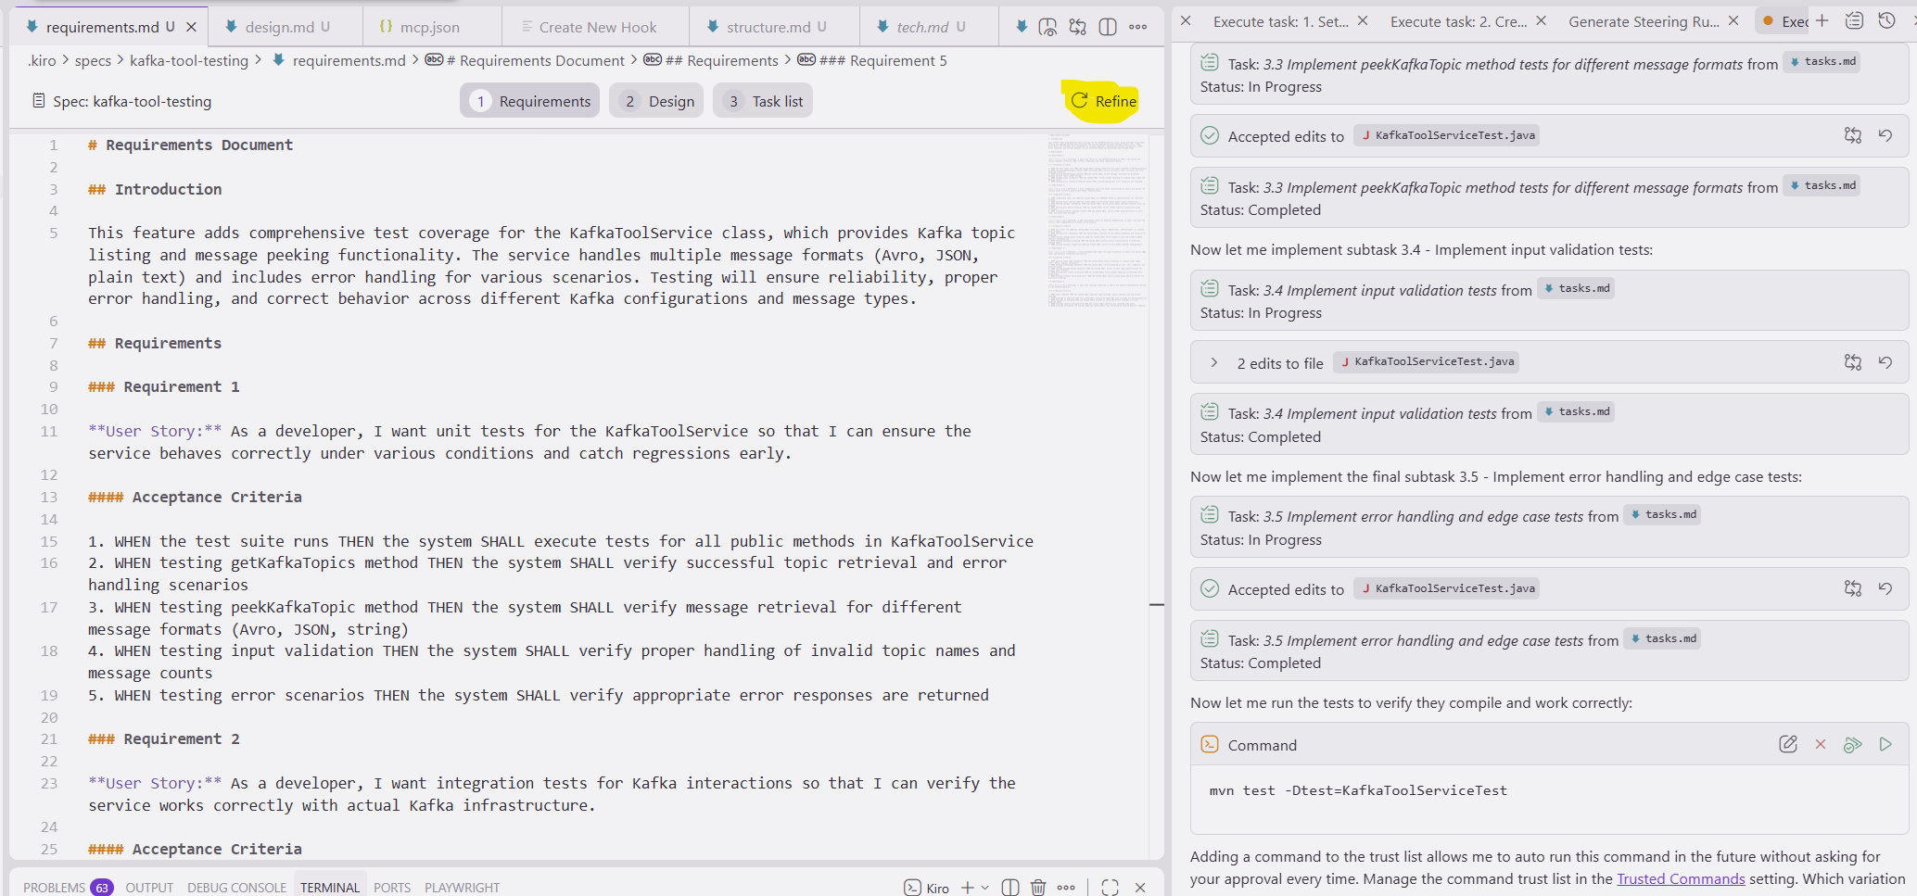
Refine : If any step is incorrect or needs refinement

Slide 9
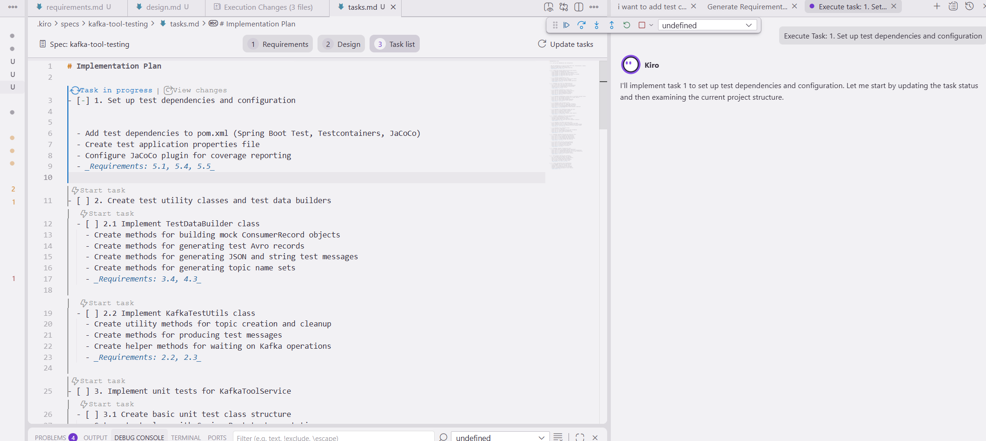
Task in progress

Slide 10
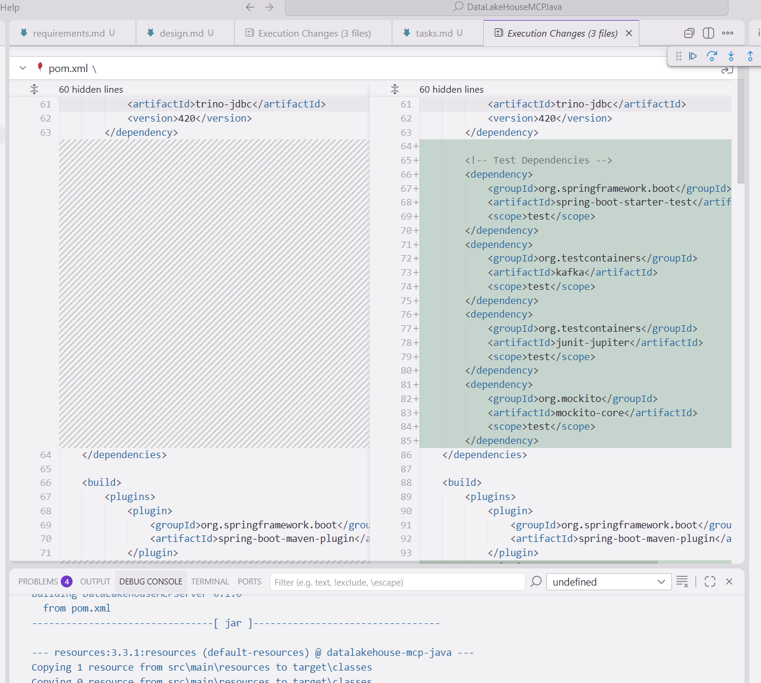
Compare and Diff the changes

Slide 11


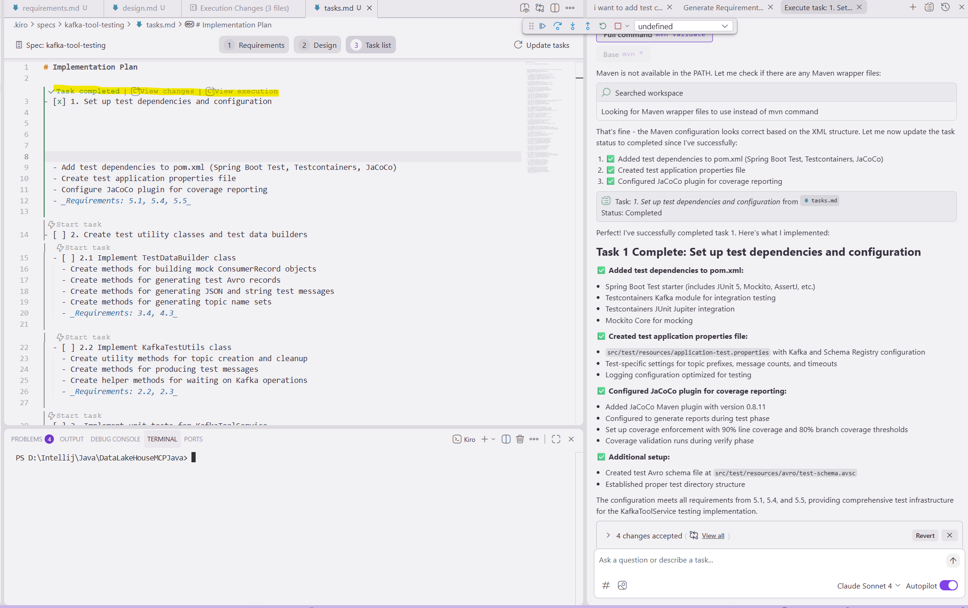
Task completed | View changes | View execution

Slide 12
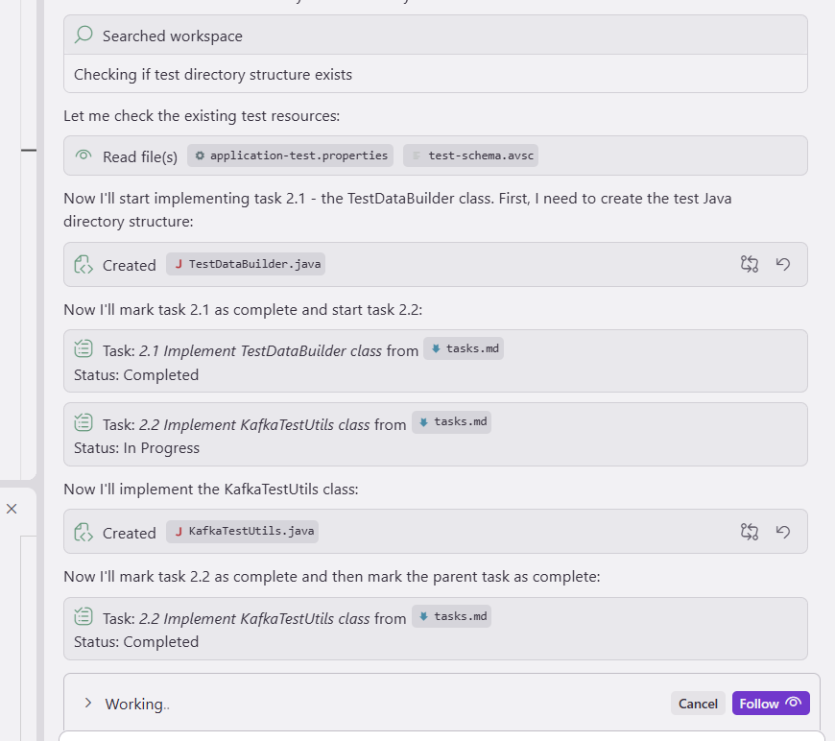

Slide 13
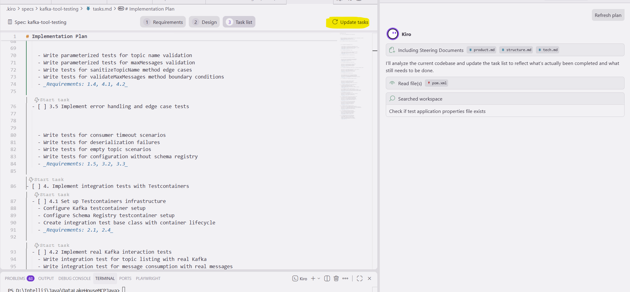
Update tasks : Analyze the current codebase and update the task list to reflect what's actually been completed and what still needs to be done.

Slide 14
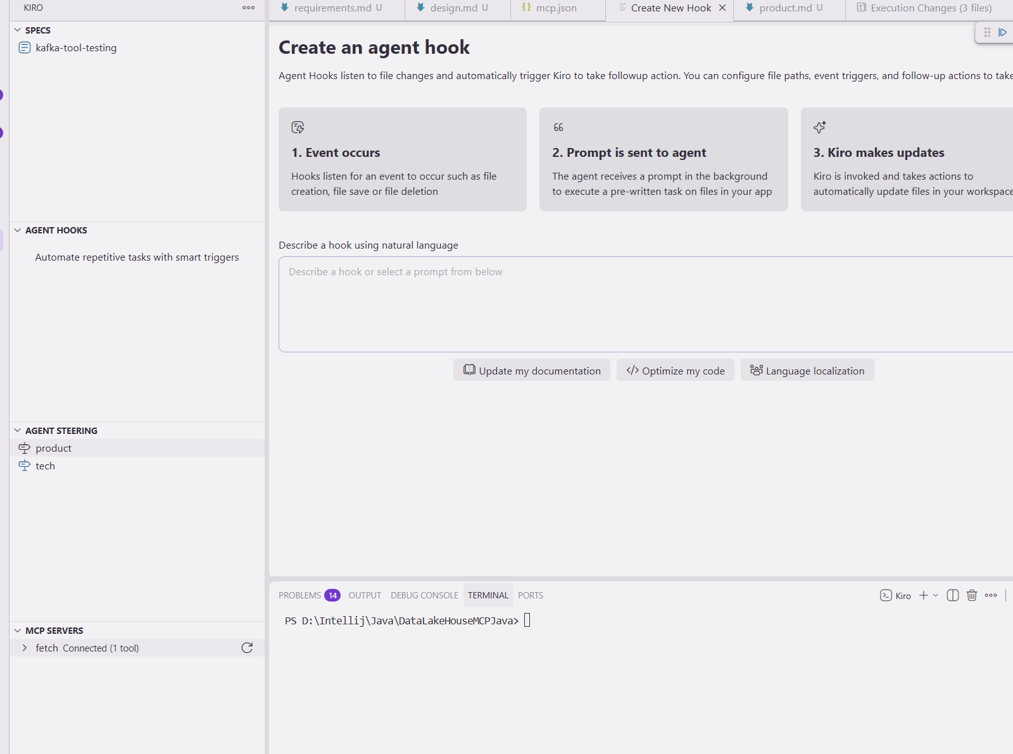
Specs | Agent Hooks | Agent Steering | MCP Servers
Specs :
i) Can add more specs and commit
Agent Hooks:
i) Can run in background

Slide 15
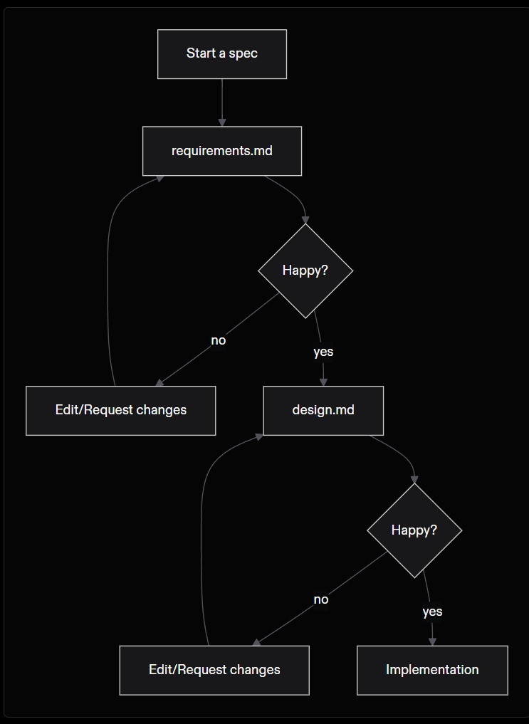

Slide 16
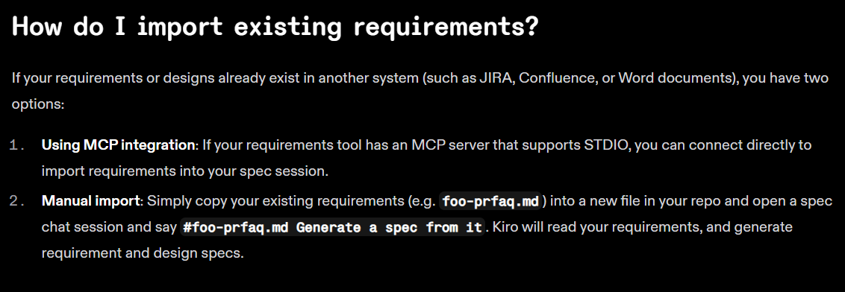

Slide 17
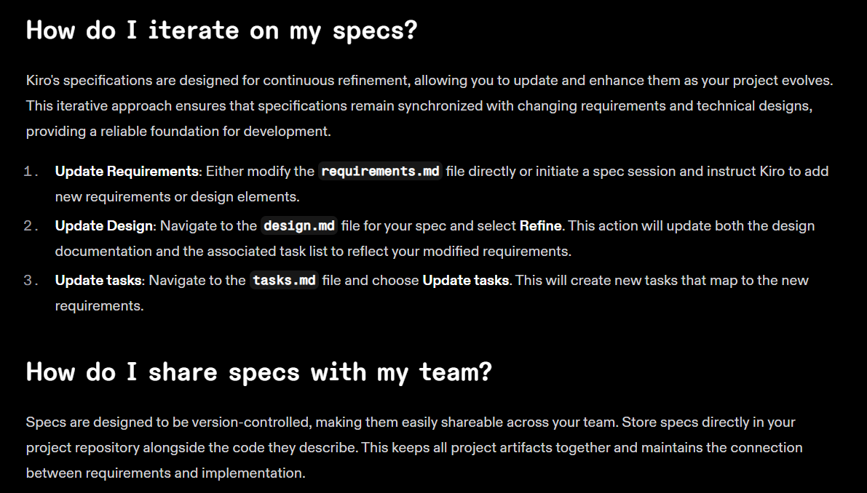

Slide 18
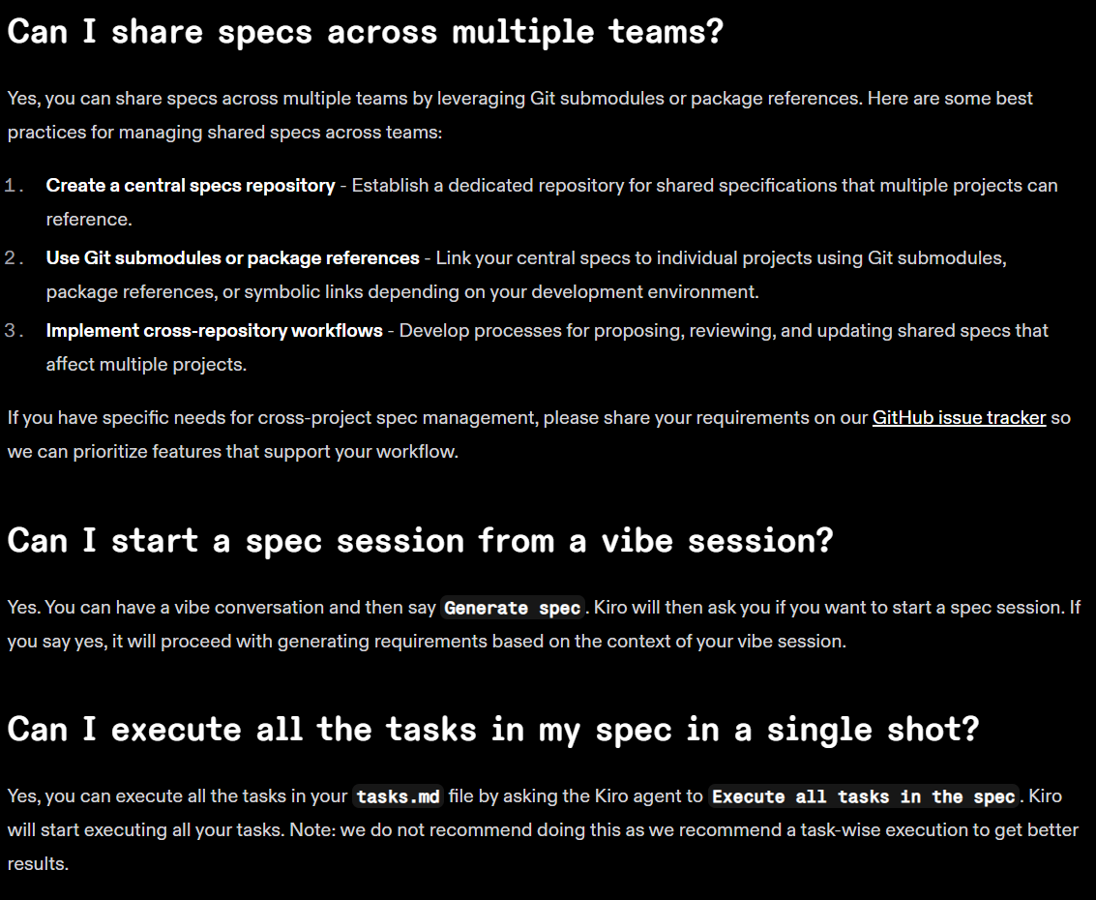

Slide 19
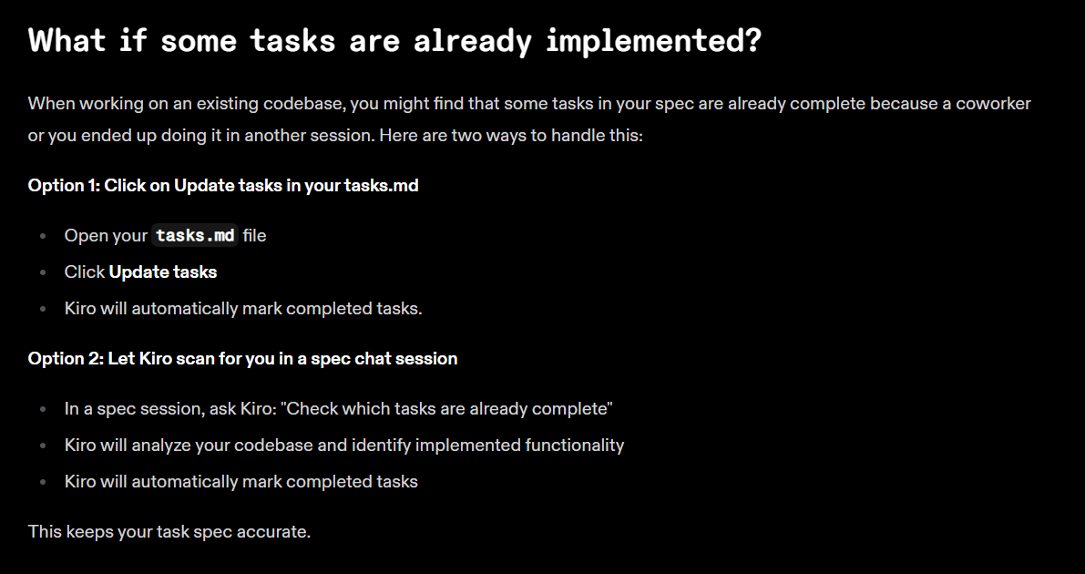

Slide 20
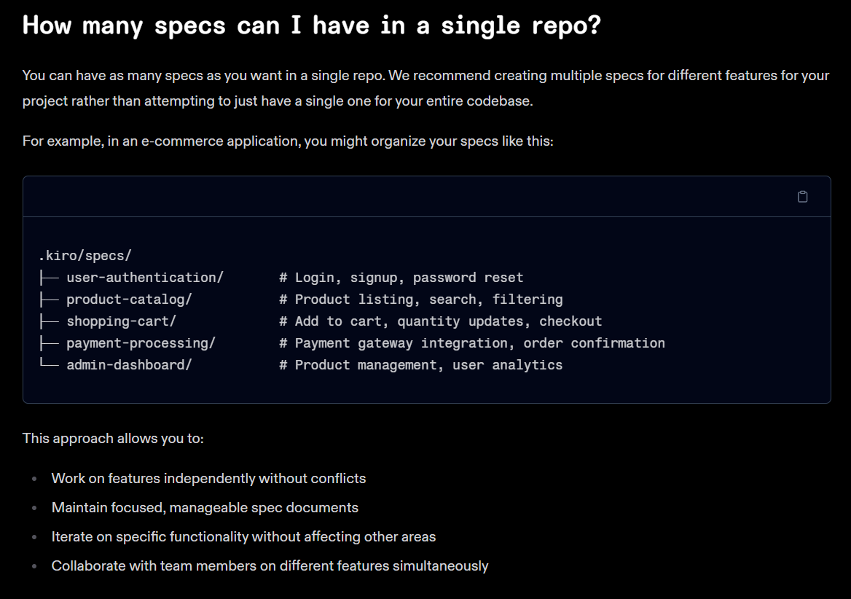

Slide 21
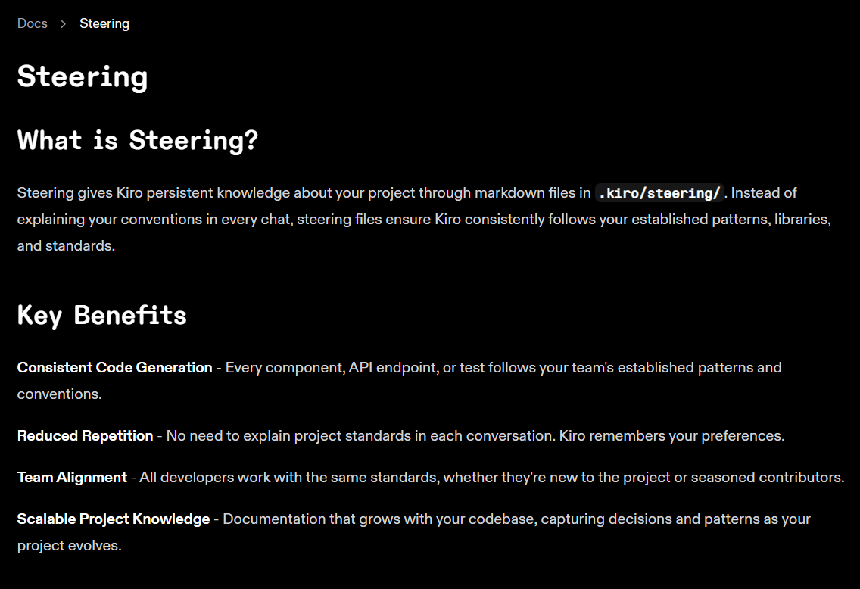

Slide 22
