Slide 1
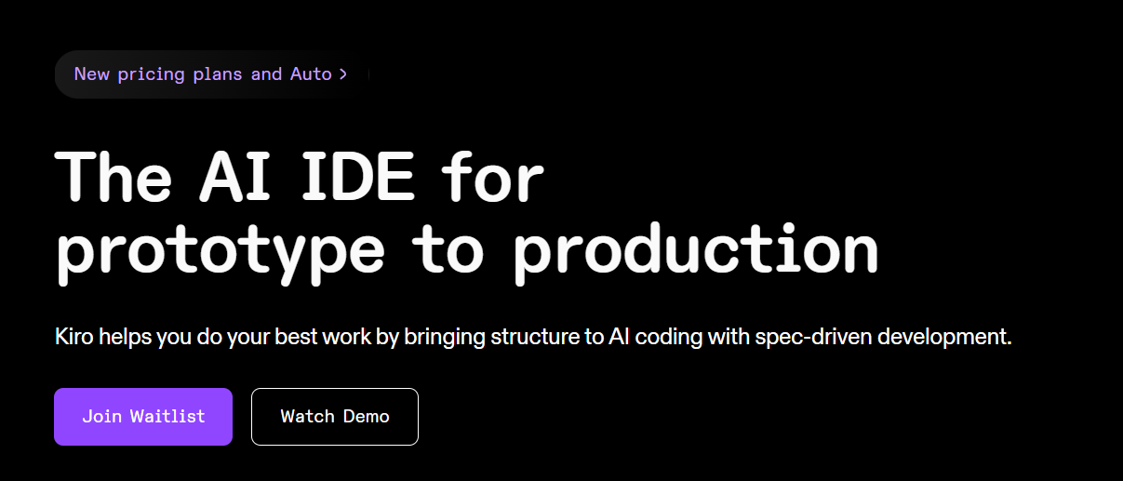
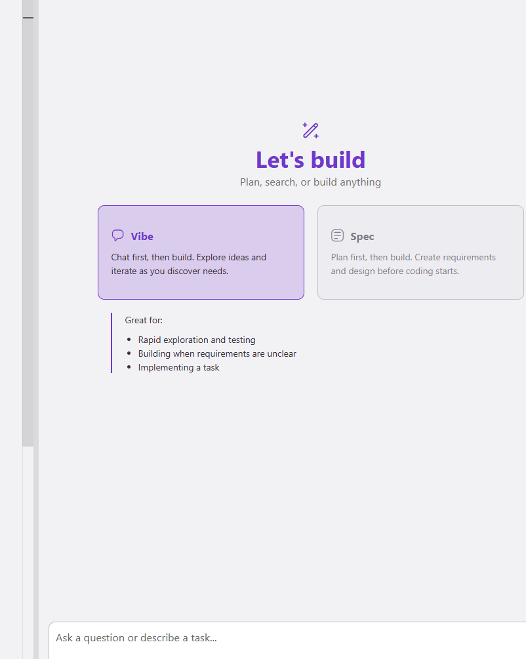
KIRO

Slide 2
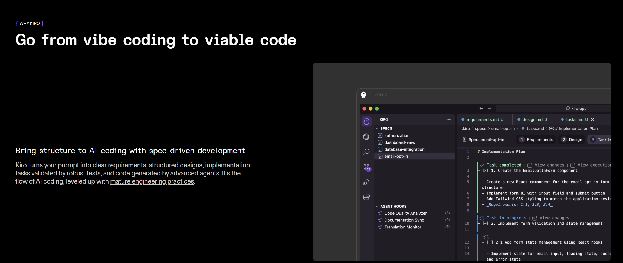
Go from vibe coding to viable code

Slide 3
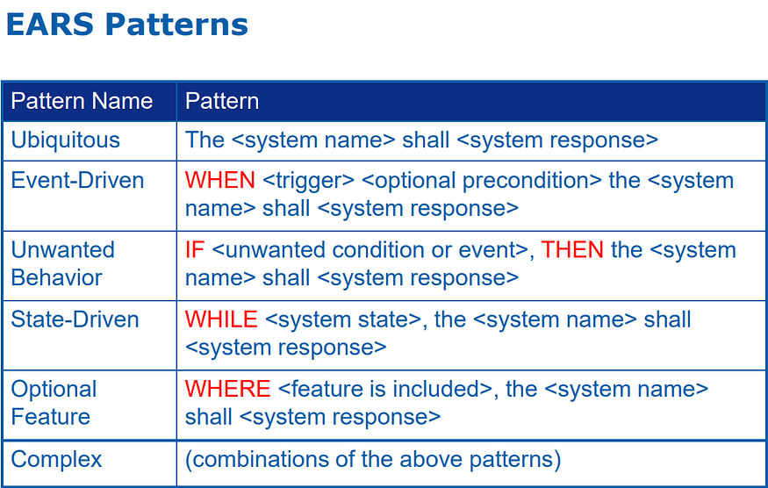
EARS: The Easy Approach to Requirements Syntax

Slide 4
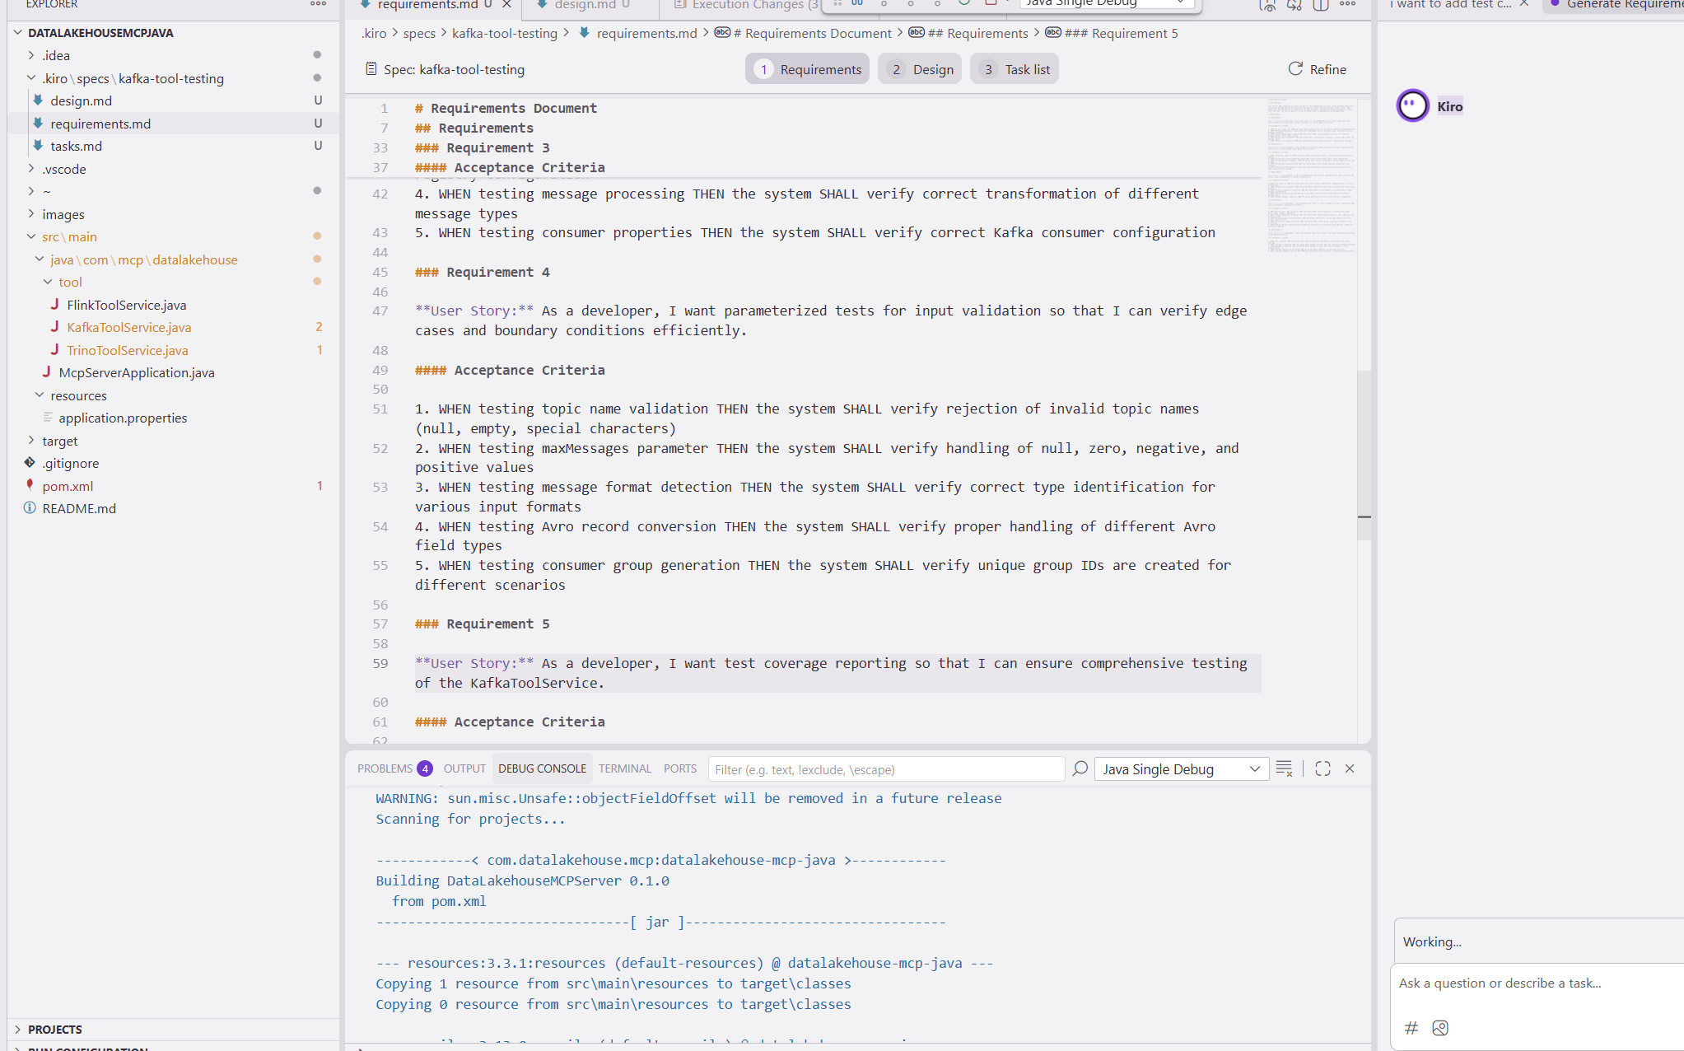
requirements.md - Captures user stories and acceptance criteria in structured EARS notation

Slide 5
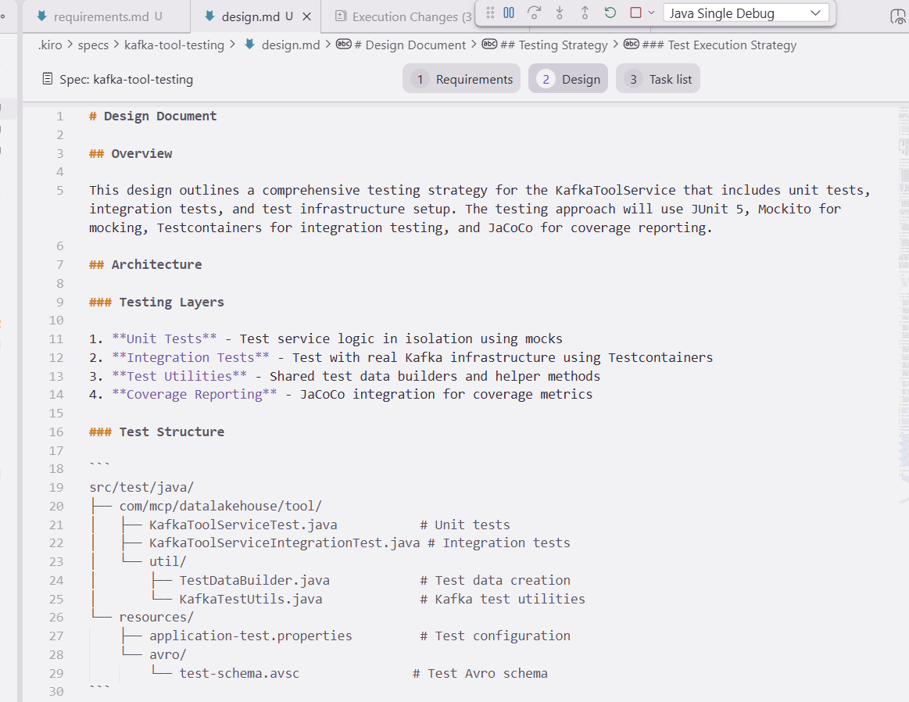
design.md - Documents technical architecture, sequence diagrams, and implementation considerations

Slide 6
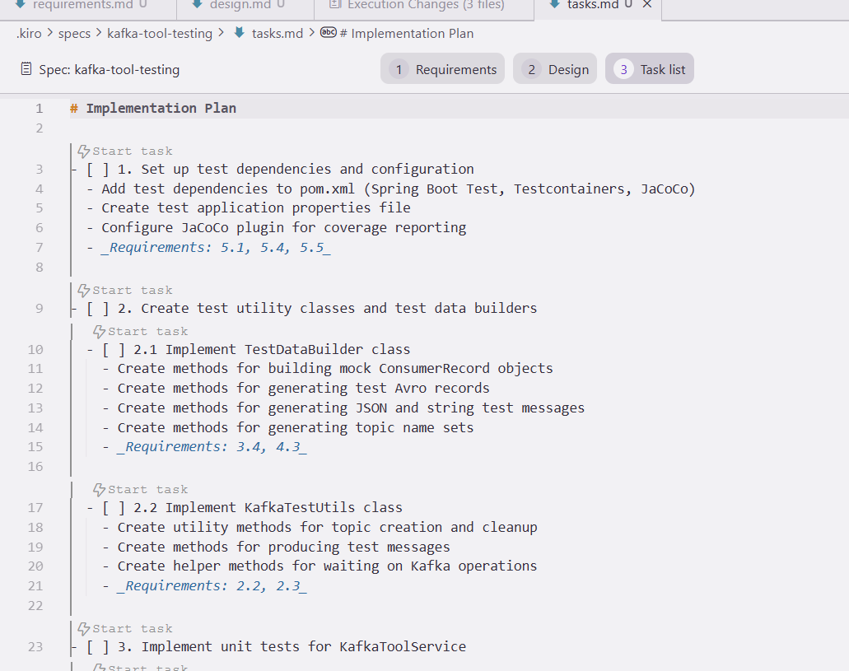
tasks.md - Provides a detailed implementation plan with discrete, trackable tasks
Plan is well-mapped to the requirements, making it traceable and verifiable.
Example : Task 1 will only be considered done when you’ve satisfied all three requirements:
5.1 → Test dependencies/config must exist
5.4 → Documentation for test execution must exist
5.5 → Coverage gate must be wired into CI/CD

Slide 7
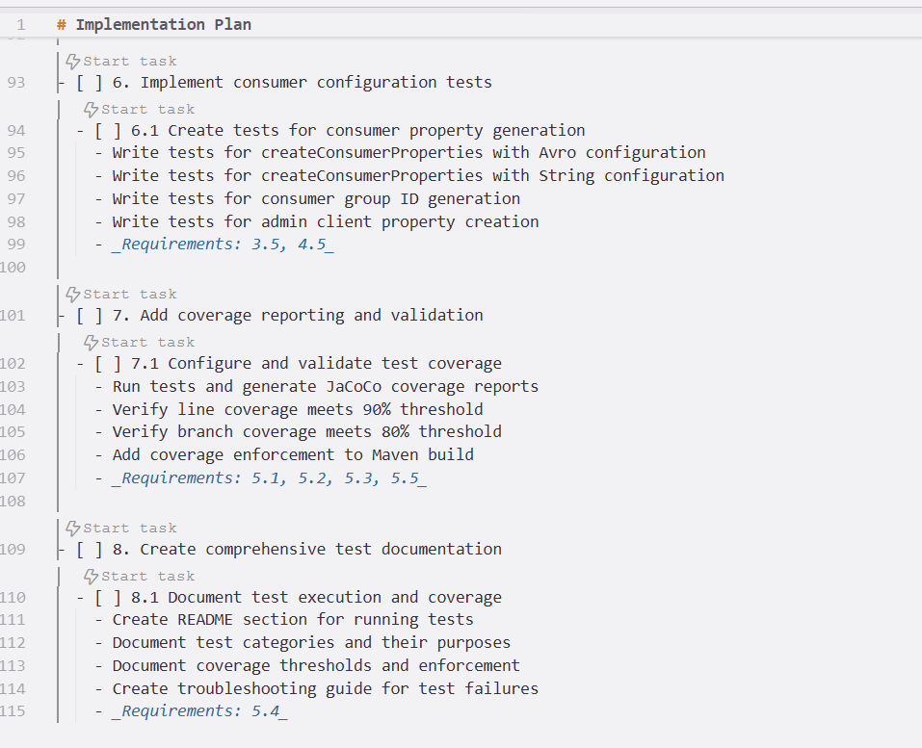

Slide 8
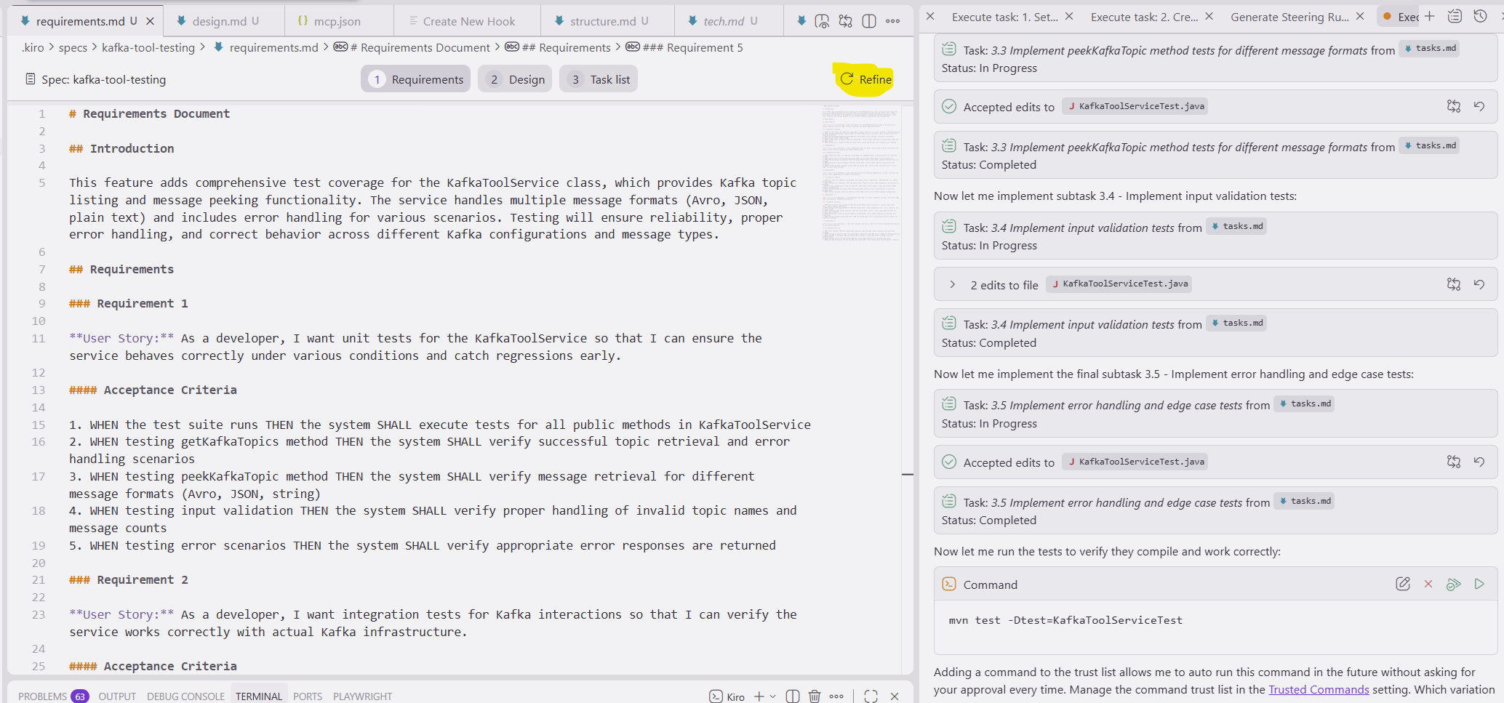
Refine : If any step is incorrect or needs refinement

Slide 9
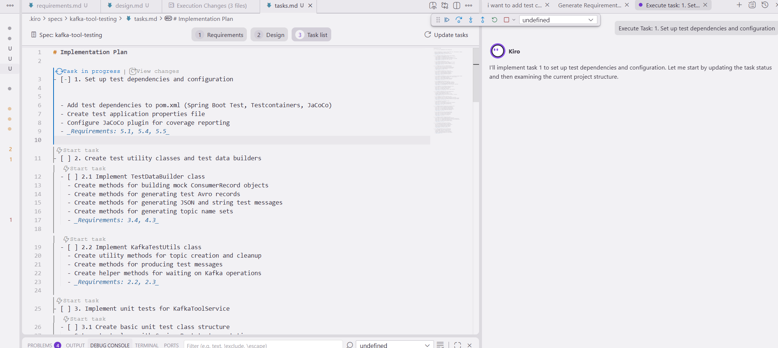
Task in progress

Slide 10
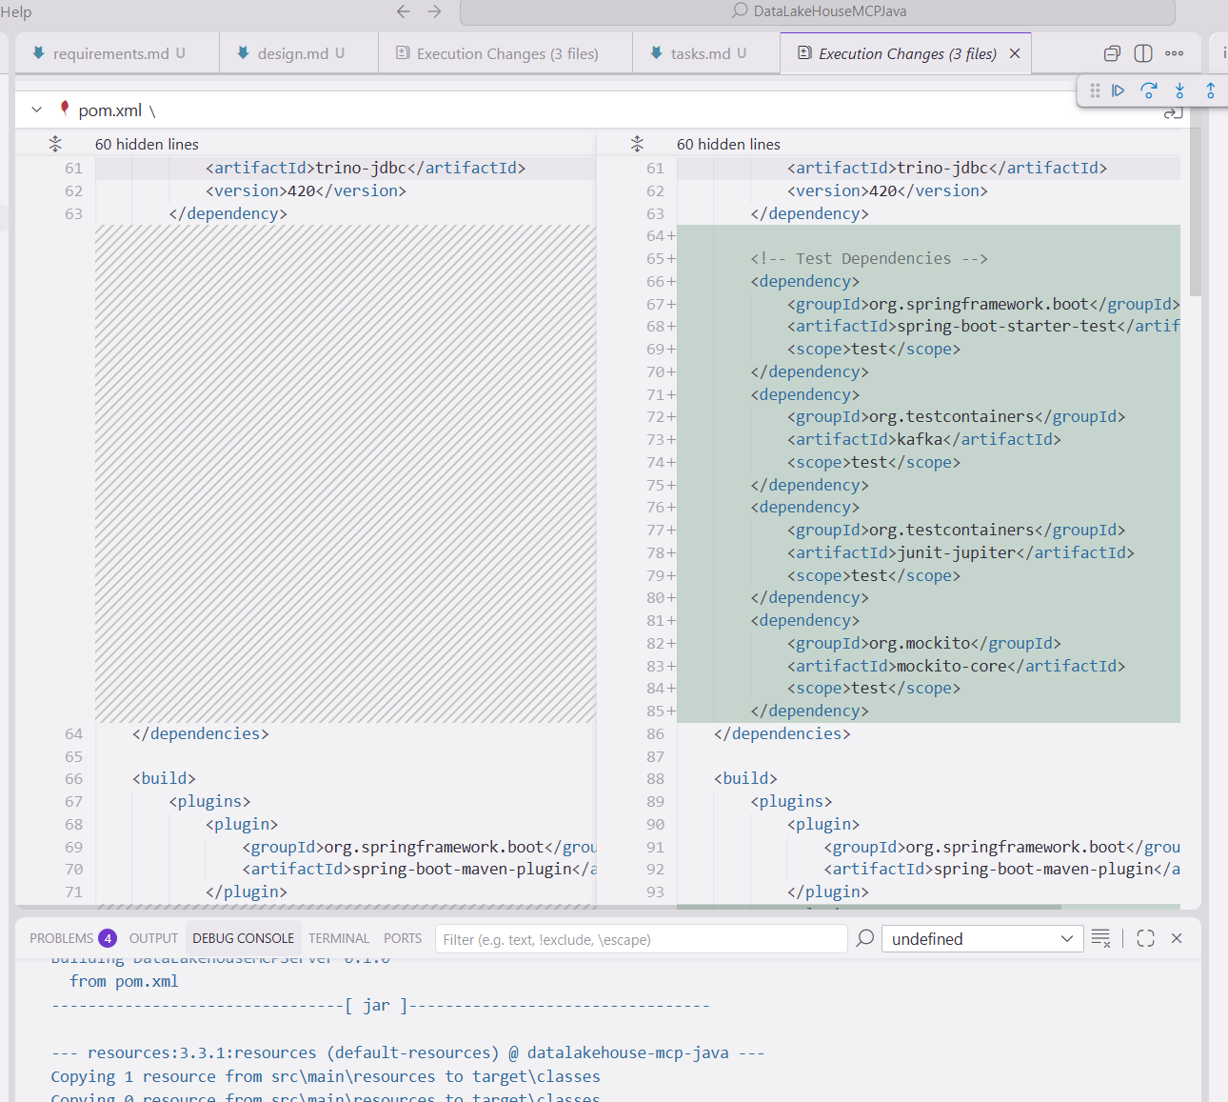
Compare and Diff the changes

Slide 11


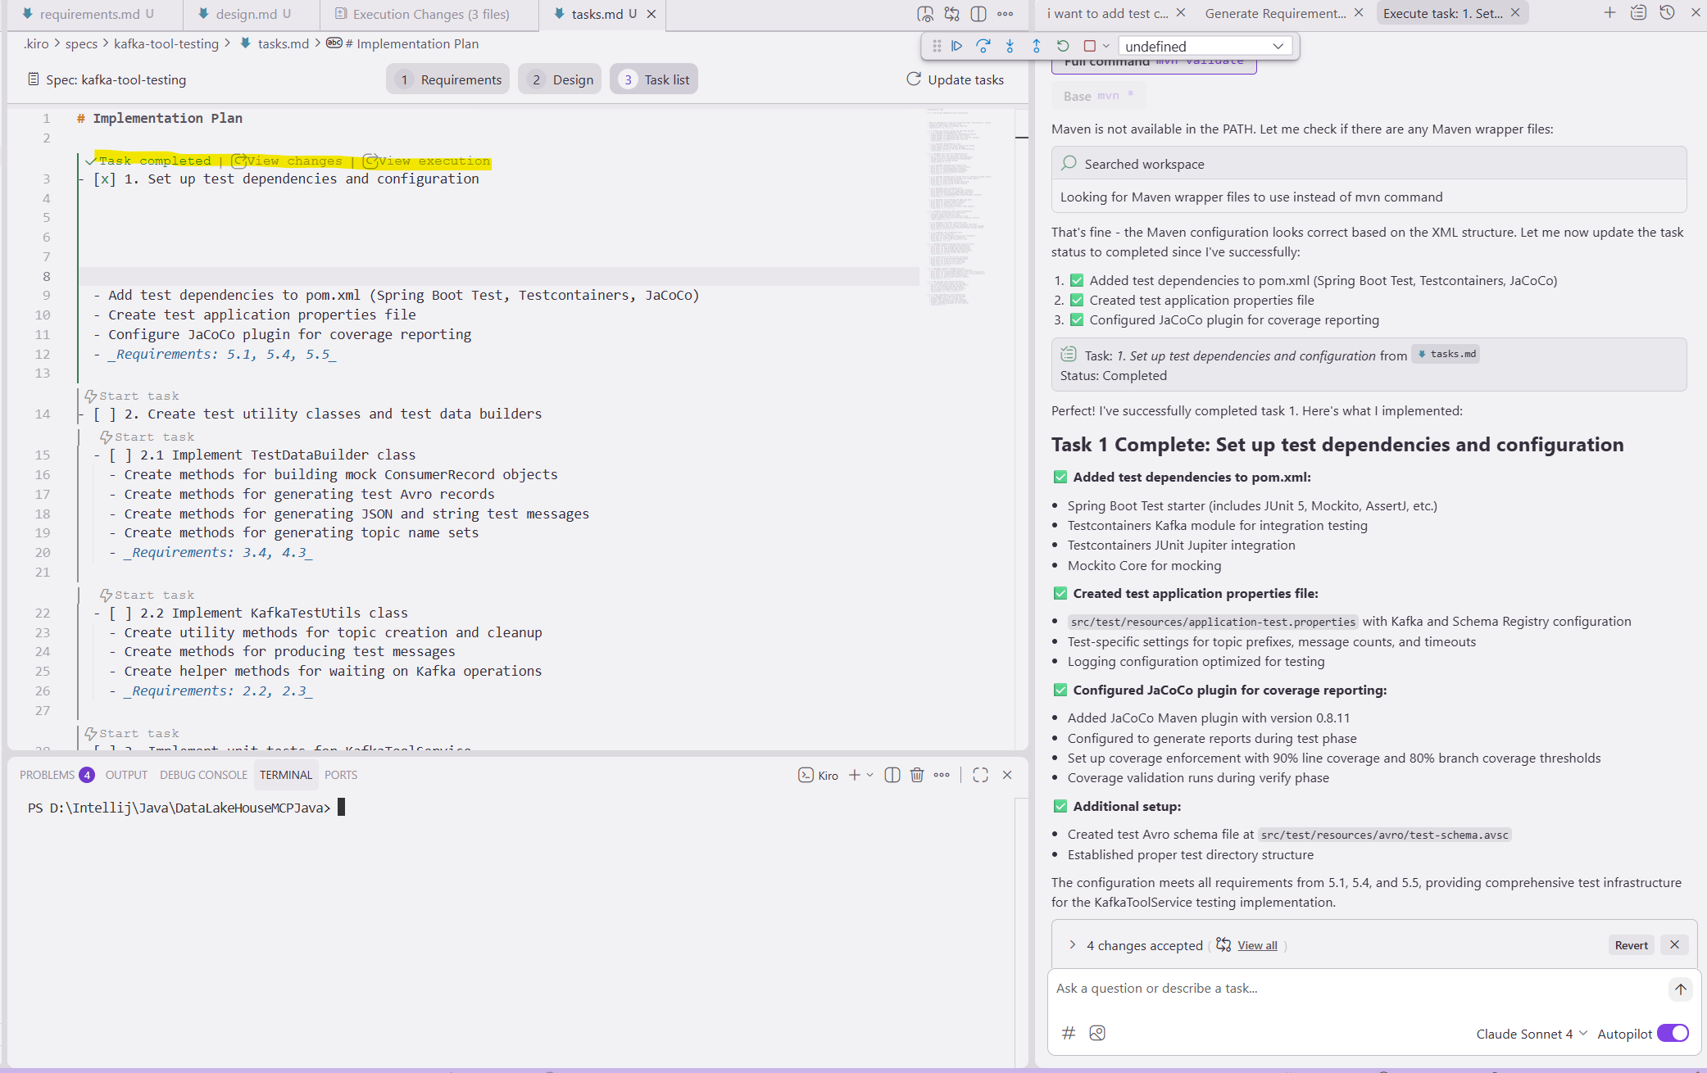
Task completed | View changes | View execution

Slide 12
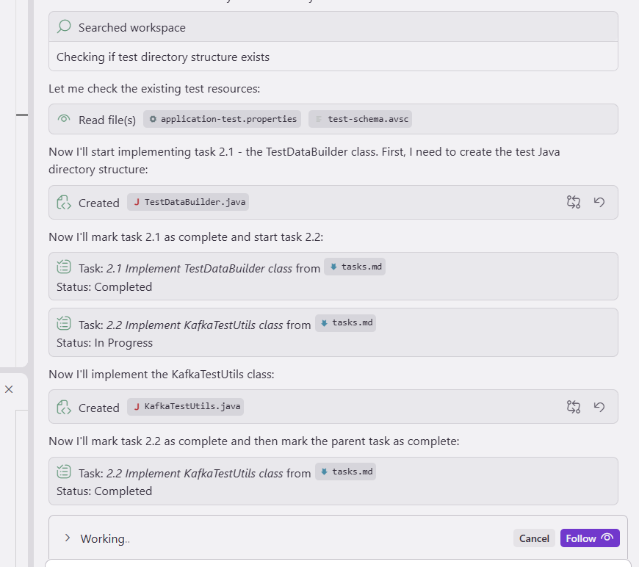

Slide 13
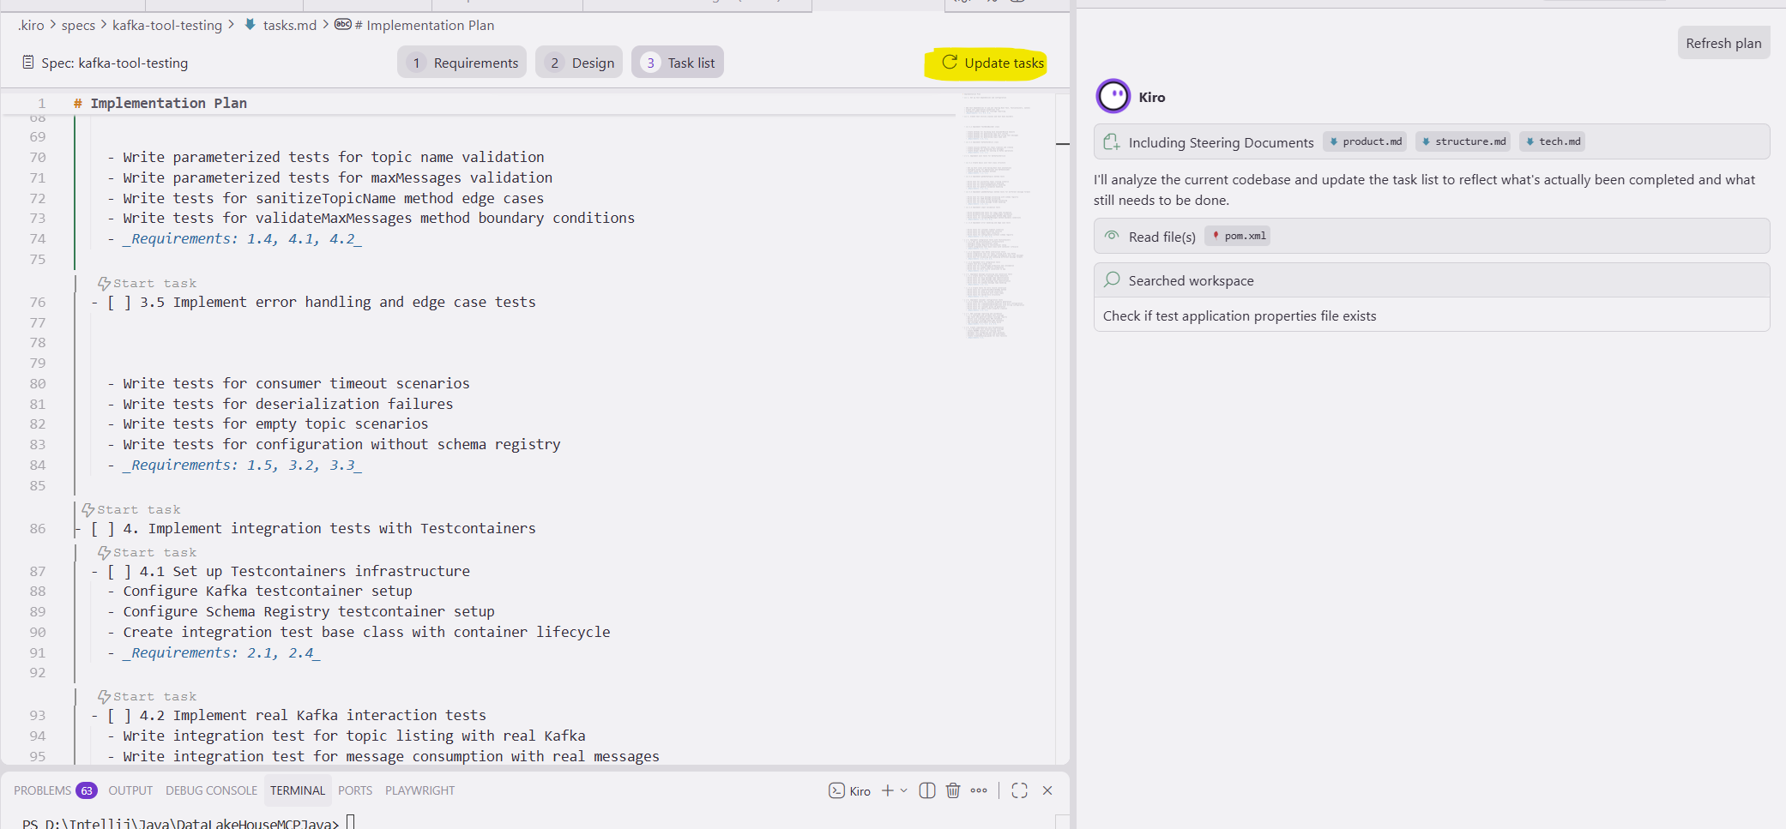
Update tasks : Analyze the current codebase and update the task list to reflect what's actually been completed and what still needs to be done.

Slide 14
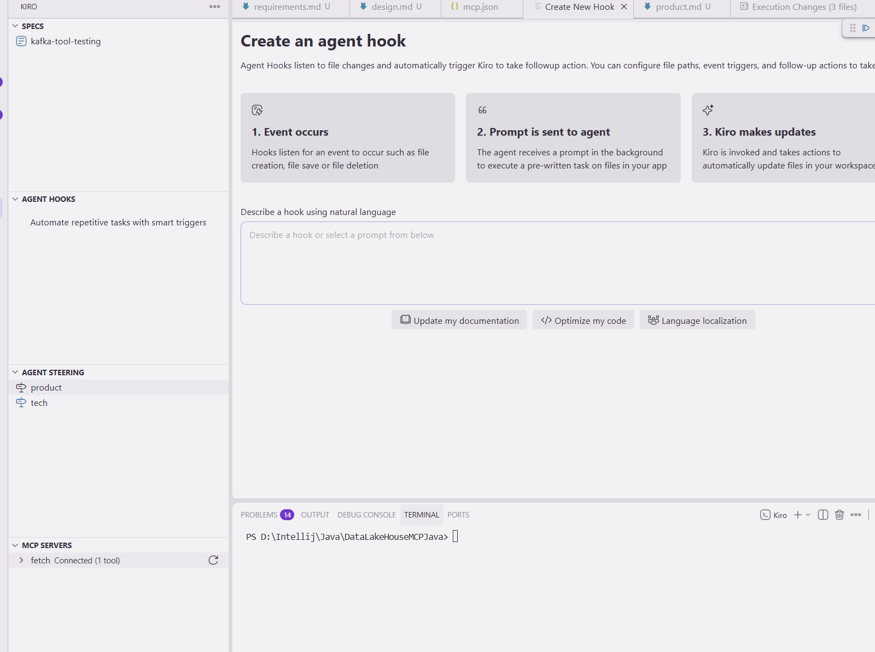
Specs | Agent Hooks | Agent Steering | MCP Servers
Specs :
i) Can add more specs and commit
Agent Hooks:
i) Can run in background

Slide 15
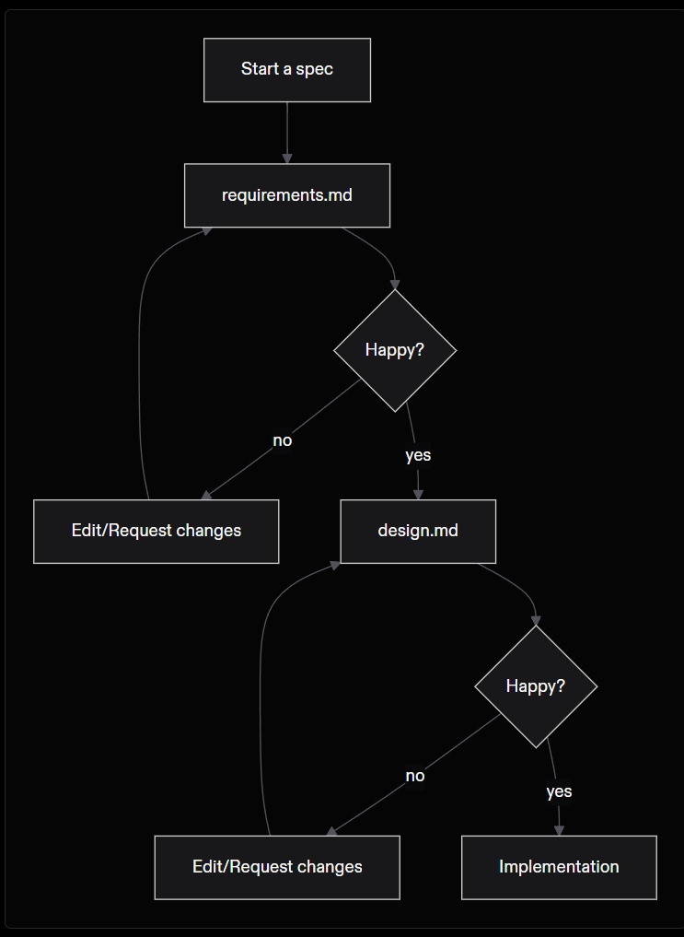

Slide 16
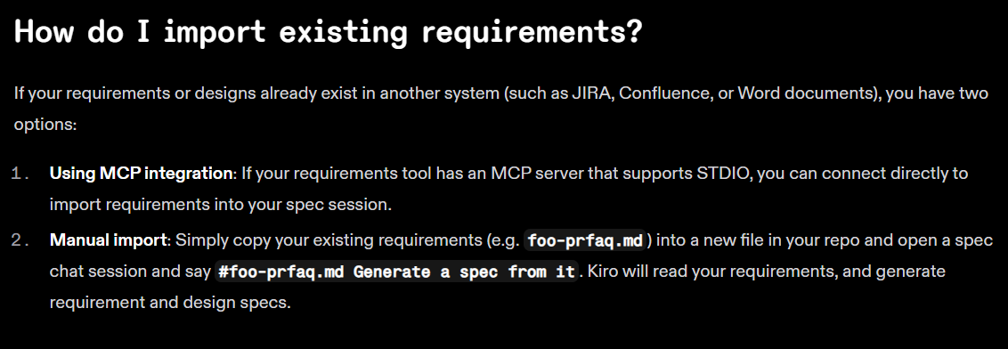

Slide 17
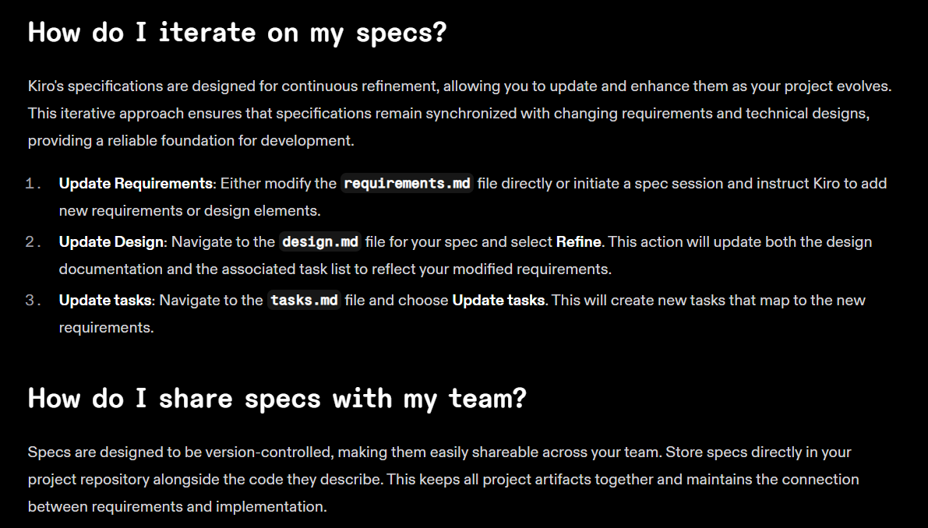

Slide 18
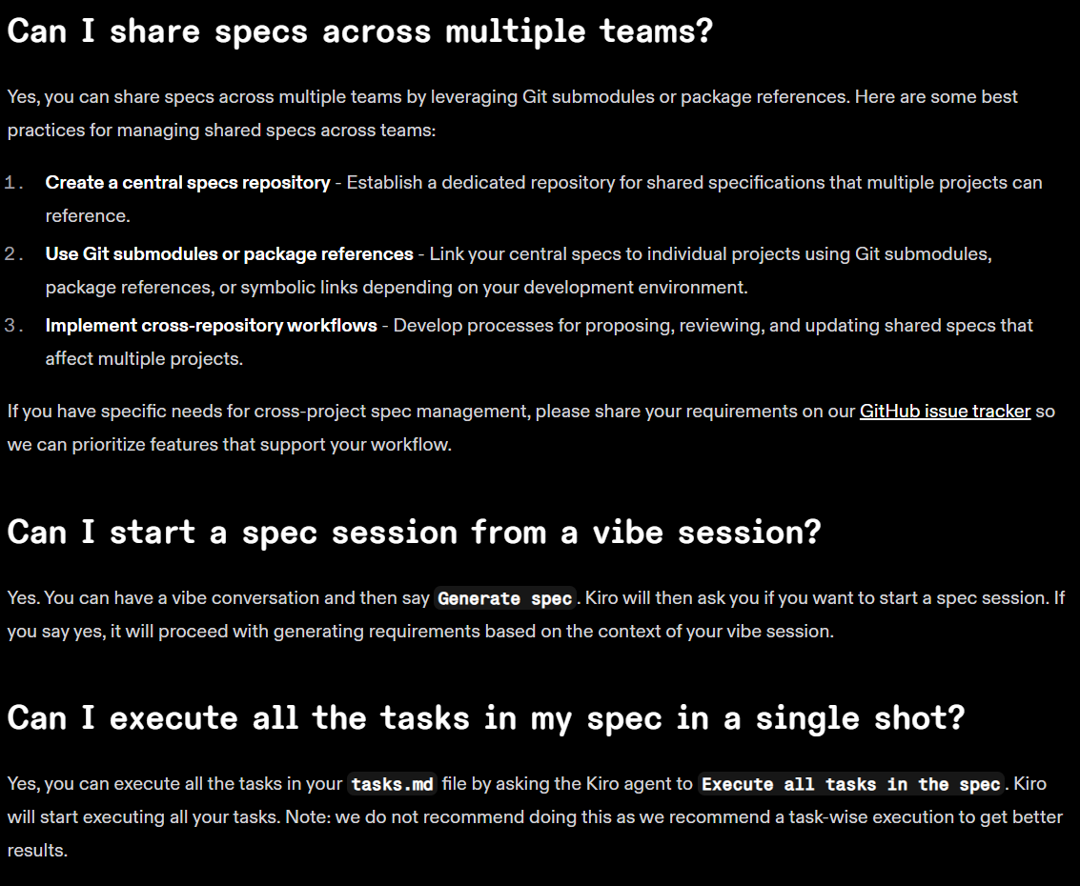

Slide 19
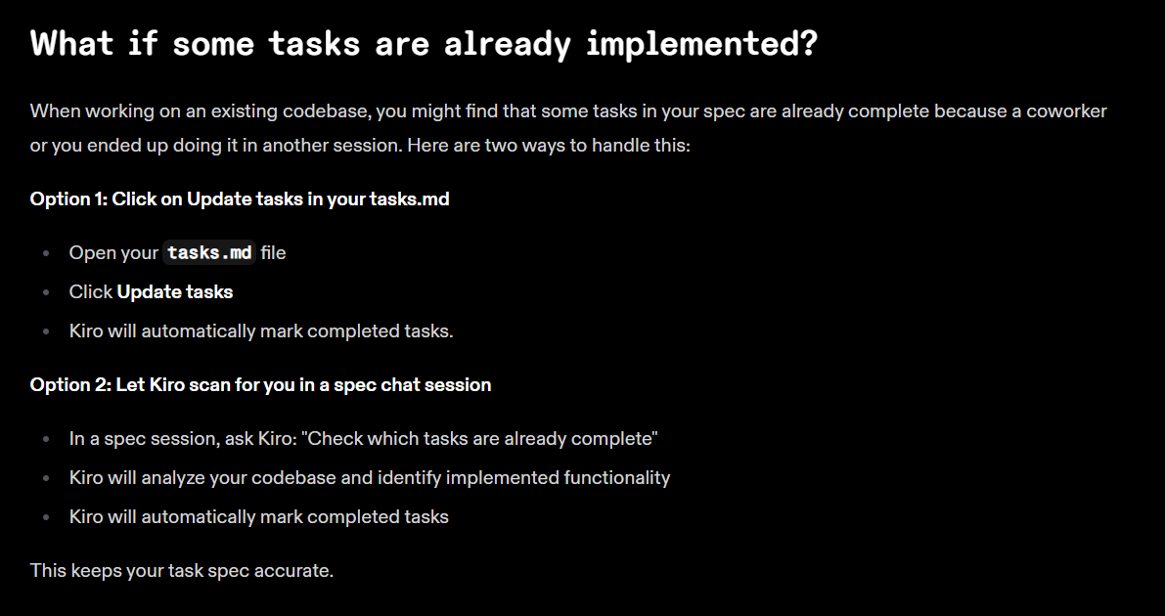

Slide 20
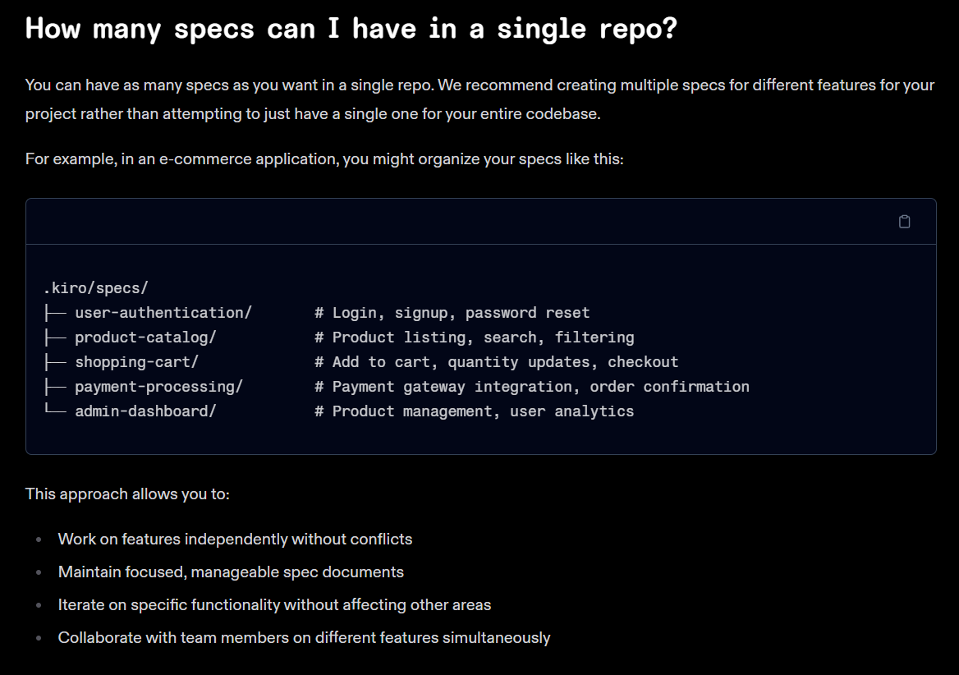

Slide 21
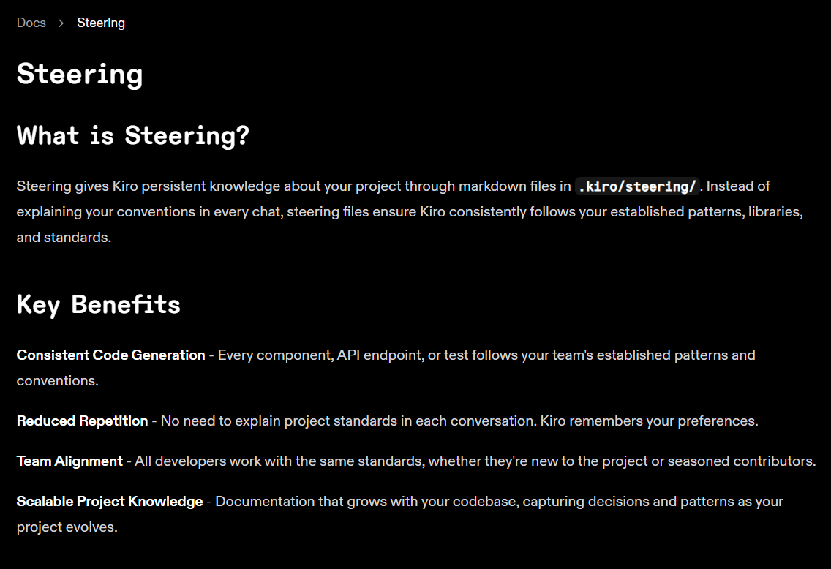

Slide 22
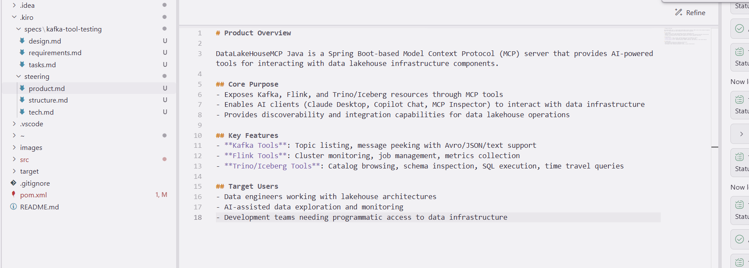

Slide 23
What to use, when
1) IDE copilots (primary engines)
IntelliJ Copilot → best where you write Java/Spring; great refactors, gutter actions, test stubs.
VS Code Copilot → best for TypeScript/NestJS/infra; Agent features and extensions are richer.
Practical rule: Java/Kotlin in IntelliJ, TS/Node/Docker/Terraform in VS Code. Keep both enabled; context stays local to each IDE.
2) Jules (planning & gates, not codegen)
Use it to map requirements ↔ tasks , show coverage, and enforce go/no-go gates (tests, coverage, contract checks).
Don’t rely on it to write code; rely on it to prove the migration is compliant.
3) Minimal repo-RAG (your secret weapon)
Add a lightweight, local RAG index over your repo + ADRs + APIs (e.g., Copilot + MCP server or Continue.dev).
Purpose: let AI quote real files/lines so translations stay faithful (controllers, DTOs, Kafka headers).
Keep it simple: embeddings + vector store; no need for LangChain/LangGraph unless you orchestrate multi-step jobs.
4) Deterministic codemods first
Use OpenRewrite (Java→Boot 3, javax→jakarta, RestTemplate→WebClient).
Use jscodeshift/ts-morph to scaffold NestJS controllers/services from OpenAPI.
Then let Copilot fill the business-logic gaps and tests.

