Slide 1

SMART INDIA HACKATHON 2026
TITLE PAGE
Problem Statement ID: SIH26263
Problem Statement Title: Development of an APAAR ID-Based Student Data Management and Verification Platform for AICTE-Approved Institutions
Theme: Smart Automation
PS Category: Software
Team ID:

Slide 2
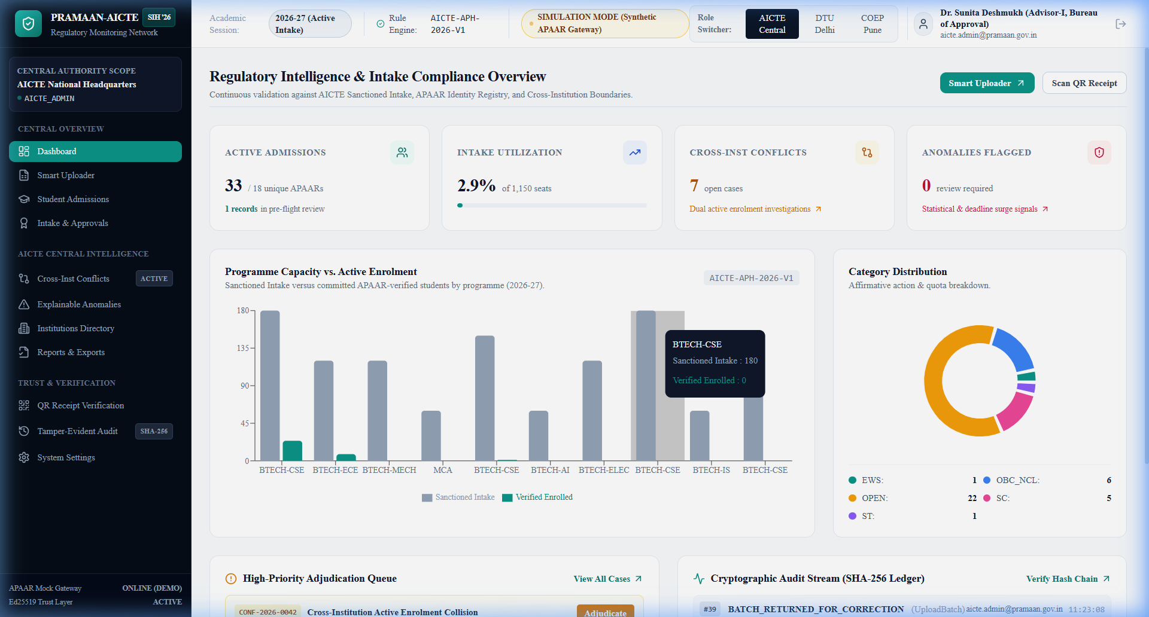
PRAMAAN-AICTE: APAAR-BASED REGULATORY MONITORING & VERIFICATION
TCE_Yquanto
Proposed Solution (Describe your Idea/Solution/Prototype)
Detailed explanation of the proposed solution:
* High-trust, privacy-preserving regulatory intelligence platform for AICTE and institutions.
* End-to-end ERP/spreadsheet ingestion with automated schema mapping and preflight validation.
* Role-separated workspaces: Institution Data Desk, Central Review Console, and Trust Gateway.
How it addresses the problem:
* Unifies fragmented records by anchoring admissions to verified APAAR identity references.
* Prevents phantom seats and ghost admissions via AICTE Approval Handbook (APH 2026-27) quota rules.
* Detects multi-college double enrollments through automated cross-institution duplicate collision radar.
Innovation and uniqueness of the solution:
* Zero Plaintext Storage: Keyed HMAC-SHA256 indexing + dynamic masking (********1234).
* Cryptographic Verifiability: Asymmetric Ed25519 digital signatures on all verification receipts.
* Tamper-Evident Ledger: Append-only sequential SHA-256 hash chaining securing all decisions.
Prototype Evidence: AICTE Central Regulatory Monitoring Console with real-time intake utilization, active college directory, duplicate radar, and verification audit counts.

Slide 3
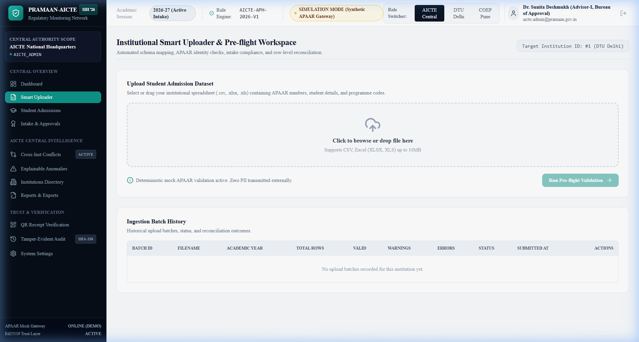
TECHNICAL APPROACH & ARCHITECTURE
TCE_Yquanto
Technologies to be used:
* Frontend Architecture: Next.js 14 App Router, TypeScript, Tailwind CSS, Recharts.
* Backend API Services: Python 3.10, FastAPI, Pydantic V2, Uvicorn, OpenAPI 3.1 REST contracts.
* Database & Persistence: SQLite 3 (WAL mode) / PostgreSQL dual-dialect via SQLAlchemy ORM.
* Security & Cryptography: Ed25519 (RFC 8032) asymmetric signatures, Keyed HMAC-SHA256, bcrypt.
* Data Processing: Pandas and OpenPyXL for fault-tolerant tabular ingestion and reconciliation.
Methodology and process for implementation:
* Multi-Tier Validation Pipeline:
1. Ingestion Desk: CSV/Excel drag-and-drop with fuzzy header mapping & course code tolerance.
2. Preflight Gate: Regex syntax checks, in-file duplicate detection, and intake ceiling audits.
3. Atomic Two-Phase Commit: Staging into decoupled StudentIdentity and AdmissionRecord.
4. Regulatory Adjudication: Automated double-enrollment radar with recorded reviewer remarks.
5. Cryptographic Proof: Ed25519-signed verification receipts and tamper-evident SHA-256 audit.
Prototype Evidence: Smart Ingestion Desk with automated schema mapping, pre-flight validation status, row findings ledger, and atomic batch commitment.

Slide 4
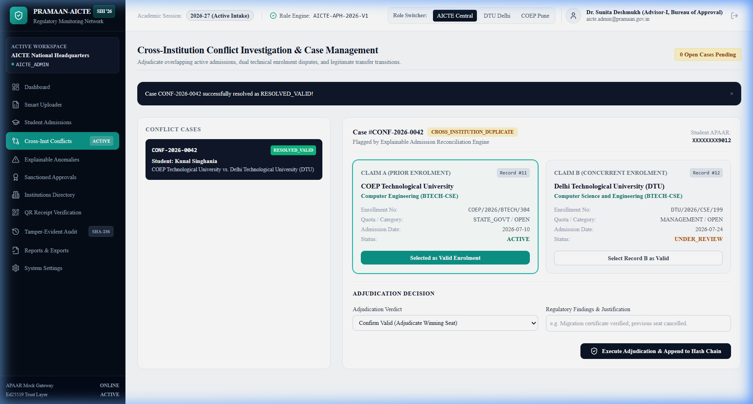
FEASIBILITY AND VIABILITY
TCE_Yquanto
Analysis of the feasibility of the idea:
* Operational Feasibility: Zero specialized hardware needed; works over modern web browsers.
* Verified Engineering Prototype: 31/31 passing unit/integration tests, 79% backend coverage.
* High Performance: Sub-50ms deterministic preflight checks; handles 5,000+ student batches.
Potential challenges and risks:
* Data Inconsistency: Unstandardized CSV/Excel exports from fragmented college ERP systems.
* Identity Privacy Risk: Exposure of plaintext student identifiers violating DPDP Act 2023.
* Multi-College Collisions: Fraudulent concurrent admissions across multiple institutions.
* Unauthorized Record Tampering: Illicit modification of approved intake quotas or student status.
Strategies for overcoming these challenges:
* Resilient Header Engine: Fuzzy column mapping and alias normalization (BTECH-CSE <-> CSE-BTECH).
* Privacy-by-Design: Keyed HMAC-SHA256 one-way hashing with zero plaintext APAAR storage.
* Concurrency Radar: Real-time cross-college duplicate detection with side-by-side adjudication.
* Tamper-Evident Ledger: Sequential SHA-256 hash chaining immediately exposes historical alterations.
Prototype Evidence: Cross-Institution Duplicate Collision Radar with side-by-side college enrollment audit, quota verification, and regulatory adjudication controls.

Slide 5
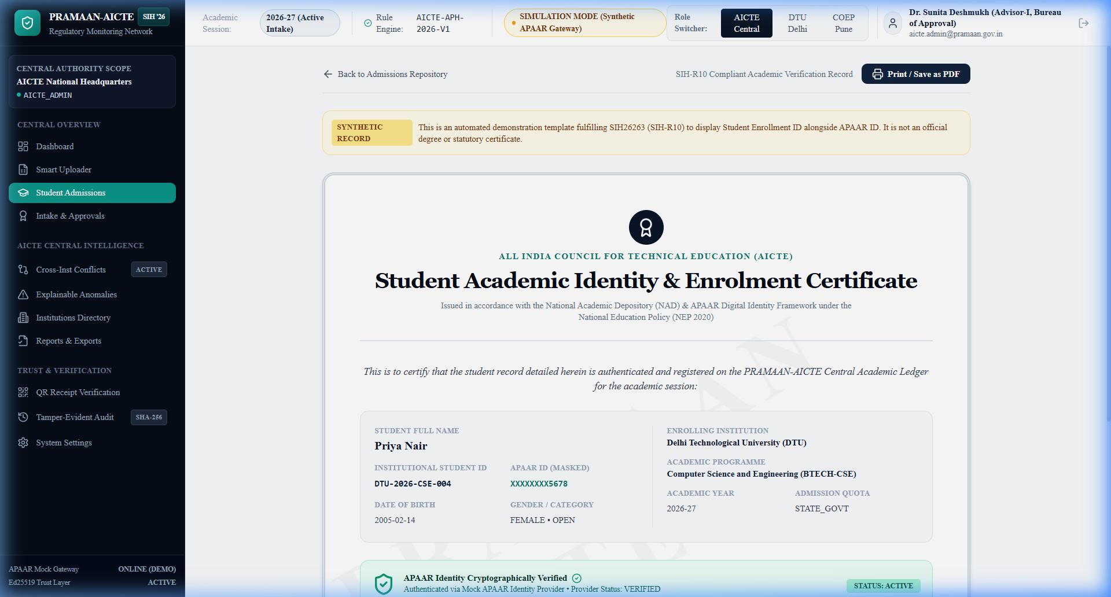
IMPACT AND BENEFITS
TCE_Yquanto
Potential impact on the target audience:
* AICTE & Regulators: Instant national visibility over intake compliance and automated quota audit.
* Institutions: Streamlined digital admissions reconciliation; eliminates manual verification delays.
* Students & Parents: Fraud-free seat allocation; verifiable academic identity credentials.
* Industry & Employers: Instant zero-trust verification of student credentials via QR scanning.
Benefits of the solution:
* Economic Benefit: Prevents ghost-seat grant diversion and illegal seat-blocking across colleges.
* Social Equity: Enforces reservation limits and supernumerary seats (TFW 5%, EWS 10%, NRI/FN 15%).
* Regulatory Integrity: Guarantees compliance with NEP 2020 and DPDP Act 2023 privacy mandates.
* Environmental & Operational: 100% paperless verification eliminating physical transit and forgery.
* SIH-R10 Compliance: Side-by-side Student ID and Masked APAAR ID on verifiable certificates.
Prototype Evidence: SIH-R10 Academic Certificate displaying Student ID alongside Masked APAAR ID with verified government seal and Ed25519 QR verification code.

Slide 6
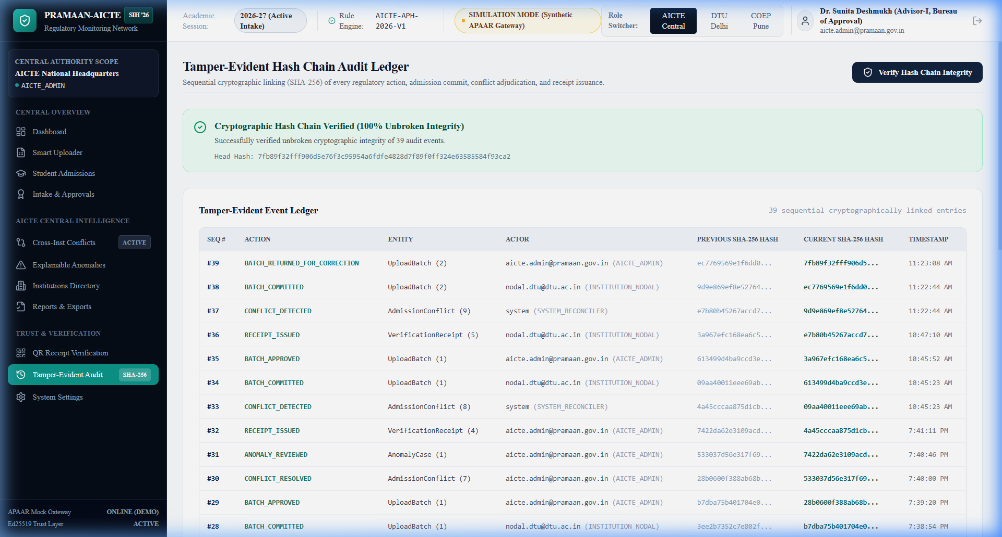
RESEARCH AND REFERENCES
TCE_Yquanto
Details / Links of the reference and research work:
* AICTE Approval Process Handbook (APH 2026-27):
Norms for intake capacity, supernumerary quotas (TFW 5%, EWS 10%, NRI/FN 15%).
* National Education Policy (NEP 2020) & NAD:
Framework for APAAR (Automated Permanent Academic Account Registry) and ABC.
* IETF RFC 8032:
Edwards-Curve Digital Signature Algorithm (Ed25519) for tamper-proof verification receipts.
* Digital Personal Data Protection Act (DPDP Act 2023):
Principles of purpose limitation, data minimization, and identifier pseudonymization.
* NIST Special Publication 800-107:
Cryptographic hash standards for sequential hash-chain audit logging.
* Live Prototype Repository & Working Evidence:
https://github.com/naveeshpcbin/APAAR-ID-BASED-SYSTEM
Prototype Evidence: Tamper-Evident SHA-256 Hash Chain Audit Ledger proving mathematical immutability across all admissions, commits, and review approvals.

