Slide 1

SMART INDIA HACKATHON 2026
TITLE PAGE
Problem Statement ID: SIH26263
Problem Statement Title: Development of an APAAR ID-Based Student Data Management and Verification Platform for AICTE-Approved Institutions
Theme: Smart Automation
PS Category: Software
Team ID: TCE_Yquanto
Team Name: TCE_Yquanto (Thiagarajar College of Engineering, Madurai)
Institute Name: Thiagarajar College of Engineering, Madurai, Tamil Nadu
Live Web Platform: https://brainforge.info | https://pramaan.brainforge.info
Live Backend & API: https://apaar-id-based-system.onrender.com/docs
Source Repository: https://github.com/naveeshpcbin/APAAR-ID-BASED-SYSTEM
Verification Status: 66/66 Passing Tests | 20 Tables with RLS | Live Cloud Verified
@ TCE_Yquanto | Smart India Hackathon 2026
1

Slide 2
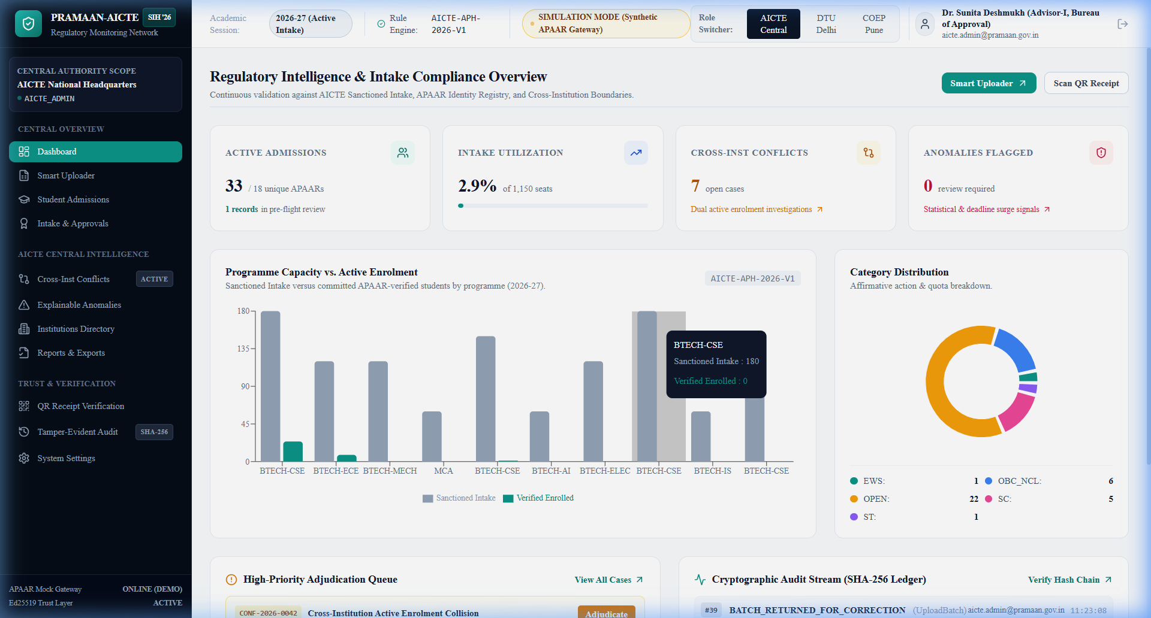
PROPOSED SOLUTION: THE PRAMAAN-AICTE RECONCILIATION SYSTEM
TCE_Yquanto
1. REGULATORY CHALLENGE ADDRESSED
AICTE CENTRAL APEX COMMAND & RECONCILIATION DASHBOARD
- Fragmented Institutional Data: Divergent college ERP spreadsheet schemas, non-standard column headers, and unverified declarations.
- Reconciliation Bottlenecks: Difficulties cross-verifying declared enrolments against actual student records and AICTE approval ceilings.
- Intake & Duplicate Risks: Lack of automated visibility into over-intake breaches, quota diversion, and concurrent multi-college claims.
2. WHAT PRAMAAN-AICTE IMPLEMENTS
- Decoupled Institutional Portals: Role-separated desks for College submission and Central AICTE regulatory governance.
- Automated Ingestion Desk: CSV/Excel file parsing with resilient column alias mapping into standard staging rows.
- Deterministic 3-Way Reconciliation: Pure Python comparison engine cross-checking declarations, staged student records, and approved capacity.
- Persisted Validation Runs: Stores row-level findings with precise classification: approved, quota breach, syntax error, or duplicate.
3. KEY WORKFLOW & GOVERNANCE VALUE
- Explainable Row-Level Findings: Direct, transparent feedback explaining specific discrepancy causes without opaque batch rejection.
- Quarantine & Resubmission: Interactive in-browser quarantine sandbox allowing institutions to correct data before council commit.
- Controlled Central Decisions: Council review workflow supporting formal decisions: approve, return for correction, or reject.
- Audit Traceability: Complete validation run history and append-only sequential SHA-256 audit chaining across actions.
- Central Intake Intelligence: Live monitoring of sanctioned intake vs enrolled students across B.Tech, MCA, and Diploma.
- Deterministic Review Desk: Instant identification of seat limit breaches, unverified candidates, and duplicate claims.
- Multi-Tenant Governance: Seamless institutional isolation between AICTE Central Regulators, DTU Delhi, and COEP Pune.
Deterministic Python Core
3-Way Cross-Reconciliation
Cryptographic Verification & Audit
66/66 Verified Passing Tests

Slide 3
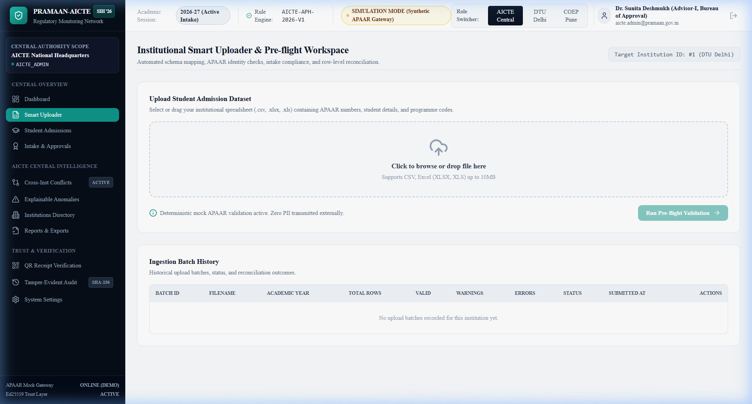
TECHNICAL APPROACH AND SYSTEM ARCHITECTURE
TCE_Yquanto
5-STAGE RECONCILIATION & GOVERNANCE PIPELINE
VERIFIED 4-LAYER SYSTEM ARCHITECTURE
STAGE 1: Resilient File Ingestion
Upload institutional CSV/Excel files; dynamic column alias matching auto-normalizes divergent schemas into standardized staging records.
- Presentation Layer: Next.js 14 (App Router), TypeScript, Tailwind CSS, Recharts for analytics; deployed on Vercel Edge.
- Application & API: FastAPI (Modular Monolith), Python 3.10+, Pydantic v2, Uvicorn, 73 endpoints; deployed on Render Cloud.
- Persistence & Schemas: SQLAlchemy ORM, Supabase PostgreSQL 17.11 (20 tables with RLS enabled) / SQLite WAL mode.
- Cryptography & Security: Ed25519 (RFC 8032 signing), Keyed HMAC-SHA256, sequential SHA-256 audit chaining.
STAGE 2: Pure Python Validation Engine
Deterministic rule engine parses syntax, detects in-batch duplicates, verifies 12-digit APAAR format, and runs cross-field consistency checks.
PROTOTYPE EVIDENCE: SMART INGESTION DESK
STAGE 3: 3-Way Dynamic Reconciliation
Cross-compares declared student counts against verified stage records and sanctioned intake quotas from dynamic reference tables.
STAGE 4: Council Review & Audit Ledger
Central officers review row-level discrepancy findings; make formal Approve/Return decisions; actions chained into append-only SHA-256 audit ledger.
STAGE 5: Cryptographic Verification Receipt
Approved student records receive an asymmetric Ed25519 digital signature and portable verification receipt with offline verifiable QR code.
Smart Ingestion Desk: Automated schema mapping, pre-flight validation status, row findings ledger, and atomic batch commitment.

Slide 4
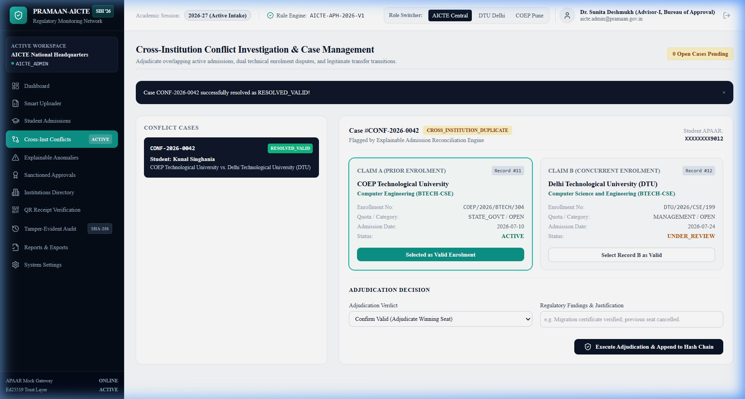
FEASIBILITY, VIABILITY AND RISK MITIGATION
TCE_Yquanto
IMPLEMENTATION FEASIBILITY & VERIFIED MATURITY
GOVERNANCE RISKS & TECHNICAL COUNTERMEASURES
- Architectural Feasibility: Zero-install web architecture. Standard modern browser access across Windows, Linux, and macOS. Decoupled Next.js client and FastAPI modular backend.
- Verified Test Suite (66/66 Passing): Exhaustive automated verification across 14 test suites covering authentication, institution onboarding, batch upload, deterministic reconciliation, security, and reference data.
- Deterministic Logic Integrity: Reconciliation logic is pure, explainable Python with explicit rule sets for sanctioned intake and supernumerary quotas; avoids opaque or non-deterministic AI decisions.
- Synthetic Data Testing Engine: Database-backed synthetic APAAR identities and editable approval/declaration models enable comprehensive pre-deployment stress testing and repeatable verification.
- Dual-Dialect Database Support: SQLAlchemy ORM architecture with dynamic driver fallback (psycopg3/psycopg2) verified on local SQLite WAL mode and Supabase PostgreSQL 17.11 (20 tables, RLS active).
- Live Production Cloud Verification: Full cloud deployment verified live: FastAPI backend on Render with PostgreSQL connection, Next.js frontend on Vercel with custom domain brainforge.info, and 100% end-to-end integration pass.
- Inconsistent Spreadsheets: Colleges use varying ERP column headers. -> Control: Header alias normalizer maps 50+ divergent column variants into standard canonical schema.
- Identifier Privacy Exposure: Storing plaintext student APAAR IDs risks data leakage. -> Control: Keyed HMAC-SHA256 pseudonymized indexing and dynamic masking ensure zero plaintext PII exposure.
- Concurrent Admissions: Students admitted concurrently across different institutions. -> Control: Cross-institution collision radar cross-checks active admissions against central records and flags duplicates.
PROTOTYPE EVIDENCE: DUPLICATE COLLISION RADAR
Duplicate Collision Radar: Side-by-side college enrollment audit, quota verification, and regulatory adjudication controls.

Slide 5
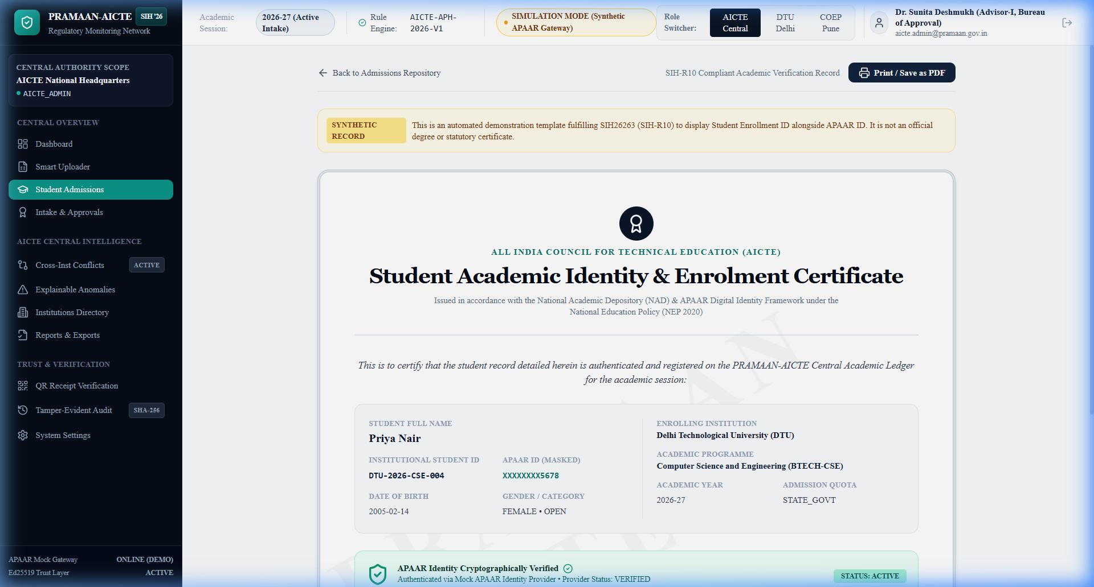
MULTI-STAKEHOLDER IMPACT & DEGREE VERIFICATION
TCE_Yquanto
MULTI-STAKEHOLDER REGULATORY IMPACT
SIH-R10 ACADEMIC CERTIFICATE & ED25519 QR PROOF
- AICTE & Regulatory Councils: Comprehensive real-time visibility into institutional enrolment versus sanctioned intake quotas; early detection of unauthorized excess enrolments and quota breaches.
- Approved Institutions: Standardized data submission, instant row-level discrepancy explanations, and controlled resubmission workflows replacing prolonged paper audit cycles.
- Students & Deserving Candidates: Transparent tracking protects legitimate seat allocations and safeguards affirmative action quotas from unauthorized commercial reallocation.
- Academic Verifiers & Employers: Fast offline verification via QR code and cryptographically signed verification receipts without requiring manual institutional registrar confirmation.
- Social Equity & Affirmative Action: Rigorous enforcement of statutory and supernumerary quotas (TFW, EWS, Kashmiri Migrants) against arbitrary substitution.
- Administrative & Paperless Efficiency: 100% digital data reconciliation replaces manual paperwork, physical affidavits, and physical institutional auditing logistics.
- Dual Identity Display: Certificates present Student Enrolment Roll No (ENR-108410E1) alongside masked APAAR ID (XXXXXXXX7890) and category quota status.
- Asymmetric Ed25519 QR Code: Embedded high-density QR code carries a digitally signed verification token; verifiers validate data integrity against AICTE public key offline.
- Integrity Boundary Clarification: Digital signature confirms platform-level record integrity and non-tampering; explicitly distinguished from official government identity confirmation.

Slide 6
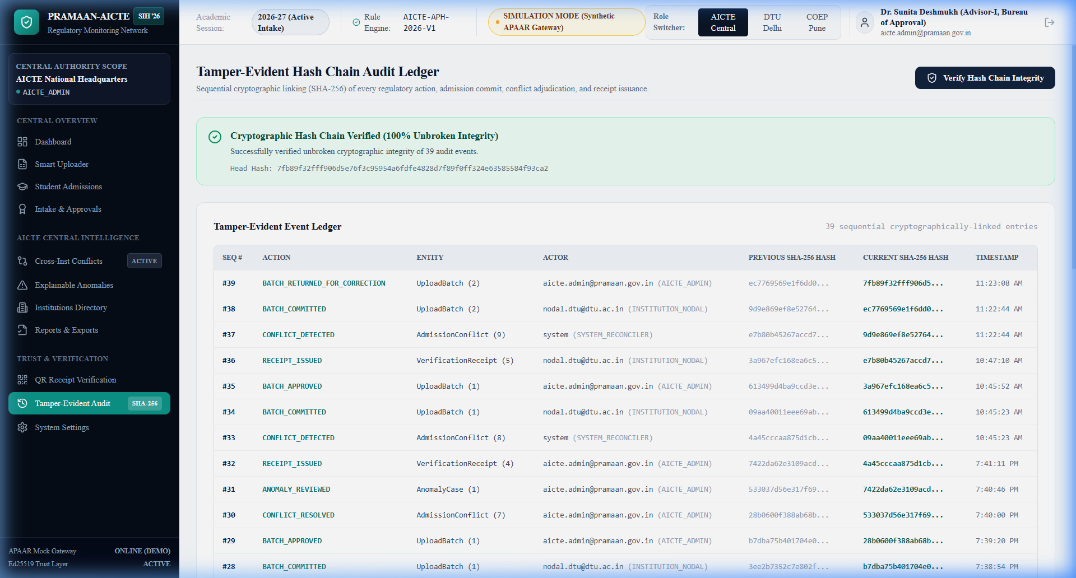
RESEARCH, REFERENCES AND PROJECT RESOURCES
TCE_Yquanto
AUTHORITATIVE STANDARDS & REGULATORY CITATIONS
SCOPE DIFFERENTIATION (PRIOR ART VS PRAMAAN-AICTE)
- AICTE Approval Process Handbook (APH 2026-27)
Statutory norms for approved institutional intake capacity, supernumerary seat limits (TFW, EWS, Kashmiri Migrants), and programme approval guidelines.
- National Education Policy (NEP 2020) & APAAR / ABC
Government policy framework establishing the 12-digit Automated Permanent Academic Account Registry as the lifelong national academic identifier.
- Digital Personal Data Protection Act (DPDP Act 2023)
Data fiduciary compliance, purpose limitation, identifier pseudonymization, dynamic masking, and student consent management frameworks.
- IETF RFC 8032: Ed25519 Cryptography Specification
Edwards-Curve Digital Signature Algorithm (Curve25519) providing mathematical non-repudiation and instant receipt verification.
- NIST SP 800-107: Recommendation for Secure Hashing
Cryptographic guidelines for sequential SHA-256 hash chaining utilized in the tamper-evident regulatory audit trail.
- Validation Scope: Generic uploads check syntax only. PRAMAAN performs 3-way reconciliation (Declarations x Uploads x Sanctioned Capacity).
- Reference Data: Traditional workflows rely on static assumptions. PRAMAAN integrates dynamic database references with live revalidation.
- Finding Resolution: Standard systems use opaque batch rejections. PRAMAAN provides row-level explainable findings and an editable quarantine sandbox.
- Verification Output: Conventional portals yield unverified spreadsheets. PRAMAAN produces Ed25519-signed verification receipts and QR proofs.
TAMPER-EVIDENT AUDIT LEDGER & LIVE DEPLOYMENT
- Live Web Platform: https://brainforge.info | https://pramaan.brainforge.info (Vercel Edge, SSL active)
- Live Backend & API: https://apaar-id-based-system.onrender.com/docs (73 OpenAPI endpoints)
- Source Repository: https://github.com/naveeshpcbin/APAAR-ID-BASED-SYSTEM (Full code, tests, migrations)
- Verification Status: 66/66 Unit Tests + 20 Phase F E2E Checks + Live Cloud Verified

