Slide 1

SMART INDIA HACKATHON 2026
TITLE PAGE
Problem Statement ID: SIH26263
Problem Statement Title: Development of an APAAR ID-Based Student Data Management and Verification Platform for AICTE-Approved Institutions
Theme: Smart Automation
PS Category: Software
Team ID: [YOUR TEAM ID]
Team Name: TCE_Yquanto (Thiagarajar College of Engineering)
Live Repository: https://github.com/naveeshpcbin/APAAR-ID-BASED-SYSTEM
Prototype Domain: https://pramaan-aicte.yourdomain.com [PASTE CUSTOM DOMAIN HERE]

Slide 2
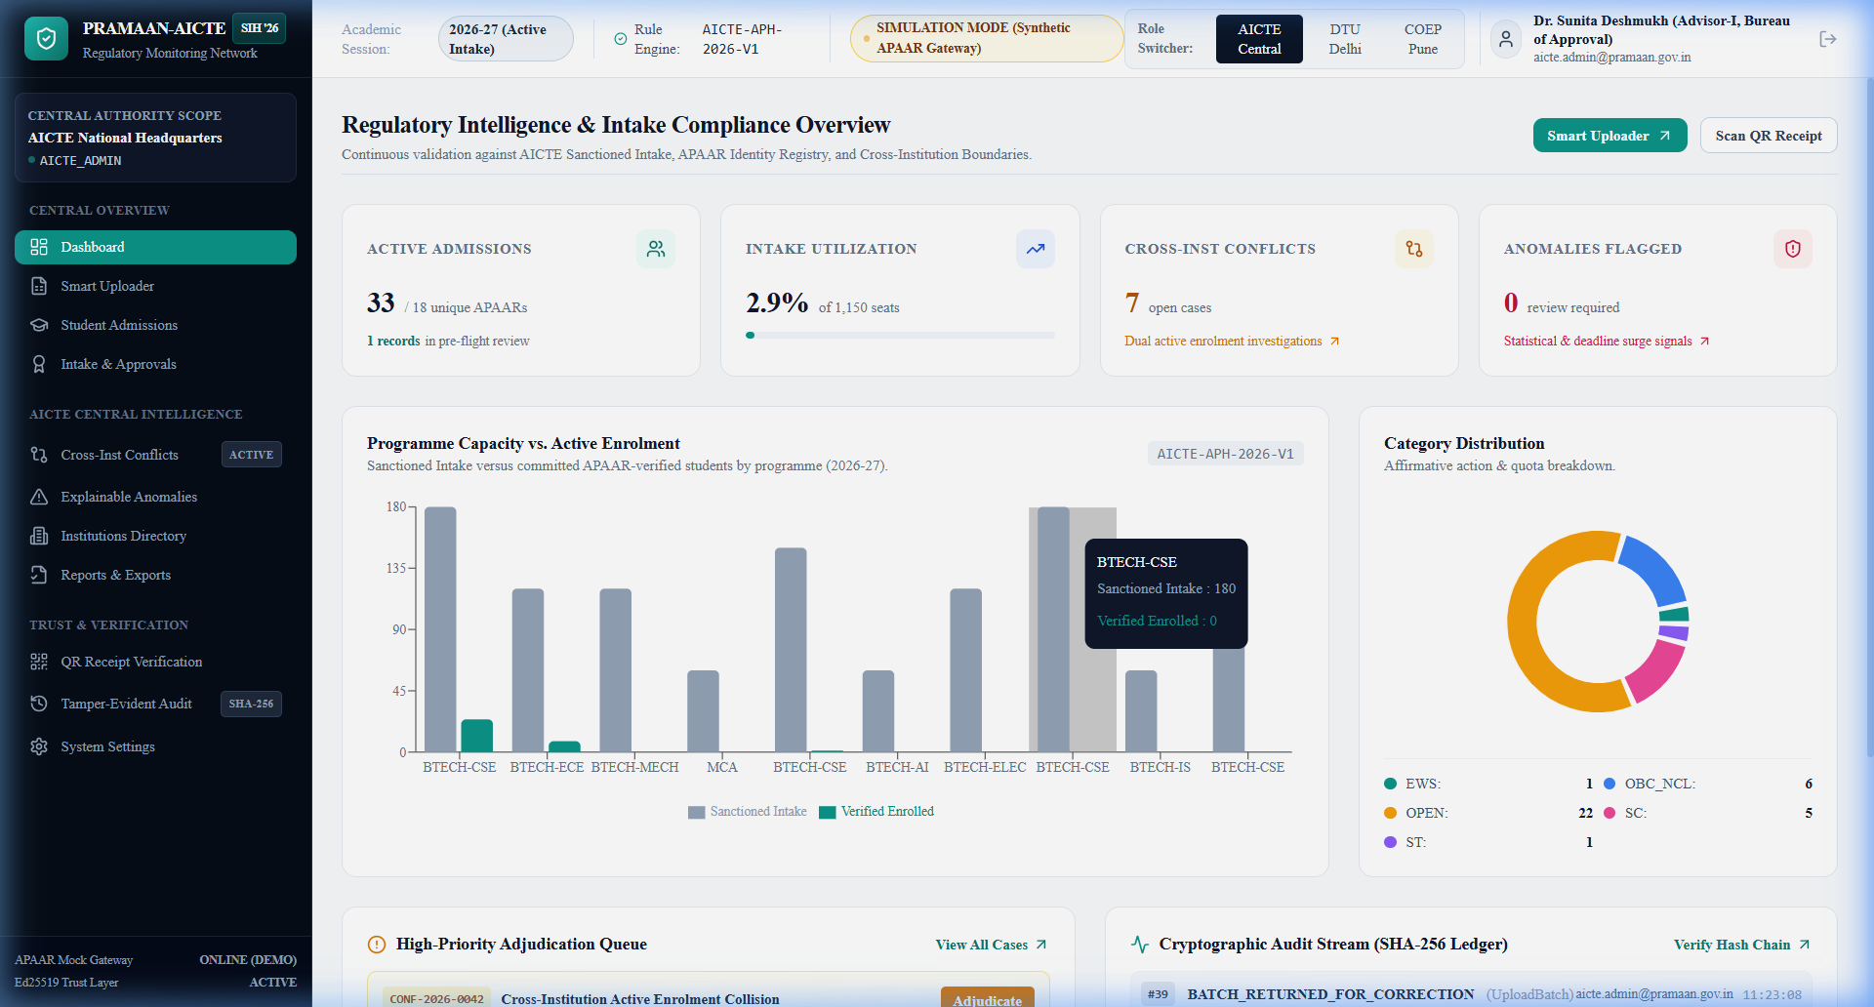
PRAMAAN-AICTE: APAAR-BASED REGULATORY RECONCILIATION & MONITORING
TCE_Yquanto
Proposed Solution & Architectural Overview
• Dual-Portal Ecosystem: Decouples institutional ingestion workspaces from the AICTE Central Executive Command Center for tenant privacy.
• Automated Batch Lifecycle: Excel/CSV upload -> Smart Header Alias Normalization -> Pre-flight Sandbox -> Atomic 2-Phase Commit.
• Real-Time Regulatory Audit: Continuous validation ensures complete institutional record authenticity before official academic census locking.
Addressing Core Problem Vulnerabilities
• Ghost Admissions Elimination: Anchors all technical admissions to verified 12-digit national APAAR IDs validated via Verhoeff dihedral D5 permutations.
• Intake Ceiling Enforcement: Validates admissions against versioned AICTE Approval Handbook (APH 2026-27) limits (General, TFW 5%, EWS 10%, NRI/FN 15%).
• Cross-College Collision Radar: Real-time cross-institutional duplicate detection prevents fraudulent concurrent multi-college technical admissions.
Key Technical Innovations & Security Layer
• Zero Plaintext Storage: Keyed HMAC-SHA256 indexing + dynamic masking (XXXX-XXXX-9012) satisfies DPDP Act 2023 without searchable plaintext exposure.
• Asymmetric Verifiability: Issues Ed25519 (Curve25519) digitally signed verification receipts with high-density QR codes (zero PII in public URLs).
• Tamper-Evident Ledger: Sequential SHA-256 cryptographic hash chain guarantees non-repudiation and detects single-bit database modifications.
PROTOTYPE EVIDENCE & LIVE VERIFICATION
AICTE National Command Center (/dashboard) featuring live sanctioned vs verified intake metrics, affirmative action quotas, duplicate conflict alerts, and real-time audit ledger feeds.

Slide 3
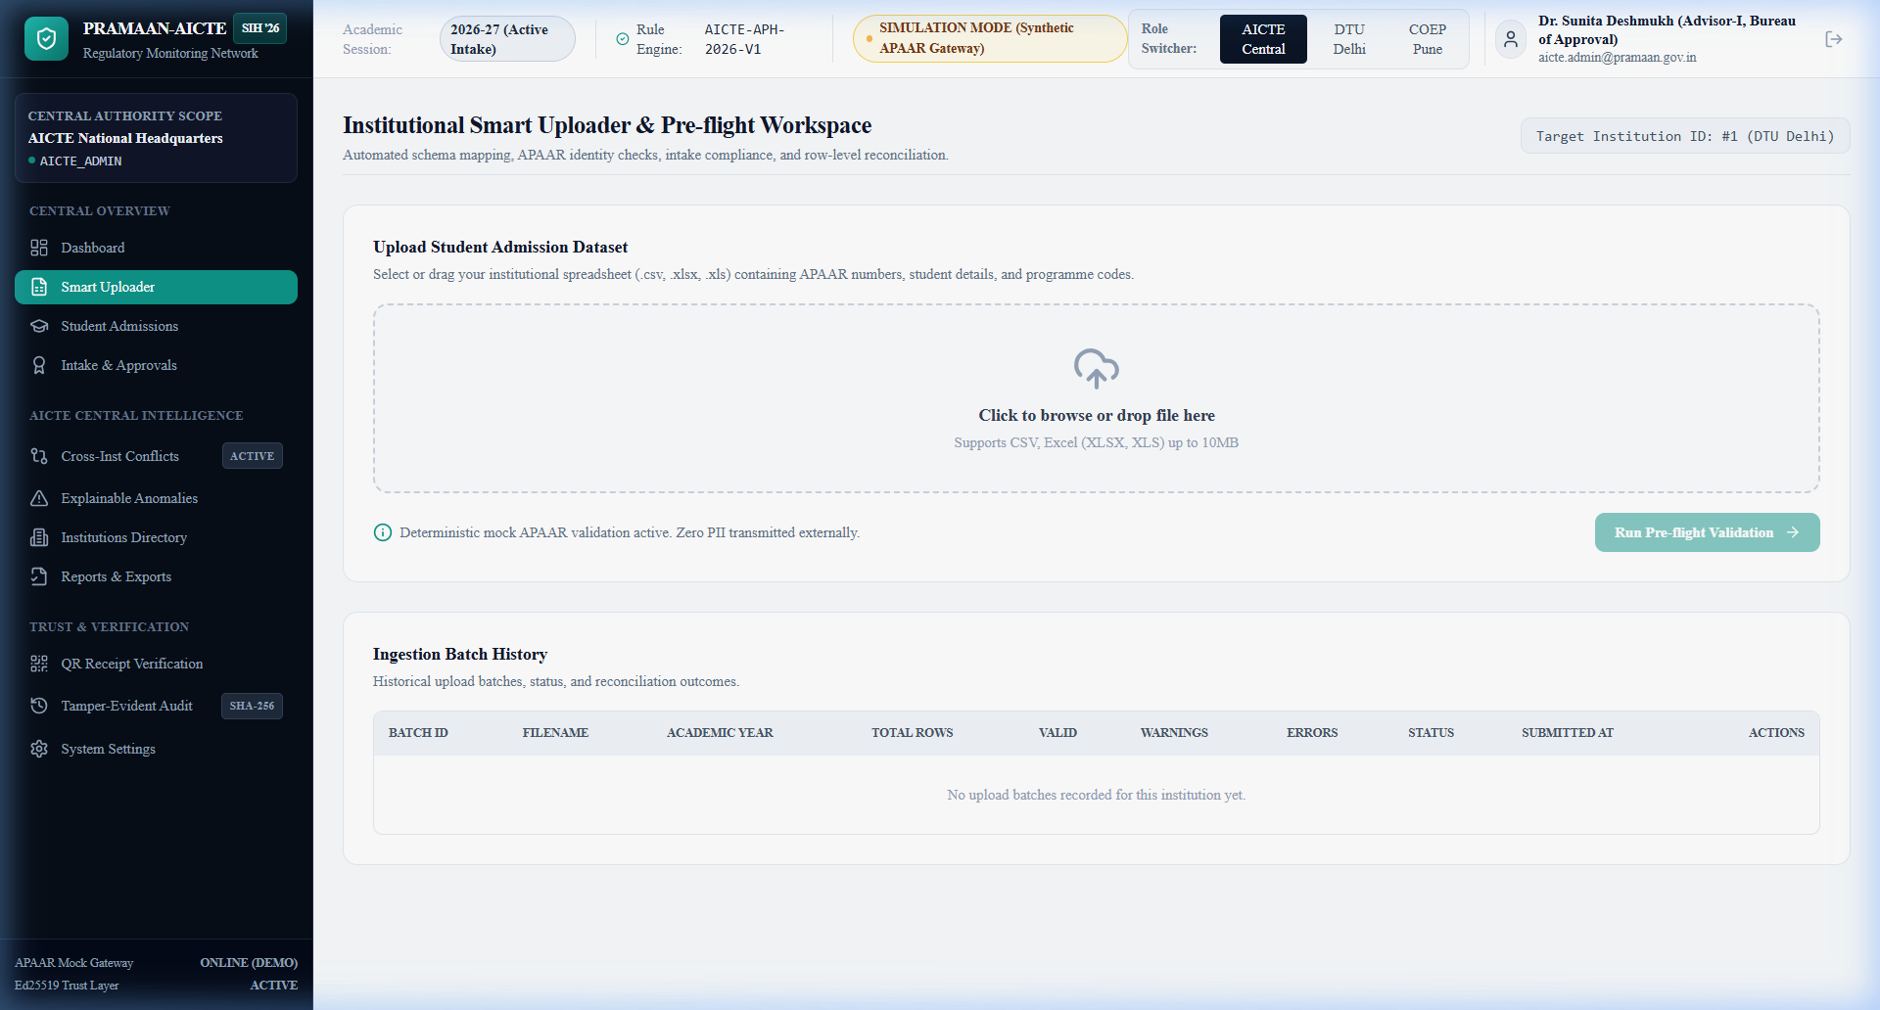
TECHNICAL APPROACH & DECOUPLED GOVERNANCE ARCHITECTURE
TCE_Yquanto
Core Production Technology Stack
• Frontend Architecture: Next.js 14 App Router, TypeScript (Strict), Tailwind CSS, Lucide Icons, Recharts Analytics.
• Backend Micro-Services: Python 3.10+, FastAPI (Modular Monolith), Pydantic v2, Uvicorn, OpenAPI 3.1 REST contracts.
• Persistence & Cloud DB: Supabase Cloud PostgreSQL (Port 6543 pooler, RLS policies) / SQLite WAL zero-setup local dev.
• Security & Cryptography: Ed25519 asymmetric signatures (PyNaCl/RFC 8032), Keyed HMAC-SHA256, bcrypt password hashing.
• Resilient Ingestion Core: Pandas & OpenPyXL with regex normalizer for fault-tolerant tabular parsing across diverse ERP schemas.
5-Tier Implementation Methodology & Pipeline
• 1. Resilient Ingestion Desk: Sub-50ms fuzzy alias matching resolves inconsistent college column headers (e.g., student_apaar <-> apaar_id).
• 2. Pre-flight Validation Gate: Quarantines rows; executes Verhoeff identity syntax, approved intake bounds, and supernumerary quota isolation.
• 3. Atomic Staging Sandbox: Enables in-browser spreadsheet inspection, error highlighting, and inline corrections prior to permanent submission.
• 4. Regulatory Adjudication: Automated double-enrollment radar triggers dispute hearings with recorded reviewer remarks and college notices.
• 5. Cryptographic Proof Engine: Issues Ed25519 signed verification receipts and appends tamper-evident SHA-256 audit ledger events.
PROTOTYPE EVIDENCE & LIVE VERIFICATION
Smart Ingestion Desk (/uploads) showcasing automated schema normalizer, pre-flight error severity categorization (ERROR, WARNING, INFO), inline cell editing, and atomic batch commitment.

Slide 4
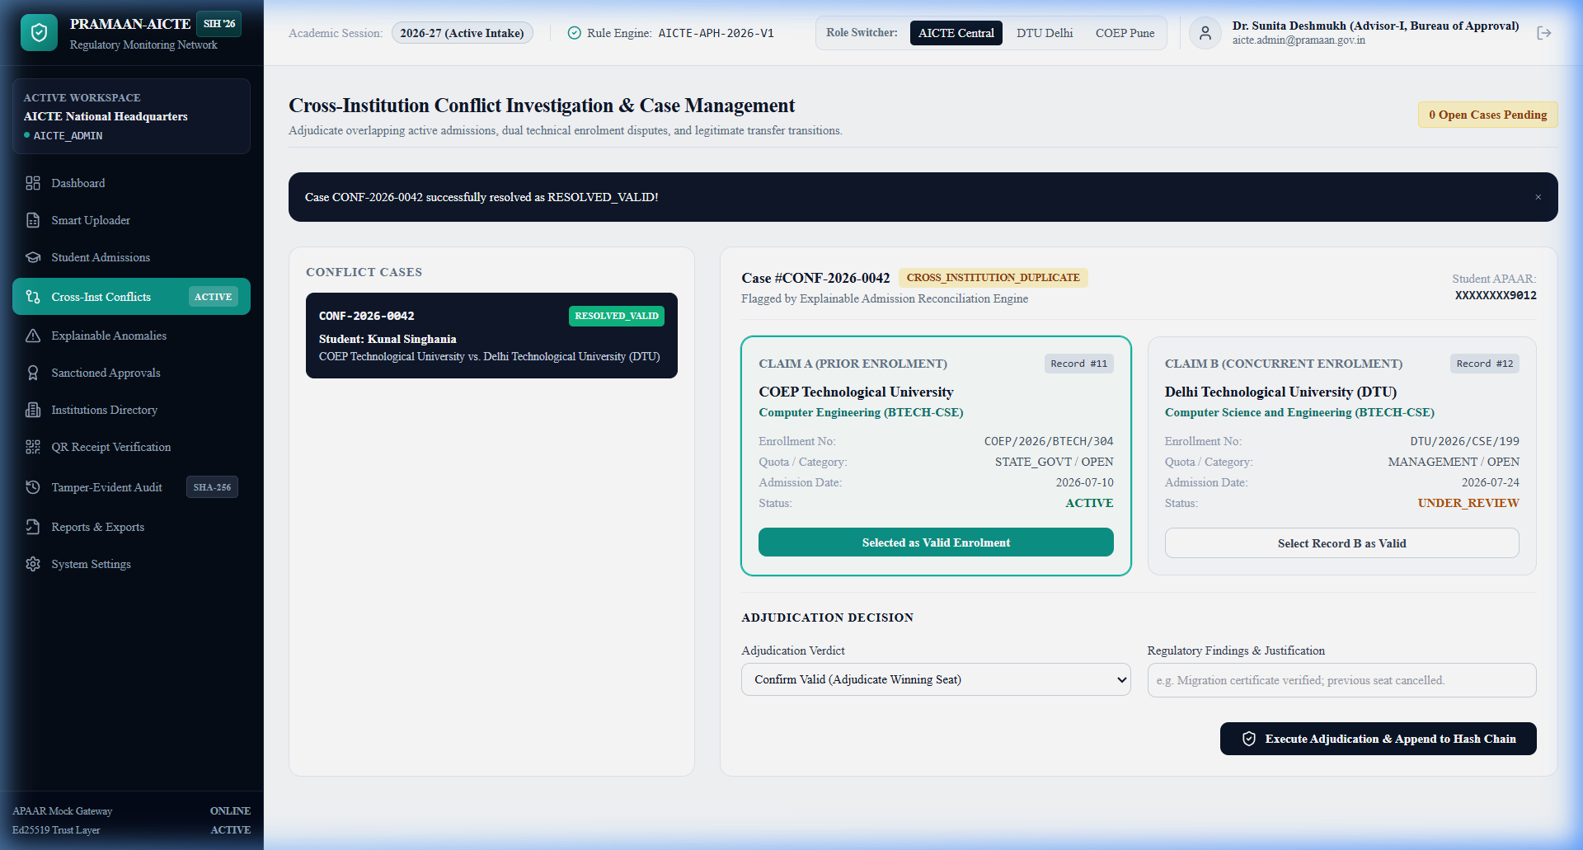
FEASIBILITY, SCALABILITY & RISK MITIGATION FRAMEWORK
TCE_Yquanto
Feasibility Analysis & Scalability Metrics
• Operational Feasibility: Zero client installation; operates seamlessly over standard institutional web browsers on any modern OS.
• Verified Prototype: Exhaustively verified with 59/59 passing pytest test suite and 33/33 live verified FastAPI endpoints.
• High-Throughput Ingestion: Chunked asynchronous database commits process 5,000+ student batches in under 2 seconds.
Identified Governance Challenges & Risks
• Heterogeneous College Formats: Thousands of approved colleges maintain conflicting spreadsheet schemas, date layouts, and branch codes.
• Identity Privacy Risks: Plaintext storage or logging of 12-digit student APAAR identifiers violates DPDP Act 2023 mandates.
• Cross-Institution Collisions: Simultaneous student admission claims across multiple colleges create jurisdictional deadlocks.
• Database Tamper Risks: Risk of illicit database modification of sanctioned intake quotas or student admission statuses.
Concrete Technical Countermeasures
• Fuzzy Normalization Engine: Regex alias dictionary automatically standardizes column headers and auto-detects date formats.
• Privacy-Preserving Hashing: HMAC-SHA256 indexing + dynamic masking guarantees zero plaintext APAAR exposure across the cloud.
• Side-by-Side Adjudication: Automated dispute queue with side-by-side claim timestamps, fee receipts, and one-click resolution.
• Cryptographic Hash Chain: Sequential SHA-256 hash chaining mathematically exposes any historical record tampering.
PROTOTYPE EVIDENCE & LIVE VERIFICATION
Cross-Institution Duplicate Adjudication Console (/conflicts) demonstrating Case CONF-2026-0042 (DTU Delhi vs COEP Pune) with side-by-side claim timestamps, fee proofs, and resolution controls.

Slide 5
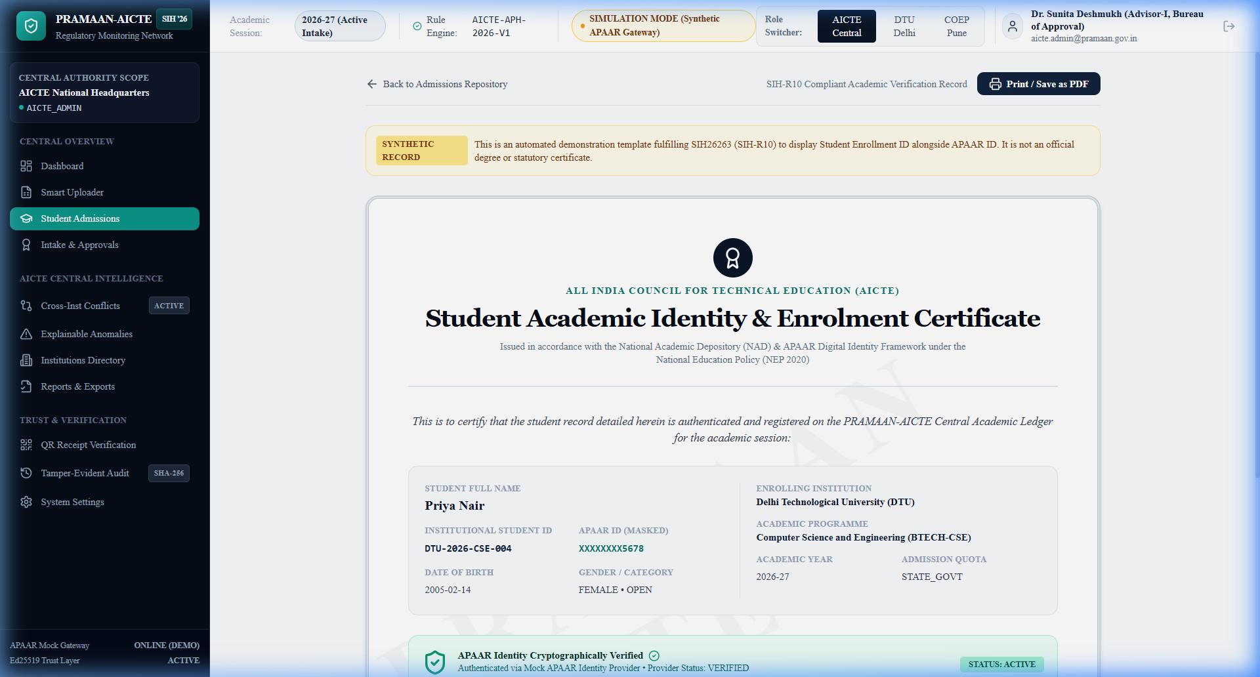
REGULATORY IMPACT, SOCIAL EQUITY & SIH-R10 COMPLIANCE
TCE_Yquanto
Impact on Target Regulatory Stakeholders
• AICTE & Regulators: Complete nationwide visibility over technical admissions; eliminates ghost seats and manual verification backlogs.
• Institutions & Colleges: Eliminates physical documentation overhead; reduces annual student admission auditing from 3 months to 5 minutes.
• Students & Parents: Guarantees authentic seat reservation; transparent supernumerary quota allocation protects deserving students.
• Employers & Verifiers: Sub-second zero-trust academic verification via mobile QR scan without contacting institutional registrars.
Quantifiable Multi-Dimensional Benefits
• Economic Benefit: Stops ghost-seat grant diversion and illegal seat-blocking, saving crores in fraudulent scholarship reimbursements.
• Social Equity: Strictly safeguards affirmative action quotas (TFW 5%, EWS 10%, KM, NRI/FN 15%) from unauthorized reallocation.
• NEP 2020 & DPDP Alignment: Full alignment with National Academic Depository (NAD), DigiLocker, and DPDP Act 2023 privacy mandates.
• Environmental & Operational: 100% paperless verification workflow eliminates courier delays and physical document falsification.
• SIH Requirement 10 Compliance: Built-in Degree Certificate Generator displaying Student ID alongside Masked APAAR ID and Ed25519 QR.
PROTOTYPE EVIDENCE & LIVE VERIFICATION
SIH-R10 Compliant Degree Certificate Engine (/admissions/certificate/[id]) displaying Student Roll No, Masked APAAR ID, Council Seal, and Asymmetric Ed25519 QR Code for instant offline verification.

Slide 6
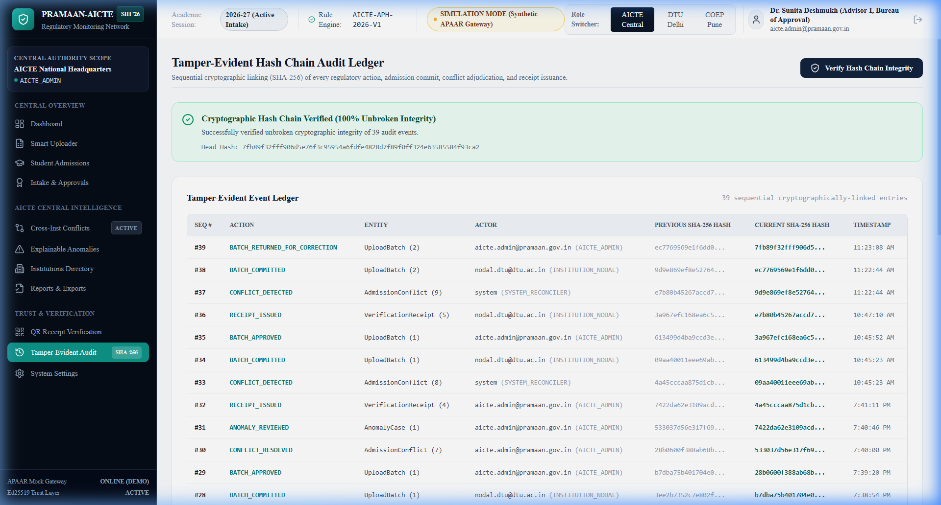
RESEARCH CITATIONS, REPOSITORY & LIVE EVALUATION LINKS
TCE_Yquanto
Formal Regulatory & Cryptographic References
• AICTE APH 2026-27: Approval Process Handbook norms for sanctioned intake ceilings, supernumerary quotas, and NRI/OCI/FN rules.
• NEP 2020 & NAD: Framework for APAAR (Automated Permanent Academic Account Registry) and Academic Bank of Credits (ABC).
• IETF RFC 8032: Edwards-Curve Digital Signature Algorithm (Ed25519 / Curve25519) for tamper-proof academic credentials.
• DPDP Act 2023: Section 4 data fiduciary mandates, purpose limitation, identifier pseudonymization, and student consent mechanisms.
• NIST SP 800-107 & Verhoeff: Permutation algorithms on Dihedral Group D5 for checksums and sequential SHA-256 cryptographic hash-chains.
Live Deployment, Source Code & Verification Links
• Open-Source GitHub Repo: https://github.com/naveeshpcbin/APAAR-ID-BASED-SYSTEM
• Live Hosted Platform: https://pramaan-aicte.yourdomain.com (Paste custom domain here)
• Interactive Swagger Docs: https://pramaan-backend.onrender.com/docs (FastAPI OpenAPI 3.1)
• Supabase Cloud Database: Ref: xvuqedqfdeybryvbablt (PostgreSQL Pooler aws-0-ap-south-1)
• Evaluator Quick Credentials: Central Admin: aicte.admin@pramaan.gov.in | Password: Admin@12345
PROTOTYPE EVIDENCE & LIVE VERIFICATION
Tamper-Evident SHA-256 Cryptographic Audit Ledger (/audit) verifying unbroken hash-chain continuity from Genesis Block 0 across all admissions, batch commits, and review decisions.

