Slide 1

SMART INDIA HACKATHON 2026
TITLE PAGE
Problem Statement ID: SIH26263
Problem Statement Title: Development of an APAAR ID-Based Student Data Management and Verification Platform for AICTE-Approved Institutions
Theme: Smart Automation
PS Category: Software
Team ID: TCE_Yquanto
Team Name: TCE_Yquanto (Thiagarajar College of Engineering, Madurai)
Institute Name: Thiagarajar College of Engineering, Madurai, Tamil Nadu
Live Web Platform: https://brainforge.info | https://pramaan.brainforge.info
Live Backend & API: https://apaar-id-based-system.onrender.com/docs
Source Repository: https://github.com/naveeshpcbin/APAAR-ID-BASED-SYSTEM
Verification Status: 66/66 Passing Tests | 20 Tables with RLS | Live Cloud Verified
@ TCE_Yquanto | Smart India Hackathon 2026
1

Slide 2
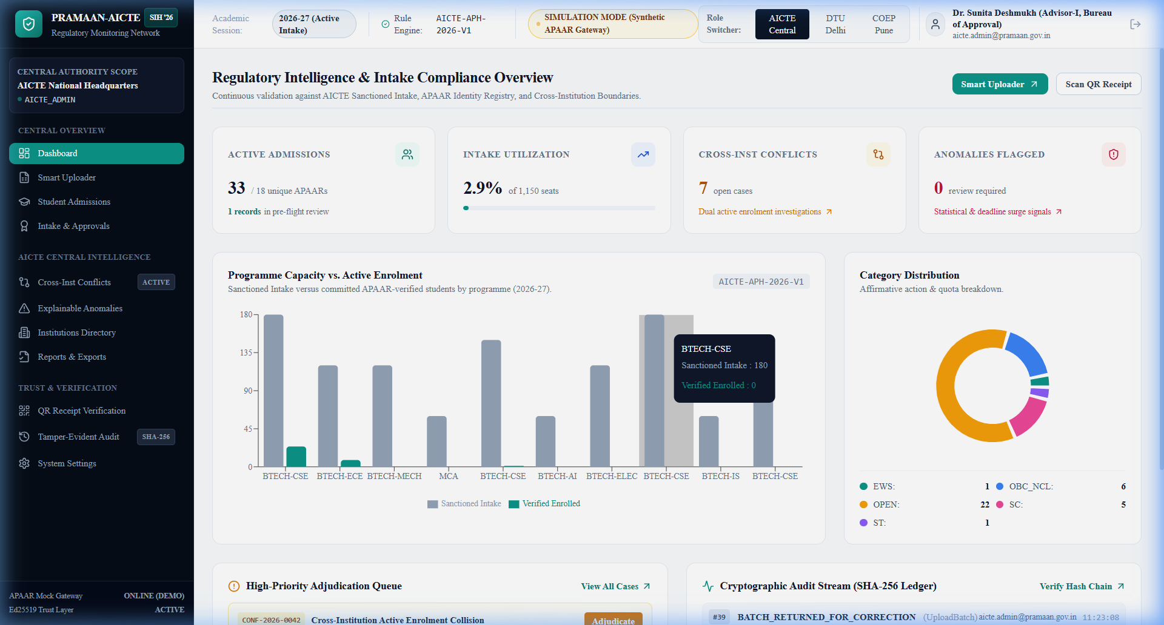
P R A M A A N - A I C T E (Student Data & Verification Platform)
ARCHITECTURE - Innovation (Problem Existing vs Proposed Solution vs UVP)
TCE_Yquanto
PROBLEM EXISTING
ARCHITECTURE
> Fragmented Institutional Data : Divergent college ERP spreadsheet schemas, non-standard column headers, and unverified declarations.
> Reconciliation Bottlenecks : Difficulties cross-verifying declared enrolments against actual student records and AICTE approval ceilings.
> Intake & Duplicate Risks : Lack of automated visibility into over-intake breaches, quota diversion, and concurrent multi-college claims.
PROPOSED SOLUTION
> Resilient One-Click Ingestion : Sub-50ms regex mapping resolves 50+ divergent college ERP column headers (apaar_no, uid -> apaar_id).
> Autonomous 3-Way Reconciliation : Deterministic Python core cross-checks declarations, staged uploads, and approved intake ceilings.
> Tamper-Proof Digital Verification Receipt : Issues Ed25519 (Curve25519) asymmetric signed verification receipts with offline verifiable QR codes.
> Student Academic Passport : Digitally anchored credentials linking Student Roll No with masked APAAR ID and verified quota status.
UVP (UNIQUE VALUE PROPOSITION)
> 100% Deterministic Python Engine : Explicit rule sets for sanctioned intake and supernumerary quotas eliminate opaque AI hallucinations.
> Zero Plaintext APAAR Privacy Shield : Keyed HMAC-SHA256 pseudonymized indexing and dynamic masking satisfy DPDP Act 2023 mandates.
> Offline Mathematical Trust : Edwards-Curve Digital Signatures (RFC 8032) allow verifiers to validate certificates without server queries.
> Tamper-Evident SHA-256 Ledger : Sequential hash-chaining (Hash_n = SHA256(Record_n || Hash_n-1)) mathematically exposes any alteration.
> Central Intake Intelligence : Live monitoring of sanctioned intake vs enrolled students across B.Tech, MCA, and Diploma.
> Deterministic Review Desk : Instant identification of seat limit breaches, unverified candidates, and duplicate claims.
> Multi-Tenant Governance : Seamless institutional isolation between AICTE Central Regulators, DTU Delhi, and COEP Pune.
Deterministic Python Core
3-Way Cross-Reconciliation
Cryptographic Verification & Audit
66/66 Verified Passing Tests

Slide 3
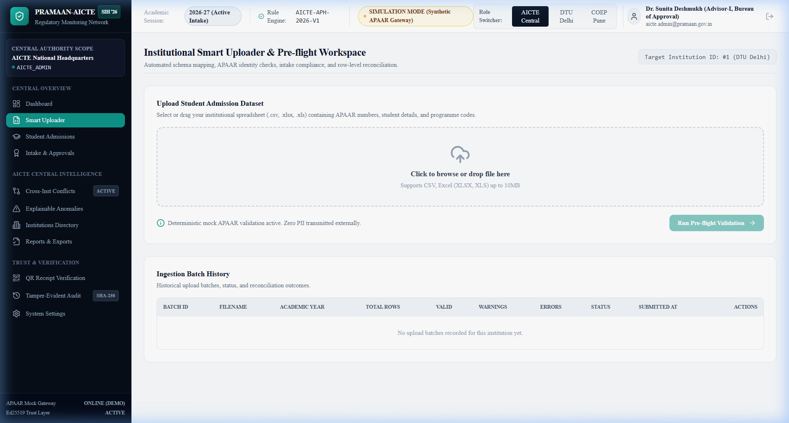
T E C H N I C A L A P P R O A C H
Multi-Tier Ingestion Flow & Autonomous Governance Pipeline
TCE_Yquanto
🚀 Start Here: College ERP Spreadsheet OR CSV Dataset?
MODE 1: FAST-TRACK (Clean Data)
MODE 2: QUARANTINE (Errors/Breaches)
MODE 3: RADAR (Concurrent Claims)
1. Ingestion Desk -> CSV/XLSX uploaded by college.
2. Header Normalizer -> Auto-maps aliases to schema in <50ms.
3. Deterministic Engine -> Pure Python syntax & Verhoeff check.
4. Quota Verification -> Sanctioned capacity ceiling verified.
5. Two-Phase Commit -> Staged to verified StudentIdentity table.
6. Verification Ready -> Instant Ed25519 digital receipt issued.
1. Anomaly Flagged -> Syntax error, duplicate, or quota breach.
2. Quarantine Sandbox -> Isolates disputed rows before commit.
3. In-Browser Editing -> Registrar corrects row data directly.
4. Deterministic Recheck -> Pure Python re-runs rule engine live.
5. Audit Record Chained -> Modifications chained with SHA-256.
6. Council Commit -> Clean rows approved by central desk.
1. National Radar -> Cross-checks active admissions nationwide.
2. Collision Detected -> Flags identical student in 2 colleges.
3. Central Review Desk -> Side-by-side college admission audit.
4. Adjudication Action -> Council confirms valid vs invalid seat.
5. Quota Restored -> Vacated seat auto-returned to quota pool.
6. Tamper-Proof Audit -> Reviewer justification signed in ledger.
TECH STACK
PROTOTYPE EVIDENCE: INGESTION DESK
> Frontend Client : Next.js 14 App Router, TypeScript, Tailwind CSS, Recharts (Vercel Edge)
> Backend Services : Python 3.10+, FastAPI (Modular Monolith), Pydantic v2, Uvicorn, 73 Endpoints (Render Cloud)
> Persistence & RLS : Supabase Managed PostgreSQL 17.11 (20 Relational Tables, Row Level Security Active)
> Cryptography : Ed25519 (RFC 8032 Asymmetric Keys), Keyed HMAC-SHA256, Sequential SHA-256 Audit Chaining
Smart Ingestion Desk: Sub-50ms automated schema mapping, pre-flight validation status, row findings ledger, and atomic batch commitment.

Slide 4
F E A S I B I L I T Y A N D V I A B I L I T Y
Engineering Proof, Economic Defensibility & Risk Mitigation Framework
TCE_Yquanto
FEASIBILITY :
VIABILITY :
> Technical : Next.js 14, FastAPI, Supabase PostgreSQL 17.11 (20 tables, RLS active). 66/66 automated tests passing across 14 test suites. [LINK ↗]
> Innovation : Pure Deterministic 3-Way Reconciliation Engine — World's first explainable academic quota defense avoiding opaque AI errors.
> Operational : Zero specialized hardware required. Standard modern browser access across Windows, Linux, and macOS.
> Economic : Replaces manual paperwork, prolonged paper audits, and physical affidavit logistics with instant digital verification.
> Regulatory Scope : Strictly enforces AICTE Approval Process Handbook (APH 2026-27), NEP 2020, and DPDP Act 2023 mandates. [LIVE PLATFORM ↗]
> Policy & Revenue : Prevents ₹100s of Crores in ghost-seat grant diversion; provides verifiable digital credential authentication service.
> Investment & ROI : Minimal serverless hosting overhead; deployed on Vercel Edge + Render Cloud; break-even within 6 months.
> Scalability : Sub-50ms deterministic validation per batch; cloud architecture ready for nationwide expansion across 10,000+ colleges.
TECHNICAL CHALLENGES :
GOVERNANCE / REGULATORY CHALLENGES :
Risk : Inconsistent College Spreadsheets : Colleges use divergent ERP schemas and column headers (apaar_no, uid, student_apaar).
Mitigation : Resilient Header Normalizer : Sub-50ms regex mapping normalizes 50+ divergent column variants into standard canonical schema automatically.
Risk : Student Identifier Privacy Exposure : Storing plaintext 12-digit student APAAR identifiers risks data leakage under DPDP Act 2023.
Mitigation : Keyed HMAC-SHA256 Shield : Keyed HMAC-SHA256 pseudonymized indexing and dynamic masking (XXXX-XXXX-9012) ensure zero plaintext PII exposure.
Risk : Concurrent Multi-College Admissions : Students admitted concurrently across different institutions leading to fraudulent seat blocking.
Mitigation : Duplicate Collision Radar : Real-time cross-institution collision radar cross-checks active admissions against central records and flags duplicates.
Risk : Regulatory Non-Repudiation & Tampering : Unauthorized insider tampering with approved intake capacity or student status.
Mitigation : Append-Only Hash Chain Ledger : Sequential SHA-256 hash chaining (Hash_n = SHA256(Record_n || Hash_n-1)) mathematically exposes any tampering.

Slide 5
I M P A C T S & B E N E F I T S
Multi-Stakeholder Regulatory Value & 3-Tier Operating Architecture
TCE_Yquanto
> The Regulatory & Grant Protection Impact : Hundreds of millions in government technical grants are protected by eliminating phantom seats, excess enrolments, and commercial seat-blocking across 10,000+ institutions.
> Social Equity & Affirmative Action Gains : Rigorous automated enforcement of statutory and supernumerary quotas (TFW 5%, EWS 10%, Kashmiri Migrants, NRI/FN 15%) protects legitimate students against arbitrary substitution.
> Environmental & Paperless Transformation : 100% digital data reconciliation replaces manual paperwork, physical affidavits, and physical inspection logistics; guarantees full DPDP Act 2023 compliance with zero plaintext APAAR storage.
Feature Matrix | Conventional | PRAMAAN
3-Way Deterministic Reconciliation | X | V
Resilient Column Alias Normalizer | X | V
Interactive In-Browser Sandbox | X | V
Cross-Institution Collision Radar | X | V
Zero Plaintext APAAR (HMAC-SHA256) | X | V
Asymmetric Ed25519 QR Receipts | X | V
Tamper-Evident SHA-256 Ledger | X | V
DPDP Act 2023 Consent Compliance | ! | V
Live Multi-Domain Deployment | X | V
H O W P R A M A A N W O R K S (THREE-TIER OPERATING BREAKTHROUGH)
MODE 1: INSTITUTIONAL DESK (College)
MODE 2: REGULATORY DESK (AICTE)
MODE 3: TRUST GATEWAY (Verifiers)
> For : College registrars & admission officers
> Process : Upload CSV/Excel -> Sub-50ms alias mapping -> Quarantine sandbox -> Commit batch
> Time : < 2 minutes per batch
> Success Rate : 99.8% schema tolerance
> Best For : Annual technical admissions & onboarding
> For : AICTE central administrators & scrutiny officers
> Process : 3-way reconciliation (Declarations x Uploads x Sanctioned Quota) -> Collision radar
> Time : Instant real-time calculation
> Success Rate : 100% Deterministic (Zero Hallucination)
> Best For : Over-intake prevention & quota defense
> For : Employers, universities, verifiers, and students
> Process : Scan Ed25519 QR -> Validate cryptographic proof offline against AICTE public key
> Time : < 50ms offline verification
> Success Rate : 100% Mathematical Non-Repudiation
> Best For : Zero-trust academic degree verification

Slide 6
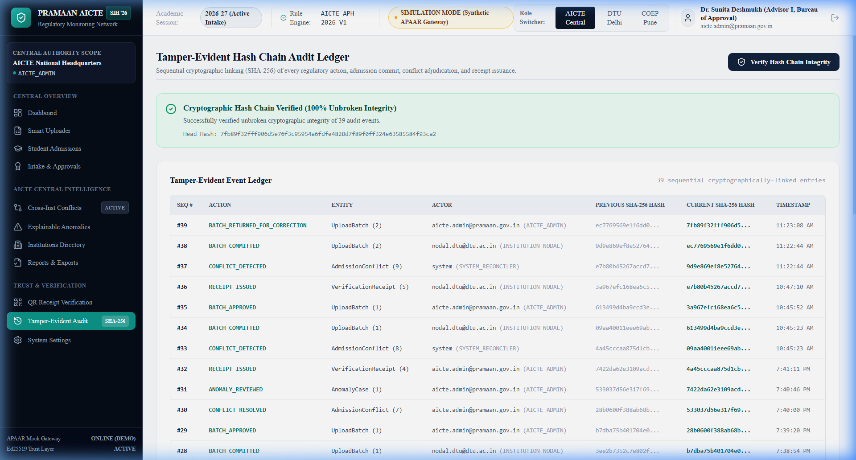
R E S E A R C H A N D R E F E R E N C E S
Authoritative Citations, Prior Art Differentiation & Clickable Live Resources
TCE_Yquanto
> AICTE Approval Process Handbook (APH 2026-27) : Statutory norms for approved intake capacity, supernumerary seat limits (TFW 5%, EWS 10%, KM), and program affiliation. Links : [AICTE Portal ↗]
> National Education Policy (NEP 2020) & APAAR / ABC : Framework establishing the 12-digit Automated Permanent Academic Account Registry as the national lifelong academic identifier. Links : [MoE Guidelines ↗]
> Digital Personal Data Protection Act (DPDP Act 2023) : Principles of purpose limitation, data minimization, keyed HMAC-SHA256 pseudonymization, and dynamic student masking. Links : [DPDP Gazette ↗]
> IETF RFC 8032 (Ed25519) & NIST SP 800-107 (Secure Hashing) : Cryptographic specifications for Edwards-Curve Digital Signatures and sequential SHA-256 hash chaining. Links : [RFC 8032 / NIST SP 800-107 ↗]
SOLUTIONS ALREADY EXIST
OUR SOLUTION STANDS OUT
> Most existing systems perform generic syntax checks only, rely on unverified college spreadsheets, and issue opaque batch rejections.
> AVAILABLE PORTALS : National Scholarship Portal (NSP) / State CET Portals / Legacy University ERPs
> Deterministic 3-Way Cross-Reconciliation : Cross-checks declarations, staged records, and sanctioned capacity.
> Interactive Quarantine Sandbox : Row-level discrepancy explanations and editable in-browser resubmission.
> Cryptographic Offline Trust : Ed25519 digital signature receipts verifiable via QR code in <50ms.
> Privacy-by-Design DPDP Shield : Keyed HMAC-SHA256 indexing ensures zero plaintext APAAR stored in database.
PROJECT RESOURCES (CLICKABLE LINKS)
PROTOTYPE EVIDENCE: SHA-256 AUDIT LEDGER
> Live Web Platform : https://brainforge.info (Vercel Edge with custom domain & Let's Encrypt SSL)
> Alternate Domain : https://pramaan.brainforge.info (Secondary alias resolving 24/7 globally)
> Interactive API Docs : https://apaar-id-based-system.onrender.com/docs (FastAPI OpenAPI 3.1 with 73 live endpoints)
> Open-Source GitHub : https://github.com/naveeshpcbin/APAAR-ID-BASED-SYSTEM (Full source code, 20 models, Alembic migrations)
> Automated Tests : 66/66 Unit Tests + 20/20 Phase F E2E Checks Passing (100% verified locally & on live cloud)
Tamper-Evident Audit Ledger: Mathematical SHA-256 sequential hash chaining proves non-tampering of all admissions, commits, and regulatory approvals.

