Slide 1
Chair Order Extractor 2.0
Navesh Kumar

Slide 2
Agenda
1. Product Demo : Before and After
2. Solution Architecture Presentation
3. Logic Walkthrough

Slide 3
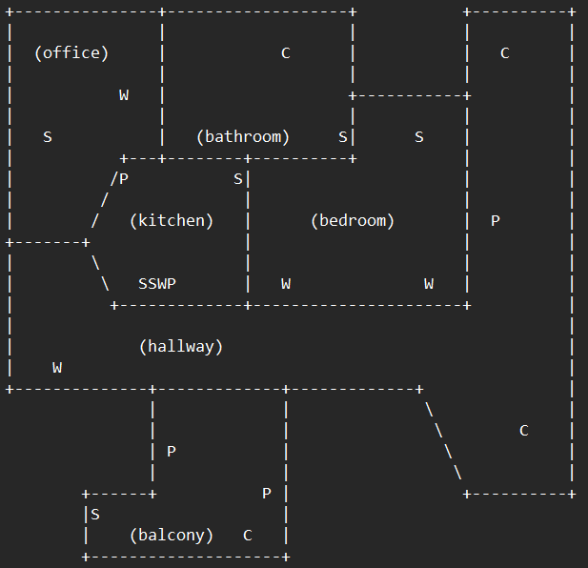
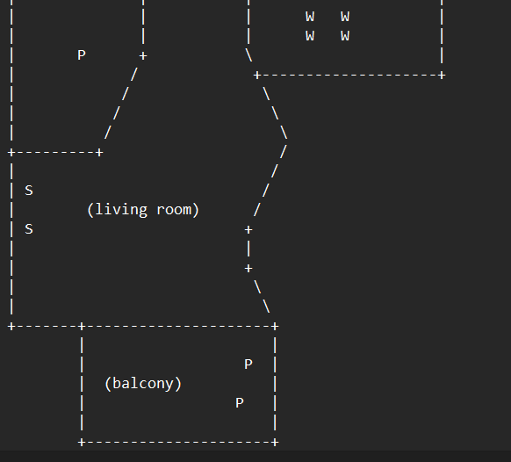
Comparison of Old and New Extractor
This was a deliberate design choice with a inference of the sample file but code was designed to incorporate this very scenario. Hence with 2 extra routines of python we again have a stable build
The algorithm was designed not to expect blanks as the sample file of the problem statement indicated that the floor plan would always be a rectangular space with the complete rectangle being populated by blanks in case a rectangle by virtue of design is not present
With the map now being coerced to act like a rectangular plane by adding spaces to the non blank area the same code, designed for the job will work with the same efficiency

Slide 4




Development Strategy and Product Delivery
Dev Tool : Python
Final Product name : chairoderextractor.py
Delivery : A .py file (developed as a one-time activity)
Customer Experience: Command Line Operated tool
Receive product Via Email
Install at the Input file location
Use command Line to run Product
Receive output file as .txt

Slide 5
Product Assumptions
The input file will always be called “floorplan01.txt”
The separators that define the “rooms” in the “floor plan” will always be ‘+’ or ‘-’ or ‘|’ or ‘/’ or ‘\’
This product in the current stage will not be delivered continuously
Client is ready for one-time installing activity as given in stepbystepreadme.txt. Client has a system that can install and run Python 3.10 and above

Slide 6
Solution Architecture
Paste Code where input file “floorplan01.txt” is located
Find Rooms. Mark the room as “visited”
Find this “visited” room’s name
Find Chairs in room in this room
Start Search for “not visited” room or if finished then output
Set working directory
“chairorder.txt” is available at the same location as code
Write compliant file

Slide 7
Algorithm : Breadth First Search (bfs)
Enter for search
(Room1)
(Room2)
Search must avoid Separators
Search will recognise boundary
Search must avoid going to another room while getting name of current room and chairs in the current room
“\” is an escape hence skipping escape is to be accounted
C1
C2
C2
Enter for search
(Room1)
(Room2)
VISITED
C2
C1
C2

Slide 8
Algorithm : Breadth First Search (bfs)
Neighbour 1 i-,j-
Neighbour 2 i-,j
Neighbour 3 i-,j+
A current cell indexed as (“ i ”, “ j ”) in a 2-dimensional grid can have 8 neighbours as shown in diagram
INVALID NEIGHBORS
Separator ‘+’ or ‘-’ or ‘|’ or ‘/’ or ‘\’
Double escape of separator “\”
Boundary of the floor plan
Visited cell
Neighbour 8 i ,j-
Current Position i , j
Neighbour 4 i ,j+
Neighbour 7 i+ , j-
Neighbour 6 i+, j
Neighbour 5 i+ , j+

Slide 9
Libraries used
1. numpy dependency version : numpy 1.22.3

