Slide 1
Operation raccoon

Slide 2
Problem Definition
FX markets are subject to volatility
Some clients trade in different currencies
Spot-trades tied to transactions/GetRate
Some make efforts to manage risk with various levels of complexity
Forwards
Options / Structured Options
FX Derivatives
Some clients do transactions based on FX movements:
Those who do: Predict transactions to arm salespeople with meaningful insights
Those who don’t: Find clients who may benefit from products based on volume
Also due to 2X multiplier on the board, all time-series based solutions will not be entertained

Slide 3
Hypothesis
If a client regularly makes a transaction based on a specific FX movement, then the next time this movement is observed, that client will make a transaction.

Slide 4
Data
MI360 contains nearly 3 years of transactions by over 500,000 clients
`$_VA` indicates value of the transaction to HSBC, no rows NAN
`Client ID_` is an alpha-numeric identifier for a client, no rows NAN
`Transaction Date` is the date of a transaction, no rows NAN
Other columns that may be interesting are industry, geographic region, etc.
KDB holds FX rates
Very rich information, highs and lows for every day for many currencies
Split up over many volumes and joins are spooky
Currency Data also holds FX rates
`Date` col acts as a tag for the rest of the row
Every other entry is a ratio of currency value relative to USD at close

Slide 5
Goal
Rank all clients by their propensity to make an FX related transaction
Create a simplified output for salesperson, perhaps “Top 5” list
For each client, describe what movement was interesting:
Arm salesperson with what movements raised flag for particular client
“Hello <client>, we’ve noticed that when <movement> happens, you usually <transaction>, just now <movement> has happened. May I help you with <transaction> today?”

Slide 6
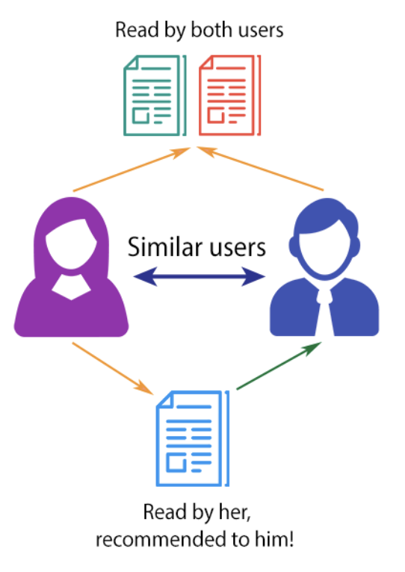
Traditional Approach?
K-Nearest Neighbours, the use of collaborative filtering
Negatives:
Cold start problem
Popularity bias
Scalability issues

Slide 7
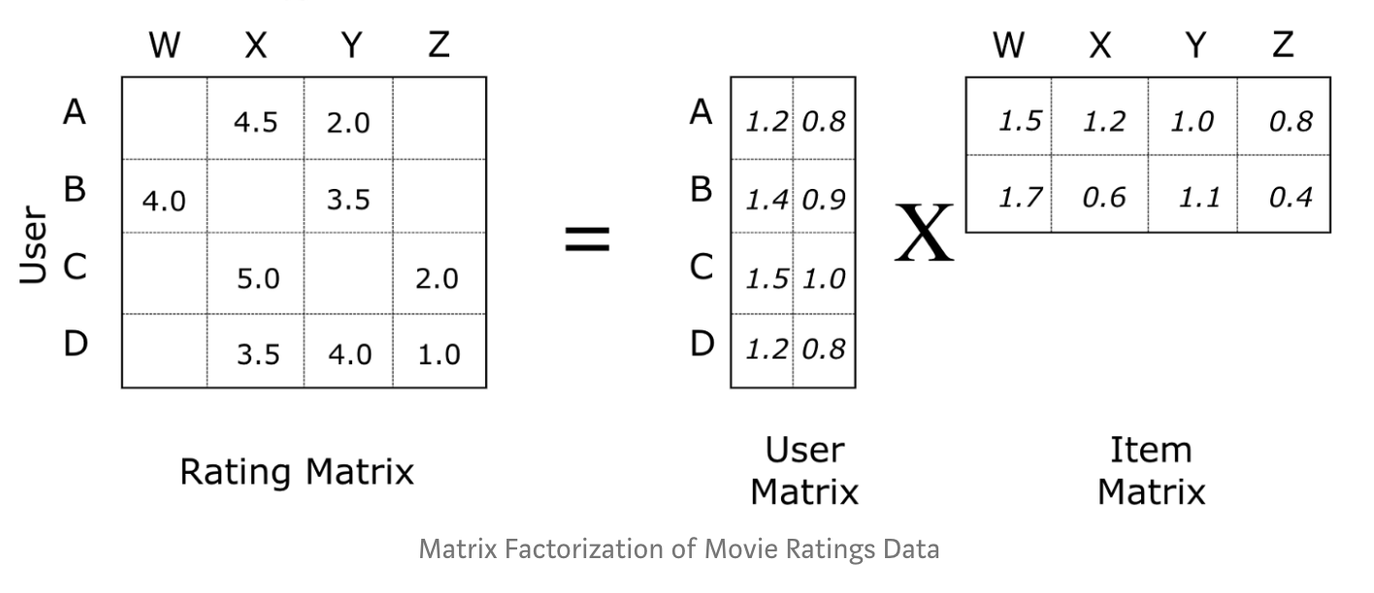
Inspiration
Netflix had a similar problem with recommendations for movies for its users
Matrix Factorization was used to solve this problem - works as below:

Slide 8
Netflix Problem cont.
“A user has these ratings for these movies, next time we see user, what movie should we suggest to maximize rating?”
Intuitively user and client are both IDs of somebody, ratings and FX Moves are ordinal, and movies, like transactions, are discrete events. By making the obvious substitutions we arrive at the problem being written:
“A client has these FX moves for these transaction volumes, next time we see client, what transaction volume should we suggest to maximize FX moves?”
But these substitutions do not answer our goal (we are recommending clients, not volume)

Slide 9
Netflix Problem cont. cont.
“A user has these ratings for these movies, next time we see user, what movie should we suggest to maximize rating?”
Instead shoehorn the goal “we see FX move, what client should we suggest to maximize transaction volume” by substituting user for FX move, movie for client, and rating for transaction volume
“An FX move has these transaction volumes for these clients, next time we see FX move, what client should we suggest to maximize transaction volume?”

Slide 10
Methodology
Preprocess data by obtaining the total value added for each FX Move. E.g.
 | USD+1 | USD+2 | USD-1 | USD-2 | GBP+1 | GBP+2
Company A | 1000 | NaN | NaN | NaN | 3000 | 5000
Company B | NaN | 3000 | NaN | 2000 | NaN | NaN
Note: This is aggregated value added and it is time series independent
Apply a matrix decomposition algorithm to predict the value of the NaNs
Recommend the top 5 companies based on highest value added

Slide 11
Planned Roadmap
Extract, Transform, Load
Both datasets into PySpark dataframe
Throw out all unused cols, throw out rows beyond common date range
Split data into training and verification sets still based on date
Load into new dataframe of format needed for SVD
Train Model
Create simplified models for both Movements and Clients
Verify that trained models can predict matrix saved for verification (if not, panic)
Create Interface
Enter new FX information
Generate recommendations based on all moves (different than single user recommendation)
Receive client suggestions and reasons they were chosen

