Slide 1
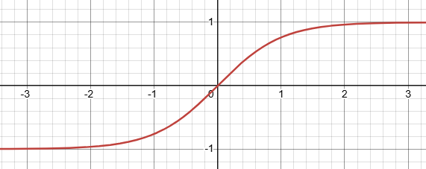
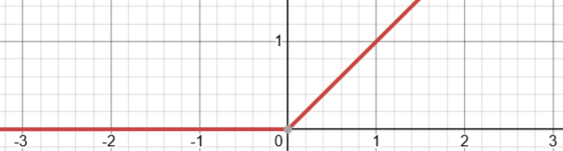





Recurrent Neural Network
Vanishing gradient limits long-term memory.
Input h0(t)
RNN h1(1)
RNN h2(3) …
RNN h#(t)
$$tanh\left({h0}_{(4)}W1+{h1}_{(3)}U1+b1\right)$$
$$tanh\left({h1}_{(1)}W1+{h2}_{(0)}U2+b2\right)$$
$$tanh\left(h_{(\#−1, t)}W\#+h_{(\#, t−1)}U\#+b\#\right)$$
2*2
1*2
t=0
t=1
t=2
t=3
t=4
U1
0 | 0
0 | 0 | 0 | 0 | 0
…
1*3
3*2
V*n
1 | 2 | 3
2 | 1 | 3
3 | 2 | 1
0 | 0 | 1
W1
+ b1
➔ σ = h1(1)
Linear
Projection
0 | 0
0 | 0
0 | 0
0 | 0
0 | 0 | 0 | 0 | 0
0 | 0 | 0 | 0 | 0
0 | 0 | 0 | 0 | 0
0 | 0 | 0 | 0 | 0
5*n
…
…
…
…
5*5
U2
U2
1*5
n*1
5*n
2*5
W3
W2
+ b2
➔ σ = h2(3)
1*n
4*3 x 3*2 ➔ 4*2
4*2 x 2*5 ➔ 4*5
4*5 x 5*n ➔ 4*n
Next
Token
Recurrent
Hyperbolic tangent
U_{t}
$$tanh(x)=\frac{e^{x}−e^{−x}}{e^{x}+e^{−x}}$$
σ
X_{n-1}
h
W_{t}
H
X_{n}
ReLU
$$y=max(0, x)$$

Slide 2
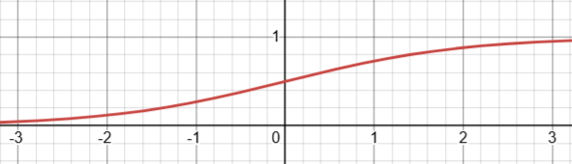






Long Short-Term Memory
LSTM struggles with context.
Input x(t)
Forget Gate
3*2
2*2
h(t)
C(t)
$$f_{t}=σ\left(x_{t}W_{f}+h_{t−1}U_{f}+b_{f}\right)$$
Wf
+b➔ σ
Uf
t=0
t=1
t=2
t=3
t=4
= f4
0 | 0
0 | 0
Input Gate
3*2
2*2
$$i_{t}=σ\left({x_{t}W}_{i}+h_{t−1}U_{i}+b_{i}\right)$$
1 | 2 | 3
2 | 1 | 3
3 | 2 | 1
0 | 0 | 1
Wi
+b➔ σ
Ui
0 | 0
0 | 0
0 | 0
0 | 0
0 | 0
0 | 0
0 | 0
0 | 0
Candidate Cell Status
= i4
$${\text{€}}_{t}=tanh\left(x_{t}W_{c}+h_{t−1}U_{c}+b_{c}\right)$$
3*2
2*2
Wc
+b➔ tanh
Uc
Cell Status Update
= €4
$${ C}_{t}=f_{t} ⨀{ C}_{t−1}+i_{t} ⨀{ \text{€}}_{t}$$
h3
C3
x(4)
f4
Ꙩ C3
+
i4
Ꙩ
€4
= C4
h4
C4
Output Gate
3*2
2*2
$$O_{t}=σ\left(x_{ t}W_{o}+h_{t−1}U_{o}+b_{o}\right)$$
Wo
+b➔ σ
Uo
1*3
= O4
1*2
1*2
Hidden State
$$h_{t}=O_{t}⨀tanh(C_{t})$$
O4
Ꙩ
tanh(C4)
= h4
U_{t}
Long
σ
c
Sigmoid Function
h
C
$$σ\left(x\right)=\frac{1}{1+e^{−x}}$$
X_{n-1}
W_{t}
H
X_{n}

Slide 3



Multi Head Attention
Spatial point-to-point direct links bypass the temporal ‘for-loop’, unlocking perfect parallelism.
3*3
Transformer
W_{v}
$$Q=X_{i}∙W_{q}$$
$$K=X_{i}∙W_{k}$$
$$V=X_{i}∙W_{v}$$
3*3
2 | 3 | 4 | 5
1 | 3 | 2 | 4
4 | 5 | 8 | 6
4*3
W_{k}
K^{T}
X_{i}
V
Attention( X_{i} )
3*3
t=1
t=2
t=3
t=4
1 | 2 | 3
2 | 1 | 3
3 | 2 | 1
2 | 3 | 1
Layer n
1 | 1 | 2
2 | 1 | 1
 |  |  | =
1 | 2 | 1
1 | 3 | 1
16 | 16 | 32
66 | 42 | 60
74 | 76 | 66
101 | 159 | 92
$$A_{{N∗d}_{h}}^{i}=Softmax\left(\frac{{QK}^{T}}{\sqrt{d_{h}}}⊙M\right)∗V$$
16 | 24 | 32 | 31 |  | 1
18 | 24 | 34 | 28 |  | 1 | 1
 |  |  |  | Ꙩ
12 | 20 | 22 | 29 |  | 1 | 1 | 1
11 | 20 | 22 | 28 |  | 1 | 1 | 1 | 1
W_{q}
Causal
Mask
4*3
MHA
Q
x
A^{i}
$$X_{N∗d}=GPU.cat(A_{d_{h}}^{0},A_{d_{h}}^{1},…,A_{d_{h}}^{h−1})$$
KV cache
Multi-Head
A0
GPU
parallelism
A1
W_{v}
…
X_{n-1}
W_{k}
A^{i}
A
X_{n}
W_{q}
…
A^{h-1}

Slide 4


Gated DeltaNet
A linear attention model that evolves blind accumulation into precise erasing and overwriting.
Linear Attention: ..Mamba2/GLA.
Delta Rule: ...
Deprioritize
Outdated data
S0
Delta Rule
Update State
Memory Matrix
N*d
d*d
v_{t}
S1 …
$$≅Γ$$
Linear
Projection
t=1
t=2
t=3
t=4
1 | 2 | 3
2 | 1 | 3
3 | 2 | 1
0 | 0 | 1
W_{v}
1*d
S_{t-2}
k_{t}^{T}
V*d
k_{t}
Linear
Attention
Residual Connection
W_{z}
W_{k}
0 | 0 | 0 | 0
0 | 0 | 0 | 0
0 | 0 | 0 | 0
0 | 0 | 0 | 0
v_{t}
0 | 0 | 0 | 0
0 | 0 | 0 | 0
0 | 0 | 0 | 0
0 | 0 | 0 | 0
q_{t}
O^{i}
d*1
d*d
d*1
d*d
d*1
N*d
1*d
w_{αt}
*
S_{t-1}
+
=
S_{t}
•
➔
w_{βt}
X_{n}
MLP
SwiGLU
x _{t}
Ꚛ
W_{q}
q_{t}
q_{t}
k_{t}^{T}
v_{t}
H_{i+1}
n x (c*d)
X_{i}
c*d
c
Chunk i
q_{t}
.
.
.
n
$$β_{t}$$
G
Chunk-wise Parallel:
Inter-chunk (RNN) =Qchunk*Hchunki-1
Intra-chunk (Attn) =
O^{i}

Slide 5
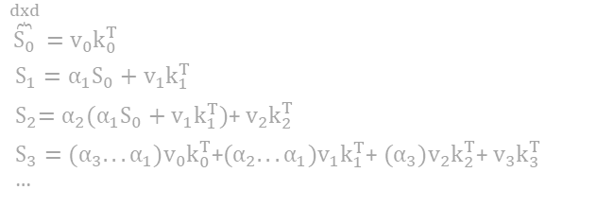
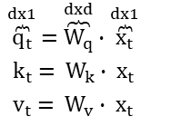
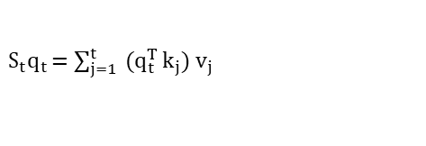
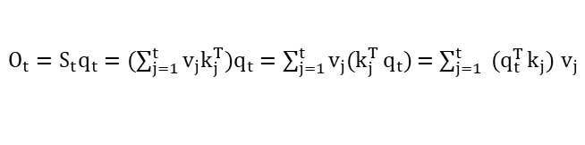
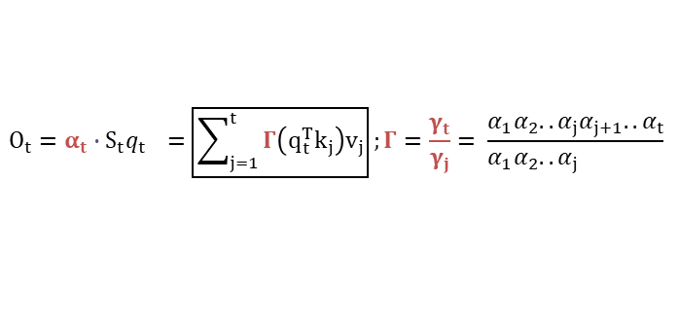
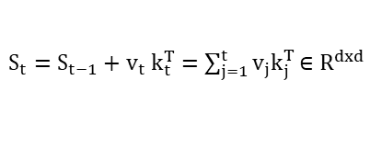

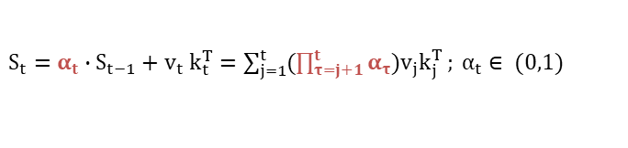
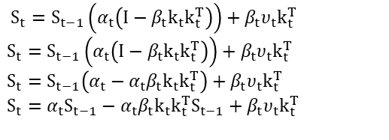
Gated Delta Network
A linear attention model that evolves blind accumulation into precise erasing and overwriting.
Linear Attention: ..Mamba2/GLA.
Delta Rule: ...
Linear Attention
$\overset{dx1}{\overbrace{q_{t}}}$ = $\overset{dxd}{\overbrace{W_{q}}}∙\overset{dx1}{\overbrace{x_{t}}}$
$${ k}_{t} = W_{k}∙ x_{t}$$
${ v}_{t} = W_{v}$ $∙$ $x_{t}$
$S_{t}=S_{t−1}+v_{t} k_{t}^{T}=\sum_{j=1}^{t}{v_{j}k_{j}^{T}}$ $∈R^{dxd}$
$O_{t}=S_{t}q_{t}=(\sum_{j=1}^{t}{v_{j}k_{j}^{T}})q_{t}=\sum_{j=1}^{t}{v_{j}(k_{j}^{T}}q_{t})$ = $\sum_{j=1}^{t}{ (q_{t}^{T}}k_{j}) v_{j}$
Manba2/Gated LA
$\overset{dxd}{\overbrace{S_{0}}}$ $=v_{0}k_{0}^{T}$
$S_{1}=α_{1}S_{0}+v_{1}k_{1}^{T}$
${ S}_{2}=α_{2}(α_{1}S_{0}+v_{1}k_{1}^{T})$+ $v_{2}k_{2}^{T}$
$S_{3}={(α}_{3}...α_{1})v_{0}k_{0}^{T}$+${(α}_{2}...α_{1})v_{1}k_{1}^{T}$+ ${(α}_{3})v_{2}k_{2}^{T}$+ $v_{3}k_{3}^{T}$
…
Chunk-wise
$S_{t}=S_{t−1}\left(α_{t}\left(I−β_{t}k_{t}k_{t}^{T}\right)\right)+β_{t}υ_{t}k_{t}^{T}$
$S_{t}=S_{t−1}\left(α_{t}\left(I−β_{t}k_{t}k_{t}^{T}\right)\right)+β_{t}υ_{t}k_{t}^{T}$
$S_{t}=S_{t−1}\left(α_{t}−α_{t}β_{t}k_{t}k_{t}^{T}\right)+β_{t}υ_{t}k_{t}^{T}$
$S_{t}={α_{t}S}_{t−1}−{α_{t}β_{t}k_{t}k_{t}^{T}S}_{t−1}+β_{t}υ_{t}k_{t}^{T}$
$S_{t}=α_{t}∙S_{t−1}+v_{t} k_{t}^{T}=\sum_{j=1}^{t}{(\prod_{τ=j+1}^{t}{α_{τ}})v_{j}k_{j}^{T}}; α_{t}∈ (0,1)$
$$O_{t}=α_{t}∙S_{t}q_{t } =\boxed{\sum_{j=1}^{t}{Γ\left(q_{t}^{T}k_{j}\right)v_{j}}};Γ=\frac{γ_{t}}{γ_{j}}= \frac{α_{1}α_{2}..α_{j}α_{j+1}..α_{t}}{α_{1}α_{2}..α_{j} }$$
$$≅O_{N∗d}=\left({QK}^{T}⊙Γ\right)∗V$$
Chunk-wise
$S_{t}=S_{t−1}\left(α_{t}\left(I−β_{t}k_{t}k_{t}^{T}\right)\right)+β_{t}υ_{t}k_{t}^{T}$
$S_{t}q_{t}$ = $\sum_{j=1}^{t}{ (q_{t}^{T}}k_{j}) v_{j}$
1*3

Slide 6
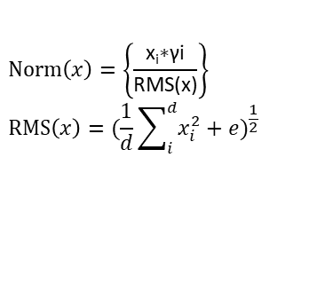
Kimi Delta Attention
-- struggles with context.
MoE
X
Attn
➔
FFN
N*d
d*d
Transformer
X
W_{k}
N*d
·
➔
…
The
fox
jumps
over
the
lazy
dog
?
K
N*d
N*d
N*d
d*d
2 | 3 | 4 | 5
1 | 3 | 2 | 4
4 | 5 | 8 | 6
X
d*d
N*d
X
X
·
W_{q}
N*d
·
W_{v}
➔
➔
➔
N*d
N*d
Q
Causal
Mask
V
A
RMS
1 | 2 | 3
2 | 1 | 3
3 | 2 | 1
2 | 3 | 1
16 | 24 | 32 | 31 | Ꙩ | 1
18 | 24 | 34 | 28 | Ꙩ | 1 | 1
12 | 20 | 22 | 29 | Ꙩ | 1 | 1 | 1
11 | 20 | 22 | 28 | Ꙩ | 1 | 1 | 1 | 1
=
=
=
=
16 | 0 | 0 | 0 |  | 1 | 1 | 2
18 | 24 | 0 | 0 |  | 2 | 1 | 1
 |  |  |  | x |  |  |  | =
12 | 20 | 22 | 0 |  | 1 | 2 | 1
11 | 20 | 22 | 28 |  | 1 | 3 | 1
16 | 16 | 32
66 | 42 | 60
74 | 76 | 66
101 | 159 | 92
0.7 | 0.7 | 1.4
1.2 | 0.7 | 1
1 | 1 | 0.9
0.8 | 1.3 | 0.7
…
The
fox
jumps
over
the
lazy
dog
?
…
The
fox
jumps
over
the
lazy
dog
?
=
$$Norm\left(x\right)=\left\{\frac{\text{x}\text{i}\text{∗γi}}{\text{RMS(x)}}\right\}$$
$$RMS\left(x\right)={(\frac{1}{d}\sum_{i}^{d}{x_{i}^{2}+e})}^{\frac{1}{2}}$$

