Slide 1
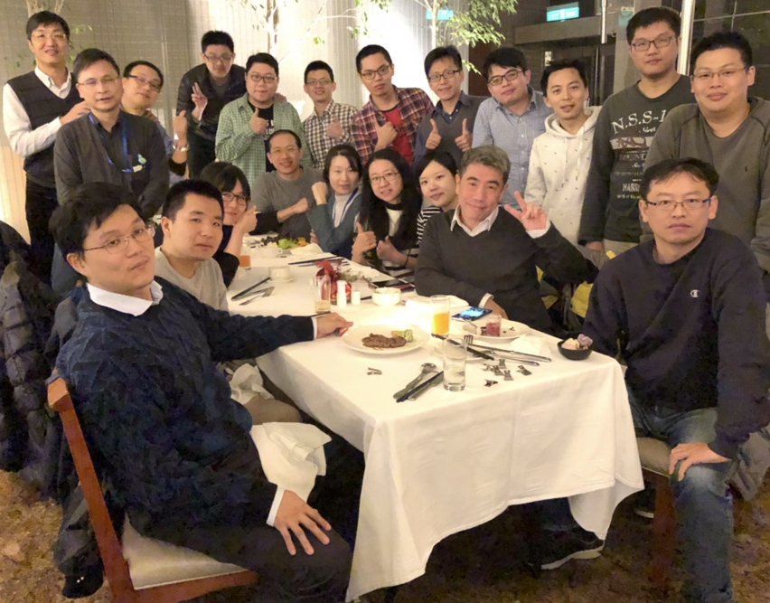
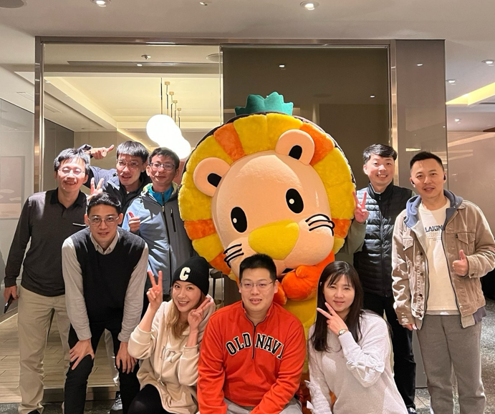

Attention Is All You Need
2017
Google Brain: Google Research University of Toronto
Ashish Vaswani (Essential AI*) Niki Parmar (Anthropic) Aidan N.Gomez (Cohere*)
Noam Shazeer (Google) Jakob Uszkoreit (Inceptive*)
Lukasz Kaiser (OpenAI) Llion Jones (Sakana AI*) -- «The Transformer Eight»
Illia Polosukhin (NEAR Protocol*)
Gemma 4 Technical Report
2026
Google DeepMind Gemma Team
2018
2024
Centrillion Technology
Bioinformation Dept.
Felix & Allen
2026/09/16
As a biotech laboratory based in TaiYuen Hi-Tech Industrial Park (台元科技園區), we focus on genotyping, spatial sequencing, and AI-driven genome decoding.
Notes:
老師, 以及各位專家先進, 還有同學們早安.
簡單自我介紹, 我們公司是洪老師所帶領的一個生技實驗室, 位於台元科技園區.
主要研發方向包含: 基因分型, 空間定序, 以及透過AI技術對生資訊息進行解碼.
今天內容: 取自兩份paper, (2017 attention, 與 2026 Gemma 4)

Slide 2
Agenda
Overview
      ML
    Training Stages
Transformer
    Self-Attention
    FFN and MoE
    Linear Projection
    Embeddings
    Position Encoding
    Summary
GPT
    Pre-Training
    MLP
    Backpropagation
    Training Cluster
    AI Ecosystem
Gemma Family
    MTP
    Supervised FT
    PEFT: QLoRA
    PEFT: DoRA
    Gemma4: PLE
AI Runtime
    MCP
    Agent Skill
    LLM Wiki
    SLM Engine
    Emerging Trends
Conclusion
    Benchmarking x3
    Building the Agent
Overview (AI Evolution from Alex Net to GPT)
Transformer (Basic model type has: Dense and MoE)
GPT (How GPT predict next token?)
Gemma Family ( Cloud: Gemini ➔ Agent: Gemma 4)
AI Runtime (Environment of AI Agent, SLM, LLM, RAG and MCP)
Conclusion (A Holistic Perspective)
Notes:
這是解說內容與次序. 目標如下
學習gemma 4與相關的背景知識.
當前的AI生態與趨勢, 一些實作分享
(希望目的) 讓大家能更精確看懂”AI技術與文章”

Slide 3
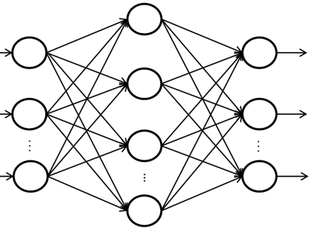











Overview
Data is fuel, DL is the engine, and compute is the rocket.
Evolution from Alex Net to GPT
 | Pre-Training | Fine-Tuning | Loss | Parameter | Attention | Model | Agent | CV
2010s | Word2Vec |  |  |  |  | RNN, LSTM |  | CNN, Alex Net
2015 |  |  |  |  |  | RSN | Alpha Go | YOLO v1
2017 |  |  | PPO |  | PE | Transformer
2018 | BERT | SFT | RLHF |  | RoPE | BERT | GPT
2019 |  | Full FT
2020 | GPT-3 |  |  |  | NoPE |  | RAG | YOLO v4
2021 |  | Instruction | Alignment | PEFT |  | Prompt
2022 |  | FLAN (zero-shot) |  | LoRA |  | CoT | ReAct
2023 | Instruct GPT | Self-Instruct | DPO | QLoRA |  | DS MLA
2024 | CAI | Self-Alignment | GPRO | DoRA |  | DS MoBA | MCP Agentic RAG
 |  |  |  |  |  | Modern BERT
2025 |  |  |  |  |  | Bit Net (1.58) | Skill
 |  |  |  |  |  | DeepSeek V4
2026 | Native Multimodal | Parameter Efficient FT |  |  |  | Kimi K3, Gemma 4 | LLM Wiki | YOLO26
 | Reasoning | PEFT |  |  |  | GUFF | Intention | ONNX
Current Edge AI: Llama4, Qwen 3, DeepSeek-V4, Mistral 3, Kimi K3, Gemma4
SLM, Low cost,
Easy SFT and
Apache 2.0 …
Notes:
1. Transformer 架構 (2017年)與自注意力機制：它打破了過去 RNN、CNN 等舊架構無法高效平行運算的瓶頸。
讓電腦能夠同時處理巨量文字，並理解詞彙在不同上下文中的超長距離關聯。
2. ChatGPT (2022年) LLM爆發, AGI的起點: 當模型參數與資料量大到一定程度時，會產生「湧現能力（Emergent Abilities）」（如推理、寫程式、多步驟思考）。
3. AI Agent (2026): 過去的 LLM 主要是根據機率「直覺式」地預報下一個字，容易產生幻覺且無法解決複雜的數理邏輯。這項突破讓 AI 在回答前學會了「自我反思」、「規劃步驟」與「糾正錯誤」。這讓 AI 在科學、進階程式設計、數學奧林匹亞等難題上的表現提升到了人類博士等級，實現了從「資訊檢索」到「真正具備邏輯推理」的質變。

Slide 4
Machine Learning
Establish a model to predict unknown outcomes
AI
ML
DL
Core Element
Data: The fuel for ML, consisting of Features (inputs) and Labels (correct answers).
Model: An optimized mathematical formula capable of making decisions.
Algorithm: Learning tool (e.g., like loss function and optimizer).
LLM
Main Types of ML
Unsupervised: Data is unlabeled, no pre-defined answers provided.
  Reduction: PCA, t-SNE and UMAP.
  Clustering: K-mean and GMM.
Supervised: Data is labeled, comes with the correct answers.
  Build Model: Linear Regression, SVM, Decision Tree. ➔ Facial Recognition System
  Semi-Supervised: When labels are expensive. ➔ GAN, Medical Imaging
  Self-Supervised: When Labels are Plentiful. ➔ GPT-Pretraining
Reinforcement: Learning through trial and Error within an environment. ➔ GPT-RLHF
Notes:
1. 史前探索期：架構與基礎建立（2018 - 2019 年）
核心特徵：Transformer 架構問世，BERT 與 GPT-1 / GPT-2 開始探索自我監督式學習（Self-Supervised Learning）。
訓練特點：模型參數量僅在數億（Millions）到十億（1B）等級。此時業界主要在摸索如何讓模型理解基本的文字上下文，訓練資料主要使用高品質的維基百科或特定書籍。
2. 軍備競賽期：參數決定一切（2020 - 2021 年）
核心特徵：由 OpenAI 提出的 Kaplan Scaling Law 主導。該定律認為只要算力充足，應該把資源最大化地投入在增加模型參數量。
代表模型：GPT-3（175B）、Gopher（280B），甚至出現上千億參數的巨型模型。
訓練盲點：當時的模型雖然極度巨大，但平均只分配了 300B（3,000億） 左右的 Token（文字標記）。這導致模型雖然有極強的記憶能力，但由於訓練資料量相較於參數太少，實際上處於嚴重的「訓練不足（Undertrained）」狀態。
3. 計算最佳化期：Chinchilla 定律的效率革命（2022 - 2023 年）
核心特徵：DeepMind 發表 Chinchilla Scaling Law，打破了「越巨越好」的迷思。業界開始意識到：參數量與資料量（Tokens）必須以 1:1 的等比例規模同步放大。
代表模型：Chinchilla（70B 模型餵養 1.4T 資料）、Meta Llama 1 & 2 系列。
影響與改變：
「小而精悍」成為主流：同樣的運算成本，用 70B 的小模型搭配巨量資料，表現全面超越 280B 的大模型。
開源大爆發：因為模型引進「Chinchilla 定律」縮小了體積，消費級顯示卡（如 RTX 4090 或單張 A100）也開始能跑得動 7B 或 13B 的高水準模型，極大加速了開源社群（如 Hugging Face）的繁榮。
4. 資料壁壘與多模態期（2024 - 2026 年）
核心特徵：人類高質量文字資料即將耗盡，業界遭遇 "Data Wall"（資料牆）。訓練重點從「堆疊公開網頁資料」轉向資料品質（Data Quality）、合成資料（Synthetic Data）與極限過度訓練（Over-training）。
代表模型：Llama 3（8B 模型卻使用了驚人的 15T tokens，遠遠超越 Chinchilla 最優比例，證明過度訓練能壓榨出更強的推理能力）、GPT-4o、Claude 3.5。
現代演進趨勢：
混合專家架構（MoE, Mixture of Experts）：如 GPT-4 與 Mixtral。不維持單一龐大核心，而是由多個小專家模型組合，每次只觸發部分參數，在推理時兼顧高水準與低成本。
後訓練（Post-Training）與強化學習（RLHF/RLAIF）：基礎訓練（預訓練）結束後，大量依賴「思維鏈（Chain of Thought, CoT）」、人類反饋與AI反饋強化學習，提升模型的邏輯推理與「對齊（Alignment）」能力。
原生多模態：不再只是文字，影像、聲音、視訊的權重在訓練初期就與文字完全融合，融合成一體化的核心大模型。

Slide 5
LLM Training Stages
Injecting domain knowledge and aligning preference behaviors. (GPT ➔ Causal LM)
Preference Pair
The capital of France?
“Paris.”👍, “Bonjour!“ ❌
Raw Text
The capital city of France is Paris,
which is famous for the Eiffel Tower
and its rich history of art and fashion …
Q&A Pair
Q: The capital of France?
➔ Ans: “Paris.”
Datasets
High-quality
data at scale
Pre-Training
Base
Model
Distillation
Student
Model
SFT
Quality is
all you need.
RLHF
Human
Preferences
LLM, RAG
& MCP
Self-Supervised
Learning
Supervised
Learning
Reinforcement
Learning
Training Stage
(Goal: Alignment)
AI Runtime
RLHF Optimization
PPO aligns via multiple models.
DPO aligns via direct optimization
GRPO aligns via self-correction.
Mentor Model
Regularities of NL
Reasoning
World Fact (CAI)
SFT
Instruction Tuning (Google FLAN)
Masked Loss (GPT)
PEFT
On-Policy Distillation
RL: (PPO/GRPO)

Slide 6
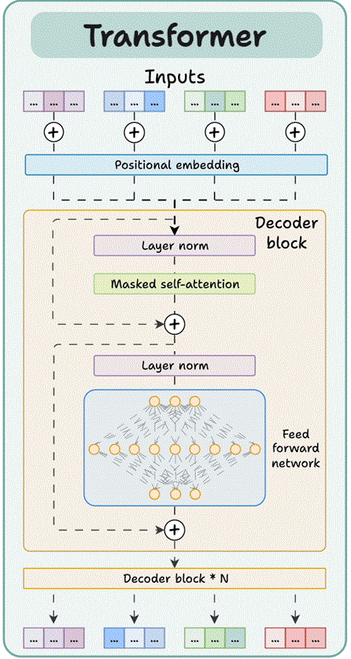
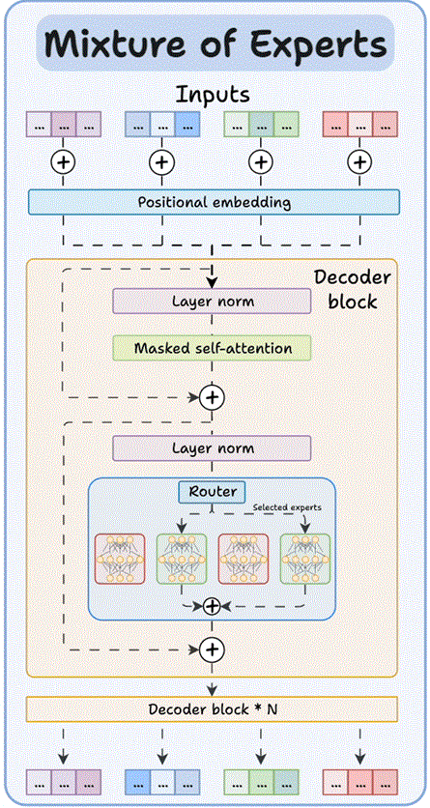

Transformer Architecture
Dense for efficient edge intelligence; MoE for massive cloud scale..
Overview
      ML
    Training Stages
Transformer
    Self-Attention
    FFN and MoE
    Linear Projection
    Embeddings
    Position Encoding
    Summary
GPT
    Pre-Training
    MLP
    Backpropagation
    Training Cluster
    AI Ecosystem
Gemma Family
    MTP
    Supervised FT
    PEFT: QLoRA
    PEFT: DoRA
    Gemma4: PLE
AI Runtime
    MCP
    Agent Skill
    LLM Wiki
    SLM Engine
    Emerging Trends
Conclusion
    Benchmarking x3
    Building the Agent
Vocabulary
[ VC ] _{Mxd}
Attention Parameters
WQ_{dxd}, WK_{dxd}, WV_{dxd}, WO_{dxd}
$$C_{k=2}^{m=16}$$
Feed Forward Network
A_{dxd}, U_{dxd}, D_{dxd}
MoE Gating Matrix
[ R_{E} ] _{dx16}.

Slide 7

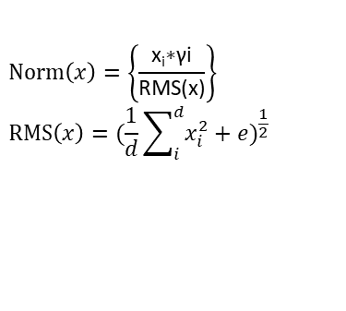
Self-Attention
Capturing context, compressed into the latest token.
MoE
X
Attn
➔
FFN
N*d
d*d
X
W_{k}
N*d
Transformer
·
➔
The
fox
jumps
over
the
lazy
dog
.
…
K
N*d
N*d
N*d
d*d
2 | 3 | 4 | 5
1 | 3 | 2 | 4
4 | 5 | 8 | 6
X
d*d
N*d
X
X
·
W_{q}
N*d
·
W_{v}
➔
➔
➔
N*d
N*d
Q
Causal
Mask
V
A
RMS
1 | 2 | 3
2 | 1 | 3
3 | 2 | 1
2 | 3 | 1
16 | 24 | 32 | 31 | Ꙩ | 1
18 | 24 | 34 | 28 | Ꙩ | 1 | 1
12 | 20 | 22 | 29 | Ꙩ | 1 | 1 | 1
11 | 20 | 22 | 28 | Ꙩ | 1 | 1 | 1 | 1
=
=
=
=
16 | 0 | 0 | 0 |  | 1 | 1 | 2
18 | 24 | 0 | 0 |  | 2 | 1 | 1
 |  |  |  | x |  |  |  | =
12 | 20 | 22 | 0 |  | 1 | 2 | 1
11 | 20 | 22 | 28 |  | 1 | 3 | 1
16 | 16 | 32
66 | 42 | 60
74 | 76 | 66
101 | 159 | 92
0.7 | 0.7 | 1.4
1.2 | 0.7 | 1
1 | 1 | 0.9
0.8 | 1.3 | 0.7
…
.
dog
lazy
the
over
jumps
fox
The
…
.
dog
lazy
the
over
jumps
fox
The
=
$$Softmax\left(\frac{{QK}^{T}}{\sqrt{d_{h}}}\right)∗V \text{➔} Attention$$
$$Norm\left(x\right)=\left\{\frac{\text{x}\text{i}\text{∗γi}}{\text{RMS(x)}}\right\}$$
$$RMS\left(x\right)={(\frac{1}{d}\sum_{i}^{d}{x_{i}^{2}+e})}^{\frac{1}{2}}$$

Slide 8
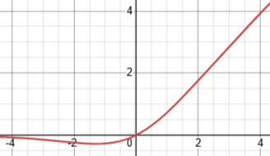

FFN and MoE
Deepening token representations with non-linear mapping after context synthesis.
Dense FFN: Straightforward architecture and H/W friendly deployment.
Sparse MoE: Minimal computational cost and maximized model capacity.
Mixture Of Exports
Dense Feed Forward Network
0.81 | 0.7 | 0 | 1.1 | … | … | 0.1 | 0.6
0.75 | 0.6 | 0.9 | 0.14 | … | 0.25 | 0.2 | 2.1
1.7 | 4.8 | 2.1 | 0.3 | … | 0.6 | 1.9 | 1.5
0.2 | 1.5 | 0.7 | 0.8 | … | 1.1 | 0.5 | 0.3
N*d
d*S
S*d
N*d
d*16
N*16
➔
X
W_{activate}
Ꙩ
X
W_{up}
x
X
x
W_{G}
➔
W
_{down}
Softmax
0.07 | 0.25 | 0.11 | 0.13 | … | 0.17 | 0.1 | 0.08
-ꚙ | 24% | -ꚙ | -ꚙ | … | 6% | -ꚙ | -ꚙ
➔
Top 2
1
2
3
1
1
1
1
1
$$swish\left(β,x\right)=\frac{x}{1+e^{−βx}}$$
➔
1
1
1
1
1
14
1
1
X₂
x 0.8
+
X₁₄
x 0.2
X

Slide 9

Liner Projection
Converts continuous vectors from the semantic space back into human-readable words.
Semantics Space: LLM use Embedding Matrix to sketch and shape by attention.
Next Token: First word of the following response.
$$Pi=\frac{e^{Zi}}{\sum_{j}^{V}{e^{Zj}}}$$
Softmax
V*d
V*2
V*d
0.7 | 0.7 | 1.4
1.2 | 0.7 | 1
1 | 1 | 0.9
0.8 | 1.3 | 0.7
0.1 | 0.7 | 2
0.4 | 1 | 2.8
 | …
 | …
0.1 | 3 | 0.1
 | …
2 | 0.9 | 0.7
2.58 | 9%
3.82 | 32%
4.05 | 41%
3.13 | 16%
Pangram
…
N*d
d*1
X
…
.
dog
lazy
the
over
jumps
fox
The
X_{L}
0.7
1.3
0.8
new
=
1*d
➔

Slide 10



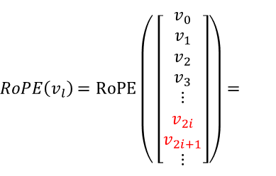







Token Embeddings
Pairwise dimension rotations enable multi-scale positional sensitivity across long contexts.
i
$$i=0,1,…, \frac{d}{2}−1$$
$$\overset{⃑}{υ_{ι}}$$
X
l
$R_{lθ_{i}}∗\left[\begin{aligned}v_{2i} \\ v_{2i+1}\end{aligned}\right]$
$${θ_{i}=base}^{\frac{−2i}{d}}$$
$$R_{lθ_{i}}=\left[\begin{matrix}\cos{lθ_{i}} & −sin{{lθ}_{i}} \\ \sin{lθ_{i}} & \cos{lθ_{i}}\end{matrix}\right]$$
$\left[\begin{aligned}v_{2i} \\ v_{2i+1}\end{aligned}\right]$
$$l∗θ_{i}$$
$RoPE\left(v_{l}\right)$ $=RoPE\left( \left[\begin{aligned}v_{0} \\ v_{1} \\ v_{2} \\ v_{3} \\ ⋮ \\ v_{2i} \\ v_{2i+1} \\ ⋮\end{aligned}\right]\right)=$
$$\left[\begin{matrix}\cos{lθ_{0}} & −sin{lθ_{0}} \\ \sin{lθ_{0}} & \cos{lθ_{0}}\end{matrix}\right]\left[\begin{aligned}v_{0} \\ v_{1}\end{aligned}\right]$$
$$\left[\begin{matrix}\cos{lθ_{1}} & −sin{lθ_{1}} \\ \sin{lθ_{1}} & \cos{n{lθ}_{1}}\end{matrix}\right]\left[\begin{aligned}v_{2} \\ v_{3}\end{aligned}\right]$$
$⋮$
$\left[\begin{matrix}\cos{lθ_{i}} & −sin{lθ_{i}} \\ \sin{lθ_{i}} & \cos{lθ_{i}}\end{matrix}\right]\left[\begin{aligned}v_{2i} \\ v_{2i+1}\end{aligned}\right]$
$⋮$
Notes:
* 第L個token的第i組dimension,
* 位置編入(i, l), 不要爆炸(有界限, 正餘弦特性), 愈遠影響愈小
* 維度正交(轉動範圍, 轉動敏感度)

Slide 11
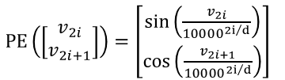

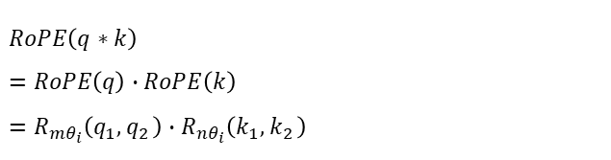


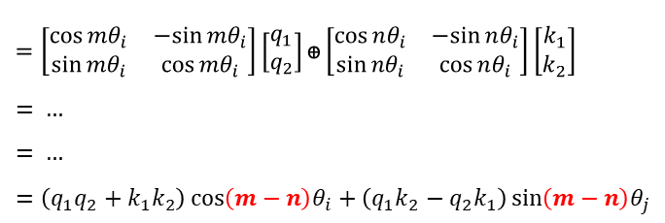



Rotary of Position Encoding
Relative Distance as the Core Variable.
X
QK^{T}
i
X
Q
K
m
$$\overset{⃑}{q}$$
(q₁, q₂)
(k₁, k₂)
n
$$\overset{⃑}{k}$$
$$RoPE\left(q∗k\right)$$
$$=RoPE\left(q\right)∙RoPE\left(k\right)$$
$$=R_{mθ_{i}}\left(q_{1}{,q}_{2}\right)∙R_{nθ_{i}}\left(k_{1}{,k}_{2}\right)$$
$$R_{mθ_{i}}=\left[\begin{matrix}\cos{mθ_{i}} & −sin{mθ_{i}} \\ \sin{mθ_{i}} & \cos{mθ_{i}}\end{matrix}\right]$$
$$R_{nθ_{i}} =\left[\begin{matrix}\cos{nθ_{i}} & −sin{ nθ_{i}} \\ \sin{nθ_{i}} & \cos{ nθ_{i}}\end{matrix}\right]$$
Sinusoidal Position Encoding
Rotary PE
No PE
Decoupling
PE Every where
$$=\left[\begin{matrix}\cos{mθ_{i}} & −sin{mθ_{i}} \\ \sin{mθ_{i}} & \cos{mθ_{i}}\end{matrix}\right]\left[\begin{aligned}q_{1} \\ q_{2}\end{aligned}\right]ꚛ\left[\begin{matrix}\cos{nθ_{i}} & −sin{nθ_{i}} \\ \sin{nθ_{i}} & \cos{nθ_{i}}\end{matrix}\right]\left[\begin{aligned}k_{1} \\ k_{2}\end{aligned}\right]$$
= …
= …
$$=\left(q_{1}q_{2}+k_{1}k_{2}\right)\cos\left(m−n\right)θ_{i}+\left(q_{1}k_{2}−q_{2}k_{1}\right)\sin\left(m−n\right)θ_{j}$$
$PE\left(\left[\begin{aligned}v_{2i} \\ v_{2i+1}\end{aligned}\right]\right)=\left[\begin{aligned}\sin\left(\frac{v_{2i}}{{10000}^{{2i}/d}}\right) \\ \cos\left(\frac{v_{2i+1}}{{10000}^{{2i}/d}}\right)\end{aligned}\right]$
$$\sin\left(m−n\right)=\sin{(m)}\cos{(n)}−\sin{(m)}\sin{(n)}$$
$$\cos\left(m−n\right)=\cos{(m)}\cos{(n)}+\sin{(m)}\sin{(n)}$$
$RoPE\left(\overset{⃑}{v}\right) =\left[\begin{matrix}\cos{lθ_{i}} & −sin{lθ_{i}} \\ \sin{lθ_{i}} & \cos{lθ_{i}}\end{matrix}\right]\left[\begin{aligned}v_{2i} \\ v_{2i+1}\end{aligned}\right]$
$$No PE +PE\left(\overset{⃑}{v}\right)$$
$$No PE$$
Notes:
Attention 分數 = 距離 +字詞本身的語意內容相乘, 絕對位置m和n確實被完全簡化成了相對距離(m-n) 。
RoPE 雖然在預處理時，是各自對 Query 和 Key 依據「絕對位置」單獨進行旋轉；但在進入注意力機制算內積的那一瞬間，絕對位置會自動抵銷，最終決定關聯度分數的，只剩下兩者的「相對距離(m-n)」。
問題: 1. 延宕運算(要token推移完成, 才可編碼), 2. 阻礙壓縮 (KV-Cache低秩壓縮是線性轉換, RoPE會被破壞)
結論: DS.MLA解偶, Kimi徹底拋棄.

Slide 12
Summary: GPT Program Flow
Tokenizer ➔Embeddings ➔Positional Encoding ➔Self-Attention ➔FFN ➔Linear Projection
Position
Encoding
RMS (X)
Attention (X)
X = X + A
RMS (X)
FFN(X, A, U, D)
X = R + X
Softmax (X)
Max Prob.
V*d
N*d
V*d
V*1
V*d
…
.
dog
lazy
the
over
jumps
fox
The
VC
vocabulary
d*d
Q
N*N
N*d
d➔S➔d
W_{z}
P
Prob.
VC
vocabulary
·
W_{q}
➔
QK^{T}
v
MoE
Transformer
…
…
N*d
d*1
X
W_{k}
K
X
·
·
➔
➔
➔
·
W_{v}
➔
V
X
R
Max
Lookup Table:
Token ➔ Embedding
Transformer
Attention + MoE
Residual
Add(R, X_{n}) ➔ X_{n+1}
L x Layers
(X_{n}) ➔ X_{n+1}
Linear Projection
Semantic space ➔ Next token
Linear Combination: Feature extraction, semantic fusion.
Non-linear Activation: Noise filtering, modeling capabilities, collapse prevention.
Notes:
Transformer就是attention+moe, 濃縮“語意空間” (多層結構, 持續加權), 使得gpt能夠”映射”下一個字.
全部的底層核心:正規化(保護梯度爆炸或消失), 線性組合(加權), 透過非線性激活函式分層(防崩潰).

Slide 13
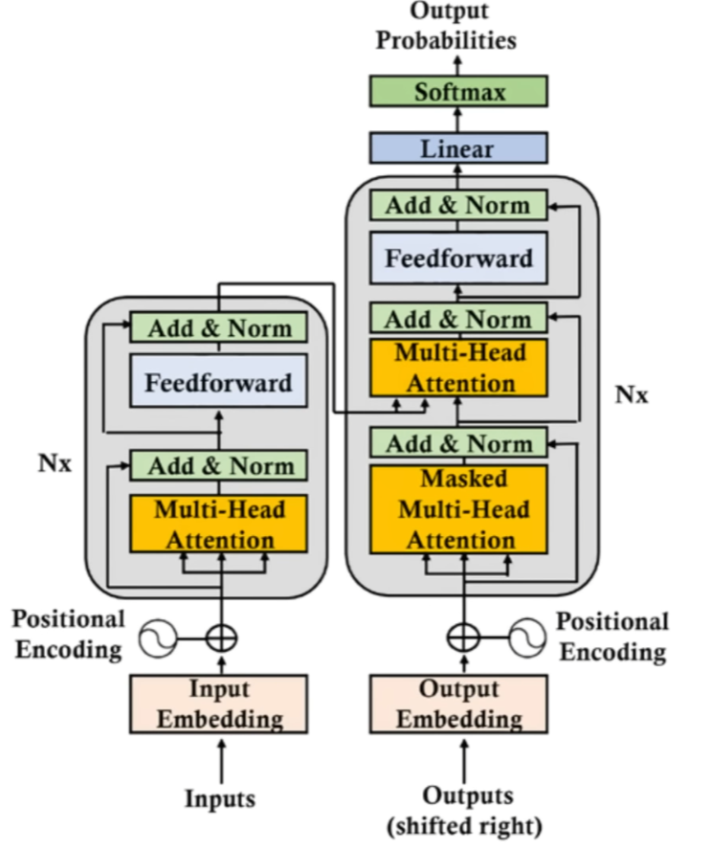
Generative Pretrained Transformer
ChatGPT is developed by OpenAI.
Output
Probabilities
SP
-
-
Decoder
SoftMax
Linear
Encoder
SP
HC
-
Add & Norm
Feed Forward
SP
HC
Input
Add & Norm
N x
Masked
Multi-Head
Attention
SP
HC
Input
Output
+
~
Input
Embedding
Output
Embedding
Inference
ML: Establish a model to predict unknown outcomes
GPT: Establish a language model to predict next token
Training: Minimize the prediction errors.
Input
(User)
Output
(Next Token)
Notes:
ML:人做, DL:機器做.
用最少的參數, 描摹正確的結果.

Slide 14
Pre-Training
Optimizes base model parameters via self-supervised learning.
Output
Probabilities
Transformer Lifecycle
Forward (Inference): Predict next token.
Backward (Training): Minimize prediction errors.
Datasets
…
…
…
SoftMax
Linear
Cross Entropy
Loss
Add & Norm
How
are
You
?
Predict
Feed Forward
Model (Parameters)
0 | 0 | 0.5
0.5 | 0.5 | 0
Predicted Token |  |  |  | Target Token
“?” |  |  |  | “Fabulous”
1 | 1 | 1 | 11 | 4 | 0 | 0
Add & Norm
N x
2 | 2 | x
Masked
Multi-Head
Attention
=
Backpropagation
Optimizer
Adam, SGD …
 | 0.4 | 0 | 0.1
 | 0.7 | 0.3 | 0
“?” |  |  |  | “Fabulous”
2.2 | 0.6 | 0.2 | 3.6 | 4 | 0 | 0
+
~
=
 | 0.8 | 0 | 0
 | 0.9 | 0.1 | 0
=
“?” |  |  |  | “Fabulous”
3.4 | 0.2 | 0 | 0.4 | 4 | 0 | 0
Input
Embedding
Output
Embedding
 | 1 | 0 | 0
 | 1 | 0 | 0
=
“Fabulous” |  |  |  | “Fabulous”
4 | 0 | 0 | 0 | 4 | 0 | 0
Input
(Datasets)
Optimizer
Cross Entropy
Loss
Backpropagation
Notes:
紅色覆蓋區: 訓練過程中, 會調到參數(權重矩陣)的部分.
(訓練, 推論)都是context(資料,對話)傳下來, 轉為token embedding.
逐次訓練, 誤差由11降到0, 每次“反饋傳遞”都是告訴”前一層”, ”哪些權重要調整”.

Slide 15
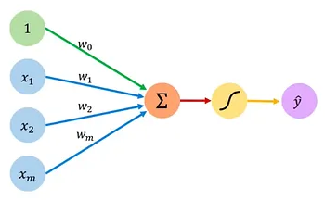
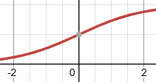
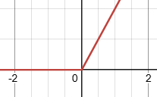
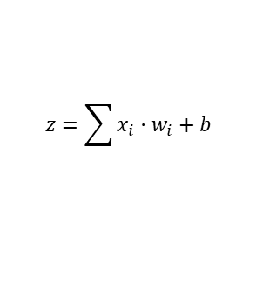
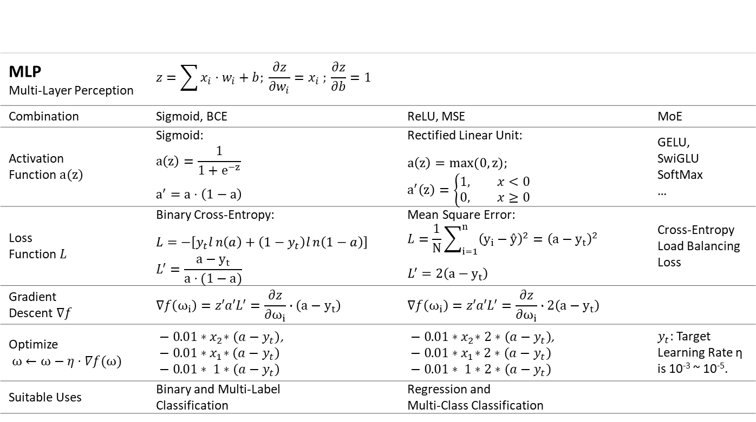
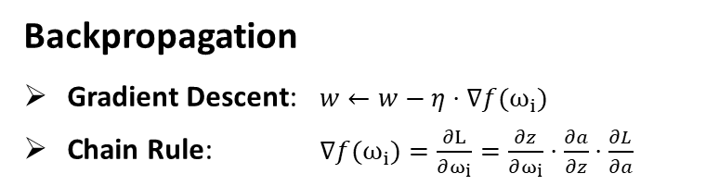
MultiLayer Perceptron
MLP applies backpropagation to resolve intricate, non-linear problems.
Backpropagation
Gradient Descent: $w←w−η⋅∇f(ω_{i})$
Chain Rule: $∇f(ω_{i})=\frac{∂L}{∂ω_{i}}=\frac{∂z}{∂ω_{i}}⋅\frac{∂a}{∂z}⋅\frac{∂L}{∂a}$
$$z=\sum{x_{i}⋅w_{i}}+b$$
Activation
Function
MLP Multi-Layer Perception | $$z=\sum{x_{i}⋅w_{i}}+b; \frac{∂z}{∂w_{i}}=x_{i} ; \frac{∂z}{∂b}=1$$
Combination | Sigmoid, BCE | ReLU, MSE | MoE
Activation Function $a\left(z\right)$ | Sigmoid: $$a\left(z\right)=\frac{1}{1+e^{−z}}$$ $$a^{′}=a⋅\left(1−a\right)$$ | Rectified Linear Unit: $$a\left(z\right)=max(0, z);$$ $$a^{′}\left(z\right)=\left\{\begin{aligned}1, x<0 \\ &0, x≥0\end{aligned}\right.$$ | GELU, SwiGLU SoftMax …
Loss Function $L$ | Binary Cross-Entropy: $$L=−\left[y_{t}ln\left(a\right)+\left(1−y_{t}\right)ln\left(1−a\right)\right]$$ $$L^{′}=\frac{{a−y}_{t}}{a⋅(1−a)}$$ | Mean Square Error: $$L=\frac{1}{N}\sum_{i=1}^{n}{{\left(y_{i}−ŷ\right)}^{2}}={\left(a−y_{t}\right)}^{2}$$ $$L^{′}=2\left(a−y_{t}\right)$$ | Cross-Entropy Load Balancing Loss
Gradient Descent $∇f$ | $$∇f\left(ω_{i}\right)=z′a′L′=\frac{∂z}{∂ω_{i}}∙\left(a−y_{t}\right)$$ | $$∇f\left(ω_{i}\right)=z′a′L′=\frac{∂z}{∂ω_{i}}∙2\left(a−y_{t}\right)$$
Optimize $ω←ω−η⋅∇f(ω)$ | $− 0.01{∗x}_{2}∗\left(a−y_{t}\right)$, $$− 0.01{∗x}_{1}∗\left(a−y_{t}\right)$$ $$− 0.01∗ 1∗\left(a−y_{t}\right)$$ | $− 0.01{∗x}_{2}∗2∗\left(a−y_{t}\right)$, $$− 0.01{∗x}_{1}∗2∗\left(a−y_{t}\right)$$ $$− 0.01∗ 1∗2∗\left(a−y_{t}\right)$$ | $y_{t}$: Target Learning Rate η is 10⁻³ ~ 10⁻⁵.
Suitable Uses | Binary and Multi-Label Classification | Regression and Multi-Class Classification
Notes:
ML是手動, DL是自動, MLP是DL的最基礎單位. 進而組合出整個模型.
權重的修正, 依靠back propagation, 持續修正就最佳化.
講究: 效率 (方向要對, 力道恰當, 過程不會爆炸, 不會消失)
這是最常見, 又簡單的組合. 我們可以知道”如何迭代每個w”

Slide 16
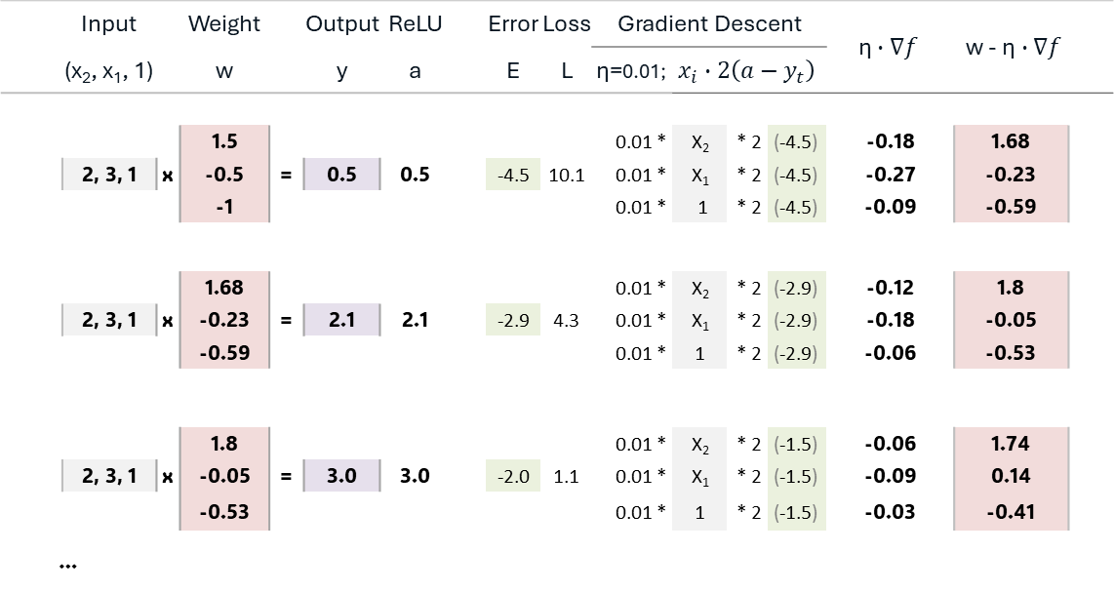
Back Propagation
Backpropagation is determined by the learning rate, input value and error term.
 | Input |  | Weight |  | Output | ReLU |  | Error | Loss | Gradient Descent |  |  |  | $$\text{η}∙∇f$$ | w - $\text{η}∙∇f$
 | (x₂, x₁, 1) |  | w |  | y | a |  | E | L | η=0.01; | $$x_{i}∙2\left(a−y_{t}\right)$$
 |  |  | 1.5 |  |  |  |  |  |  | 0.01 * | X₂ | * 2 | (-4.5) | -0.18 | 1.68
 | 2, 3, 1 | x | -0.5 | = | 0.5 | 0.5 |  | -4.5 | 10.1 | 0.01 * | X₁ | * 2 | (-4.5) | -0.27 | -0.23
 |  |  | -1 |  |  |  |  |  |  | 0.01 * | 1 | * 2 | (-4.5) | -0.09 | -0.59
 |  |  | 1.68 |  |  |  |  |  |  | 0.01 * | X₂ | * 2 | (-2.9) | -0.12 | 1.8
 | 2, 3, 1 | x | -0.23 | = | 2.1 | 2.1 |  | -2.9 | 4.3 | 0.01 * | X₁ | * 2 | (-2.9) | -0.18 | -0.05
 |  |  | -0.59 |  |  |  |  |  |  | 0.01 * | 1 | * 2 | (-2.9) | -0.06 | -0.53
 |  |  | 1.8 |  |  |  |  |  |  | 0.01 * | X₂ | * 2 | (-1.5) | -0.06 | 1.74
 | 2, 3, 1 | x | -0.05 | = | 3.0 | 3.0 |  | -2.0 | 1.1 | 0.01 * | X₁ | * 2 | (-1.5) | -0.09 | 0.14
 |  |  | -0.53 |  |  |  |  |  |  | 0.01 * | 1 | * 2 | (-1.5) | -0.03 | -0.41
…
Y_{t} = 5
10
4.3
1.68
1.1
1.8
1.5
-0.5
-0.23
-0.05
-1
-0.59
-0.53
Local
Gradient
Global
Gradient
Why must we normalize input?
Local Gradient: Driving by input (x), not the weight value (w).
Error Amplification: Large weights push more blame backward to previous layers.

Slide 17



AI Training Cluster
99% computing power is used for pre-training.
GPU
ABF | Chip on Wafer on Substrate
RDL | Chip on Panel on Substrate
PCB | Chip on Wafer on Panel
Intel EMIB ➔ CoWoS L
AI
HBM
Rack & Server
NV-Link / MTK-SerDes
Micro LED/Marvell CPO / WSE
Rubin NVL72:
Compute Server x 18
Switch Server x 9
Cost: $7~8M ➔ 9M
Chip
CoWoS
Die
ABF
SAMSUNG
30%
CoPoS
SK Hynix
55%
RDL
ABF
Micron
15%
Die Saw
CCL
PCB
Rack
Memory
(HBM4 & DDR5)
35%
Server
Main Board
PCB: 20~30 Layers
ABF: 12~20 Layers
MLCC
Memory
HBM = 12 x DRAM Dies
HBM➔DRAM
Cooling
System
GPU
44%
Main Board
Networking
& PCBs
20%
VRAM
3%
Power &
Cooling
2%
CPU
DRAM
CPU
GPUs
Power
Supply
GPU
HBM
CoWoS
20%
GPU
Heat Sink
GPU➔NPU (TPU, LPU)
H100
Cost: $3.5k ➔ $30k
HBM
40%
Rack
Others
30%
Data
Center
Server
Rack
10%
AI Logic
...
AI:300 + HBM:1400 + PT:800+1000
Notes:
輝達新一代的 Vera Rubin NVL72 機櫃每座配備 72 顆 Rubin GPU 與 36 顆 Vera CPU，
整座機櫃造價約 780 萬美元(折合新台幣超過 2 億元)。
以輝達劃時代的H100 (80GB SXM5)為例，其HW BOM約為 3,320 美元, 但終端市售價格卻高達 25,000 至 40,000+ 美元。
1. 結論: 大概了解成本(gpu:300, HBM:1400, cowos:800, test/ABF: 1000)
2. 問題: 散熱(算力, 先進製程), 傳輸 (記憶體, 矽光子, MTK序列器)

Slide 18
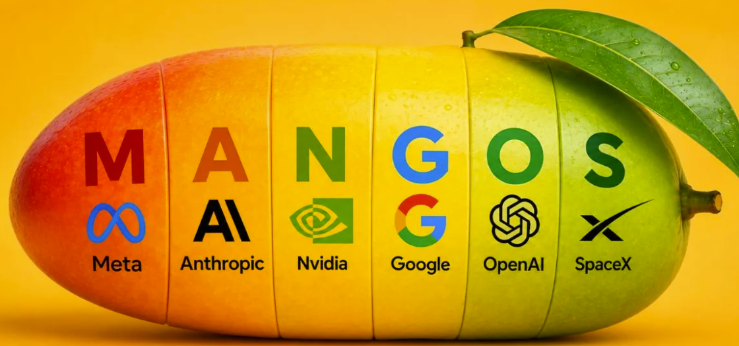


AI Ecosystem
Edge AI: Tiny Models, Lower Computing, Higher Privacy.
AI Frontier Models (MMLU, Throughput, TTFT, ITL)
Anthropic – Fable 5
OpenAI – GPT 5
Google – Gemini 3
Meta – Llama 4
SpaceXAI – Grok 4
DeepSeek – V4
Zhipu AI – GLM 5
Moonshot AI – Kimi K3
Mistral AI – Pixtral
Amazon – Nova
Training Framework
PyTorch |  |  | JAX/XLA
Meta: TorchTitan | MS: DeepSpeed | NV: Megatron-LM | Google: MaxText
GPU (CUDA C++ / Triton) |  |  | TPU
Cloud Infrastructure Training and Reasoning
NV Blackwell, TensorRT
AMD Instinct, ROCm
Google Trillium(v6e) | TPU 8i, -
AWS ASIC | Inferentia2(Inf2), -
Inference Engine
UC Berkeley |  | NV: TensorRT-LLM
vLLM | SGLang
AI PC Environment
NV GeForce, CUDA
AMD Ryzen AI, XDNA
Intel Core Ultra, OpenVINO
Apple M4/M3, Core ML + MLX
Qualcomm Hexagon, QNN SDK
MS, - , ONNX Runtime (ORT)
Ollama, - , GGUF
AI PC Application
Agent | SDK
OpenClaw, Hermes | CrewAI, LangGraph, Langflow, AG2, Dify
Notes:
1. MMLU (Massive Multitask Language Understanding), 大規模多任務語言理解
2. TTFT (Time to First Token), 首字輸出時間
3. ITL (Inter-Token Latency),字與字之間的延遲 (評估AI 生成流暢度的效能指標)
訓練: 雲端/資料/算力/ 推論能力強/正確/ 輸出: (模型, 權重矩陣)
推論: 整合資源(高效) / 啟動門檻低, 省記憶體 / 易於 (落地/佈署/微調, 開源)
應用: Agent/邊緣運算/ 要求(方便好用, 多語, 多模態/ 應用廣/續航/)

Slide 19
Gemma Family
Gemma 4 empowers local devices with autonomous agency.
Features
Gemma 3: Multimodal, multilingual 140+ and single chip.
Gemma 4: Native Multimodal, Apache 2.0, CoT, <|think|> and multi-token prediction (MTP) and Per Layer Embedding (PLE).
26B
MoE
Gemini 3
Dense
E2B/E4B
(PLE)
12B/31B
 | Type | Layers | Language Model | Context Window | Memory consumption
 |  |  |  |  | Parameters | FP16 | SFP8 | Q4_0
Server | 31B | 60 | Dense | 256k | 31B | 58 GB | 31 GB | 17.5 GB
 | 26B | 40 | MoE, Diffusion |  | 4B /26B | 48 GB | 26 GB | 14.4 GB
PC/NB | 12B | 48 | Dense |  | 12B | 27 GB | 12 GB | 6.7 GB
Mobile | E4B | 30 | Dense, PLE | 128k | (4.5+3.5) /8B | 18 GB | 9 GB | ~4.5 GB
 | E2B | 30 |  |  | (2.3+2.8) /5B | 12 GB | 6 GB | ~2.9 GB
Gemma 4
MTP
Notes:
Google的策略: Gemini 雲端的AI王者 (Open AI ChatGPT, Anthropic Claude), Gemma 邊緣首選.
Gemma 3: 多語/單晶片
Gemma 4: 多模態/開源/思考鏈/MTP/PLE, 低參數
1. 深度求索 (DeepSeek) —— 國際賽道上的「定價破壞者」, DeepSeek V4 Pro: 極致的性價比與推理王者。
2. 阿里通義千問 (Qwen) —— 規格最齊全的「全能多面手」, Qwen 3.8 Max 系列: 多語言與工程落地首選。
3. 月之暗面 (Moonshot AI) —— 長文本的「破局者」, Kimi K3: 超長上下文窗口與 Agent 執行力。
4. 智譜 AI (Z.ai) —— 中文政企與開發者的「全棧標竿」, GLM-5.3 / GLM-5 系列: 開源 Coding 與多模態先鋒。

Slide 20
Multi-Token Predication
MTP breaks the single-token autoregressive limit.
Features
Traditional LM: Massive initial prefill phase, single-token autoregressive decoding.
Gemma 4 MTP: Shared KV-cache, tree attention, processes 12 tokens per layer, parallel verification.
Benefit: Zero-prefill latency for all subsequent candidate tokens.
Speculative
Decoding
(Tokens: n=4)
K
Q
KV
Cache
KV
KV
Multi-Token
Target
Model
(30~60 Layers)
X
NxD
Drafter
Model
(4 Layers)
X
NxD
Multi-Token
Activation
Multi-Token
T₀ | T₁ | T₂ | T₃
3 SWA + 1
Full Attention
Attn ₀
A₀
A₀
T₀ T₁ T₂
3 x 4 Tokens
Attn ₁
A₁
A₁
…
T₀ | T₁ | T₂ | T₃
…
…
…
T₀ | T₁ | T₂ | T₃
Attn ₁₁
A₁₁
A₁₁
Verify
Next
Gemma 4 + Gemini Diffusion: Generate sequentially Parallel block refinement.
➔
Notes:
訓練: 同時訓練一個草稿模型(蒸餾)
推論: 快速吐出3組4字預測, 進行驗證 (可節省kv-cache的搬運時間)

Slide 21
Supervised Fine-Tuning
SFT shapes behavior via structured, high-quality QA pairs, not knowledge.
Loss of
Next Token
Loss of
Next Token
Loss of
Answer
Time
VRAM
Cost
Optimizer
SGD,
Adam,
*AdamW,
Paged AdamW
…
FFN
FFN
FFN
Layer↓,
Dimension↓
Quantization
MHA
MHA
Score
Score
FFN
A
FFN
A
Full-FT
mobile phone
MHA
Mentor
Model
Q&A
…
MHA
A
MHA
A
PEFT + Q
4-bit / 8-bit
Distillation
Full-FT + QAT
Dataset
…
…
Loss of
Answer
Q&A
(MCQ)
Q&A
(MCQ)
P ➔ INT4
Quantization
PRUNING
(Dimension ↓)
PTQ
(Precision ↓)
FFN
Adapter
P ➔ INT4
NV, Qualcomm
Pre-Training
QAD
MHA
Adapter
Logit
Parameter-Efficient Fine-Tuning (PEFT)
Fine-Tuning Framework
FFN
A
Q&A
…
1%
Quantization-Aware (QA)
Fake Quantization
FP: Quantization Noise
BP: Straight-Through Estimator
PEFT + QAT
MHA
A
Mentor
Model
Notes:
紅色區域為: 權重更改區

Slide 22
PEFT: Quantization Low-Rank Adaptation
QLoRA freezes the base model, squeezing updates through a narrow parameter bottleneck (r).
100 x 200
LoRA
Freeze All
Inject Layers
Active LoRA (A+B)
Quantization
1 x 100
a11 | a12 | a13 | …
a21 | a22 | a23 | …
a31 | a23 | a33 | …
… | … | … | …
1 x 200
x1 | x2 | x3 | …
x
=
a11 | a12 | a13 | …
100 x 8
+
8 x 200
100 x 200
b11 | b12 | …
b21 | ... | ...
b31 | … | …
… | … | …
a11 | a12 | a13 | …
a21 | a22 | a23 | …
a31 | a23 | a33 | …
… | … | … | …
LoRA
x
c11 | c12 | c13 | …
… | … | … | …
=
32
bits
b11 | b12 | b13 | b14 | b15 | b16 | b17 | b18
4 bits
0 | 1 | 2 | 3 | 4 | 5 | 6 | 7 | 8 | 9 | 10 | 11 | … | … | 30 | 31
100 x 1
QLoRA
b11
b21
b31
…
1 x 200
x
c11 | c12 | c13 | …

Slide 23


PEFT: Weight-Decomposed LoRA
DoRA fundamentally improves LoRA by decomposing weights into magnitude and direction.
100 x 200
1 x 100
a11 | a12 | a13 | …
a21 | a22 | a23 | …
a31 | a23 | a33 | …
… | … | … | …
1 x 200
x1 | x2 | x3 | …
x
=
a11 | a12 | a13 | …
100 x 8
8 x 200
A
x
B
W₀
Supervised
Fine Tune
100 x 200
0.1 x
W₁
+ 0.9 x
W₀
m11 | m12 | m13 | …
Ꙩ (
)
m: 1 x 100
Hadamard Product
Element-wise
Multiplication
Norm
100 x 200
1 x 100
1 x 200
LoRA
DoRA
x1 | x2 | x3 | …
x
Final
=
a11 | a12 | a13 | …
$$W_{final}=A×B+W_{0}$$
$$W_{final}=m⊙\frac{A×B+W_{0}}{\left\|A×B+W_{0}\right\|}$$
Notes:
微調階段: 會動到的矩陣A, B, m

Slide 24
Gemma 4: Per Layer Embeddings
PLE is a soft-gated, lightweight MoE variant that dynamically activates layer-wise token embeddings.
Next Layer
Next Layer
Next Layer
Residual Connection
1 | 2 | 3 | .. |  | … |  | .. | D₁₅₃₆
FFN
E
E
E
E
FFN
+
a1 | a2 | a₃ | .. |  | … |  | .. | a₁₅₃₆
FFN
NxD
E
E
E
E
FFN
Nxd
E
E
E
E
1xd
x
U
dxD
VC
E
E
E
E
VC
VC
PLE
MoE
Router
Layer Embedding
v₁ | v₂ | v₃ | … | v₂₅₆
MHA
MHA
MHA
token
Token Indexing
Ꙩ
QKV
N x 8192
QKV
N x 2048
QKV
Nx1536
PLE
256
g₁ | g₂ | g₃ | … | g₂₅₆
Sigmoid
Ꙩ
σ
1xd
X
NxD
X
NxD
X
NxD
w₁ | w₂ | … |  | .. | w₂₅₆
Input Layer
Input Layer
Input Layer
Gating Router
x
W
Dxd
VC
VC
VC
X₁ | X₂ | X₃ | .. |  | … |  | .. | X₁₅₃₆
D

Slide 25
AI Runtime
RAG boosts agent accuracy but adds latency; parallel frameworks like ReWOO restore speed.
Training Stages
(Goal: Alignment)
Runtime
(Goal: Smarter AI Agent)
Thought
Pre-Training
& SFT
LLM
Reasoning
ReAct
Action
Observation
Prompt
…
Result
Result
Done
Workflow
Input Processing
Model Router
Tool Calling
Output Parsing
Agentic RAG Retrieval-Augmented Generation
Native | No reasoning
Modular | Heuristic rules
Early Agentic | ReAct
Modern Agentic RAG | Reflexion: Evaluator node
 | ReWOO: Reasoning without observation
 | TOT: Tree of thoughts
Language Agent Tree Search | LATS = ToT + ReAct + MCTS
Final
Answer
…
VDB
MCP
Skill
Get me
TSMC’s
Earnings
report.
AI Agent
(Router)
Agentic
RAG
User
Vector
DB
MCP
(Tools)
Skill
(Scripts)
LLM
Wiki

Slide 26

Model Context Protocol
MCP enables AI Agents to connect with external tools and data sources.
Semantic
Search
MCP Host
LLM
Model
AI Agent
(PC/NB)
Retrieve
MCP
Client
MCP
Protocol
Vector
DB
Accurate Data
and Rules
Model Engine
Result
Get Price
MCP
Client
MCP
Protocol
MCP
Server
Real-Time
Message
Result
Action
MCP
Client
MCP
Protocol
Skill
Scripts
Call
Function
Get me TSMC’s
Earnings report.
MCP
Client
MCP
Protocol
RAG MCP
Server
User
Steps
Initialization & Discovery: MCP server provides tool schemas to the host.
Reasoning & Tool Call: LLM sends request to MCP server.
Execution & Injection: Server returns data to host for LLM context injection.

Slide 27
Agent Skills
Skills are dynamic, on-demand SOPs that guide agents using tools.
Semantic
Search
Search TSMC.
LLM
Model
AI Agent
(PC/NB)
What is TSMC Trading at?
Model Engine
Generate the report.
Here you are.
Skill
Scripts
Get me TSMC’s
Earnings report.
User
AI Agent Skills
Autonomous Task Execution: Empowers AI to move beyond text and directly trigger actions.
Secure Guardrail Enforcement: Restricts AI behavior within save boundaries.

Slide 28
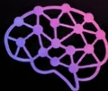
LLM Wiki
LLMs eliminate the boring bookkeeping of knowledge management, ensuring wikis grow effortlessly.
Vector RAG
Vanilla RAG | Rapid context retrieval
Graph RAG | Global document insights
LLM Wiki | Knowledge Asset
AI Agent
LLM Wiki
Andrej Karpathy’s Gist
Data level: Raw / Wiki / Schema
Raw stores assets, Wiki compiles knowledge, and Schema directs the AI Agent.
Instruct: Compile / Query / Lint
Compile integrate data, Query retrieves insights, and Lint audits the final knowledge base.
MCP
Client
User
Human-in-the-Loop Framework
Ingest(raw) ➔ Instruct(C/Q/L) ➔ Review ➔ Setup(schema)
GitHub: nashsu/llm_wiki, atomicstrata/llm-wiki-compiler, Knowledge-vault.

Slide 29


SLM Engine
Run language models locally and efficiently with minimal hardware resources.
Engine
Training Framework: Optimizes model weights using gradients.
Inference Engine: Runs trained models to generate predictions.
Training
Stage
(Cloud)
Backward Pass
Checkpointing
Attention
KV-Cache
Inference
Server
(LLM)
Cloud
Edge
Computing
Resource / 100
SFT &
Quantization
(Edge AI)
Throughput,
PEFT
Latency, TTFT,
Operator Fusion
AI PC
(SLM)
Model File
(GGUF, ONNX)
FT-Engine
Hugging Face TRL
Unsloth (No Code)
Axolotl (Geek)
LLaMA-Factory
MLX-LM (Apple)
Model
Llama 3
Gemma 4
DeepSeek
Qwen 3
Mistral
Edge Engine
Ollama
llama.cpp (Geek)
MLX (Apple)
ONNX Runtime (MS)

Slide 30
Emerging Trends in AI Systems
From Scale-Driven infrastructure to intelligence at the edge.
Cloude
AI
Data Center
Azure, AWS, GPT, Cloud Code, Grok
 | LLM | SLM
Parameter | 70B~405B | 3~8B
H/W | GPUs | NPU/SoC
Memory | HBM | 4~16GB
Power Consumption | MW (Cooling) | W (FAN)
Prompt ➔ Context ➔
Loop Engineering
Edge AI
Context
Intent
On-premise and Local
Enabling secure, low-latency, and privacy-first on-device AI.
Inner
Loop
Action
Adjustment
Observation
AI Agent
Key Trends
Data Transition: Shifting from Quantity (raw web) to Quality (curated corpora).
Architecture (MoE): Activating only relevant sub-networks to drastically lower inference costs.
Native Modality: Integrating real-time voice and video natively for next-gen AI Agents.
Efficient Deployment: Embracing Smaller Language Models (SLMs) for secure, on-device AI.

Slide 31
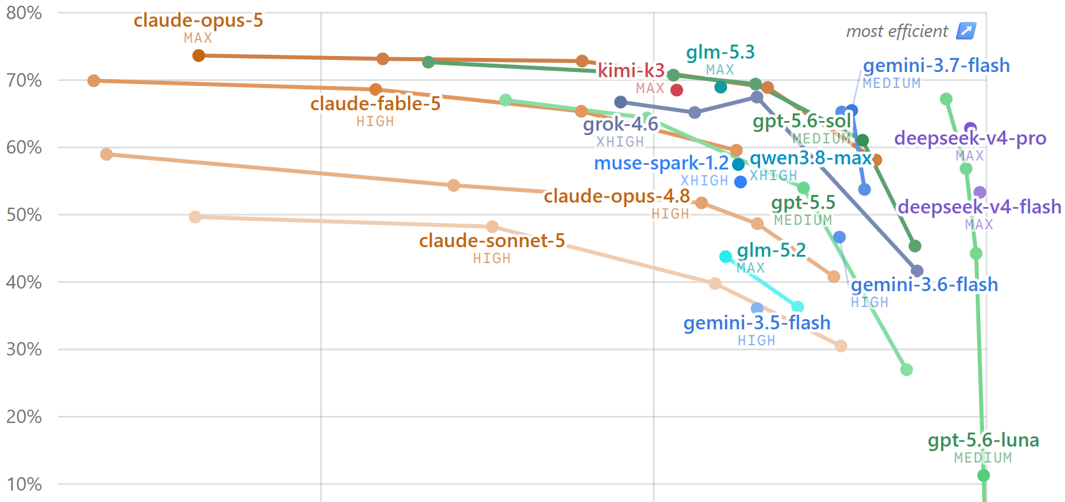
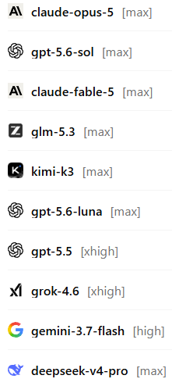
DeepSWE: Deep Software Work Engineering
DeepSWE: Measuring Frontier Coding Agents on Original, Long-Horizon Engineering Tasks.
月之暗面
Moonshot
智譜AI
Avg cost per task
(113 tasks, updated Aug 20, 2026)

Slide 32
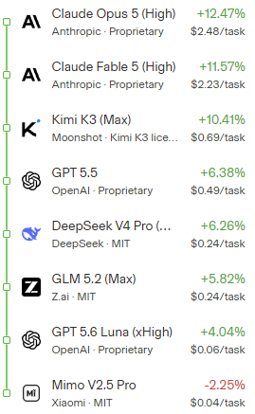
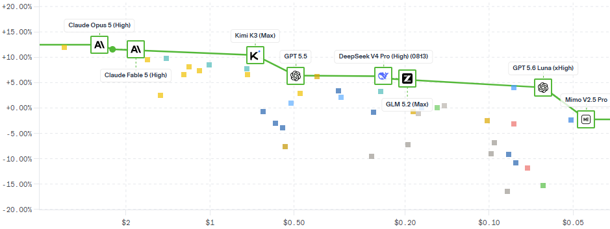
Agent Arena
Dynamic ranking of models on how well they orchestrate tools for real-world agentic tasks, based on signals like tool reliability, task completion, and steerability.
Pareto Frontier
Net Improvement x Cost/task
from real Agent Mode tasks
小米集團
Median cost per task
(last 14 days, Aug 20, 2026)

Slide 33
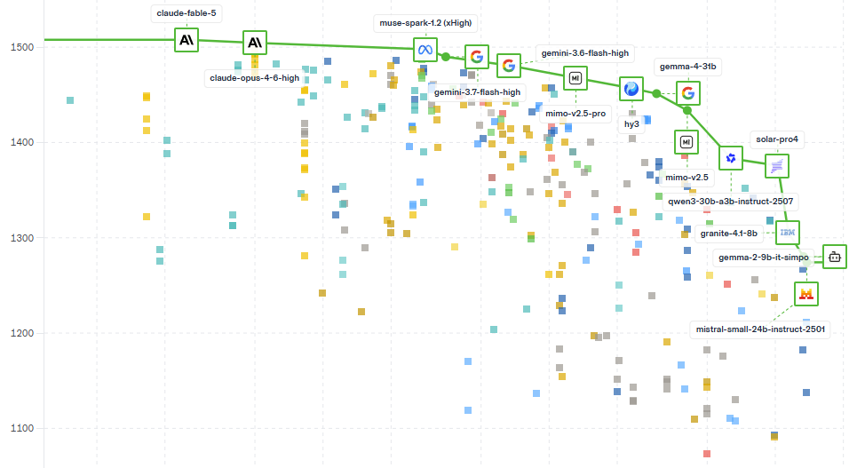


Text Arena
View overall rankings across various AI models in text-to-text tasks across math, coding, creative writing, and other open-ended domains.
Meta
騰訊混元
Pareto Frontier
Model performance
at each price point
韓國
Upstage AI
阿里巴巴
IBM
Arena
Score
Blended price per 1M tokens
(3:1 Ratio)
$50
$20
$2
$1
Notes:
所有的模型都進化快速, 落地應用更是關鍵。

Slide 34




The Evolution of Open-Source LLMs
From 2020 to 2026.
 | Modern Open-Source Backbone |  |  |  | Cross-Border Academic Collaboration | Community -Driven Pioneers | Independent & Native Pillars
 | DeepMind (Google) | Phi (Microsoft) | Meta AI (FAIR) | Mistral AI (Europe) | BigScience (Hugging Face, France and 1000+ scientists ) | EleutherAI (Hugging Face, CoreWeave, Stability AI, …) | Technology Innovation Institute (NV) | Qwen (Alibaba) | DS MoE (DeepSeek) | KIMI (Moonshot)
2020 |  |  |  |  |  | GPT-Neo
2021 |  |  |  |  |  | GPT-J
2022 |  |  |  | OPT | BLOOM | GPT-NeoX
2023 |  | Phi-1 | Llama 1 | Mistral 7B / Mixtral |  | LLeMA | Falcon | Qwen 1.0 | DeepSeek LLM
2024 |  | Phi-3 | Llama 3 |  |  |  | Falcon 3 | Qwen 2.5 | DeepSeek V3
2025 | Gemma 3 | Phi-4 | Llama 4 | Mistral Large 3 |  | The Common Pile | Falcon H1 | Qwen 3.0
2026 | Gemma 4 | Phi-4 Vision | Muse 1 | Mistral Small 4 |  | LM-Evaluation-Harness | Falcon H1R | Qwen 3.8 | DeepSeek V4 | Kimi K3
Notes:
AI 開源的真正目的:建立生態, 而大廠(OpenAI、Google 雲端)要掌握關鍵核心。
目前開源都屬於”Open-Weights”模型, 下載到地端運行或微調(LoRA/DoRA), 缺乏”訓練數據集”與”清洗資料的腳本”。
真正的開源: 只有少數機構(如 OLMo, IBM Granite, Allen Institute)會把數據集、訓練日誌、源碼全部公開。

Slide 35





Building the Bio-IT AI Agent
AI agents will collaborate with Summit Spatial sequencers to complete tasks.
Buildup
Fine-Tuning Solution: Support QLoRA. (Unsloth, Hugging Face TRL)
Model Engine: Freeze base weight. ( llama, Gemma 4)
Agent: OpenClaw and bio-python library.
User
Dr. BioByte,
Please interpret
My gut biopsy.
Terrible,
Zero fast food.
Eat real grass.
Unsloth 非樹懶
/ʌn.slɑːθ/
MCP
BioMCP
(GenomOncology)
Fine-Tunning Environment
GPU
Inference Environment
PC/NB
Unsloth
Gemma 4
MyVariant.info
(Scripps Research Institute)
Axolotl 美西螈
/ˈæk.sə.lɑ.təl/
Ollama
LLaMA-Factory
/ˈlɑː.mə/小羊駝

Slide 36
Practice: Unsloth
SFT and Quantization
import torch
from unsloth import FastLanguageModel
from transformers import TrainingArguments
from trl import SFTTrainer
# 1. Load Initialized Model and Tokenizer
max_seq_length = 2048 # Context Length
model, tokenizer = FastLanguageModel.from_pretrained(
model_name="unsloth/gemma-2-9b-it", # Init
max_seq_length=max_seq_length,
load_in_4bit=True, # 4-bit
)
# 2. Setup Unsloth PEFT(QLoRA)
model = FastLanguageModel.get_peft_model(
model,
r=16,
lora_alpha=16,
target_modules=["q_proj", "k_proj", "v_proj",
"o_proj", "gate_proj", "up_proj", "down_proj"],
lora_dropout=0, # Best performance
bias="none",
use_gradient_checkpointing="unsloth", # Ultra-low VRAM
random_state=3407,
)
# 3. Setup Unsloth Optimizer
training_args = TrainingArguments(
output_dir="./gemma-unsloth-output",
per_device_train_batch_size=2,
gradient_accumulation_steps=4,
warmup_steps=5,
max_steps=60,
learning_rate=2e-4,
fp16=not torch.cuda.is_bf16_supported(),
bf16=torch.cuda.is_bf16_supported(),
logging_steps=1,
optim="adamw_8bit",
)
# 4. Start Training
trainer = SFTTrainer(
model=model,
tokenizer=tokenizer,
train_dataset=dataset, # Aligned Data!!
dataset_text_field="text",
max_seq_length=max_seq_length,
dataset_num_proc=2,
args=training_args,
)
trainer_stats = trainer.train()
Exporting GGUF
# Save tuned weights into compressed Ollama GGUF format
model.save_pretrained_gguf("my_gemma_model", tokenizer, quantization_method="q4_k_m")

