Slide 1


Standardization of CCSA
Yuming GE, China Academy of Information and Communications Technology (CAICT)
Leader of the IMT-2020 (5G) PG C-V2X WG and CCSA TC10

Slide 2
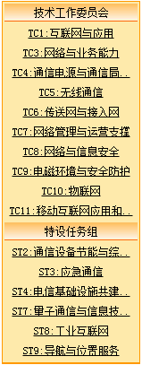
CCSA Organizations
Special Task Groups
Technical Committees
TC1:Internet and application
TC3:Network
TC4:Communication power supply & station operational environment
TC5:Wireless communication
TC6:Transport and access network
TC7:Network management & operation support
TC8:Network & information security
TC9:Electromagnetic environment &protection
TC10:IoT
TC11:Mobile internet application and terminal technical
ST2:Communications Equipment Energy-saving and Comprehensive Utilization
ST3:Emergency Communication
ST4:Telecommunication Infrastructure Construction and Sharing
ST7:Quantum communication and information technology
ST8:Industry Internet
ST9:Navigation and location services
Notes:
CCSA标准组织

Slide 3
MEC related
Standard name | Leader | State
面向LTE-V2X的多接入边缘计算业务架构和总体需求 MEC service architecture and overall requirements for LTE-V2X | 中国电信 China Telecom | 报批稿 Draft for Approval
面向C-V2X的多接入边缘计算服务能力开放和接口技术要求（第一阶段） MEC capability opening and interface technical requirements for C-V2X (phase I) | 中国电信 China Telecom | 报批稿 Draft for Approval
面向车路协同路边设备RSU运维管理平台 Operation and maintenance management platform for vehicle road collaborative roadside equipment | 中国电信 China Telecom | 新立项 New WI
基于边缘计算的车路协同跨域协同交互技术要求 Technical requirements of cross domain collaborative interaction based on edge computing | 中国电信 China Telecom | 新立项 New WI

Slide 4
Upper Layer – application and message
Standard name | Leader | State
基于车路协同的高等级自动驾驶数据交互内容 High level autonomous driving data interaction content based on vehicle infrastructure cooperation | 百度 Baidu | 送审稿 draft standard for examination
面向5G V2X自动驾驶场景分析和数据集 Autonomous driving scenario analysis and data set for 5G V2X | 中兴 ZTE | 送审稿 draft standard for examination
基于5G的远程遥控驾驶 通信系统总体技术要求 5G enables remote driving: technical requirements for 5G Communication System | 中兴 ZTE | 新立项 New WI
基于5G的车联网通信技术研究 Research on 5G based internet of vehicles communication technology | 中国移动 China mobile | 研究报告讨论稿 draft report for discussion
基于LTE的车联网无线通信技术 应用标识分配及映射 Application identity assignment and mapping of internet of LTE based vehicle wireless communication technology | 大唐 Datang | 送审稿 draft standard for examination

Slide 5
Wireless
Research report name | Leader | State
车联网网络性能评估与无线信道研究 Performance evaluation of V2X network and research of sidelink wireless channel | 中国联通 China Union | 研究报告讨论稿 draft report for discussion
基于LTE的车联网无线通信技术 V2I基础信息单播传输技术要求 Technical requirements of V2I basic message unicast of LTE_x0002_based vehicular communication | 中国信通院、华为 CAICT、HUAWEI | 新立项 New WI
车载无线短距通信系统技术要求 Technical requirements of automotive wireless short-range communication system | 中国信通院 CAICT | 征求意见稿 draft standard for discussion

Slide 6
Security
Standard name | Leader | State
基于LTE的车联网无线通信技术安全证书管理系统技术要求 Technical requirements for safety certificate management system of LTE based internet of vehicle wireless communication technology | 大唐 Datang | 报批稿 Draft for Approval
C-V2X车辆异常行为管理技术要求 Technical Requirements of Vehicle Misbehavior Management for C-V2X | 中国信通院,国汽智联 CAICT，CICV | 新立项 New WI

Slide 7
LTE-V2X standardization in China
China's LTE-V2X core technology standards on air interface, network layer, message layer and security have been formulated
Category | Name | Category | Organization | Standardization Technical Committee
General | General technical requirements of LTE-based vehicular communication | Industry standard, National standard | CCSA | Communications Standardization Technical Committee
Access layer | Technical requirements of air interface of LTE-based vehicular communication | Industry standard, National standard | CCSA | Communications Standardization Technical Committee
Network layer | Technical requirements of network layer of LTE-based vehicular communication | Industry standard, National standard | C-ITS、CCSA | Communications Standardization Technical Committee
Message layer | Technical requirements of Message layer of LTE-based vehicular communication | Industry standard, National standard | C-ITS、SAE-C、CCSA | Communications Standardization Technical Committee
Security | Technical requirements of security of LTE-based vehicular communication | Industry standard, National standard | CCSA | Communications Standardization Technical Committee
 | Technical requirements of security certificate management system of LTE-based vehicular communication | Industry standard, National standard | CCSA | Communications Standardization Technical Committee
Application | Technical requirements of vehicle information interaction system of LTE-based vehicular communication | Group standard, National standard | SAE-C、C-ITS、SAC/TC114 | Automobile Standardization Technical Committee
 | Technical requirements of roadside unit of LTE-based vehicular communication | Group standard, National standard | SAE-C、C-ITS | Transportation/Road Traffic Management Standardization Technical Committee
 | Business architecture and the overall demand of for multiple access edge computing for LTE-V2X | Industry standard, National standard | CCSA | Communications Standardization Technical Committee
 | Service capability opening and interface technical requirements of multi-access edge computing for LTE-V2X | Industry standard, National standard | CCSA | Communications Standardization Technical Committee
Function application | Intersection Collision Warning , etc… | Industry standard, National standard | SAE-C/C-ITS/SAC/TC114 | Automobile/Transportation/Road Traffic Management Standardization Technical Committee
Note: The red part is the part being pushed
7

Slide 8
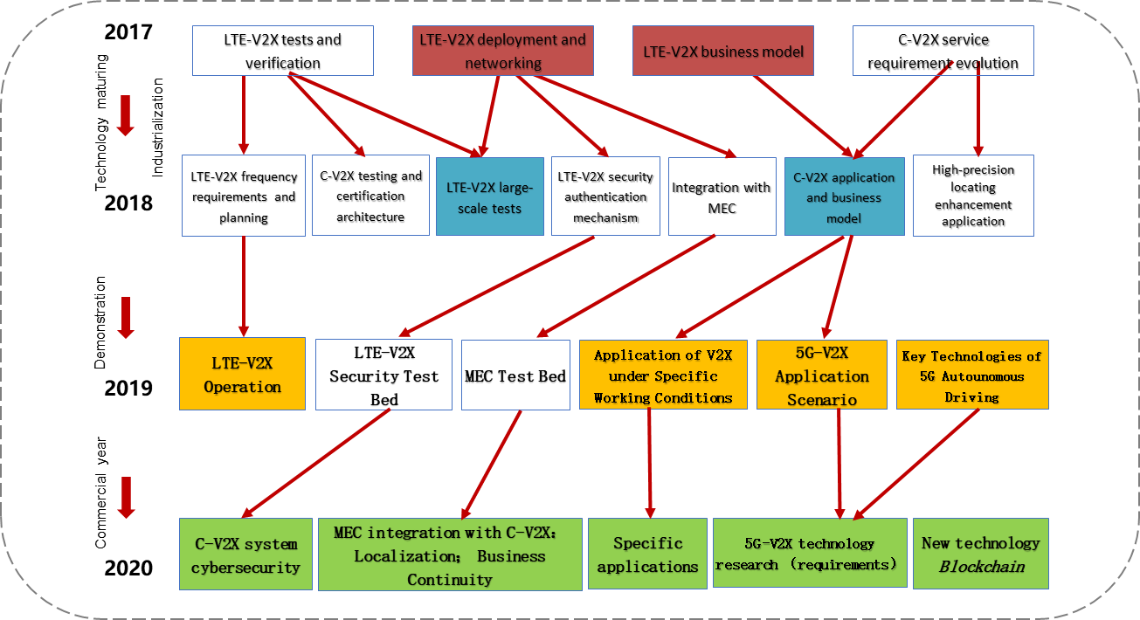
IMT-2020 Cross-Industry Cooperation

Slide 9
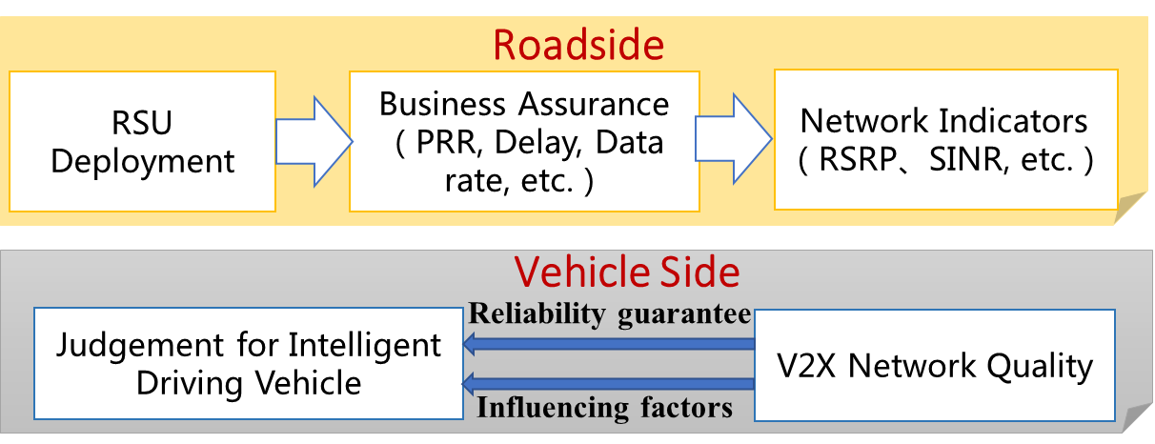
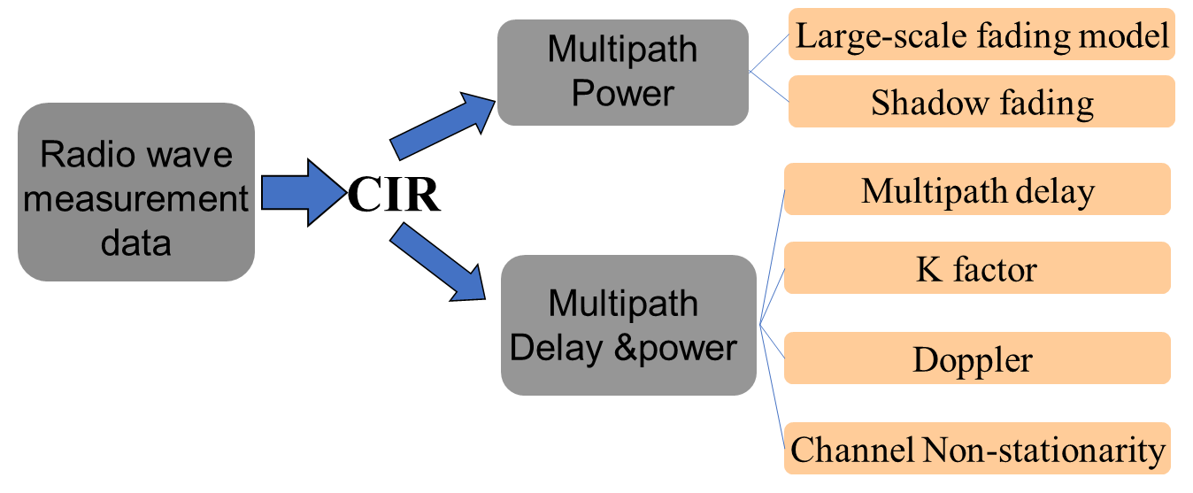
C-V2X wireless communication library
Performance Evaluation of C-V2X Network
Research of C-V2X Channel Models
Requirements:
Requirements:
(1) The channel models that mostly adopt from the urban microcellular channel model are not qualified for C-V2X
(2) The current channel models can not cover most of the C-V2X scenarios and more specific models are in demands
Research:
(1) Analyze typical C-V2X scenarios, especially for city straight, city intersections, high speeds, tunnels, scenes around the islands
(2) Deeply research the channel characters of typical scenarios and establish specific channel models for C-V2X
Research:
(1) Roadside: Establish the relationship between wireless coverage and business requirements; Propose schemes for RSU deployment
(2) Vehicles Side: Build performance evaluation system for vehicles to make reasonable judgements
(3) Intelligent Transport：Establish evaluating approach of V2X wireless communication to meet Intelligent transport requirements

Slide 10
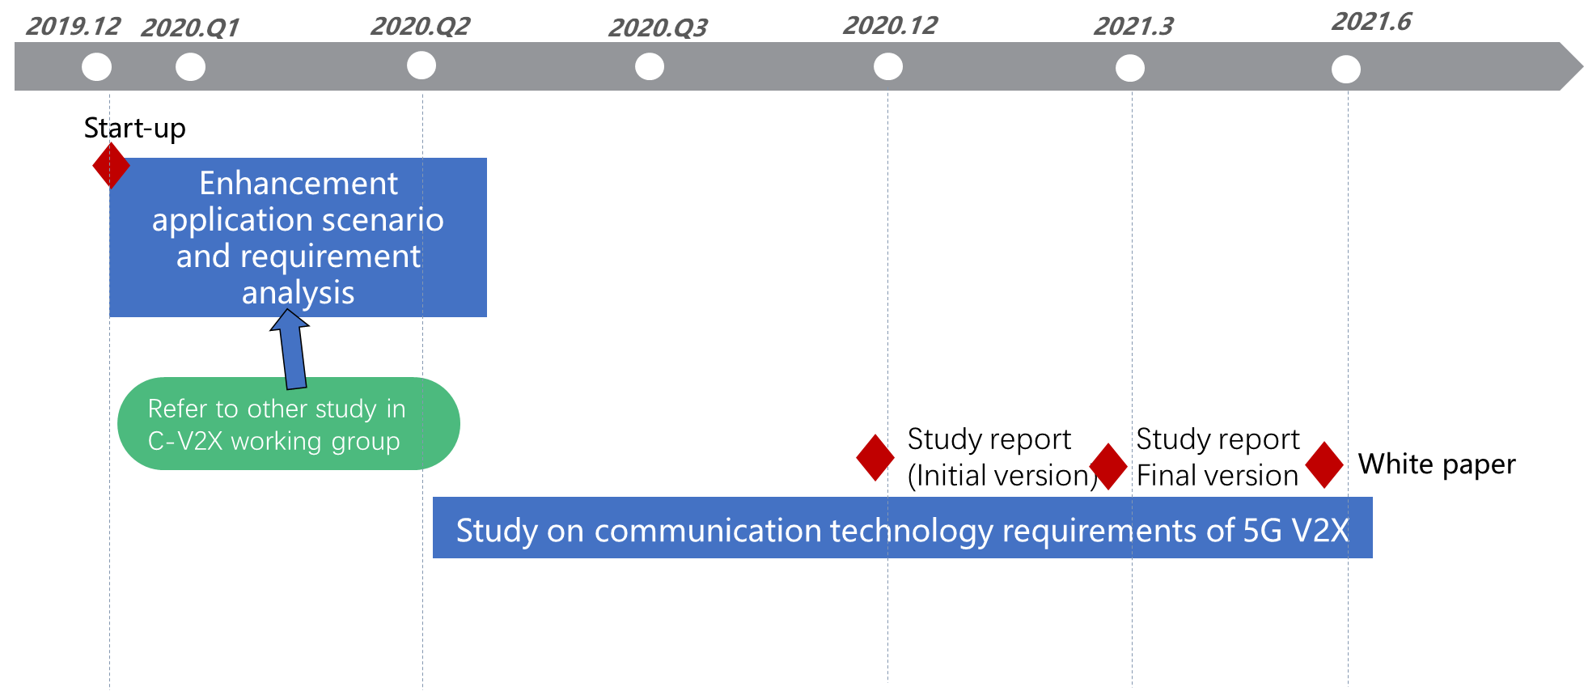
5G NR-V2X technology research （requirements）
This project studies the communication technology requirements and architecture supporting 5G V2X services. Focus on the application of key 5G communication technology in the field of V2X, and make suggestions for the future standard formulation.
Objectives：
Enhancement application scenarios and requirements analysis of V2X based on 5G
Analyze key technology requirements for wireless and core network supporting 5G application scenarios
5G NR wireless communication technology requirements, including but not limited to
NR Uu wireless communication technology applicable to V2X, such as eMBB, URLLC, etc;
NR sidelink communication mode, resource scheduling mode, congestion control, etc.;
QoS management of V2X Uu and PC5 interfaces, etc.
Core Network technology requirements, including but not limited to
Network slice
Continuity of service
QoS monitoring and prediction
Service authorization and parameter configuration V2X
V2X unicast / multicast / broadcast communication process
Network capability exposure for V2X service
Introduce 5G-V2X architecture, including cloud, network, roadside
and terminal.
Outputs and timeline

Slide 11
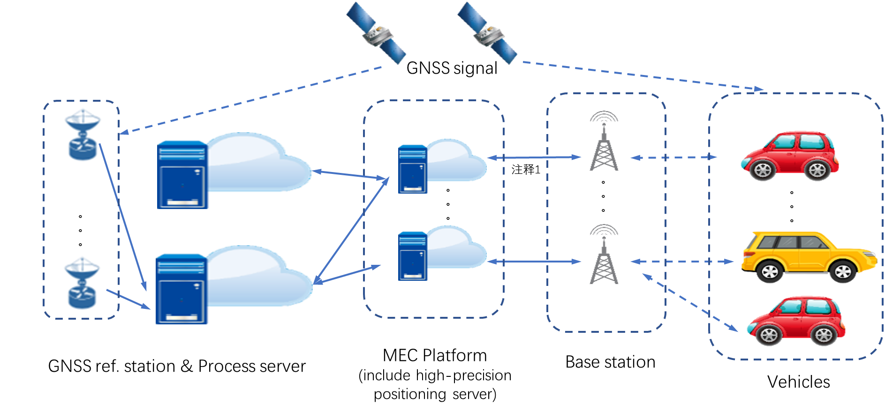
MEC integration with C-V2X
①【New WI】Research on service mobility for MEC based C-V2X scenario
②【NEW WI】Research on MEC based high precision positioning
Characteristics of MEC based V2X services：
High-speed mobility: vehicles passing through several MEC coverages quickly
Various MEC configurations: different MEC operators may setup up different MEC systems with different architectures
Strong QoE requirements: high bandwidth, super low delay and high level collaboration
Target: Optimal solution of C-V2X service mobility between different MEC platforms and different operators.
GNSS original signal: from vehicle to MEC;
GNSS reference signal: from ref. station to MEC;
MEC (high precision positioning server): vehicle’s location computation.
Target: system solution research, interface research between MEC and vehicles
③【MEC testbed】promoting evaluation and validation of the MEC testbeds, summarizing and forming the MEC integration with C-V2X cases set

Slide 12
LTE-V2X security certificate system-level test and verification
On the basis of 2019 C-V2X demo, focus on certificate management and the whole system test and verification
C-V2X Security system level test and verification
TASK1 ：Establishment of certificate management system verification environment
According to CCSA TC10 standard, set up the test verification environment, including：
Root certificate mechanism
LTE-V2XCertificate authority (ECA,PCA,ACA etc.）
Certification authority (DCM, GBA, OAuth, etc.)
1.Test verification system
2.Demonstration activities
3.Research Report
4.Solution case set
TASK 2：Certificate management process testing
Participant：
Certificate applicant（OBU、RSU）, certification authority
Verification content：
Certificate management
PC management
AC management
CRL list management
Misbehavior Authority
Link value management
Certificate management system
Terminal system security mechanism
Root
CA
LTE-V2X CA
Authentication system
OBU
RSU
TASK 3：System operation verification
Equipment communication layer
Interoperability
Signature and verification performance
Security hsm
Equipment and certificate management system level
Certificate Update
Certificate Revocation
…
Rresearch on communication security test methods (including interface, system, etc.)
ECA
PCA
ACA
CRA
DCM
GBA
OAuth
Test methods, test tools

Slide 13
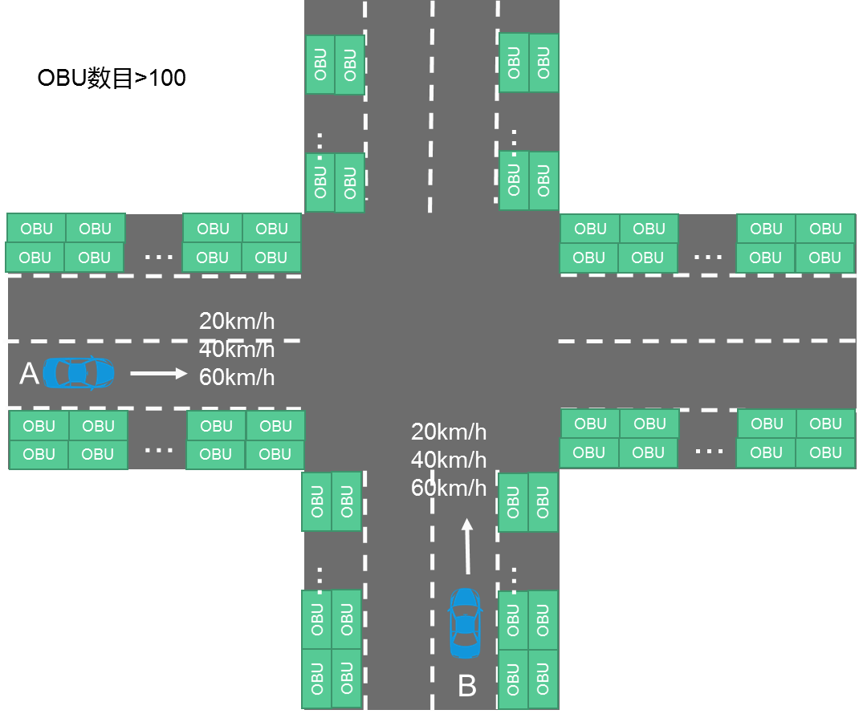
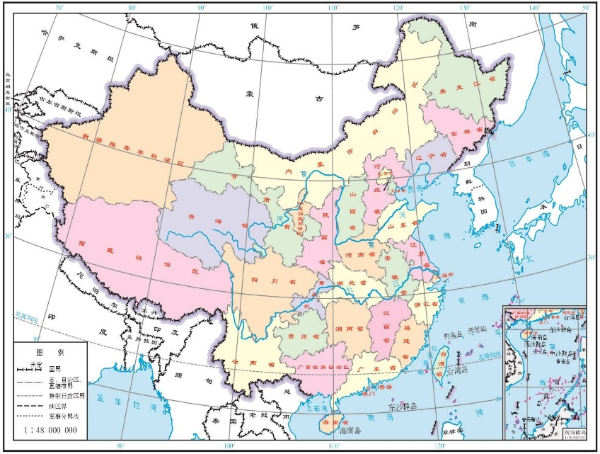


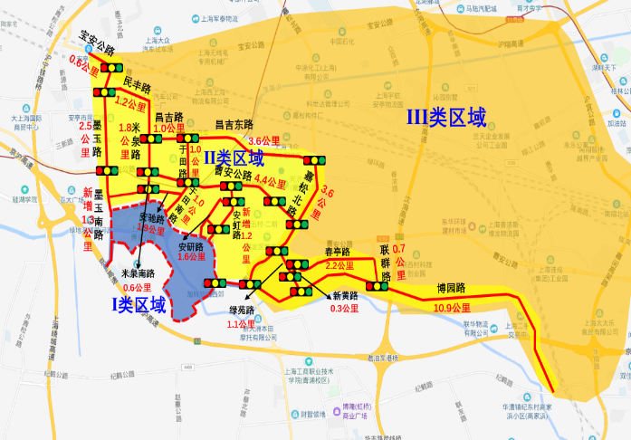







2020, Testing and Plugfest
October. 27-29, in Shanghai. Provide a large-scale test environment, 100~200 background vehicles equipped with PC5 module, Support communication performance test and application function test. Also combine with the LTE-V2X security certificate system-level test and verification
MEC Testbeds Evaluation. MEC support LTE-V2X scenarios, architecture, Ability to open and APIs definition, among the 10 released testbeds
13

Slide 14
Thank you
Ge Yuming Email: geyuming@caict.ac.cn

