Slide 1
Data Augmentation and Data Efficient Model Training

Slide 2








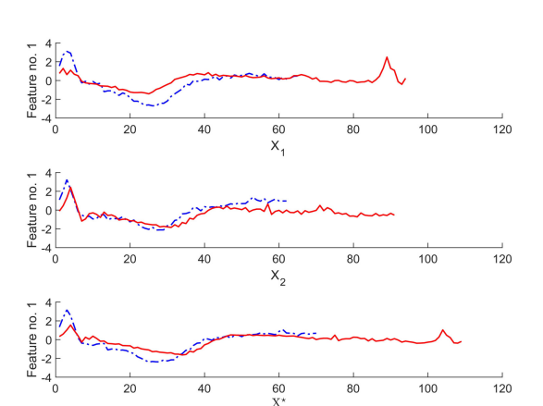
Input Data
Model in Production
Alert
Comment From
Analyst
Business Review
LLM
Database
Efficient Model
Training
Feedbacks
Data Augmentation

Slide 3
Transformation Based
Decomposition Based
Generative
Pattern Based
Automated Data Augmentation

Slide 4
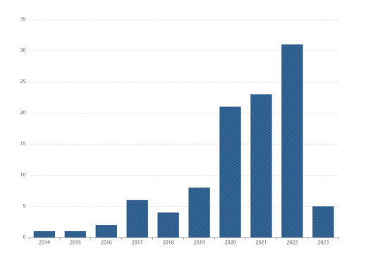
Number of Research Publications

Slide 5
Transformation Based Methods
Magnitude Transformation: e.g. Jittering, Scaling, Magnitude-Warping
Time Transformations: Change data point sequencing or timing, Window Slicing, Window Warping
Frequency Transformations: Stratified Fourier Coefficients Combination (SFCC), Random Noise Boxes (RNB)
Time Frequency transformations: Amplitude Adjusted Fourier Transform(AAFT) and Iterative Amplitude Adjusted Fourier Transform(IAAFT)

Slide 6
Pattern Based Methods
Magnitude Pattern Mining: SPAWNER, Recurrent In-Fill Masking (RIM)
Time Pattern Mining: Dynamic Time Wrapping (DTW)
Frequency Pattern Mining: Equalized Mixture Data Augmentation (EMDA), Stochastic Feature Mapping (SFM)
Time Frequency Pattern Mining: Discrete cosine transform (DCT), CNN

Slide 7
Generative Methods
Statistical Models: Mixture of Gaussian Trees, Mixture of Autoregressive Models
Deep Learning Models: GANs and cGANs with LSTMs usually, TS-GAN, IB-GAN, VAE, ExtraMAE

Slide 8
Decomposition Based Methods
Decomposition Based Methods: Empirical Mode Decomposition + LSTM, RobustSTL
Automated Data Augmentation Methods: PoseVAE + RNN-based RL, MODALS

Slide 9
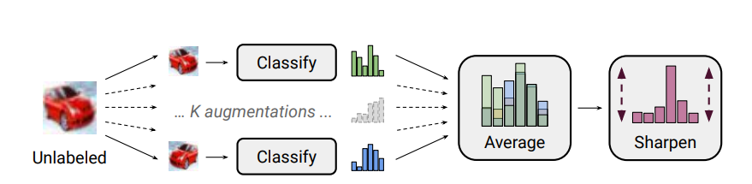
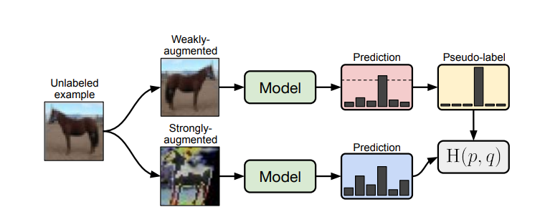
Training Techniques
MixMatch
FixMatch

Slide 10
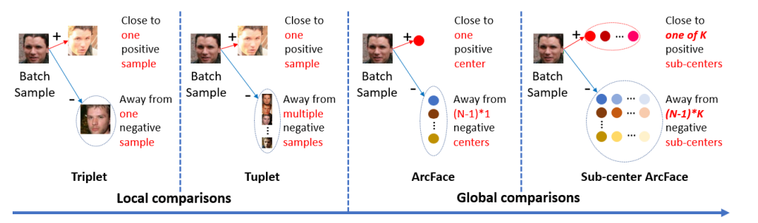
Training Techniques

Slide 11
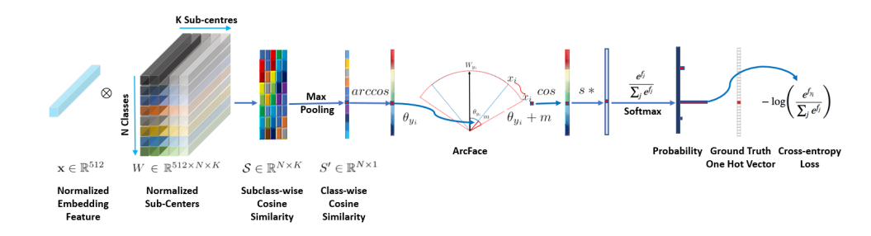
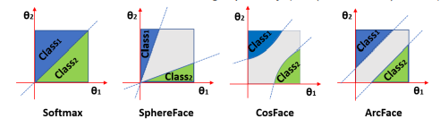
Training Techniques

Slide 12

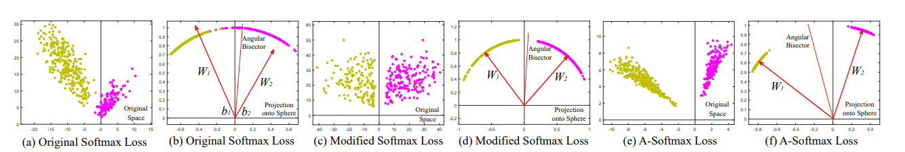
Training Techniques

Slide 13
What Do We Want to Explore
Chose one data Augmentation technique from each category and apply to Layering to evaluate the performance.
  Once new samples are generated using data augmentation, we will feed the data into our existing models to verify the result
  Then we will share the samples with business to their review
Implement Semi supervised learning Technique on Layering as a case study.

