Slide 1

AI & Agentic Design Standards
Leveraging AI in Enterprise Architecture
Offsite POV: Frameworks, Patterns & Practice

Slide 2





Executive Summary & Agenda
Agentic Design Standards (12 factors)
Enterprise Controls & Governance
Patterns & Frameworks
AI in Architecture Practice
Benefits, Risks & Recommendations
[1] [2] [3] [4]

Slide 3
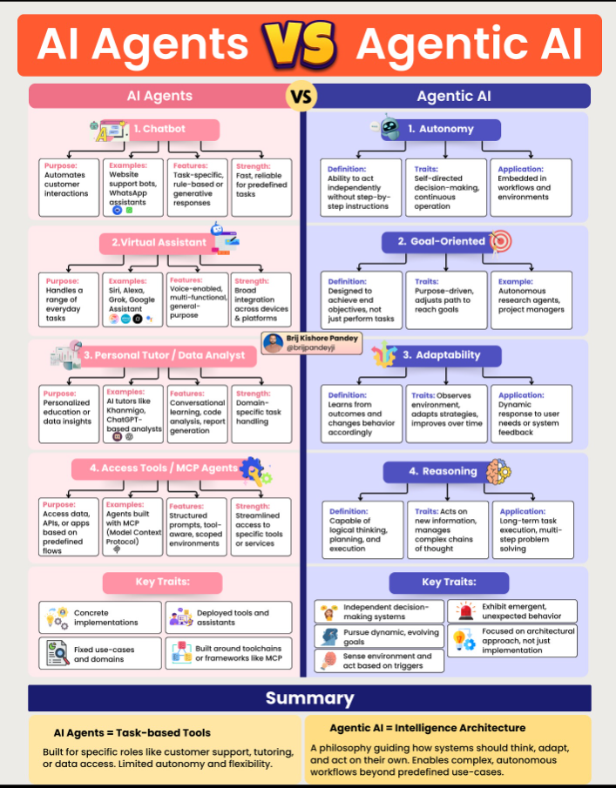
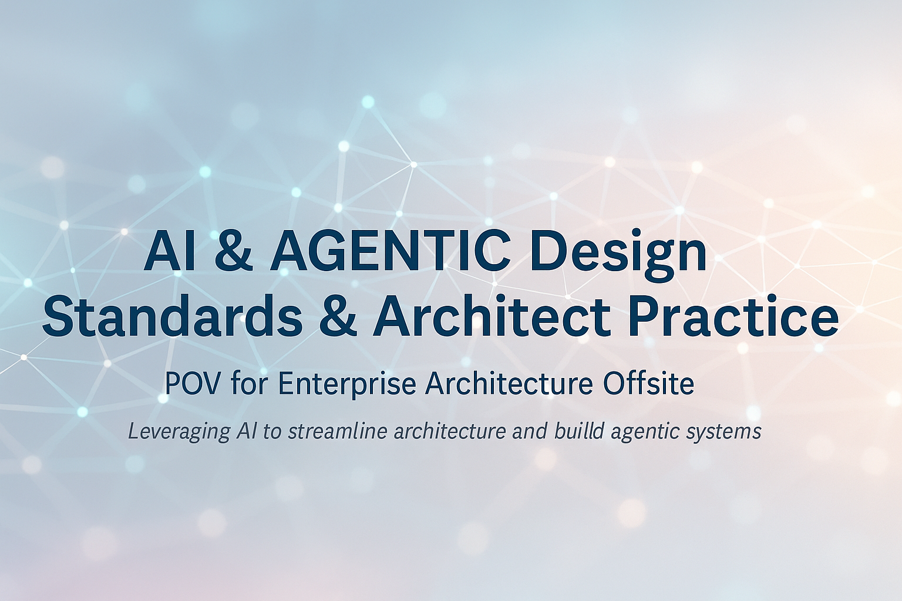

Challenges & Drivers
From Copilots to Autonomous Agents Modern AI applications demand more than reactive assistants; they require proactive agents that plan, act and collaborate to deliver multi‑step workflows. Enterprise Architecture Pain Points Architects struggle to keep standards current, produce blueprints quickly and triage designs at scale. Manual processes cannot cope with the volume and complexity of modern systems.
[1] [2] [3] [4]

Slide 4
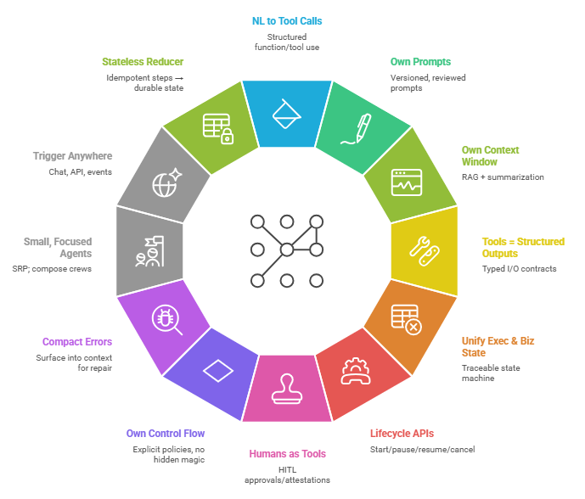
12 Factor Agents Principles for building reliable LLM applications

Slide 5



High Level Enterprise Deployment Controls
Identity & Access
Observability & Logging
Leverage enterprise identity (SSO, RBAC) so agents act within user permissions and actions are traceable.
Capture every decision, action and context for audit and debugging. Use distributed tracing & dashboards.
Safety & Guardrails
Change Management & Governance
Enforce rate limits, content filters, human‑in‑the‑loop checks and tool permissions to prevent abuse.
Version prompts, test model changes, codify rules and follow AI DevOps pipelines for compliant rollouts.
[1] [2] [3] [4]

Slide 6
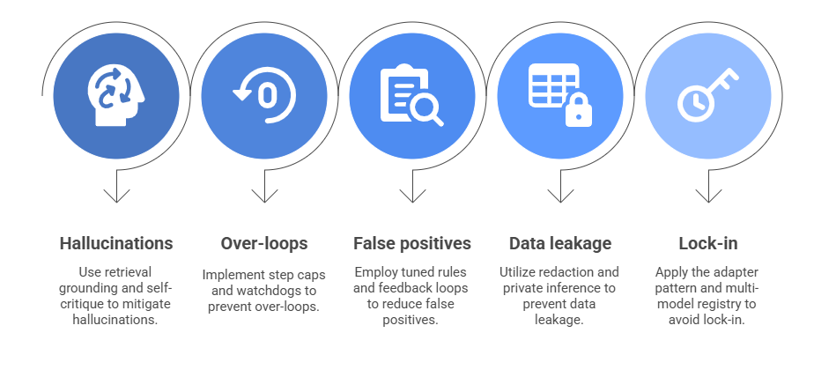
Risks Management in LLMs and Agentic AI
[1] [2] [3]

Slide 7
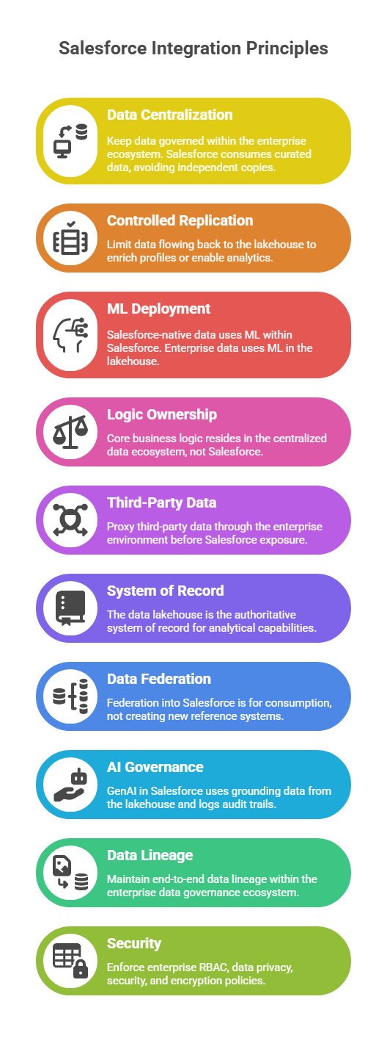
Guiding Principles
[1] [2] [3] [4]

Slide 8
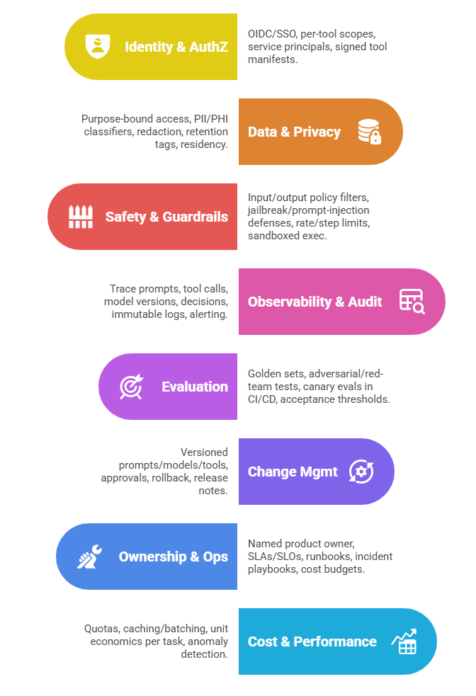
Minimum Control Baseline for 3rd Party Agentic Solutions
IC-01
IC-02
IC-03
IC-04
IC-05
IC-06
IC-07
IC-08
[1] [2] [3] [4]

Slide 9
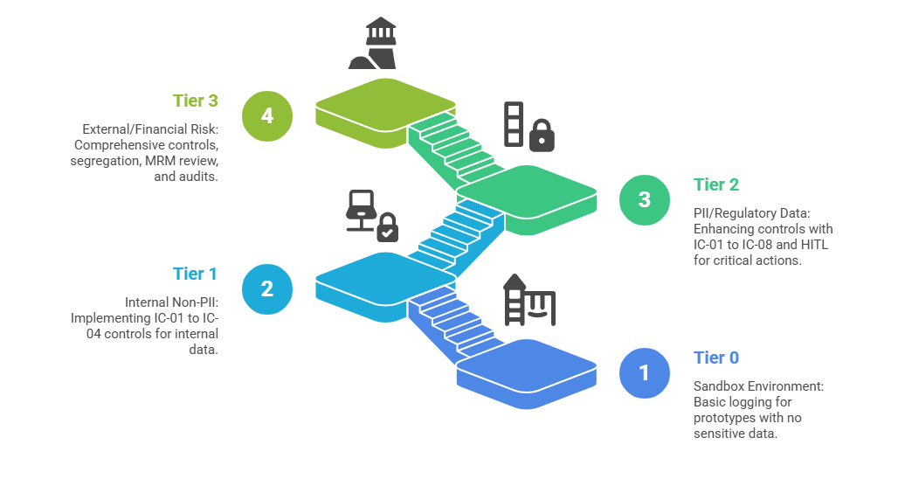
Risk Tiering and Gates

Slide 10
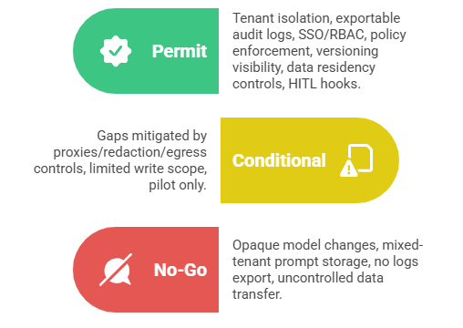
Rubrics

Slide 11
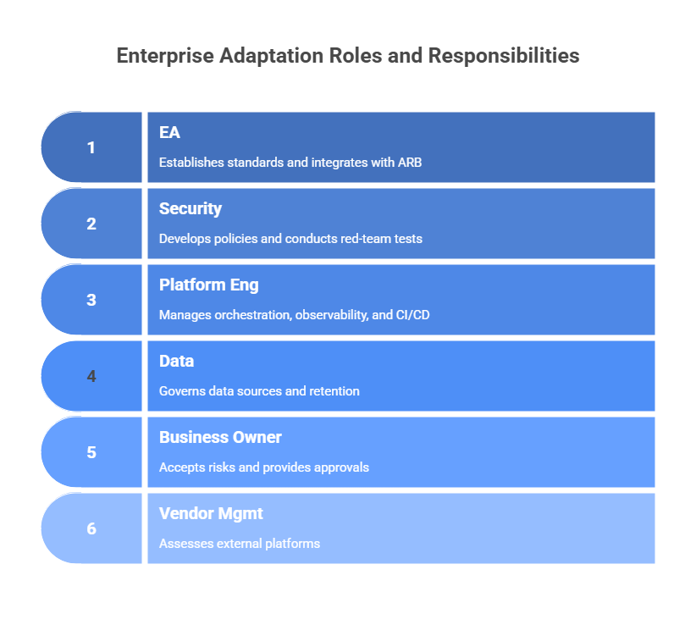

Slide 12
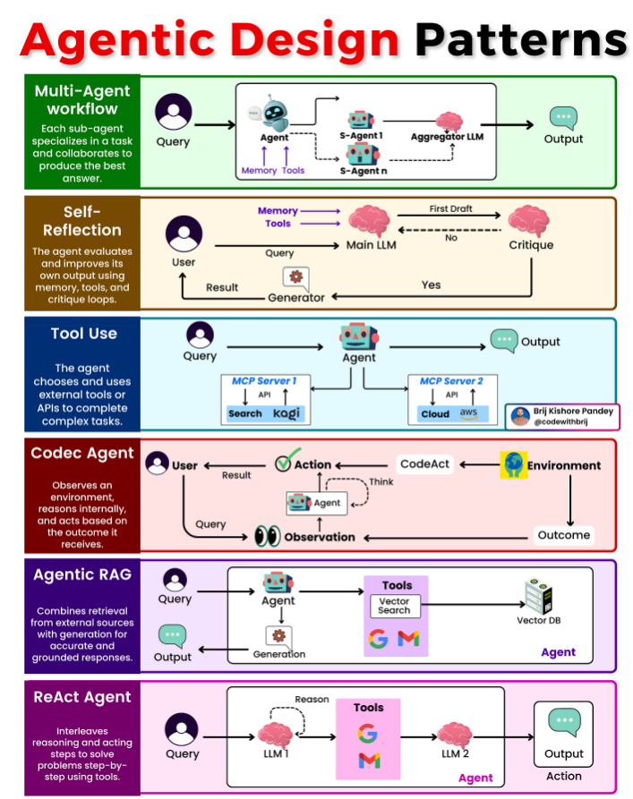
Design Patterns for Agents
[1] [2] [3] [4]

Slide 13
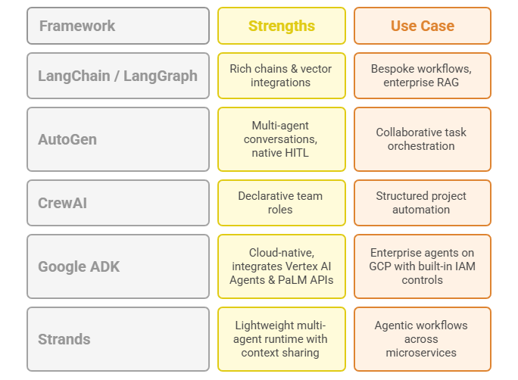





Frameworks
[1] [2] [3]

Slide 14
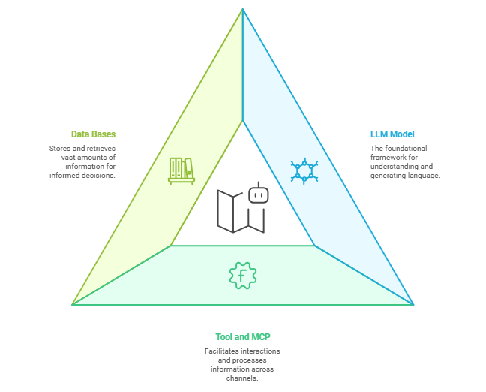
Components of the Agentic AI Systems
[1] [2] [3]

Slide 15




AI in Architecture Practice
Standards Renewal
Monitor releases & usage
AI summarises impacts
Draft updated standards
Architect review & approve
Blueprint Generation
Gather requirements
AI drafts architecture
Collaborative refinement
Implement & document
Pre‑ARB Triage
Submit design
AI checks vs standards
Highlight risks & fixes
ARB focuses on novel issues
[1] [2] [3] [4]

Slide 16
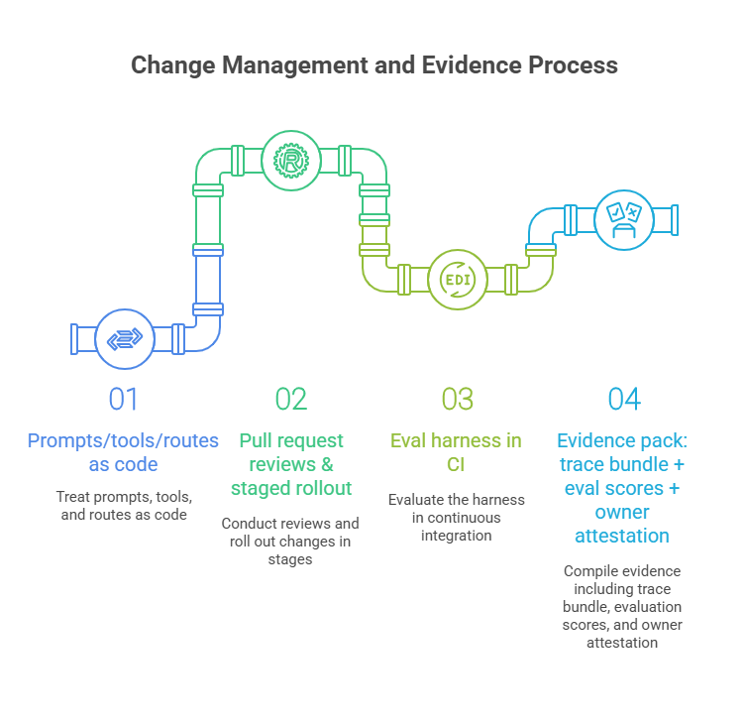

Slide 17

Architecture Governance & Enforcement
Detect Drift & Anti‑Patterns
Validate Diagrams vs Reality
CodeOps & Knowledge Repos
Continuously compare code, configs & telemetry to reference designs; flag unauthorized dependencies, layer violations and missing controls.
Cross‑check diagrams with live deployments to highlight mismatches and missing failover components.
Codify standards as rules; embed AI checks in CI/CD; populate knowledge bases and design docs automatically.
[1] [2] [3] [4]

Slide 18
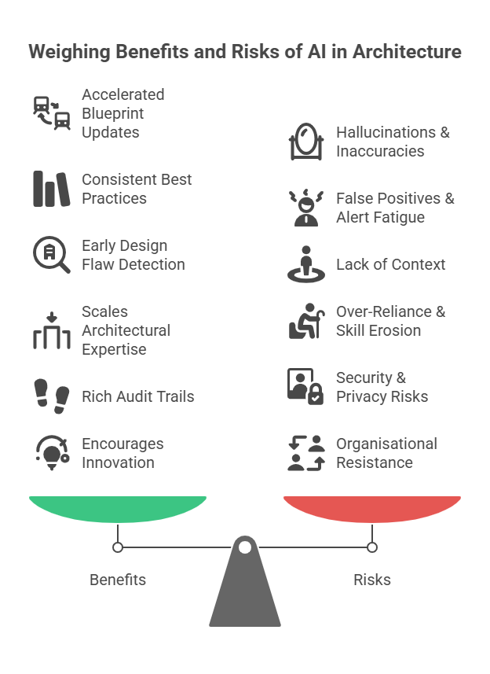
Benefits & Risks of AI in Architecture
[1] [2] [3] [4]

Slide 19

Recommendations & Next Steps
1
Adopt an Agent Framework
Select a modular platform (e.g. LangChain, AutoGen, CrewAI) and pilot your first agent with clear scope.
2
Define Roles & Guardrails
Specify agent responsibilities, tool permissions, and human approval points. Version your prompts.
3
Instrument & Monitor
Implement logging, tracing & dashboards. Capture context, actions and user identities for auditing.
4
Pilot & Iterate
Run a 90‑day pilot on a high‑value workflow (e.g. blueprint generation) with continuous feedback and improvement.
5
Educate & Align
Train architects & engineers on AI capabilities and limitations. Foster a culture of collaboration between humans and agents.
[1] [2] [3] [4]

Slide 20
Conclusion & Call to Action
Agents augment architects, not replace them. By adopting agentic design standards, rigorous controls and a deliberate implementation strategy, organisations can harness AI to accelerate architecture delivery, enforce consistency and foster innovation. Start small, measure impact, iterate and scale. Partner AI with human expertise to build systems that are robust, responsible and ready for the future.
[1] [2] [3]

