Slide 1
Agenda
Engagement Overview
Scope / Workstreams
Cross-Functional Discovery & Prioritization
Roadmap & Milestones
Intake / Governance Flow
Cadence / Reporting / Success Measures

Slide 2
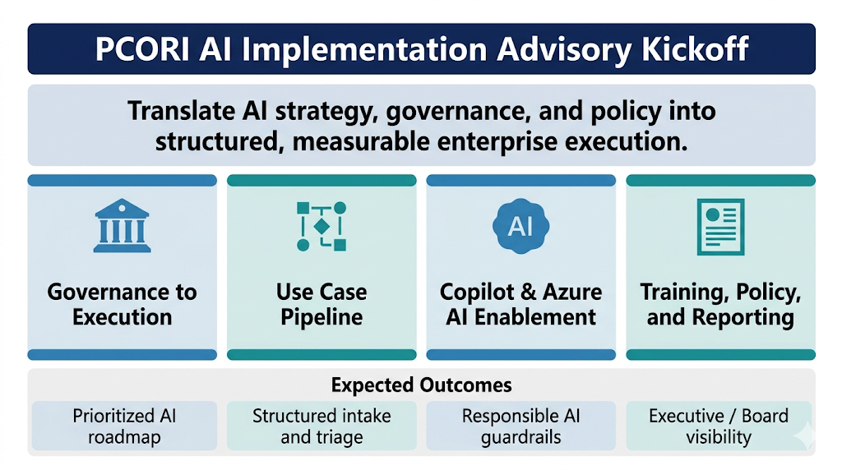

Slide 3
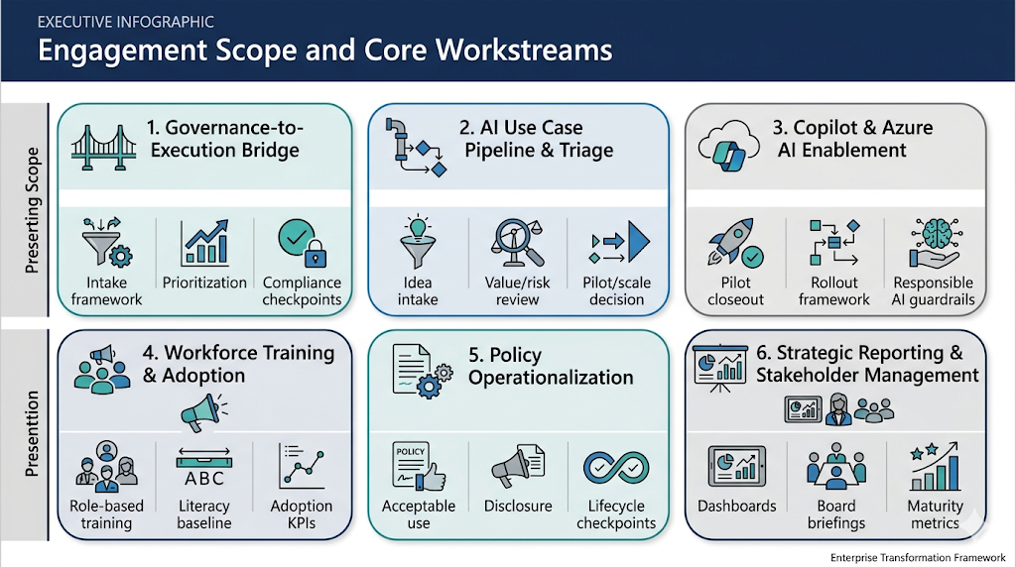

Slide 4
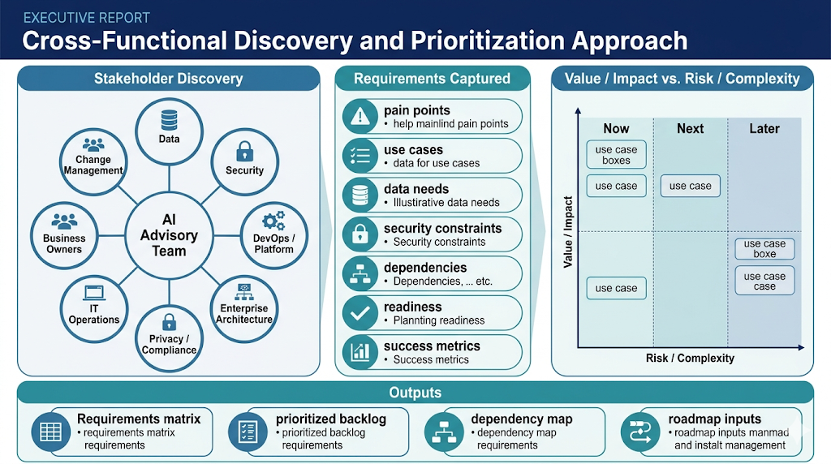
Planning readiness
Deliverable, priorities, cost

Slide 5
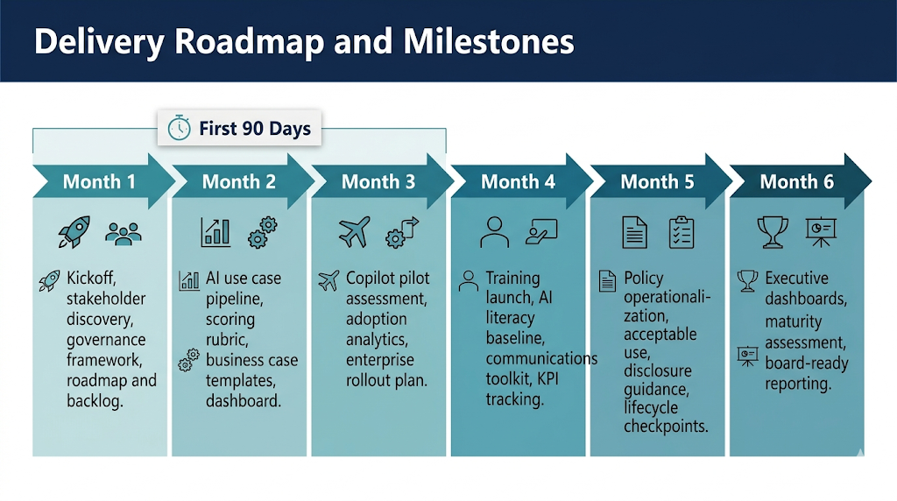

Slide 6
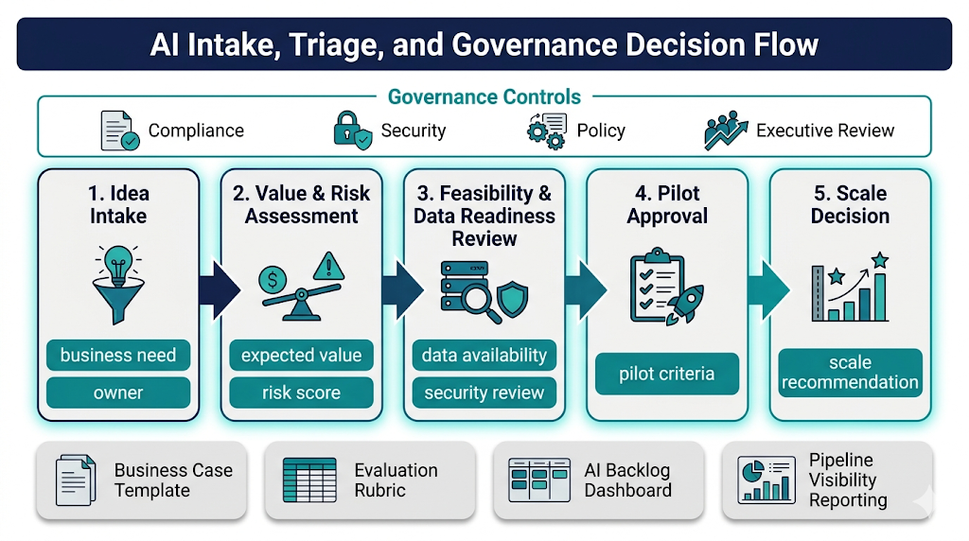

Slide 7
