Slide 1
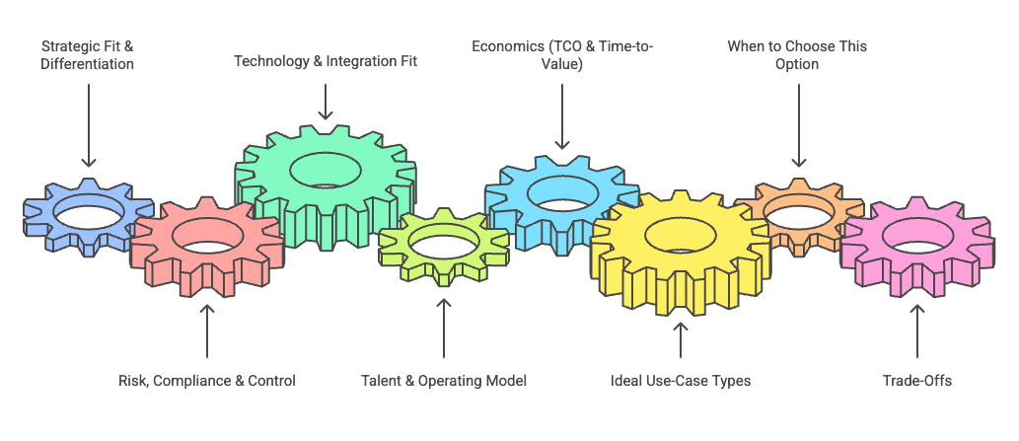
Does this use case create a defensible competitive edge (e.g., credit decisioning, fraud strategy, client advisory)?
Degree of control needed over data, prompts, models, logs; ability to meet SR 11-7, model risk, AML/KYC, privacy, audit, SOX.
How well the option plugs into core systems, APIs, ESB, event bus, observability, and existing workflow engines.
Do we have the people and operating model to build, run, and support it (LLM engineers, MLOps, SRE, product owners)?
TCO over 3–5 years vs speed: build cost, run, vendor fees, infra, and expected payback period.
Can this solution be reused across multiple LOBs/use cases (platform vs one-off pilot)?

Slide 2
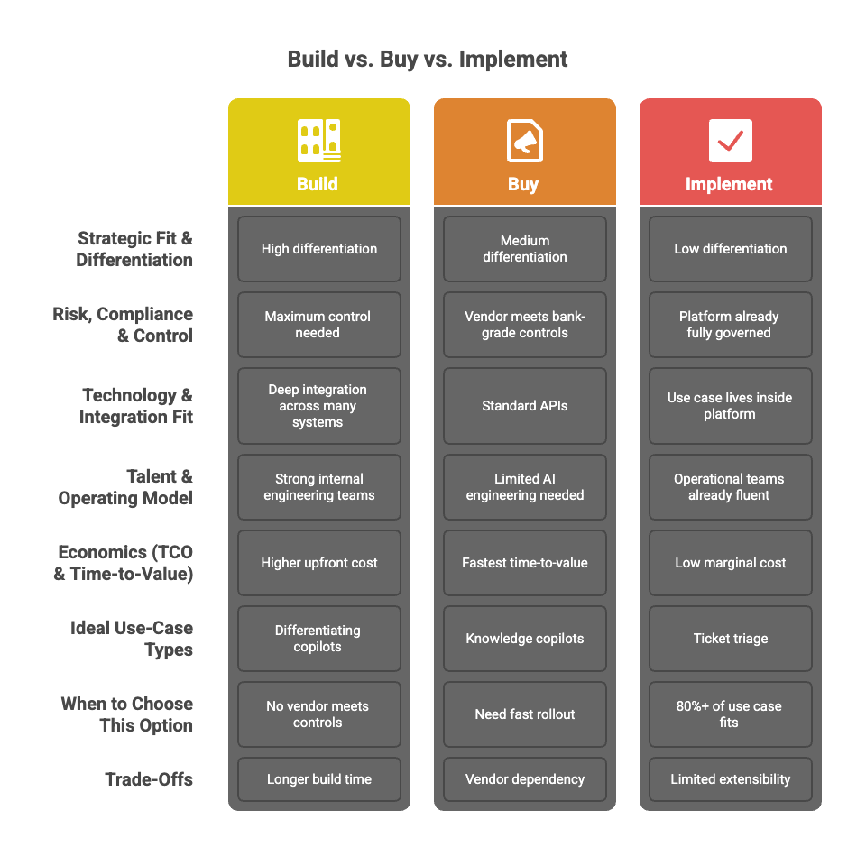

Slide 3
# | Factor | Description | Weight | Scoring Guide (1–5)
1 | Strategic Differentiation | Does this use case create a defensible competitive edge (e.g., credit decisioning, fraud strategy, client advisory)? | 25% | 1 = commodity; 3 = moderate; 5 = core differentiator tied to bank’s strategy
2 | Risk, Compliance & Control | Degree of control needed over data, prompts, models, logs; ability to meet SR 11-7, model risk, AML/KYC, privacy, audit, SOX. | 25% | 1 = vendor/control gaps; 3 = some mitigations; 5 = full, bank-grade control and oversight
3 | Tech & Integration Fit | How well the option plugs into core systems, APIs, ESB, event bus, observability, and existing workflow engines. | 20% | 1 = heavy custom glue; 3 = moderate integration; 5 = native or near-native fit
4 | Talent & Operating Model | Do we have the people and operating model to build, run, and support it (LLM engineers, MLOps, SRE, product owners)? | 15% | 1 = major gaps; 3 = some team but stretched; 5 = strong, dedicated capability
5 | Economics & Time-to-Value | TCO over 3–5 years vs speed: build cost, run, vendor fees, infra, and expected payback period. | 10% | 1 = negative ROI or >3 yr payback; 3 = borderline; 5 = strong ROI and <18 mo payback
6 | Reuse & Platform Leverage | Can this solution be reused across multiple LOBs/use cases (platform vs one-off pilot)? | 5% | 1 = one-off; 3 = some reuse; 5 = high reuse / shared platform potential
On a 1–5 scale:
< 3.0 → ❌ Do not choose (solution is weak / misfit)
3.0 – 3.6 → 🤔 Viable but marginal – only pick if it’s clearly better than others or a stopgap
3.7 – 4.3 → ✅ Strong fit – good candidate
> 4.3 → ⭐ Strategic fit – very strong, likely preferred if risk/compliance is OK

Slide 4

Salesforce (Agentforce / Einstein 1)
Agentforce provides autonomous agents that can answer questions, take actions, and orchestrate tasks across Salesforce (Sales/Service/Marketing/Commerce) using your CRM data.
Deeply tied to customer 360, sales/service workflows and can trigger flows, update records, and interact with external systems via Salesforce integrations and Flow.
Pros
Excellent for front-office use cases: agentic sales assistants, service agents, call-center co-pilots, case triage, cross-sell/upsell journeys.
Strong ecosystem, security posture, and large partner network; Salesforce very used in FS.
Native data access control, approval workflows, and auditability within Salesforce objects.
Multi-agent roadmap and deep integration with OpenAI/Anthropic models via secure Salesforce cloud.
Cons / Risks
Primarily powerful within the Salesforce estate—less ideal as the only enterprise-wide orchestrator.
Licensing + usage costs can be substantial across thousands of users.
Deep customer-data use triggers model risk, explainability, and fair-lending concerns for some use cases.
Factor | Weight | Score | Comment
Strategic Differentiation | 25% | 4 | Strong differentiation for customer experience but not a full enterprise agent layer.
Risk, Compliance & Control | 25% | 4 | Mature FS controls; still needs tight governance for AI-driven recommendations.
Tech & Integration Fit | 20% | 4 | Great inside Salesforce; decent outward via APIs/Flow/Events but not a universal orchestrator.
Talent & Operating Model | 15% | 4 | Banks already have Salesforce admins/devs; can upskill to Agentforce config.
Economics & Time-to-Value | 10% | 3 | Fast value where Salesforce is core; cost can spike at scale.
Reuse & Platform Leverage | 5% | 4 | Reusable across many CRM/service use cases; less so for pure back-office.
Score: 3.9
✅ Strong fit

Slide 5
UiPath (Autopilot + Agent Builder)
Autopilot brings generative AI into UiPath for developers, testers, analysts and “everyone,” helping build automations, generate workflows, and describe changes in natural language.
UiPath Agent Builder allows low-code creation of specialized enterprise agents that can understand context, make decisions, and execute complex processes while using UiPath’s enterprise-grade security and governance.
Pros
Very strong fit for back-office, operations, and middle-office flows already automated or RPA-friendly.
Governance, logs, approvals, and exception handling are well understood in banks using UiPath RPA today.
Agent Builder + Orchestrator give you an agentic control layer across many legacy systems.
Cons / Risks
Best suited where you already have UiPath widely deployed; otherwise, integration/skill ramp needed.
Less focused on knowledge-centric workflows (e.g., deep knowledge search) vs workflow/RPA-centric use cases.
Complex estate of bots/agents can become hard to govern without strong CoE.
Factor | Weight | Score | Comment
Strategic Differentiation | 25% | 4 | Big differentiator in operational efficiency for KYC, ops, reconciliations, etc.
Risk, Compliance & Control | 25% | 5 | Strong enterprise controls, logging, RBAC; already accepted in many banks.
Tech & Integration Fit | 20% | 4 | Excellent where UiPath is entrenched; multiple connectors to core/batch/legacy.
Talent & Operating Model | 15% | 4 | Many banks have RPA CoEs; easy upsell to agentic.
Economics & Time-to-Value | 10% | 4 | Good ROI when piggybacking existing automation; moderate license cost.
Reuse & Platform Leverage | 5% | 4 | RPA+agents become a shared “digital workforce” across functions.
Score: 4.15
✅ Strong fit

Slide 6
Oracle HCM (Oracle AI for HCM)
Oracle AI for HCM embeds traditional + generative AI into HR processes: hiring, talent management, career development, and HR service delivery.
Typical behaviors: draft job descriptions, summarize employee info, suggest career paths, assist managers with performance/talent actions.
Pros
Deeply integrated with core HR data (single HCM suite).
Oracle emphasizes data protection, privacy, and guardrails inside its HCM stack.
Good for agentic assistants focused on HR operations, employee self-service, and manager decision support.
Cons / Risks
Best suited where you already have UiPath widely deployed; otherwise, integration/skill ramp needed.
Less focused on knowledge-centric workflows (e.g., deep knowledge search) vs workflow/RPA-centric use cases.
Complex estate of bots/agents can become hard to govern without strong CoE.
Factor | Weight | Score | Comment
Strategic Differentiation | 25% | 3 | HR excellence helps, but not core competitive edge vs other banks.
Risk, Compliance & Control | 25% | 4 | HCM data is sensitive; Oracle provides strong controls & guardrails.
Tech & Integration Fit | 20% | 3 | Great if Oracle HCM is your system of record; otherwise heavy lift.
Talent & Operating Model | 15% | 3 | Requires Oracle HCM functional + admin skillset; less generic.
Economics & Time-to-Value | 10% | 3 | Solid ROI for HR, but benefits are concentrated in one function.
Reuse & Platform Leverage | 5% | 2 | Mostly HR-specific; limited reuse for broader banking processes.
Score: 3.2
🤔 Viable but marginal

Slide 7
ServiceNow (SNOW – Now Assist & AI Agent)
Now Assist combines generative AI with ServiceNow’s workflow platform: summarising tickets, incidents, chats; recommending actions; generating catalog items and playbooks.
ServiceNow now offers AI Agents and “Now Assist Skills” to deliver proactive, autonomous experiences across ITSM, HR, customer service and more.
Pros
Extremely strong where you use SNOW for ITSM, HRSM, CSM, risk & compliance workflows.
AI acts inside existing workflows with full logging, RBAC, approvals, and audit trails.
Moveworks acquisition bolsters conversational/assistant experience for employee support.
Cons / Risks
Like Salesforce, strongest inside the SNOW estate—not ideal as the only enterprise orchestrator.
Licensing for AI features can be steep; need good use-case selection.
Complex SNOW customization can create technical debt if not governed tightly.
Factor | Weight | Score | Comment
Strategic Differentiation | 25% | 4 | Big differentiator in service quality & internal productivity.
Risk, Compliance & Control | 25% | 5 | Very strong governance, logging, approvals in regulated industries.
Tech & Integration Fit | 20% | 4 | Excellent for ITSM/HRSM/CSM; lots of connectors for bank systems.
Talent & Operating Model | 15% | 4 | Many banks already have SNOW admin & platform teams.
Economics & Time-to-Value | 10% | 3 | Fast value for service flows; license uplift must be justified.
Reuse & Platform Leverage | 5% | 4 | Reused across IT, HR, risk, and customer support workflows.
Score: 4.15
✅ Strong fit

Slide 8
Jira (Jira Software / Jira Service Management with Atlassian Intelligence)
Atlassian Intelligence in Jira adds AI for work item creation, summarization, ticket triage, and incident assistance.
AI can scan Confluence pages to generate Jira tasks and pre-fill details, plus summaries issues, suggest next steps, and assist in Jira Service Management.
Pros
Great for engineering and ITSM/DevOps flows in Jira: incident analysis, ticket routing, backlog grooming.
Good developer adoption; AI embedded directly where engineers work.
Cloud-native collaboration across Jira Software, Jira Service Management, and Confluence.
Cons / Risks
Less mature for regulated, cross-system enterprise orchestration vs UiPath/SNOW.
Many banks still on Data Center or behind strict data residency rules; some AI features are cloud-first.
Risk/compliance patterns not as “baked-in” for banking as SNOW/UiPath.
Factor | Weight | Score | Comment
Strategic Differentiation | 25% | 3 | Improves SDLC/DevOps efficiency but not bank-wide differentiator.
Risk, Compliance & Control | 25% | 3 | Improving; may fall short of strict data/sovereignty needs in some banks.
Tech & Integration Fit | 20% | 3 | Strong within Atlassian stack; average for core bank systems.
Talent & Operating Model | 15% | 4 | Engineers already live in Jira; adoption is natural.
Economics & Time-to-Value | 10% | 4 | Fast incremental value; AI add-ons relatively easy to justify.
Reuse & Platform Leverage | 5% | 3 | Focused on SDLC / ITSM; moderate reuse beyond tech teams.
Score: 3.25
🤔 Viable but marginal

Slide 9
Harness (Harness AI / AIDA)
Harness AI (AIDA) uses a multi-agent approach across the SDLC to improve coding, build, deploy, security, reliability and cost optimization.
Features include AI-driven CD error analysis, root-cause suggestions, and CI/CD troubleshooting that correlate failures with issues and suggest remediations.
Pros
Strong for DevOps and SRE in a bank that uses Harness for CI/CD and feature delivery.
Multi-agent pattern is very aligned with “agentic AI” in SDLC context (different agents for build, deploy, cost, reliability).
Can notably reduce MTTR and increase deployment safety.
Cons / Risks
Very narrowly focused on software delivery, not business processes like KYC or loan ops.
Adoption cost if you’re not already a Harness shop.
Still evolving; banks need strong vendor due diligence for AI governance.
Factor | Weight | Score | Comment
Strategic Differentiation | 25% | 3 | Differentiates engineering productivity & release velocity, less so core banking product.
Risk, Compliance & Control | 25% | 3 | Pipeline logs & controls are good, but AI governance is emerging.
Tech & Integration Fit | 20% | 3–4 | 4 if Harness is your CI/CD backbone; 2–3 otherwise.
Talent & Operating Model | 15% | 3 | Requires DevOps teams to adopt a new or extended tool.
Economics & Time-to-Value | 10% | 3–4 | Can be strong ROI in reduced failure/MTTR where SDLC pain is high.
Reuse & Platform Leverage | 5% | 2 | Mostly SDLC-only; limited reuse in non-tech functions.
Score: 3.1
🤔 Viable but marginal

Slide 10
Atlassian (Platform & Atlassian Intelligence / Rovo / Dia)
Atlassian Intelligence is AI across Confluence, Jira, etc., helping draft content, summaries docs, and generate tasks.
Atlassian is rolling out Rovo, an AI teammate across the suite, and has acquired The Browser Company’s AI browser Dia to bring agents closer to users’ daily work across web apps.
Pros
Strong for knowledge management + collaboration: Confluence summaries, decision docs, runbooks, etc.
Rovo + Dia direction points towards cross-app AI assistant that can act beyond Jira/Confluence.
Deep adoption in engineer/PM/product orgs.
Cons / Risks
Many features are cloud-first; strict on-prem/data-center banks may not get full capability.
Governance, lineage, and FS-specific controls less mature than SNOW/UiPath.
Still more of an “AI teammate” than a robust, auditable agentic workflow engine for regulated ops.
Factor | Weight | Score | Comment
Strategic Differentiation | 25% | 3–4 | Can enable superior internal collaboration & SDLC, but often not front-office differentiator.
Risk, Compliance & Control | 25% | 3 | Improving, but FS-grade controls and on-prem options may be limited.
Tech & Integration Fit | 20% | 3 | Strong within Atlassian stack; moderate outside.
Talent & Operating Model | 15% | 4 | Huge user familiarity; low friction to adopt AI helpers.
Economics & Time-to-Value | 10% | 4 | Quick wins in documentation, knowledge, task generation.
Reuse & Platform Leverage | 5% | 3–4 | Can be reused across engineering, product, some ops teams.
Score: 3.4
🤔 Viable but marginal

