Slide 1


Slide 2
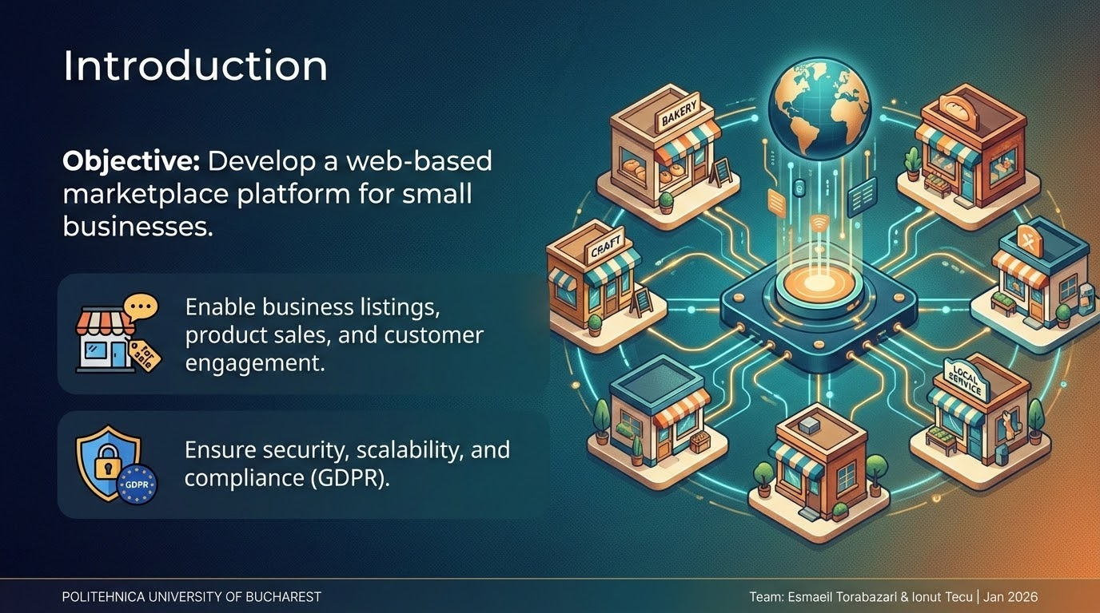
Platform Features
• User Registration & Authentication
• Business Listings & Product Management
• AI-Based Search & Filtering
• Blockchain-Secured Customer Reviews
• Order Management & Payment Integration
• Mobile App & Admin Dashboard

Slide 3
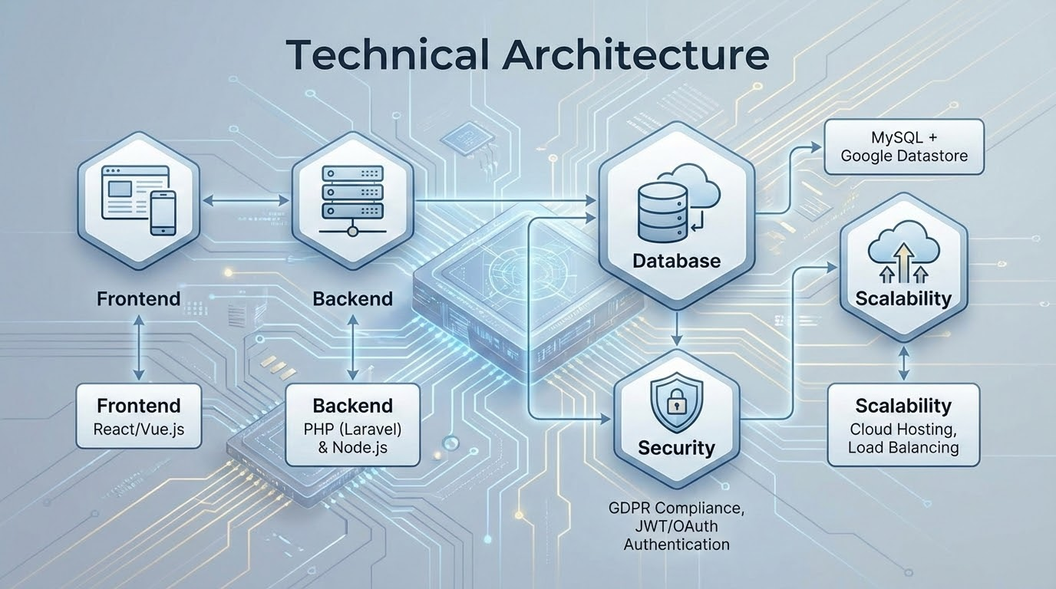

Slide 4
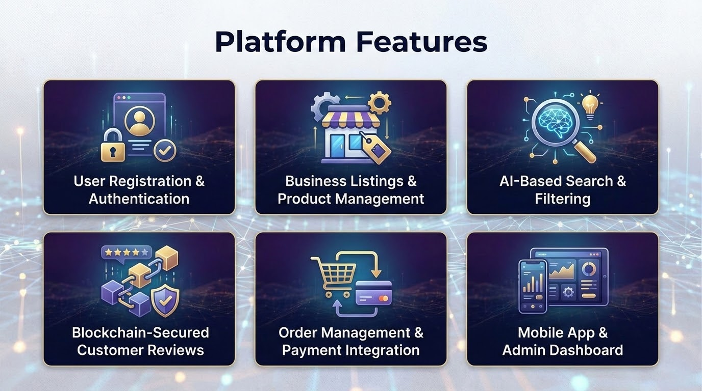
Challenges & Solutions
• Market Competition – Unique Features & Personalization
• User Adoption – Training & Onboarding Support
• Scalability – Cloud Infrastructure & Load Balancing
• Security – Data Encryption, Secure APIs

Slide 5
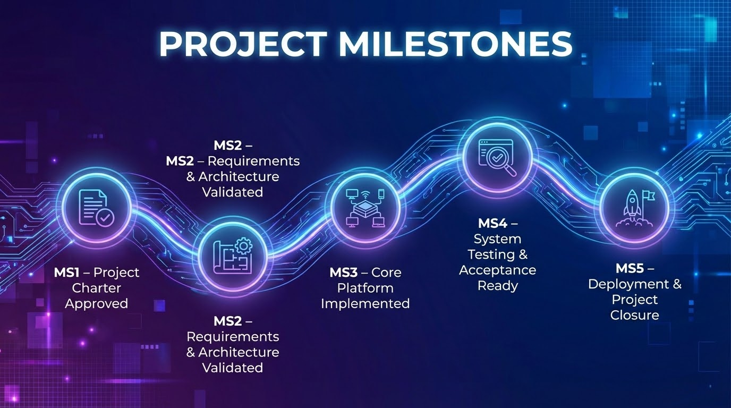

Slide 6
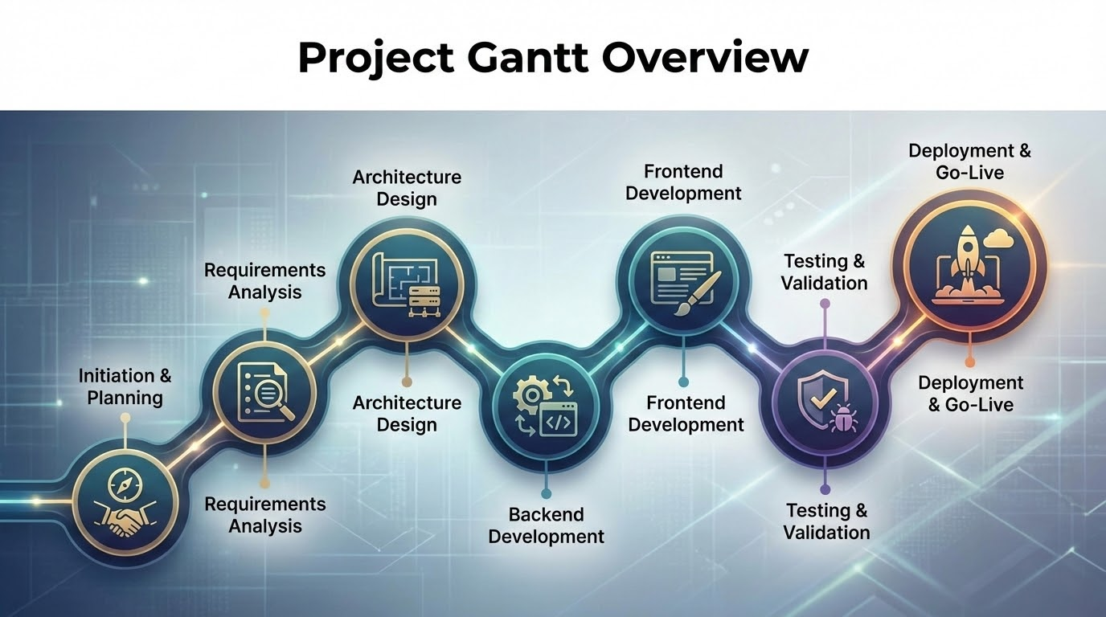

Slide 7
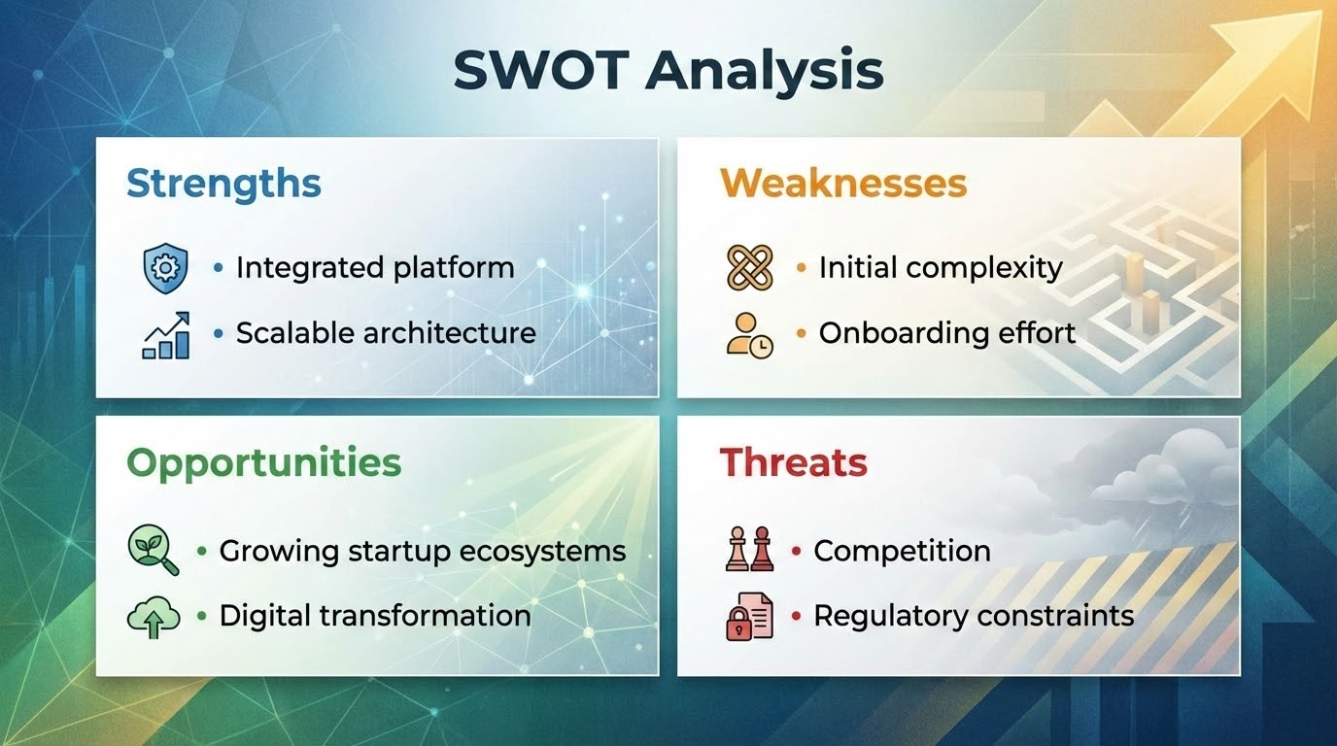

Slide 8
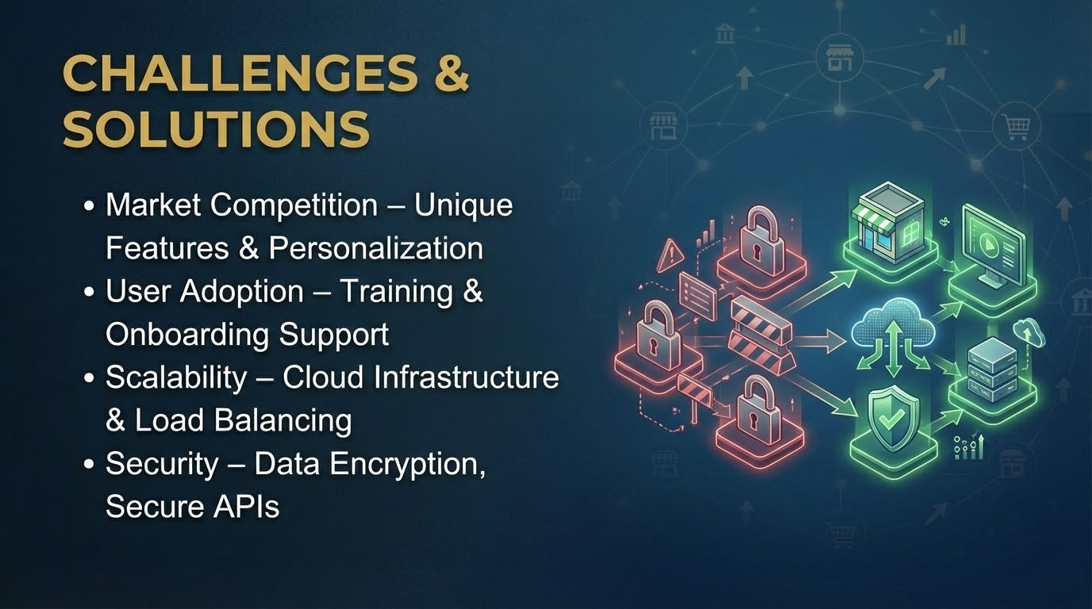
Platform Features
• User Registration & Authentication
• Business Listings & Product Management
• AI-Based Search & Filtering
• Blockchain-Secured Customer Reviews
• Order Management & Payment Integration
• Mobile App & Admin Dashboard

Slide 9
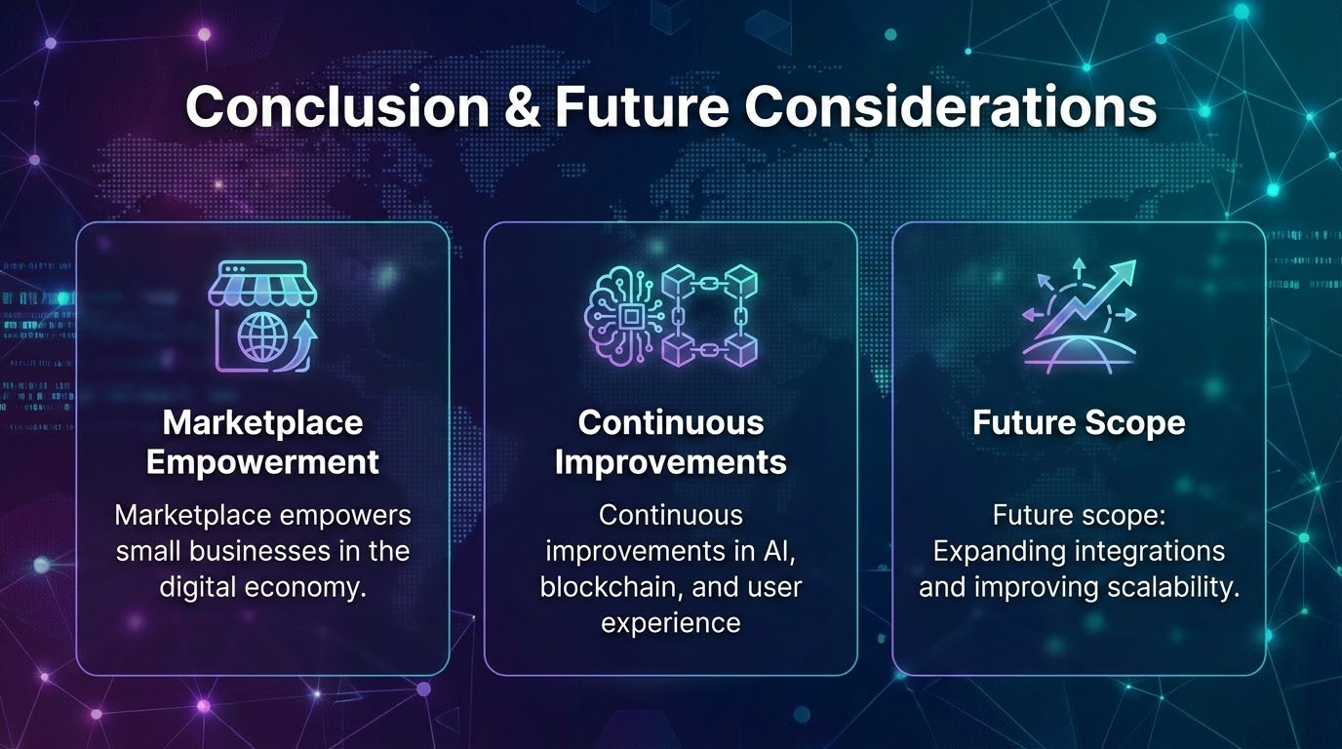
Conclusion & Future Considerations
• Marketplace empowers small businesses in the digital economy.
• Continuous improvements in AI, blockchain, and user experience.
• Future scope: Expanding integrations and improving scalability.

Slide 10


