Slide 1
Treap
Created by
Navid Anjum Chowdhury
id#1410951642
Abrar Ahnaf
id#

Slide 2
Treap
Dictionary Data Structure
Treap is a BST
  binary tree property
  search tree property
Treap is also a heap
  heap-order property
  random priorities
priority
key
2
9
6
7
4
18
7
8
9
15
10
30
15
12

Slide 3
Each node contains
Data
/ Key (comparable)
Priority
(random integer)
Left
child
reference
right
child
reference
class TreeNode
{
public:
int priority;
ItemType element;
TreeNode *left;
TreeNode *right;
};

Slide 4
class BST
{
public:
BST();
bool isEmpty();
void insert(ItemType);
void remove(ItemType);
bool find(ItemType);
void printInOrder();
void printPreOrder();
void printPostOrder();
  void Remove(ItemType);
private:
TreeNode<ItemType> *Insert(ItemType item, TreeNode<ItemType>* root);
TreeNode<ItemType>* LL_Rotate(TreeNode<ItemType>* k2);
TreeNode<ItemType>* RR_Rotate(TreeNode<ItemType>* k2);
  void Delete(ItemType ,TreeNode<ItemType>* &root);
  TreeNode<ItemType> *root;
  bool find(TreeNode<ItemType> *n,ItemType);
  void printInOrder(TreeNode <ItemType> *n);
  void printPreOrder(TreeNode <ItemType> *n);
  void printPostOrder(TreeNode <ItemType> *n);
};

Slide 5
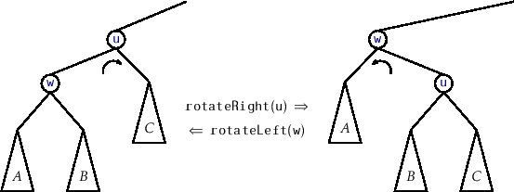
Rotation

Slide 6
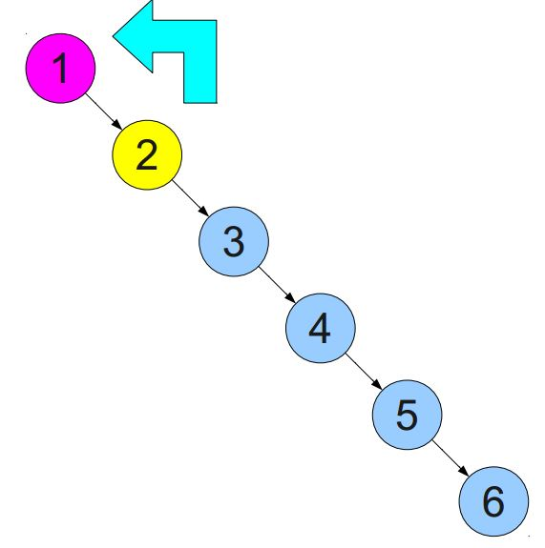
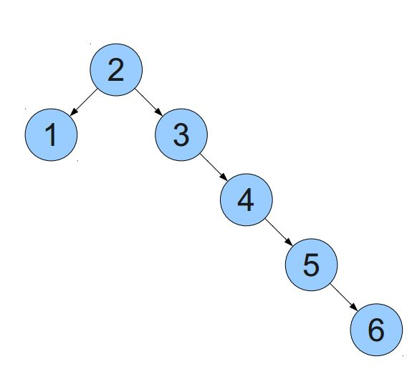
Rotation

Slide 7
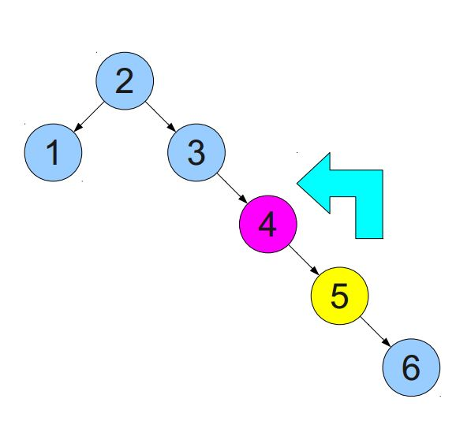
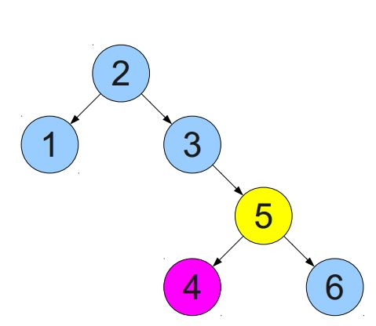
Rotation

Slide 8
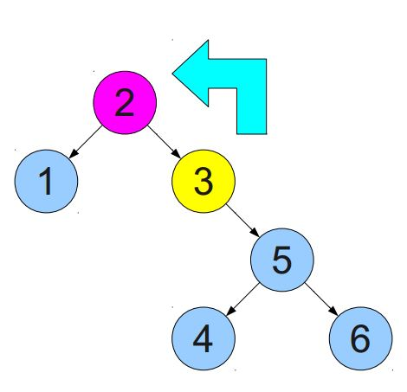
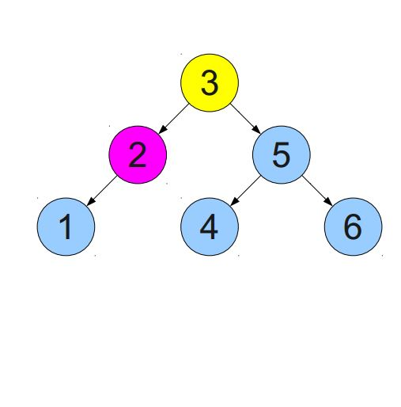
Rotation

Slide 9
Rotation
template<class ItemType>
TreeNode<ItemType>* BST<ItemType>:: RR_Rotate(TreeNode<ItemType>* k2)
{
TreeNode<ItemType>* k1 = k2->left;
k2->left = k1->right;
k1->right = k2;
return k1;
}
template<class ItemType>
TreeNode<ItemType>* BST<ItemType>::LL_Rotate(TreeNode<ItemType>* k2)
{
TreeNode<ItemType>* k1 = k2->right;
k2->right = k1->left;
k1->left = k2;
return k1;
}

Slide 10
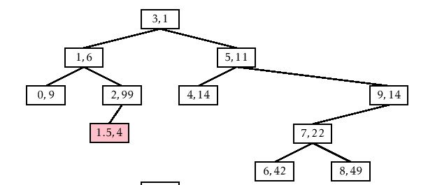
Insert
Choose a random priority
Insert as in normal BST
Rotate right/left
until heap order is restored

Slide 11
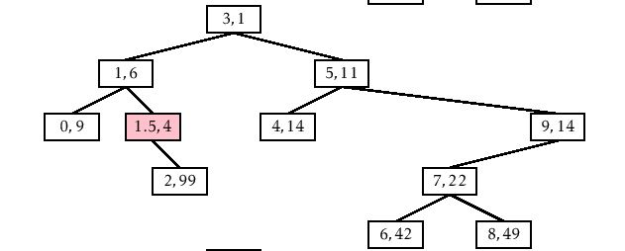
Insert

Slide 12
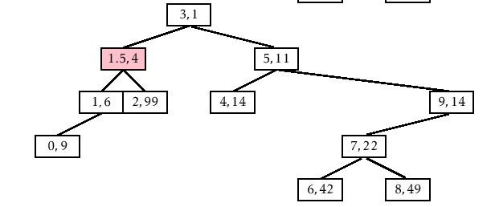
Insert

Slide 13
Insert
template<class ItemType>
TreeNode<ItemType>* BST<ItemType> ::
Insert (ItemType item, TreeNode<ItemType>* root)
{
TreeNode<ItemType>* p_node = new TreeNode<ItemType>;
p_node->left=p_node->right=NULL;
p_node->element=item;
p_node->priority=rand();
if(root==NULL)
return (root = p_node);

Slide 14
Insert
if(item <= root->element)
{
root->left = Insert(item, root->left);
if(root->left->priority < root->priority)
root = RR_Rotate(root);
}
else
{
root->right = Insert(item, root->right);
if(root->right->priority < root->priority)
root = LL_Rotate(root);
}
return root;
}

Slide 15
Operations:
MakeEmpty
Function | Initializes tree to empty state.
Postcondition | Tree exists and is empty.
Boolean IsEmpty
Function | Determines whether tree is empty.
Postcondition | Returns true if tree is empty and false otherwise.
Boolean IsFull
Function | Determines whether tree is full.
Postcondition | Returns true if tree is full and false otherwise.

Slide 16
int LengthIs
Function | Determines the number of elements in tree.
Postcondition | Returns the number of elements in tree.
RetrieveItem(ItemType& item, Boolean& found)
Function | Retrieves item whose key matches item's key (if present).
Precondition | Key member of item is initialized.
Postcondition | If there is an element someItem whose key matches item's key, then found = true and item is a copy of someItem; otherwise, found = false and item is unchanged. Tree is unchanged.
InsertItem(ItemType item)
Function | Adds item to tree.
Precondition | Tree is not full. item is not in tree.
Postcondition | item is in tree. Binary search property is maintained.

Slide 17
DeleteItem(ItemType item,TreeNode<ItemType>* &root)
Function | Deletes the element whose key matches item's key.
Precondition | Key member of item is initialized. One and only one element in tree has a key matching item's key.
Postcondition | No element in tree has a key matching item's key.
Print()
Function | Prints the values in the tree in ascending key order.
Postcondition | Items in the tree are printed in ascending key order.

Slide 18
Delete
void BST<ItemType>::Delete(ItemType item ,TreeNode<ItemType>* &root)
{
if(root==NULL)
{
cout<<"treap is empty, delete failed!\n";
return;
}
if(item< root->element)
Delete(item, root->left);
else if(item > root->element)
Delete(item, root->right);
else
{
if(!root->left || !root->right)
{
TreeNode<ItemType>* temp = root;

Slide 19
Delete
if(!root->left){
root = root->left;
}
else{
root = root->left;
}
delete temp;
}
else
{
if(root->left->priority < root->right->priority)
{
root = RR_Rotate(root);
Delete(item, root->right);
}
else
{
root = LL_Rotate(root);
Delete(item, root->left);
}
}
}
}

Slide 20
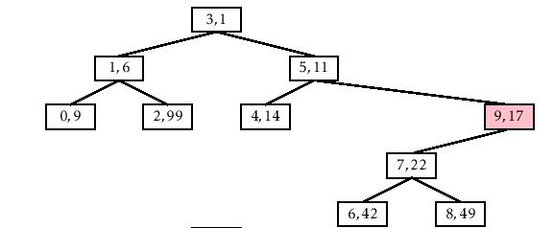
Delete

Slide 21
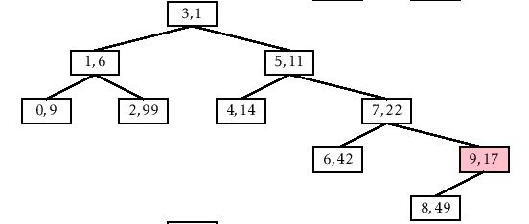
Delete

Slide 22
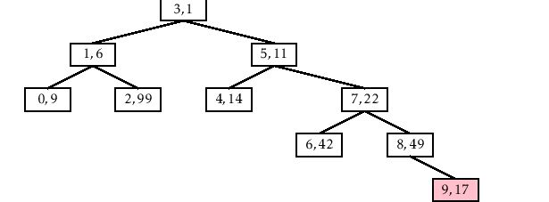
Delete

Slide 23
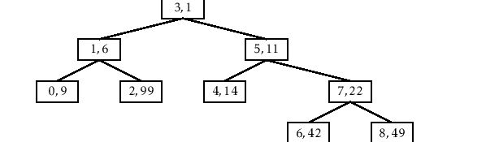
Delete

Slide 24
Diagram
Treap Summary
Implements
Dictionary ADT
Memory use
insert in
expected O(log n) time
delete in
expected O(log n) time
find in
expected O(log n) time
but worst case O(n)
O(1) per node
about the cost
of
AVL tree

Slide 25


