Slide 1
Hybrid Crowd Density Estimation
for Edge Deployment
A Lightweight LCDNet + MobileCount + MobileNetV2 Router Pipeline
4.35M Parameters
MAE 180.9
~55ms / image
on NWPU-Crowd 500-image val
Group Thesis Presentation · 5-Member Team
Datasets: NWPU-Crowd · ShanghaiTech Part A & B
Hardware: NVIDIA GeForce RTX 3050 (8 GB) · Python 3.11 · PyTorch 2.6

Slide 2
Background & Motivation
Why do we need a hybrid approach?
The Core Problem
Single-Model Dilemma
Our Solution
• Crowd monitoring is critical for public safety
• Heavy models (CSRNet, 16.26M params): accurate but not edge-deployable
• Adaptive routing: pick the right model per image
• Real events: festivals, stadiums, emergencies
• Lightweight models alone: fast but insufficient for dense crowds
• LCDNet for sparse scenes (≤100 people)
• Traditional systems: cloud-dependent, high latency
• No single model handles both extremes well
• MobileCount (distilled) for dense scenes (>100)
• Raw video transmission → privacy risk (GDPR)
• Crowd density spans 0 → 20,033 in NWPU dataset
• Total system: 4.35M params, ~55ms, on-device

Slide 3
Research Objectives
1
Build a fully lightweight hybrid pipeline (≤5M params total) for edge crowd density estimation
2
Train and domain-adapt specialist models: LCDNet for sparse, MobileCount (distilled) for dense
3
Design a learned router that dispatches each image to the correct specialist without human intervention
4
Apply knowledge distillation (CSRNet teacher → MobileCount student) to improve accuracy at zero deployment cost
5
Evaluate on NWPU-Crowd (500-image val) and zero-shot on ShanghaiTech Part A & B
6
Quantify the accuracy-efficiency trade-off with oracle, ablation, calibration, and threshold analyses

Slide 4
Datasets
NWPU-Crowd (primary) · ShanghaiTech A & B (cross-dataset eval)
NWPU-Crowd
ShanghaiTech Part A
ShanghaiTech Part B
PRIMARY
CROSS-DATASET (EVAL ONLY)
CROSS-DATASET (EVAL ONLY)
• 5,109 images total
• 482 images (300 train, 182 test)
• 716 images (400 train, 316 test)
• 2,133,375 head annotations
• 241,677 head annotations
• 88,488 head annotations
• Count range: 0 – 20,033 per image
• Count range: 33 – 3,139
• Count range: 9 – 578
• Train: 3,109 · Val: 500 · Test: 1,500
• Predominantly dense urban crowds
• Sparse street-level scenes
• Diverse scenes, lighting, perspectives
• Zero-shot — never used in training
• Zero-shot — never used in training
⚠ No ShanghaiTech samples used in any stage of training, validation, or hyperparameter selection

Slide 5
System Architecture
End-to-end hybrid inference pipeline
P(dense) ≥ p* = 0.85
INPUT IMAGE
384×384
MobileNetV2
ROUTER
2.55M params
4.8ms GPU
LCDNet
SPARSE SPECIALIST
0.92M params
23.1ms GPU
(count ≤ 100)
MobileCount
(DISTILLED)
DENSE SPECIALIST
0.88M params
3.4ms GPU
(count > 100)
DENSITY MAP
→ sum()
→ COUNT
Total Deployed: 4.354M parameters · ~55ms avg end-to-end (RTX 3050) · ~210ms CPU
P(dense) < 0.85
CSRNet (16.26M params) used as knowledge distillation TEACHER during training only — NEVER deployed at inference

Slide 6
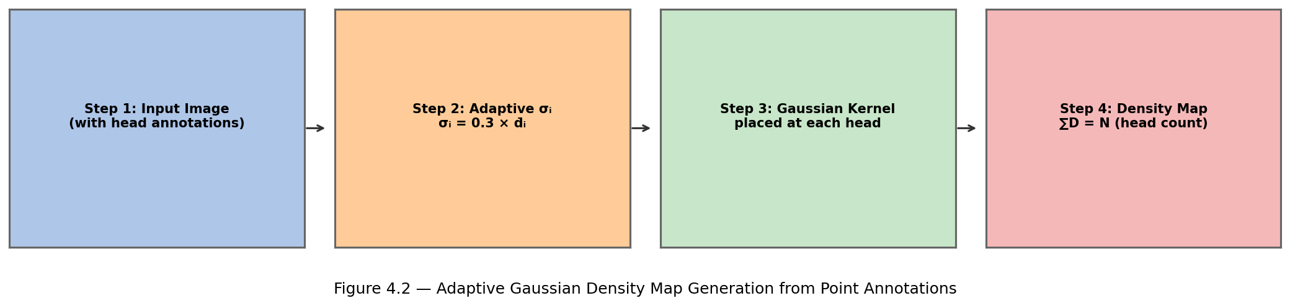
Preprocessing Pipeline
Adaptive Gaussian density map generation
Density Map Formula
Data Augmentation (Training Only)
σᵢ = β · d̄ᵢ where β = 0.3, k = 3 nearest neighbours
• Random horizontal flip (p=0.5)
• d̄ᵢ = mean Euclidean distance to 3 nearest head annotations
• Mass conservation enforced: ∬D(x,y)dxdy = N (head count)
• Fallback σ = 15px for single-annotation images
• σ clipped to [4.0, 30.0] pixels to prevent degenerate kernels
• Random 384×384 crop from 512×512 (p=0.3)
• Brightness ±20%, Contrast ±20%
• Saturation ±20%, Hue perturbation
• Applied identically to image + density map

Slide 7
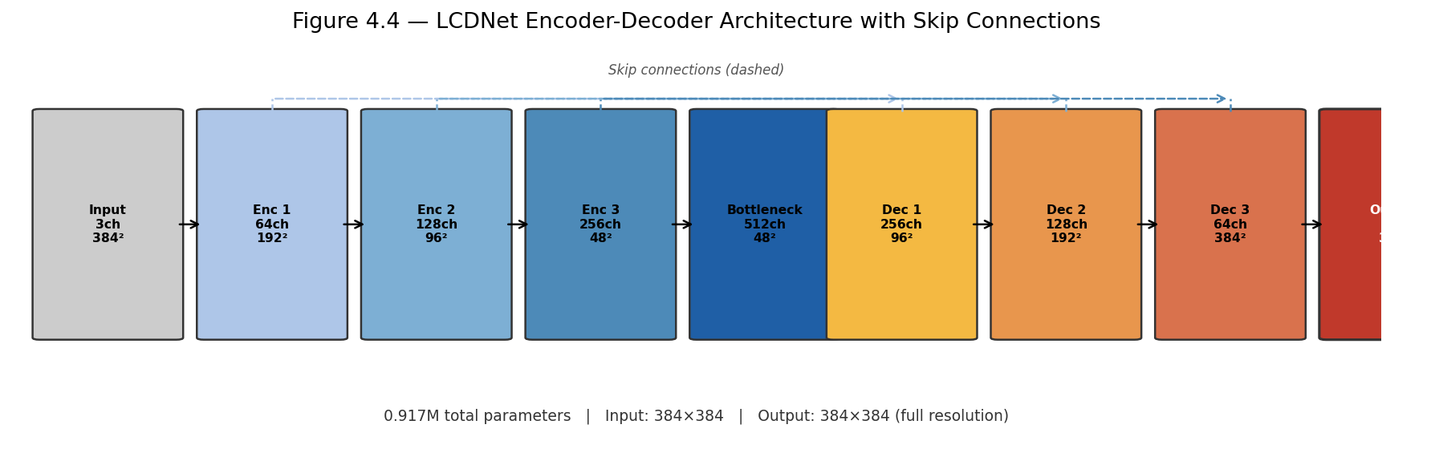
LCDNet — Sparse Scene Specialist
Depthwise-separable encoder-decoder · 0.917M parameters
Stage
Output
Params
Encoder 1
192×192×64
~3.5K
Encoder 2
96×96×128
~17K
Encoder 3
48×48×256
~66K
Bottleneck
48×48×512
~264K
Decoder 1
96×96×256
~396K
Design Choices
Decoder 2
192×192×128
~99K
• Depthwise separable convolutions: ~8× fewer params than standard convolutions
Decoder 3
384×384×64
~25K
• Skip connections preserve fine spatial detail across the downsampling hierarchy
Output Head
384×384×1
~18.5K
• Full-resolution output (384×384) — higher accuracy than 1/8 resolution
TOTAL
0.917M
• Domain-adapted on NWPU sparse subset: sparse MAE 273 → 21.5

Slide 8
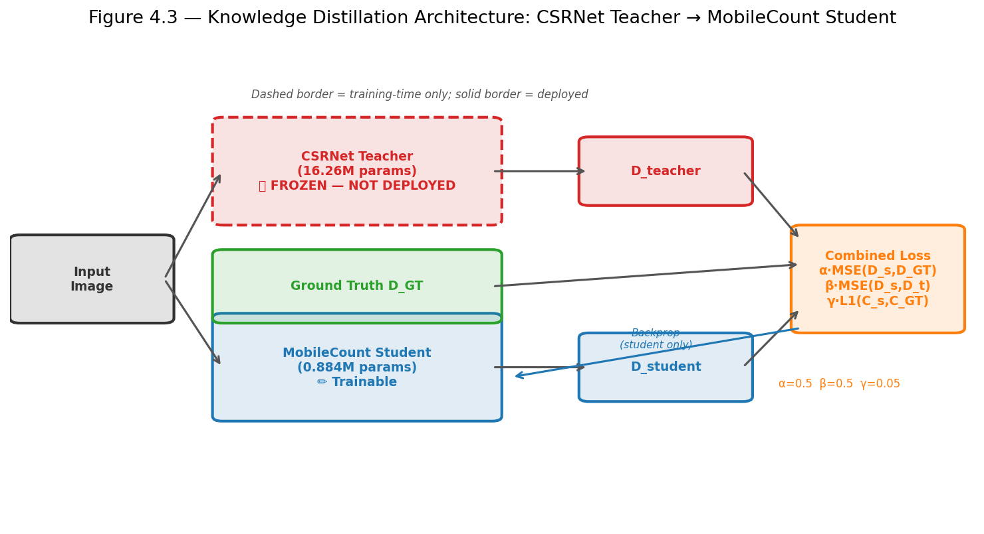
MobileCount + Knowledge Distillation
Dense specialist: 0.884M params · CSRNet teacher (never deployed)
Distillation Results
Metric
Baseline
Distilled
MAE
213.2
198.7 ✓
RMSE
803.6
778.5
Params
0.884M
0.884M
GFLOPs
1.07
1.07
GPU (ms)
3.4
3.4
Distillation Loss:
L = 0.5 · MSE(student, GT) + 0.5 · MSE(student, teacher) + 0.05 · L1(count_student, count_GT)
12 epochs · AdamW (lr=5×10⁻⁵) · Cosine LR · Best checkpoint at epoch 9 · ~4 hours on RTX 3050 · Teacher discarded after training
→ 14.5 MAE improvement at ZERO deployment cost (same params, GFLOPs, latency)

Slide 9
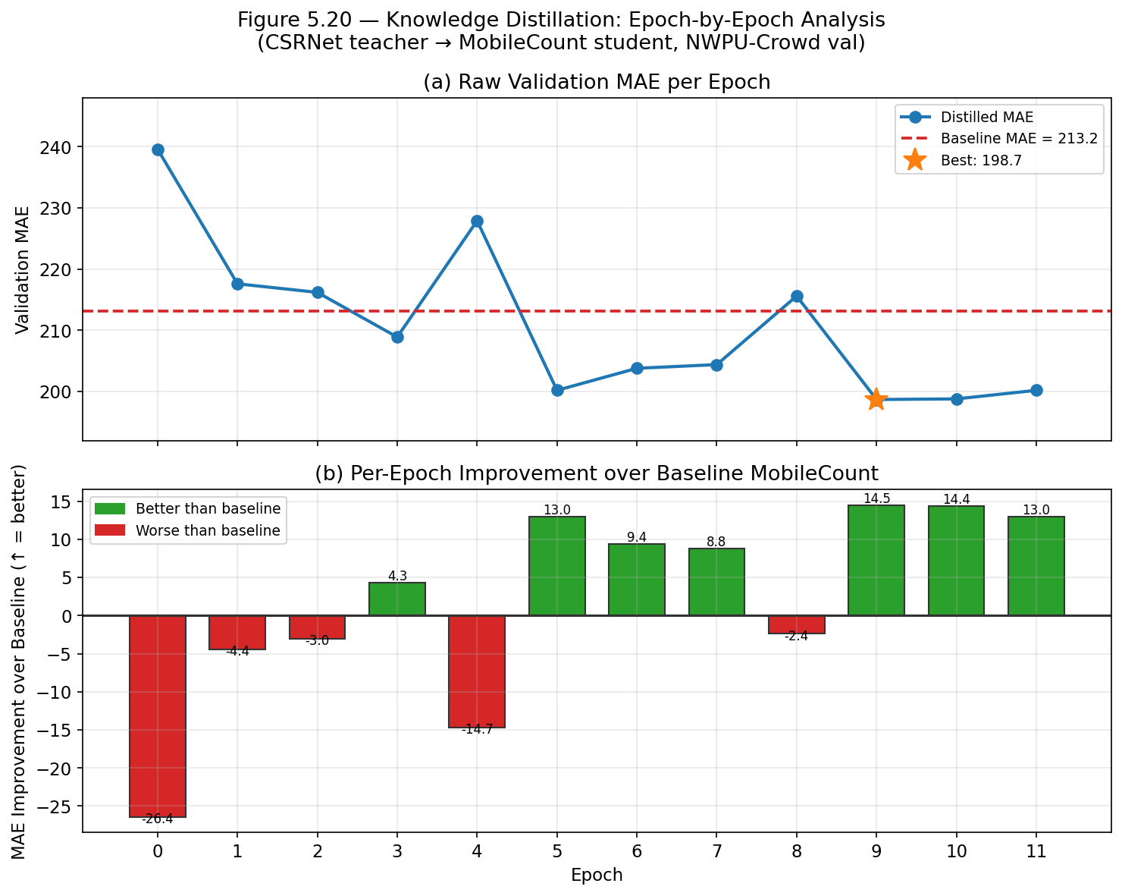
Knowledge Distillation Training Curve
Per-epoch validation MAE — NWPU-Crowd

Slide 10
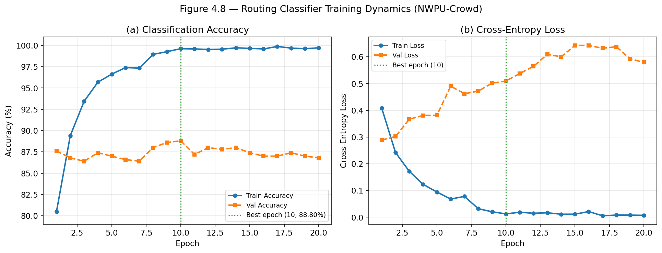
Routing Classifier Training
MobileNetV2 binary classifier · T = 100 (sparse/dense threshold)
Final Router Metrics
Val Accuracy
88.80%
ECE
0.095
Params
2.552M
GFLOPs
0.33
GPU latency
4.8 ms
CPU latency
8.9 ms
Best epoch
10 of 25
Train time
85.6 min

Slide 11
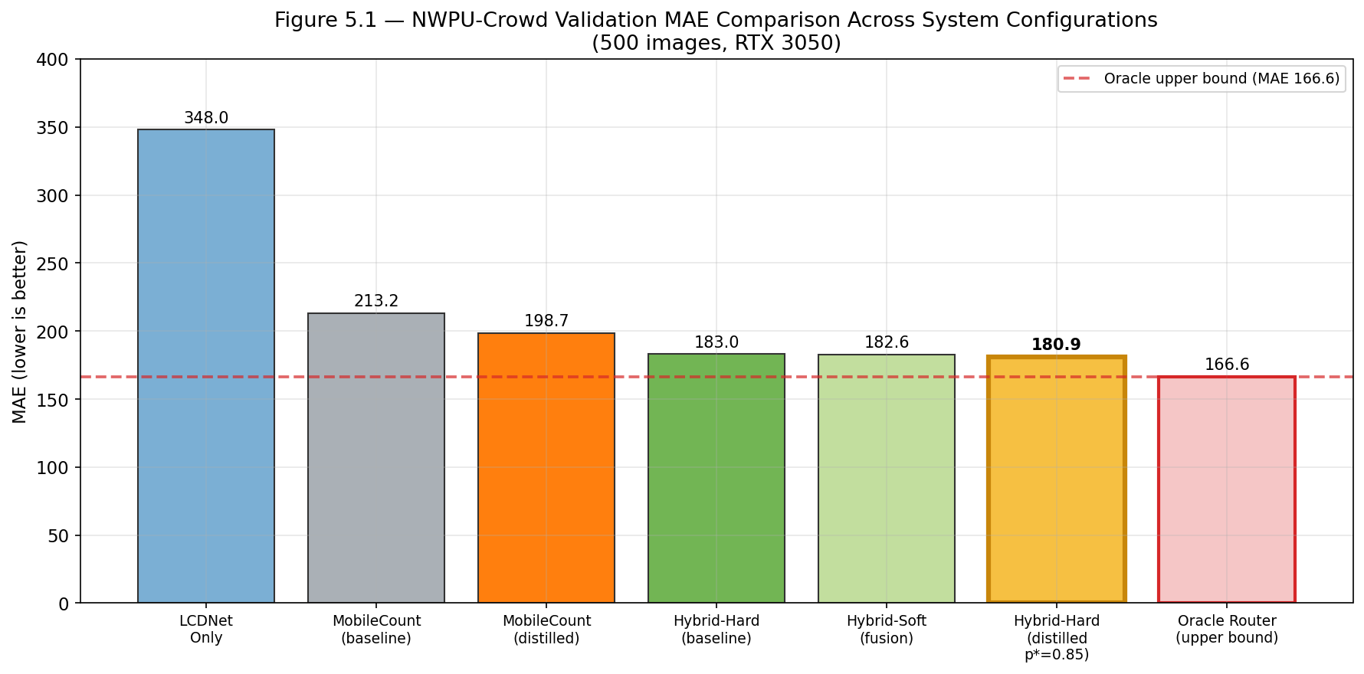
Primary Evaluation Results
NWPU-Crowd Validation Set · 500 images · RTX 3050
Configuration
MAE↓
RMSE↓
Params
LCDNet Only
348.0
1033.9
0.92M
MobileCount (base)
213.2
803.6
0.88M
MobileCount (distil)
198.7
778.5
0.88M
Hybrid-Hard (base)
183.0
787.7
4.35M
Hybrid-Soft (fusion)
182.6
763.8
4.35M
★ BEST (dist,p*=.85)
180.9
763.6
4.35M
Key Findings:
Oracle (upper bound)
166.6
751.1
—
• Hybrid beats both standalone specialists: MAE 180.9 vs 198.7 (MobileCount) and 348.0 (LCDNet)
• Outperforms NWPU-Crowd paper baseline (218.0) by 37.1 MAE points
• Gap to oracle (166.6) = 14.3 MAE = cost of ~11% router misclassification rate

Slide 12
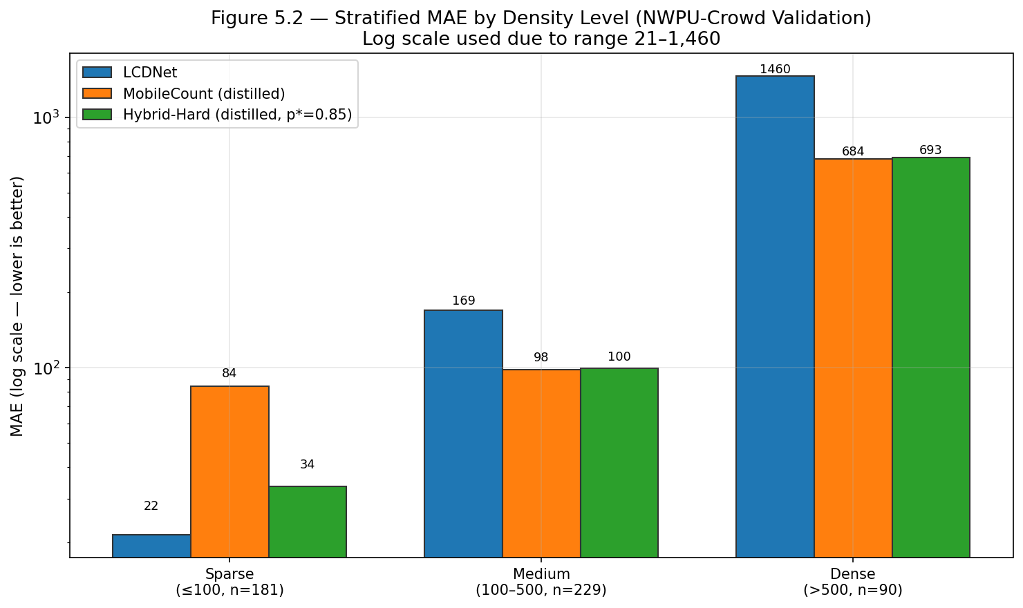
Density-Stratified Evaluation
Where does routing help most?
SPARSE
(≤100 people, n=181)
MEDIUM
(100–500, n=229)
DENSE
(>500, n=90)
MobileCount: 84.5
Hybrid: 33.6
→ −60.2%!
MobileCount: 98.4
Hybrid: 99.5
≈ no change
MobileCount: 683.6
Hybrid: 692.8
both saturate
Routing's primary contribution is the sparse stratum:
60.2% MAE reduction by sending sparse images to LCDNet instead of MobileCount.
In real deployments with more sparse scenes (indoor, low-traffic), this advantage grows substantially.

Slide 13
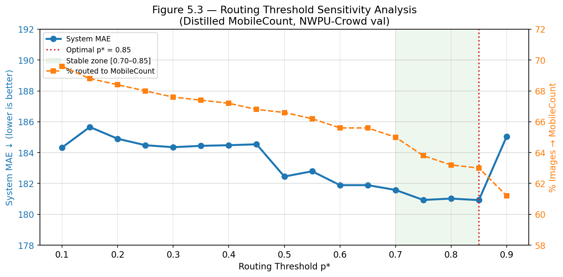
Routing Threshold Optimisation
Post-training sweep — no retraining required
Threshold Sweep Results
Threshold
MAE↓
p* = 0.50 (default)
182.45
p* = 0.70
181.58
p* = 0.75
180.93
★ p* = 0.85 (BEST)
180.92
p* = 0.90
185.05
Key Observations:
• Stable zone p* ∈ [0.70, 0.85]: MAE varies < 1 point
• p* = 0.85: route to MC only if ≥85% confident dense
• Gain: −1.5 MAE vs default argmax (p*=0.50)
• Zero cost: no retraining, no model changes

Slide 14
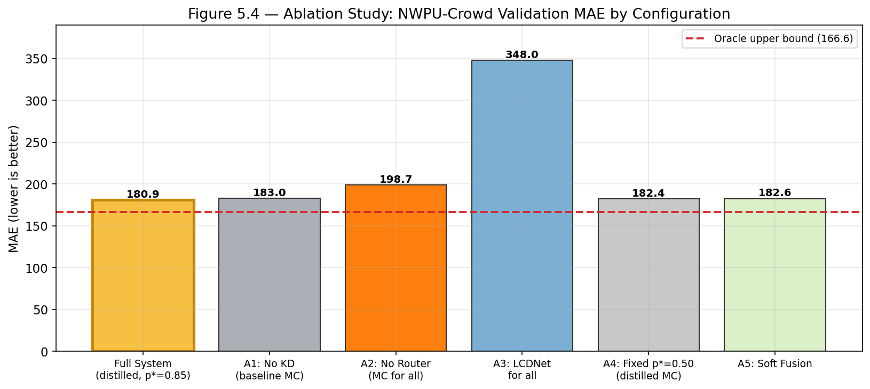
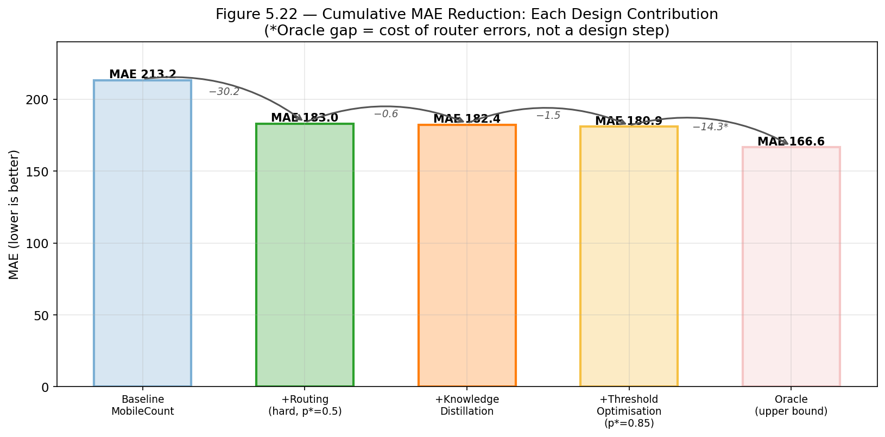
Ablation Study
Isolating each design contribution
What Each Component Contributes
+17.8 MAE
Routing is dominant
Remove router → MAE 198.7
+2.1 MAE
KD is 2nd contributor
Replace distilled → baseline MC
+1.5 MAE
Threshold tuning is free
Use default p*=0.50 instead of 0.85
+1.7 MAE
Soft fusion: no benefit
Excluded from final system

Slide 15
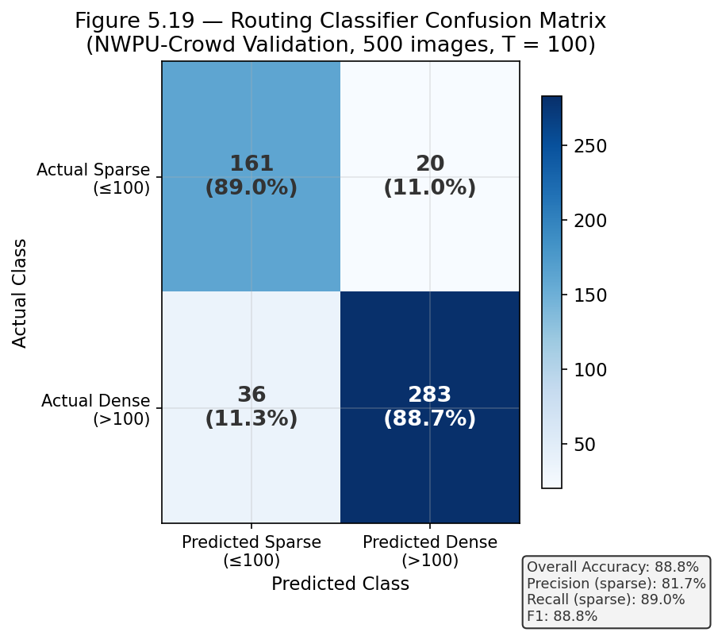
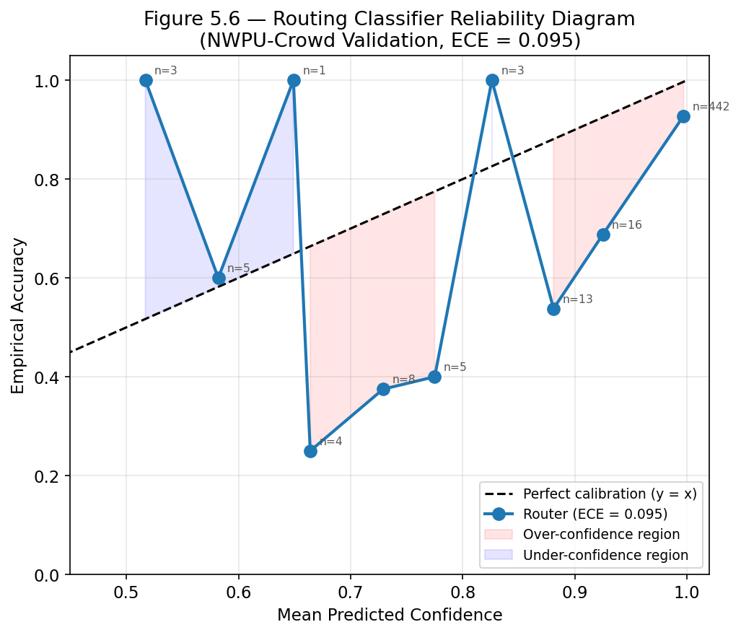
Router Performance & Calibration
Accuracy · ECE · Confusion Matrix

Slide 16
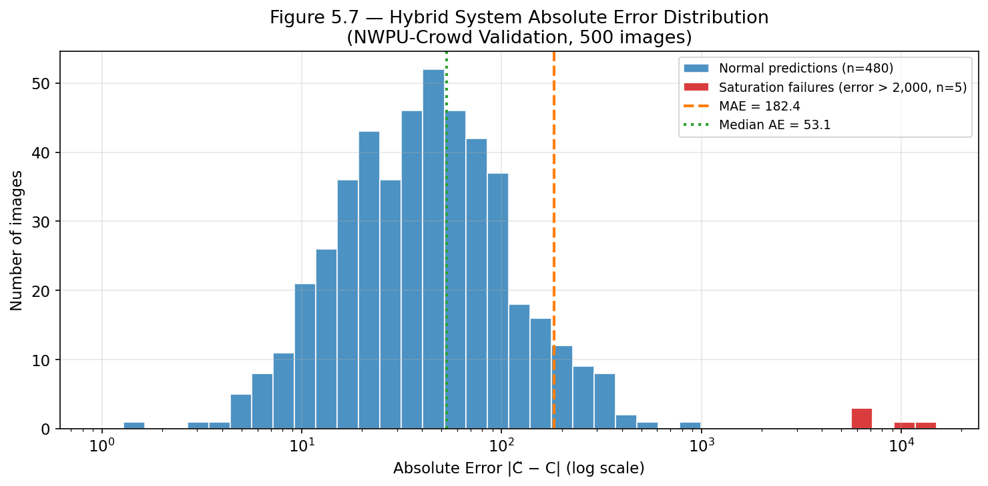
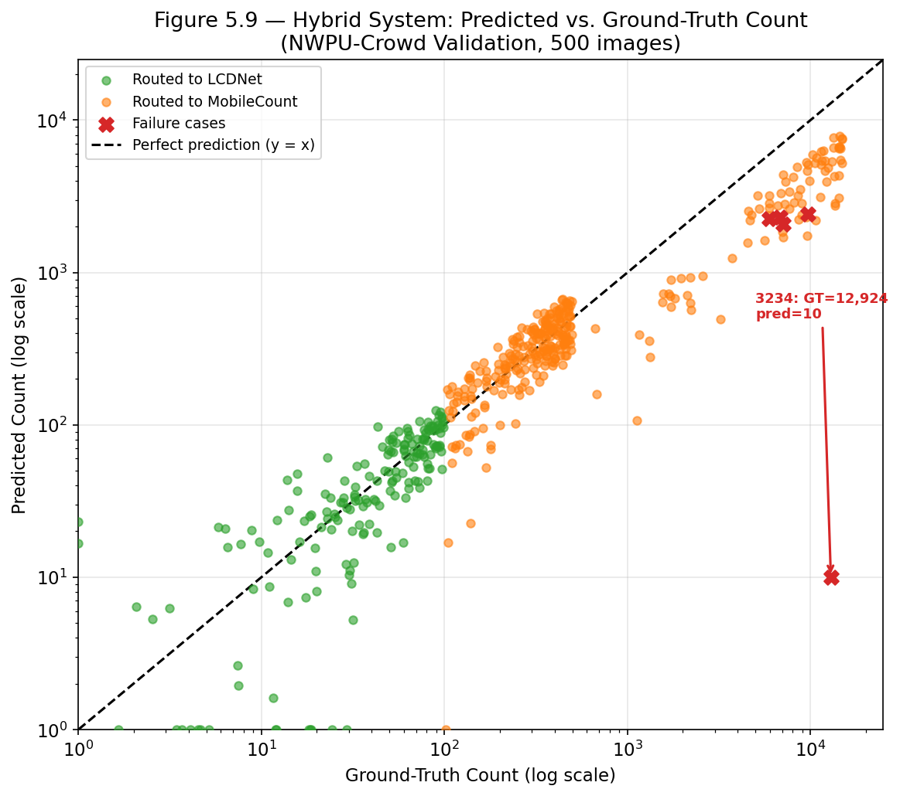
Error Distribution & Failure Cases
Understanding where and why the system fails
Representative Failure Cases
Image
GT Count
Predicted
Root Cause
3234
12,924
10 (LCDNet)
Router 99% confident SPARSE — catastrophic miss (~25 MAE impact)
3408
9,728
2,428 (MC)
Both specialists saturate — capacity limit, not routing error
3353
7,122
2,077 (MC)
Same — density beyond sub-1M model capacity

Slide 17
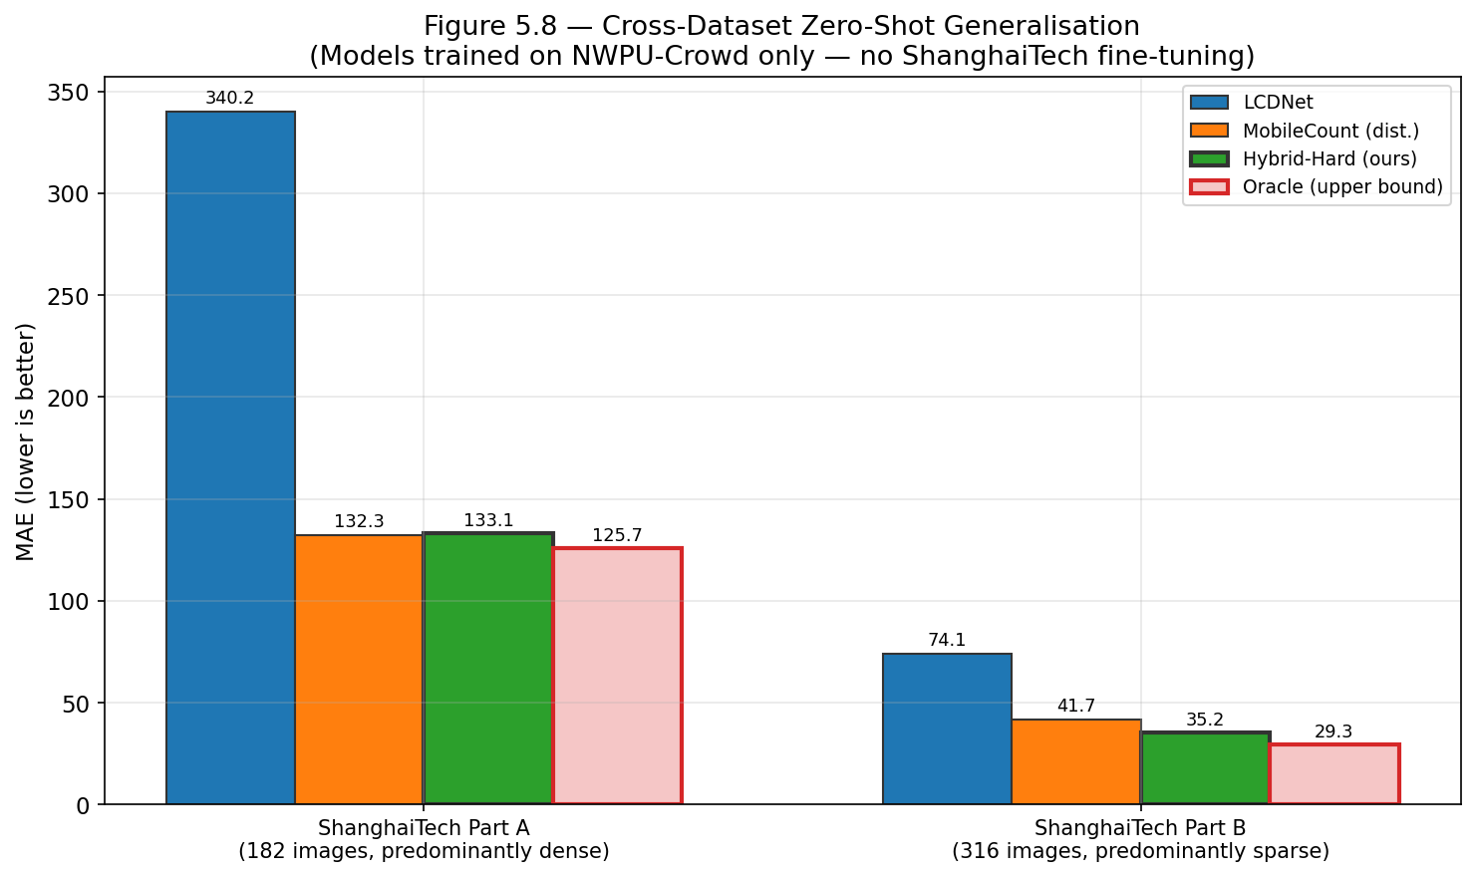
Cross-Dataset Generalisation
Zero-shot evaluation — no fine-tuning on ShanghaiTech
ShanghaiTech Part B (sparse-dominated)
ShanghaiTech Part A (dense-dominated)
LCDNet: 74.1 · MobileCount: 41.7 · Hybrid: 35.2 · Oracle: 29.3
→ Hybrid beats both standalone models — routing generalises to unseen data
LCDNet: 340.2 · MobileCount: 132.3 · Hybrid: 133.1 · Oracle: 125.7
→ Hybrid ≈ MobileCount (95.1% of images routed to MC) — expected tie on dense data

Slide 18
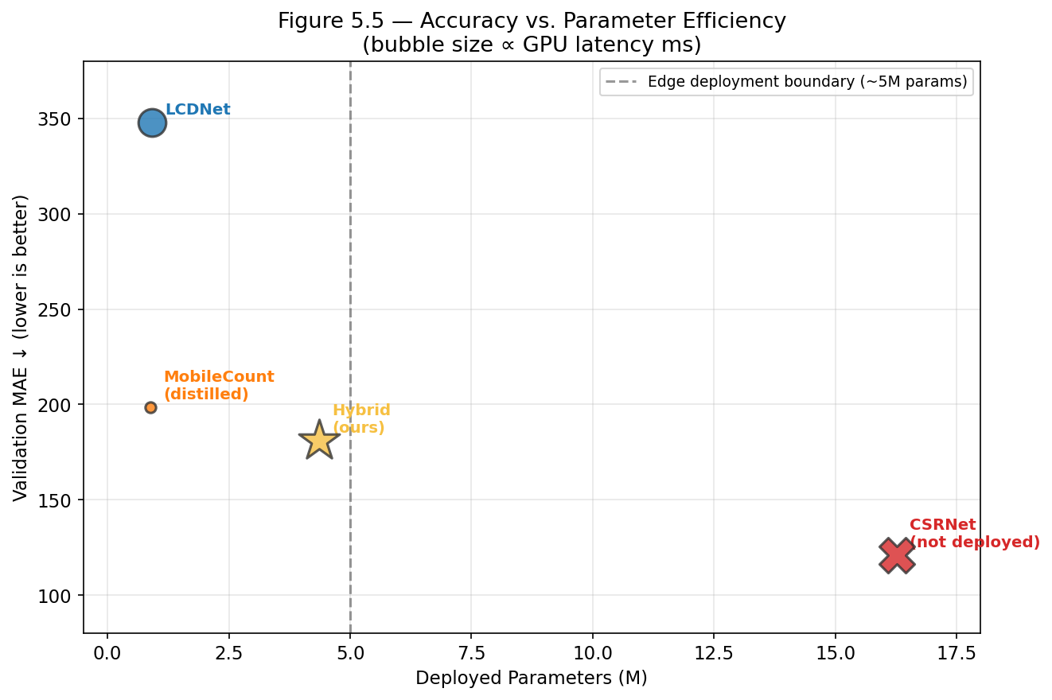
Edge-Deployment Efficiency Profile
Parameters · GFLOPs · GPU + CPU latency · Memory
Component
Params
GFLOPs
GPU (ms)
CPU (ms)
GPU Mem
Router
2.552M
0.33
4.8
8.9
52.6 MB
LCDNet
0.917M
14.59
23.1
208.8
368.8 MB
MobileCount
0.884M
1.07
3.4
13.5
63.6 MB
SYSTEM
4.354M
—
~55
~210
—
CSRNet†
16.26M
—
—
—
not deployed
† CSRNet used as training-time teacher only
vs CSRNet deployed: 4.35M vs 16.26M = 73.3% parameter reduction
Dense path: Router + MobileCount = ~8ms GPU · Sparse path: Router + LCDNet = ~28ms GPU

Slide 19
Comparison with Published Methods
NWPU-Crowd Validation
ShanghaiTech Part A (zero-shot)
Method
Year
MAE↓
Params
Method
Year
MAE↓
Params
Dataset paper baseline
2020
218.0
—
MCNN
2016
110.2
~1M
CSRNet
2018
~121
16.26M
CSRNet
2018
68.2
16.3M
MobileCount (baseline)
2024
213.2
0.88M
SANet
2018
67.0
~10M
MobileCount (distilled)
2024
198.7
0.88M
CAN
2019
62.3
~5M
★ Hybrid (ours)
2024
180.9
4.35M
★ Hybrid (ours)*
2024
133.1
4.35M
* Not optimised for ShanghaiTech — trained on NWPU-Crowd, evaluated zero-shot.
MAE gap vs dedicated methods = domain shift penalty, not an accuracy failure.
Key contribution: 4.35M params vs 5–16M for published methods with full ShanghaiTech training.

Slide 20
Conclusion & Future Work
Key Contributions
Future Work
Hybrid System
MAE 180.9 · beats both specialists · outperforms NWPU baseline (218.0)
→ Physical Jetson Nano benchmarking + power profiling
Edge-Deployable
→ INT8 quantization / TensorRT for further 2–4× speedup
4.35M params · 73.3% smaller than CSRNet · ~55ms/image RTX 3050
→ Confidence-aware fallback to prevent catastrophic misroutes
Knowledge Distillation
−14.5 MAE on MobileCount at zero deployment cost · 18.4× smaller than teacher
→ Higher-capacity 3rd path for extreme density (>3,000)
Cross-Dataset
ShanghaiTech Part B MAE 35.2 without fine-tuning
→ Federated learning for privacy-preserving model updates
Sparse Routing
60.2% MAE reduction on sparse scenes via LCDNet routing
→ Temporal smoothing for video stream deployment
"A 4.35M-parameter system that beats models 4× its size — through smart, learned routing."

Slide 21
Questions?
MAE 180.9
4.35M params
−60.2%
Best System Result
(NWPU-Crowd val, 500 images)
Total Deployed
(73.3% smaller than CSRNet)
Sparse Routing Gain
(84.5 → 33.6 MAE)
GitHub: Crowd-Desnsity-Hybrid-Model · NWPU-Crowd + ShanghaiTech Part A & B

