Slide 1
Hybrid Crowd Density Estimation
for Edge Deployment
LCDNet + MobileCount + MobileNetV2 Router
4.35M params
MAE 180.9
~55 ms
Total Deployed Parameters
Best System (NWPU val)
Avg Latency (RTX 3050)
NWPU-Crowd · ShanghaiTech Part A & B · PyTorch 2.6 · RTX 3050
Group Thesis Presentation · 5-Member Team
Dept. of Computer Science & Engineering

Slide 2
Background & Motivation
Why does crowd estimation need a hybrid approach?
The Problem
Single-Model Dilemma
Our Solution
• Crowd incidents cause fatalities
• Heavy models accurate on dense scenes but need 16M+ params
• Router dispatches each image to best model
• Manual counting: slow, error-prone
• Lightweight models fast but fail on dense crowds
• LCDNet: sparse scenes (≤100 people)
• Cloud systems: latency + privacy risk
• NWPU counts range: 0 – 20,033
• MobileCount: dense scenes (>100)
• GDPR: raw video = personal data
• No single lightweight model handles both
• 4.35M params · 55ms · on-device
• Edge hardware: 5–10W power budget

Slide 3
Research Objectives
1
Build a fully lightweight hybrid pipeline (≤5M params) for edge crowd density estimation
2
Train and domain-adapt specialists: LCDNet for sparse, distilled MobileCount for dense
3
Design a MobileNetV2 router that automatically routes images without human intervention
4
Apply knowledge distillation (CSRNet teacher → MobileCount student) for free accuracy gain
5
Evaluate on NWPU-Crowd validation (500 images) — zero-shot on ShanghaiTech A & B
6
Quantify accuracy-efficiency trade-off: oracle, ablation, calibration, threshold analyses

Slide 4
Datasets
NWPU-Crowd: primary · ShanghaiTech A & B: zero-shot evaluation only
PRIMARY DATASET
CROSS-DATASET (EVAL ONLY)
CROSS-DATASET (EVAL ONLY)
NWPU-Crowd
ShanghaiTech Part A
ShanghaiTech Part B
• 5,109 total images
• 182 test images
• 316 test images
• 2,133,375 annotations
• 241,677 head annotations
• 88,488 head annotations
• Count: 0 – 20,033 per image
• Count range: 33 – 3,139
• Count range: 9 – 578
• Train 3,109 · Val 500 · Test 1,500
• Predominantly dense urban scenes
• Predominantly sparse street scenes
• Threshold T=100 for routing labels
• Never used in training
• Never used in training

Slide 5
System Architecture
End-to-end hybrid inference pipeline — all inference on-device
INPUT
IMAGE
384×384
MobileNetV2
ROUTER
2.55M params
4.8ms GPU
LCDNet
SPARSE
0.92M
23ms
MobileCount
DEPLOYED
0.88M
3.4ms
DENSITY
MAP
→ COUNT
P(dense) ≥ 0.85 → MC
Total: 4.35M params · 73.3% smaller than CSRNet · Dense path ~8ms · Sparse path ~28ms
P(dense) < 0.85 → LCD
CSRNet (16.26M params) — KD teacher during training ONLY — never deployed at inference

Slide 6
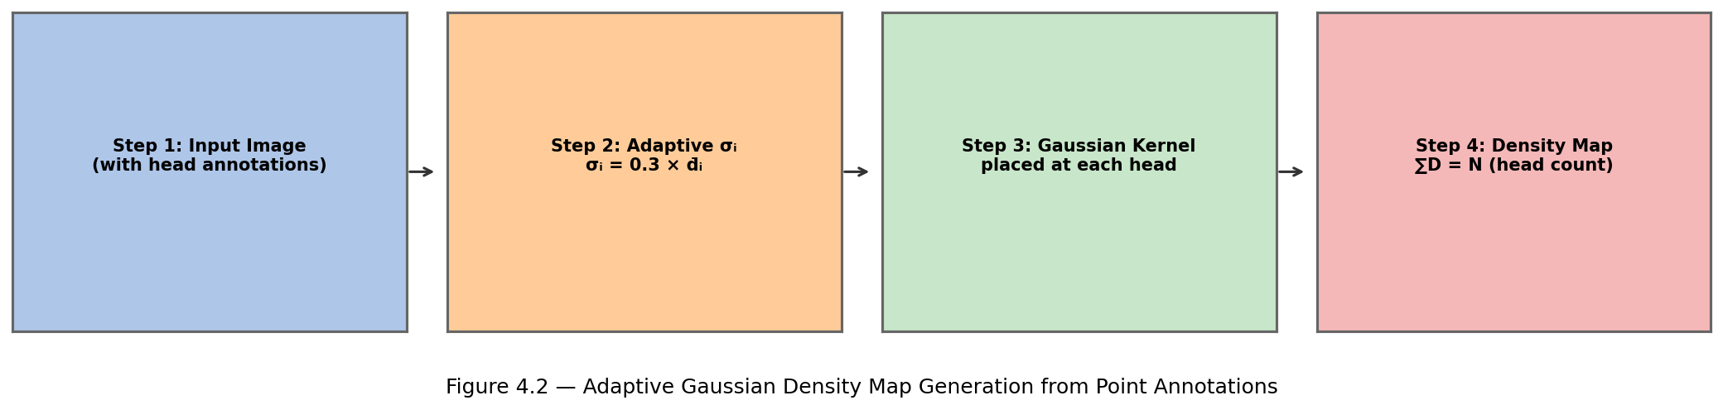
Preprocessing Pipeline
Adaptive Gaussian density map generation from head point annotations
Density Map Formula
Data Augmentation
σᵢ = β · d̄ᵢ (β = 0.3, k = 3 neighbours)
• Horizontal flip (p=0.5)
• d̄ᵢ = mean dist to 3 nearest annotations
• Random 384×384 crop from 512×512 (p=0.3)
• Mass conservation: ∬D = N (head count)
• Brightness/contrast ±20%
• Fallback σ = 15px for single annotations
• Applied to image AND density map equally
• σ clipped to [4.0, 30.0] pixels
• ImageNet normalisation: mean [0.485, 0.456, 0.406]

Slide 7
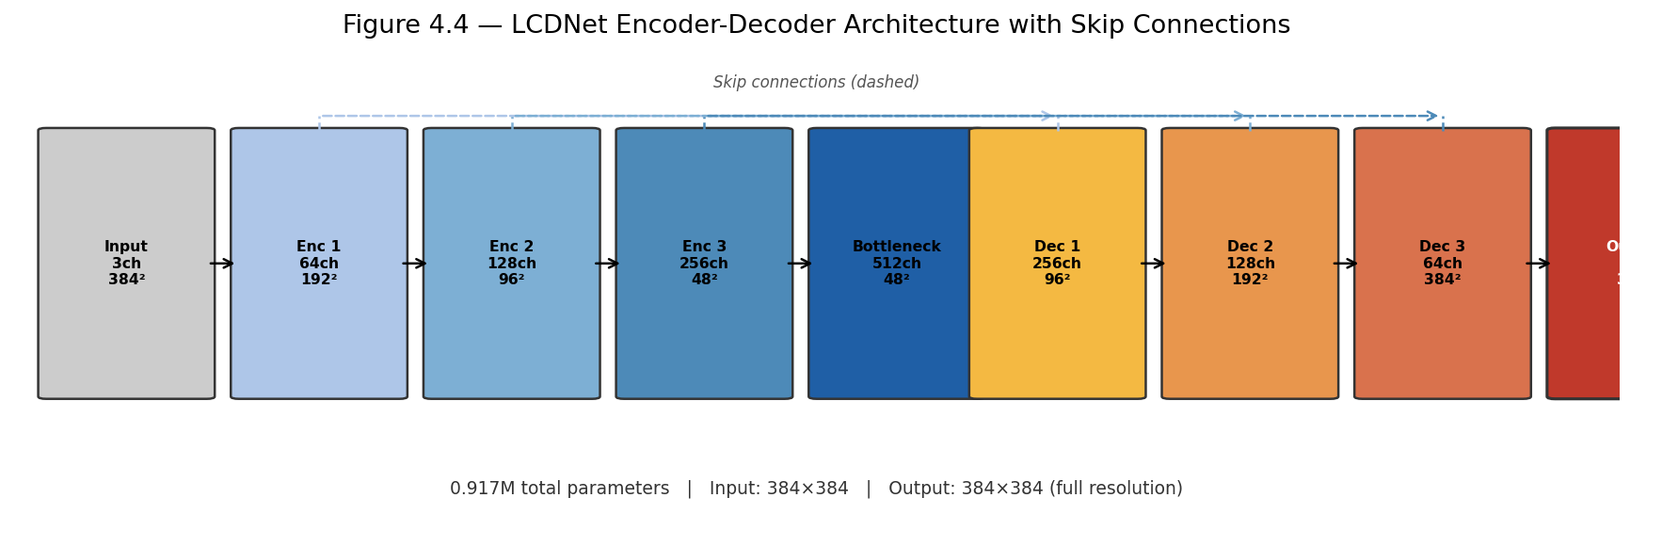
LCDNet — Sparse Scene Specialist
Depthwise-separable encoder-decoder · Full-resolution output · 0.917M parameters
Architecture Summary
Stage
Output
Params
Encoder 1
192×192×64
~3.5K
Encoder 2-4
...
~347K
Decoder 1-3
...
~520K
Output Head
384×384×1
~18.5K
TOTAL
0.917M
Key Design Choices
• ~8× fewer params via depthwise separable convolutions
• Full resolution output — better accuracy than 1/8 res
• Skip connections preserve fine spatial details
• Domain-adapted on NWPU sparse → sparse MAE: 273 → 21.5

Slide 8
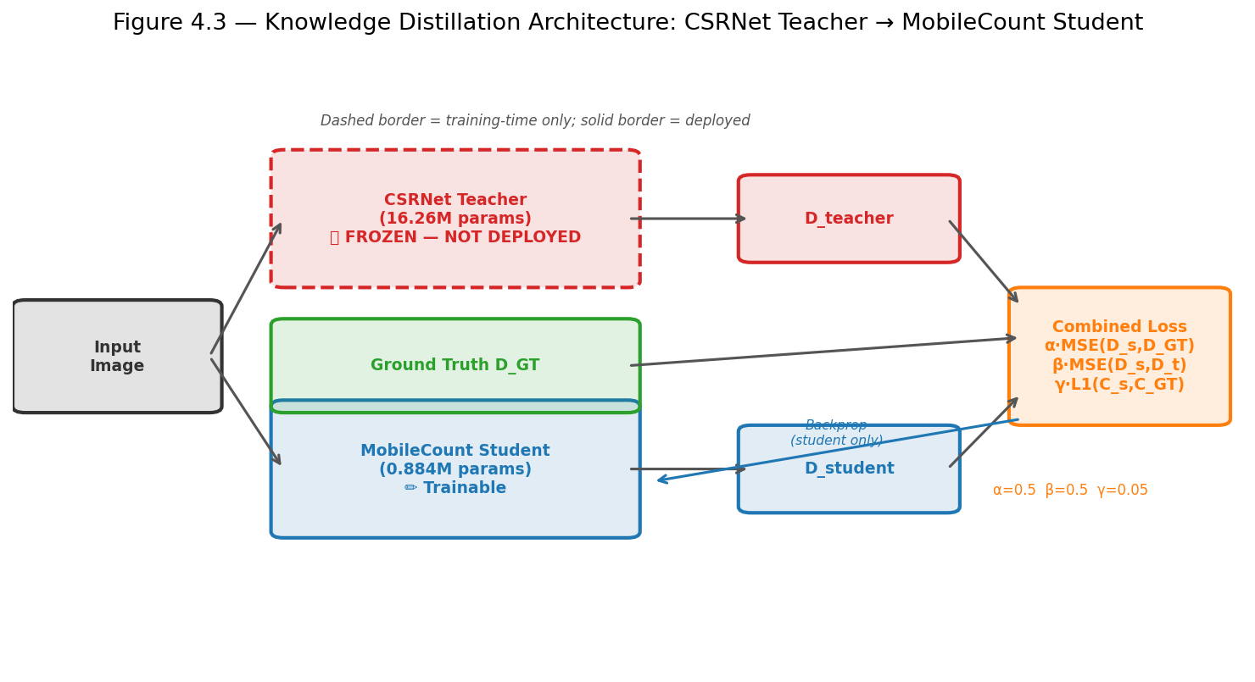
MobileCount + Knowledge Distillation
Dense specialist with CSRNet teacher (training only) · 0.884M deployed
Distillation Results
Metric
Baseline
Distilled
MAE
213.2
198.7 ✓
RMSE
803.6
778.5
Params
0.884M
0.884M (same)
GFLOPs
1.07
1.07 (same)
GPU (ms)
3.4
3.4 (same)
Loss: L = 0.5·MSE(student,GT) + 0.5·MSE(student,teacher) + 0.05·L1(count)
−14.5 MAE
• 12 epochs · AdamW lr=5×10⁻⁵ · Best at epoch 9 · ~4hrs RTX 3050
at ZERO deployment cost

Slide 9
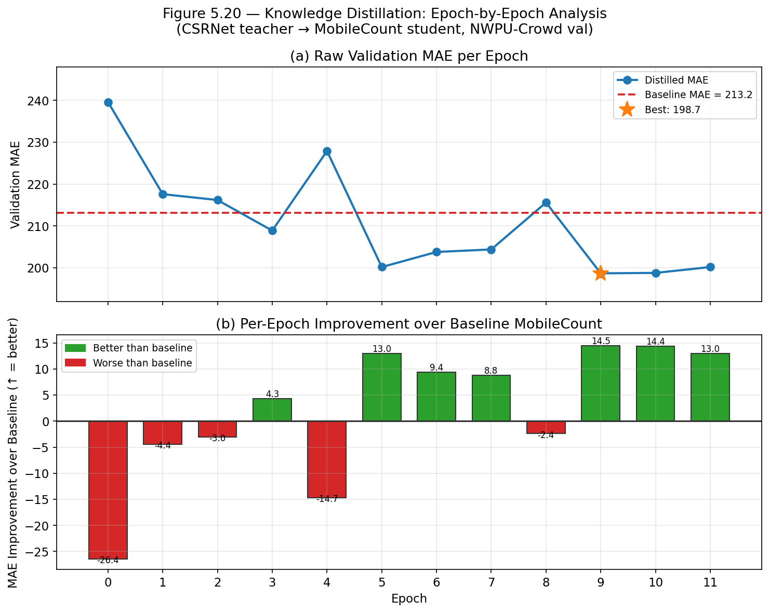
Knowledge Distillation Training
Per-epoch validation MAE · NWPU-Crowd full validation set (500 images)

Slide 10
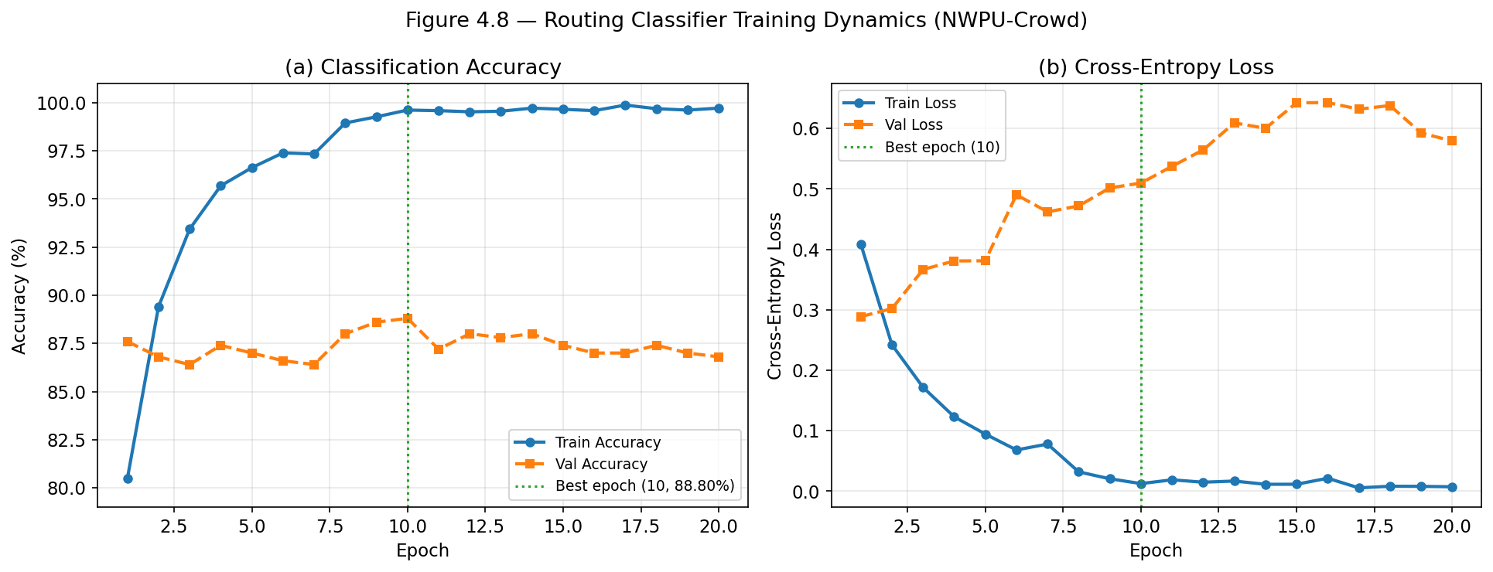
Routing Classifier Training
MobileNetV2 binary classifier · routing threshold T = 100
Final Metrics
Val Accuracy
88.80%
ECE (calibration)
0.095
Parameters
2.552M
GFLOPs
0.33
GPU latency
4.8 ms
CPU latency
8.9 ms
Best epoch
10 / 25
Train time
85.6 min

Slide 11
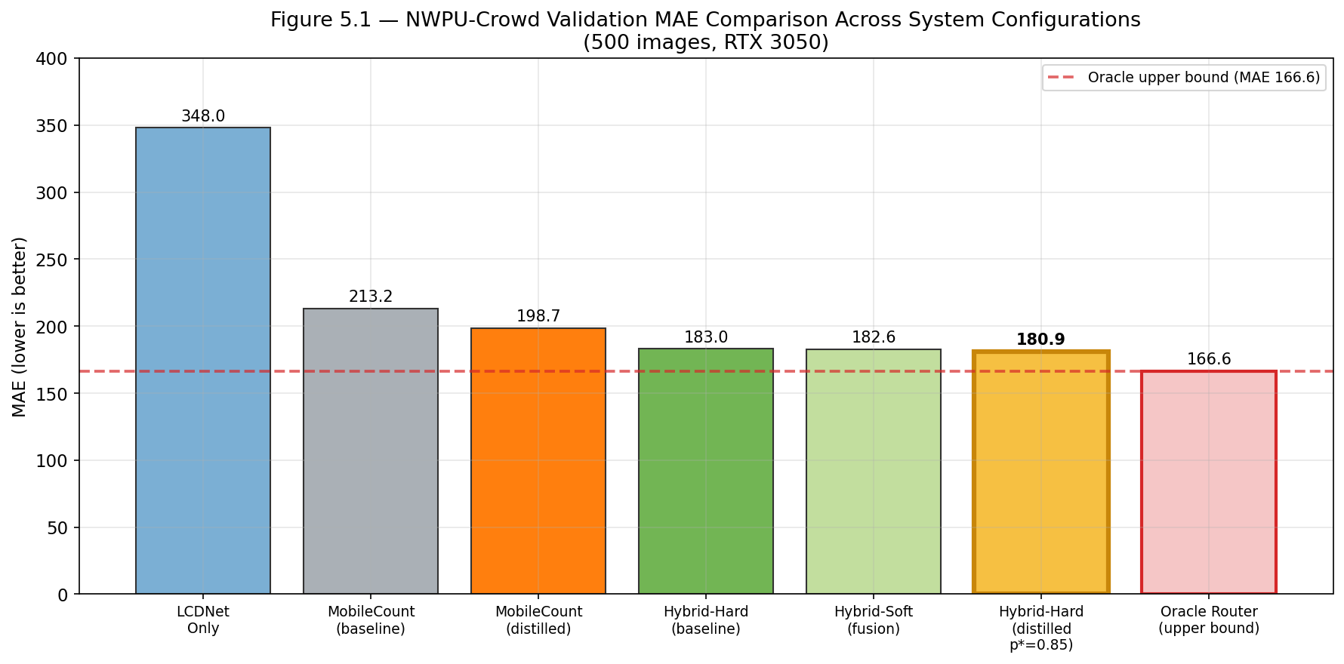
Primary Evaluation Results
NWPU-Crowd Validation · 500 images · all checkpoints evaluated on RTX 3050
Config
MAE
RMSE
Params
LCDNet Only
348.0
1034
0.92M
MC (baseline)
213.2
803.6
0.88M
MC (distilled)
198.7
778.5
0.88M
Hybrid-Hard
183.0
787.7
4.35M
Hybrid-Soft
182.6
763.8
4.35M
★ BEST (dist,p*=.85)
180.9
763.6
4.35M
Oracle UB
166.6
751.1
—
• Hybrid beats both standalone specialists: 180.9 vs 198.7 (MC) and 348.0 (LCDNet)
• Outperforms NWPU-Crowd paper baseline (MAE 218.0) by 37.1 MAE points
• Gap to oracle (166.6) = 14.3 MAE = cost of ~11% router misclassification

Slide 12
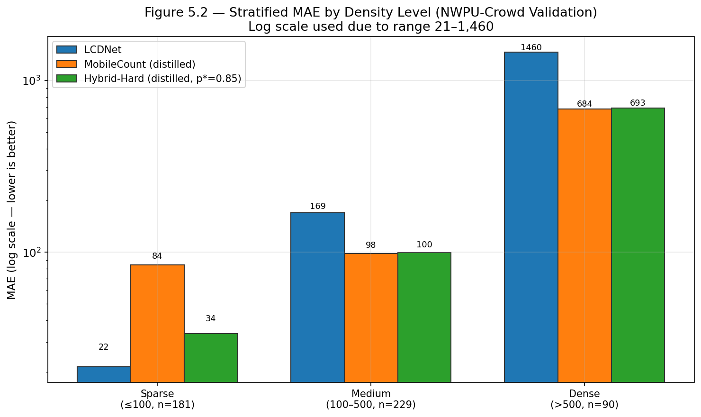
Density-Stratified Evaluation
Performance breakdown by crowd density level
SPARSE ≤100 · n=181
MobileCount: 84.5 → Hybrid: 33.6 → −60.2%!
MEDIUM 100–500 · n=229
MC: 98.4 → Hybrid: 99.5 → routing neutral
DENSE >500 · n=90
MC: 683.6 → Hybrid: 692.8 → both saturate
Routing's primary benefit is the sparse stratum: 60.2% MAE reduction.
In deployments where sparse scenes dominate (indoor, low-traffic), the advantage grows substantially.
Extreme density (>3,000): both models saturate — fundamental capacity limit, not a routing issue.

Slide 13
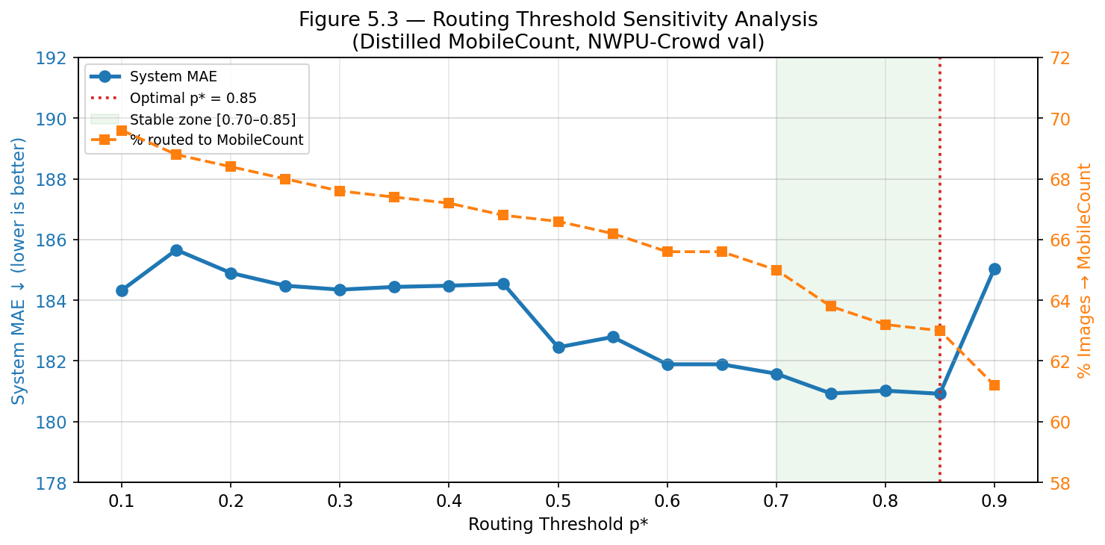
Routing Threshold Optimisation
Post-training calibration · no retraining required · free performance gain
Sweep Results
p*
MAE
p* = 0.50 (default)
182.45
p* = 0.70
181.58
p* = 0.75
180.93
★ p* = 0.85 (BEST)
180.92
p* = 0.90
185.05
• Stable zone p* ∈ [0.70, 0.85]: MAE varies < 1 point — robust to threshold choice
• p* = 0.85 routes to MobileCount only when router is ≥85% confident the scene is dense
• Best gain: −1.5 MAE vs default argmax (p*=0.50) with zero retraining cost

Slide 14
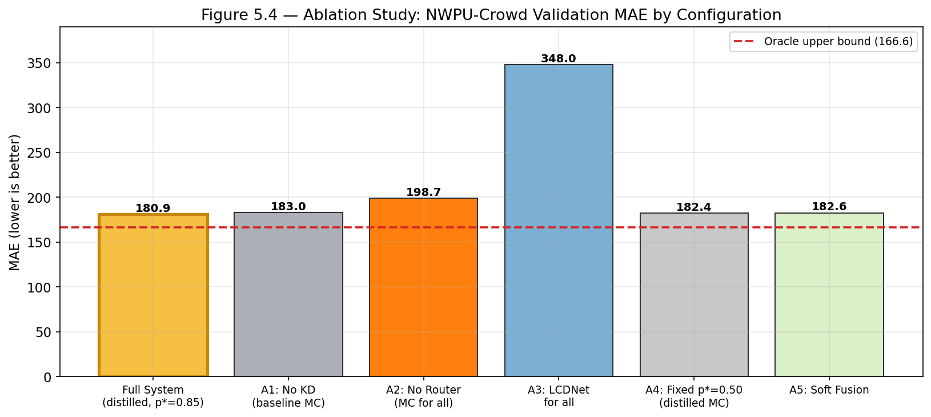
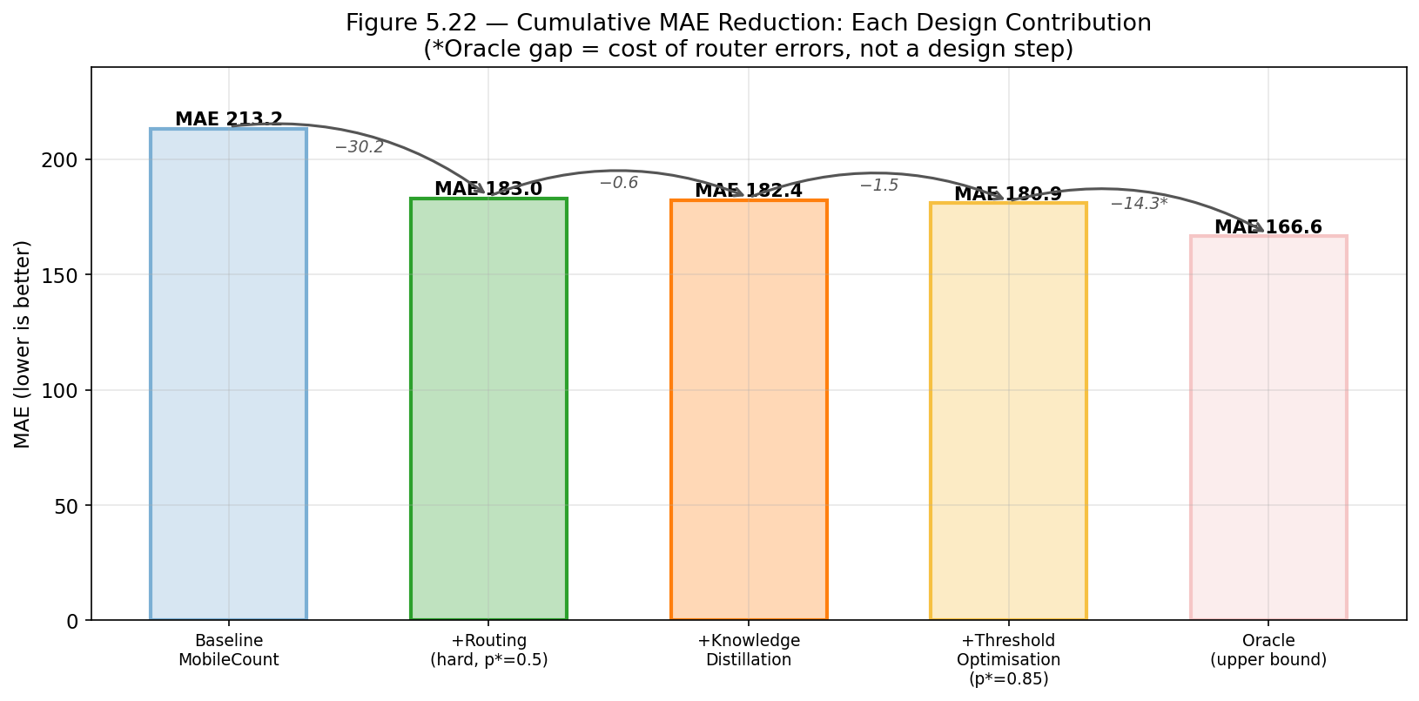
Ablation Study
Isolating the contribution of each design decision
+17.8 MAE if remove routing → Routing is the DOMINANT contributor
+2.1 MAE if remove KD → Distillation: free accuracy gain
+1.5 MAE if skip threshold sweep → Calibration: zero-cost gain
+1.7 MAE with soft fusion → Soft fusion excluded: no benefit

Slide 15
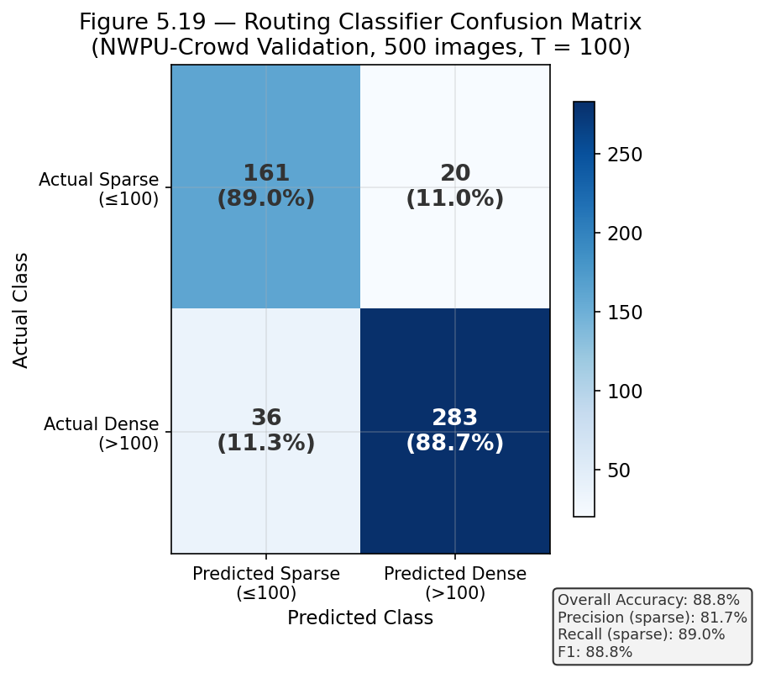
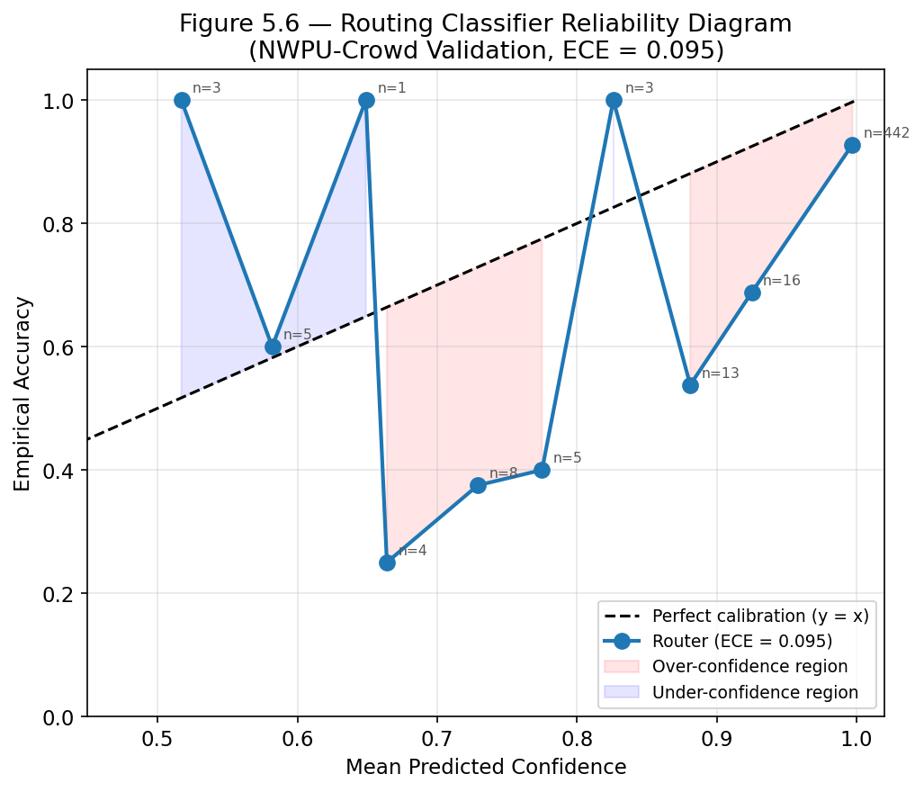
Router Performance & Calibration
Accuracy · ECE · Confusion Matrix · Confidence Distribution

Slide 16
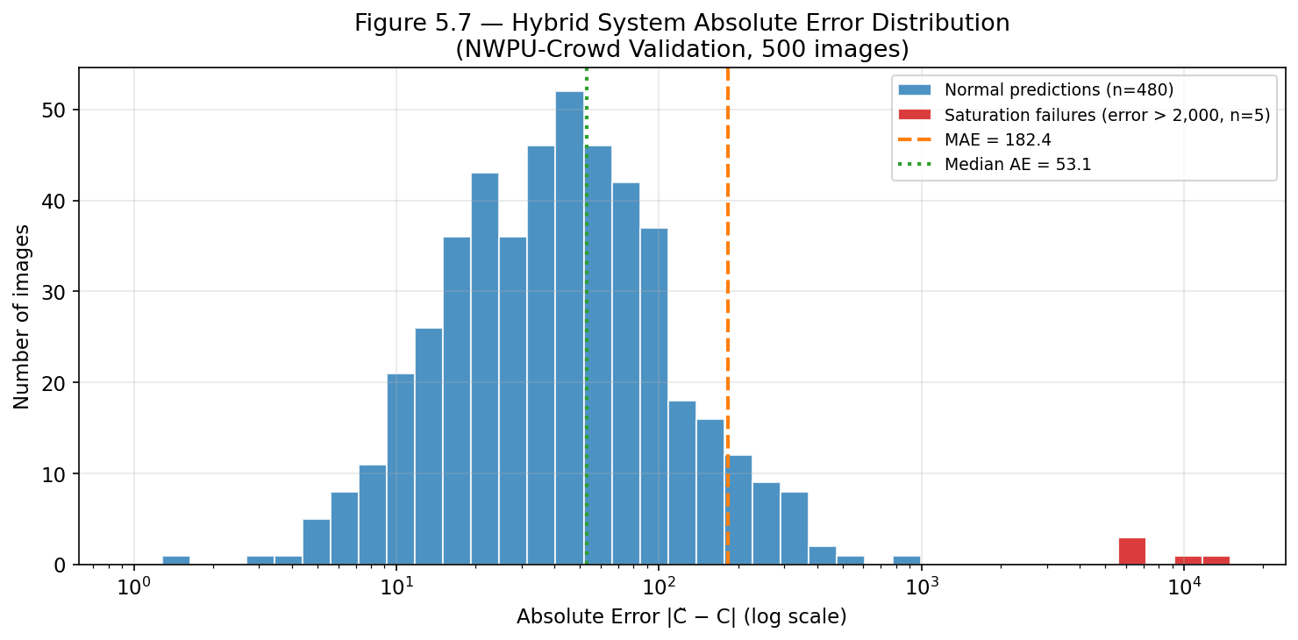
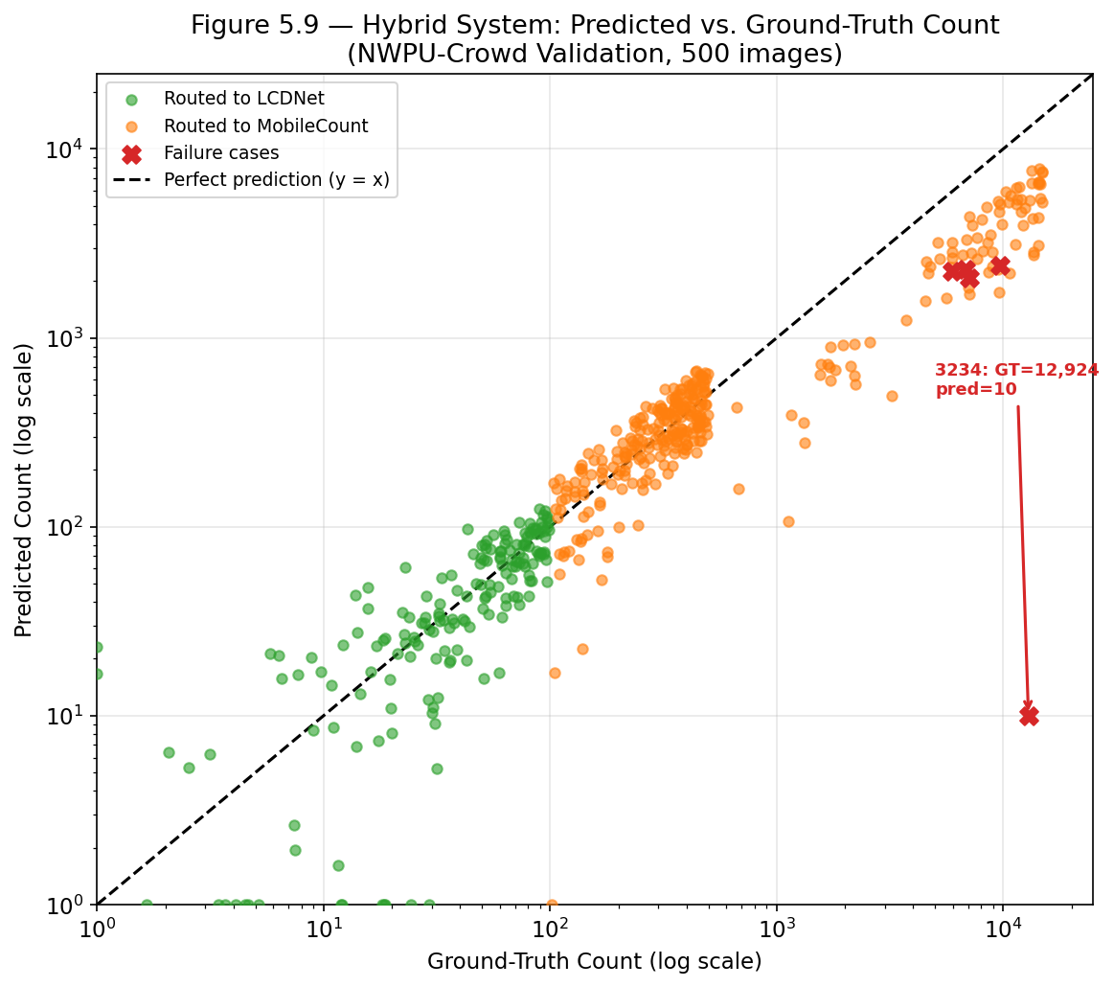
Error Distribution & Failure Cases
Understanding the heavy tail and catastrophic misroutes
Image
GT
Predicted
Root Cause
3234
12,924
10 (LCDNet)
Router 99% confident sparse — catastrophic miss (~25 MAE impact)
3408
9,728
2,428 (MC)
Both specialists saturate — model capacity limit
3353
7,122
2,077 (MC)
Density beyond 0.88M parameter capacity

Slide 17
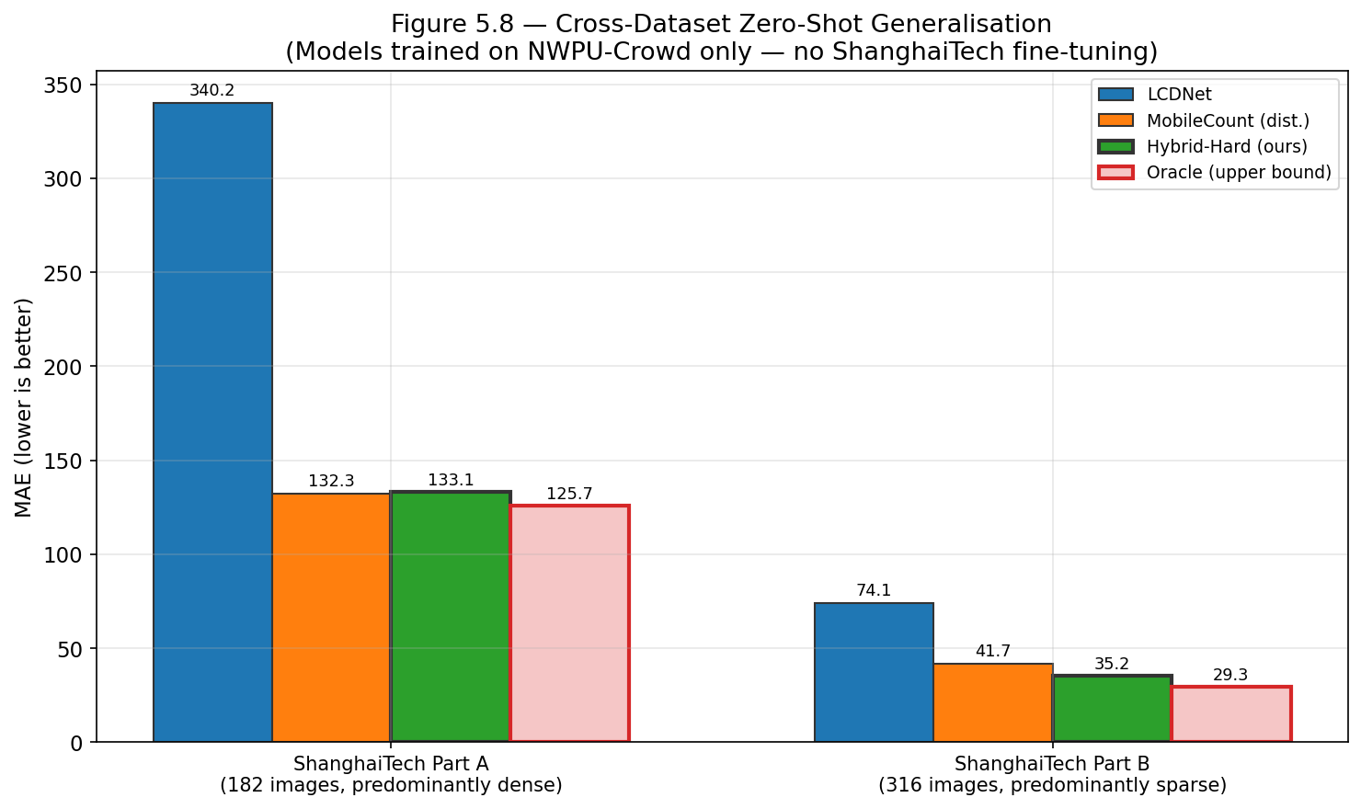
Cross-Dataset Zero-Shot Generalisation
Trained on NWPU-Crowd only · ShanghaiTech never seen during training
ShanghaiTech Part B (sparse-dominated, 316 images)
ShanghaiTech Part A (dense-dominated, 182 images)
LCDNet: 74.1 · MC: 41.7 · Hybrid: 35.2 ✓ · Oracle: 29.3
LCDNet: 340.2 · MC: 132.3 · Hybrid: 133.1 ≈ tie · Oracle: 125.7
→ Hybrid beats both standalone models
→ 95.1% routed to MobileCount — expected tie

Slide 18
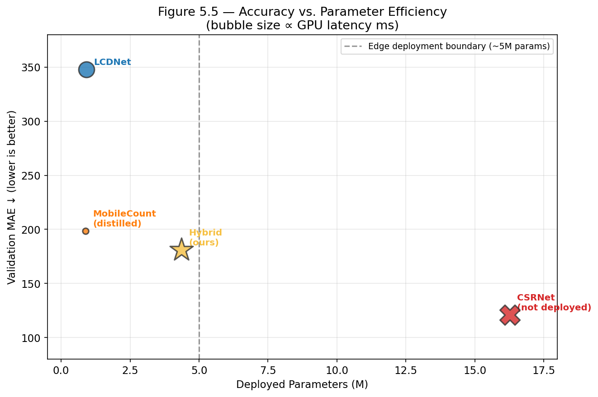
Edge-Deployment Efficiency Profile
Params · GFLOPs · GPU + CPU latency · vs CSRNet baseline
Component
Params
GFLOPs
GPU ms
CPU ms
Router
2.552M
0.33
4.8
8.9
LCDNet
0.917M
14.59
23.1
208.8
MobileCount
0.884M
1.07
3.4
13.5
TOTAL SYSTEM
4.354M
—
~55 avg
~210 avg
CSRNet†
16.26M
—
N/A
N/A
† CSRNet is training-time teacher only — never deployed · vs CSRNet: 73.3% smaller
Dense path: Router + MobileCount ≈ 8ms GPU · Sparse path: Router + LCDNet ≈ 28ms GPU
All measurements: NVIDIA RTX 3050 8GB · Jetson Nano deployment = future work

Slide 19
Comparison with Published Methods
NWPU-Crowd Validation
ShanghaiTech Part A (zero-shot)
Method
Year
MAE
Params
Method
Year
MAE
Params
Dataset baseline
2020
218.0
—
MCNN
2016
110.2
~1M
CSRNet
2018
~121
16.26M
CSRNet
2018
68.2
16.3M
MC (baseline)
2024
213.2
0.88M
SANet
2018
67.0
~10M
MC (distilled)
2024
198.7
0.88M
CAN
2019
62.3
~5M
★ Hybrid (ours)
2024
180.9
4.35M
★ Hybrid*
2024
133.1
4.35M (zero-shot)
* Hybrid trained on NWPU-Crowd only — zero-shot evaluation on ShanghaiTech. MAE gap = domain shift penalty.
Key: 4.35M params vs 5–16M for dedicated methods — competitive efficiency at a fraction of the cost.

Slide 20
Conclusion & Future Work
Hybrid System
MAE 180.9 · beats both standalone specialists · outperforms NWPU baseline (218.0)
Edge-Deployable
4.35M params · 73.3% smaller than CSRNet · ~55ms/image on RTX 3050
Knowledge Distillation
CSRNet→MobileCount: −14.5 MAE at zero deployment cost · 18.4× smaller
Cross-Dataset
ShanghaiTech Part B: MAE 35.2 zero-shot · generalises without fine-tuning
Sparse Routing
60.2% MAE reduction on sparse scenes · primary contribution of routing
Future Work
→ Jetson Nano benchmarking
→ INT8 quantization (2–4× speedup)
→ Confidence-aware fallback routing
→ High-density 3rd path (>3,000)
→ Federated learning integration
→ Temporal smoothing for video
"A 4.35M-parameter system that beats models 4× its size — through smart, learned routing."

Slide 21
Thank You · Questions?
Q & A
MAE 180.9
4.35M params
−60.2%
Best Result — NWPU-Crowd val
73.3% smaller than CSRNet
Sparse routing gain
GitHub: Crowd-Density-Hybrid-Model · NWPU-Crowd + ShanghaiTech Part A & B · PyTorch 2.6

