Slide 1
As-is process map
Current Advanced Tissue Models supplier controls and informal part qualification
New supplier, new part
Existing supplier, new part
New supplier, existing part
668008 SOP, SUPPLIER
CONTROLS, ATM
668007 SOP,PURCHASING
AND PLANNING,ATM
668009 DOP,SUPPLIER
SELECTION,APPROVAL AND
MONITORING,ATM
Original labels retained
ATM (Advanced Tissue Models)
SOP (Standard Operating Procedure)
DOP (Department Operating Procedure)
WI (Work Instruction)
ASL (Approved Supplier List)
668504 WI, SUPPLIER
AUDITING, ATM
668529 ATM,WI,ASL USE
AND MAINTENANCE
Once supplier is on ASL, informal part qualification process is done; 1st article inspection or multiple lots inspected prior to dropping inspection reqt’s.
Same informal process is done for new parts from existing suppliers
Review draft • 17 September 2026 / 1
Notes:
This is the current-state map supplied by Oscar. The note describing reduced inspection is source history, not a new authorization. No supplier training step appears in the source map.
Source: original Map A and Map B, working handoff v1 dated 16 September 2026, original supplier training draft dated 4 June 2026, and Oscar decisions dated 17 September 2026. Document identifiers ending XXX remain unassigned.

Slide 2
To-be process map
Supplier approval precedes tissue personnel certification and component qualification
668008
Supplier Controls
Tissue
NEW 668XXX
Tissue Supplier Personnel
Training and Certification
668009
Supplier Selection, Approval
and Monitoring
668529
Supplier approval recorded
in the Approved Supplier List
Personnel gate
≥95% first-pass yield
≥2 consecutive harvest days
≥30 inspected units per person/task/family
Non-tissue
NEW 668XXX
Component Qualification
Tissue and non-tissue paths
668504
Supplier Auditing
Tissue part gate
Every qualification lot ≥95% first-pass yield
Lot count requires approval before execution
All existing documents remain separate.
Blue = local document Green = new training procedure
668529
Qualified part and supplier-site
scope recorded
668007
Purchasing and Planning
Lead time and reorder points
Review draft • 17 September 2026 / 2
Notes:
668008 and 668009 remain separate. No document retires or absorbs another. New supplier with an existing tissue part still requires site/supplier-specific qualification. Personnel turnover alone does not automatically requalify an already-qualified part.
Source: original Map A and Map B, working handoff v1 dated 16 September 2026, original supplier training draft dated 4 June 2026, and Oscar decisions dated 17 September 2026. Document identifiers ending XXX remain unassigned.

Slide 3
To-be qualification document map
Corporate references remain amber; local qualification documents remain blue
668XXX SOP,COMPONENT
QUALIFICATION,ATM
REF: DOP,PPQP 1003684
Pilot PPQP quick reference guide
non-prime parts
1049262 SOP,REGULATED
MATERIALS COMPLIANCE
854133 SOP,MATERIALS
853313 SOP,ENVIRONMENTAL
COMPLIANCE SYSTEMS (ROHS)
668XXX FORM,COMPONENT
QUALIFICATION,CHECKLIST,ATM
REF: FORM,PPQP CHECKLIST
1004112
668XXX WI,FAIR,ATM
REF: DOP,FAIR 854197
FAIR quick reference guide
1009008 WI,ROHS
DOCUMENTATION FOR MATERIALS,
PARTS, AND SUB-ASSEMBLIES
Tissue checklist evidence
Personnel certification plus approved
qualification lots inspected at the supplier site
668XXX FORM,FAIR,ATM
REF: FORM,FAIR 800084
FAIR (First Article Inspection Report) PPQP (Purchased Part Qualification Process)
SOP (Standard Operating Procedure) DOP (Department Operating Procedure) WI (Work Instruction)
ATM (Advanced Tissue Models) RoHS (Restriction of Hazardous Substances)
Review draft • 17 September 2026 / 3
Notes:
Original corporate labels retained. Applicability is determined for each part. Do not assume tissue exemption from any corporate material requirement. Verify current controlled revisions before release. PPQP means Purchased Part Qualification Process in the source handoff.
Source: original Map A and Map B, working handoff v1 dated 16 September 2026, original supplier training draft dated 4 June 2026, and Oscar decisions dated 17 September 2026. Document identifiers ending XXX remain unassigned.

Slide 4
Supplier training process map
Harvest and build personnel follow training, monitoring, certification and the qualification handoff
Not ready: return to Training Phase
1 Prerequisites
Supplier status verified
Controlled instruction and specification
Qualified trainer and inspector
Per-unit trainee attribution ready
2 Training Phase
Tissue expert demonstrates the task
Operations Supervisor supports
Coaching and questions permitted
3 Readiness sign-off
Trainer and inspector agree
Record task, revisions and date
Ready
6 Certification
Supplier Engineer evaluates evidence
Record on 800082 and training log
Scope: person, site, task and family
5 Personnel gate
≥95% first-pass yield
≥2 consecutive harvest days
≥30 units in the evaluation window
4 Monitoring Phase
Trainee performs the task
Inspector examines every unit
Record first result and attribution
Pass
No
New supplier or tissue part
Separate component qualification follows.
Every lot ≥95%; approved lot count required.
Existing part with new personnel: assess whether
part requalification is needed.
Gate not met or technique concern
Continue only under defined monitoring controls
Recurring <95%: inspector shadows and retrains
Fresh monitoring window after coached retraining
Review draft • 17 September 2026 / 4
Notes:
Procedure Sections 4–6. Inspector certification follows a separate attribute-agreement route, not the harvest yield gate. Training outputs cannot be counted as unassisted certification evidence. At 30 units, 29 passes meet the threshold and 28 fail.
Source: original Map A and Map B, working handoff v1 dated 16 September 2026, original supplier training draft dated 4 June 2026, and Oscar decisions dated 17 September 2026. Document identifiers ending XXX remain unassigned.

Slide 5
Recurring low yield and recovery
The 95% threshold stays in force; recurring results below it trigger inspector shadow training
Yield below 95%
Flag the result and segregate
nonconforming output
Supplier Engineer and Quality review
Use the approved recurrence rule
Check technique, process and
inspection consistency
Recurring below 95%
Inspector shadows harvesting technician
Reinforces training and inspects output
Records defects and observed causes
Process or material cause: correct the process and assess part requalification.
Supplier-site versus receipt difference: investigate handling, freezing and transport.
Do not assign a cause to the technician from yield alone.
Routine work and trend review
Independent incoming inspection
continues at Advanced Tissue Models
Recovery approval
Supplier Engineer reviews evidence
Quality authorizes return to routine work
Update status and training records
Technique corrected
Fresh unassisted monitoring window
≥95% first-pass yield / ≥30 units
≥2 consecutive harvest days
Gate passed
Gate not met: keep monitoring controls and repeat training or correct the process
Exception path: Quality approves the scope, duration, added inspection and exit criteria in writing before work.
Expiration ends the authorization. A deviation does not certify personnel, qualify a part or release nonconforming tissue.
Review draft • 17 September 2026 / 5
Notes:
Every failure receives review. The numeric recurrence count/window is not approved yet and must be set in Appendix A before release. Do not wait for a monthly call to contain an identified issue. A quality-approved deviation is a controlled exception, not certification or product release.
Source: original Map A and Map B, working handoff v1 dated 16 September 2026, original supplier training draft dated 4 June 2026, and Oscar decisions dated 17 September 2026. Document identifiers ending XXX remain unassigned.

Slide 6
Entry paths and qualification boundaries
Each trigger enters the appropriate stage without repeating unrelated approvals
Trigger
Personnel route
Component qualification
New supplier, new or existing tissue
Full training, monitoring and certification
Required for the supplier/site and part
Existing supplier, new tissue
Family-specific training and certification
Required for the new part scope
New or reassigned personnel, existing part
Train and certify the individual
Assess impact; no automatic repeat
Instruction or specification revision
Training on changes; evaluate monitoring need
Quality and Design Engineer assess impact
Technique issue or recurring yield below 95%
Inspector shadow training, then fresh monitoring
Assess process or part impact
Approved inactivity limit reached
Reassess competence and repeat monitoring
Assess only if other changes occurred
Quality certifies inspection personnel with the Design Engineer using attribute agreement.
The harvest yield gate does not establish inspection accuracy.
Review draft • 17 September 2026 / 6
Notes:
Source: original Map A and Map B, working handoff v1 dated 16 September 2026, original supplier training draft dated 4 June 2026, and Oscar decisions dated 17 September 2026. Document identifiers ending XXX remain unassigned.

Slide 7
Release decisions and remaining fields
The approved decisions are incorporated; incomplete settings prevent controlled release
Confirmed by Oscar
Required before controlled release
30 inspected units per person, task and tissue family
At least 2 consecutive harvest days
95% minimum first-pass yield for personnel and lots
Recurring low yield triggers inspector shadow training
Quality-approved deviations with explicit controls
668008, 668009 and all other documents stay separate
Qualification-lot count and lot/sample definition
Recurrence count and review window below 95%
Inspector agreement criteria and reference-set design
Confirmed acceptance specification and revisions
Monitoring attempt limit and inactivity interval
Approved attribution method and record repository
These fields require designated stakeholder approval. Blank fields do not authorize qualification or shipment.
Review draft • 17 September 2026 / 7
Notes:
Source: original Map A and Map B, working handoff v1 dated 16 September 2026, original supplier training draft dated 4 June 2026, and Oscar decisions dated 17 September 2026. Document identifiers ending XXX remain unassigned.

Slide 8
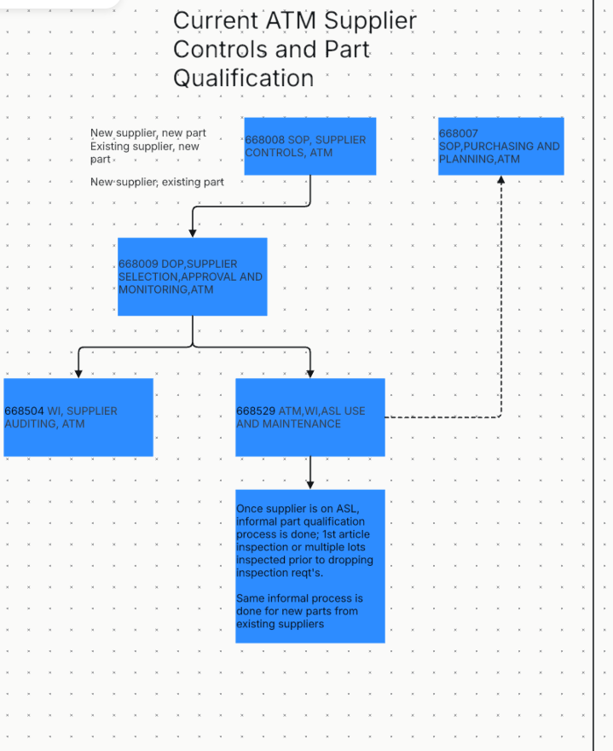
Original current-state map reference
Unaltered source image for comparison with the editable maps
Review draft • 17 September 2026 / 8
Notes:
Source map reproduced without changes.
Source: original Map A and Map B, working handoff v1 dated 16 September 2026, original supplier training draft dated 4 June 2026, and Oscar decisions dated 17 September 2026. Document identifiers ending XXX remain unassigned.

Slide 9
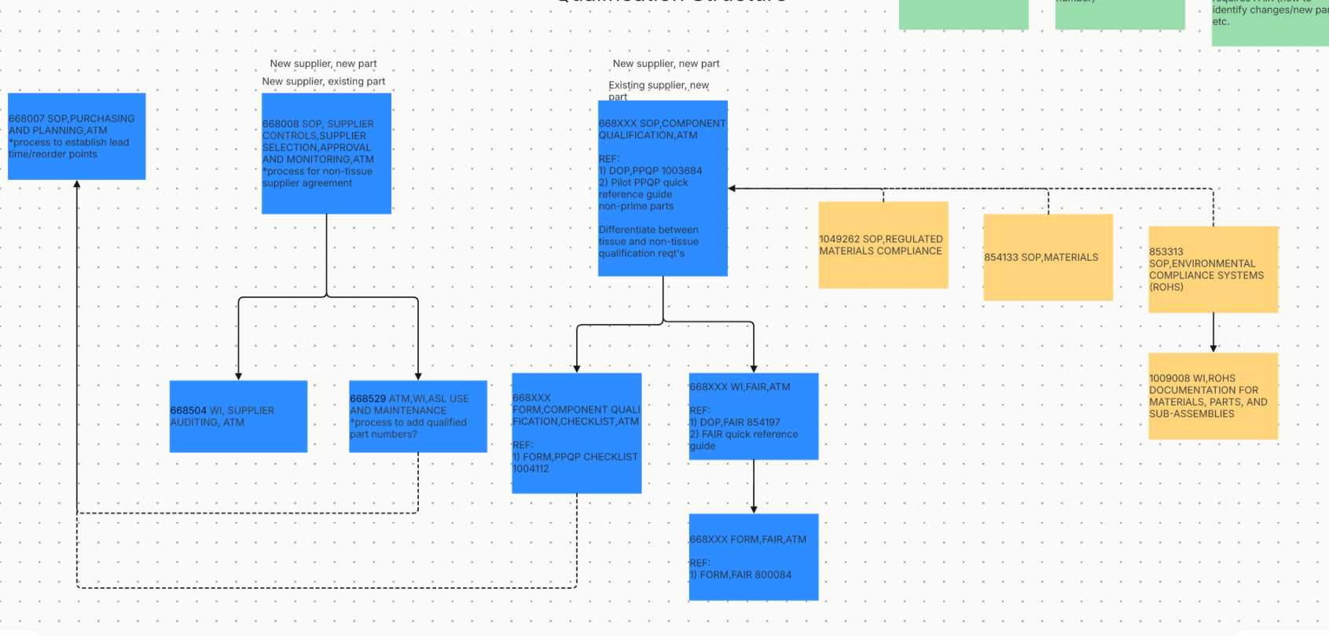
Original proposed map reference
Unaltered source image for comparison with the editable maps
Review draft • 17 September 2026 / 9
Notes:
The source screenshot cuts off the green notes along the top. Their missing content is not reconstructed. Its merged 668008/668009 label is superseded by Oscar’s 17 September decision to retain separate documents.
Source: original Map A and Map B, working handoff v1 dated 16 September 2026, original supplier training draft dated 4 June 2026, and Oscar decisions dated 17 September 2026. Document identifiers ending XXX remain unassigned.

