Slide 1
NCATS OLIGOTOX OPEN DATA CHALLENGE · PHASE 2
OligoTox-Kidney
A curated, per-measurement kidney-toxicity dataset for oligonucleotide therapeutics
65 oligos · 111 measurements · 35 target genes · 100% kidney-specific
Phase 2 · Data Generation · prepared for biochemistry-expert review · June 2026
Notes:
One-line pitch: a clean, well-documented dataset of how oligonucleotide drugs harm the kidney, for the NIH/NCATS Phase 2 data challenge (which scores datasets). Oligo = a drug made of a short strand of genetic letters. Nephrotoxicity = kidney toxicity. Per-measurement = one experimental result per row.

Slide 2
THE IDEA IN ONE SENTENCE
Oligonucleotide drugs can injure the kidney in a way the standard safety test misses — so we built a dataset that captures the right signal, one experiment per row, every value traceable to its source.
Notes:
The 'standard safety test' is the cheap 'are the cells alive?' test. These drugs often DON'T kill cells, so that test gives a false all-clear. Our dataset records the subtler 'alive but not working' damage instead.

Slide 3
Why this matters
Oligonucleotides are a booming drug class — ~19 approved, dozens in trials, treating diseases nothing else could.
But the kidney is a common casualty. It filters and concentrates these drugs, so it sees high levels — several oligos have caused proteinuria, kidney injury, even failure.
The catch: the damage is often invisible to routine cell-survival screening.
The gap Phase 2 targets
Most public oligo-tox data is hepatic; kidney data is thin. No open dataset pairs each oligo's design (sequence + chemistry) with a graded kidney outcome — exactly what an in-silico model needs to predict risk early. That is what we assembled.
OligoTox-Kidney · NCATS OligoTox Open Data Challenge — Phase 2
3
Notes:
Oligo drugs are fast-growing and important; the kidney is especially exposed because it filters and concentrates them. Most existing OPEN oligo-tox data is about the LIVER; kidney is under-served, so an open kidney set fills a real gap (Phase 2 'potential impact').

Slide 4
PART 1
The science: a quiet kind of kidney injury
Why a cell-survival test gives these drugs a false 'all-clear'

Slide 5
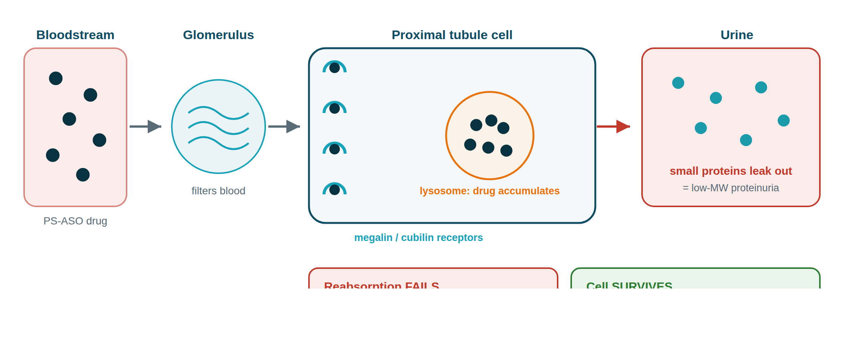
How these drugs injure the kidney
PS-ASOs are filtered, vacuumed into proximal-tubule cells by megalin/cubilin, and stored in lysosomes. Small-protein reabsorption fails → proteinuria — yet the cell stays alive.
OligoTox-Kidney · NCATS OligoTox Open Data Challenge — Phase 2
5
Notes:
The kidney filters blood; proximal-tubule cells reabsorb small proteins. Megalin/cubilin receptors grab those proteins — and also these drugs, which pile up in lysosomes. The clogged cell stops reabsorbing → proteins leak to urine (proteinuria), but the cell does not die. Functional (not lethal) injury = grade 1.

Slide 6
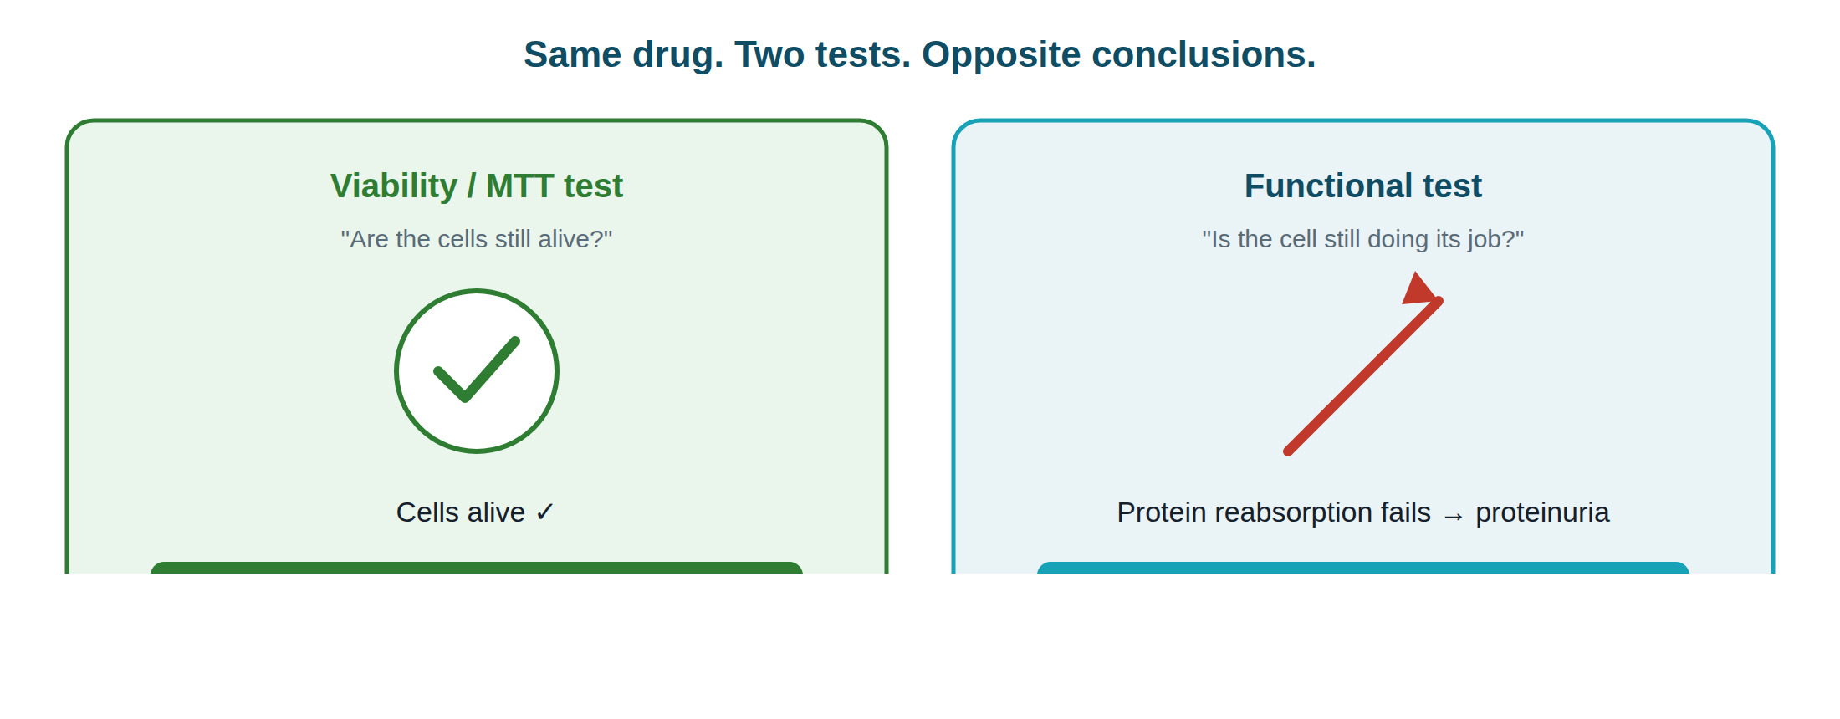
The trap: one drug, two tests, opposite answers
A viability/MTT screen asks only 'are the cells alive?' — and these drugs don't kill cells. So routine screening calls them clean. Our schema captures the functional signal it misses.
OligoTox-Kidney · NCATS OligoTox Open Data Challenge — Phase 2
6
Notes:
MTT/viability = the cheap 'are cells alive?' test. These drugs leave cells alive, so it says 'safe' — a false all-clear. The functional test (does the cell still reabsorb protein?) reveals the real problem.

Slide 7
So we record the right readouts
We weight the data toward function and injury markers, not cell survival:
functional
35
clinical renal outcome
27
histopathology
24
injury biomarker
16
viability (contrast only)
7
accumulation
2
'Readout' = one measured thing. Biomarkers (KIM-1, NGAL, clusterin, cystatin C) rise when the kidney is stressed. Functional + biomarker rows (51) dwarf viability rows (7) — by design.
OligoTox-Kidney · NCATS OligoTox Open Data Challenge — Phase 2
7
Notes:
Readout category = the KIND of measurement. We deliberately collected mostly functional and injury-biomarker results and only a few viability ones (kept to contrast).

Slide 8
PART 2
What we built
The dataset, its structure, and how toxicity is scored

Slide 9
The dataset at a glance
65
111
100%
16
unique oligos (7 families)
graded measurements (≥100 target)
kidney-specific (no padding)
distinct sources, cited
Spans every oligo modality, all three study types (dish / animal / human), and the full severity range — including deliberate negative controls.
35 target genes · 33/65 sequences filled (rest 'TBD', never guessed) · every row carries its source.
OligoTox-Kidney · NCATS OligoTox Open Data Challenge — Phase 2
9
Notes:
65 distinct drugs; 111 measured results. Every row is kidney-specific (no padding). 'Modality' = drug family. 'Negative controls' = known-safe examples. 'TBD' = missing data we refused to guess.

Slide 10
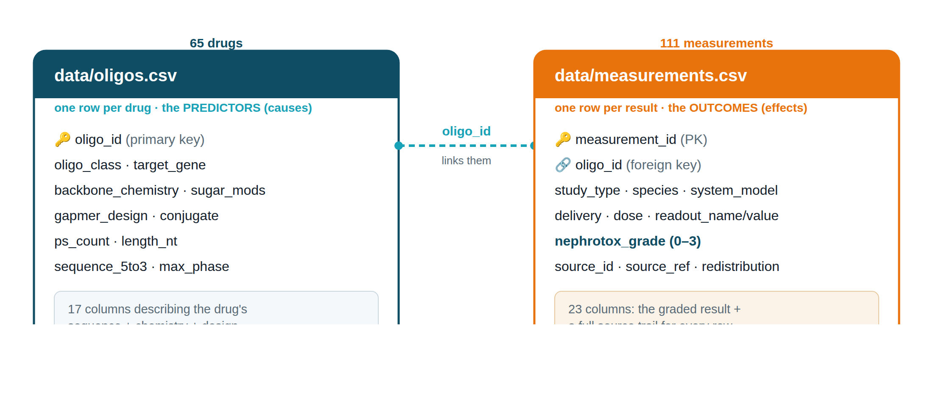
How the data is organised — two linked tables
One table describes each drug (the suspected causes); the other lists each result (the effects). They share oligo_id, so any result links back to its drug.
OligoTox-Kidney · NCATS OligoTox Open Data Challenge — Phase 2
10
Notes:
Two tables avoid repetition. oligos.csv = one row per drug with design predictors (causes). measurements.csv = one row per result with the graded outcome (effects). Primary key = unique ID; foreign key = oligo_id linking a result to its drug.

Slide 11
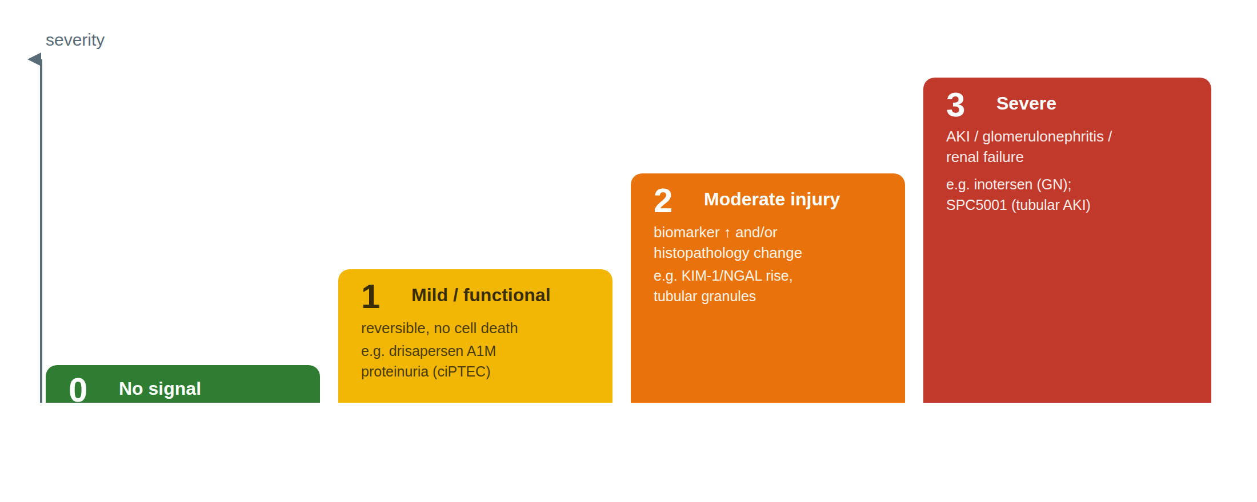
The scoring system: a 0–3 severity grade
Each result gets one ordinal grade by a written rubric (schema.md). All grades are currently flagged 'provisional' — confirming them is the sign-off we're asking a biochemistry expert for.
OligoTox-Kidney · NCATS OligoTox Open Data Challenge — Phase 2
11
Notes:
0 = no signal (safe control). 1 = mild/functional/reversible (cells don't die). 2 = moderate — biomarker rise and/or histopathology. 3 = severe — AKI/glomerulonephritis/failure. Anchors: inotersen (3), SPC5001 (3), drisapersen (1). All provisional until expert sign-off.

Slide 12
Grades span the full range — including safe controls
0 — no signal (controls)
27
1 — mild / functional
30
2 — moderate injury
39
3 — severe
15
A healthy spread across all four levels — a usable dataset needs examples of every severity. The 27 grade-0 rows are real negative controls (GalNAc-siRNA, intrathecal ASO, aptamer).
OligoTox-Kidney · NCATS OligoTox Open Data Challenge — Phase 2
12
Notes:
111 results by severity: 27 safe, 30 mild, 39 moderate, 15 severe. Grade-0 rows are deliberate safe examples of kidney-sparing drug types.

Slide 13
Coverage: every oligonucleotide family
ASO gapmer
40
GalNAc-siRNA
12
splice-switching ASO
4
PMO
4
siRNA
2
1st-gen PS-DNA
2
aptamer
1
Gapmer = DNA 'gap' + modified wings (cuts target RNA). siRNA = double-stranded silencer; GalNAc = liver-homing sugar tag. PMO = neutral splice fixer. Aptamer = an oligo folded to grab a protein.
OligoTox-Kidney · NCATS OligoTox Open Data Challenge — Phase 2
13
Notes:
All oligo families are represented; gapmers dominate (most common, most kidney-relevant).

Slide 14
Coverage: dish → animal → human (the translation axis)
STUDY TYPE
SPECIES
animal
53
human
58
clinical (human)
39
mouse
30
in-vitro (dish)
19
multi-species
8
rat
8
monkey
7
Having dish, animal, and human rows side by side — measured the same way — lets the animal-to-human translation gap be studied directly (Finding 3).
OligoTox-Kidney · NCATS OligoTox Open Data Challenge — Phase 2
14
Notes:
In-vitro (dish), in-vivo (animal), clinical (human) all present across species — so you can compare how well animal results predict human ones (the translation gap).

Slide 15
PART 3
How we built it
Methodology, the integrity rule, and the sources researched

Slide 16
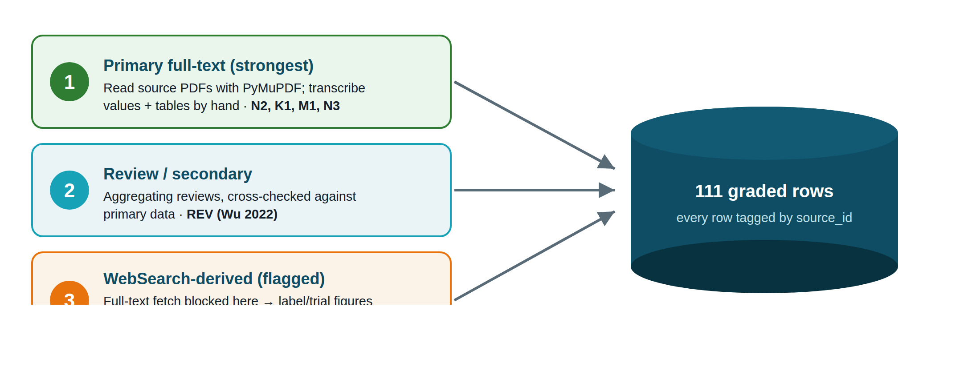
Three ways we gathered data — each tagged per row
Every row records how it was obtained, so its reliability is visible. Web-search rows are flagged for re-checking because this secure environment blocks downloading full papers.
OligoTox-Kidney · NCATS OligoTox Open Data Challenge — Phase 2
16
Notes:
Three methods, strongest first: (1) primary full-text read with PyMuPDF; (2) review/secondary, cross-checked; (3) WebSearch-derived ('WS', 36 rows) — flagged for verification because full-text fetch is blocked here. source_id tags every row.

Slide 17
The rule that makes the dataset trustworthy
⚠ Strict no-fabrication policy
Drug sequences and toxicity values are never invented or recalled from memory. A value goes in only if an explicit, citable, redistribution-permitted source states it. Drugs with no published kidney data were omitted, not padded.
Why sequences are 33/65, not 65/65
The 32 blanks are real gaps, honestly marked 'TBD'. A falsely-complete table can't be trusted at all.
Why it matters to a reviewer
If the easy fields were fudged, none of the hard toxicity values could be believed. Honest blanks are the credibility of the whole dataset.
OligoTox-Kidney · NCATS OligoTox Open Data Challenge — Phase 2
17
Notes:
We never make up two things: the drug's genetic sequence and any toxicity number — even the AI assistant could only fill them from a real citable source. Drugs lacking published kidney data were left out, not invented. That is why only 33/65 have sequences.

Slide 18
Sources researched
STRICT-KIDNEY PRIMARY (READ IN FULL)
ANCHORS · REVIEW · PATENTS
• Janssen 2019 · drisapersen, human kidney-cell injury (N2·10)
• Wu 2022 · marketed-ASO nephrotoxicity review (REV)
• US 11,105,794 B2 · patent tox panel (N3·21)
• inotersen · NEJM + FDA label — severe anchor (A1)
• Moisan 2017 · human tubule-cell panel (M1·11)
• Sandelius 2020 · urine injury-biomarkers (K1·9)
• mipomersen, volanesorsen · gapmer renal signals
• van Poelgeest 2013 · SPC5001 first-in-human AKI (A3)
• inclisiran, givosiran, nusinersen · safe controls
• Arch Toxicol 2021 · SPC5001 kidney-on-chip (A4·5)
• US 11,479,818 B2 · 2nd patent, queued (N4)
+ 36 'WS' rows from FDA/EMA labels & pivotal trials: patisiran, vutrisiran, lumasiran, nedosiran, eplontersen, tofersen, bepirovirsen, olpasiran, the DMD PMOs, pegaptanib, fitusiran, zilebesiran — plus Crooke 2018 (human) & Yu 2012 (monkey).
OligoTox-Kidney · NCATS OligoTox Open Data Challenge — Phase 2
18
Notes:
Best kidney-specific papers (read in full) plus real-world anchors/reviews/patents. N3 patent was the biggest source (sequence + toxicity together). 36 'WS' rows came from label/trial summaries and are flagged for re-checking.

Slide 19
PART 4
What the data shows
Three findings worth a biochemistry expert's attention

Slide 20
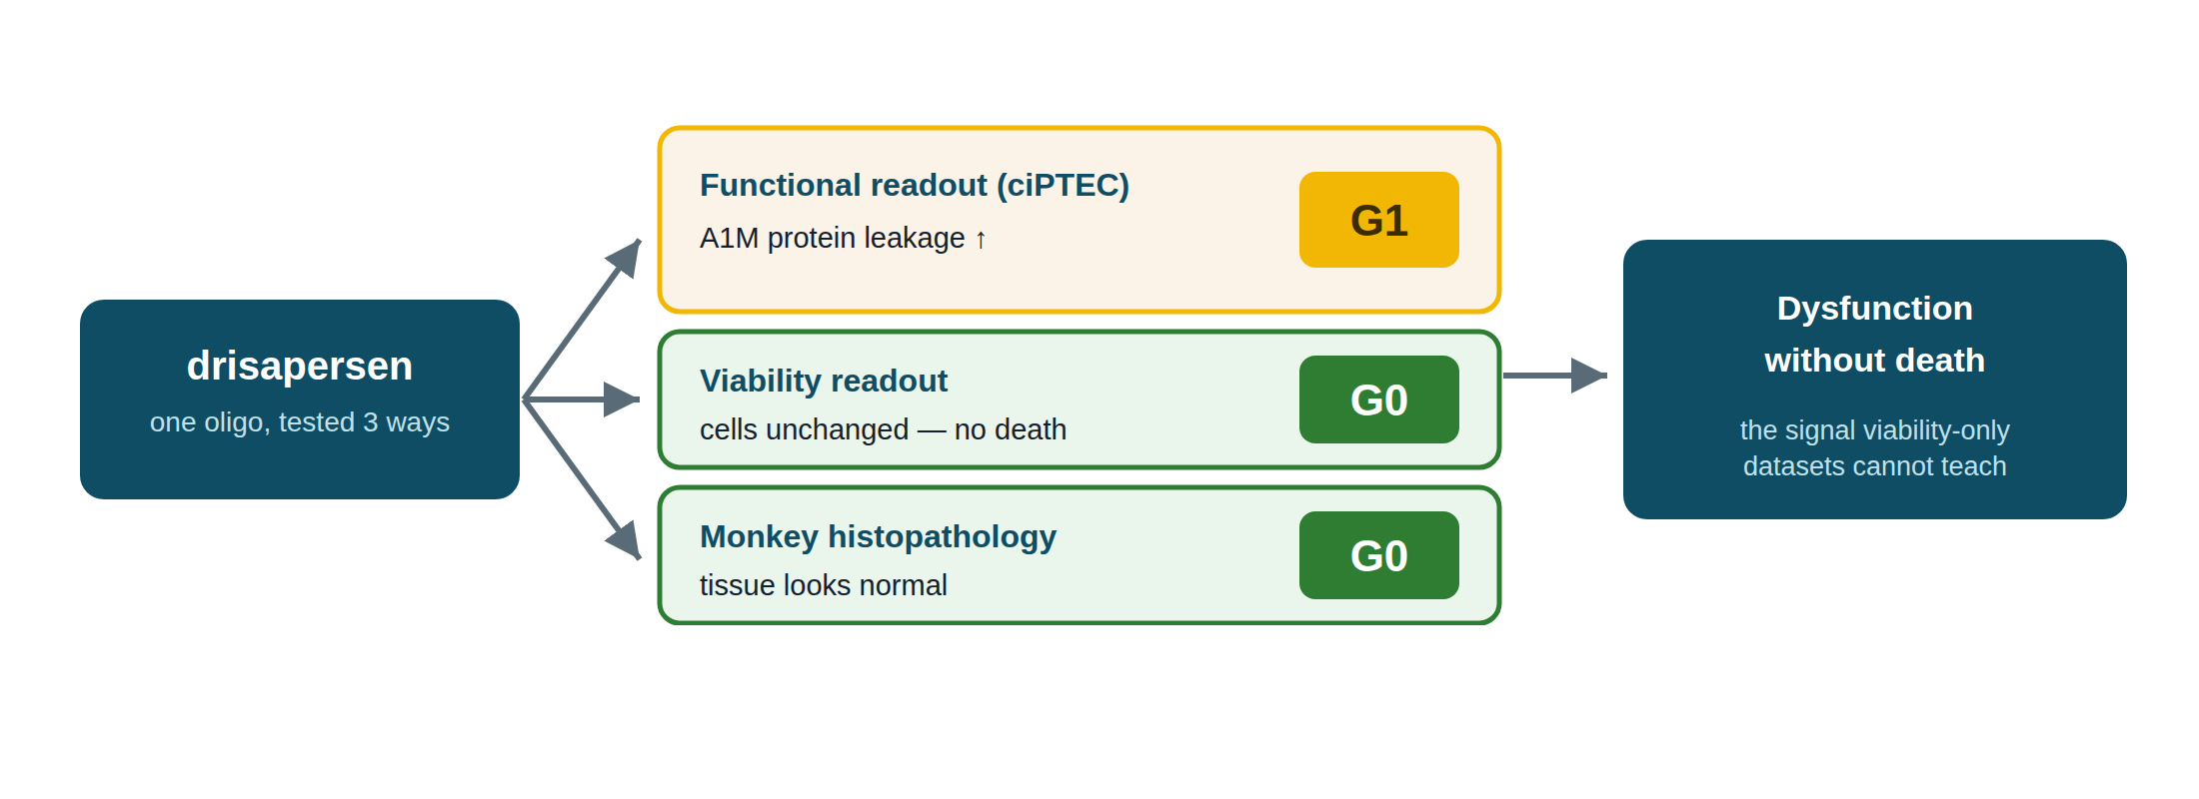
Finding 1 — the 'invisible' injury, captured
For the same drug we store paired rows: a mild grade on the functional test, a clean grade on viability/tissue. Side by side they encode 'dysfunction without death'.
OligoTox-Kidney · NCATS OligoTox Open Data Challenge — Phase 2
20
Notes:
For drisapersen we have three rows: protein leak in human kidney cells (grade 1), cells alive (grade 0), monkey tissue normal (grade 0). Together = dysfunction without death — which viability-only datasets can't teach a model.

Slide 21
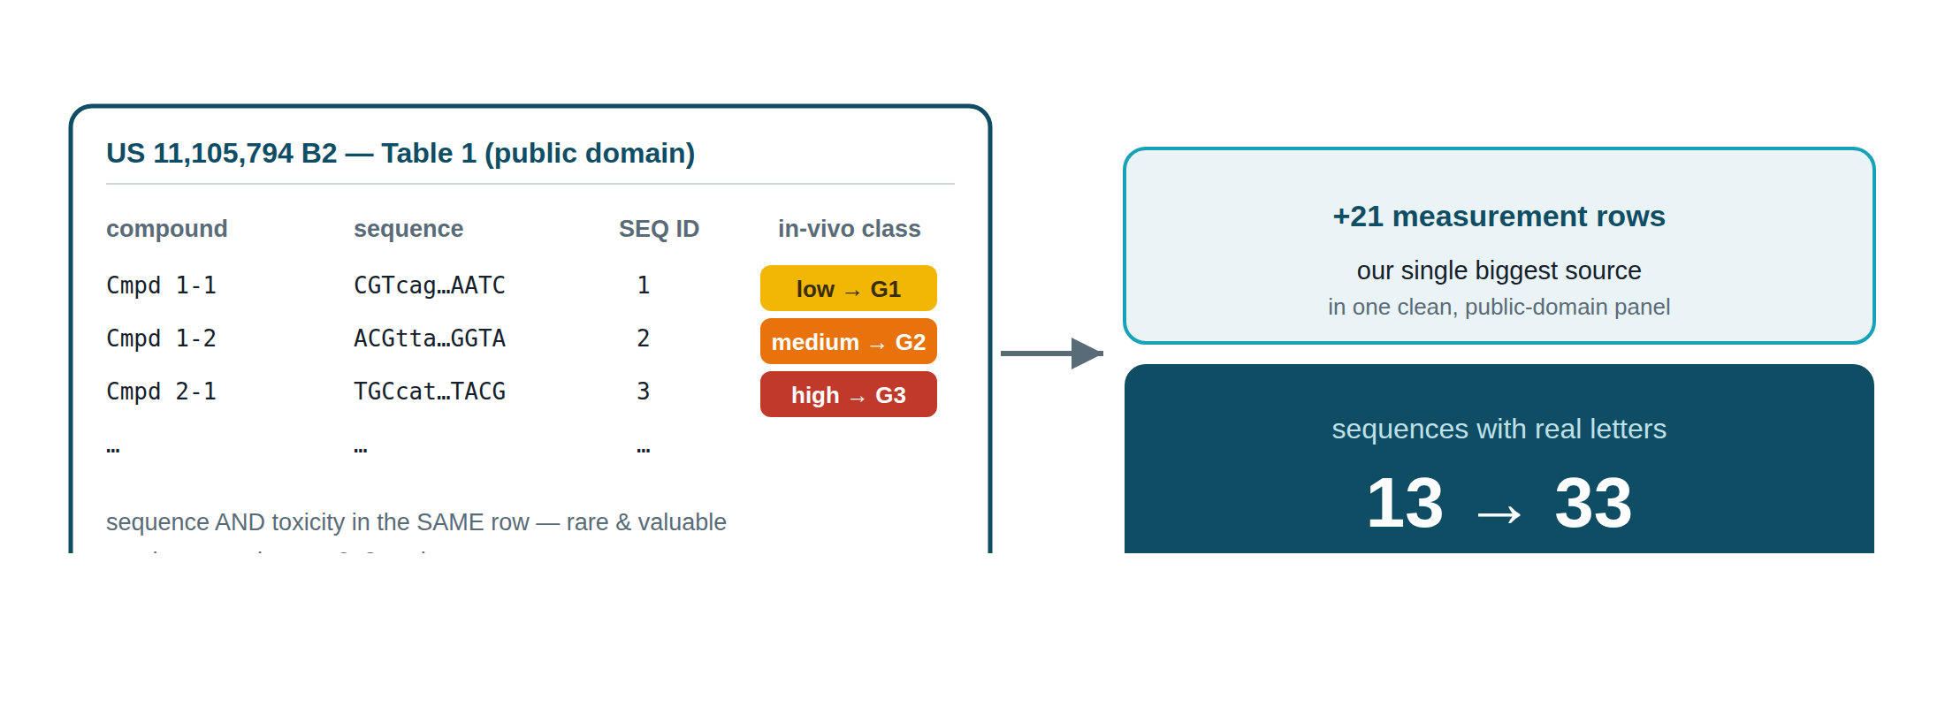
Finding 2 — a patent unlocked sequence + toxicity together
Most sources give a sequence or a toxicity value. This public-domain patent table gave both in the same row for many oligos — the most model-ready slice, and it tripled sequence coverage.
OligoTox-Kidney · NCATS OligoTox Open Data Challenge — Phase 2
21
Notes:
US 11,105,794 Table 1 lists many oligos with BOTH sequence and an animal nephrotox rating. We mapped the word-ratings (innocuous/low/medium/high) to 0–3. +21 rows; sequences 13→33. Public domain = freely reproducible.

Slide 22
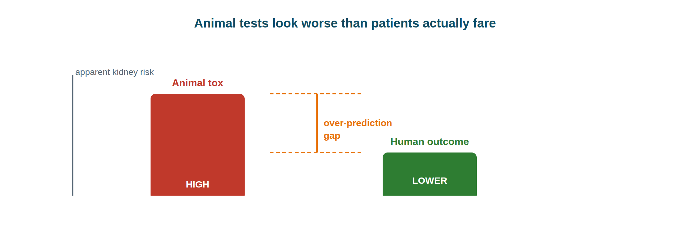
Finding 3 — animal tests over-predict human risk
A known, consistent bias for this class: animal kidneys look worse than patients turn out to be. We captured human and animal rows side by side so the gap can be modelled, not ignored.
OligoTox-Kidney · NCATS OligoTox Open Data Challenge — Phase 2
22
Notes:
For these drugs, animals show more kidney damage than humans actually get. We placed human (Crooke 2018) and animal (Yu 2012 monkey) data in the same table, measured the same way, so the gap is analysable rather than hidden.

Slide 23
PART 5
Why it fits Phase 2 — and what's next
Judging criteria, trust, limitations, and the ask

Slide 24
Built for the four Phase-2 judging criteria
1 · Ability to solve
2 · Potential impact
A model-ready design — sequence + chemistry predictors vs. graded, per-condition kidney outcomes; the patent panel even puts sequence AND toxicity in one row.
Fills a real public-domain gap: most open oligo-tox data is hepatic — kidney is thin. First open set linking design to graded nephrotoxicity, incl. the functional phenotype.
3 · Feasibility & rigor
4 · Transparency & reproducibility
Strict no-fabrication, per-row provenance, controlled vocabularies and automated QC (0 orphans) — a set researchers can trust and reuse on release.
Open license (CC-BY) intended; every value traceable to source; all stats regenerate from data/ — FAIR, aligned to NIH data-sharing.
NCATS's four Phase-2 confidence factors — the dataset was designed against them, not retro-fitted. Submission window 1 May – 31 Dec 2026.
OligoTox-Kidney · NCATS OligoTox Open Data Challenge — Phase 2
24
Notes:
NCATS scores Phase 2 on four confidence factors; this maps our work to each: (1) useful for predictive models — predictors vs graded outcome; (2) fills the hepatic-vs-kidney gap; (3) trustworthy — sourced, QC'd; (4) open & re-checkable — CC-BY, FAIR, regenerable.

Slide 25
Mapped to Phase-2's technical scoring rubric
Experimental design
20 pts
Controls built in — 27 grade-0 negative controls and severe positive anchors (inotersen GN, SPC5001 AKI), plus within-compound functional-positive / structural-negative pairs. Source-study replicates stay traceable through per-row provenance.
Data translatability
20 pts
Built for modeling — explicit predictor variables (sequence, chemistry, backbone, gapmer design, conjugate) against graded toxicity indicators; 7 modalities, full 0–3 range; captures functional-not-cytotoxic + the animal→human gap.
Dataset management & documentation
10 pts
FAIR by construction — stable IDs, open CSV + CC-BY, controlled vocabularies (common data elements), a full data dictionary, per-row provenance, automated QC. A Public Access & Dissemination Plan (PADP.md) accompanies the submission.
The Evaluation Panel's technical criteria (≈50 pts shown) — complementing the four judging factors.
OligoTox-Kidney · NCATS OligoTox Open Data Challenge — Phase 2
25
Notes:
The granular technical scoring: Experimental design (20) — controls & replicates; Data translatability (20) — can it improve predictive models; Dataset management (10) — metadata, FAIR, common data elements. Plus the required PADP.md in the repo.

Slide 26
Every row is defensible
PROVENANCE — THE PAPER TRAIL
QUALITY CONTROL — ALL PASSING
Each measurement carries its source, the exact table/figure/claim, and its redistribution right, so any value can be re-checked at its origin.
✓ every category value from an allowed list
✓ column counts intact (17 / 23)
✓ every result links to a real drug — 0 orphans
✓ no duplicate IDs · grades all 0–3
✓ no-guessing sequence rule held
47 public-domain rows
64 summary-stat rows
16 sources
OligoTox-Kidney · NCATS OligoTox Open Data Challenge — Phase 2
26
Notes:
Two trust pillars: provenance (source_id/ref/table + redistribution right per row) and automated QC (enum checks, column counts, 0 referential orphans, no dup IDs, grades 0–3, no-guessing rule) — all passing.

Slide 27
Honest limitations
• Grades are provisional — by rubric, awaiting expert sign-off.
• In-vitro human-cell rows (19) are the core but a minority — top growth priority.
• Sequences 33/65 — remaining gaps left blank, never guessed.
• Animal over-prediction is present by design — model it, don't ignore it.
• 36 'WS' rows rest on web summaries — need primary-source check.
Stating the soft spots plainly is part of the deliverable — a reviewer should know exactly where to push.
OligoTox-Kidney · NCATS OligoTox Open Data Challenge — Phase 2
27
Notes:
We state weaknesses openly: grades not expert-confirmed yet; 32 sequences blank; 36 web-sourced rows need re-checking; human-cell rows are the valuable core but still a minority; and the animal-over-prediction bias must be modeled.

Slide 28
What we need from the biochemistry expert
1
Grade sign-off. Check the rubric→row mapping in measurements.csv so we can remove the 'provisional' flag. Hot spots: the grade 2↔3 line (biomarker rise vs. true AKI) and the patent words→grade mapping.
2
Biology sanity check. Is the functional-vs-structural story (megalin/cubilin → protein leak → grade 1) faithful, and are the readout→severity calls physiologically sound?
3
Source confidence. Flag any anchor — especially the 36 'WS' rows — you'd want re-verified against the primary text before release.
On hold until sign-off: the ≤12-page narrative · verifying WS rows · backfilling sequences · mining patent N4 for more rows.
OligoTox-Kidney · NCATS OligoTox Open Data Challenge — Phase 2
28
Notes:
The concrete ask: (1) review the 0–3 grades vs the rubric and confirm/correct — focus on the 2-vs-3 boundary and the patent word→grade mapping; (2) sanity-check the core biology; (3) flag sources to re-verify (esp. the 36 web-summary rows). Everything else is paused until they weigh in.

Slide 29
Where everything lives
README.md
strategy, scope, live record counter
schema.md
data dictionary + the grade rubric
METHODOLOGY.md
how it was built (sources → grading → QC)
PADP.md
public access & dissemination plan (licensing)
PRESENTATION.md
this deck (+ plain-English speaker notes)
data/oligos.csv
65 drugs · 17 design columns
data/measurements.csv
111 graded rows ← review here
sources/
the source PDFs + the source registry
Thank you — feedback welcome at the row level. Every number in this deck regenerates from data/; nothing is hand-maintained prose detached from the tables.
OligoTox-Kidney · NCATS OligoTox Open Data Challenge — Phase 2
29
Notes:
A map of the project folder. The key file for review is data/measurements.csv (the graded results); the rubric is in schema.md. Every count regenerates from data/, so the deck can't drift from the data.

