Slide 1
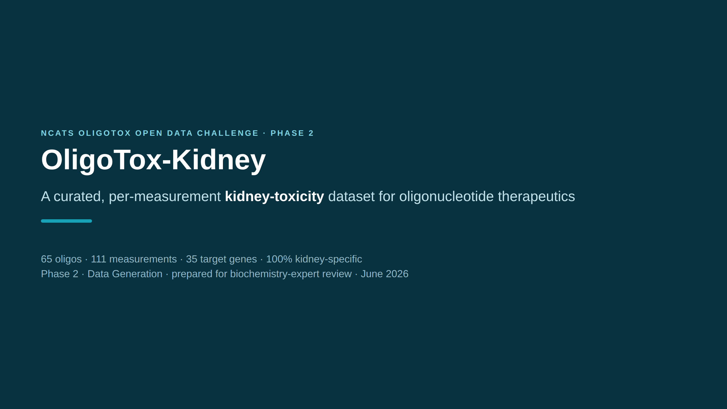
Notes:
SPEAKER NOTES — plain English One-line pitch: we built a clean, well-documented SPREADSHEET of evidence on how oligonucleotide drugs can harm the kidney — for a public NIH/NCATS data challenge. Terms: • "Oligonucleotide" (oligo) = a drug made of a short string of genetic letters (DNA/RNA), ~12–25 long, designed to switch a specific gene on/off. ~19 approved. • "Nephrotoxicity" = kidney toxicity (nephro = kidney). • "Per-measurement" = each row is one experimental result, the finest detail. • "NCATS Phase 2" = the data-generation phase of the challenge; it scores DATASETS. This deck is for a biochemistry expert to review the science and sign off the grades.

Slide 2
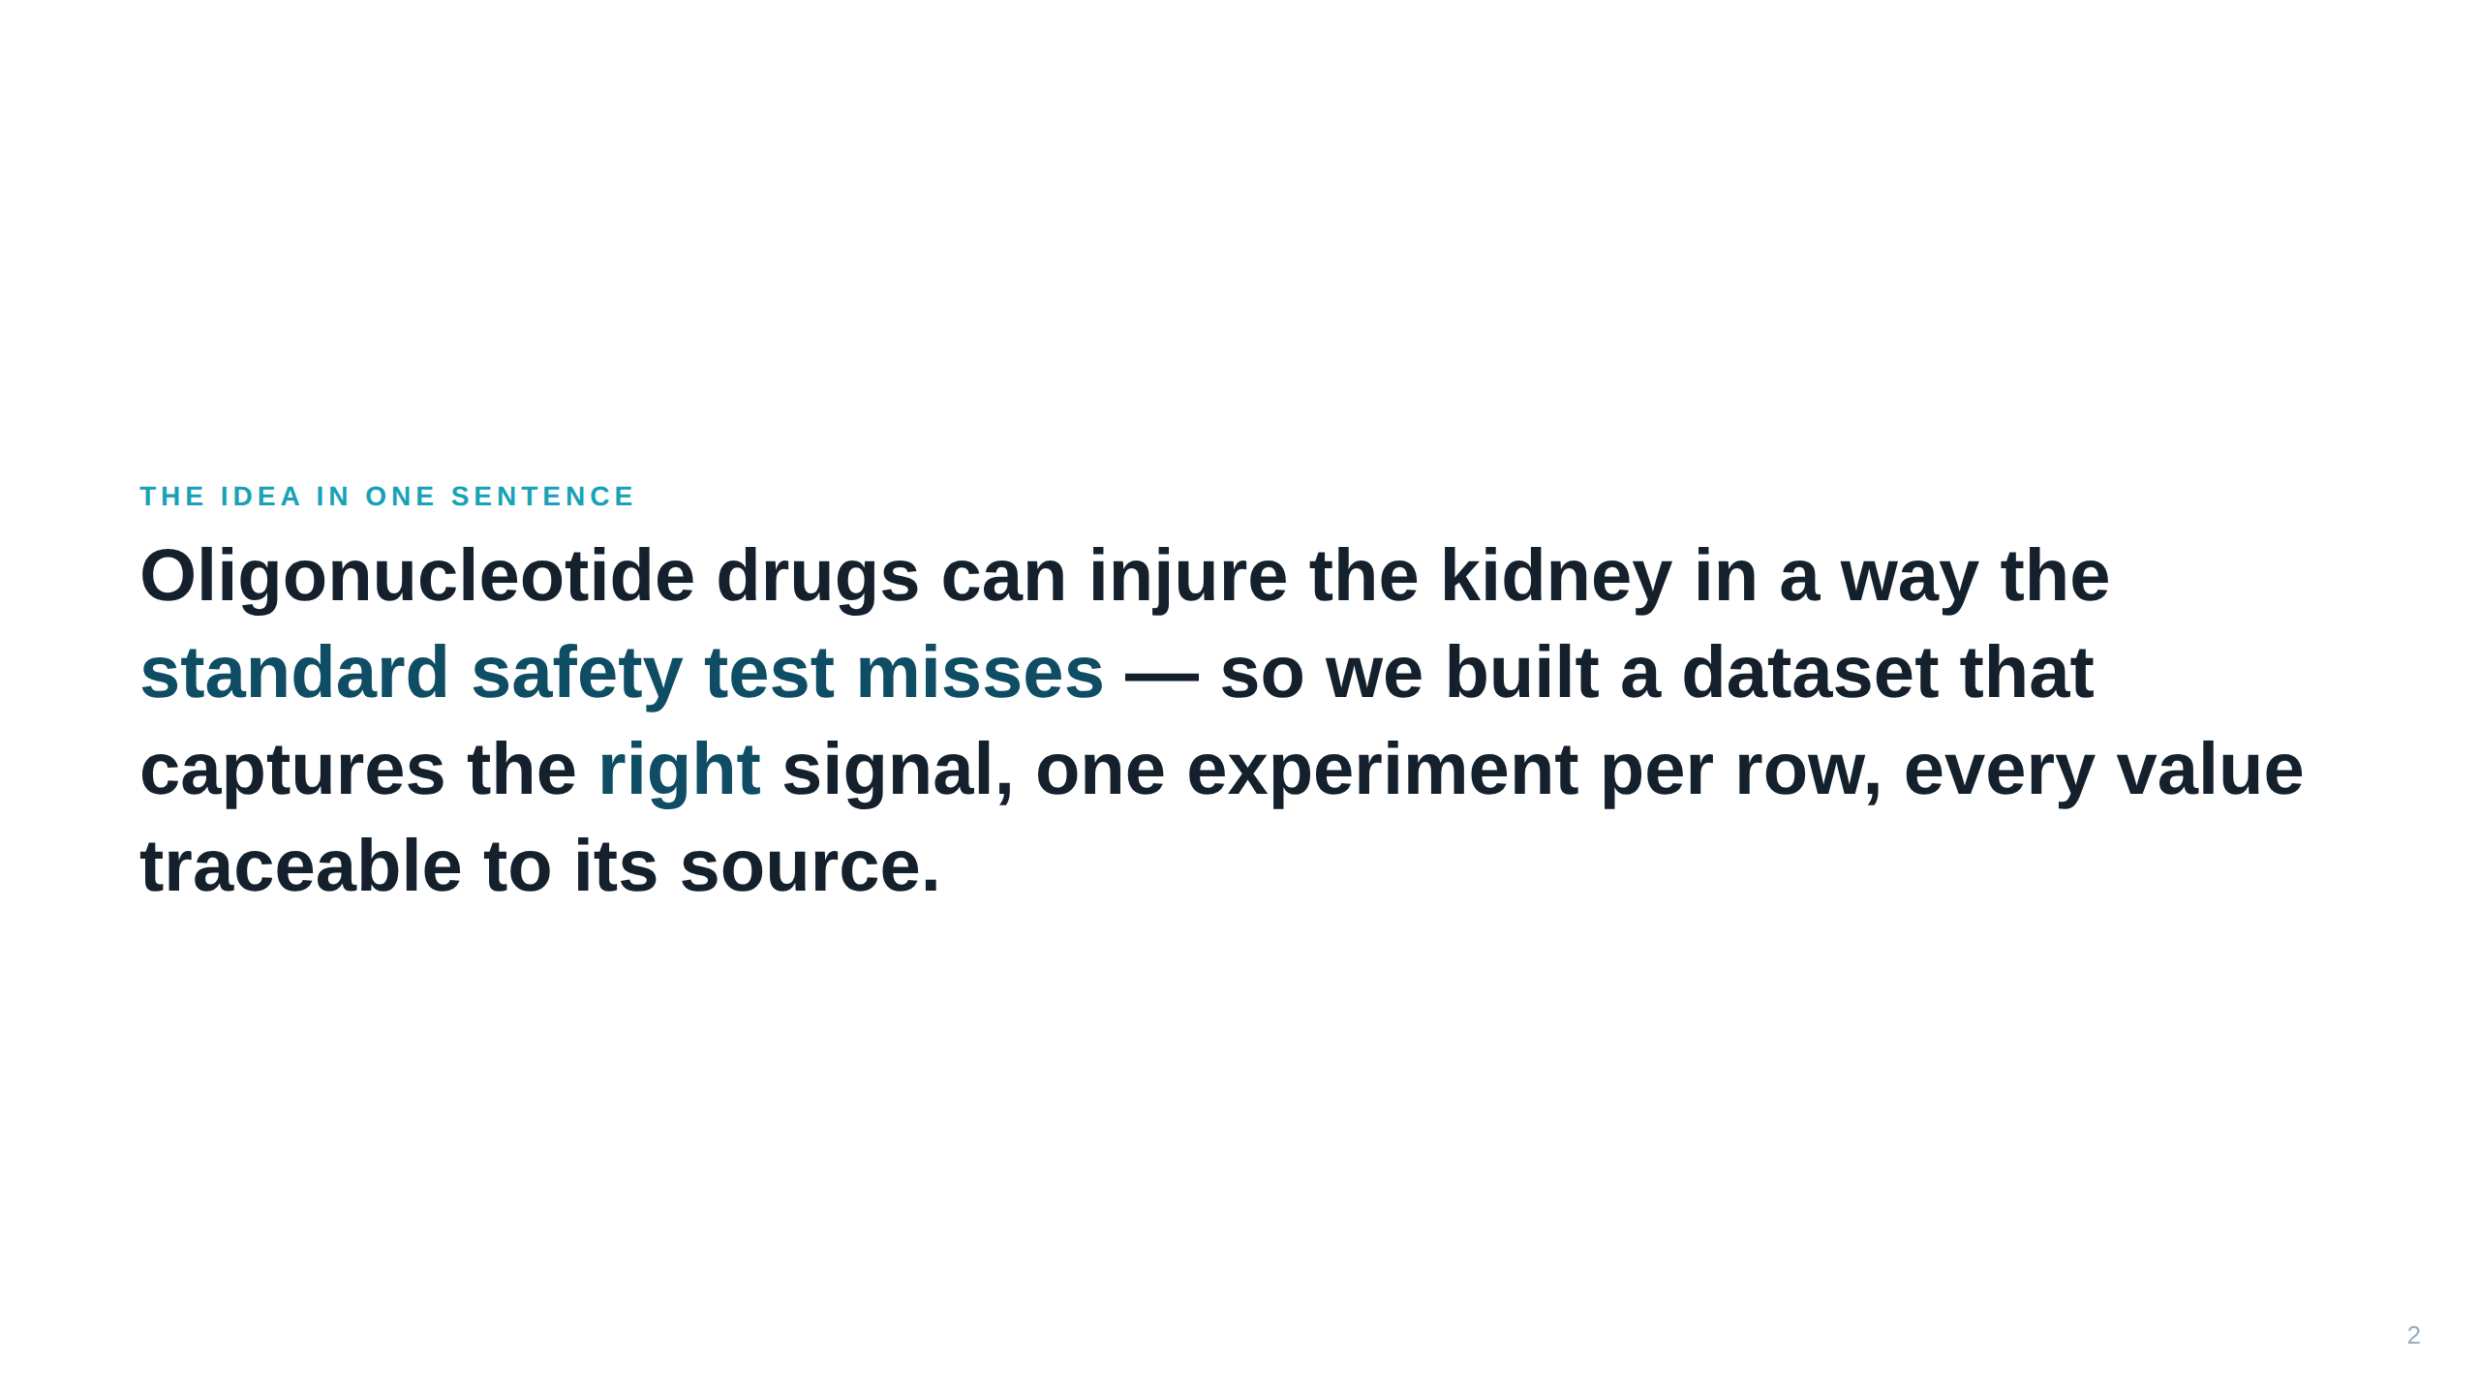
Notes:
SPEAKER NOTES — plain English This frames the whole project. The "standard safety test" is the cheap "are the cells alive?" test. These drugs often DON'T kill cells, so that test gives a false all-clear. Our dataset is designed to record the subtler "the cell is alive but not working" damage instead. "Traceable to source" = every number points back to the exact paper/patent table it came from.

Slide 3
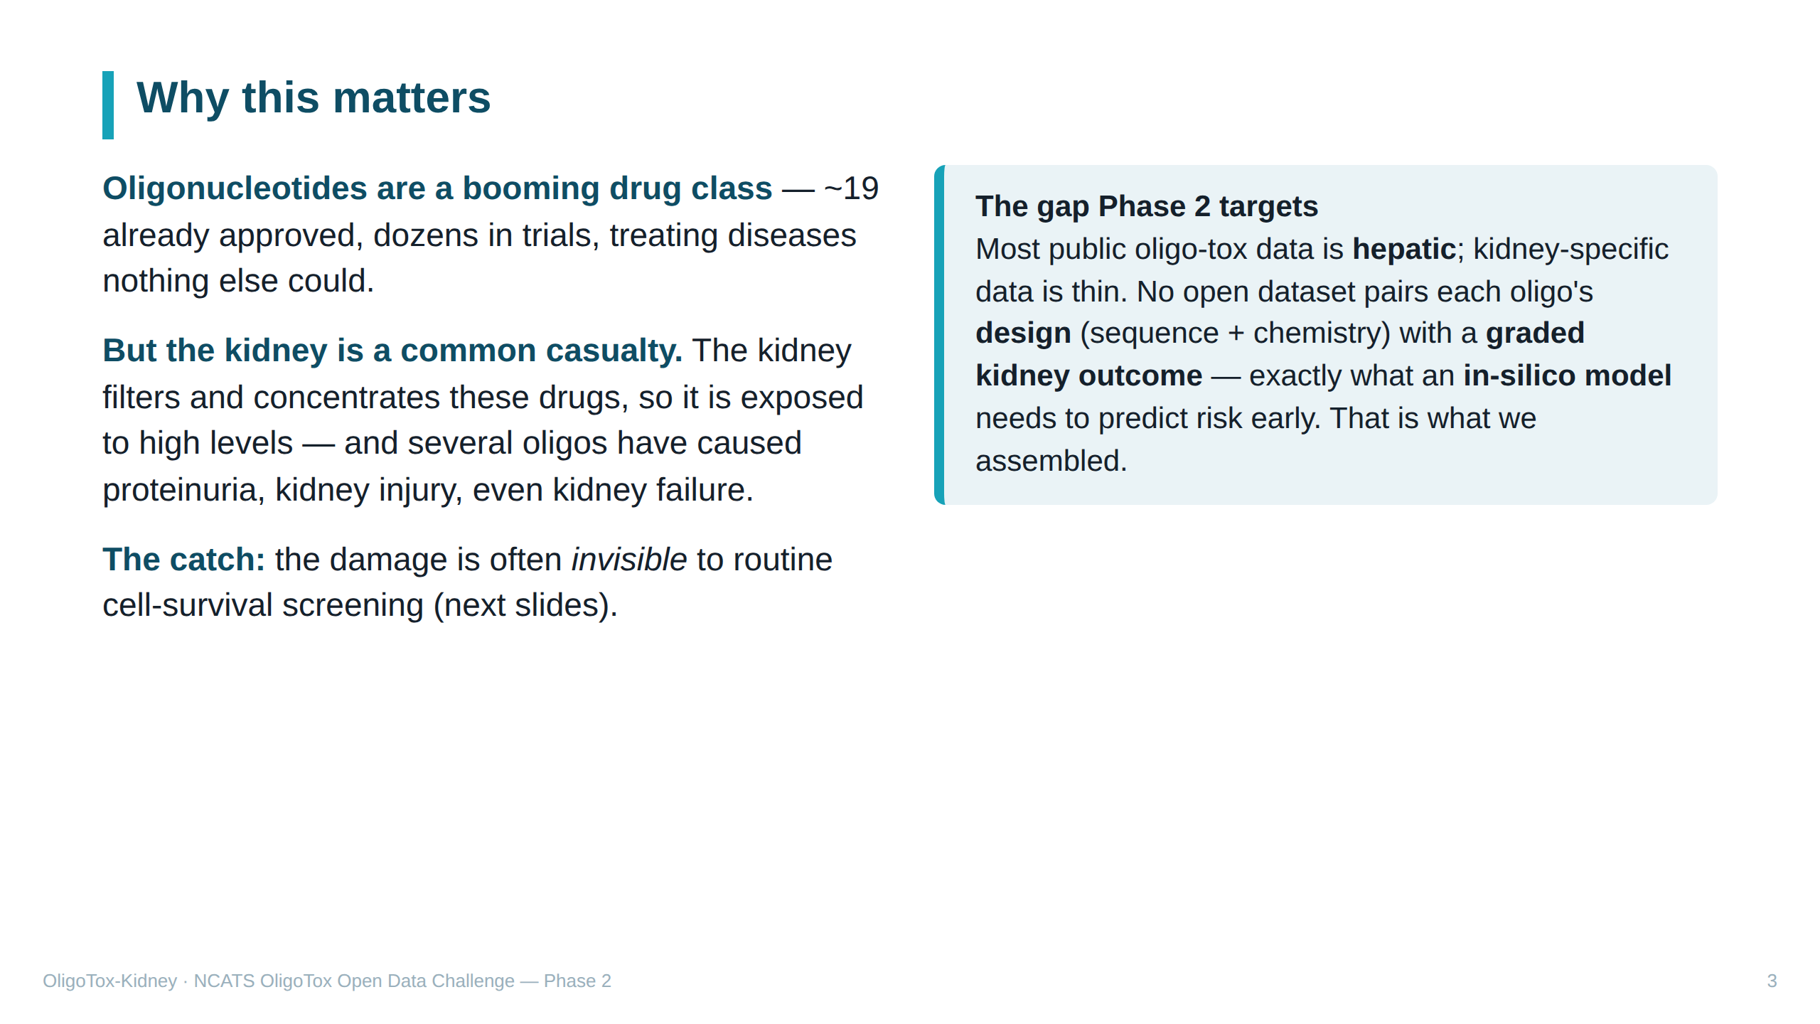
Notes:
SPEAKER NOTES — plain English Why kidney, why now. Oligo drugs are a fast-growing, important class. The kidney is especially exposed because it filters the blood and concentrates whatever passes through, so these drugs pile up there. Several have caused real kidney problems. "Proteinuria" = protein leaking into urine, a classic kidney-trouble sign. Most existing open oligo-tox data is about the LIVER; kidney is under-served — so an open kidney set fills a real public gap (Phase 2's "potential impact"). The missing piece is a tidy table linking each drug's design to a kidney-toxicity score, ready for an in-silico model — that is our contribution.

Slide 4
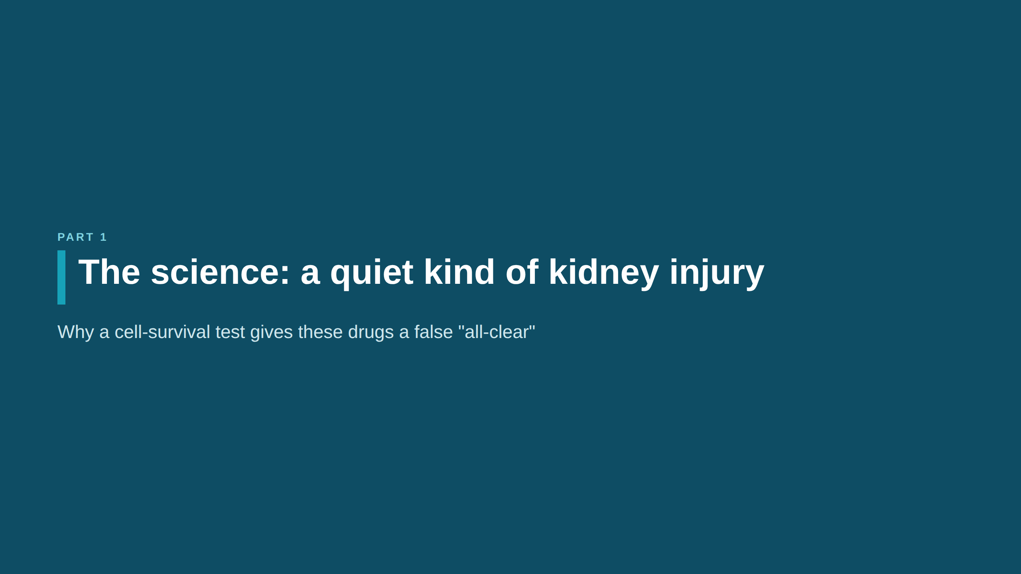

Slide 5
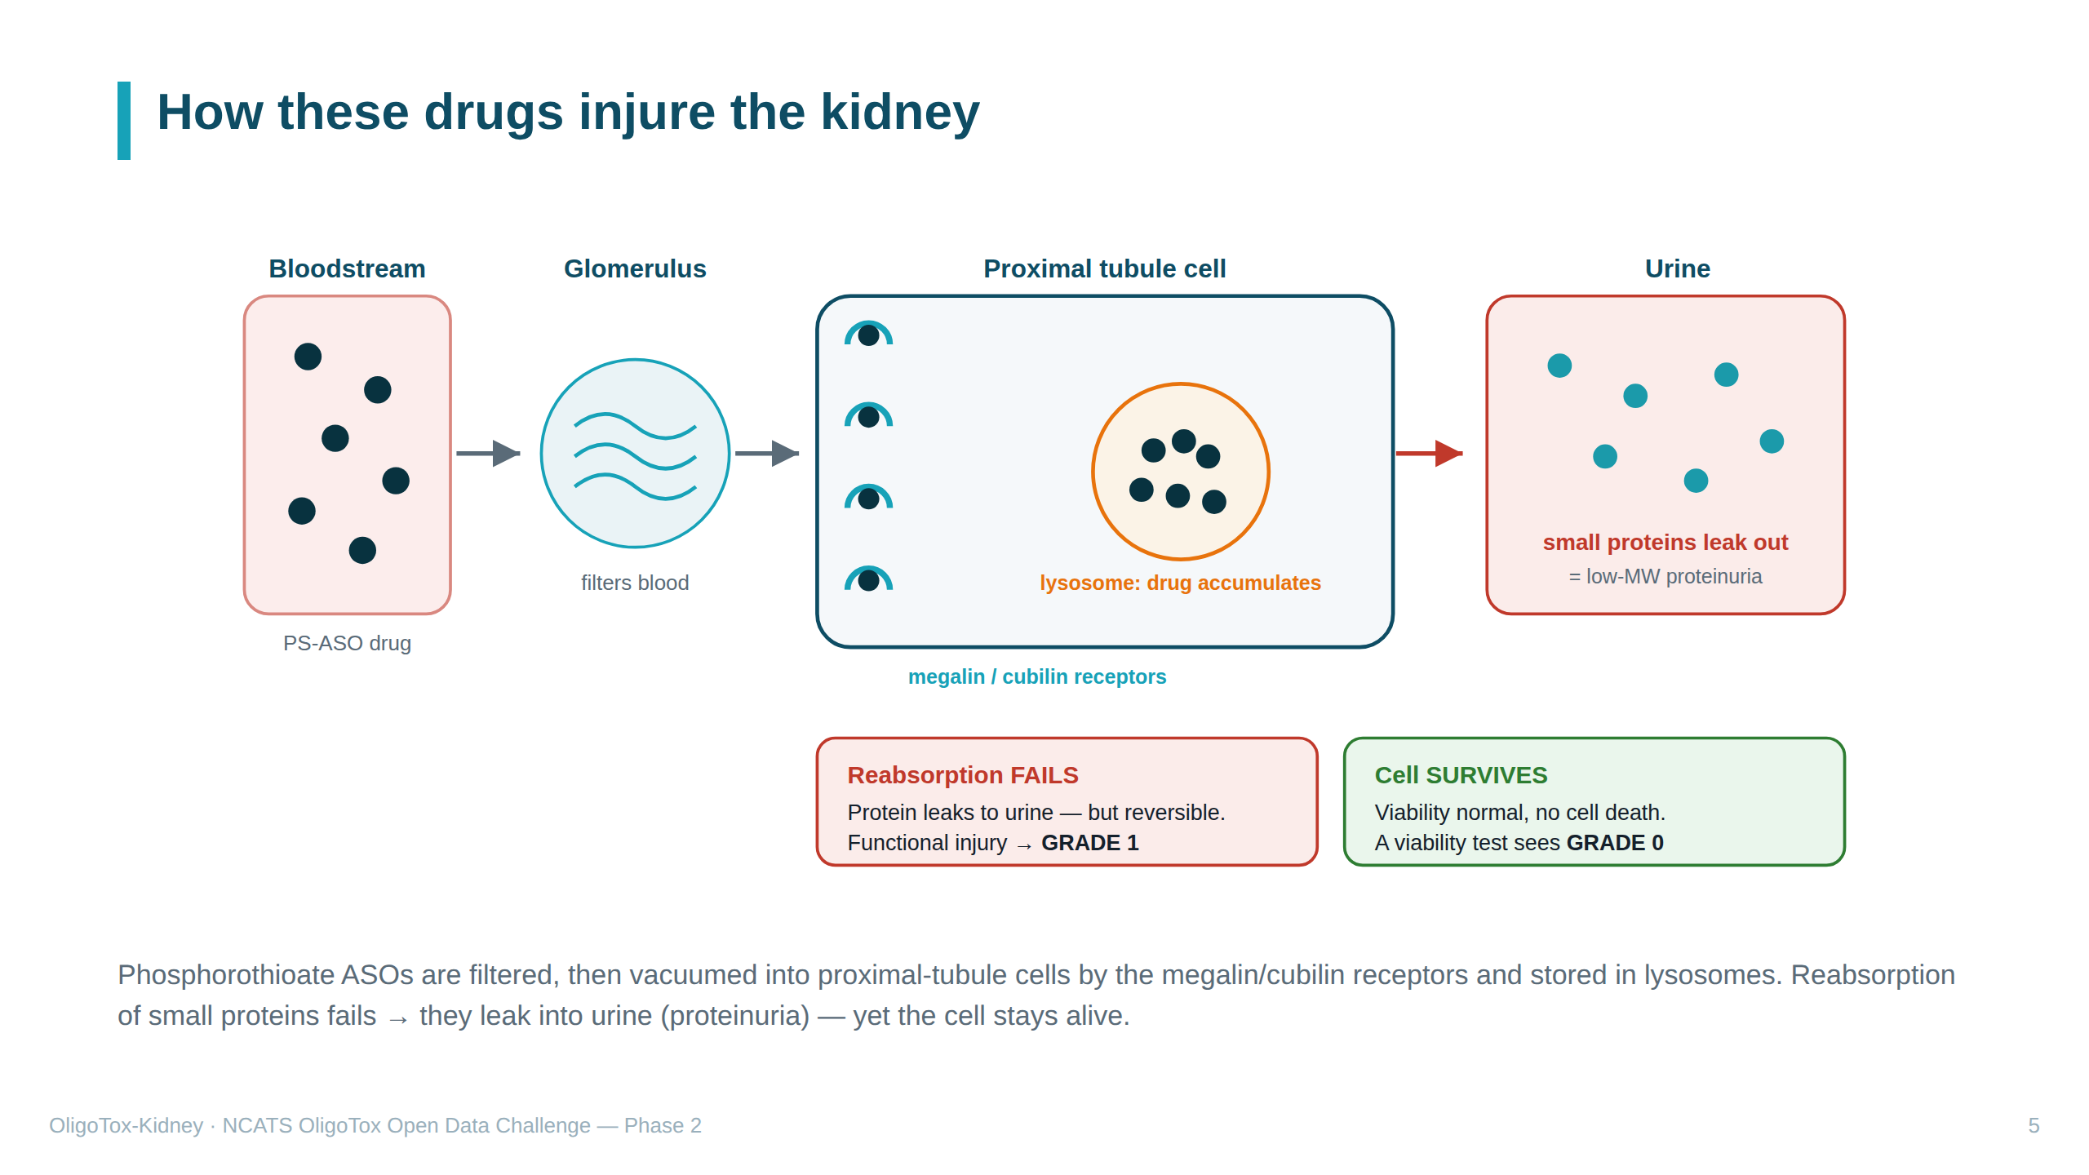
Notes:
SPEAKER NOTES — plain English (the key science slide) 30-second kidney primer: the kidney filters blood; tiny tubes called TUBULES then reabsorb the good stuff (small proteins, sugars) back into the blood. The PROXIMAL TUBULE is the main reabsorbing stretch; its lining cells do this work. The pathway, left to right in the diagram: • "PS-ASO" = the most common oligo type; "phosphorothioate (PS)" = a sulfur tweak to the drug's backbone that makes it stable and sticky — and easily taken into cells. • "Glomerulus" = the kidney's filter; the drug passes into the filtered fluid. • "Megalin / cubilin" = receptors (molecular catcher's mitts) on the tubule cells whose normal job is to grab small proteins back — they also grab these drugs. • "Endocytosis" = the cell swallowing them inside; "lysosome" = the cell's recycling bin, where the drug piles up. • Result: the busy, clogged cell stops reabsorbing small proteins, so those proteins LEAK into urine = "low-MW proteinuria." But the cell does NOT die. This is "functional" (not working right) vs "cytotoxic" (killed). It's usually reversible. We score this mild functional injury as GRADE 1.

Slide 6
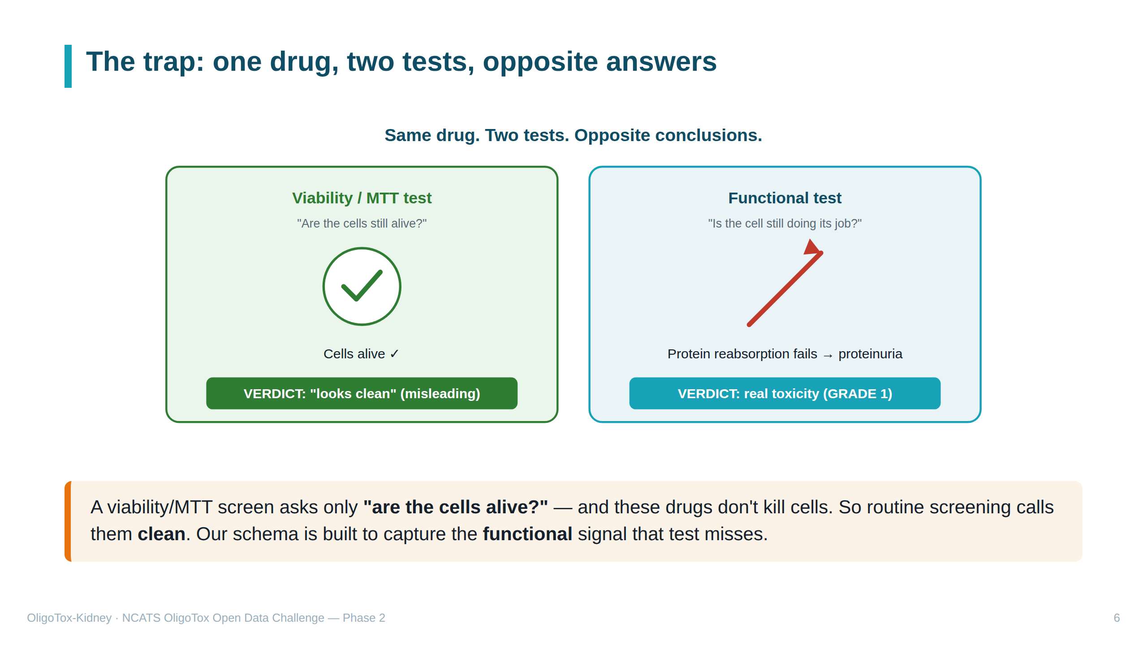
Notes:
SPEAKER NOTES — plain English "MTT / viability test" = the standard cheap lab test that just checks if cells are still alive. Because these drugs leave cells alive, that test says "safe" — a false all-clear. The functional test (does the cell still reabsorb protein?) reveals the real problem. The whole dataset exists to record that second kind of result, not just the misleading first kind.

Slide 7
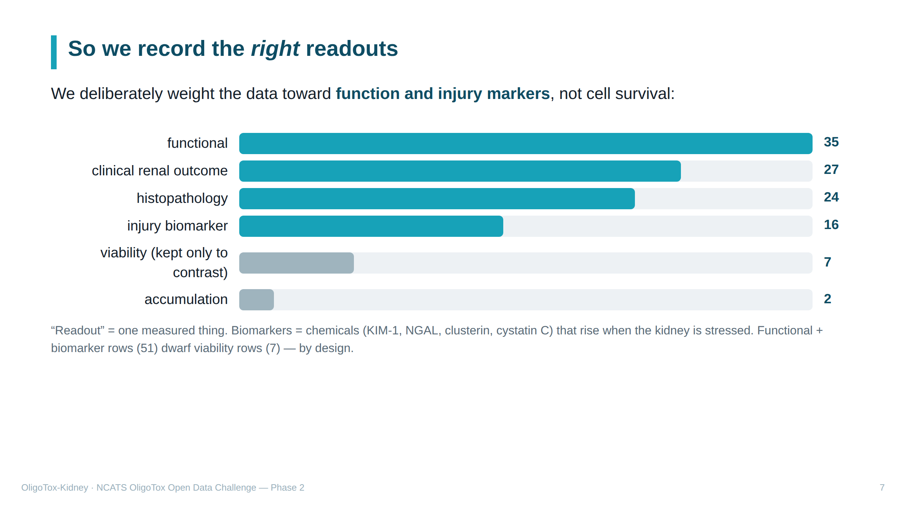
Notes:
SPEAKER NOTES — plain English "Readout category" = the KIND of measurement in a row. The bars show how our 111 rows split. We intentionally collected mostly FUNCTIONAL and INJURY-BIOMARKER results (the meaningful ones) and only a few VIABILITY results (kept just to contrast against them). Biomarkers named: KIM-1, NGAL, clusterin, cystatin C — chemicals measurable in urine/blood that signal kidney stress early. "Histopathology" = what the tissue looks like under a microscope.

Slide 8
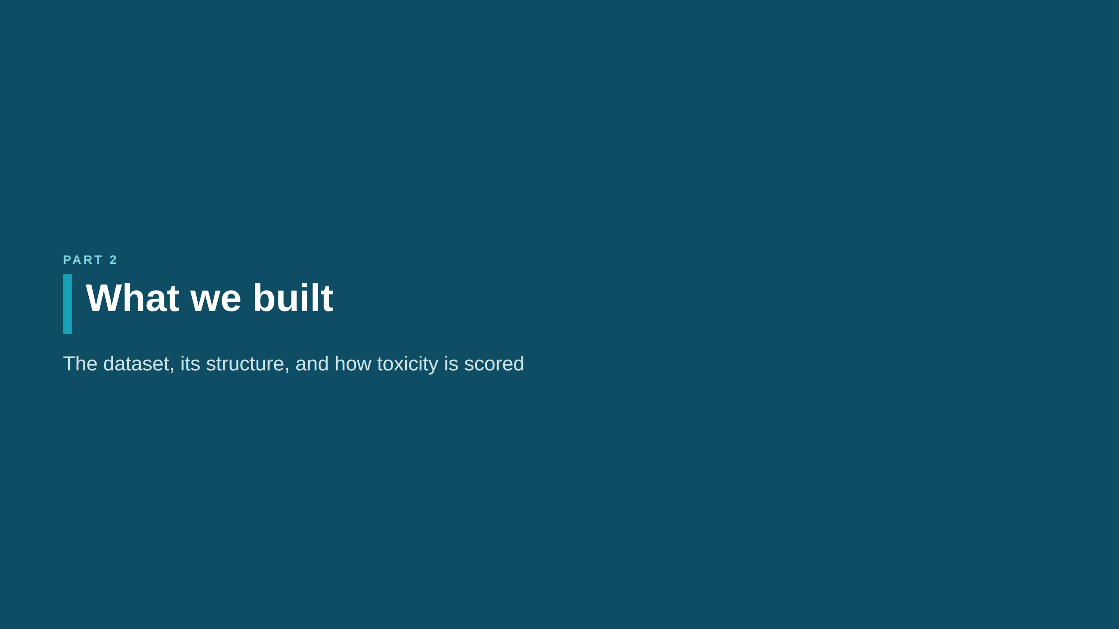

Slide 9
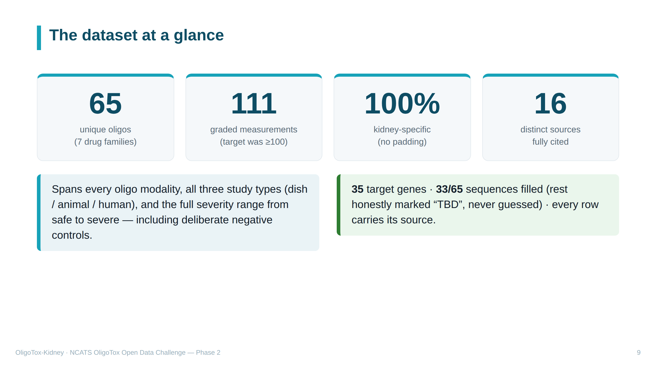
Notes:
SPEAKER NOTES — plain English The scoreboard. 65 distinct drugs; 111 measured results (a drug can appear in several rows). Every row is kidney-specific — we did not pad with other-organ data. 16 separate sources, all cited. "Modality" = drug family. "Negative controls" = known-safe examples, needed so a model can tell safe from harmful. "TBD" = our literal label for missing data we refused to guess.

Slide 10
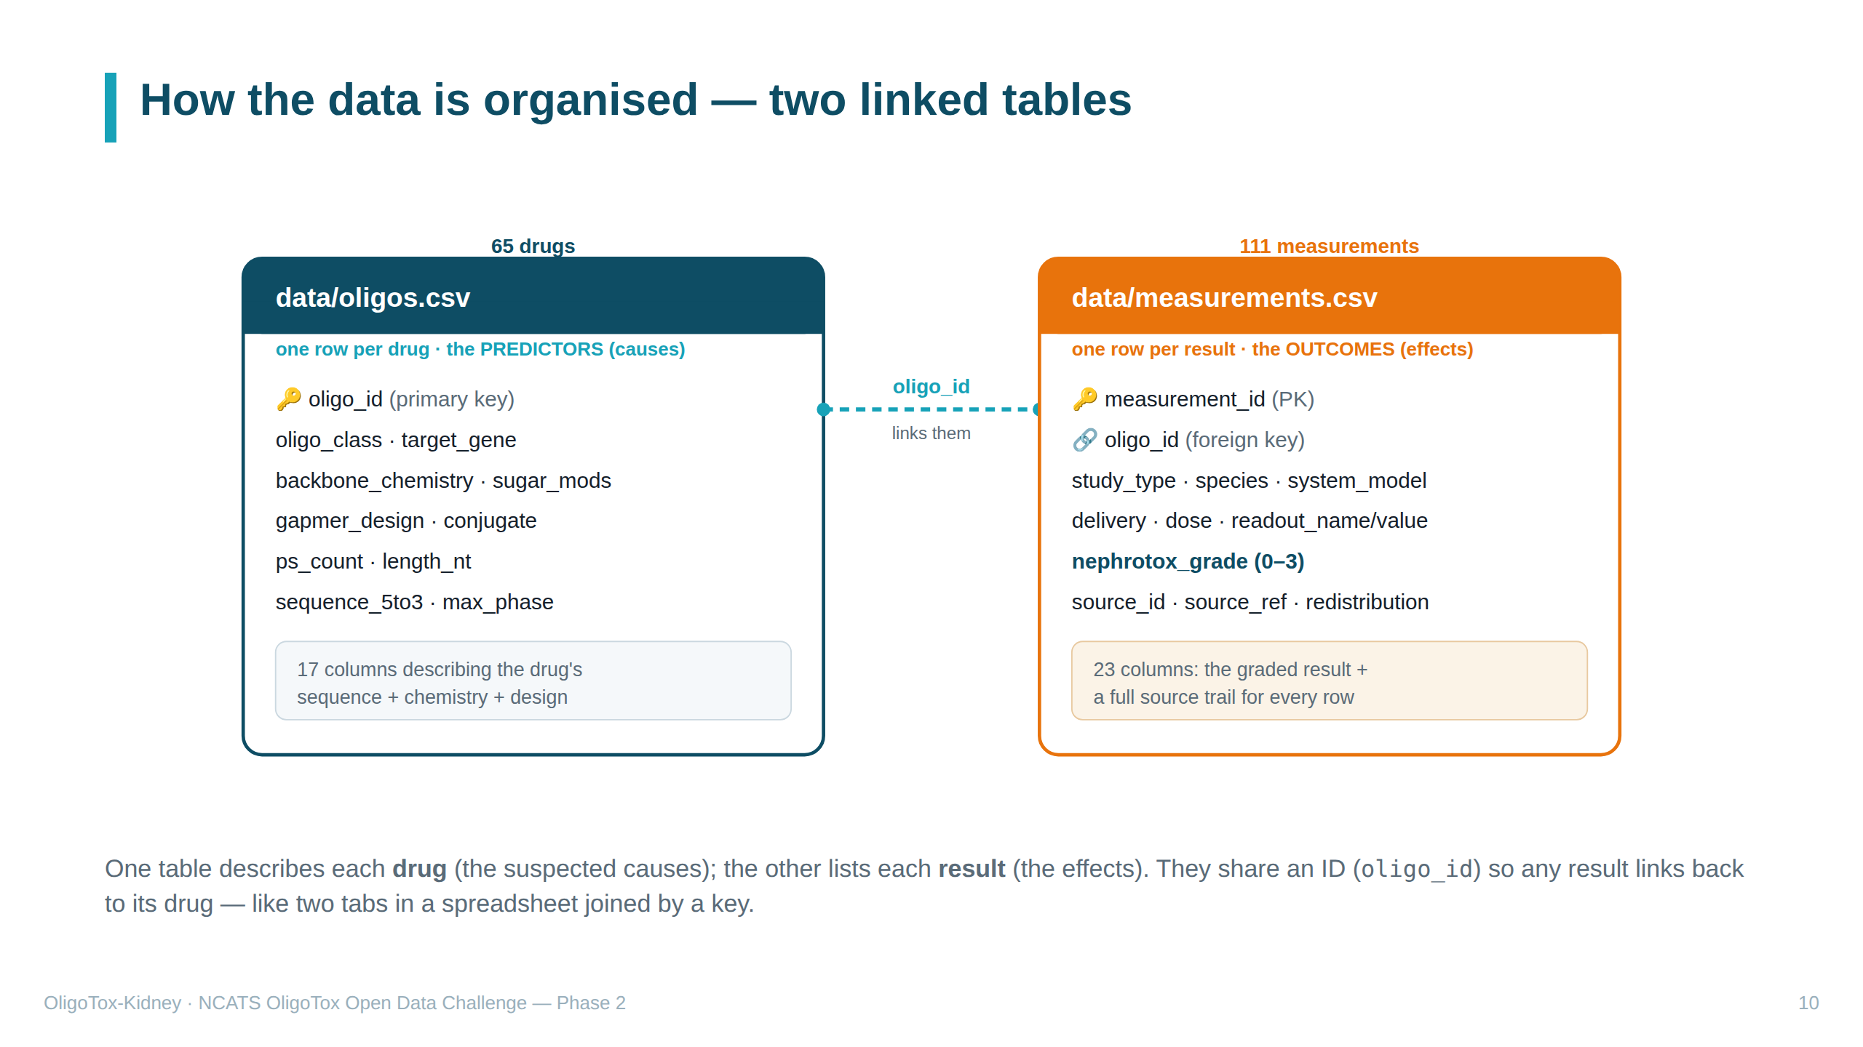
Notes:
SPEAKER NOTES — plain English Two tables avoid repetition. Left = oligos.csv, one row per DRUG with its design features (the suspected CAUSES of toxicity). Right = measurements.csv, one row per RESULT with the graded outcome (the EFFECTS). "Primary key (PK)" = a table's unique ID column. "Foreign key (FK)" = a column pointing to another table's key; here each result stores the oligo_id of its drug, so the two tables join. Predictor examples: sequence, chemistry, gapmer design. Outcome example: nephrotox_grade plus a full source trail.

Slide 11
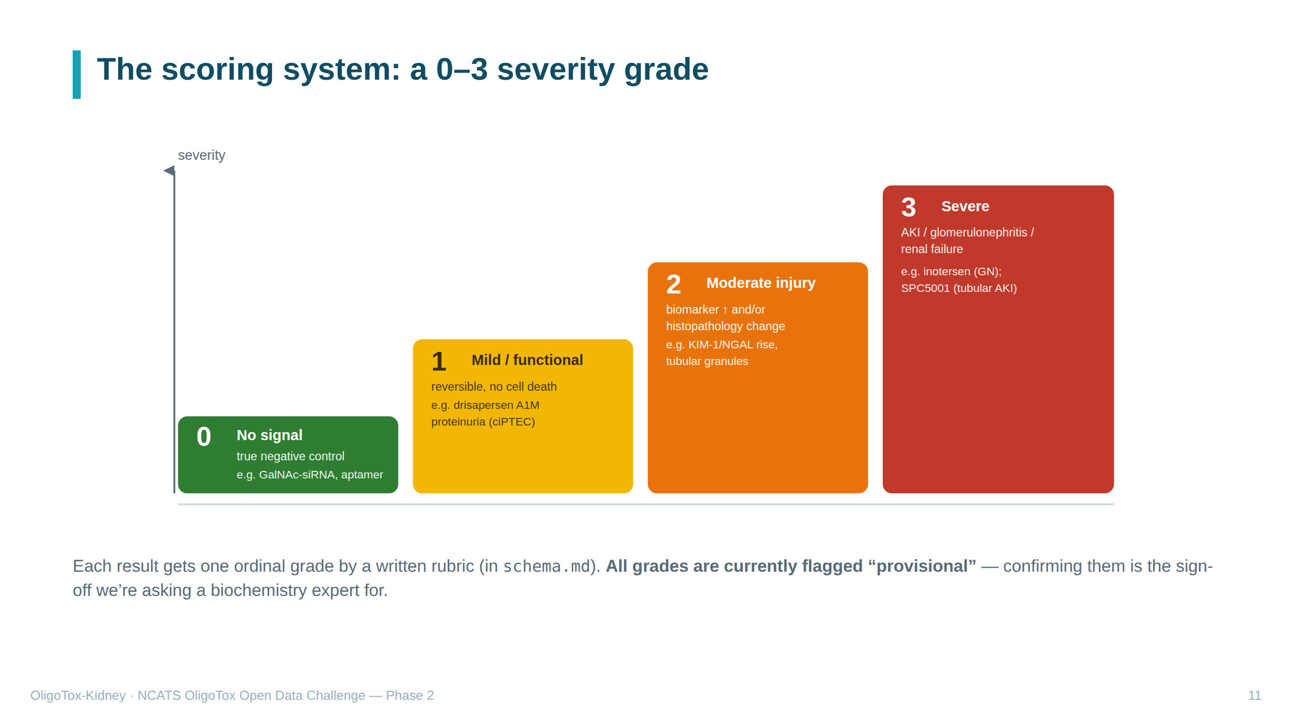
Notes:
SPEAKER NOTES — plain English Our single "answer" column: a 0-to-3 severity score. 0 = no kidney signal (a genuinely safe example). 1 = mild/functional/reversible — the sneaky protein-leak, cells don't die. 2 = moderate — an injury biomarker rises and/or tissue looks abnormal. 3 = severe — actual acute kidney injury, glomerulonephritis (inflammation of the filter units), or kidney failure. "Ordinal" = ranked (0<1<2<3) but gaps aren't necessarily equal. "Rubric" = the written rulebook for assigning grades. "Anchor" = a famous example that pins each level (inotersen for severe, etc.). Every grade is PROVISIONAL until a biochemistry expert confirms it.

Slide 12
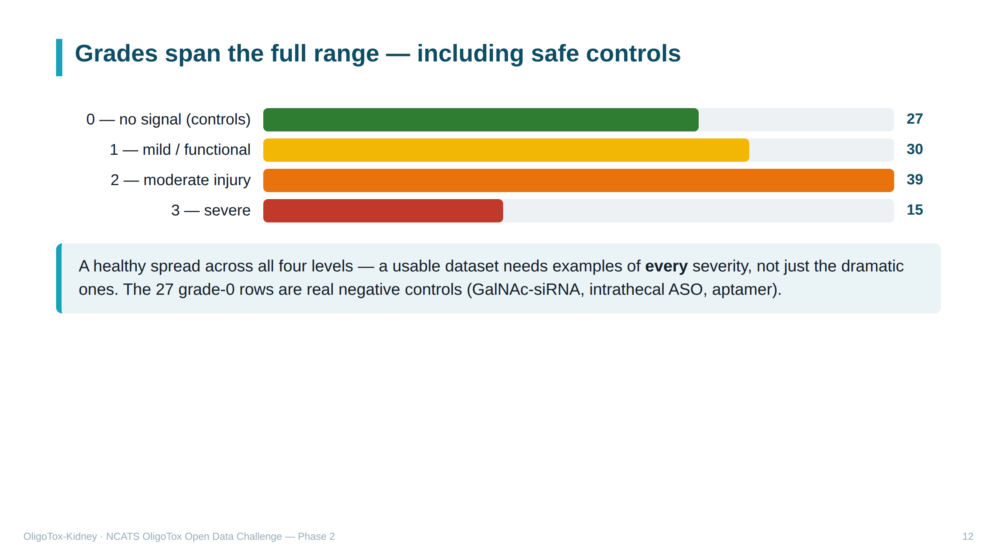
Notes:
SPEAKER NOTES — plain English How the 111 results split by severity: 27 safe, 30 mild, 39 moderate, 15 severe. A good dataset needs all levels represented. The grade-0 rows are deliberate SAFE examples — drug types that spare the kidney: "GalNAc-siRNA" (liver-targeted, so little reaches the kidney), "intrathecal" ASOs (injected into spinal fluid), and aptamers. Bars are coloured green→yellow→orange→red to match the grade ladder.

Slide 13
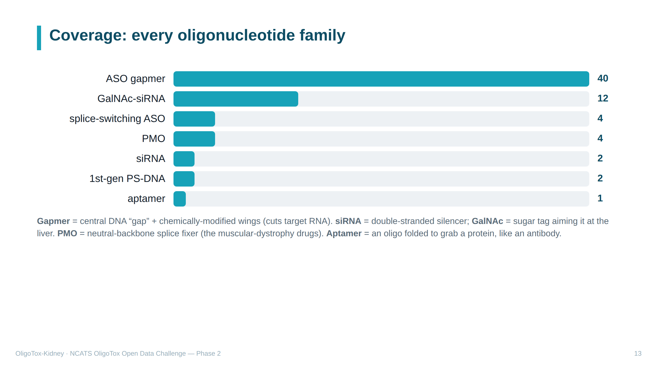
Notes:
SPEAKER NOTES — plain English Our drugs cover all the oligo families. Gapmers (40) dominate because they're the most common and most kidney-relevant ASO design. Quick glossary: • ASO gapmer — antisense strand with a DNA gap flanked by modified wings; the gap lets the enzyme RNase H chop the target RNA. • GalNAc-siRNA — double-stranded silencer carrying a GalNAc sugar that homes it to the liver (so the kidney is largely spared). • splice-switching ASO / PMO — change how a gene is assembled rather than destroying it; PMOs are the Duchenne muscular-dystrophy drugs. • 1st-gen PS-DNA — older phosphorothioate DNA oligos. • aptamer — an oligo folded into a 3-D shape that binds a target protein.

Slide 14
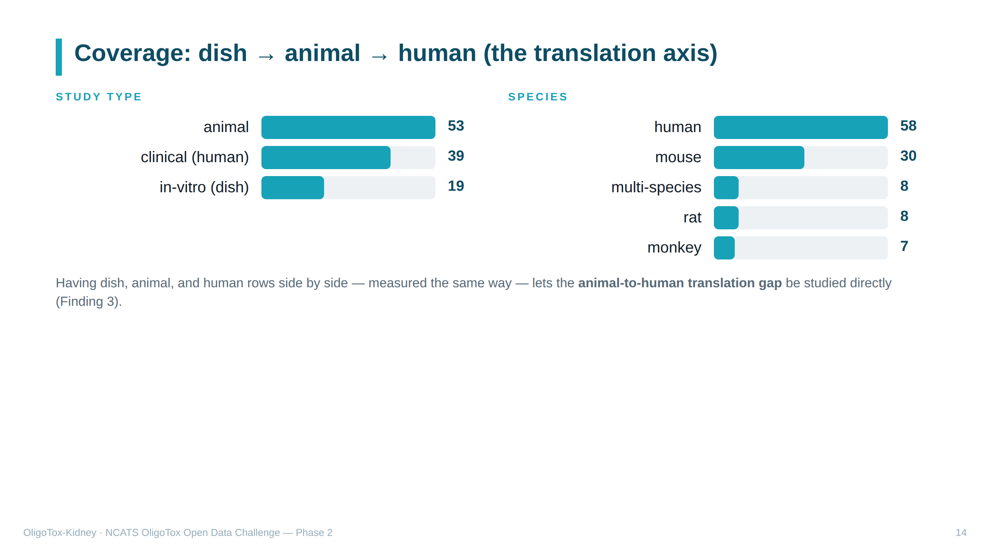
Notes:
SPEAKER NOTES — plain English Where the results come from. "In-vitro" = in a dish; "in-vivo" = in a living animal; "clinical" = in human patients. We have all three, across several species. Why it matters: because human and animal results sit in the same table measured the same way, you can directly compare how well an animal result predicts the human one — the "translation gap" we return to in Finding 3.

Slide 15
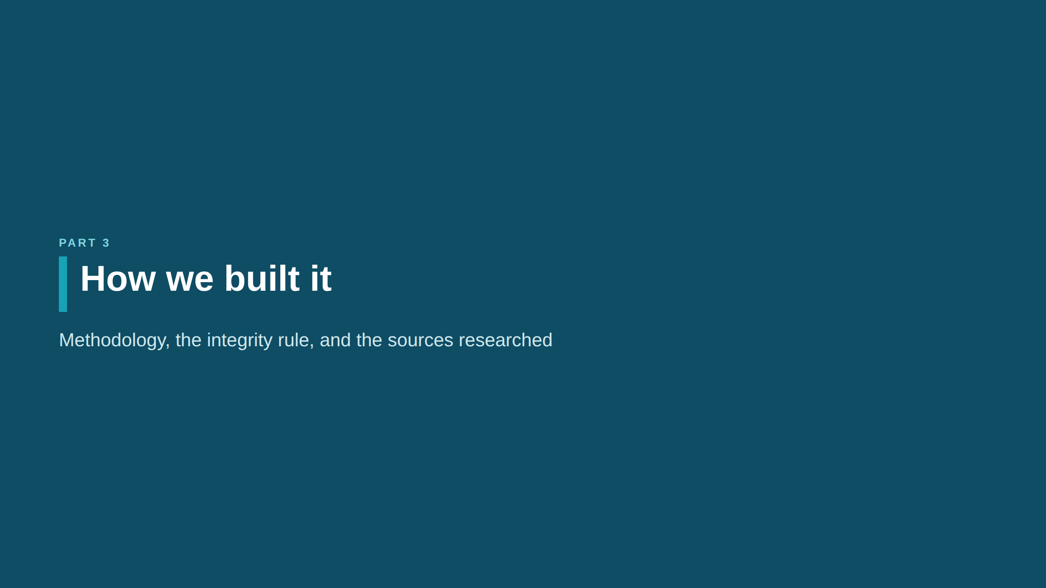

Slide 16
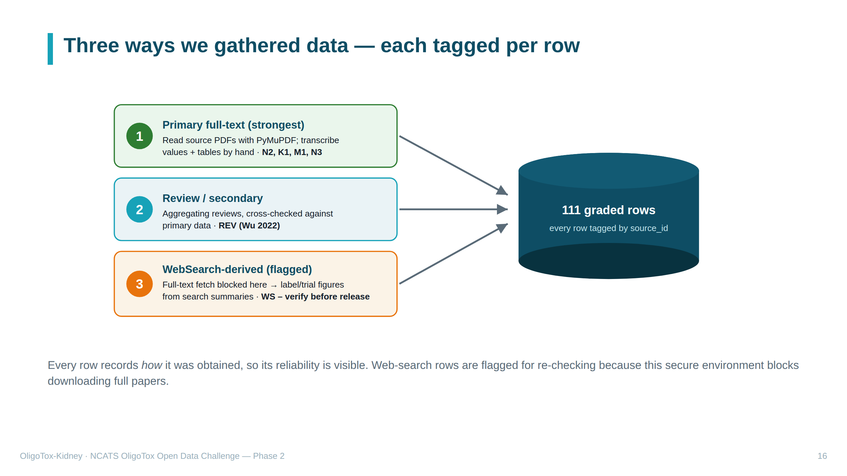
Notes:
SPEAKER NOTES — plain English Three data-gathering methods, strongest first: 1. PRIMARY full-text — we read the original papers/patents (PDFs) with a tool called PyMuPDF and typed values in by hand. Gold standard. 2. REVIEW / secondary — summary papers that aggregate many studies, cross-checked against primary data. 3. WEBSEARCH-derived ("WS") — the weakest tier. Our secure computer BLOCKS direct downloading of full papers, so for some drugs we took figures from search-engine summaries of their official label/trial, and FLAGGED those rows to be verified against the original before any public release. 36 of 111 rows are this type. "source_id" = a code in each row naming its source, so everything is traceable.

Slide 17
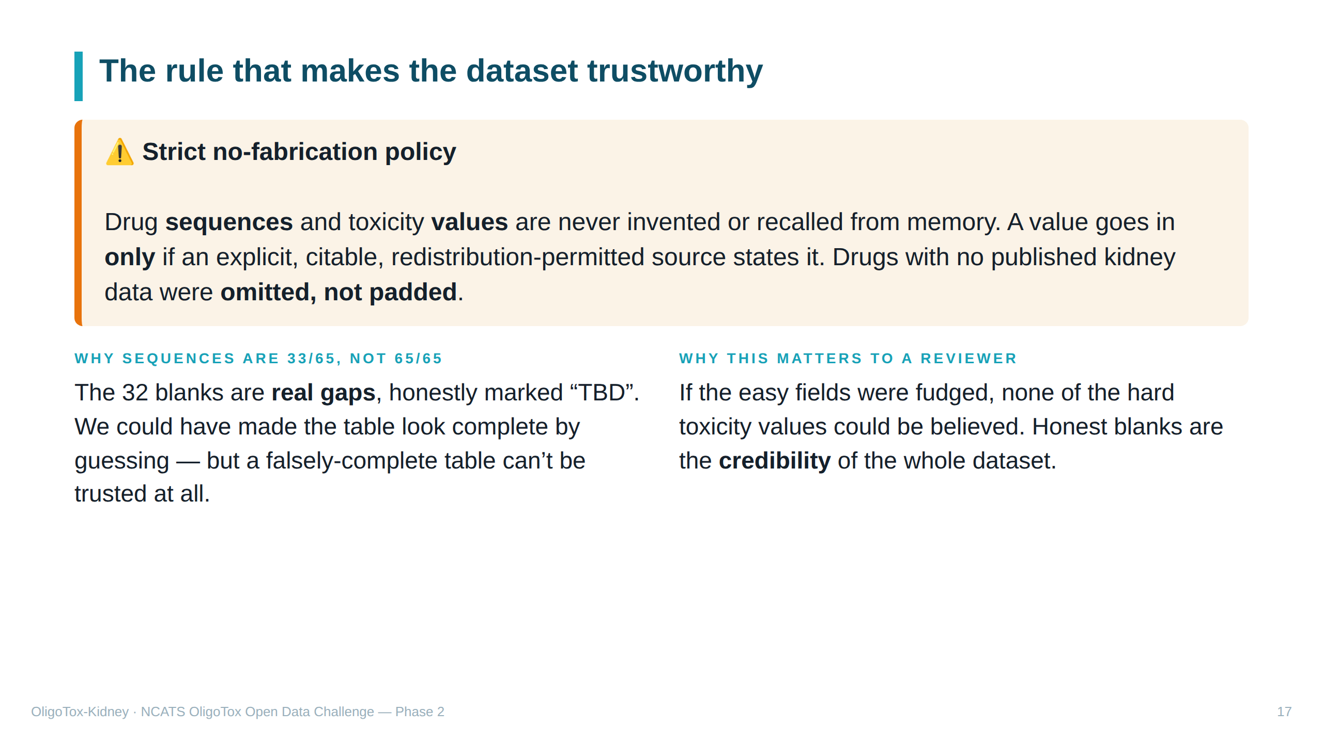
Notes:
SPEAKER NOTES — plain English Our integrity rule, stated loudly because it's WHY the data can be trusted. We never make up two things: the drug's genetic SEQUENCE and any toxicity NUMBER. Even though an AI assistant helped build this, it was not allowed to fill those from memory — only from a real, citable, copy-permitted source. If a drug had no published kidney data, we left it out rather than invent rows to hit the target. That's why only 33 of 65 drugs have sequences — the rest are honest blanks, which is more trustworthy than a fake-complete table.

Slide 18
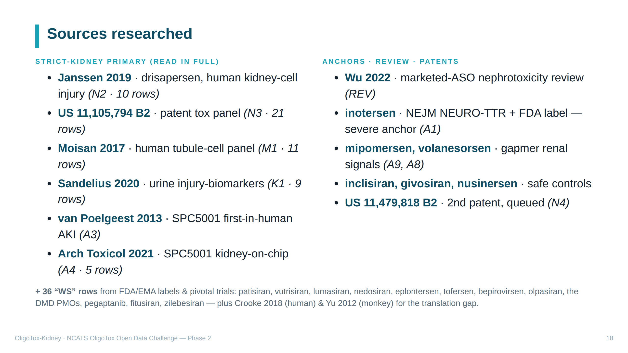
Notes:
SPEAKER NOTES — plain English Our bibliography, split into the best kidney-specific papers (read in full) and the real-world anchors/reviews/patents. The number in italics is each source's code and how many rows it gave. Highlights: • N2 Janssen — showed the sneaky dish phenotype + gave 3 real sequences. • N3 patent — the jackpot: a public-domain table of many oligos with sequence AND toxicity together (21 rows, our biggest source). • M1 Moisan / K1 Sandelius — human kidney-cell panels and urine biomarkers. • A3/A4 SPC5001 — a drug that caused acute kidney injury first-in-human, also reproduced on a "kidney-on-chip" (a chip with living kidney cells). • A1 inotersen — our severe anchor (caused glomerulonephritis in patients). • Safe controls: inclisiran, givosiran, nusinersen. The 36 "WS" rows are mostly approved drugs whose data came from label/trial summaries (flagged for re-checking). Crooke 2018 (human) and Yu 2012 (monkey) let us compare species.

Slide 19
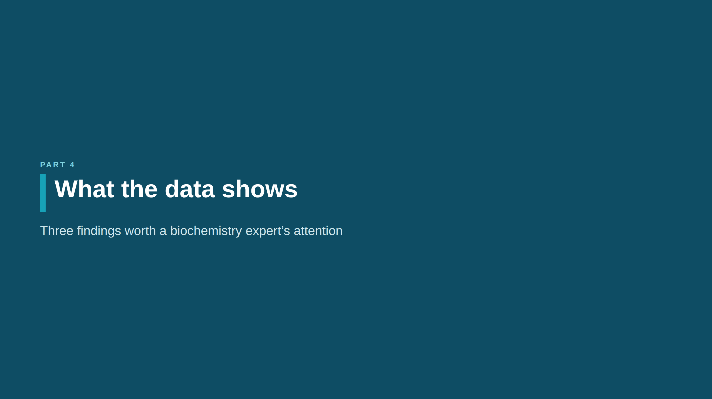

Slide 20
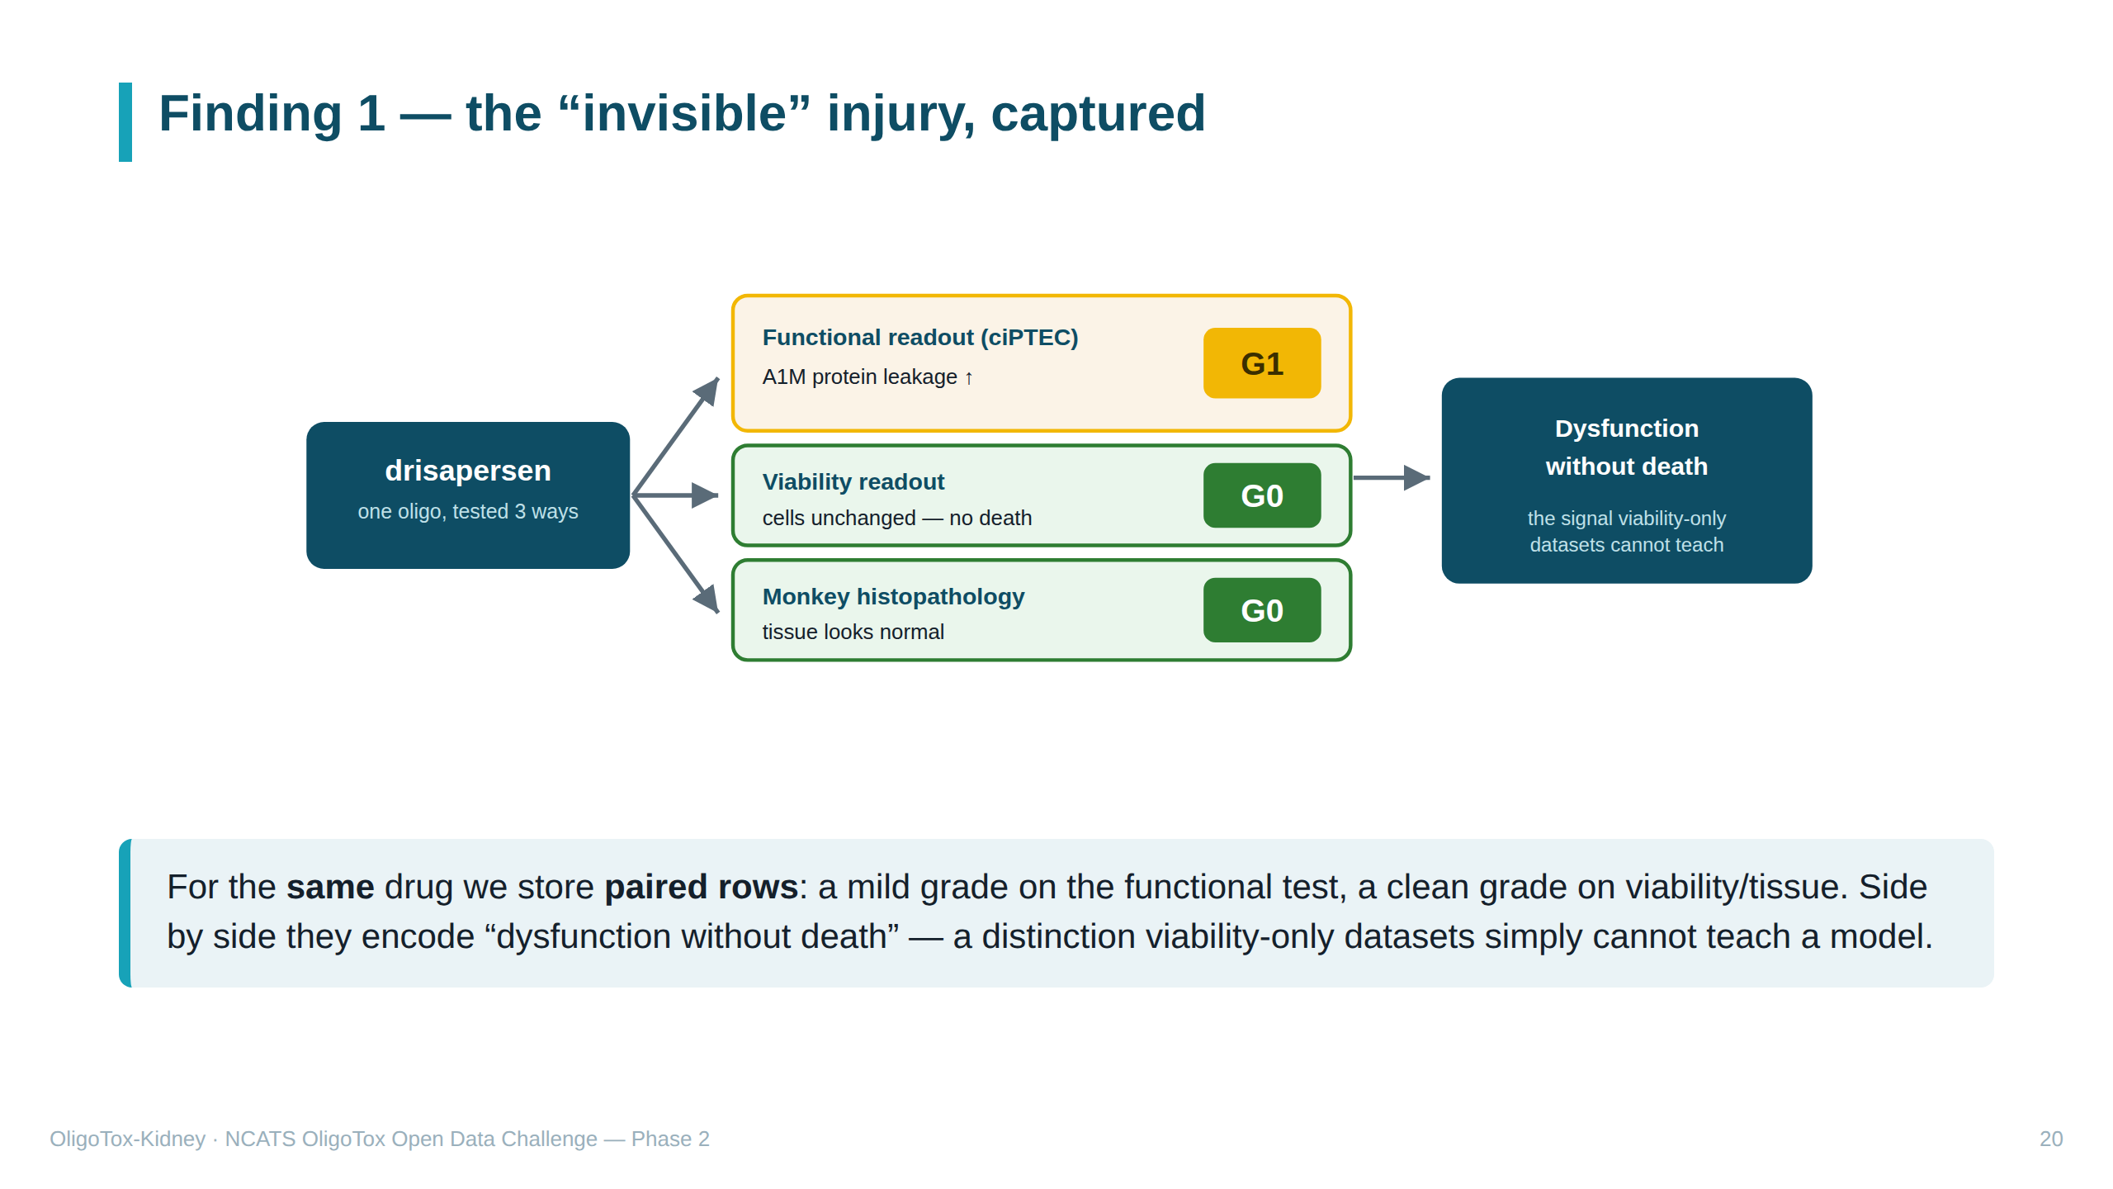
Notes:
SPEAKER NOTES — plain English Finding 1: we successfully captured the sneaky damage in machine-readable form. For one drug (drisapersen) we have three rows: protein leak in human kidney cells → grade 1; cells alive → grade 0; monkey tissue normal → grade 0. Together they say "the cell malfunctions without dying." A model trained on this can learn the difference between reversible functional proteinuria and real structural injury — something an alive/dead-only dataset can never convey.

Slide 21
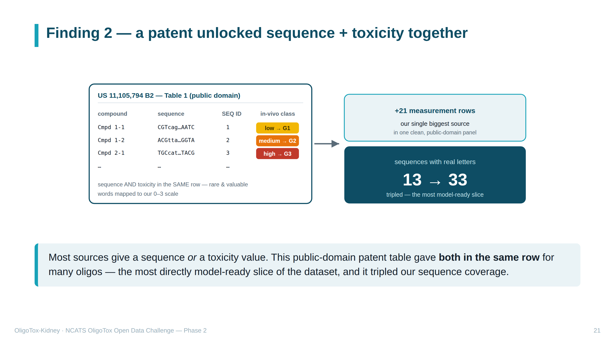
Notes:
SPEAKER NOTES — plain English Finding 2: one patent (US 11,105,794) was a goldmine. Its Table 1 lists many oligos each with BOTH the genetic sequence AND a kidney-toxicity rating in animals — rare, because usually those live in different places. The patent rated toxicity in words (innocuous/low/medium/high); we translated those into our 0–3 numbers. It added 21 rows and tripled our real sequences from 13 to 33. Because cause (sequence) and effect (grade) sit together, it's the most "model-ready" data. "Public domain" = freely reproducible (US patents are).

Slide 22
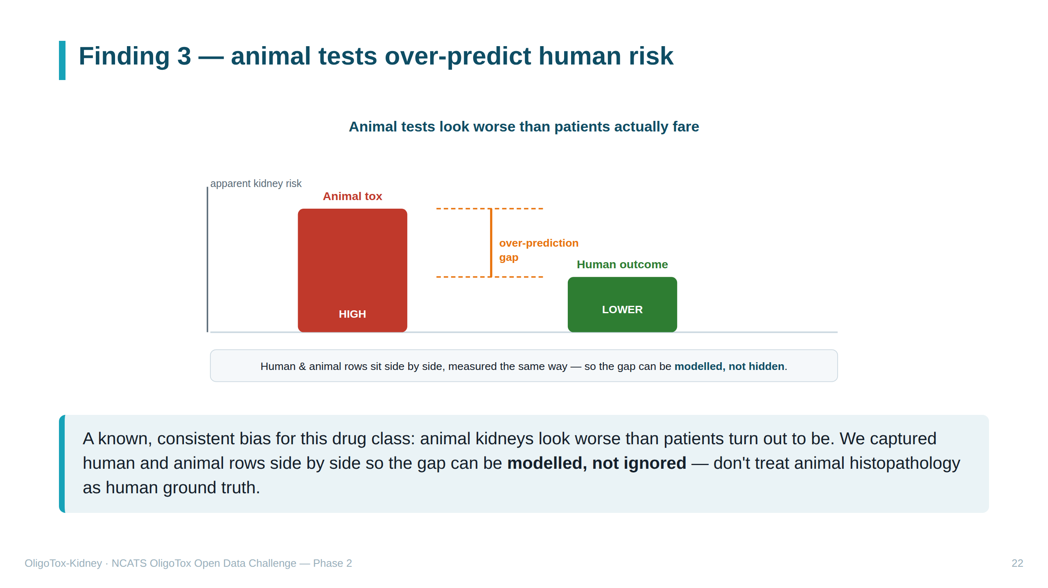
Notes:
SPEAKER NOTES — plain English Finding 3: for these drugs, animal studies tend to show MORE kidney damage than humans actually experience. This over-prediction is a known, consistent pattern — so a model could learn to correct for it. We deliberately placed human data (e.g. Crooke 2018) and animal data (e.g. Yu 2012 monkey) in the same table, measured the same way, so the gap is visible and analysable rather than hidden. "Don't treat animal histopathology as ground truth" = don't assume the animal microscope result equals the human truth.

Slide 23
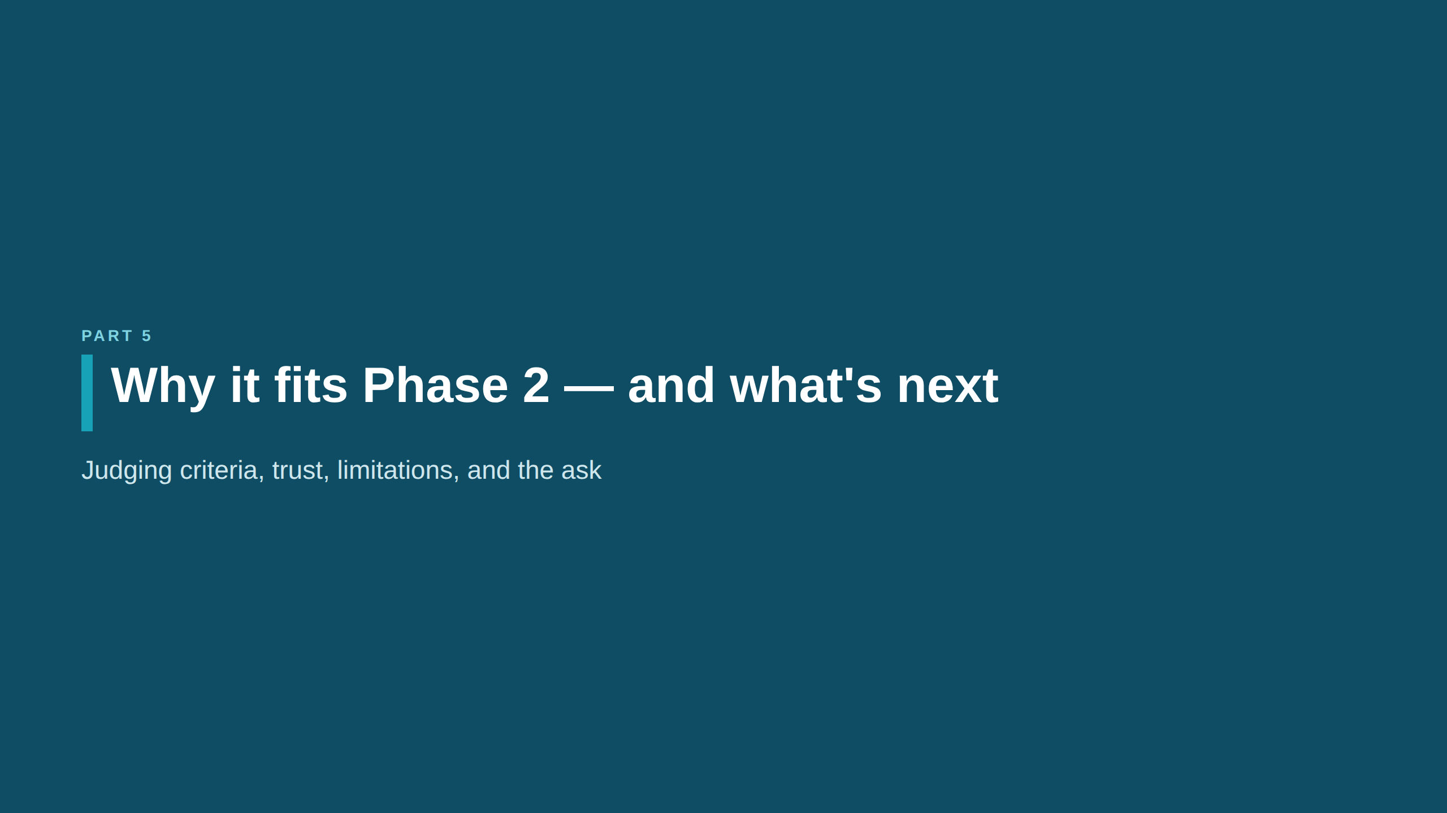

Slide 24
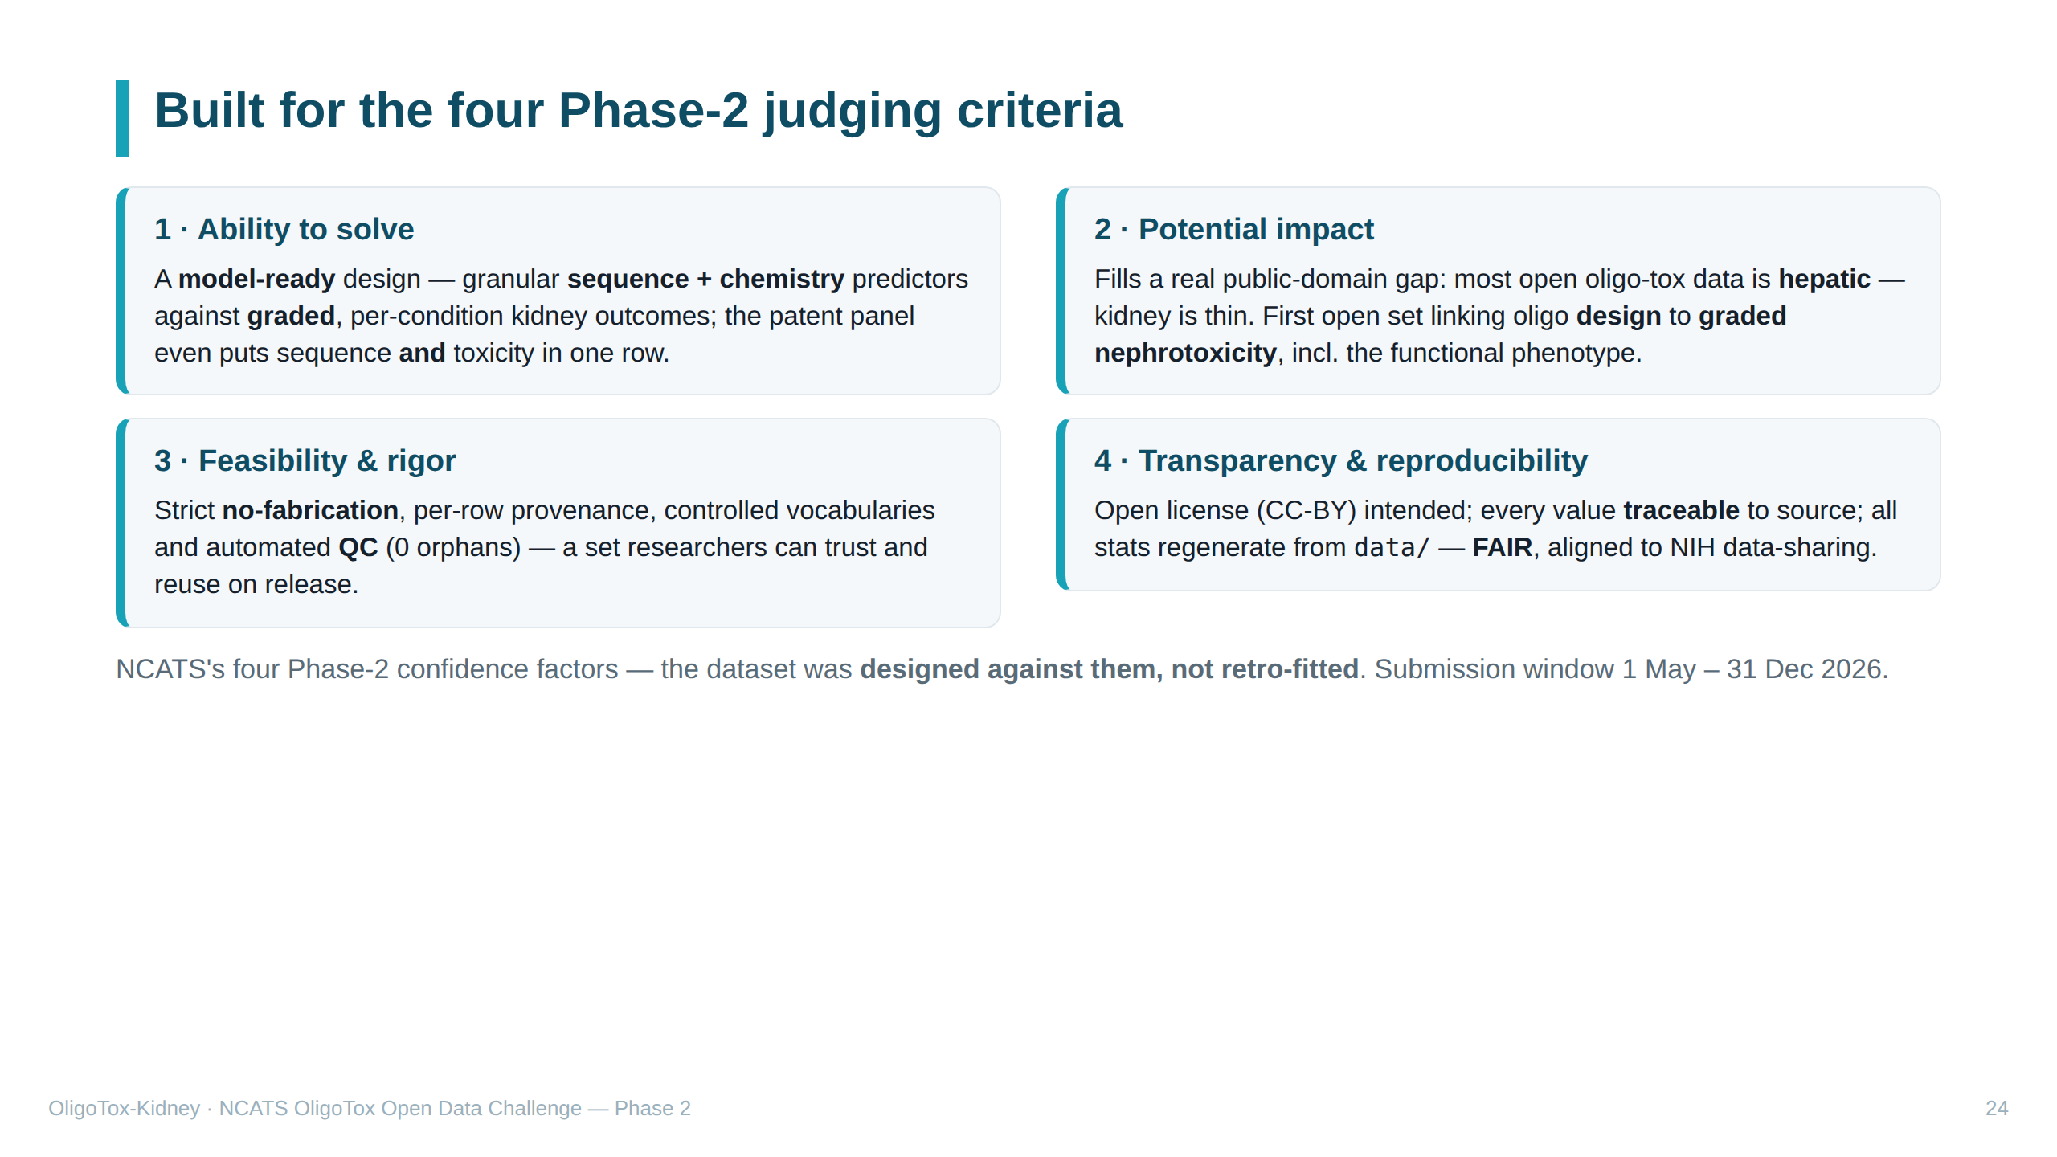
Notes:
SPEAKER NOTES — plain English NCATS scores Phase 2 on four "confidence factors"; this slide maps our work to each: 1. Ability to solve — is the data useful for building computer models that PREDICT oligo toxicity? Our design pairs each drug's sequence/chemistry with a graded kidney outcome — exactly what such a model needs. 2. Potential impact — does it fill a public gap? Most existing open oligo-tox data is about the LIVER; kidney data is scarce. Ours is the first open set linking oligo design to graded KIDNEY toxicity, including the easily-missed functional injury. 3. Feasibility & rigor — would researchers trust it? Yes: nothing fabricated, every row sourced, controlled vocabulary, automated quality checks all passing. 4. Transparency & reproducibility — is it open and re-checkable? Intended CC-BY open license; every value traces to its source; all the numbers regenerate from the data files. "FAIR" = Findable, Accessible, Interoperable, Reusable — the standard for good scientific data that NIH's data-sharing policy expects. We designed for these four from the start, rather than fitting them afterward.

Slide 25
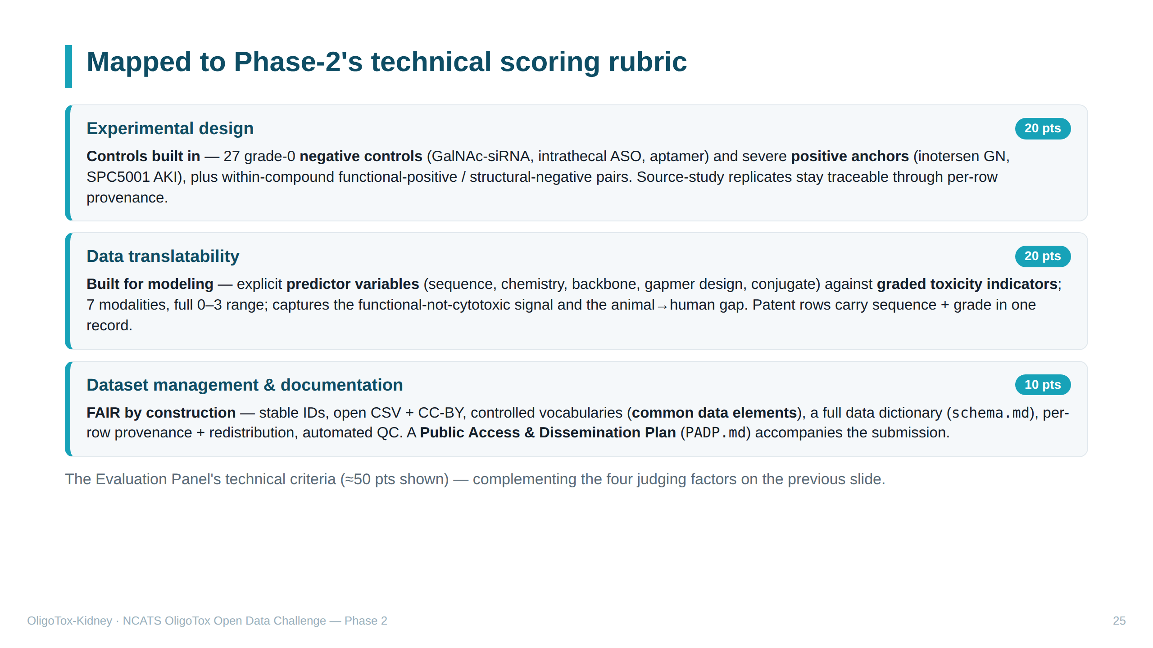
Notes:
SPEAKER NOTES — plain English The previous slide covered the four high-level "judging factors." This one maps the more granular TECHNICAL SCORING the Evaluation Panel applies, point by point: • Experimental design (20 pts) — reviewers look for proper controls and replicates. We include 27 known-SAFE negative controls and clear severe positives (inotersen, SPC5001), plus paired rows on the same drug; replicates live in the source studies our provenance points to. • Data translatability (20 pts) — can the data actually improve predictive models? Our design lines up drug predictors (sequence/chemistry/design) against graded toxicity, across all modalities and severities, and captures the two hardest signals (functional-not-lethal injury; animal-vs-human gap). • Dataset management & documentation (10 pts) — metadata, FAIR, and "common data elements" (shared, standard field definitions). We use stable IDs, an open license, controlled vocabularies, a full data dictionary, per-row provenance, and QC — plus the required Public Access & Dissemination Plan (PADP.md) in the repo.

Slide 26
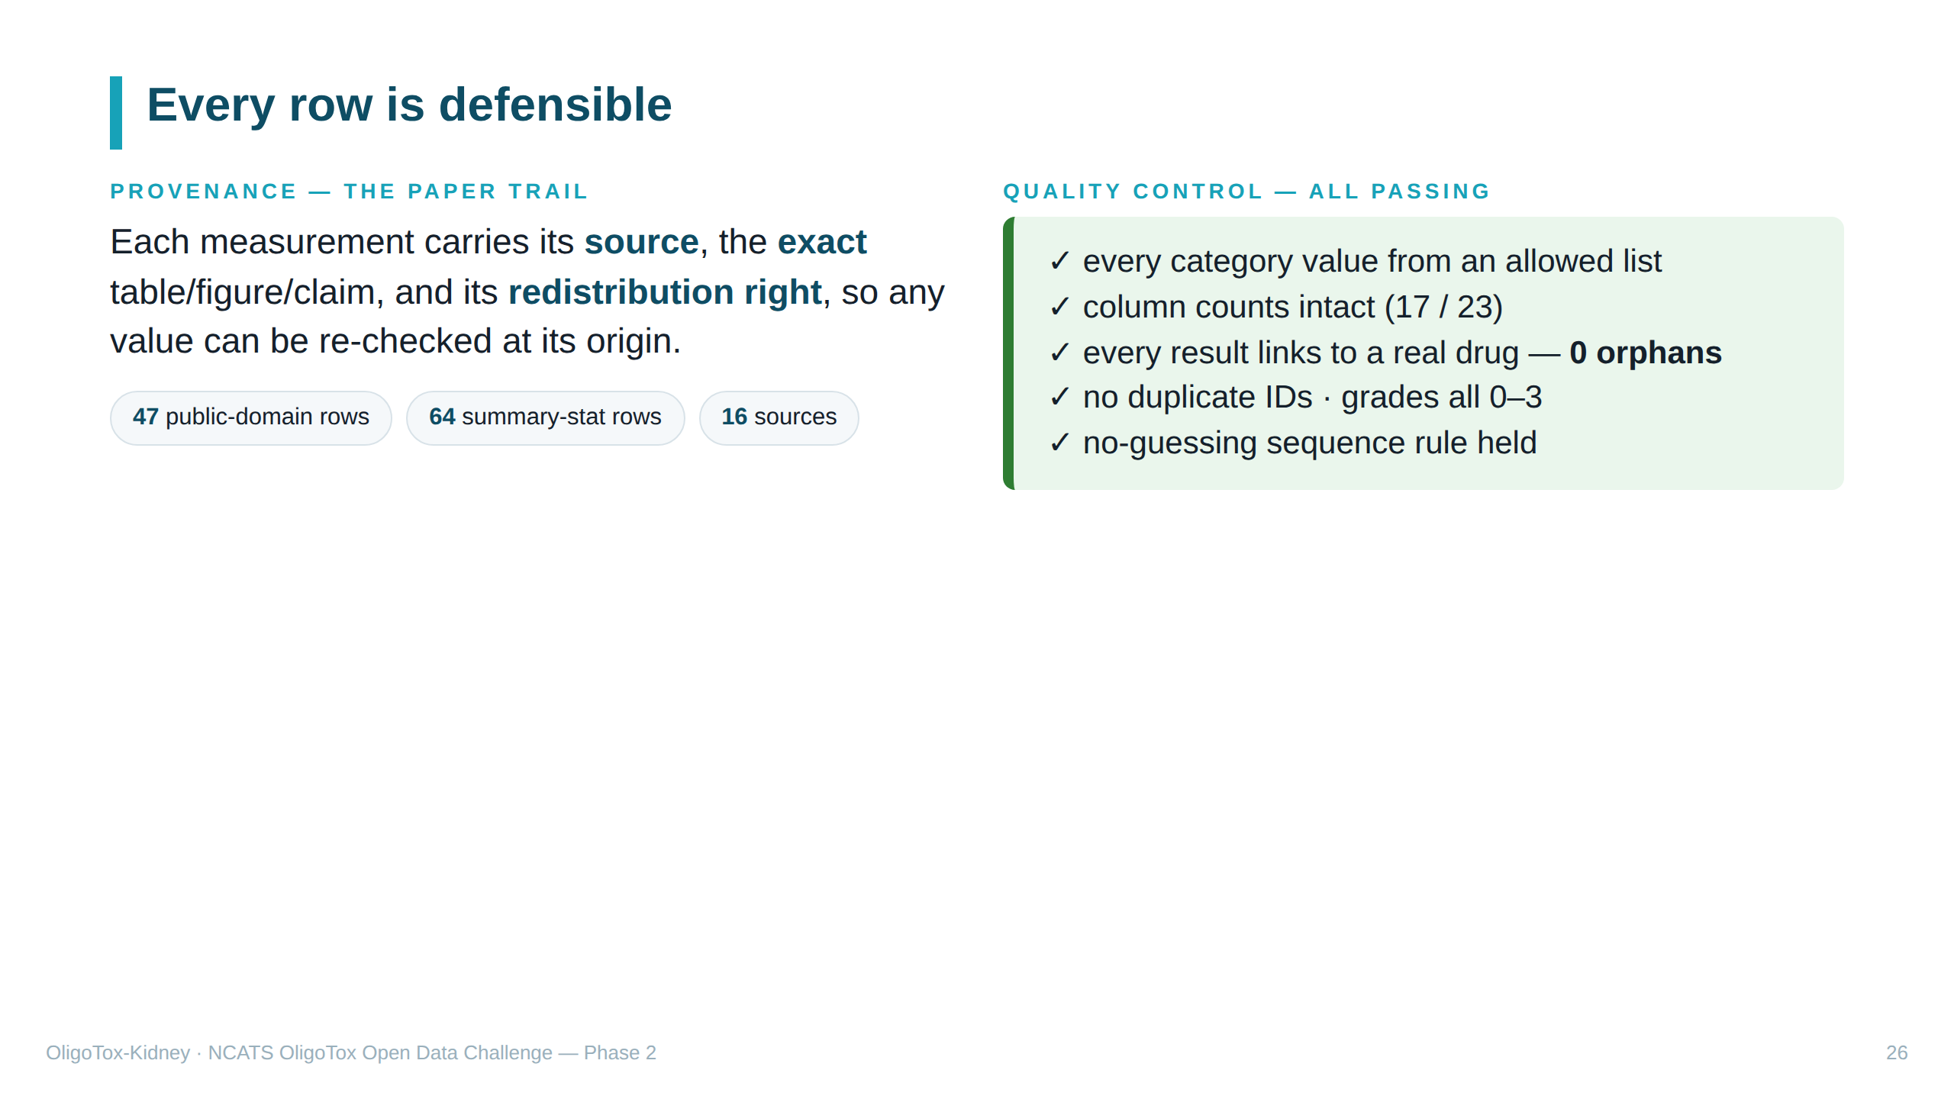
Notes:
SPEAKER NOTES — plain English Two trust pillars. PROVENANCE = the documented origin of each value: which source, which exact table/figure, and whether we're legally allowed to republish it ("public domain" = yes, e.g. patents and government labels; "summary stat" = we only reproduce summary figures from copyrighted journals). QUALITY CONTROL = automated checks that run after each data addition: valid categories, right column counts, every result points to a real drug (no "orphans"), no duplicate IDs, grades within 0–3, and the no-guessing rule. All currently pass.

Slide 27
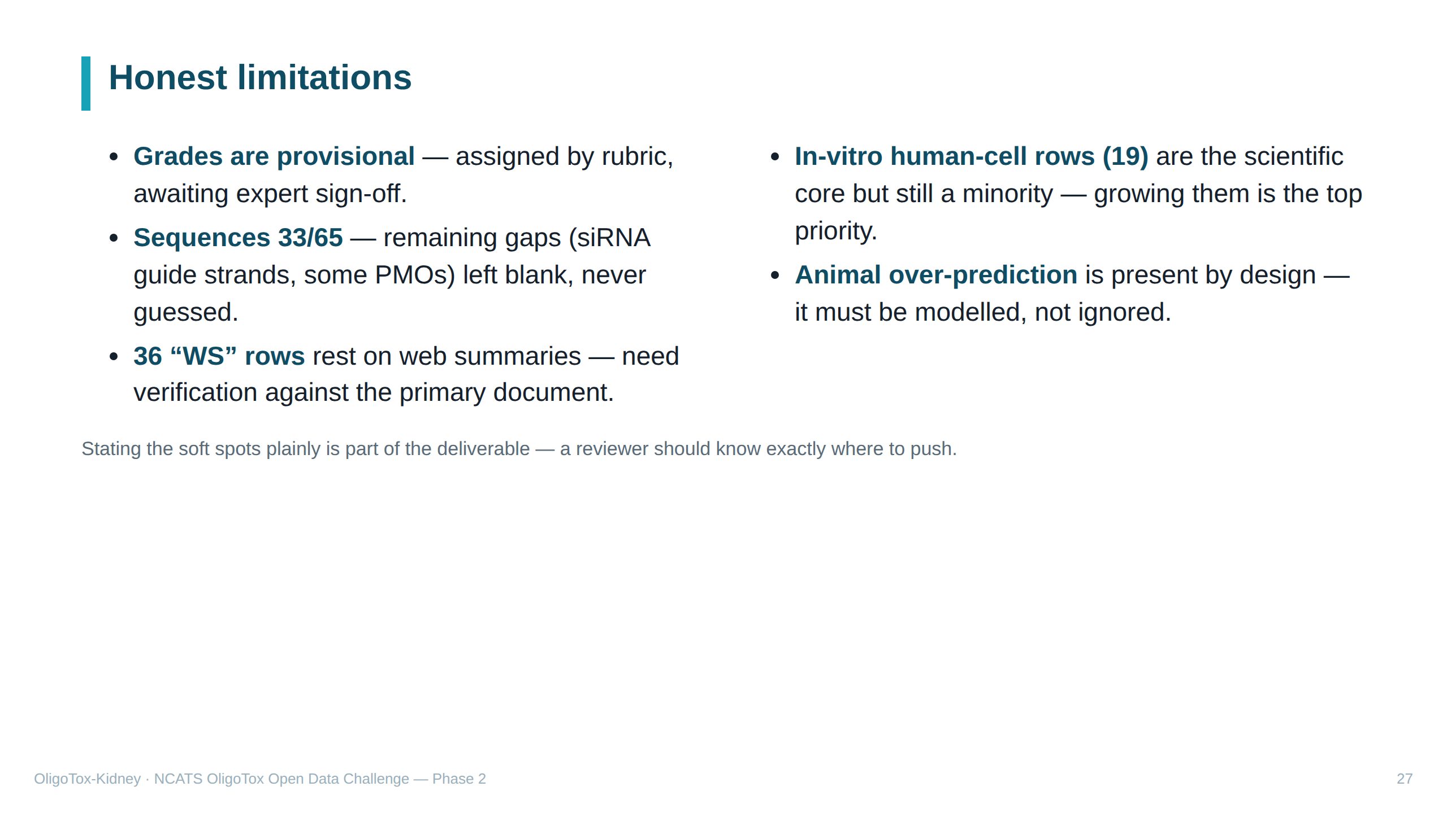
Notes:
SPEAKER NOTES — plain English We state our weaknesses openly — for a scientist that builds trust. The grades aren't expert-confirmed yet; 32 sequences are still blank; 36 rows came from web summaries and need re-checking; the human-cell-in-a-dish rows (the most valuable) are still a minority we want to grow; and the animal-over-prediction bias must be accounted for in any model.

Slide 28
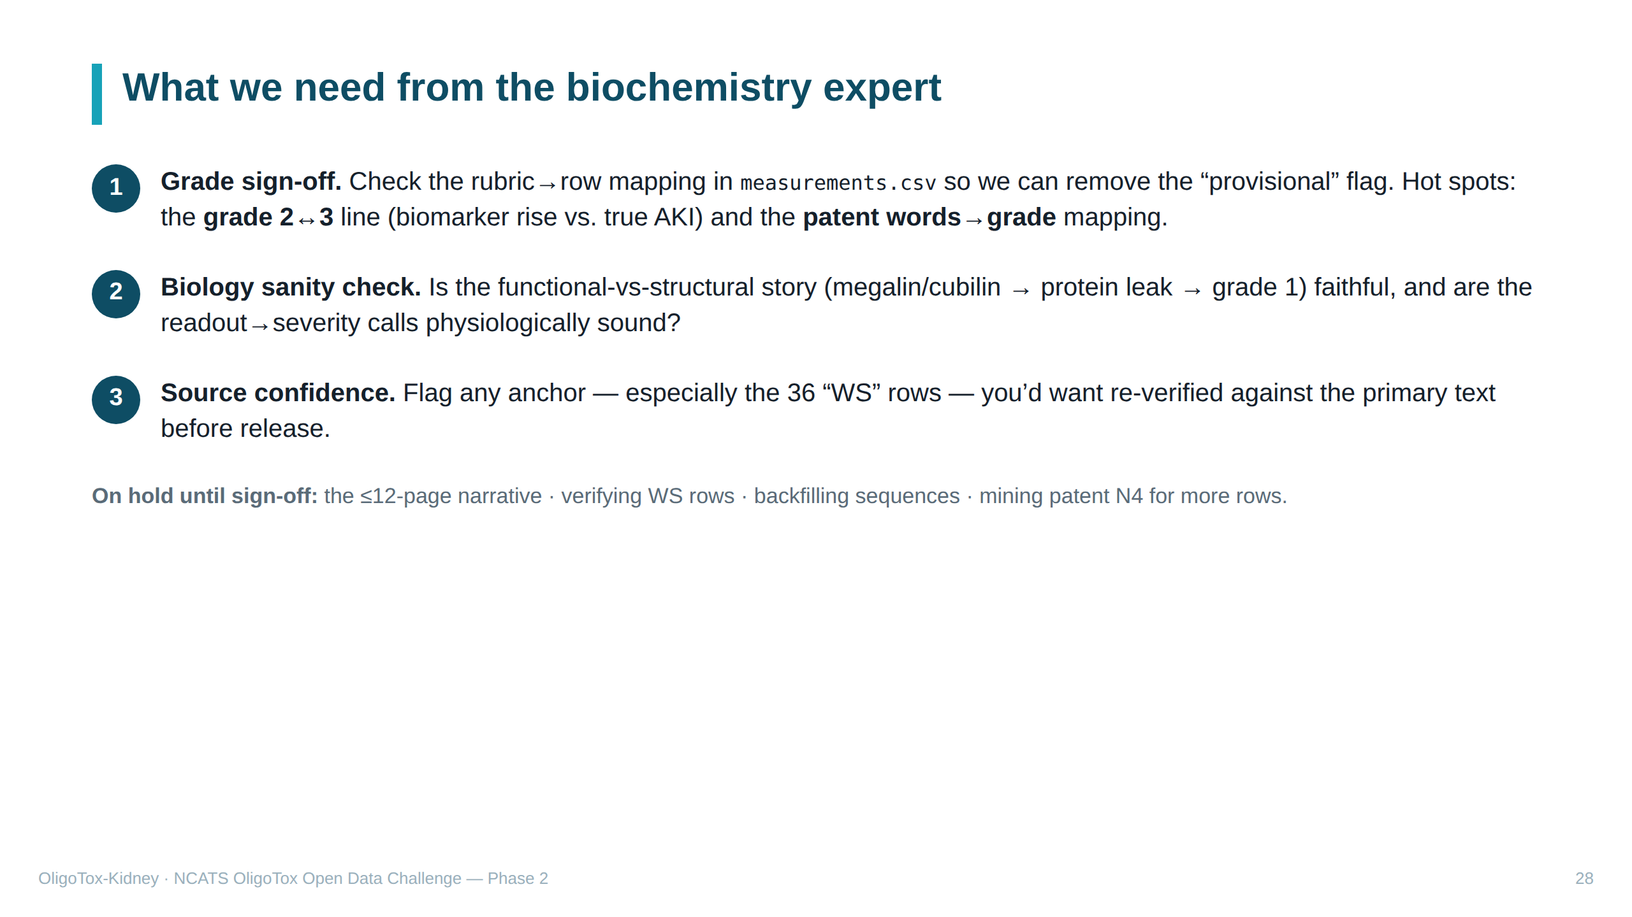
Notes:
SPEAKER NOTES — plain English The concrete ask. (1) The big one: review our 0–3 grades against the rulebook and confirm/correct them — focus on the 2-vs-3 boundary and whether we converted the patent's word-ratings correctly; their sign-off lets us finalise the grades. (2) Sanity-check the core biology story. (3) Point out any source they'd want re-verified, especially the web-summary rows. Everything else (the written narrative, WS verification, more sequences, a second patent) is paused until they weigh in, so we don't polish things that might change.

Slide 29
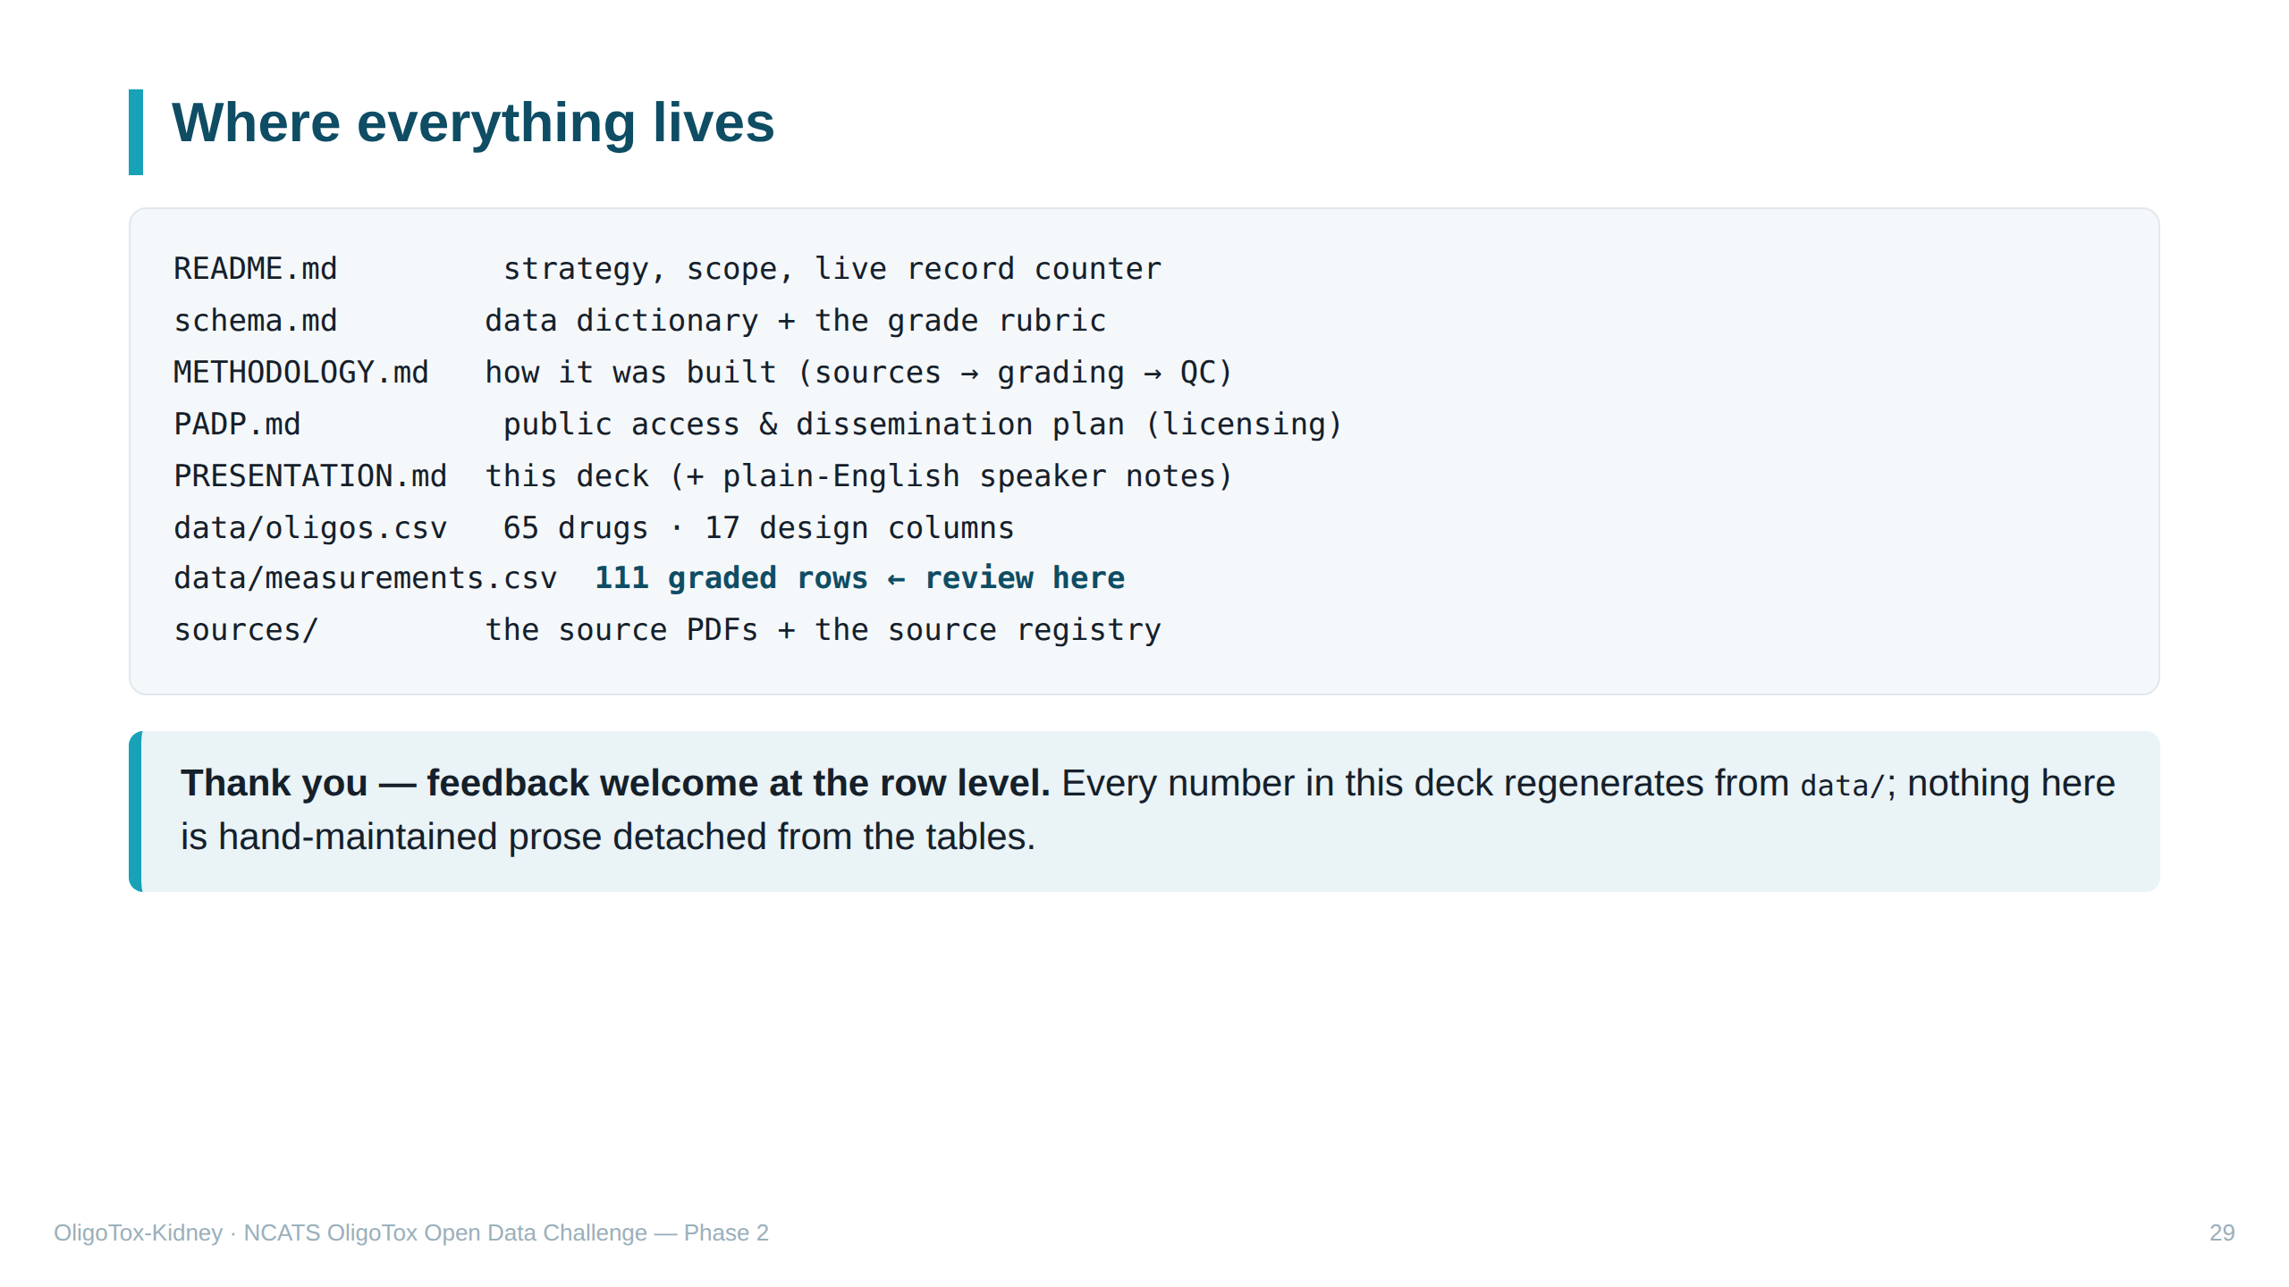
Notes:
SPEAKER NOTES — plain English A map of the project folder so the biochemistry expert knows where to look. The key file for review is data/measurements.csv (the graded results); the rulebook is schema.md. Closing point: every count on these slides comes straight out of the data files, so the deck can't drift from the underlying data. We'd love comments on specific rows, not just general impressions.

