Slide 1
Internship Presentation:
Data Analytics
Made by: Shudanshu
Reg no: 211090001
Branch: Extc

Slide 2


BUSINESS:CASE STUDY
1. Introduction
Company Overview:
Bellabeat is a wellness technology company focused on health products for women.
Founded in 2013 by Urška Sršen and Sando Mur.
Vision: Empower women with insights into health, activity, and mindfulness.
Project Overview:
Analyze smart device data to identify trends and opportunities.
Present recommendations to improve marketing strategy for one of Bellabeat’s products.

Slide 3
2. Business Task
Objective:
Understand trends in smart device usage.
Apply insights to improve customer engagement with Bellabeat products.
Create high-level recommendations for marketing.
3. Data Overview
Primary Dataset:
Fitbit Fitness Tracker Data (Public Domain).
Data includes physical activity, heart rate, and sleep monitoring from 30 users.
Considerations:
Dataset limitations (sample size, biases).
Possible integration of additional data sources to enrich insights.

Slide 4
4. Data Processing
Steps Taken:
Imported data into analytical tools (e.g., R, SQL, or spreadsheets).
Cleaned and verified data integrity.
Filtered relevant fields for analysis.
5. Analysis and Key Findings
Smart Device Trends:
High usage during specific periods (e.g., mornings for fitness, evenings for mindfulness).
Sleep tracking and hydration features highly appreciated.
Wearables are popular for fitness and stress tracking.
Insights for Bellabeat Products:
Opportunity to emphasize mindfulness and stress tracking in marketing.
Potential to increase app engagement by gamifying health goals (e.g., hydration levels).
Cross-promotion of products (e.g., connecting Spring water bottle data with activity insights).

Slide 5
6. Recommendations:
Product-Specific:
Focus on promoting the Leaf wellness tracker as a versatile lifestyle product.
Use the Bellabeat app to deliver personalized daily wellness tips.
Marketing Strategy:
Develop campaigns highlighting how Bellabeat integrates daily health routines.
Leverage social media to create awareness around product benefits.
Collaborate with influencers in the wellness space to enhance product visibility.
Customer Engagement:
Launch a subscription-based program offering exclusive content and challenges.
Enhance app features to provide holistic health recommendations based on combined product usage.
Examples:
Trends in activity and sleep data (bar charts, line graphs).
Customer usage by time of day (heatmaps).

Slide 6
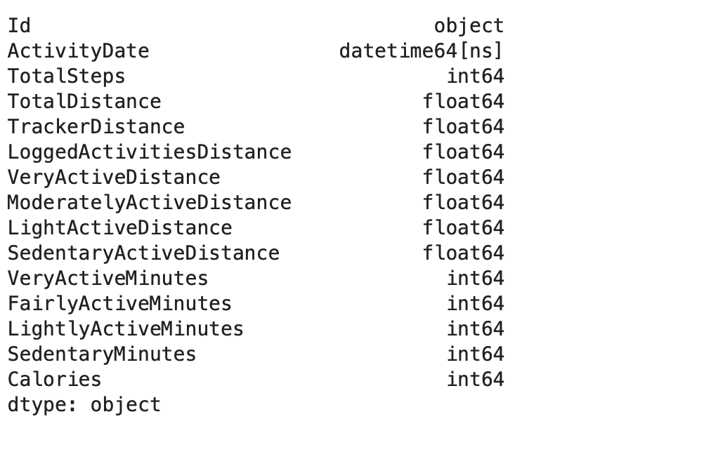
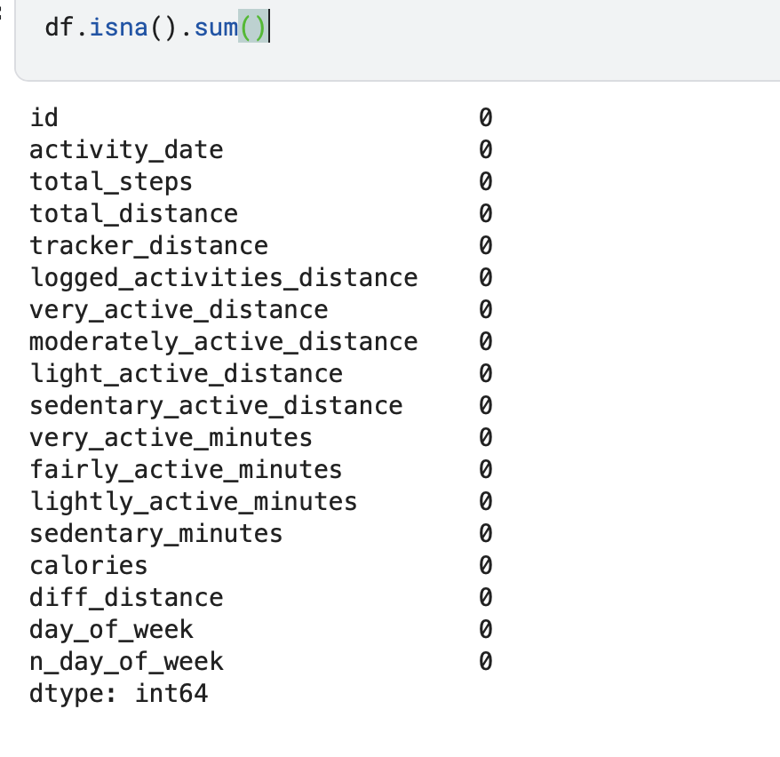
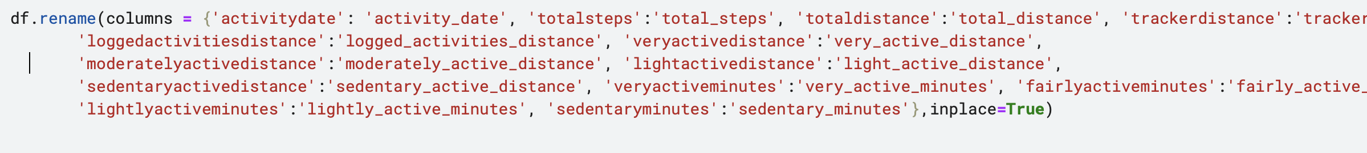
DataSet Features
Dataset Cleaning

Slide 7
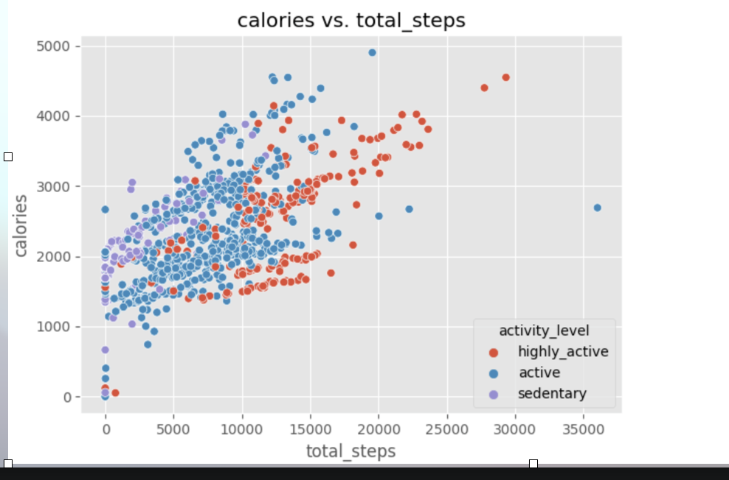
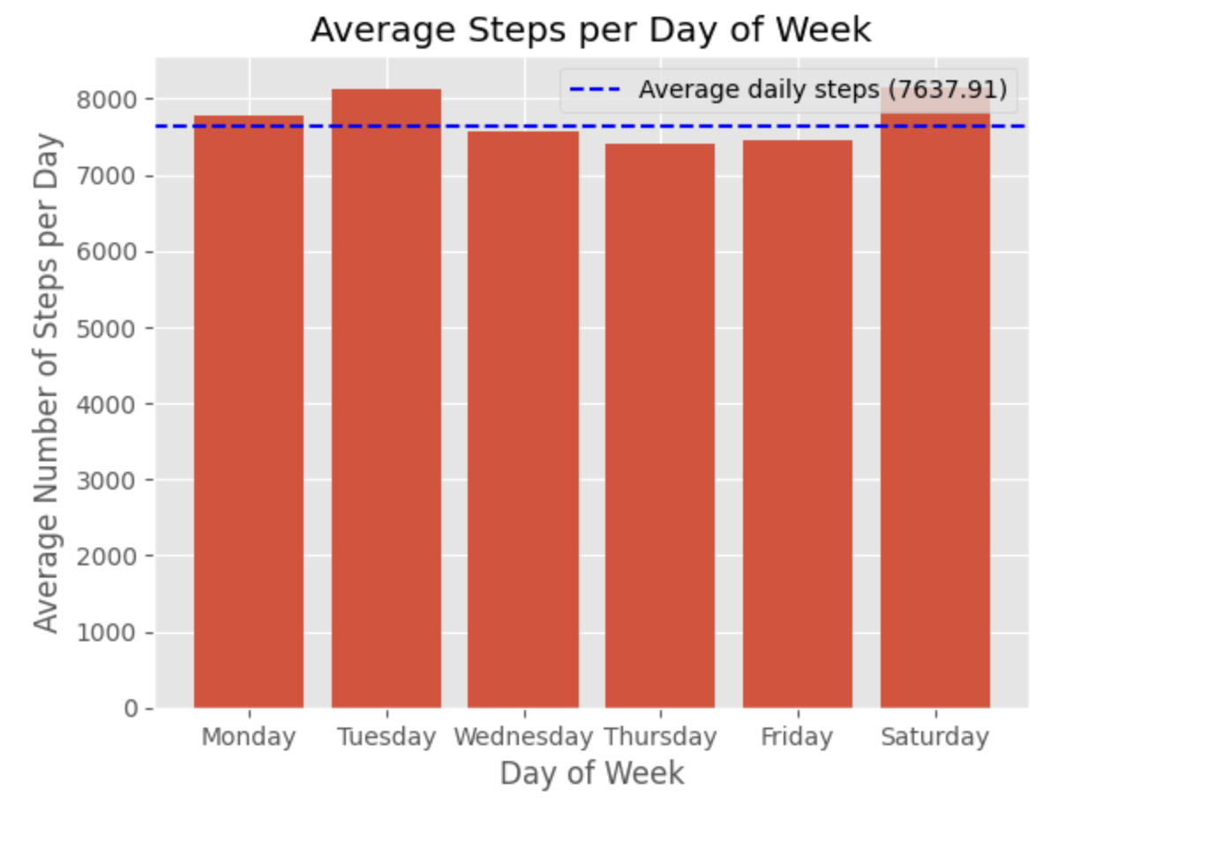
Output of Analysis:Plotting
2. Correlation Between Steps and Calories Burned
The scatter plot of total_steps vs. calories shows a positive correlation, meaning that more steps generally result in higher calories burned.
Users with higher activity levels (Active and Highly Active) tend to burn more calories, indicating the effectiveness of activity in influencing calorie burn.
3. Weekly Activity Patterns
Users’ average steps varied across the week:
Higher activity levels observed on weekdays, especially Monday to Friday.
Slight dips in average steps over the weekend, reflecting reduced activity.
This information can help design reminders and promotions for weekends to encourage consistent activity
.

Slide 8
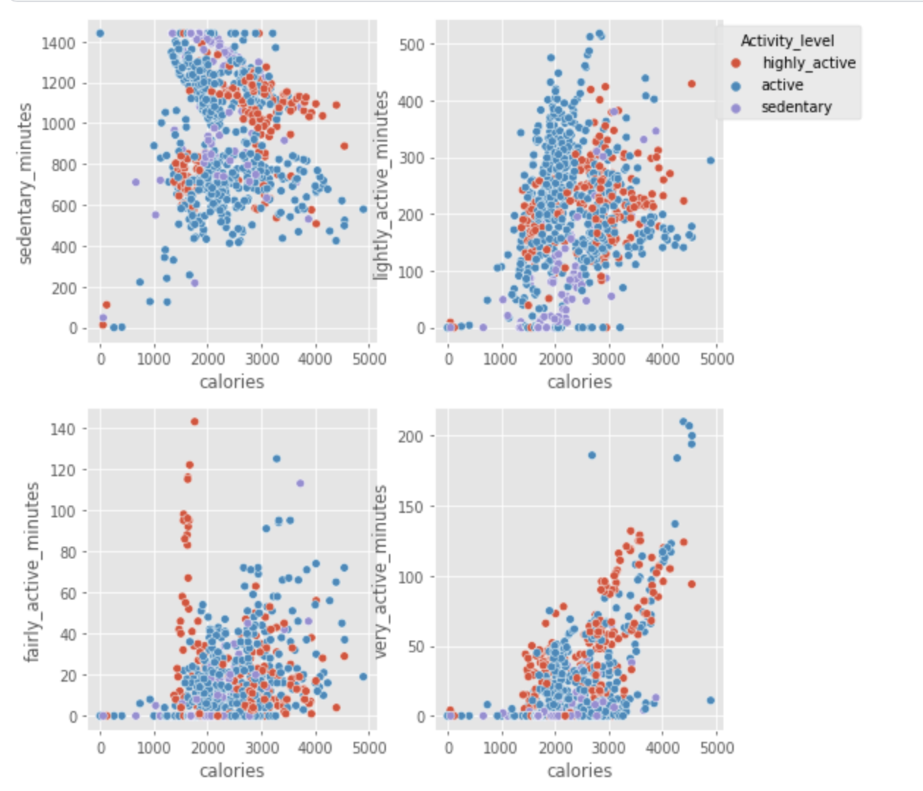
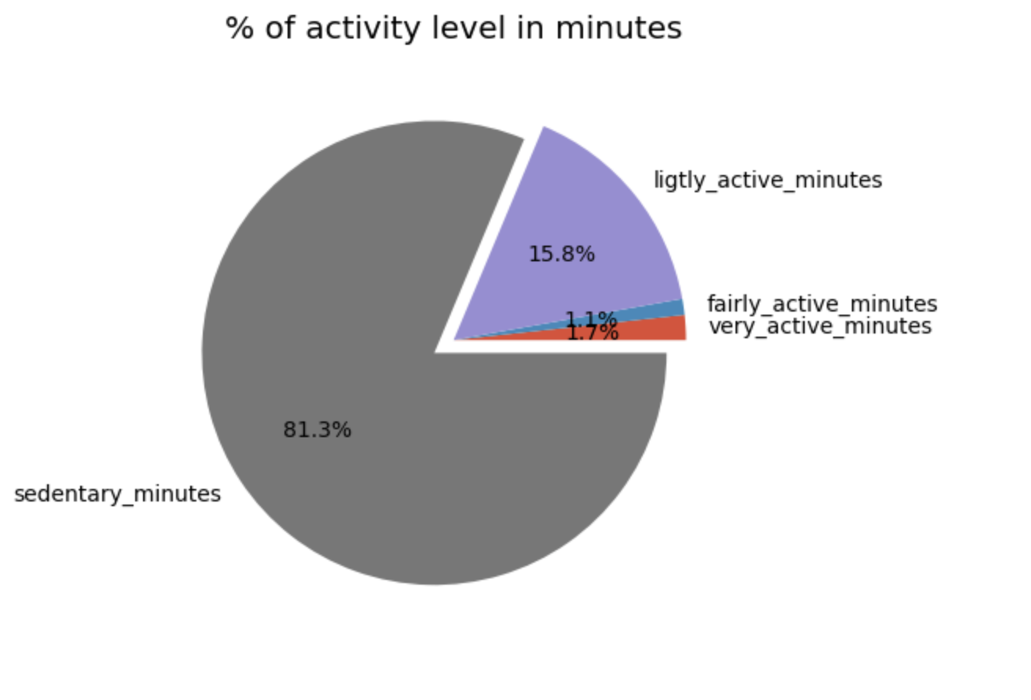
4. Activity Time Distribution
The distribution of time spent on different activity levels (very active, fairly active, lightly active, and sedentary) reveals:
A significant percentage of users' time is sedentary.
Lightly active minutes also make up a considerable portion of time, while very active minutes are the lowest.
5. Relationship Between Activity Minutes and Calories
Scatter plots comparing different activity levels (sedentary, lightly active, fairly active, very active) with caloriesshow:
Sedentary minutes have the least impact on calorie burn.
Lightly, fairly, and very active minutes progressively increase calorie burn, with very active minutes having the most significant effect.

Slide 9
Recommendations
Personalized Feedback:
Provide daily insights based on users’ activity levels (e.g., sedentary users receive tips to achieve light activity goals).
Gamify step goals to encourage more engagement and activity.
Weekend Campaigns:
Offer weekend challenges to boost activity on Saturdays and Sundays, such as streak rewards for completing a target number of steps.
Calorie-Burn Messaging:
Educate users about the benefits of active minutes on calorie burn via in-app notifications and content.
Sedentary Break Reminders:
Include app reminders for users to take short active breaks during extended sedentary periods.
Data-Driven Marketing:
Use insights about active and highly active users to create targeted social media campaigns highlighting the benefits of Bellabeat’s trackers.

Slide 10
Many thanks For Listening!

