Slide 1
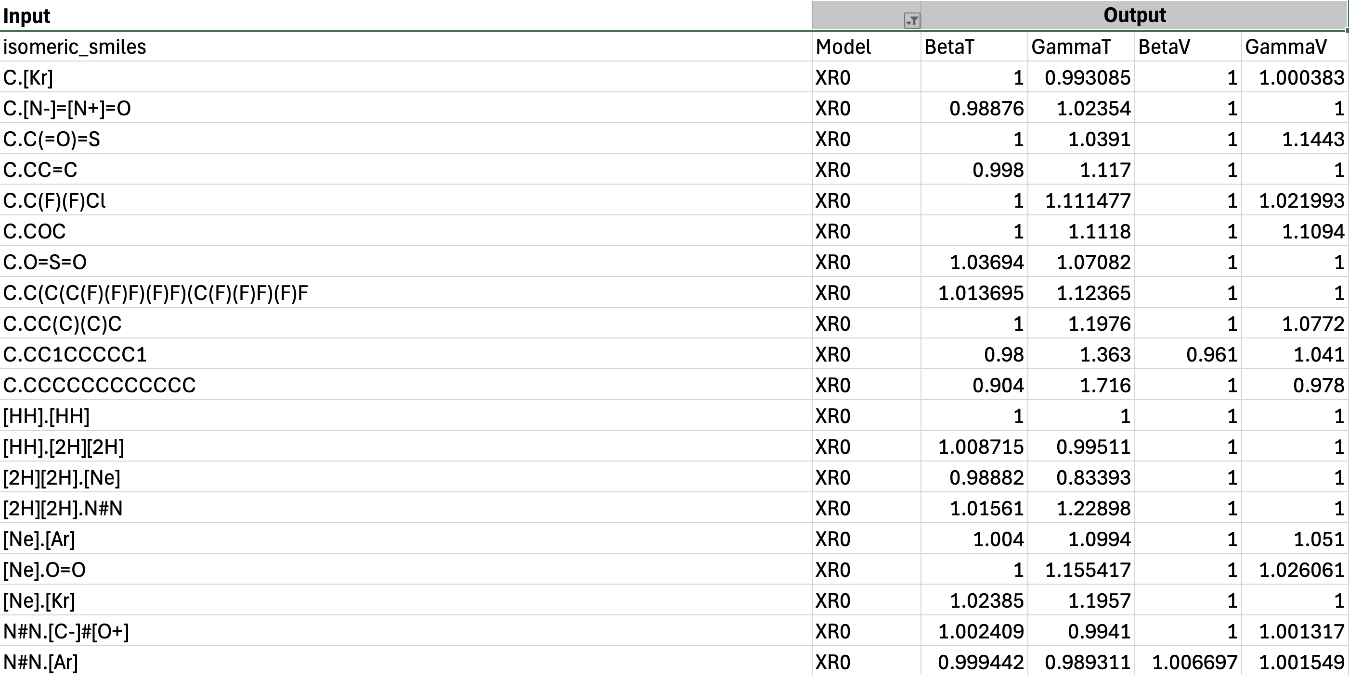
Training dataset for Molecular Descriptor-based model (AlvaDesc) [XR0]
Mixed-SMILES code
Average alvadesc descriptors (6000+)

Slide 2
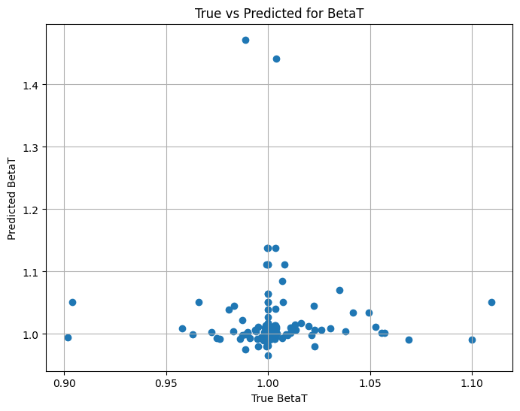
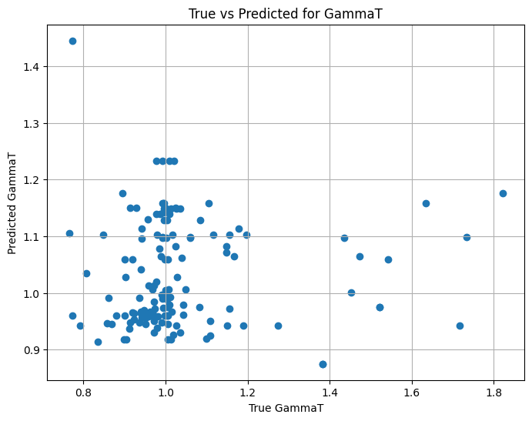
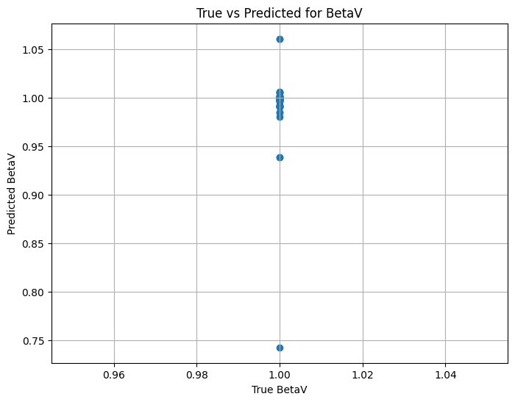
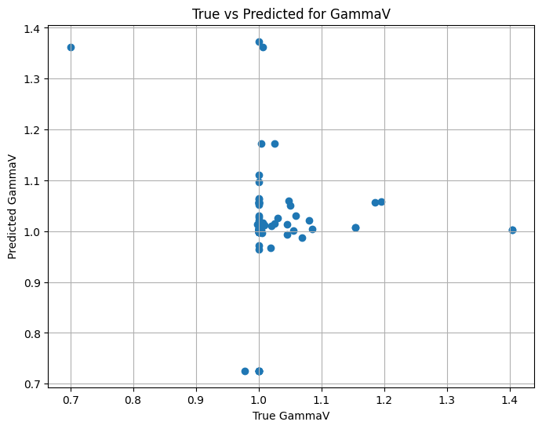
Averaged descriptor-based NN
BetaT
RMSE: 0.068
R² Score: -7.67
----------------
GammaT
RMSE: 0.201
R² Score: -0.231
----------------
BetaV
RMSE: 0.0243
R² Score: 0.0
----------------
GammaV
RMSE: 0.109
R² Score: -2.05
----------------

Slide 3
Deep set neural network (Pytorch)
1
2
Chem
Berta
Final prediction NN
Deep layer
SMILES
1
SUM
BetaT,
GammaT,
BetaV,
GammaV
SMILES
2
Step 1: Tune only
2
Step 2: Fine-tune all
1
+
2

Slide 4
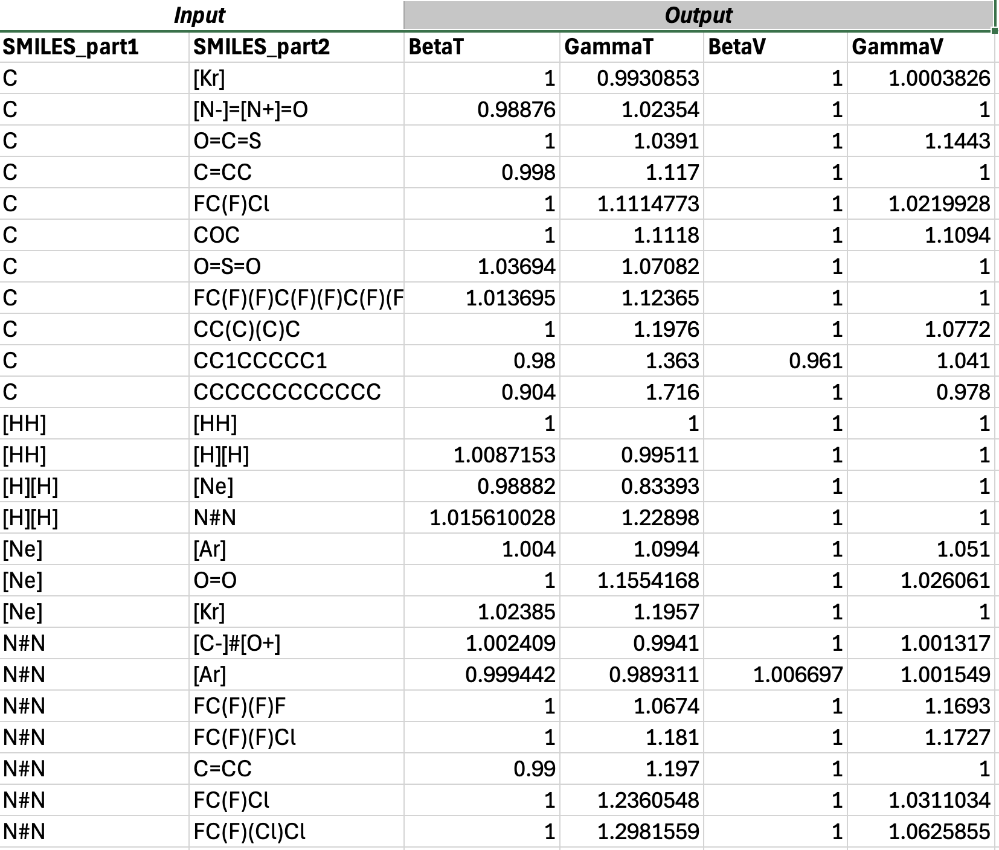
Training dataset of XR0 model
Chemical formula
SMILES code

Slide 5
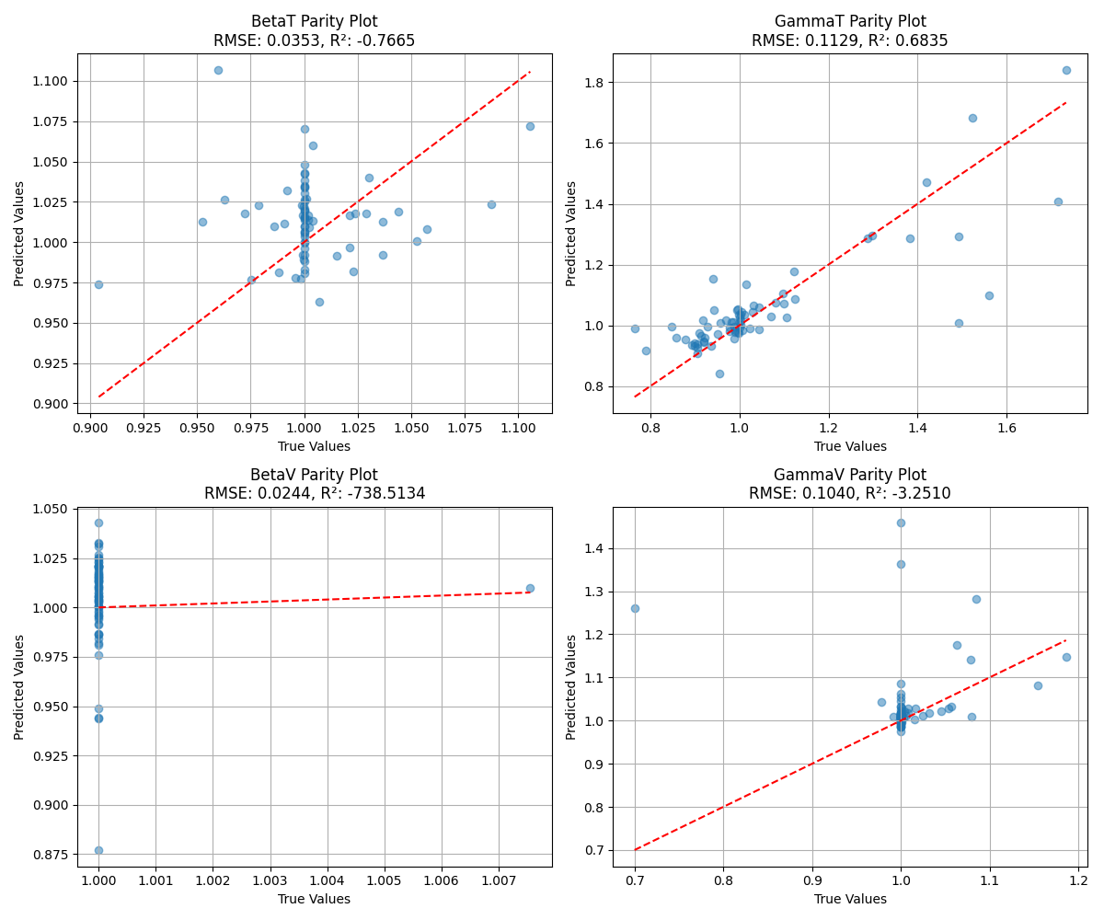
True vs Predicted coeffecient values for XR0 model
Argon/Neopentane
Argon/Ethanol

Slide 6
Argon/Neopentane
BetaT=1
GammaT=Pred
BetaV=1
GammaV=1
Argon/Ethanol

Slide 7
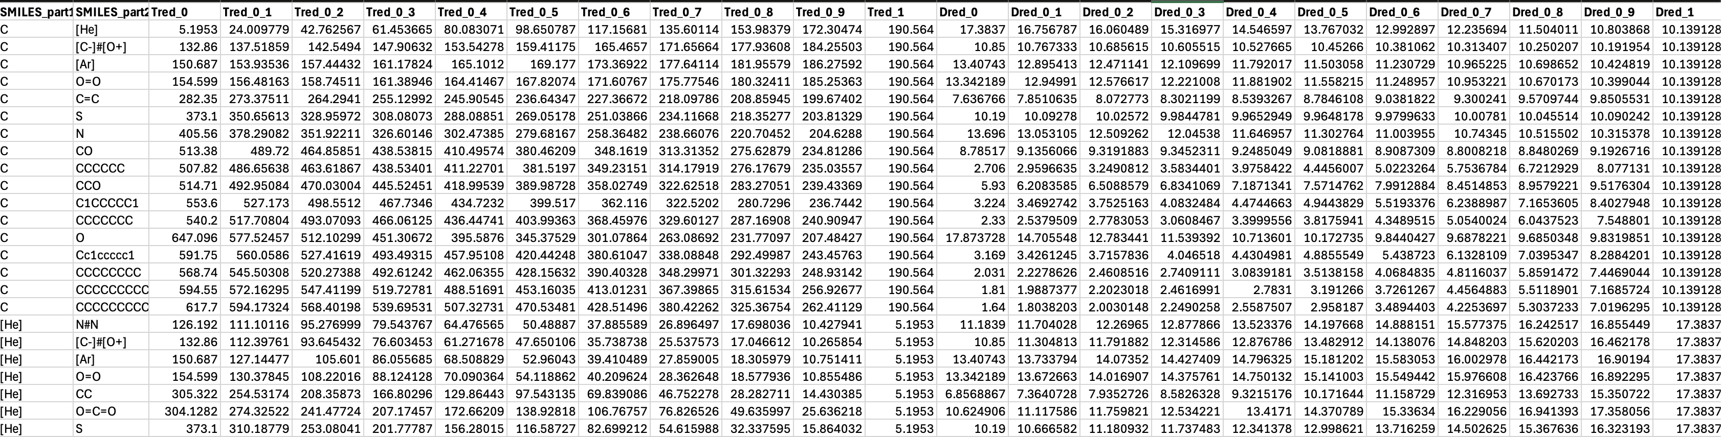
Training dataset of KW0 model
SMILES code
T Red (Molar ratio [X1:X2] (0 to 1))
D Red (Molar ratio [X1:X2] (0 to 1))

Slide 8
Helium/Isopentane
Hydrogen/Carbon monoxide

