Slide 1
Flatfs – A metadata based file system
Supervisor name: professor Stijn dekeyser
Student number: u1095090
Name: Navin Rajendra prasad

Slide 2
1. Problems
Computer Users are facing difficulty to manage large number of files.
Key Problem : How can a user store a file in a particular location and retrieve it easily in the future.
Present file system is HFS – Hierarchical File system
HFS has the following issues
Searching using Metadata is limited.
Poor Classification of files.

Slide 3
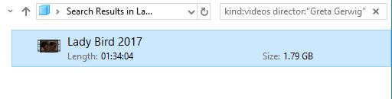
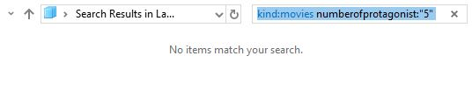
HFS Searching using Metadata
Consider a searching operation to find a file.

Slide 4

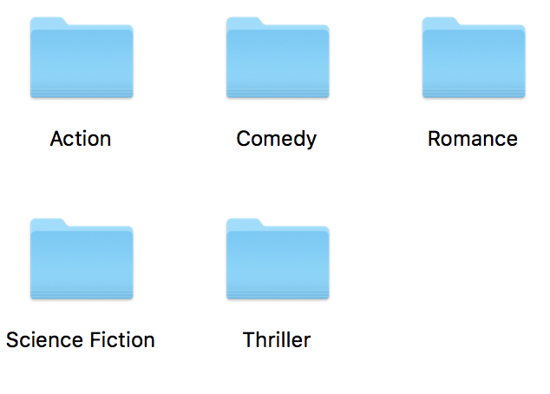
Poor classification of files
Consider a folder Movies. Which one of the following can be a direct subfolder of the folder Movies?

Slide 5
Importance of the problem
A typical disk in
1992 – 300MB
2009 – 300GB
2016 – 1TB
Need for new file system.
Opportunities in creating a new file system:
Access time of file is reduced.
Convenience in managing files.

Slide 6
2. AIMS
To develop a FlatFS(Flat File System) using FUSE(File System in Userspace).
FlatFS is implemented on top of HFS.
While creating a file, more metadata information of a file is obtained. (Key, Value Pairs)
Based on the metadata information searching operation is optimized.

Slide 7
3. background
It is also reported by researchers that traditional file systems does not meet users Needs. [Reference-1]
Existing file system has a high cost to search a file. [Reference-2]

Slide 8
4. Requirements
Linux Operating System.
FUSE (File System in Userspace) library.
Sqlite3 library.
C++ compiler.

Slide 9
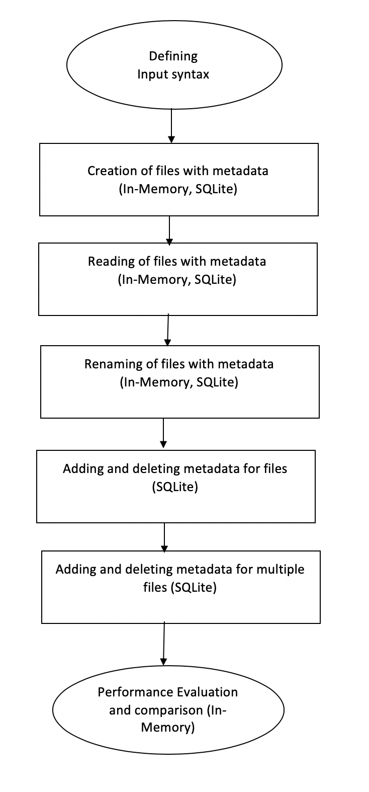
5. Flow of the project

Slide 10
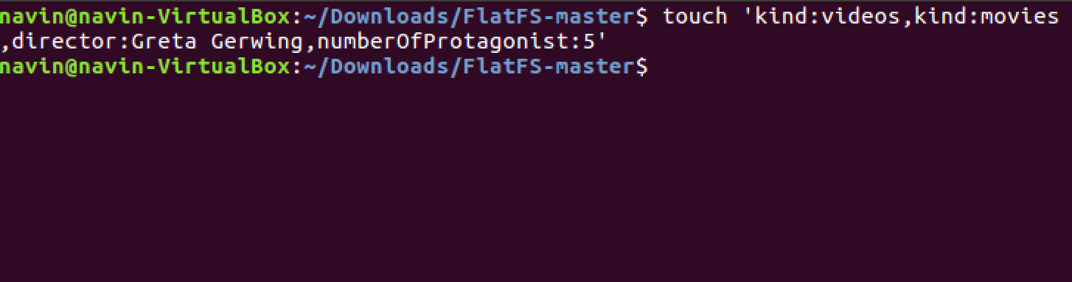
6. Creating Files Based on Key, Value Pairs

Slide 11
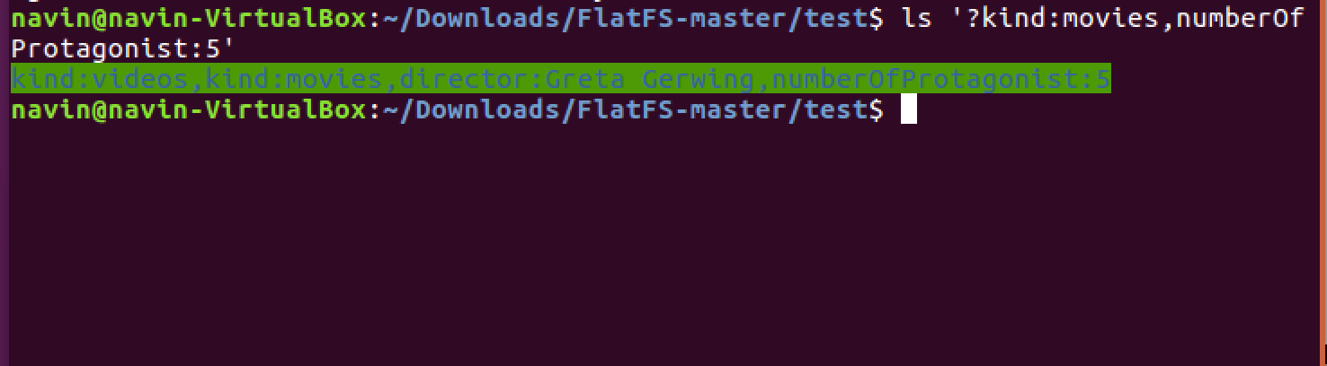
7. Solution for HFS Searching Using Metadata

Slide 12
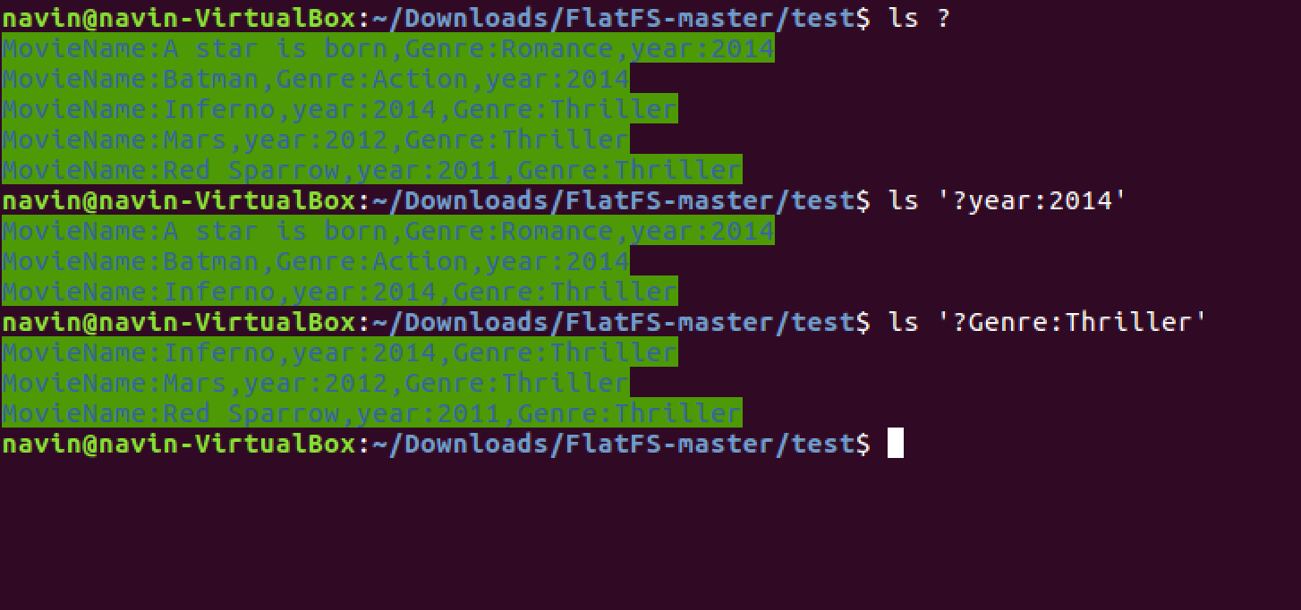
8. Solution for poor classification

Slide 13
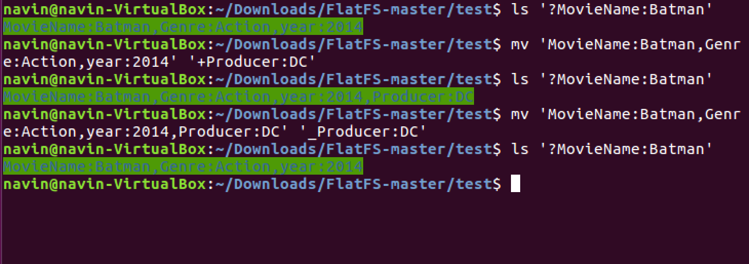
9. Adding and deleting metadata’s for a file

Slide 14
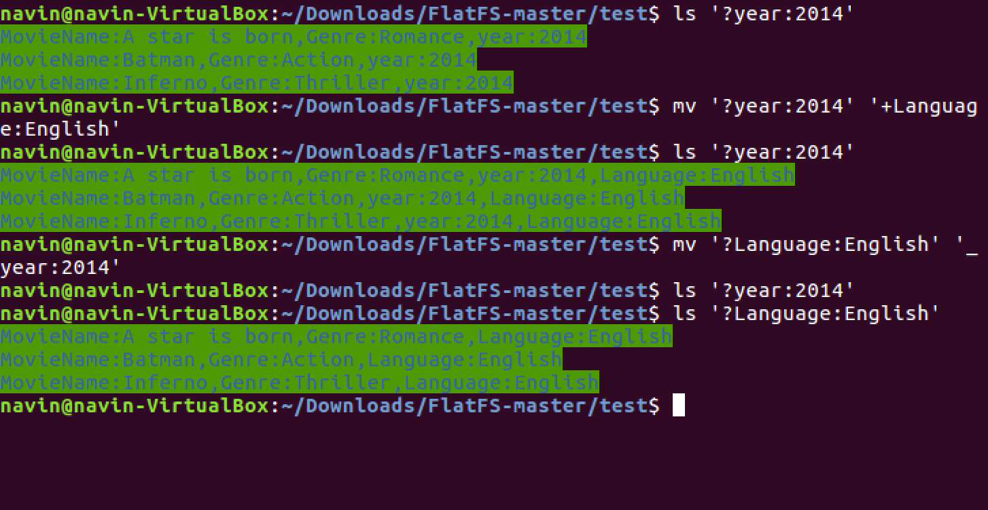
10. Adding and deleting metadata’s for multiple files

Slide 15
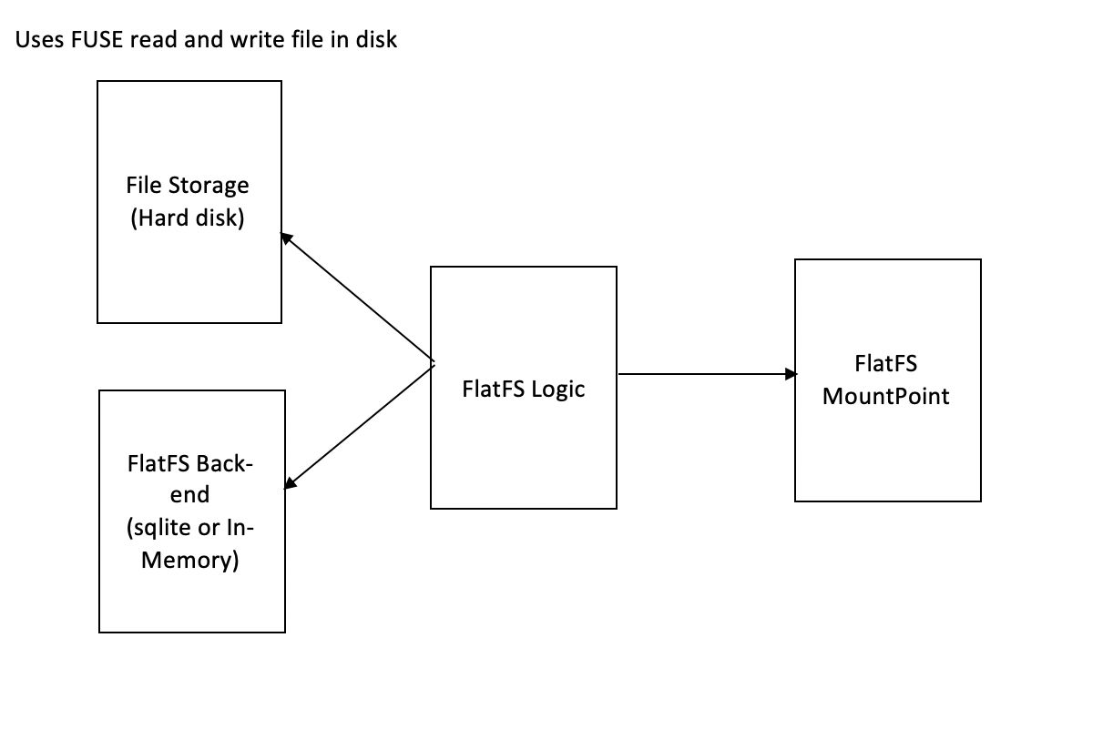
11. System architecture

Slide 16
12. FUSE – File system in userspace
Fuse a library in linux which can be used with any programing language to build a file system.
Fuse acts as a medium of communication between kernel and user commands.
How Fuse works?
User enters a file operation like ”touch newfile”.
Redirects to Create Method in fuse.
Implement file system goal for Create.
Send the modified operation to kernel.

Slide 17
13. C++, SQLITE, In-Memory
FlatFS logic is written in C++.
SqLite – used to store key value pairs in tables
Table structure: Id (type: number) – unique for a file, Key (type: string), Value (type: string)
In-Memory – Instead of using sqlite, In-Memory can used to store key,value pairs.

Slide 18
14. SQLITE vs In-Memory
SQLITE
Advantage:
Data are saved in tables for future use.
Disadvantage:
Slow Processing of data.
In-Memory
Advantage:
Fast Processing of Data.
Disadvantage:
Data can not saved for future use.

Slide 19
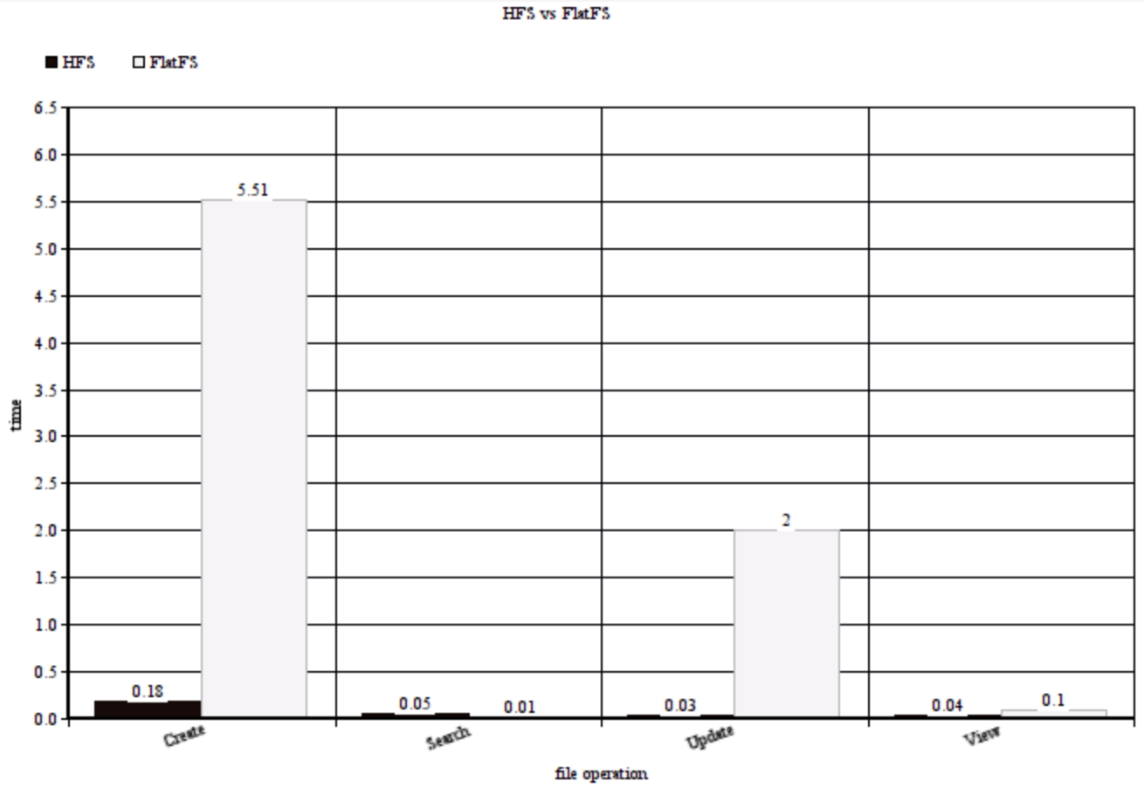
15. Performance comparison for 5000 files
HFS vs FlatFS (C++, In-Memory)

Slide 20
16. Conclusion
Overhead of Fuse and Language bindings are the main reason for poorer FlatFS Performance in Create, Update and View.
Though there are overheads for FlatFS, the performance of searching is very high and this is due to the Flat structure of the FlatFS.
Apart from performance, FlatFS has many good features which is a great merit for the User.
SQLITE implementation can be optimized, If better Query Processing database are used.

Slide 21
17. future works
Graphical file browser.
Integrating FlatFS with various existing user applications.
Metadata extraction from existing HFS (Transducer).
Using non-relational database backend.

Slide 22
18. References
Watson, Richard and Dekeyser, Stijn and Albadri, Nehad (2017) Exploring the design space of metadata-focused file management systems. In: Australasian Computer Science Week 2017 (ACSW 2017), 31 Jan - 3 Feb, 2017, Geelong, Australia.
A. Parker-Wood, D. D. E. Long, E. Miller, P. Rigaux, and A. Isaacson. A file by any other name: Managing file names with metadata. In Proceedings of International Conference on Systems and Storage, SYSTOR 2014, pages 3:1–3:11, New York, NY, USA, 2014. ACM.

Slide 23
Thank you

