Slide 1
Visual Question Answering System
Presented by: Mentored by: Rohan Naik Dr. Soumya Priyadarshini Panda
Navin Chandra
Alka Kumari
Medha Raj

Slide 2
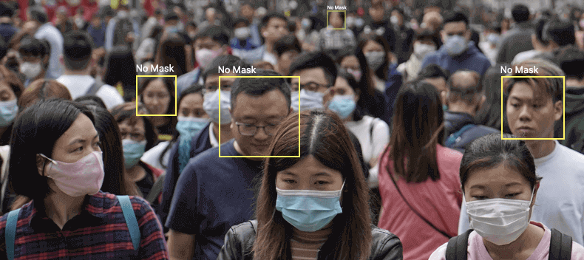
Problem Statement:
Visual Question Answering is a system to answer questions presented in a natural language about an image. This type of system solves this task, demonstrates a more general understanding of images. For all the images, the system should be able to localize the subject being referenced to in the question and detect.
This type of VQA systems are important in current scenario like Corona Virus pandemic, the authorities can ask the model to detect the people with no mask and take appropriate action on them.
We are trying to build a generalized VQA system which can detect many variety of objects and can answer user’s query more intelligently.

Slide 3
Work Flow Diagram
Study on basics of NLP and image processing
Literature study on VQA system
Study of Object detection Model
Study of Query processing tools
Implementation of object detection model
Implementation of query processing model
Final model incorporation and Testing
Model enhancement and performance analysis

Slide 4
Details of work currently executing:
Query Processing
Input: User Query
Tokenization of the given query
Lemmatization of the tokenized query
Stop word removal from the lemmatized query
Custom word removal like ‘picture’ and ‘image’
Combination of the remaining words for the purpose of object detection
For example:
Input query: Where is the zebra in the image?
Output: Zebra
The output of the query processing unit will be fed into the object detection model.

Slide 5
Details of work currently executing
Object Detection
Input
1. Output from query processing unit
2. Image input by user for object detection
Object detection model identifies the desired object to be searched.
Further it searches for the object in the image.
Then the model outputs the result according to the user query.
Model enhancement

Slide 6
Conclusion:
Understanding of both images and text.
Deep learning is showing an exponential increase in the performance
With deep learning there is a large scope of improvement.
Future Scope:
The model can be used for real time object detection in videos.
It can be trained to be used in specific domains .
For e.g. In the current scenario it can be trained for mask and helmet detection in real time.

Slide 7
Contribution
Implementation of query processing model
Implementation of YOLO model for object detection
Testing of the model using various input
Future works:
Model enhancement

